Slide 1
THYROID GLAND
Highly vascular endocrine gland
Situated in the lower part of front of neck in close relation to larynx and trachea
Secretes T3, T4 and calcitonin hormones
Weight is around 25 gm
Consists of Rt & Lt lobes which are connected by an isthmus
Each lobe is around 5cm in length , 3cm in breadth & 2cm in thickness

Slide 2
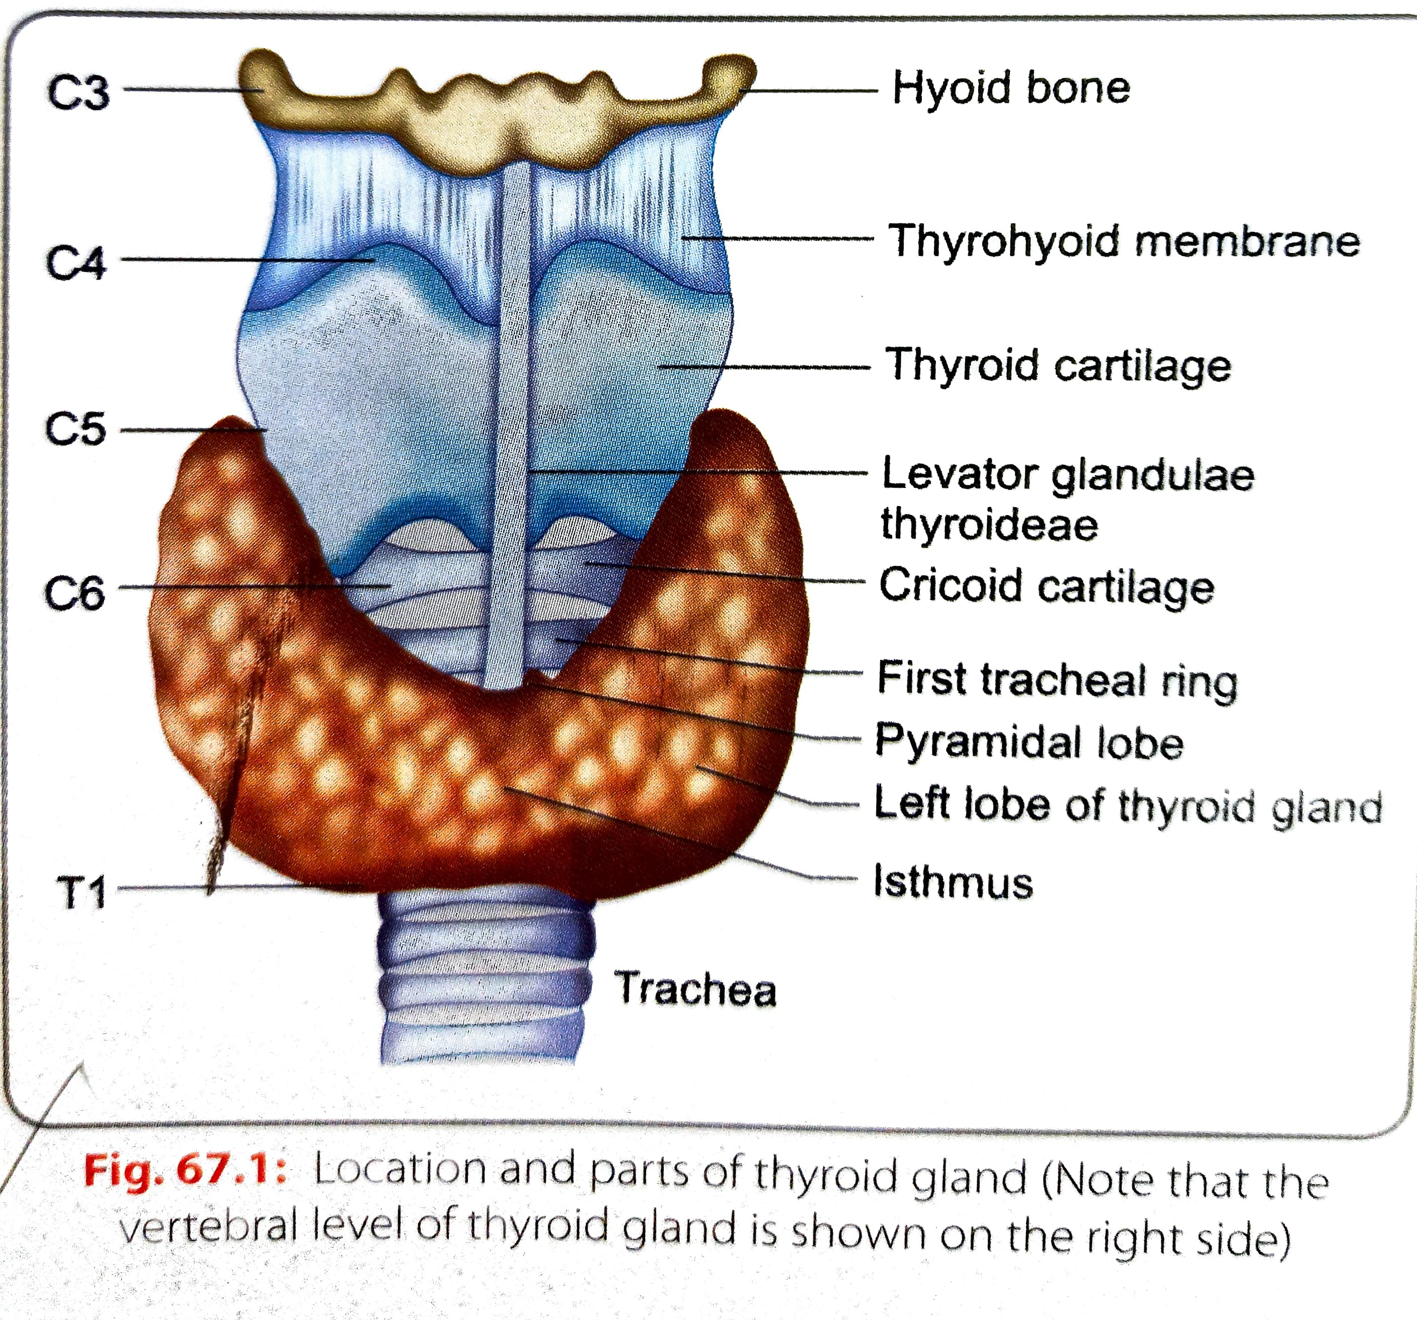
The lobes extend from the oblique line of thyroid cartilage to the level of 5th or 6th tracheal ring and correspond to C5-T1 vertebrae
The isthmus lies against the 2nd to 4th tracheal rings
A small pyramidal lobe usually extends from the upper margin of the isthmus on the Lt side
It may be attached to the hyoid bone by a slip of a muscle called levator glandulae thyroideae

Slide 3
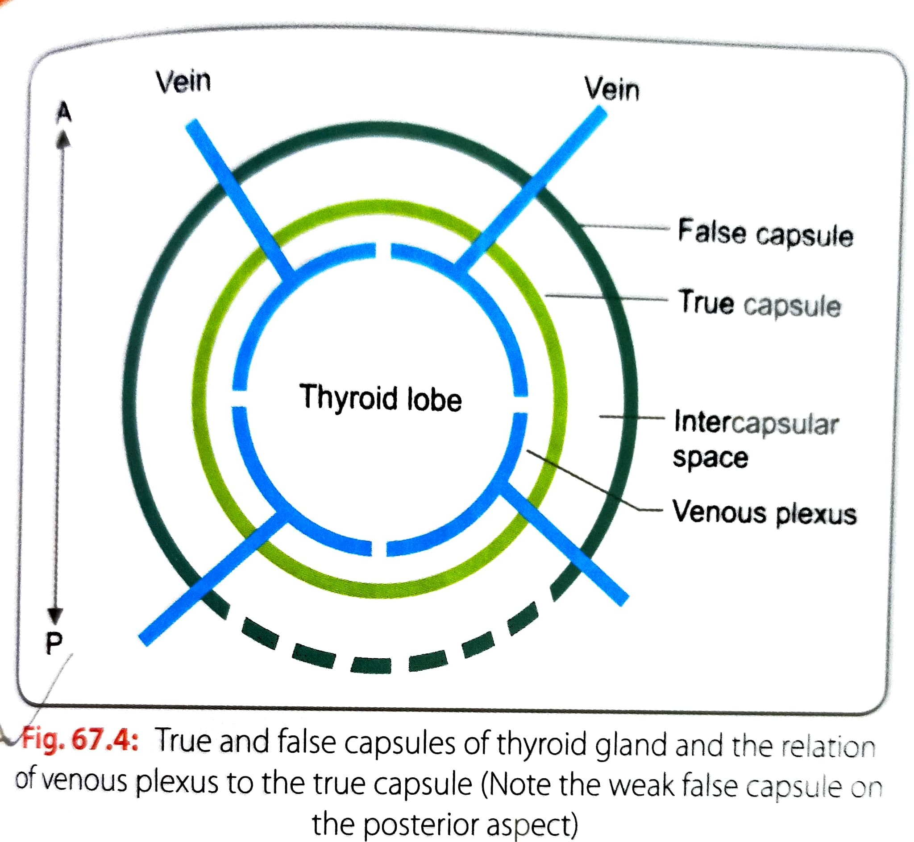
CAPSULE OF THYROID
It has a true & false capsule
True capsule is the condensation of the connective tissue stroma at the periphery of the gland
False capsule is derived from the pretracheal fascia
At the posteromedial aspect of the lobe the false capsule is thickened to form the suspensory ligament of Berry which is attached to the cricoid cartilage
The pretracheal fascia encloses the thyroid gland and is attached to the oblique line of thyroid cartilage and to the hyoid bone

Slide 4
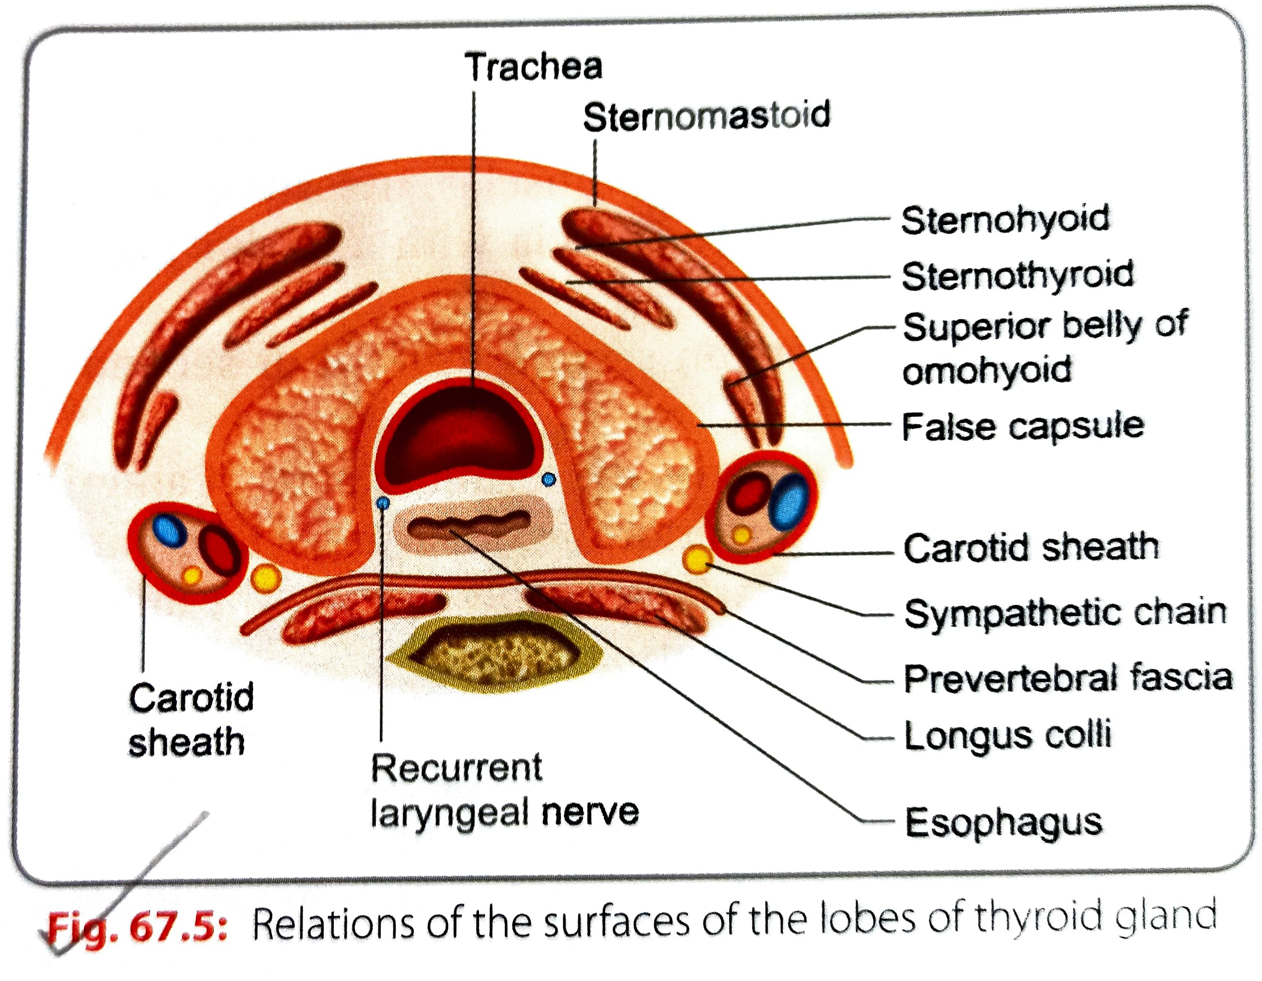
The close relation of pretracheal fascia to the thyroid gland and its attachments to hyoid bone,cricoid cartilage and thyroid cartilage are responsible for movements of the thyroid gland during swallowing and speech
Venous plexus lies deep to true capsule .

Slide 5
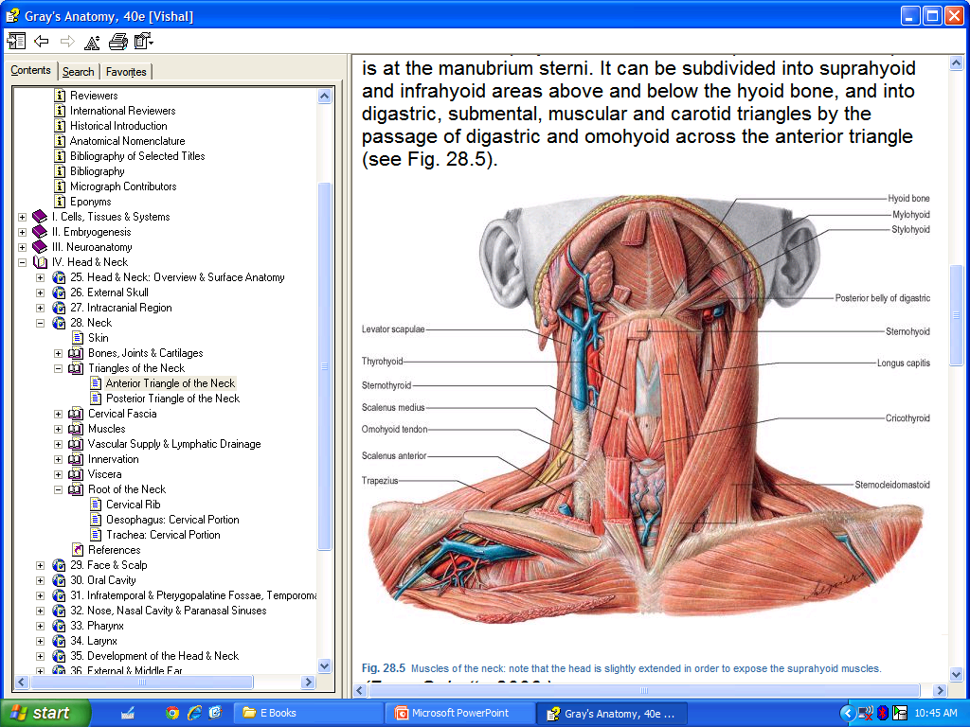
FEATURES & RELATIONS OF LOBES
Each lateral lobe of thyroid presents three surfaces, two borders and two poles
Surfaces- Superficial,Medial and Posterior
Borders- Anterior& Posterior
Poles-Apex & Base
Superficial surface - is related to
  Sternothyroid
  Sternohyoid
  Sup.belly of omohyoid and Sternocleidomastoid

Slide 6
  Medial surface- is related to
  Two tubes - Larynx and pharynx above&Trachea&oesophagus below
  Two Muscles - Inferior constrictor and cricothyroid
  Two cartilages - Cricoid& Thyroid
  Two nerves - External laryngeal&Recurrent laryngeal nerve
  Posterolateral Surface- is related to
  Carotid sheath & Its contents
  Sympathetic chain behind the carotid sheath

Slide 7
Relations of isthmus-
Anteriorly- From within outward
  Pretracheal fascia
  Strap muscles
  Investing layer of deep cervical fascia
  Superficial fascia with ant jugular vein
  Skin
Posteriorly- 2nd to 3rd or 4th tracheal ring
Along its upper margin- Anastomoses between anterior branch of superior thyroid artery of both sides
Along its lower margin- Inferior thyroid veins emerge and thyroidea ima artery enters

Slide 8
Relations of borders-
Anterior border-is related to
  Anterior branch of superior thyroid artery
Posterior border- is related to
  Parathyroid gland
  Anastomoses between posterior branch of superior thyroid artery and ascending branch of inferior thyroid artery
Relations of poles-
Apex- Superior thyroid artery& External laryngeal nerve
Base- Inferior thyroid artery and recurrent laryngeal nerve

Slide 9
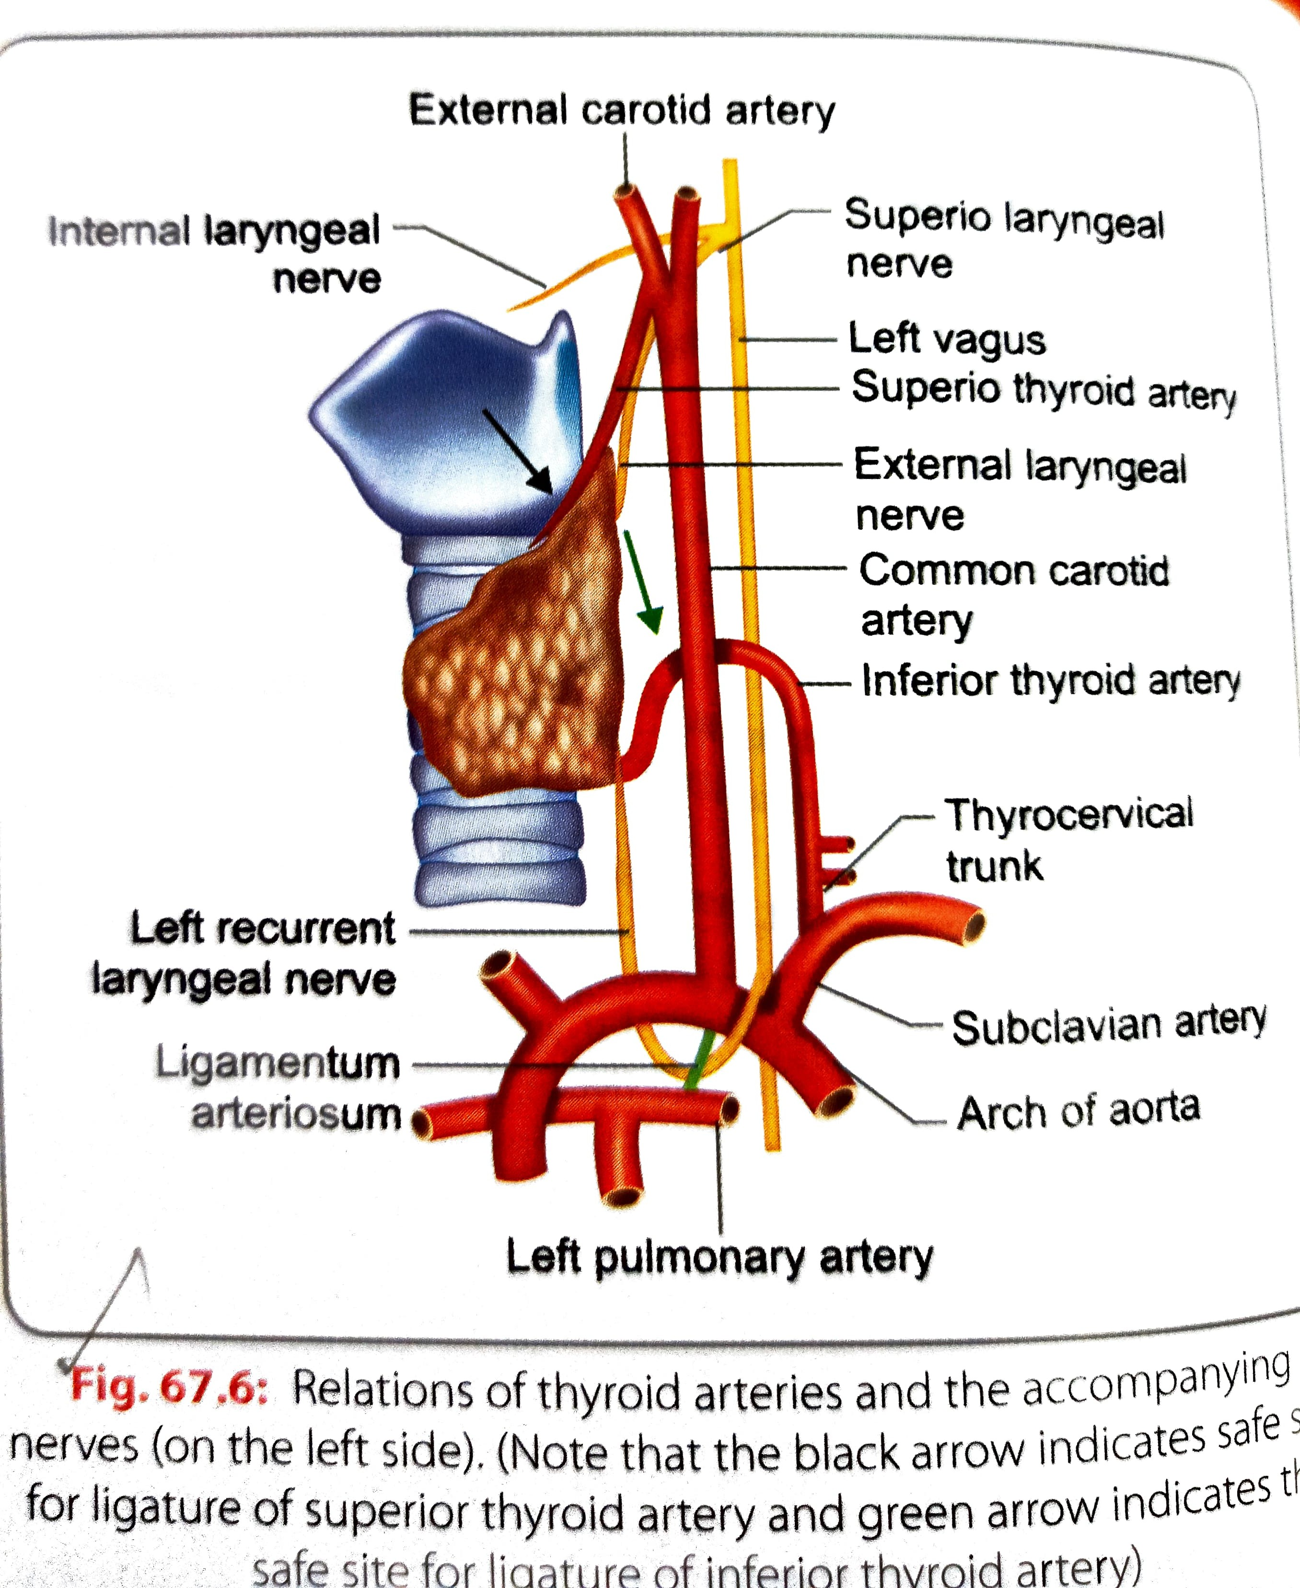
ARTERIAL SUPPLY
A pair of superior thyroid artery and inferior thyroid artery
Occasionally thyroidea ima artery

Slide 10
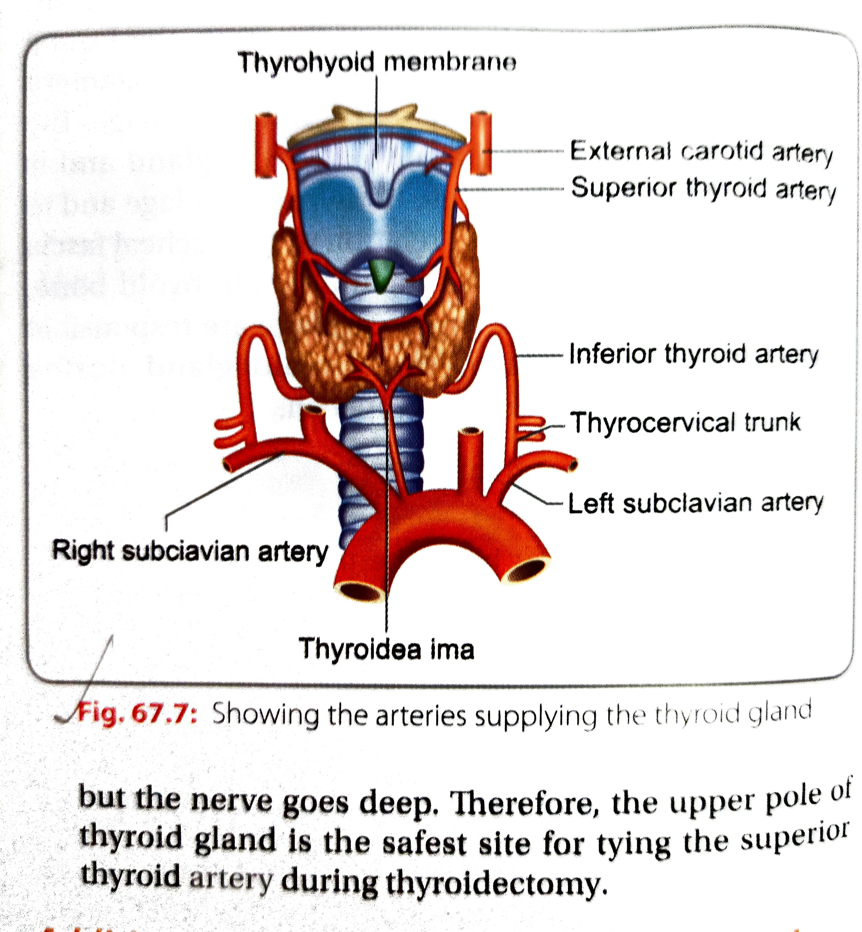

Slide 11
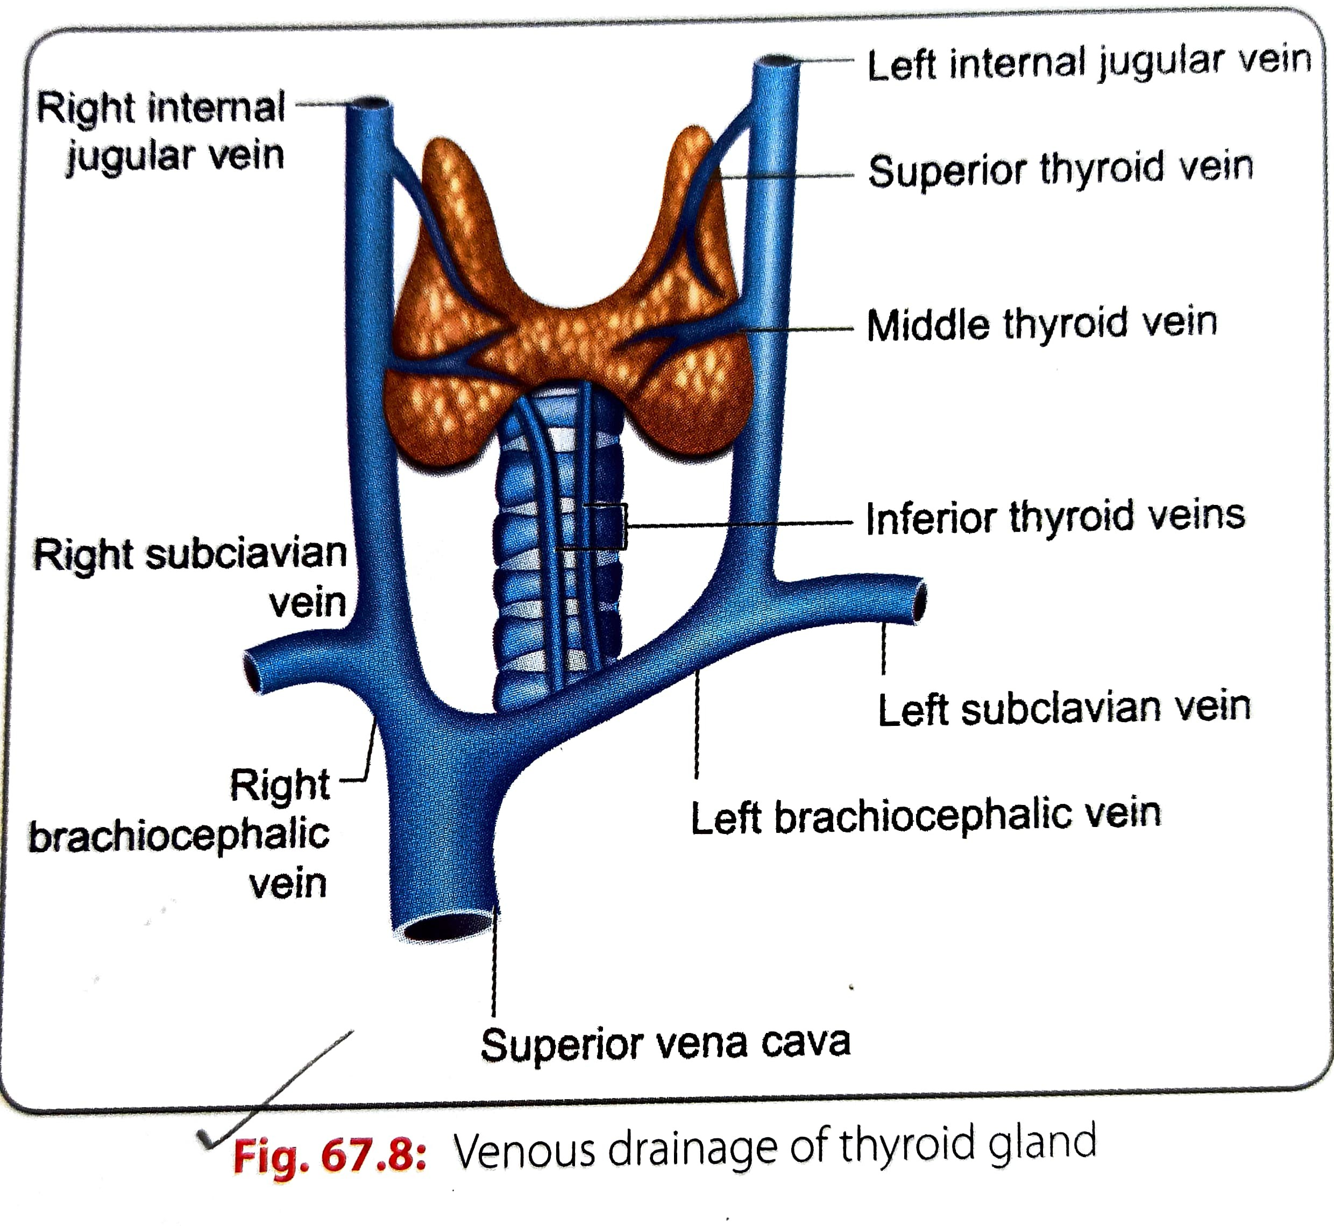
VENOUS DRAINAGE
SUPERIOR THYROID VEIN
INFERIOR THYROID VEIN
MIDDLE THYROID VEIN

Slide 12
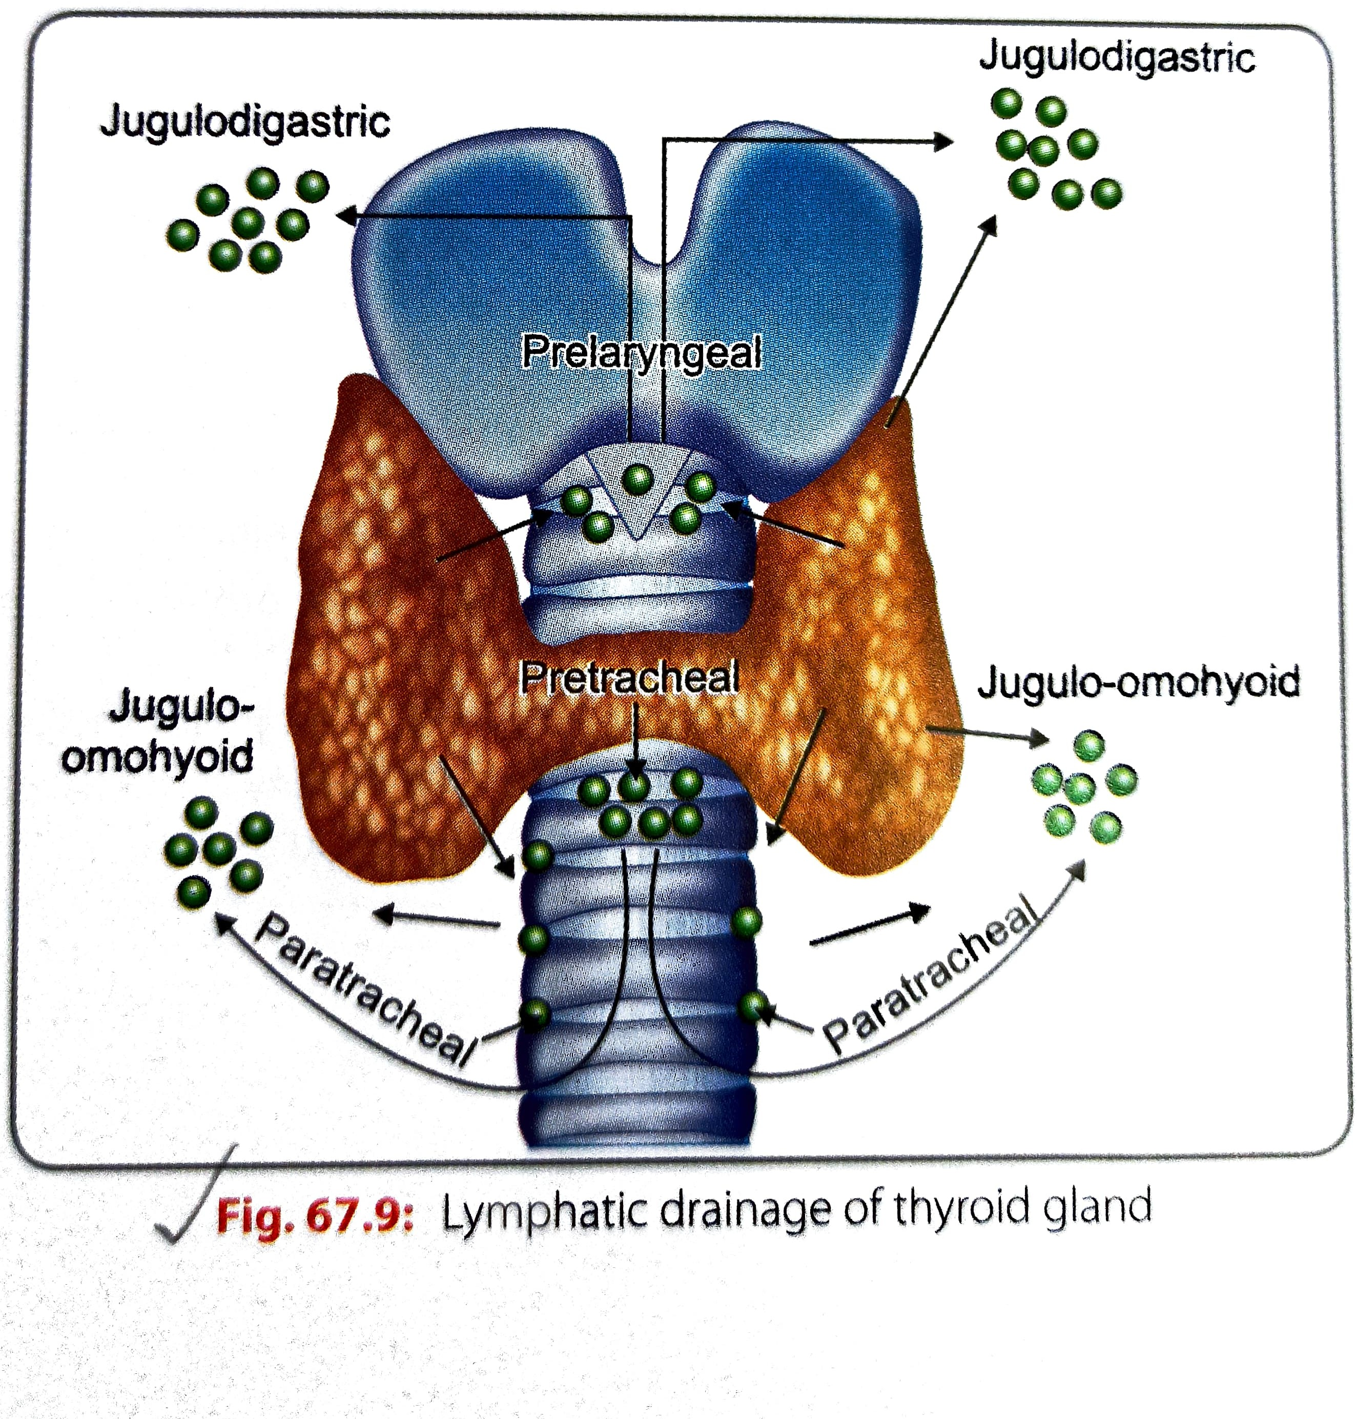
LYMPHATIC DRAINAGE
Upper part of thyroid-jugulodigastric node
Lower part of thyroid-jugulo-omohyoid node
Few vessels drain in to brachiocephalic nodes

Slide 13
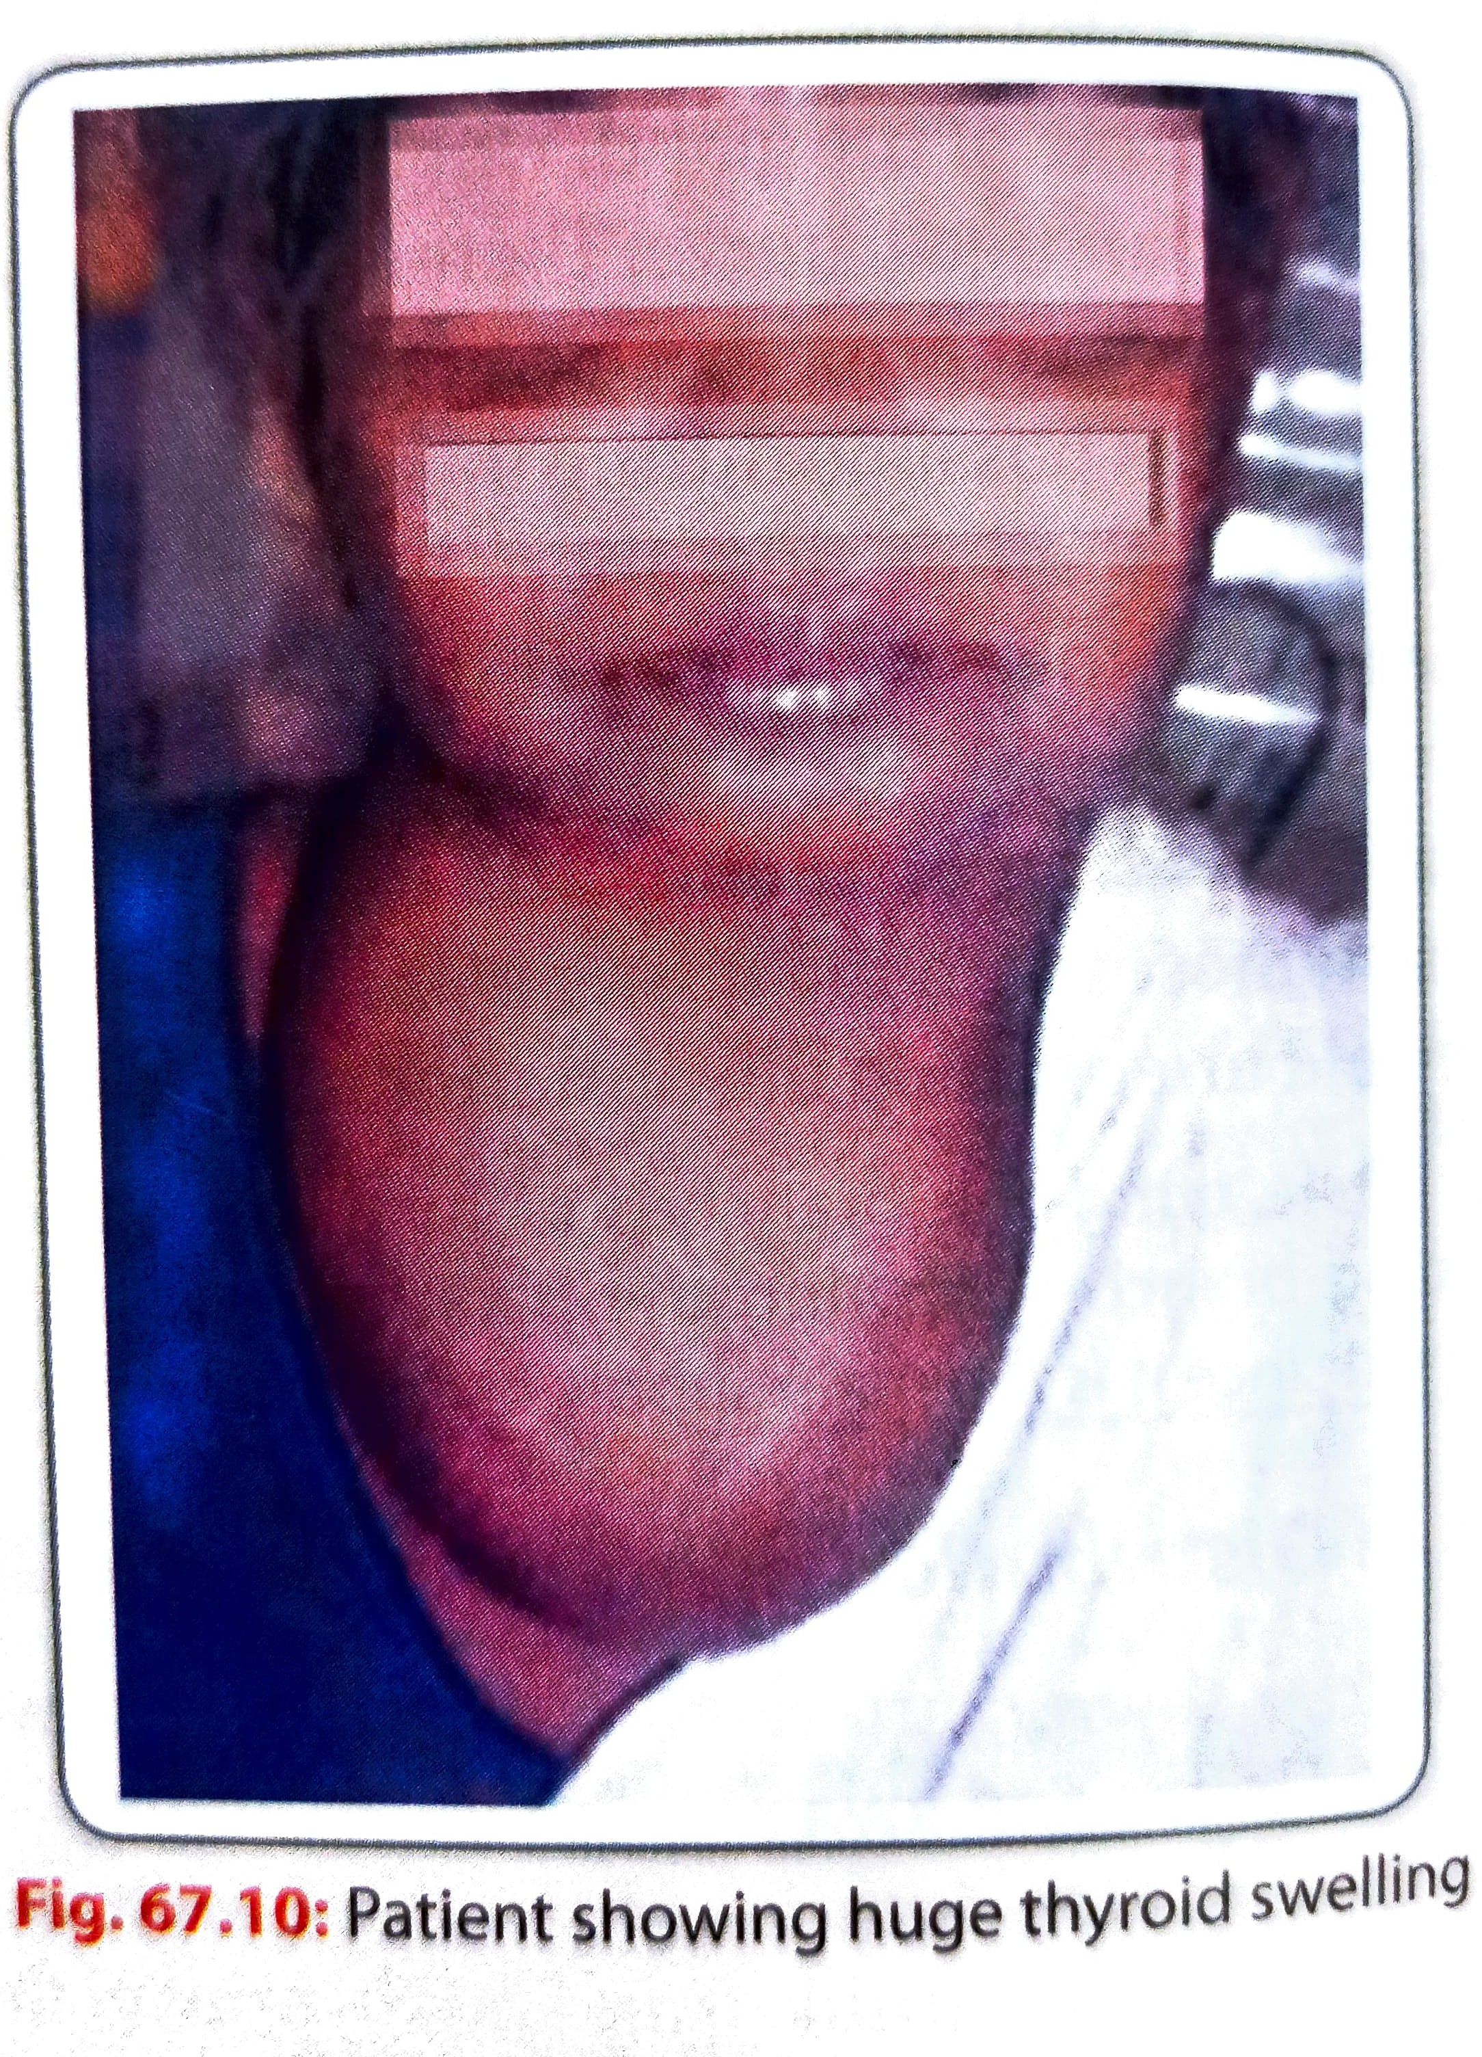
APPLIED ANATOMY
Non specific and noninflammatory swelling swelling of thyroid –Goiter
The thyroid swelling moves with deglutition
Deficiency of thyroxine in adult-myxedema
Dficiency of thyroxine in children-cretinism ,which is charracterised by stunted physical and mental growth

Slide 14
PRESSURE EFFECTS OF THYROID
Trachea-dyspnea
Oesophagus-Dysphagia
Recurrent laryngeal nerve- hoarseness of voice
Sympathetic chain-Horners syndrome

