Slide 1
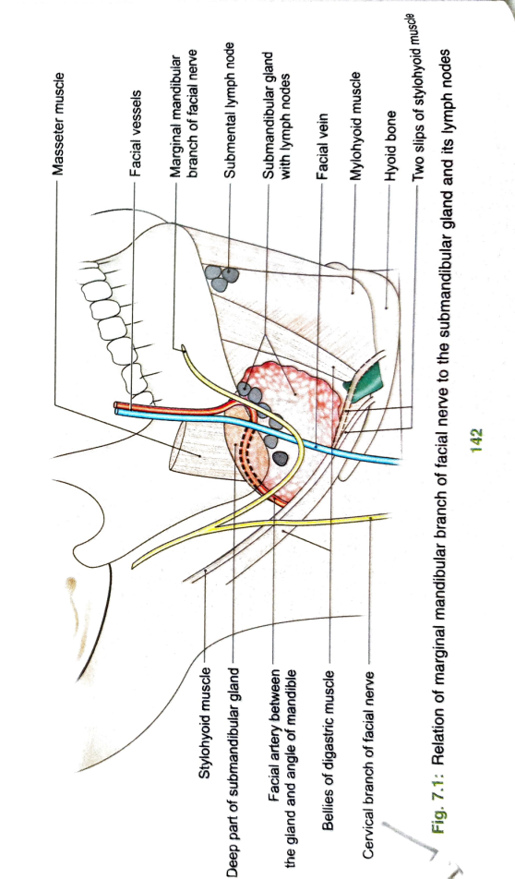
SUBMANDIBULAR REGION
This region includes the area between the mandible and the hyoid bone
Submandibular region contains the suprahyoid muscles,submandibular and submandibular salivary glands and submandibular ganglion
Suprahyoid muscles are the digastric,the stylohyoid,the mylohyoid,and the geniohyoid
First layer formed by digastric and styloid
Second layer formed by mylohyoid
Third layer formed by geniohyoid and hyoglossus
Fourth layer formed by genioglossus

Slide 2
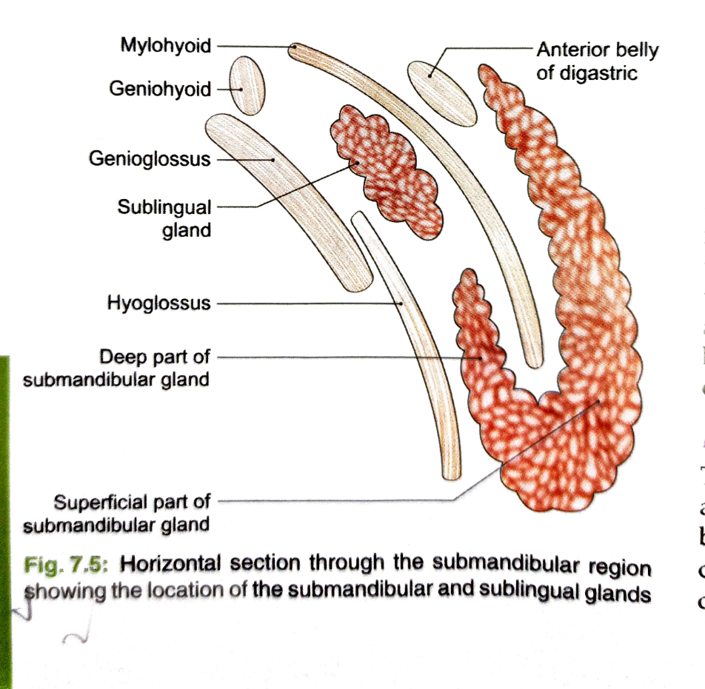
SUBMANDIBULAR SALIVARY GLAND
This is a large salivary gland ,situated in the anterior part of the digastric triangle
The wt of the gland is 15-20 gms
roughly j-shaped,indented by posterior border of mylohoid which divides it in to a larger part superficial to the muscle,and a smaller part lying deep to the muscle
Coverings-The gland is partially enclosed between two layers of deep cervical fascia

Slide 3
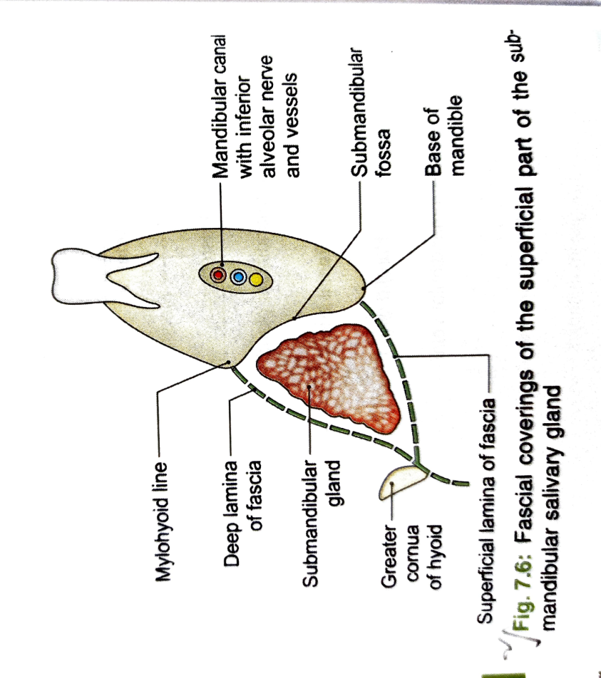
SUPERFICIAL PART
This part of the gland fills the digastric triangle
It extends superiorly deep to the mandible up to the mylohyoid line
Inferiorly-it overlaps stylohyoid and the posterior belly of digastric.
It has three surfaces-
      Inferior
      Lateral
      Medial
Relations-the inferior surface is covered by -skin,platysma,cervical branch of the facial nerve and deep fascia,facial vein,and submandibular lymph nodes

Slide 4
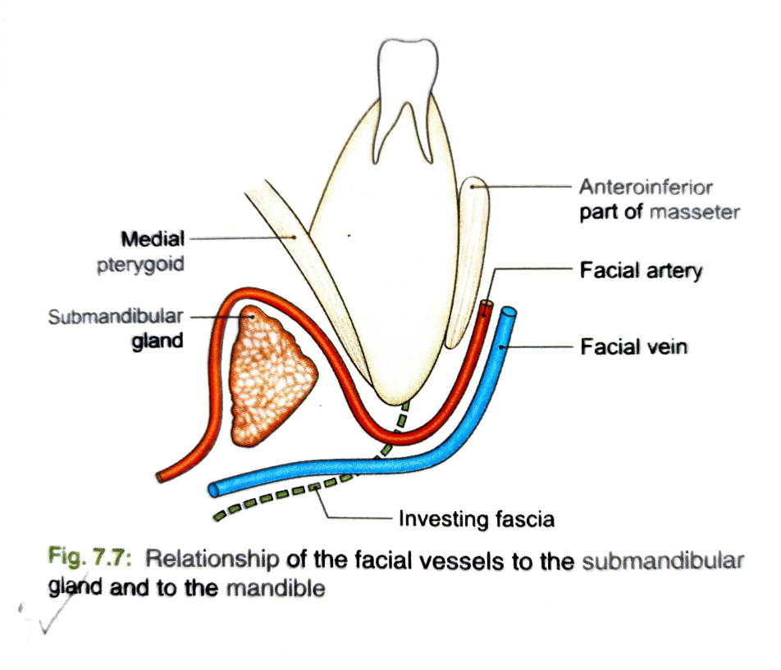
LATERAL SURFACE-Is related to submandibular fossa on the mandible,insertion of medial pterygoid and facial artery
MEDIAL SURFACE-Is related to
Anterior part-mylohyoid,submental branch of facial artery,mylohyoid nerve and vessels
Middle part-hyoglossus,styloglossus,lingual artery,XII cranial nerve
Posterior part-stylohyoid,styloglossus,IX cranial nerve

Slide 5
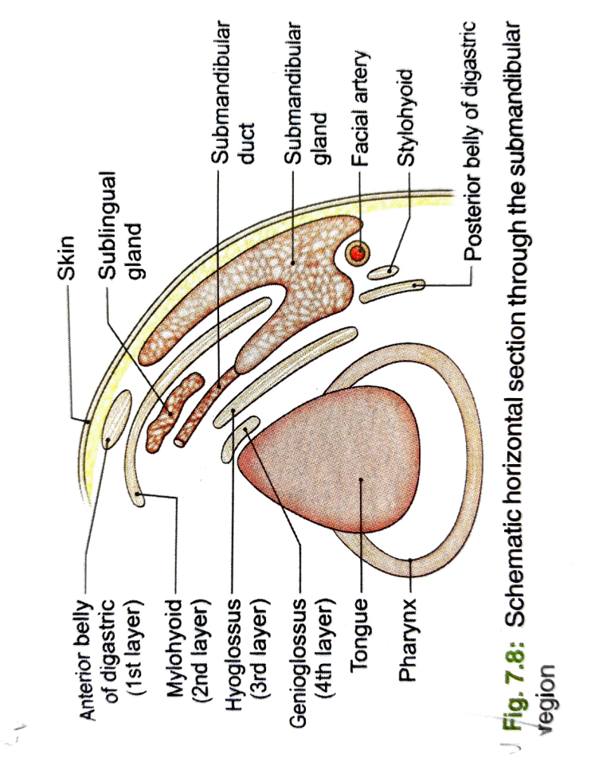
DEEP PART
This part is small in size
It lies deep to the mylohyoid, and superficial to the hyoglossus and the styloglossus
Posteriorly,it is continuous with the superficial part around the posterior border of the mylohyoid
Anteriorly, it extends up to the posterior end of the sublingual gland
RELATIONS-
Laterally-mylohyoid
Medially-hyoglossus
Above-lingual nerve and submandibular ganglion
Below-hypoglossal nerve

Slide 6
BLOOD SUPPLY & LYMPHATIC DRAINAGE
Submandibular gland is supplied by facial artery
The veins drain in to the common facial or lingual vein
Lymph passes to submandibular lymph nodes
SUBMANDIBULAR DUCT/WHARTONS DUCT
It is thin walled, 5cm long
It emerges at the ant end of deep part of gland and runs upward& forward on the hyoglossus,between the hypoglossal& lingual nerve
At the ant border of the hyoglossus,the duct is crossed by the lingual nerve
It opens on the floor of the mouth,on the summit of the sublingual papilla,at the side of the frenulum of the tongue

Slide 7
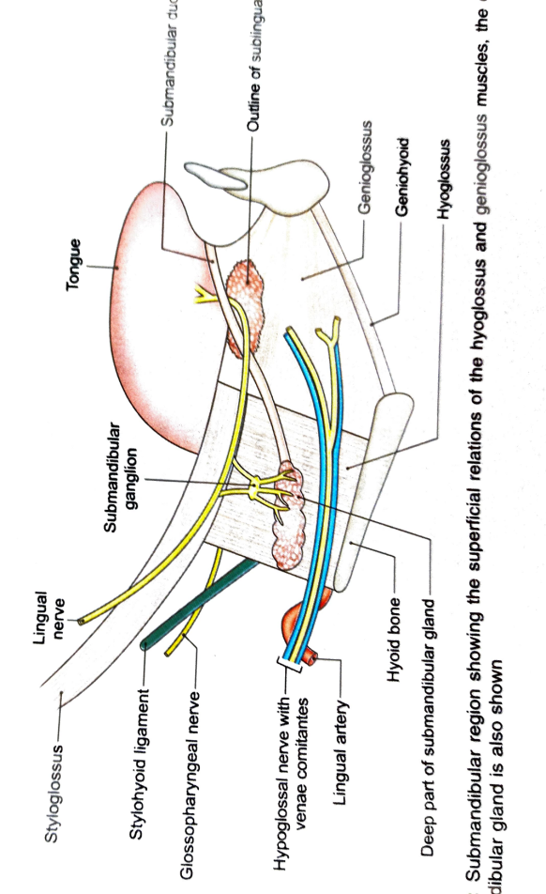
SUBMANDIBULAR GANGLION
This is peripheral parasympathetic ganglion
It is a relay station for secretomotor fibers to the submandibular & sublingual salivary glands
Topographically it is related to the lingual nerve, but functionally it is connected to the chorda tympani branch of the facial nerve
This ganglion lies on the hyoglossus muscle just above the deep part of the submandibular salivary gland,suspended from the lingual nerve by two roots

Slide 8
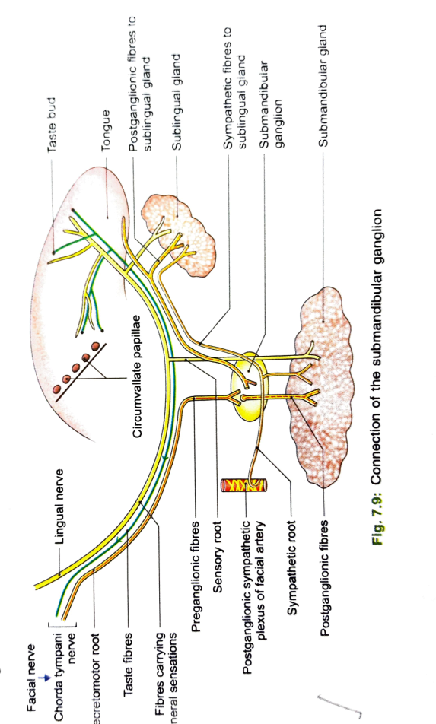
CONNECTIONS & BRANCHES
The secretomotor fibres pass from the lingual nerve to the ganglion through the posterior root.These are para sympathetic preganglionic fibres that arise in the sup salivatory nucleus and pass through nervus intermedius till the facial nerve,the chorda tympani and the lingual nerve to reach the ganglion for relay. post ganglionic fibres for the submandibular gland reach the gland through 5or 6 branches from the ganglion
Post ganglionic fibres for the sublingual glands re-enter the lingual nerve through the ant root and travel to the gland through the distal part of the lingual nerve
The sympathetic fibres are derived from the plexus around the facial artery.It contains postganglionic fibres arising in the sup cervical sympathetic ganglion.They pass through submandibular ganglion without relay and supply vasomotor fibres to the submandibular and sub lingual glands
Sensory fibres reach the ganglion through the lingual erve.

Slide 9
