Slide 1
NOSE&NASAL CAVITY
The nose consists of the external nose and the nasal cavity,both of which are divided by a septum in to rt&lt halves
The External nose has two elliptical orifices called the nostrils which are separated from each other by the nasal septumThe lateral margin,the ala nasi is rounded&mobile.
The framework of the external nose is made up above by the nasal bone,the frontal process of maxilla,and nasal part of the frontal bone
Below the frame work is formed of plates of hyaline cartilage

Slide 2
BLOOD SUPPLY OF EXTERNAL NOSE
The skin of the external nose is supplied by branches of the ophthalmic & maxillary artery
The skin of ala&the lower part of septum are supplied by branches from the facial artery
NERVE SUPPLY OF EXTERNAL NOSE-the infratrochlear&external nasal branches of the maxillary nerve

Slide 3
NASAL CAVITY
The nasal cavity extends from the nostrils in front to the posterior nasal apertures or choanae behind,where the nose opens in to the nasopharynx.
The nasal vestibule is the area of the nasal cavity lying just inside the nostril
The nasal cavity is divided in to right & lt halves by the nasal septum
The septum is made up of the septal cartilage,the vertical plate of ethmoid,and the vomer

Slide 4
WALLS OF THE NASAL CAVITY
Each half of the nasal cavity has a floor,a roof,a lateral wall,and a medial or septal wall
FLOOR-is formed by the palatine process of the maxilla and the horizontal plate of the palatine bone
ROOF-the roof is narrow and is formed anteriorly beneath the bridge of the nose by the nasal and frontal bone,in the middle by the cribriform plate of the ethmoid,located beneath the ant cranial fossa,and post by the downward sloping body of the sphenoid.
LATERAL WALL-has three projections of bone called the superior,middle and inferior conchae. the space below each conchae is called a meatus.
Spheno ethmoidal recess-the sphenoethmoidal recess is a small area above the superior concha.it receives the opening of the sphenoid air sinus.

Slide 5
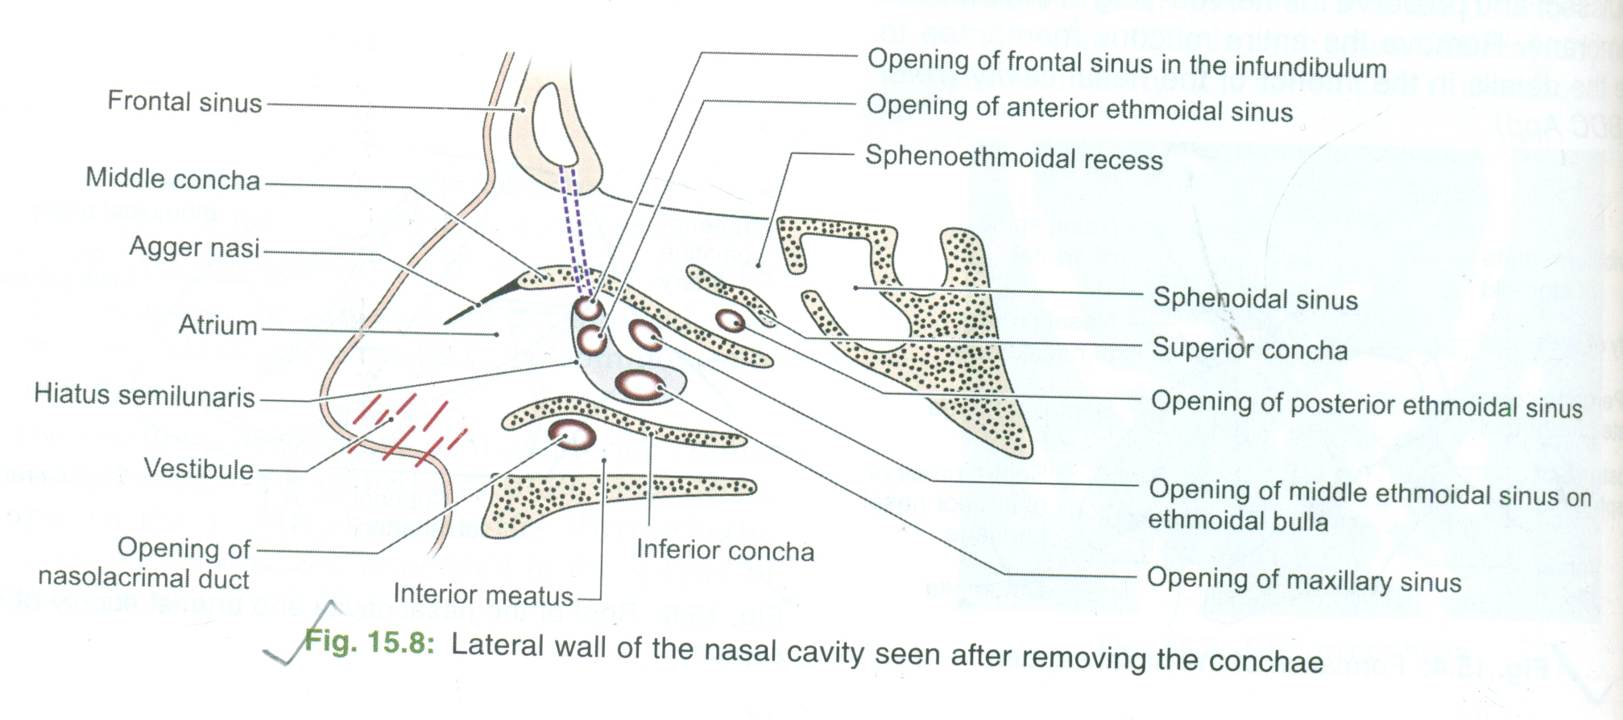
FEATURES OF LATERAL WALL
Superior meatus-the superior meatus lies below the sup concha.it receives the openings of posterior ethmoidal sinuses.
Middle meatus-the middle meatus lies below the middle concha.it has a round swelling called the bulla ethmoidalis that is formed by the middle ethmoidalis air sinuses,which open on its upper border.a curved opening,the hiatus semilunaris,lies just below the bulla. the anterior end of the hiatus leads in to a funnel shaped channel called the infundibulum, which is continuous with the frontal sinus. the maxillary sinus opens in to the middle meatus through the hiatus semilunaris.
INFERIOR MEATUS-the inferior meatus lies below the inferior concha and receives the opening of the lower end of the nasolacrimal duct, which is guarded by a fold of mucous membrane

Slide 6
MEDIAL WALL
The medial wall is formed by the nasal septum.the upper part is formed by the vertical plate of ethmoid and the vomer.
The anterior part is formed by the septal cartilage.
The septum rarely lies in the midline, thus increasing the size of one half of the nasal cavity and decreasing the size of the other.
MUCOUS MEMBRANE OF NASAL CAVITY- The vestibule is lined with with modified skin and has coarse hairs.
The area above the superior concha is lined with olfactory mucous membrane and contains nerve endings senstive to the reception of smell.
The lower part of the nasal cavity is lined with respiratory mucous membrane.
A large plexus of veins in the submucous connective tissue is present in the respiratory region.

Slide 7
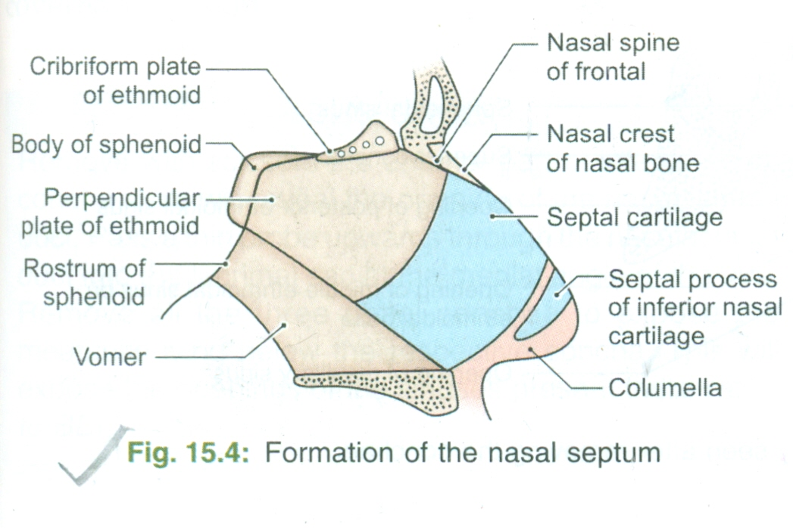
NASAL SEPTUM
Upper part is formed by the vertical plate of the ethmoid and the vomer.
The ant part is formed by the septal cartilage.the septum rarely lies in the midline.thus increasing the size of one half of the nasal cavity and decreasing the size of the other.
The cuticular part or lower end is formed by fibrofatty issue covered by skin.the lower margin of the septum is called the columella.
ARTERIAL SUPPLY-
Antero superior part-ant & post ethmoidal artery
Antero inferior part-septal branch of sup labial branch of facial artery
Posterosuperior part-sphenopalatine artery.it is main artery

Slide 8
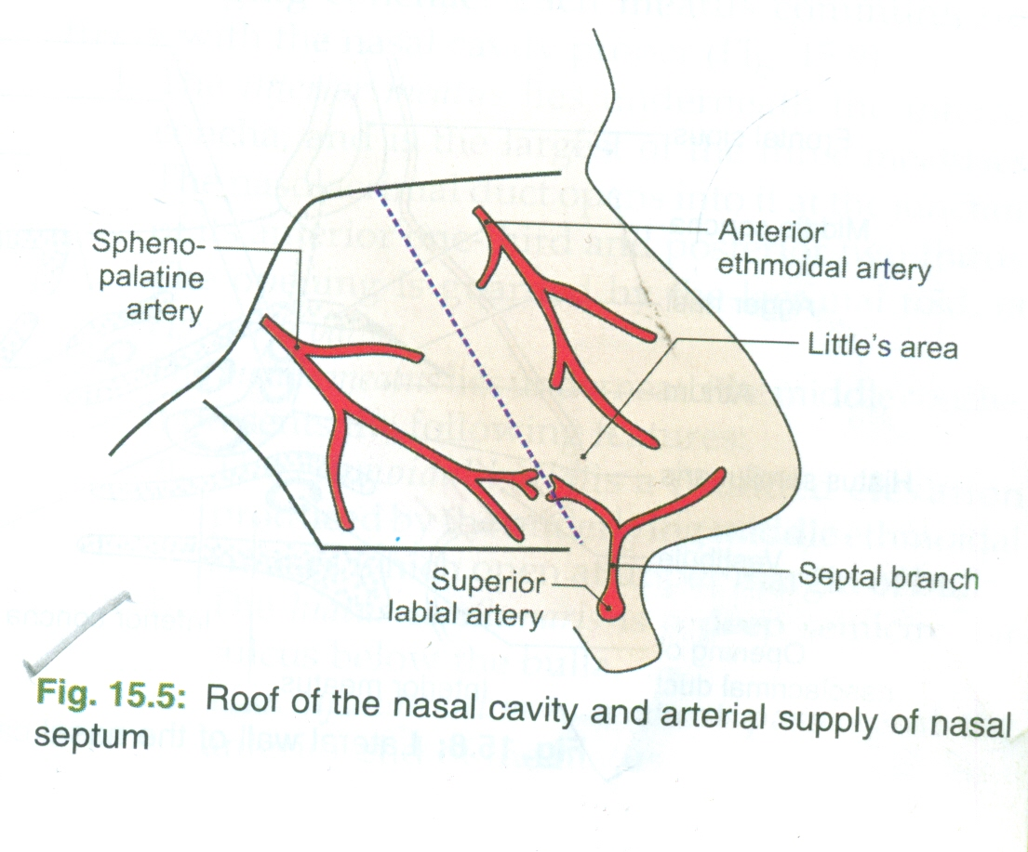
NASAL SEPTUM CONT.
The anteroinferior part or vestibule of the septum contains anastomoses between all branches,e.g.the septal branch of the superior lbial branch of the facial artery,sphenopalatine artery,and ant ethmoidal artery.these form a large capillary network called the kiesselbachs plexus.this is a common site of bleeding from the nose or epitaxis,and is known as littles area.
VENOUS DRAINAGE-The veins form a plexus which is more marked in the lower part of septum or littles areaThe plexus drains anteriorly in to the facial vein,and posteriorly through sphenopalatine vein to pterygoid venous plexus.

Slide 9
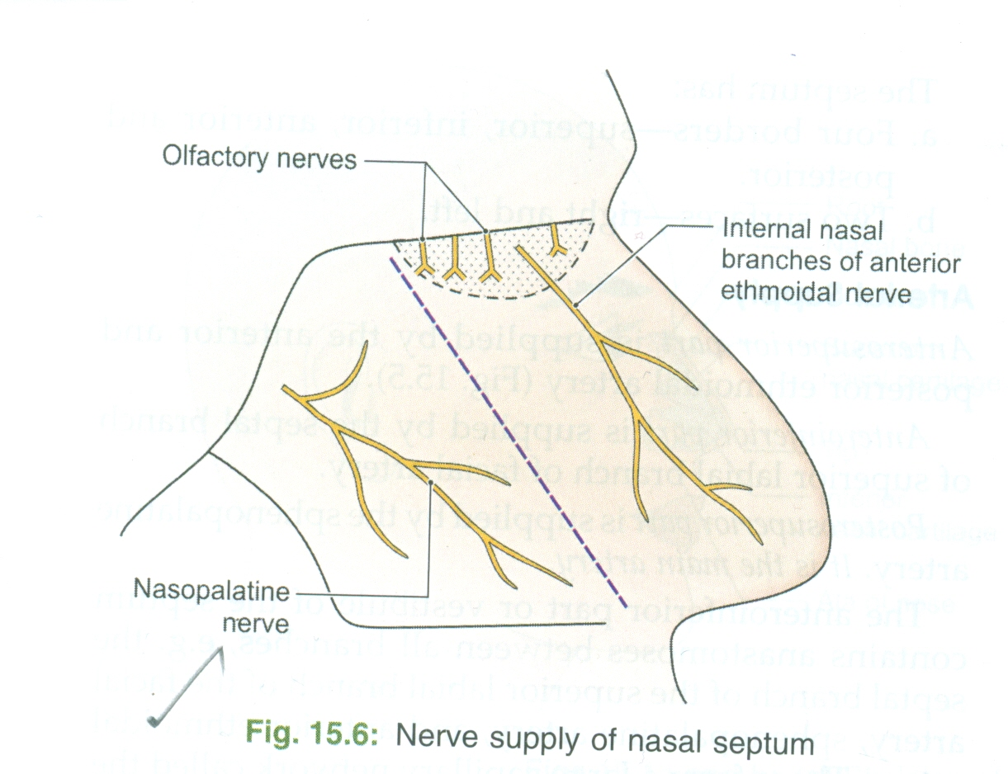
NASAL SEPTUM CONT.
NERVE SUPPLY-The antero superior part of the septum is supplied by the internal nasal branches of the ant ethmoidal nerve.
The posteroinferior part is supplied by the nasopalatine branch of the pterygopalatine ganglion. it is the main nerve.
Special sensory nerves or olfactory nerves are confined to the upper part or olfactory area.
LYMPHATIC DRAINAGE-Ant half to submandibular nodes,Posterior half to the retropharyngeal node & deep cervical nodes

Slide 10
CLINICAL ANATOMY
Sphenopalatine artery is the artery of epistaxis.
Littles area on the septum is a common site of bleeding from the nose or epistaxis
Pathological deviation of the nasal septum is often responsible for repeated attacks of common cold,allergic rhinitis,sinusitis etc. it requires surgical correction.

Slide 11
FUNCTION OF WARM BLOOD&MUCUS OF MUCUS MEMBRANE
The presence of warm blood in the venous plexuses serves to heat up the inspired air as it enters the respiratory system.
The presence of mucus on the surfaces of the conchae traps foreign particle and organisms in the inspired air,which are then swallowed and destroyed by by gastric acid.

Slide 12
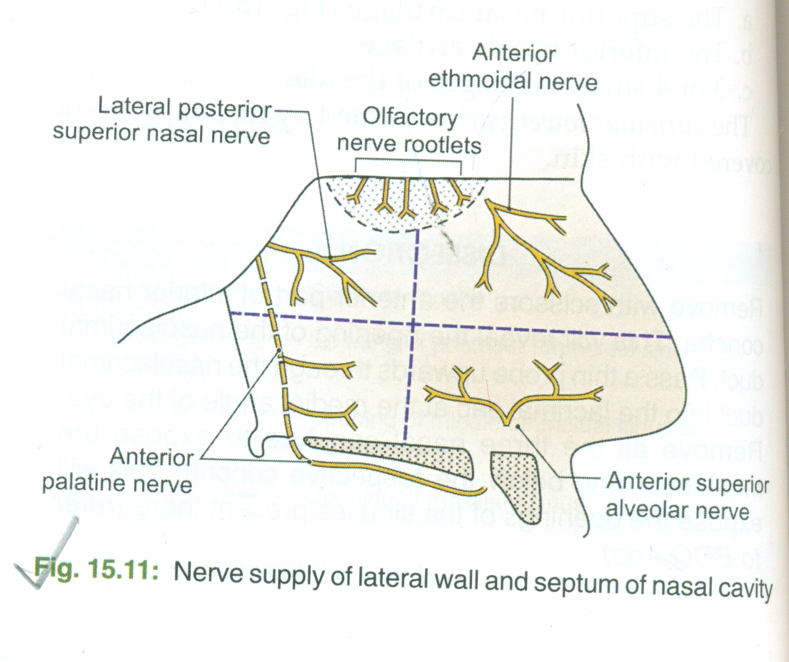
NERVE SUPPLY OF THE NASAL CAVITY
The olfactory nerves from the olfactory mucous membrane ascend through the cribriform plate of the ethmoid bone to the olfactory bulbs
The nerves of ordinary sensation are branches of the ophthalmic division and the maxillary division of the trigeminal nerve

Slide 13
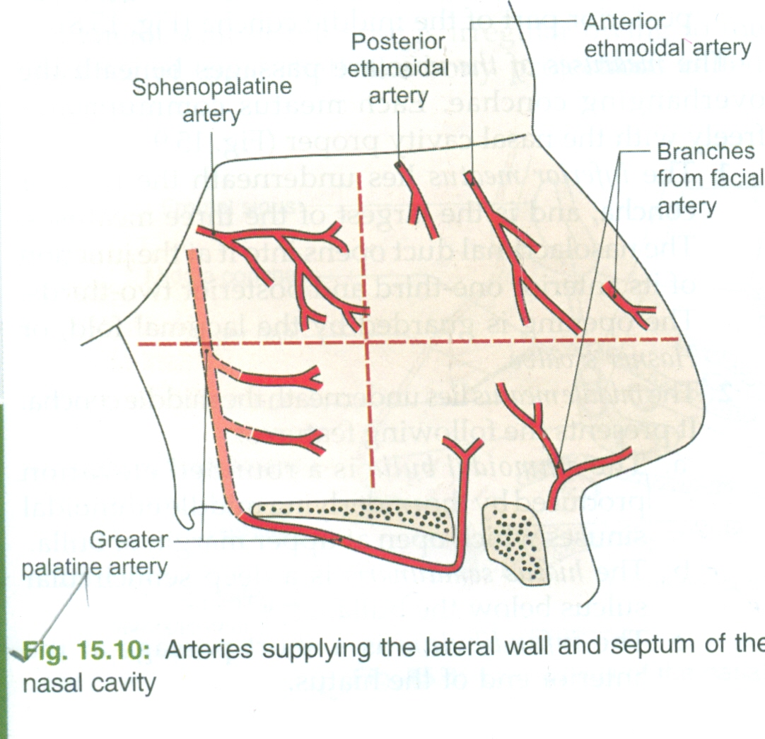
BLOOD SUPPLY OF THE NASAL CAVITY
The arterial supply to the nasal cavity is from branches of the maxillary artery,one of the terminal branches of the external carotid artery
The most important branch is the sphenopalatine artery
The sphenopalatine artery anastomoses with the septal branch of the facial artery in the region of the vestibule
The submucous venous plexus is drained by veins that accompany the areries

Slide 14
LYMPHATIC DRAINAGE OF THE NASAL CAVITY
The lymph vessels draining the vestibule end in the submandibular lymph nodes.
The remainder of the nasal cavity is drained by vessels that pass to the upper deep cervical nodes

Slide 15
THE PARANASAL SINUSES
The paranasal sinuses are cavities found in the interior of the maxilla,frontal,ethmoid & sphenoid bones
they are lined with mucoperiosteum,and filled with air
they communicate with with the nasal cavity through relatively small apertures
The maxillary &sphenoidal air sinus are present in a rudimentary form at birth;they enlarge appriciably after the 8 years and become fully formed in adolescence.
The function of the sinuses is to act as resonators to the voice
They also reduce the weight of the skull
When the apertures of sinuses or they become filled with fluid,the quality of the voice is markedly changed.

Slide 16
MAXILLARY SINUS
The maxillary sinus is pyramidal in shape and located with in the body of the maxilla.
The roof is formed by the floor of the orbit.
The floor is related to the to the roots of the premolars and molar teeth
The maxillary sinus is opens in to the middle meatus of the nose through the hiatus semilunaris.

Slide 17
FRONTAL SINUSES
Two frontal sinuses are contained with in the
They are separated from each other by a bony septum.
Each sinus is roughly triangular, extending upward above the medial end of the eye brow and backward in to the medial part of the roof of the orbit.
Each frontal sinus opens in to the middle meatus of nose through the infundibulum.
SPHENOIDAL SINUSES-The two sphenoidal air sinuses lie with in the body of the sphenoid bone.each sinus opens in to the sphenoethmoidal recess above the superior concha

Slide 18
ETHMOID SINUS
The ethmoid sinuses are ant, middle,and posterior and they are contained with in the ethmoid bone between the nose and the orbit.
They are separated from the orbit by a thin plate of bone so that infection can readily spread from the sinuses in to the orbit.the ant sinuses open in to the infundibulum,the middle sinuses open in to the middle meatus,on or above the bulla ethmoidalis;and the posterior sinuses open in to e superior meatus.

