Slide 1
PHARMACOKINETICS
DR. ANJU SAXENA

Slide 2
PH1.6 Describe salient features of absorption, distribution, metabolism and excretion of drugs with emphasis on various routes of drug administration

Slide 3
Pharmacokinetics
“What the body does to the drug”
Quantitative study of drug movement in, through and out of the body.
Four parameters are there
      Absorption
      Distribution
      Metabolism
      Excretion

Slide 4
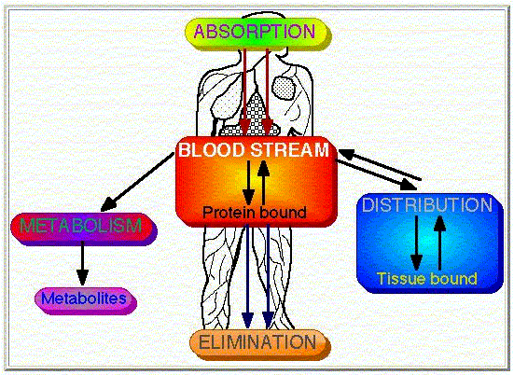

Slide 5
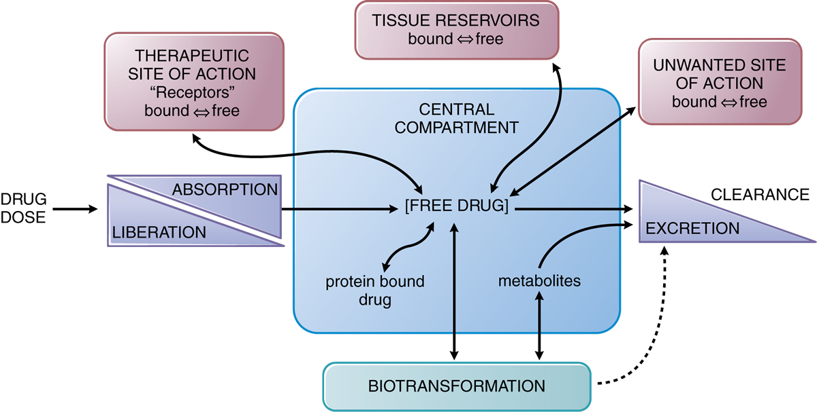

Slide 6
Drug administration → move from site of administration to tissues or cells where it will act.
Called as biotransport and the mechanisms underlying the transfer of a drug across the biological barriers are called the transport mechanisms.

Slide 7
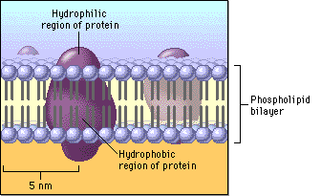
Biological Membrane
Notes:
Bilayer = phospholipid + cholesterol molecules
Intrinsic protein and extrinsic protein on lipid bilayer
Biological membranes are HIGHLY DYNAMIC STRUCTURES

Slide 8
Major transport mechanisms:
  Passive diffusion
  Carrier mediated transport
    Facilitated transport
    Active transport
  Pinocytosis/Phagocytosis
  Filtration
Notes:
DRUGs are transported across the membrane by
Passive diffusion and filtration
Specialized transport

Slide 9
PASSIVE DIFFUSION
Drug molecules pass through a biological barrier from higher concentration to lower concentration (along the concentration gradient) without requiring any expenditure of energy by the biological system.

Slide 10
Nonionised drugs can diffuse passively across the biological barriers at a rate proportional to their lipid:water partition coefficient. (drugs that are highly lipid soluble can diffuse rapidly)
Partly ionised drugs (weak electrolytes) – diffusion depends on degree of ionisation, pH and the lipid:water partition coefficient.

Slide 11
This relationship is expressed by Henderson – Hasselbach equation :
pKa (Acid) = pH + log (Conc. of nonionised acid)
(Conc. of Ionised Acid)
pKa (Base) = pH + log (Conc. of ionised Base)
(Conc. of nonionised Base)

Slide 12
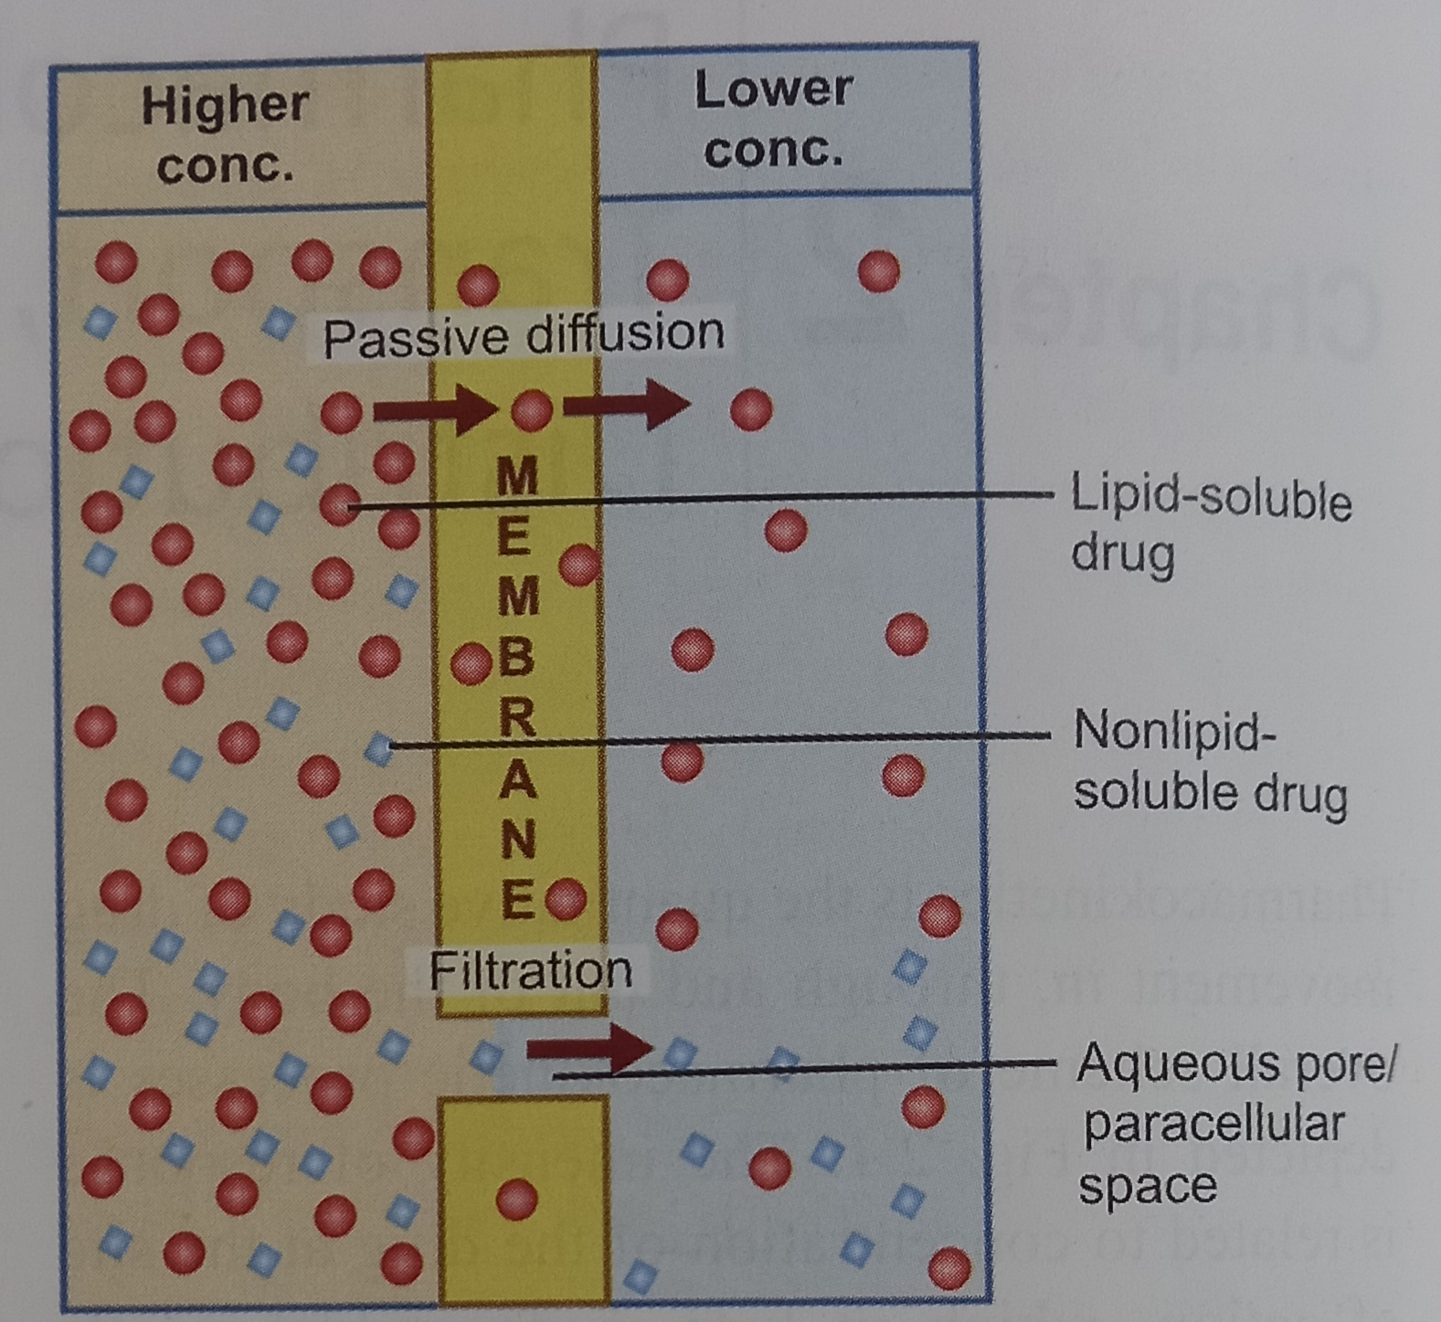

Slide 13
Influence of pH
Weak electrolytes can be weakly acidic or weakly basic.
Since the rate of passive diffusion of any weak acid or weak base depends on its degree of ionisation which in turn depends upon the pH of the surrounding medium, a relationship exists between its dissociation constant (pKa of the drug), the pH of the environment (in which it is placed) & the extent of its ionisation.
Notes:
pKa = negative log of acidic dissociation constant of weak electrolyte

Slide 14
Implications
The stronger the acid (or weaker the base), the lower will be its pKa value. On the contrary, stronger the base (or weaker the acid), the higher will be its pKa.
Weakly acidic drugs remain predominantly nonionised in acidic media and are better absorbed from places like stomach; while weakly basic drugs remain predominantly nonionised at alkaline pH and thus are better absorbed from intestine.

Slide 15
Implications
3. If pKa of the drug is equal to the pH of the medium, it would remain 50% ionised & 50% nonionised.
4. For every upward or downward shift of 1 unit of pH there is 10 fold increase or decrease in the ratio of the ionised and nonionised fraction of the drug, depending upon whether the drug was a weak acid or a weak base.
5. Strongly acidic or strongly basic drugs and quaternary ammonium compounds remain predominantly ionised at all pH and are, therefore, poorly absorbed.

Slide 16
Ion trapping – the nonionised form of the weakly acid drug (aspirin; pKa 3.5) which crosses the gastric mucosa (pH 2), reverts to the ionised form within the cell (pH 7) & hence slowly passes to the extracellular fluid - - ion trapping (contributes to gastric mucosal cell damage caused by aspirin)
Notes:
Acidic drugs ionized in alkaline urine → do not diffuse back in kidney and excreted faster
Basic drugs excreted faster in acidic urine

Slide 17
Carrier mediated transport
Some require carrier for their transport across the membrane.
Proteins = combines with the drug substrate and form a complex
Drug – carrier complex exhibits better permeability than the drug alone.
After this complex crosses the membrane, the carrier dissociates from
the drug.
2 types : facilitated diffusion & Active transport
Notes:
Polar compounds such as sugars and amino acids cannot penetrate membranes by passive diffusion.

Slide 18
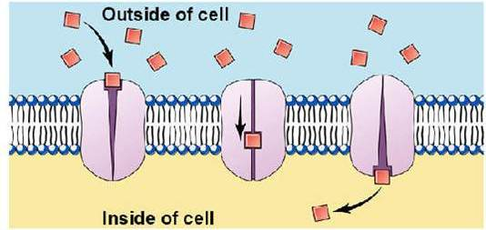
Facilitated diffusion
Features :
Carrier can move a drug substrate along its concentration gradient only (down – hill diffusion)
No extracellular energy is required for translocation of drugs
The transporter belonging to the super family of SLC transporters operates passively without needing energy.
Eg : amino acids in brain, antiviral drugs, anticancer drugs.

Slide 19
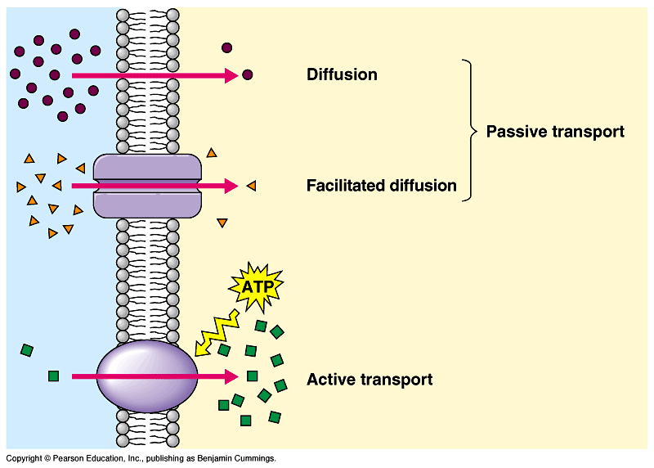
Active Transport
Energy dependent, carrier mediated transport taking place against the electro – chemical gradient.
The energy needed for the active transport is generated by the membrane ATPase.
2 types : primary active transport & secondary active transport.

Slide 20
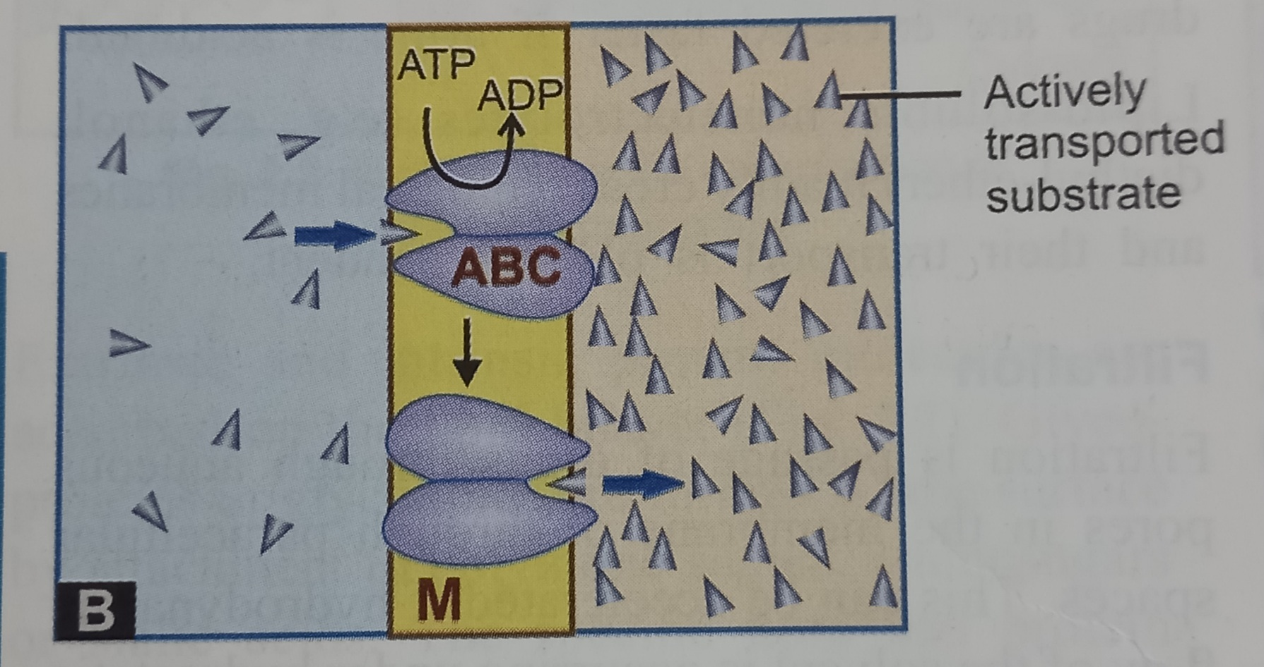
Primary active transport :
    Energy ----by the hydrolysis of ATP
    Transporter ----superfamily of ABC
    Mediate only efflux of the solute from the cytoplasm
    P-gp well known primary active transporter
Notes:
ABC = ATP binding cassette protein
Eg= p-glycoprotein, Breast cancer resistance protein (BCRP)

Slide 21
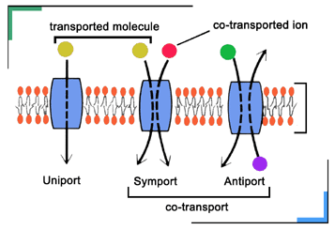
Secondary active transport
    Mediated ---SLC transporters
    Energy to pump one solute is derived from down hill movement of another solute

Slide 22
SYMPORT
  both the solutes move in the same direction
ANTIPORT
  both the solutes move in opposite direction
  Eg. OATP & OCT expressed in liver canaliculi & renal tubules are sec. active transporter
Notes:
Symport = concentration gradient are such that both the solutes move in the same direction
OATP = Organic anion transporting polypeptide
OCT = Organic cation transporter

Slide 23
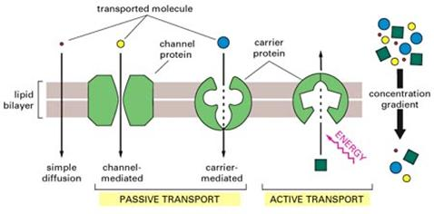

Slide 24
Carrier transport is saturable & follows Michaelis-Menten Kinetics
Maximal rate of transport is dependent on density of transporter in a particular membrane and its rate constant, Km, is governed by its affinity for the substrate
Notes:
Km = substrate concentration at which rate of transport is half maximal

Slide 25
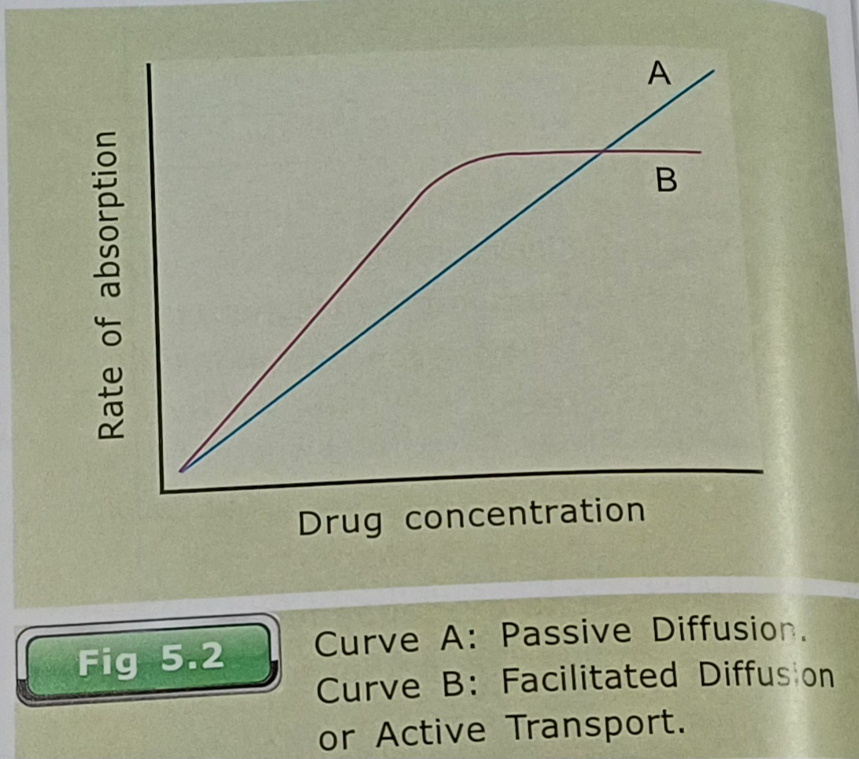

Slide 26
Pinocytosis/Phagocytosis
Engulfment of a fluid or a drug in a solution- Pinocytosis,
Eg. Polypeptides- insulin
Eating particulate matter, can also be transferred by local invagination of cell membrane.
Eg. APC phagocytose allergen, Botulinum toxin
Energy is required in these processes

Slide 27
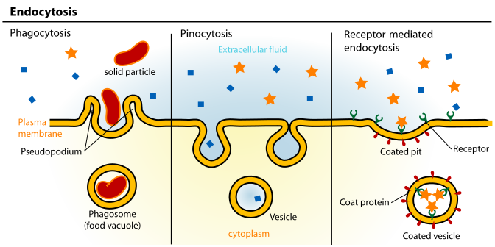
Pinocytosis/Phagocytosis

Slide 28
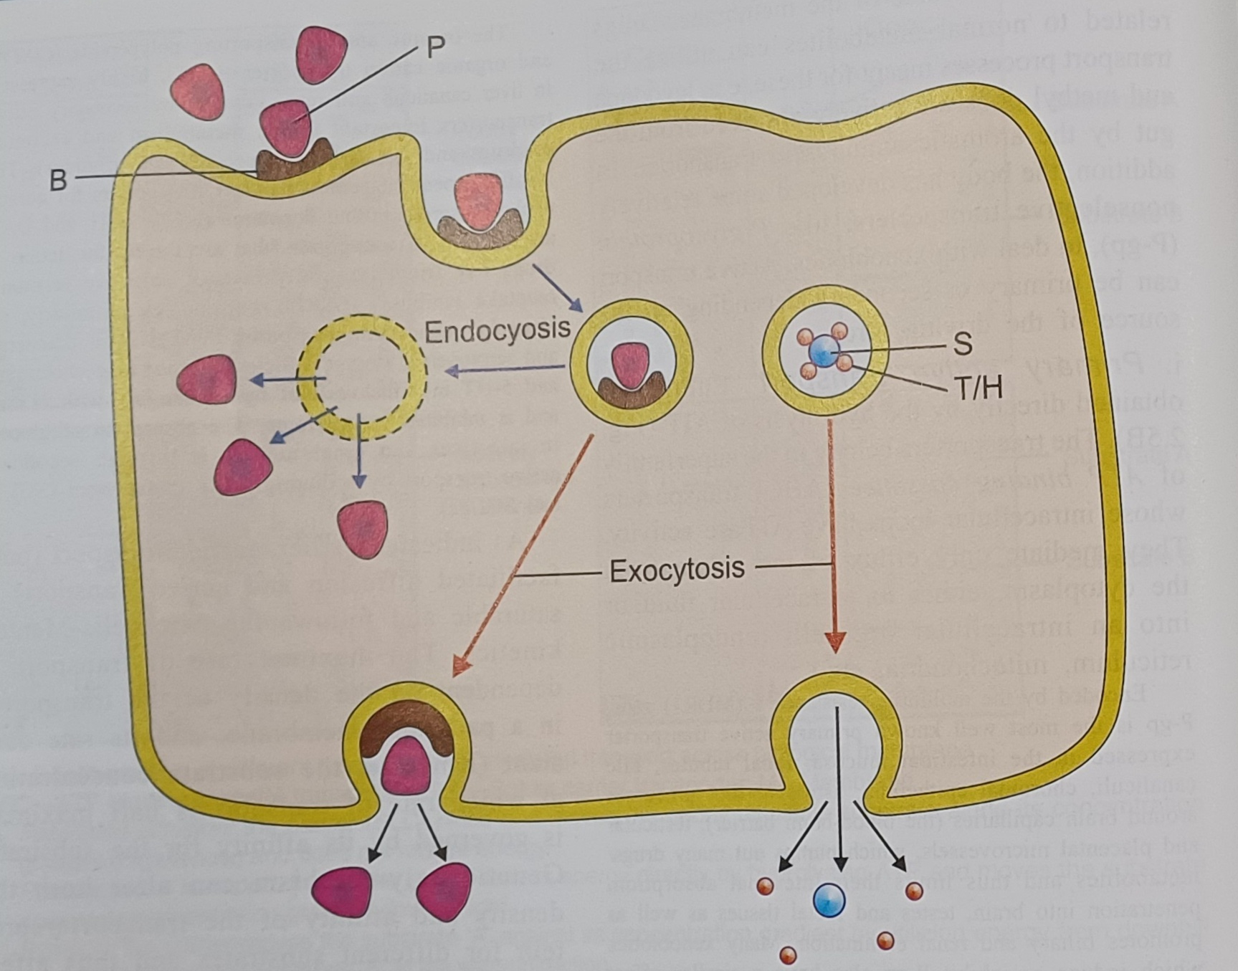

Slide 29
Filtration
Free or unbound drugs (or metabolites) of smaller molecular size can pass through the pores or spaces between the cells by the process of filtration.
Lipid insoluble drugs – cross biological membranes; size smaller than diameter of pores
Diffusion across capillaries Capillaries = dependent on rate of blood flow and not lipid solubility or pH
Notes:
Lipid insoluble drugs cross biological membranes by filtration if their molecular size is smaller than diameter of pores
Diffusion of drugs across capillaries is dependent on rate of blood flow through them rather than on lipid solubility of the drug or the pH of the medium

Slide 30
Filtration
Is a physical process where the rate of filtration is proportional to a pressure gradient.
Eg. : urea, glucose, alcohol which are filtered through glomerulus.

