Slide 1
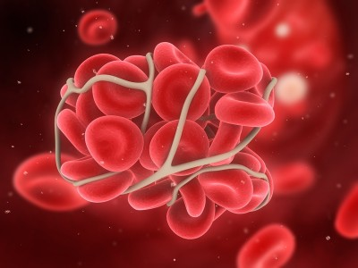
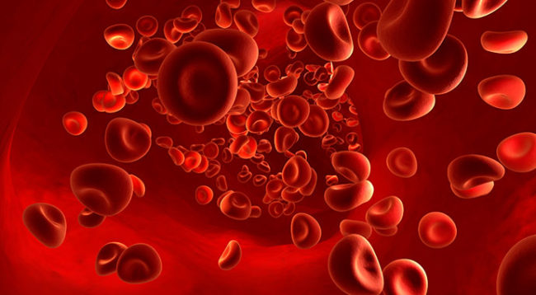
COAGULANTS
PH 4.2 Explain types, salient pharmacokinetics, pharmacodynamics, therapeutic uses and adverse effects of coagulants and device a plan to monitor therapy and management of adverse effects.
Dr. Nasra Banu
Assistant Professor

Slide 2
Maintaining blood in a fluid state
PROCOAGULANTS ANTICOAGULANTS
(promote coagulation) (inhibit coagulation)
Whether blood will coagulate depends on the balance between these two groups of substances.
In the blood stream, the anti- coagulants normally predominate, so that the blood does not coagulate.

Slide 3
BLEEDING
HAEMOSTASIS
(The process of arrest of blood loss and blood coagulation.)

Slide 4
Haemostasis is maintained in the body through three mechanisms:
Vascular spasm- The injured vessels constrict.
Platelet plug formation- The platelets adhere to damaged endothelium to form platelets plug (primary haemostasis) and then degranulate.
Blood coagulation- Clots form due to conversion of fibrinogen to fibrin and stabilize the platelet plug (secondary haemostasis).

Slide 5
HAEMOSTASIS
Stablehemostaticclot
INJURED VESSELWALL
Vasoconstriction
PLATELETS
Platelet plug
PrimaryHaemostasis
COAGULATIONFACTORS
Fibrin clot
SecondaryHaemostasis

Slide 6
CLOTTING FACTORS
Proteins present in the plasma.
There are 13 clotting factors.
On partial proteolysis they get activated and activates the next factor down in the cascade.
This cascade of proteolytic reactions are responsible for blood coagulation.
Deficiency of any one of them can lead to bleeding disorders.

Slide 7
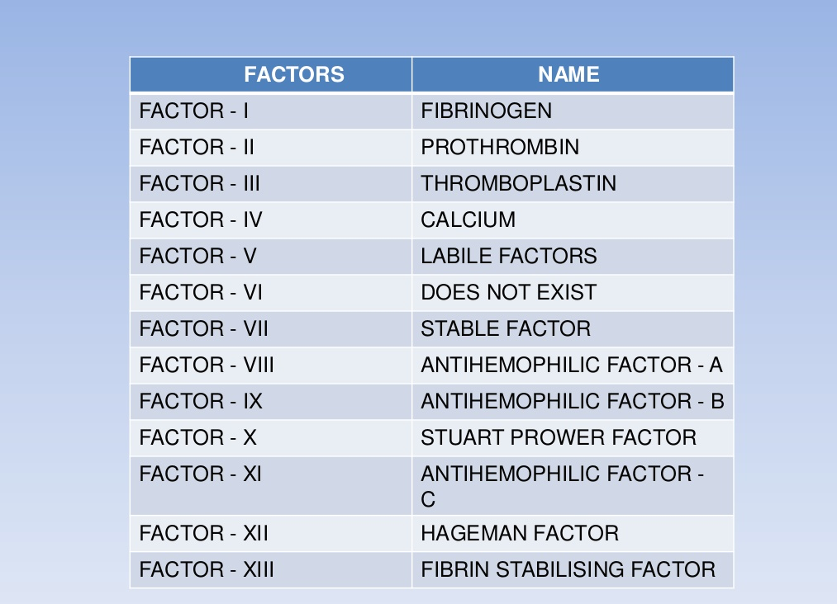

Slide 8
Coagulation Process
The clotting cascade can be triggered through two possible pathways. They are-
    Extrinsic pathway
    Intrinsic pathway
Both of them lead to the activation of final common pathway in which thrombin converts fibrinogen to fibrin.

Slide 9
COAGULATION CASCADE
INTRINSIC SYSTEM
EXTRINSIC SYSTEM
Endothelium damage
XIIa
Activated by contact with collagen
Tissue damage
VIIa
TF
VII
XIIa
XI
XIa
XIa
Ca²⁺
Kallikrein
SLOW
III
RAPID
IX
IXa
VIII a
Pl.Ph.
Ca²⁺
COMMON PATHWAY
Ca²⁺
X
Xa
X
Ca²⁺
V
Pl.Ph.
Thromboplastin/prothrombinase
PROTHROMBIN
THROMBIN
Ca²⁺
FIBRINOGEN
(polymerization)
FIBRIN (soluble)
XIIIa
Thrombin
FIBRIN (insoluble)

Slide 10
Fibrin absorbs 90% of thrombin into the clot and inactivates it.
This prevents the spread of thrombin in the blood and limits the extension of the clot beyond damage.
Fibrin are digested by plasmin.
α2-antiplasmin prevent premature lysis of fibrin.
Other natural anticoagulants are prostacyclin, antithrombin III, protein C and Heparan sulfate.

Slide 11
Some Terminologies
Thrombosis: If clotting takes place abnormally early in an intact blood vessel. The clot is called thrombus.
Embolus: when thrombus (or a part of it) is swept away in the blood from its site of formation.
If it takes too long to clot, the result is haemorrhage.

Slide 12
Bleeding Disorders
Genetically determined deficiencies (rare)
  Classical Haemophilia- A (lack of factor VIII)
  Haemophilia- B (lack of factor IX)
Acquired clotting defects (more common)
  Vitamin-K deficiency
  Excessive oral anticoagulant therapy

Slide 13
Diagnosis of Coagulation Defects
Prolonged aPTT
No change in PT
No change in aPTT
Prolonged PT
Prolonged APTT
Prolonged PT
Defect in Intrinsic pathway
Defect in Extrinsic pathway
Defect in Common pathway

Slide 14
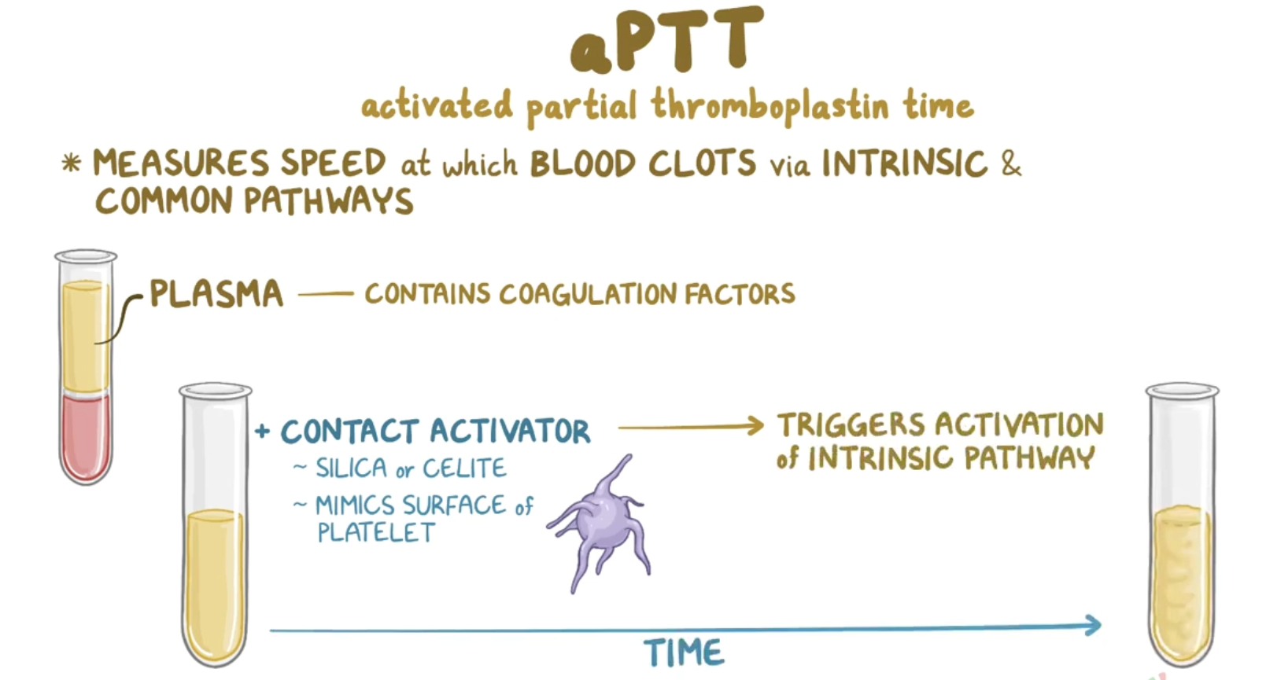

Slide 15
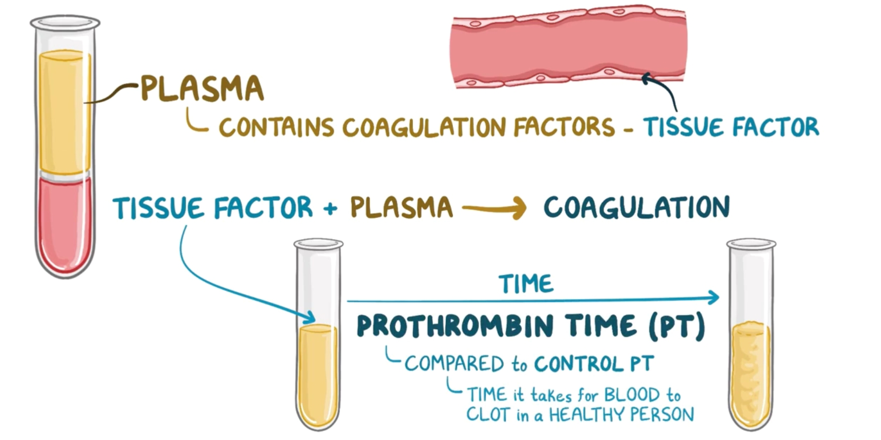

Slide 16
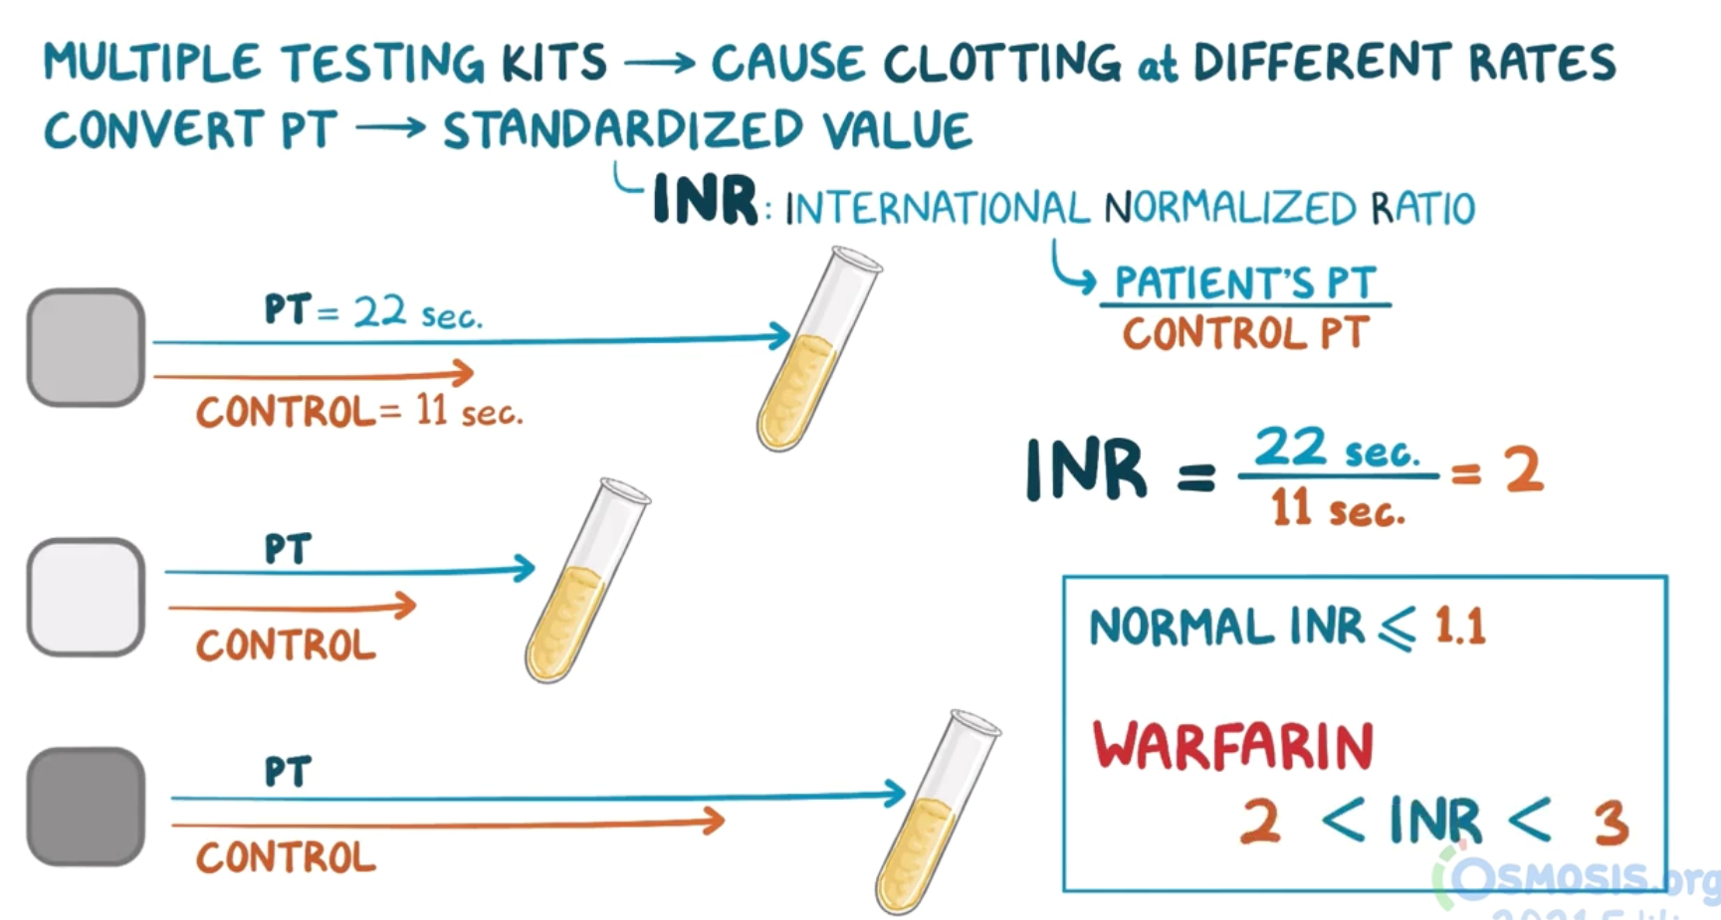

Slide 17
Drugs for Bleeding Disorders
A. Coagulants-
  1. Vitamin K
  2. Local and Systemic Haemostatic
B. Anticoagulants
  1. Heparin , Danaparoid, Lepirudin
  2. Oral Anticoagulants- Warfarin, Dicumarol, Phenindione, Rivaroxaban,
C. Thrombolytic Drugs
  1. Streptokinase
  2. Urokinase
  3. Tissue Plasminogen Activator(t-PA)

Slide 18
COAGULANTS
Substances which promote coagulation.
Indicated in hemorrhagic states.
Fresh whole blood or plasma provide all the factors needed for coagulation and are the best therapy for deficiency of any clotting factor.
They also act immediately.

Slide 19
COAGULANTS
Vitamin K
K1 (from plants) : Phytonadione
fat-soluble) (Phylloquinone)
K3 (synthetic)
—Fat-soluble : Menadione,
Acetomenaphthone
—Water-soluble : Menadione sod.
Bisulfite, Menadione sod. diphosphate.
K2 (naturally synthesize in the body by colonic bacteria): Menaquinone
2. Miscellaneous
Fibrinogen (human)
Antihaemophilic factor
Desmopressin
Adrenochrome monosemicarbazone
Rutin
Ethamsylate

Slide 20
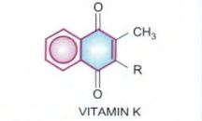
Vitamin K
Fat-soluble vitamin
Required for the synthesis of clotting factors 2,7,9 and 10.
Vit-K has a basic naphthoquinone structure, with or without a side chain (R) at position 3.
      The side chain in K1: phytyl
      K2: prenyl
      K3: no side chain

Slide 21
Dietary sources are—green leafy vegetables, such as cabbage, spinach; and liver, cheese, etc.
Daily requirement is uncertain, because a variable amount of menaquinone (vit K2) is produced by colonic bacteria.
However, the total requirement of an adult has been estimated to be 50–100 μg/day.

Slide 22
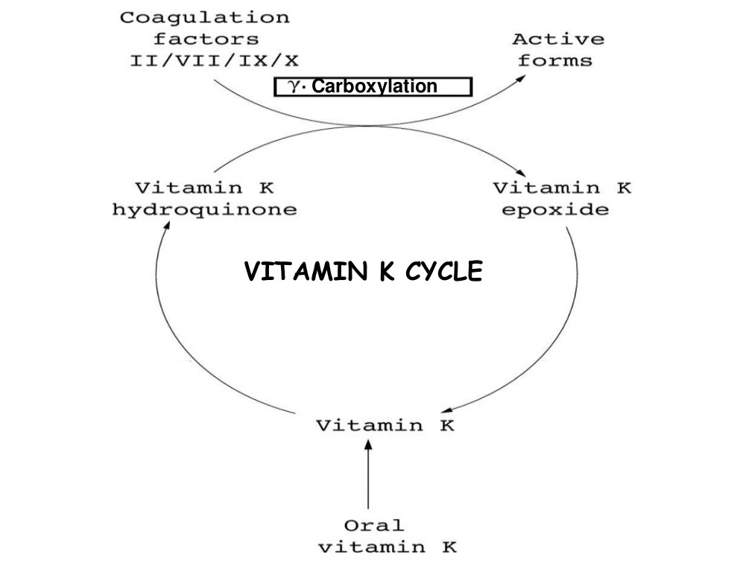
Action
Vit K acts as a cofactor at a late stage in the synthesis of coagulation proteins by liver—II, VII, IX and X.
The vit K is responsible for γ carboxylation of glutamate residues of these zymogen proteins.
This confers on them the capacity to bind Ca²⁺ and to get bound to phospholipid surfaces—properties essential for participation in the coagulation cascade.

Slide 23
Pharmacokinetics
Fat-soluble forms of vit-k are absorbed from intestine via lymph and require bile salts for absorption.
Water-soluble forms are absorbed directly into portal blood.
K1 absorbed via Active transport in jejunum.
K2 and K3 are absorbed by simple diffusion.
Metabolized in liver by glucuronide conjugation.
Metabolites are excreted in bile and urine.

Slide 24
Vit-K Deficiency
The most important manifestation: bleeding tendency
(due to lowering of the levels of prothrombin and other clotting factors in blood.)
Haematuria usually occurs first.
Other common sites of bleeding are g.i.t., nose and under the skin (ecchymoses).
Causes of vit-k deficiency:
    Liver disease
    Obstructive jaundice
    Malabsorption
    Long-term antimicrobial therapy (alters intestinal flora)
    Deficient diet (rare)

Slide 25
Use of vit-k
Prophylaxis and treatment of bleeding due to deficiency of clotting factors in the following situations:
a) Dietary deficiency: It is very rare in adults. However, when it occurs 5–10 mg/day oral or parenteral vit K rapidly corrects the defects.
b) Prolonged antimicrobial therapy: treat in the same way as dietary deficiency.
c) Obstructive jaundice or malabsorption syndromes : vit K- 10 mg i.m./day, or orally along with bile salts.
d)Liver disease (cirrhosis, viral hepatitis): synthesis of clotting factors is inadequate despite the presence of vit K.

Slide 26
e)Newborns: All newborns have low levels of prothrombin and other clotting factors.
Vit K 1 mg i.m. soon after birth has been recommended routinely.
Menadione (K3) should not be used for this purpose .
f)Overdose of oral anticoagulants:
This is the most important indication of vit K.
Phytonadione (K1) is the drug of choice.
Higher doses render the patient unresponsive to oral anticoagulants for several days.

Slide 27
Adverse Effects
Rapid i.v. injection of emulsified Vit K produces flushing, breathlessness, chest infection, fall in BP.
Death is very rare.
Menadione and its water-soluble derivatives can cause haemolysis in a dose-dependent manner.
Patients with G-6-PD deficiency and neonates are especially susceptible.
In the newborn menadione or its salts can precipitate kernicterus.

Slide 28
Other Coagulants
Fibrinogen –
Control bleeding in haemophilia, antihaemophilic globulin (AHG) deficiency and acute afibrinogenemic states.
0.5 g is infused i.v.
Antihaemophilic factor -
It is concentrated human AHG (antihaemophilic globulin).
Indicated in haemophilia and AHG deficiency.
Highly effective in controlling bleeding episodes, but action is short-lasting.

Slide 29
Desmopressin
It releases factor VIII and von Willebrand’s factor from vascular endothelium.
Checks bleeding in haemophilia and von Willebrand’s disease.
Adrenochrome monosemicarbazone
Reduces capillary fragility, control oozing from raw surfaces and prevent microvessel bleeding.
Its efficacy is uncertain.
Dose: 1–5 mg oral, i.m.

Slide 30
Rutin –
It is a plant glycoside claimed to reduce capillary bleeding.
Used in a along with vit C which is believed to facilitate its action.
Its efficacy is uncertain.
Dose of 60 mg oral BD– TDS.
Ethamsylate-
It reduces capillary bleeding when platelets are adequate.
Used in the prevention and treatment of capillary bleeding in menorrhagia, after abortion, PPH, epistaxis, malena etc.
Dose: 250–500 mg thrice daily oral/i.v.

Slide 31
Local Haemostatics (Styptics)
Substances used to control bleeding from a local and approachable site.
Particularly effective on oozing surfaces, e.g. tooth socket, abrasions, etc.
Absorbable materials like fibrin (prepared from human plasma and dried as sheet or foam)
Gelatin foam
Oxidized cellulose (as strips )
Thrombin from bovine plasma may be applied as dry powder or fresh solution.
Vasoconstrictors like 0.1% Adr solution may be soaked in sterile cotton gauze.
Astringents such as tannic acid or metallic salts are occasionally applied for bleeding gums, bleeding piles.
Russel’s viper venom acts as a thromboplastin; applied locally to stop bleeding (rarely used)

Slide 32
Sclerosing agents
These are irritants, cause inflammation, coagulation and ultimately fibrosis.
Injected into haemorrhoids (piles) or varicose vein mass. They are used only for local injection.
The substances include-
1. Sod. tetradecyl sulfate 3% with benzyl alcohol 2%:0.5–2 ml at each site.
2. Polidocanol (3% inj): 2 ml
3. Ethanolamine oleate.

Slide 33
THANK YOU

