Slide 1
AntituberculAr drugs
Dr. Sujata SINGH

Slide 2
PH 1.44: Describe the first line antitubercular drugs, their mechanism of action, side effects & doses

Slide 3
TB is a chronic granulomatous disease caused by Mycobacterium tuberculosis
5th leading cause of death among all diseases
in 2012, in India declared a notifialble disease by Govt. of India.
National programme for control and treatment→ free treatment
RNTCP launched in 1997 & treatment guidelines revised in 2010
technical and operational guidelines for TB control in India 2016
NTEP 2020

Slide 4
FIRST-LINE ANTI-TUBERCULER DRUGS:-
        High anti-tuberculer efficacy
        Low toxicity
        Used routinely
Isoniazid INH or H,
Rifampicin R
Pyrazinamide Z
Ethambutol E

Slide 5
SECOND-LINE DRUGS :-
  Low anti-tuberculer efficacy/ High toxicity/ both
  Used as reserve drugs
  Oral Drugs
  FQs: Levofloxacin (Lfx), Moxifloxacin (Mfx), Gatifloxacin
  Ethionamide (Eto)
  Prothionamide (Pto)
  Cycloserine (Cs)
  Terizidone (Trd)
  Para- aminosalicylic acid (PAS)
  Thiacetazonne ((Taz)
  Rifabutin/Rifapentin
  Injectable drugs:
  Kanamycin (Km), Amikacin (Am), Capreomycin (Cm) , Streptomycin

Slide 6
Newer Antitubercular drugs
  Bedaquiline
  Delamanid
Repurposed Antitubercular drugs
Linezolid (Lzd), Clofazimine (Cfz), Amoxicillin- Clavulanic acid (Amoxi-clav), Imepenam+ Cilastatin, Meropenam

Slide 7
Alternative grouping of ATT
Group I: 1st line oral ATT: H, R, Z,E
Group II: injectible ATT: S, Km, Am, Cm.
Group III: FQ: Lfx, Mfx, Gfx
Group IV: 2nd line oral ATT: Eto, Pto, Cs, PAS, Trd., Rifabutin, Rifapentine
Group V: Drugs with unclear efficacy: Bedaquiline, Clarithromycin, Clofazimine, Linezolid, Amoxi/Clav, Imepenam/Cilastatin

Slide 8
Isoniazid (INH/H)
Synthetic ; structural resemblance to pyridoxine
Bactericidal to rapidly-dividing tubercle bacilli
Essential component of all ATT regime unless otherwise
Acts on extracellular as well as intracellular TB
Active in acidic as well as alkaline medium
Active against M. tuberculosis & M. kansasii

Slide 9
MOA:-
Inhibits the synthesis of mycolic acid, unique fatty acid component of mycobacterial cell wall
INH by catalase peroxidase (Kat G) converts to active form → inhibits enoyl acyl carrier protein reductase (inh A ) therby inhibits FAS II involved in long chain mycolic acid synthesis
Adduct with NADP inhibits DHFRase thereby inhibits DNA synthesis

Slide 10
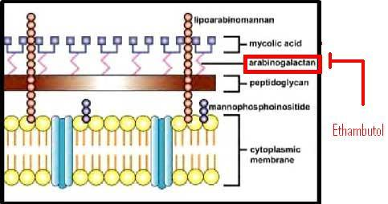

Slide 11
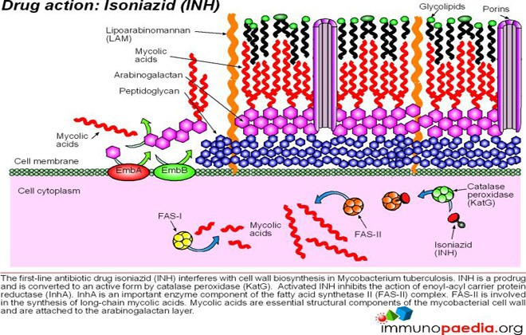
Inh

Slide 12
Mechanism of action:-
Isoniazid
(Prodrug)
catalase-peroxidase enzyme
Isoniazid
(Active)
KatG
NAD
InhA, a gene
(encodes a fatty acid
synthetase enzyme )
lipid content
(isonicotinic acyl)
binds tightly to
reduced lipid content
(isonicotinic acyl-NAD complex)
synthesis of mycolic acid
synthesis of mycobacterial cell wall.

Slide 13
Resistance :
    1 in 10⁶ bacilli –inherently resistant
    Mutation of catalase-peroxidase gene (KatG)
    Mutation in InhA
    Efflux pump, lose INH concentrating process
    Prevention of resistance :- combination of other drugs with INH.
    No cross resistance with other ATT

Slide 14
Pharmacokinetics:-
    Completely absorbed when taken orally
    Penetrates all body tissues, tubercular cavities (pleural , peritoneal), CSF & meninges
    Metabolism:N acetylation by NAT2; t1/2 1hr & 3hrs
    Acetylator status influence the nature of toxicity but not antitubercular response

Slide 15
Adverse effects:-
Peripheral neuritis paraesthesia, numbness, mental disturbance & convulsions
  In slow acetylators
      it increases the excretion of pyridoxine
      Inhibits pyridoxine kinasekinase
      Prevented by pyridoxine 10mg/d: should be given to diabetics, alcoholics, malnourished, pregnancy & lactation
Hepatitis more common in fast acetylators, in elderly & alcoholics; reversible on stopping the drug
Rashes, fever, lethargy, acne & arthlagia

Slide 16
^{INTERACTIONS:-}
  Al(OH)₃ inhibits absorption of INH.
  Enzyme inhibitor---INH inhibits Pheytoin, carbazepine, diazepam and warfarin metabolism
  Alcohol increases the risk of hepatotoxicity
  Dose: 5mg/kg/d; adult dose 300mg

Slide 17
RIFAMPICIN
bactericidal drug of the rifamycin group
Semisynthetic derived from streptomyces mediterranei
Spectrum: M. tuberculosis, M. leprae, S. aureus, N. meningitidis, H. influenzae, Brucella & Legionella.
as efficacious as INH and better than all other drugs, bactericidal action covers all subpopulations, but acts best on spurters (slowly dividing)
Both extra- and intracellular organisms are affected.
good sterilizing and resistance preventing actions

Slide 18
Mechanism of action
  Inhibits DNA-dependent RNA polymerase by binding its beta-subunit, thus preventing transcription to RNA and subsequent translation to proteins.
  Mammalian RNA polymerase does not avidly bind rifampin.

Slide 19
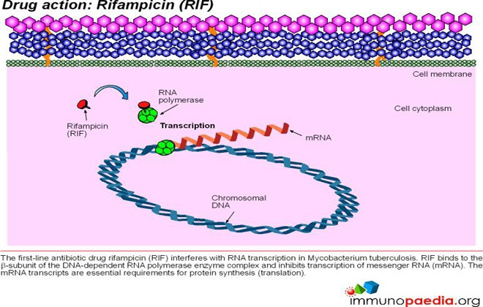

Slide 20
Resistance –
    Incidence of resistant TB is less than 10⁻⁷ Mutation in repoB gene ( β subunit of RNA polymerase)
    Prevention of resistance :- combination
    No cross resistance with other ATT
Pharmacokinetics:-
        Completely absorbed when taken orally, food ↓ absorption
        Penetrates cavities , caseous mass, placenta & meninges
        Metabolized in liver, undergo enterohepatic circulation
        t_{1/2}=2—5 hours, Excreted in bile, potent enzyme inducer

Slide 21
Adverse effects :
Hepatitis, dose related, jaundice ; is reversible on discontinuation
Respiratory syndrome - breathlessness
Cutaneous syndrome – flushing, pruritus, rash, redness and watering of eyes
Abdominal syndrome - nausea, vomiting, abdominal cramps with or without diarrhoea
Flu syndrome - with chills, fever, headache, arthralgia & malaise
urine and tears----orange-red in color

Slide 22
^{USES:-}
TB
Leprosy
Prophylaxis of meningococcal & H.Influenzae meningitis– carrier state
2nd line drug for MRSA, diptheroids & legionella
Combination of doxycycline and rifampicin--- brucellosis

Slide 23
^{INTERACTIONS:-}
Rifampicin enzyme-inducer (such as CYP2C9 and CYP3A4) ------ increasing the metabolism of many other drugs
    Warfarin
    Oral contraceptives
    Corticosteroid
    Sulfonylureas
    Theophylline
    HIV protease inhibitor

Slide 24
PYRAZINAMIDE (Z)
Pyrazine derivative of nicotinamide
Tuberculocidal, More active in acidic medium
Acts on intracellular TB & inflammatory sites
Highly effective during 1st two months of t/t, ↓ Duration
Good sterilizing activity
MOA:-
Inhibits mycolic acid synthesis
Disrupts cell membrane & its transport function
Resistance –
    Mutation in pncA gene
    Rapid development of resistance

Slide 25
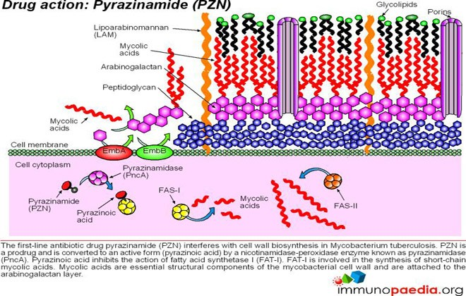

Slide 26
Pharmacokinetics:-
        Completely absorbed when taken orally
        Widely distributed , good penetration in CSF, very useful in meningeal TB
        Metabolized in liver, t_{1/2}=6-10 hours
Side effects
    Hepatotoxicity : most imp. & dose related
    Hyperuricemia, gout can occour
    Abdominal distress, arthralgia,Flushing, Rashes, Fever, Diabetes, repeated blood glucose monitoring
    Dose:1500mg (25-30 mg//kg/d)

Slide 27
ETHAMBUTOL
Ethambutol is bacteriostatic
Effective against M.tuberculosis, M. kansasii, M. avium intracellulare
Hasten rate of sputum conversion & prevent development of resistance
MOA:-
Inhibitis arabinosyl transferase (emb B) -----disrupt transfer of arabinose into arabinogalactan biosynthesis---- disrupt the assembly of cell wall
Resistance:
Mutation in emb B gene

Slide 28
PK
about 65% absorbed
penetrates meninges when inflamed
about 50% metabolised
excreted by glomerular filteration & tubular secretion
dose reduction required in renal disease

Slide 29
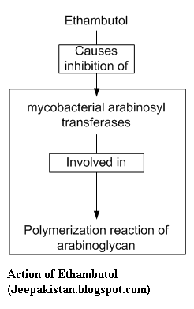

Slide 30
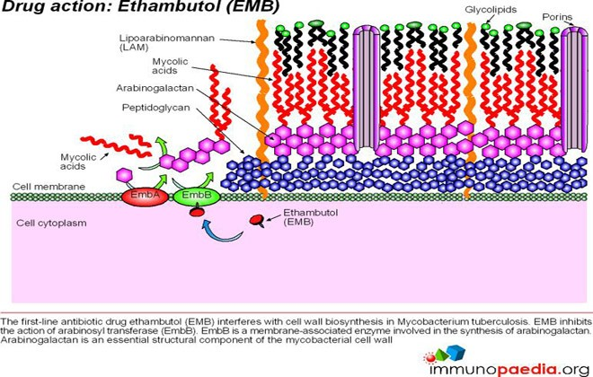

Slide 31
Adverse effects
Optic neuritis: ↓ visual acquity, unable to differentiate red green; dose dependent & duration dependent; periodic visual acquity & field of vision advised; avoided in children below 5 yrs
Decreases excretion of urates: may ppt gouty arthritis
Rash, fever, pruritus, jt. Pain, GI upset, malaise, headache, peripheral neuritis, arthralgia,
Dose: (15mg/kg/d)

Slide 32
DRUGS | CIDAL/STATIC | CELL | MEDIUM | TARGET | GENE -RESISTANCE |  | ADRs
H | Cidal | Ex+in | Acid/Alk | Mycolic acid | KAT G, Inh A, Rapid |  | Peripheral neuritis hepatitis
R | Cidal | Ex+in | Acid/Alk | RNA / protein synthesis | repoB Rapid |  | Hepatitis Resp syn Cut syn Flu syn GIT syn
Z | Cidal | In | Acidic | Mycolic acid | pncA Rapid |  | Hepatitis hyperuricemia
E | Static | Ex+in | Acid/Alk | Arbainolactan | Slow |  | Optic neuritis
S | Cidal | Ex | Alk>acid | Protein synthesis | Rapid |  | Ototoxicity nephrotoxicity

Slide 33
BIOLOGY OF TUBERCULAR INFECTION:-
Rapidly growing with highly bacillary load:- wall of a cavitary lesion where oxygen tension high & pH neutral: H is highly effective; R,E & S to lesser extent
Slow growing: Located intracellularly, at inflammed sites & pH low : Z is highly effective while H,R,E are less effective & S is ineffective
Spurters: in caseous material where oxygen tension low, pH neutral; bacilli grow intermittently. R most active
Dormant: totally inactive prolonged periods : no ATT is sig. effective
Continous shifting between these subpopulation

