Slide 1
ANTI DEPRESSANTS
By- Dr. pooja agrawal
Dept. of pharmacology

Slide 2
COMPETENCY
PH 1.19
Describe the mechanism/s of action, types, doses, side effects, indications and contraindications of antidepressants.

Slide 3
OBJECTIVES
Classify antidepressants
Describe pharmacokinetics, mechanism of action, uses and adverse effects of tricyclic antidepressants(TCA).
Describe pharmacokinetics, mechanism of action, uses and adverse effects of selective serotonin reuptake inhibitors(SSRI).
Describe pharmacokinetics, mechanism of action, uses and adverse effects of Serotonin and non-adrenaline reuptake inhibitors(SNRI)
Enlist reversible inhibitors of MAO-A and describe their clinical status and interactions
Enumerate various atypical antidepressants and describe their clinical status and advantages over TCAs
Enumerate other uses of antidepressants drugs

Slide 4
INTRODUCTION
Major depression and mania are two extremes of affective disorders
refer to a pathological change in mood state.
Major depression
sad mood
loss of interest and pleasure
low energy, worthlessness, guilt
psychomotor retardation or agitation
change in appetite and/or sleep, melancholia, suicidal thoughts
Anxiety and depression are the leading psychiatric disorders

Slide 5


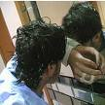

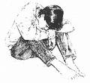


Slide 6
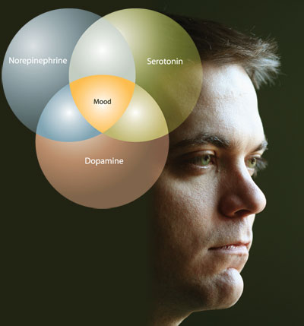
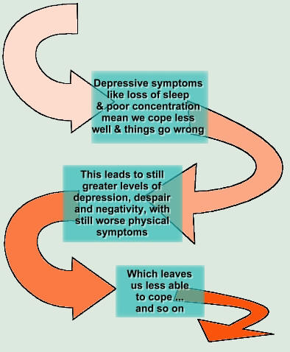

Slide 7
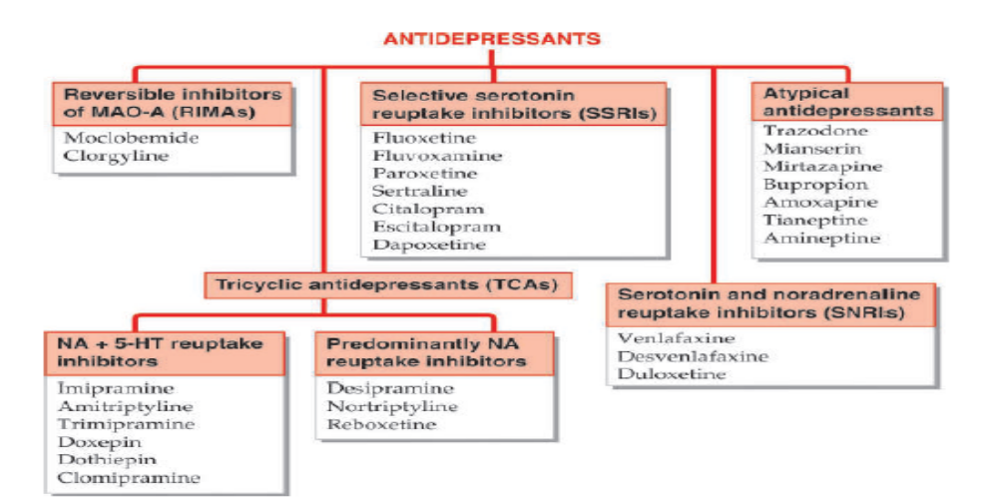
CLASSIFICATION

Slide 8
NEUROTROPHIC HYPOTHESIS OF DEPRESSION
hypothesis -depression is associated with deficiency of brain derived neurotrophic factor (BDNF) and other nerve growth factors (NGFs) in brain areas regulating feelings, emotion, cognition, hedonia, behaviour, etc.
Antidepressants promote elaboration of NGFs.
NGFs activate receptor tyrosine kinases (RTKs) and enhance axonal/dendritic growth, promote synaptic connection and improve neural plasticity.
Reduction of BDNF levels and neural mass in the limbic areas has been demonstrated in depression
Prolonged antidepressant treatment has been found to elevate BDNF levels as well as enhance neurogenesis and synaptic connections.

Slide 9
MONOAMINERGIC HYPOTHESIS OF DEPRESSION
Hypothesis -depression is caused by deficient noradrenergic and/or serotonergic transmission in the brain (mainly in cortical and limbic areas).
All classes of antidepressants (TCAs, SNRIs, SSRIs, atypical) enhance synaptic availability of NA or 5-HT or both, in one way or the other.

Slide 10
MAO INHIBITORS
Two isoenzyme forms of MAO have been identified.
MAO-A: Preferentially deaminates 5-HT and NA, and is inhibited by Clorgyline, Moclobemide.
MAO-B: Preferentially deaminates phenylethylamine and is inhibited by Selegiline.
Dopamine is equally degraded by both isoenzymes.
Distribution
MAO-A - Peripheral adrenergic nerve endings, intestinal mucosa and human placenta
MAO-B- predominates (mainly serotonergic) of brain and in platelets.
Liver contains both isoenzymes.

Slide 11
SIDE EFFECTS
postural hypotension
restlessness
insomnia
interfere with sexual function (impotence, loss of libido, anorgasmia).

Slide 12
Similar reaction can occur with cough and cold remedies which contain ephedrine or similar drugs, as well as with tricyclic antidepressants, SSRIs, SNRIs and levodopa.
Hallucinations and atropine poisoning like symptoms occur with anticholinergics.
Alcohol, sedative-antihistaminics, barbiturates and opioids are potentiated- respiratory failure.
Pethidine administered to MAO inhibited patients -fever, sweating, excitation, delirium, convulsions and respiratory depression.

Slide 13
INTERACTION
MAO inhibitors retard hydrolysis of pethidine but not its demethylation.
Excess of norpethidine (normally a minor metabolite is produced which has excitatory action)
Selective MAO-A inhibitors possess antidepressant property.
Selegiline at low doses (5–10 mg/day) selectively inhibits MAO-B, but these doses are not effective in depression.
Selegiline is metabolized to amphetamine and at higher doses it becomes nonselective MAO inhibitor; such doses exhibit antidepressant and excitant properties, therefore not clinically useful.

Slide 14
NONSELECTIVE MAO INHIBITORS
Nonselective MAO inhibitors elevate the mood of depressed patients; in some cases it may progress to hypomania and mania.
Active metabolites of nonselective MAO inhibitors inactivate the enzyme irreversibly.
Drugs themselves stay in the body for relatively short periods, but their effects last for 2–3 weeks after discontinuation: they are ‘hit and run’ drugs.

Slide 15
Selective MAO-A inhibitors possess antidepressant property.
Selegiline
selectively inhibits MAO-B at lower doses (5–10 mg/day), but these are not effective in depression.
metabolized to amphetamine and at higher doses it becomes nonselective MAO inhibitor—exhibits antidepressant and excitant properties.

Slide 16
INTERACTIONS
Cheese reaction
Certain varieties of cheese, beer, wines, pickled meat and fish, yeast extract contain large quantities of tyramine, dopa, etc.
MAO inhibited patients these indirectly acting sympathomimetic amines escape degradation in the intestinal wall and liver
reaching into systemic circulation they displace and release large amounts of NA from transmitter loaded adrenergic nerve endings
hypertensive crisis, cerebrovascular accidents.
TREATED: i.v. injection of a rapidly acting α blocker, e.g. phentolamine. Prazosin or chlorpromazine are alternatives

Slide 17
ii) Cold and cough remedies
contain ephedrine or other sympathomimetics—hypertensive reaction can occur
(iii) Reserpine, guanethidine, tricyclic antidepressants
Excitement, rise in BP and body temperature can occur when these drugs are given to a patient on MAO inhibitors.
This is due to their initial NA releasing or uptake blocking action.
(iv) Levodopa
Excitement and hypertension occur due to increase in biological t½ of DA and NA that are produced from levodopa.

Slide 18
v) Antiparkinsonian anticholinergics
Hallucinations and symptoms similar to those of atropine poisoning occur.
(vi) Barbiturates, alcohol, opioids, antihistamines
Action of these drugs is intensified and prolonged. Respiration may fail.
(vii) Pethidine
High fever, sweating, excitation, delirium, convulsions and severe respiratory depression have occurred.
MAO inhibitors retard hydrolysis of pethidine but not its demethylation.
Excess of norpethidine (normally a minor metabolite is produced which has excitatory actions)

Slide 19
REVERSIBLE INHIBITORS OF MAO-A (RIMAS)
MOCLOBEMIDE
Reversible and Selective MAO-A inhibitor with short duration of action; full MAO activity is restored within 1–2 days of stopping the drug.
Because of competitive enzyme inhibition, tyramine is able to displace it from the enzyme, so that potentiation of pressor response to ingested amines is minor, and dietary restrictions are not required.
lacks the anticholinergic, sedative, cognitive, psychomotor and cardiovascular adverse effects of typical TCAs and is safer in overdose.
good option in elderly patients and in those with heart disease.

Slide 20
ADVERSE EFFECTS
nausea, dizziness, headache, insomnia, rarely excitement and liver damage.
Chances of interaction with other drugs and alcohol are remote, but caution is advised while co-prescribing pethidine, SSRIs and TCAs.
Moclobemide -alternative to TCAs for mild to moderate depression and for social phobia.

Slide 21
TRICYCLIC ANTIDEPRESSANTS (TCAs)
IMIPRAMINE
inhibited NA and 5-HT reuptake into neurons.
first generation antidepressants-uptake blockade and direct effects on adrenergic, cholinergic and histaminergic receptors and also includes MAOIs.
Second generation antidepressants -Selective serotonin reuptake inhibitors (SSRIs), or Serotonin and noradrenaline reuptake inhibitors (SNRIs), with no direct action on cholinergic/adrenergic/histaminergic receptors, or have some atypical features.

Slide 22
PHARMACOLOGICAL ACTIONS
MOA- inhibit norepinephrine transporter (NET) and serotonin transporter (SERT)
interact with a variety of receptors viz. muscarinic, α adrenergic, histamine H1, 5-HT1, 5-HT2 and occasionally dopamine D2.
Actions of imipramine are described as prototype

Slide 23
REM sleep- phase is suppressed and awakenings during night are reduced.
Sedative ones are suitable for depressed patients showing anxiety and agitation.
TCAs lower seizure threshold and produce convulsions in overdose.
Clomipramine and bupropion
highest seizure precipitating potential.
Amitriptyline and imipramine depress respiration in overdose only.
Inhibition of NA and 5-HT uptake is associated with antidepressant action.
Inhibition of DA uptake correlates with stimulant action.

Slide 24
MECHANISM OF ACTION
MOA: inhibit NET and SERT which mediate active reuptake of biogenic amines NA and 5-HT into their respective neurons and thus potentiate them.
DA uptake-inhibited by bupropion.
TCAs indirectly facilitate dopaminergic transmission in forebrain that may add to the mood elevating action.
Tentative conclusions drawn are: and start taking interest in self and surroundings.

Slide 25
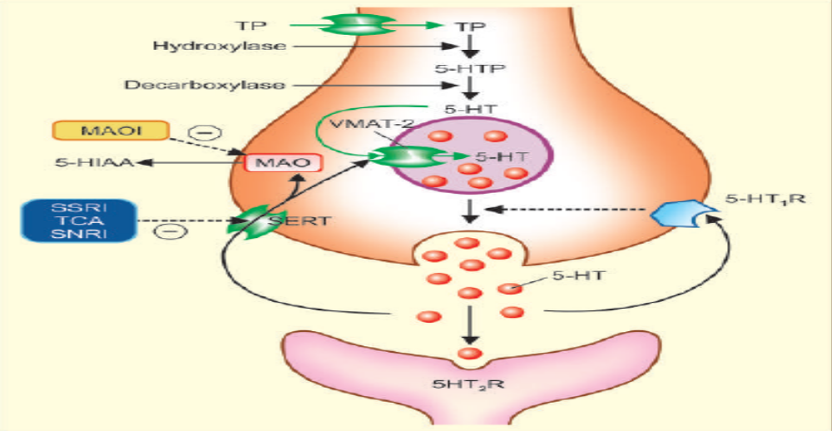

Slide 26
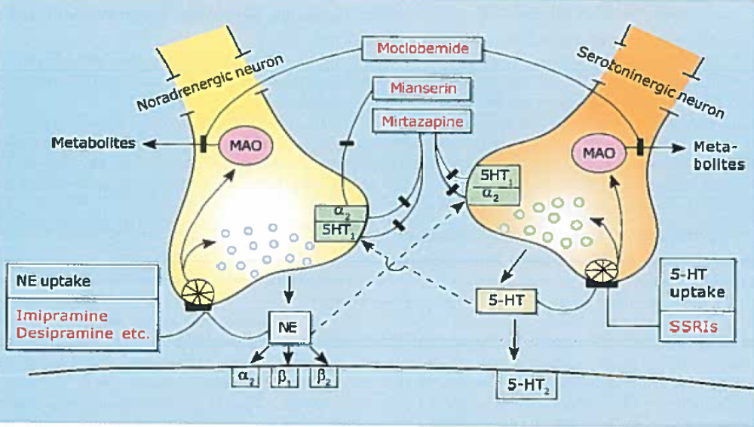

Slide 27
1.CNS
Effects differ in normal individuals and in the depressed.
In normal individuals-
peculiar clumsy feeling, tiredness, light-headedness, sleepiness, difficulty in concentrating and thinking, unsteady gait.
effects tend to provoke anxiety.
no mood elevation or euphoria; effects are rather unpleasant and may become more so on repeated administration.
Depressed patients
Little acute effects are produced, except sedation (in the case of drugs which have sedative property).
After 2–3 weeks of continuous treatment, the mood is gradually elevated, patients become more communicative

Slide 28
2.ANS
TCAs are potent anticholinergics— cause dry mouth, blurring of vision, constipation and urinary hesitancy as side effect.
anticholinergic potency is graded
TCAs potentiate exogenous an endogenous NA by blocking uptake, but also have weak α1 adrenergic blocking action.
Some, e.g. amitriptyline, doxepin, trimipramine have slight H1 antihistaminic action as well.

Slide 29
3.CVS
Tachycardia: due to anticholinergic and NA potentiating actions.
Postural hypotension: due to inhibition of cardiovascular reflexes and α1 blockade.
ECG changes and cardiac arrhythmias:
T wave suppression or inversion is the most consistent change in ECG.
Arrhythmias occur in overdose
NA potentiating + cholinergic blocking actions along with direct myocardial depression compound the proarrhythmic potential.
SSRIs, SNRIs and atypical antidepressants are safer in this regard.

Slide 30
TOLERANCE AND DEPENDENCE
Tolerance to the anticholinergic and hypotensive effects of imipramine-like drugs develops gradually, but antidepressant action is sustained.
Addiction to these drugs is rare, because their acute effects are not pleasant.
There is some evidence of physical dependence occurring when high doses are used for long periods—malaise, chills, muscle pain may occur on discontinuation and have been considered withdrawal phenomena.
Gradual withdrawal is recommended, but antidepressants do not carry abuse potential.

Slide 31
PHARMACOKINETICS
oral absorption of TCAs is good, though often slow.
highly bound to plasma and tissue proteins, therefore have large volumes of distribution (~20 L/kg).
metabolized in liver
Inactivation occurs by oxidation and glucuronide conjugation.
Various CYP isoenzymes like CYP2D6, CYP3A4, CYP1A2 and others metabolize tricylic and related antidepressants.
Metabolites are excreted in urine over 1–2 weeks.

Slide 32
plasma t½ of amitriptyline, imipramine and doxepin range between 16–24 hours.
t½ is longer for some of their active metabolites.
Because of relatively long t½s, once daily dosing (at bedtime) is practicable in the maintenance phase.
therapeutic window phenomenon has been observed, i.e. optimal antidepressant effect is exerted at a narrow band of plasma concentrations (between 50–200 ng/ml of imipramine, amitriptyline, nortriptyline).
doses need to be individualized and titrated with the response

Slide 33
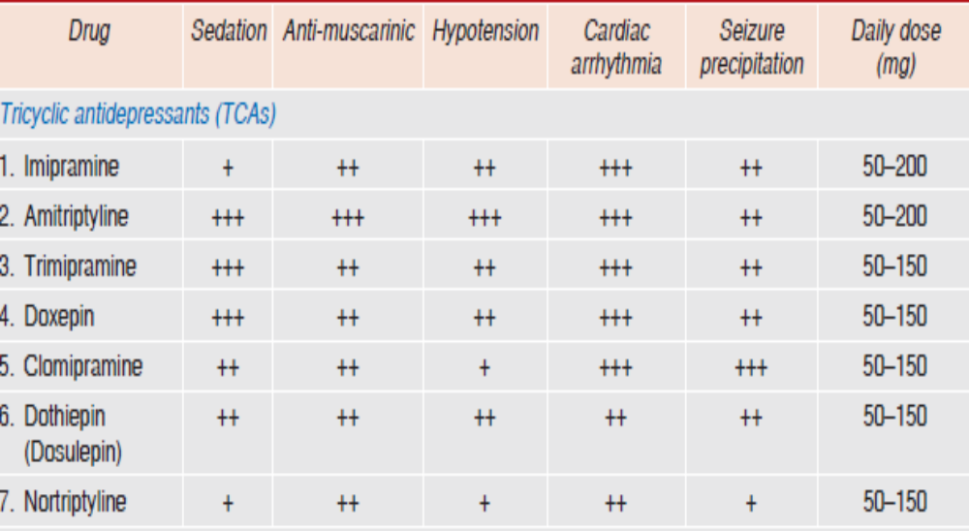

Slide 34
ADVERSE EFFECTS
ANTICHOLINERGIC: dry mouth, bad taste, constipation, epigastric distress, urinary retention (especially in males with enlarged prostate), blurred vision, palpitation.
2. Sedation, mental confusion and weakness especially with amitriptyline and more sedative congeners.
3.Increased appetite and weight gain -TCAs and trazodone
4. Sweating (despite antimuscarinic action) and fine tremors are relatively common

Slide 35
6.Seizure threshold is lowered—Bupropion, clomipramine, Amoxapine
7. Postural hypotension, especially in older patients. Less severe with desipramine-like drugs and insignificant with SSRIs/SNRIs.
8. Sexual distress
9. Cardiac arrhythmias, especially in patients with ischaemic heart disease. Arrhythmias may be responsible for sudden death in these patients.
10. Rashes and jaundice due to hypersensitivity are rare. Mianserin is more hepatotoxic.

Slide 36
ACUTE POISONING
Poisoning with TCAs is frequent; usually self-attempted for suicide, and may endanger life.
Manifestations are:
Excitement, delirium and other anticholinergic symptoms as seen in atropine poisoning, followed by muscle spasms, convulsions and coma.
Respiration is depressed, body temperature may fall, BP is low, tachycardia is prominent.
ECG changes and ventricular arrhythmias are common.

Slide 37
Treatment
is primarily supportive with gastric lavage, respiratory assistance, fluid infusion, maintenance of BP and body temperature.
Acidosis must be corrected by bicarbonate infusion.
Diazepam -injected i.v. to control convulsions and delirium.
The treatment of cardiac arrhythmias-propranolol/lidocaine
class IA and IC antiarrhythmics and digoxin -depress cardiac conduction; are therefore contraindicated.

Slide 38
INTERACTIONS
TCAs potentiate directly acting sympathomimetic amines (present in cold/asthma remedies). Adrenaline containing local anaesthetic should be avoided
2.TCAs potentiate CNS depressants, including alcohol and antihistaminic.
3. Phenytoin, phenylbutazone, aspirin and CPZ can displace TCAs from protein binding sites and cause transient overdose symptoms.
4. Phenobarbitone competitively inhibits as well as induces imipramine metabolism. Carbamazepine and other enzyme inducers enhance metabolism of TCAs.

Slide 39
5.SSRIs inhibit metabolism of several drugs including TCAs—dangerous toxicity can occur if the two are given concurrently.
6.Anticholinergic property- TCAs delay gastric emptying and retard their own as well as other drug’s absorption.
7. MAO inhibitors—dangerous hypertensive crisis with excitement and hallucinations has occurred when given with TCAs.

Slide 40
SELECTIVE SEROTONIN REUPTAKE INHIBITORS (SSRIs)
relative safety and better acceptability of SSRIs has made them 1st line drugs in depression and allowed their extensive use in anxiety, phobias, panic, OCD and related disorders.
SSRIs produce little or no sedation, do not interfere with cognitive and psychomotor function or produce anticholinergic side effects.
devoid of α adrenergic blocking action—postural hypotension does not occur, making them suitable for elderly patients.

Slide 41
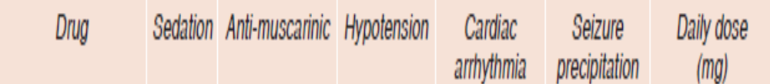
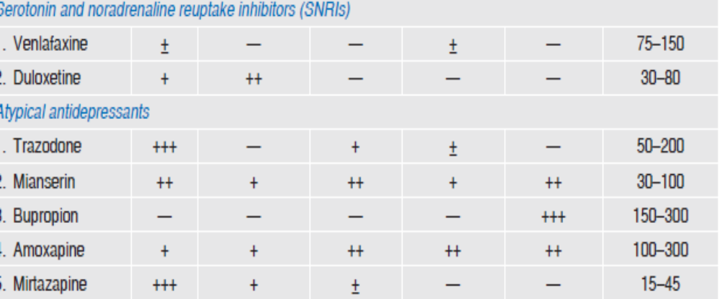

Slide 42
SIDE EFFECTS
Gastrointestinal –
nausea (due to 5-HT3 receptor stimulation),
Loose motions are due to 5-HT uptake blockade in the gut and activation of 5-HT receptors on enteric plexus neurones.
Weight gain, but they more commonly interfere with ejaculation or orgasm.
Nervousness, restlessness, insomnia, anorexia, dyskinesia and headache
Epistaxis and ecchymosis, probably due to impairment of platelet function.
Gastric blood loss due to NSAIDs may be increased by SSRIs.

Slide 43
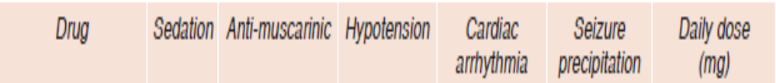
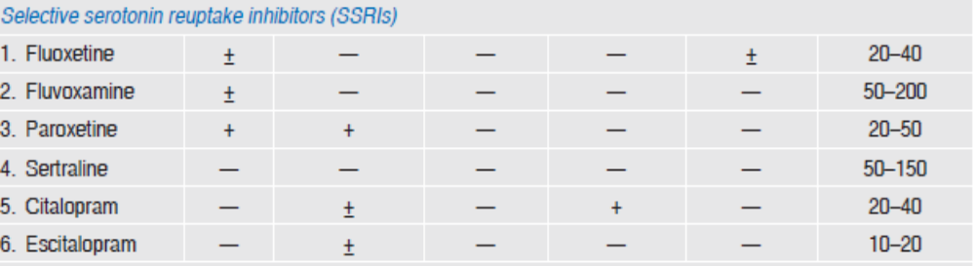

Slide 44
INTERACTIONS
Inhibit drug metabolizing isoenzymes CYP2D6 and CYP3A4: elevate plasma levels of TCAs, haloperidol, clozapine, warfarin,β blockers, some BZDs and carbamazepine.
‘Serotonin syndrome’ manifesting as agitation, restlessness, rigidity, hyperthermia, delirium, sweating, twitching's followed by convulsions can be precipitated when any serotonergic drug (e.g. MAOIs, tramadol, pethidine) is taken by a patient receiving SSRIs
Discontinuation reaction-paresthesias, bodyache, bowel upset, agitation and sleep disturbances
Because of freedom from psychomotor and cognitive impairment, SSRIs are preferred over TCAs for prophylaxis of recurrent depression (should be combined with lithium/valproate).

Slide 45
FLUOXETINE
first SSRI and longest acting.
plasma t½ is 2 days and that of its active demethylated metabolite is 7–10 days.
approved for use in children 7 years or older for depression and OCD
S/E: Agitation and dermatological reactions
Slower onset of antidepressant effect, less suitable for patients needing rapid effect

Slide 46
FLUVOXAMINE
a shorter-acting SSRI
USE: generalized anxiety disorder (GAD) and OCD.
S/E: nausea, dyspepsia, flatulence, nervousness and discontinuation reactions

Slide 47
PAROXETINE
short acting SSRI (t½ 20 hours) which does not produce active metabolite.
S/E:
GIT side effects, sexual distress, agitation and discontinuation reaction
Sedation and anti muscarinic effects are mild.

Slide 48
SERTRALINE
USE: juvenile depression has been demonstrated, and it is recommended for anxiety and post-traumatic stress disorder (PTSD) as well.
Drug interactions due to inhibition of CYP isoenzymes are less likely to occur with sertraline.
plasma t½ is 26 hours

Slide 49
CITALOPRAM
SSRI shares with sertraline a lower propensity to cause drug interactions.
t½ is 33 hours
Q-T prolongation and few deaths due to overdose of citalopram are on record, because of which it is to be avoided in patients likely to attempt suicide.
USE: mood disorders in premenstrual dysphoric disorder (PMDD)

Slide 50
ESCITALOPRAM
Active S(+) enantiomer of citalopram, effective at half the dose
USE:
anxio-depressive disorders.
Relief from menopausal hot flashes has been obtained in women who cannot take estrogens.
Side effects are milder and safety is improved.

Slide 51
DAPOXETINE
SSRI is being promoted particularly for delaying premature ejaculation
Dapoxetine acts rapidly and can be taken 1 hour before sexual intercourse.
Combined with behavioural therapies
SIDE EFFECTS : nausea, vomiting, loose motions, headache, dizziness and occasionally insomnia

Slide 52
OTHER USES OF SSRIS
SSRIs are now 1st choice drugs for OCD, panic disorder, social phobia, eating disorders, PMDD, and PTSD.
increasingly used for anxiety disorders, body dysmorphic disorder, compulsive buying, kleptomania and premature ejaculation.
Elevation of mood and increased work capacity has been reported in postmyocardial infarction and other chronic somatic illness patients.

Slide 53
SEROTONIN and NORADRENALINE REUPTAKE INHIBITORS (SNRIs)
Venlafaxine
MOA: inhibits uptake of both NA and 5-HT
in contrast to older TCAs, does not interact with cholinergic, adrenergic or histaminergic receptors or have sedative property.
A faster onset of action
USE: Mood changes and hot flashes in menopausal syndrome, social anxiety and eating disorders tends to raise rather than depress BP and is safer in overdose.
SIDE EFFECTS : nausea, sweating, anxiety, dizziness, impotence and withdrawal reactions on discontinuation

Slide 54
DESVENLAFAXINE
Desmethylvenlafaxine, an active metabolite of venlafaxine with similar actions, uses, and side effects.

Slide 55
DULOXETINE
A newer SNRI similar to venlafaxine.
mildly sedating with some anti-muscarinic effects
SIDE EFFECTS- GIT and sexual problems are milder, but agitation, insomnia and rise in BP can occur in few.
USES:
diabetic and other types of neuropathic pain,
fibromyalgia and stress urinary incontinence in women (because it increases urethral tone)
maintenance therapy in panic disorder.

Slide 56
ATYPICAL ANTIDEPRESSANTS
Trazodone
First atypical antidepressant;
MOA:
less efficiently blocks 5-HT uptake, but has prominent α adrenergic and weak 5-HT2 antagonistic actions.
metabolite is a strong 5-HT2 blocker.
sedative but not anticholinergic, causes bradycardia, less prone to cause arrhythmia.
S/E
Nausea is felt
α1 adrenergic blockade –priapism and postural hypotension.
infrequently used now

Slide 57
MIANSERIN
blocks presynaptic α2 receptors thereby increasing release and turnover of NA in brain which may be responsible for the antidepressant effect.
Antagonistic action at 5-HT2, 5-HT1c as well as H1 receptors has also been shown.
a sedative—relieves associated anxiety and suppresses panic attacks.
caused seizures in overdose.
S/E- blood dyscrasias and liver dysfunction

Slide 58
MIRTAZAPINE
MOA-.
blocks α2 auto- (on NA neurones) and hetero- (on 5-HT neurones) receptors enhancing both NA and 5-HT release.
blockade of 5-HT2 and 5-HT3 receptors -adverse effects of high serotonergic tone.
“noradrenergic and specific serotonergic antidepressant” (NaSSA).
a H1 blocker and moderately strong sedative, but only mildly antimuscarinic and not antidopaminergic.
Given once daily at bed time, it is particularly suitable for those with insomnia.
S/E-Increased appetite and weight gain

Slide 59
BUPROPION
MOA: inhibitor of DA and NA uptake has excitant rather than sedative property.
SIDE EFFECTS: insomnia, agitation, dry mouth and nausea, seizures
CONTRAINDICATION: eating disorders and in bipolar illness.
USE:
depression with atypical features, and may be added to a SSRI as an augmenting drug.
A sustained-release formulation -smoking cessation. Better results are obtained when it is combined with nicotine patch.

Slide 60
AMOXAPINE
MOA: blocks dopamine D2 receptors in addition to inhibiting NA reuptake.
USE: mixed antidepressant + neuroleptic properties; may be used for patients with psychotic depression unresponsive to other antidepressants.
S/E:
Risk of extrapyramidal side effects is also there.
Seizures (including status epilepticus) occur in its overdose

Slide 61
TIANEPTINE
Increase rather than inhibit 5-HT uptake, and is neither sedative nor stimulant.
Efficacy in anxio-depressive states, particularly with psychosomatic symptoms, as well as in endogenous depression.
SIDE EFFECTS - dry mouth, epigastric pain, flatulence, drowsiness or insomnia, tremor and bodyache.

Slide 62
AMINEPTINE
MOA: Enhances 5-HT uptake
S/E:
anticholinergic side effects including tachycardia, confusion and delirium.
Postural hypotension, conduction disturbances and arrhythmias can occur, especially in patients with heart disease.

Slide 63
Uses
1.ENDOGENOUS (MAJOR) DEPRESSION:
response takes at least 2–3 weeks to appear, full benefits take still longer.
SSRIs are currently used as first choice for their better tolerability, safety and may be higher efficacy as well.
SNRIs and newer atypical agents also offer advantages.
juvenile depression - fluoxetine and sertraline.
TCAs are now used only as alternatives in non-responsive cases or in those not tolerating the second generation antidepressants.

Slide 64
Second generation antipsychotic drug - refractory cases.
Psychotic depression -combination of a SSRI with an atypical antipsychotic like olanzapine, aripiprazole or quetiapine.
Bipolar depression-combine the antidepressant (SSRI/ SNRI/TCA/atypical) with valproate or lithium or lamotrigine to avoid the risk of switching over to mania.
ECT may be given in the severely depressed
Moclobemide, a reversible inhibitor of MAO-A, is a relatively well tolerated option for mild to- moderate depression and atypical depression.

Slide 65
2. OBSESSIVE-COMPULSIVE DISORDER (OCD):
The SSRIs, particularly fluoxamine, are the drugs of choice due to better patient acceptability.
TCAs, especially clomipramine, are also highly effective in OCD.

Slide 66
3.ANXIETY DISORDERS:
Antidepressants, especially SSRIs and SNRIs -social anxiety and generalized anxiety disorder.
Used along with a short course of BZDs, which act rapidly, to cover exacerbations.
phobic disorders, long term treatment of panic attacks and in post-traumatic stress disorder (PTSD).
Mood swings and hot flashes in menopausal women may be partly relieved by certain SSRIs when HRT is contraindicated

Slide 67
4.NEUROPATHIC PAIN:
Amitriptyline and other TCAs afford considerable relief in diabetic and some other types of chronic pain.
Duloxetine, a SNRI, is now the first line drug for diabetic neuropathy, fibromyalgia, etc.

Slide 68
5.ATTENTION DEFICIT-HYPERACTIVITY DISORDER (ADHD) IN CHILDREN:
TCAs with less depressant properties like imipramine, nortriptyline and amoxapine are now first line drugs in this disorder
Atomoxetine is a NA reuptake inhibitor unrelated to both TCAs as well as amphetamine, which is used specifically in ADHD

Slide 69
6.PREMATURE EJACULATION:
SSRIs and some TCAs, especially clomipramine have the common property of delaying and in some cases inhibiting ejaculation (this itself can cause sexual distress).
primary treatment of premature ejaculation is counselling and behavioral therapy, but this can be supplemented by drugs.
Dapoxetine is a SSRI which has been specifically introduced for this purpose.
DOSES: Clomipramine 10–25 mg three time a day

Slide 70
7.SMOKING CESSATION:
Only bupropion is approved as an aid to smoking cessation, though some TCAs have also been found to reduce craving, albeit inconsistently.
Benefits were comparable to those with nicotine gum, and the two were additive.

Slide 71
8.Enuresis:
In children above 5 years, imipramine 25 mg at bedtime is effective, but bed wetting may again start when the drug is stopped.
Elderly subjects with bed wetting have also benefited.
9. Migraine:
Amitriptyline has some prophylactic value
10. Pruritus:
Topical doxepin has been used to relieve itching in atopic dermatitis, lichen simplex, etc.

Slide 72
THANK YOU

