Slide 1
Tuberculosis and Nontuberculous
Mycobacteria Infections
Dr. Ved prakash
Professor & Head
PG Department of Microbiology

Slide 2
Learning objectives
At the end of the session, the students will be able to understand:
Classification of mycobacteria.
Antigenic structure, pathogenesis, clinical manifestations, lab diagnosis, treatment, drug resistance and prophylaxis of TB.
Newer ATT drugs and global and national TB programs.
Classification, lab diagnosis and treatment of NTM.

Slide 3
INTRODUCTION
Acid fastness: They resist decolorization by dilute mineral acids
Due to—
  (1) presence of high content of mycolic acids in the cell wall, and
  (2) integrity of the cell wall
Non-motile, non-sporing, non-capsulated, weakly gram-positive, straight or slightly curved rod-shaped bacteria - obligate aerobes

Slide 4
History
Robert Koch (1882) isolated the tubercle bacillus and proved its causative role in tuberculosis - satisfies the Koch’s postulates.

Slide 5
Classification
M. tuberculosis complex: Tuberculosis (TB) in man
M. leprae (Hansen’s bacilli): Leprosy
Nontuberculous mycobacteria (NTM): Either saprophytic in nature, e.g. M. gordonae (from tap water); or found as commensal (M. smegmatis in urine). Some cause opportunistic human infections, e.g. M. kansasii.

Slide 6
TUBERCULOSIS
M. tuberculosis complex includes:
M. tuberculosis : Most common species to cause TB in man
M. bovis (bovine tubercle bacillus)
Other members are less common human pathogens - M. africanum, M. microti, M. caprae, M. pinnipedii, M. canetti, M. suricattae, M. orygis, M. mungi and the recently described dassie bacillus and chimpanzee bacillus.

Slide 7
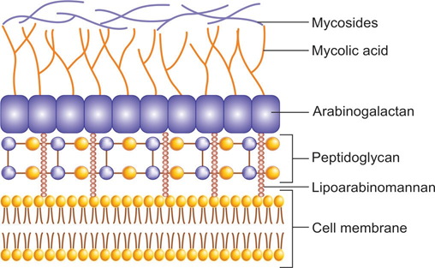
Cell wall of M. tuberculosis

Slide 8
Mycosides : Are phenolic glycolipids or peptidoglycolipds
Mycolic acid layer: Is a dense band on long chain α alkyl and β-hydroxy fatty acids attached by ester bonds to the terminal arabinose units of arabinogalactan

Slide 9
Antigenic Structure
1. Cell wall (insoluble) antigens:
Peptidoglycan layer – maintains shape & rigidity
Arabinogalactan layer - survival of M.tuberculosis within macrophages
Mycolic acid layer - principal constituent, confers very low permeability, acid fastness and reduces the entry of most antibiotics
Outermost layer - lipids, glycolipids & mycosides

Slide 10
1. Cell wall (insoluble) antigens
Proteins (e.g. porins, transport proteins) - found throughout various layers
Plasma membrane - helps in attachment to host cell and is also a target antigen used for diagnosis

Slide 11
2. Cytoplasmic (soluble) antigens:
These include antigen 5, antigen 6, antigen 60
Used in serodiagnosis of tuberculosis.

Slide 12
Pathogenesis - Source of Infection
Human - cases of pulmonary tuberculosis
Bovine source (unpasteurized infected milk)

Slide 13
Pathogenesis - Mode of Transmission
Air-borne: Inhalation of aerosols - coughing, sneezing, or speaking of infected
Tiny dry droplet nuclei (<5 μm size) - suspended in the air for several hours
Other modes of transmission - rare, such as:
  Inoculation
  Ingestion

Slide 14
Pathogenesis - Risk Factors
Sputum positive patients with Bacillary load at least 10⁴ bacilli/mL
Cavitary lesions in lung - more bacillary load
Overcrowding in poorly ventilated rooms
Low cell-mediated immunity – HIV

Slide 15
Other comorbid conditions - Post-silicosis, postransplantation, hemodialysis, diabetes, IV drug abuse, smoking, etc.
Age: Late adolescence and early adulthood
Sex: women at 25–34 years, men in older ages

Slide 16
Pathogenesis - Sequence of Pathogenic Events
Droplet nuclei inhaled - Majority trapped in upper airways and expelled out & usually <10% reach the alveoli
Adhesion to macrophages - lipoarabinomannan (LAM) binds to complement receptors and mannose receptors - internalization

Slide 17
Phagocytosis by macrophages - enhanced by complement (C3b) mediated opsonisation of bacilli
Survival inside the macrophages - cell wall LAM impairs phagosome-lysosome fusion - replicate inside the macrophage - macrophage ruptures & releases bacilli – cycle continues

Slide 18
Host Immune Response –
Cell-mediated Immune Response
Macrophages present the mycobacterial antigens to TH (T helper) cells - TH1and TH2 subsets.
TH1 cells release - IL-2 and IFN-γ - activate monocytes and macrophages
Activation of TH1 cells - development of two host responses:
  1. A macrophage-activating response
  2. Tissue-damaging response.

Slide 19
1. A macrophage-activating response:
IFN γ activates macrophages
Tubercles: a favorable sign
Hard tubercles: initially hard - central zone containing activated macrophages (epithelioid and giant cells) and a peripheral zone of lymphocytes and fibroblasts

Slide 20
Soft tubercles - central part undergoes caseous necrosis - Bacilli inhibited within this necrotic environment because of low oxygen tension and low pH - lesion heals and calcifies.

Slide 21
2. Tissue-damaging response:
Minority of cases, associated with risk factors -macrophage-activating response is weak & bacilli more virulent
Mycobacterial growth inhibited only by an intensified delayed hypersensitivity reaction - lung tissue destruction

Slide 22
Spread of caseous necrosis
1. Direct draining into the airways - discharged with cough
2. Lymphatic spread - reseeding into same or opposite lung → disseminate to other organs.
3. Hematogenous spread to various organs

Slide 23
Humoral Immune Response:
TH2 release - IL-4, IL-5 - activate B-cells - antibodies.
  M. tuberculosis being obligate intracellular organism, humoral immunity plays a minor role
  Anti-LAM antibodies play a role in preventing dissemination of tuberculosis in children.

Slide 24
Clinical Manifestations
Tuberculosis (TB) is classified as:
  Pulmonary TB and
  Extrapulmonary TB

Slide 25
Pulmonary Tuberculosis (PTB)
Accounts for 60–90% of all cases of tuberculosis (TB). It can be
Further categorized into primary or postprimary (secondary) types

Slide 26
Comparison of primary and secondary pulmonary tuberculosis
Features | Primary PTB | Post-primary (adult-type)/secondary PTB
Results due to | Initial exogenous infection with tubercle bacilli | Exogenous reinfection Endogenous- reactivation of latent primary lesion
Age group affected | Children | Adults
Parts of lungs commonly affected | Sub pleural lesion affecting, upper part of lower lobe and lower part of upper lobe | Apical and posterior segments of the upper lobes (high oxygen tension)
Lesions formed at the initial sites | Fibrotic nodular lesions are formed (Ghon focus) | Hematogenous seedling in the apex of lungs called Simon’s focus Reactivated Simon focus with central caseation (Assmann focus)

Slide 27
Features | Primary PTB | Post-primary (adult-type)/secondary PTB
Lymph node | Ghon focus with associated hilar lymphadenopathy is common (called as primary complex) | Lymph node involvement is unusual
Clinical feature | It may be asymptomatic or may present with fever, productive cough (with or without hemoptysis) and occasionally chest pain, night sweating, weight loss | Lesions undergoing necrosis and tissue destruction, leading to cavity formation. Symptoms are similar, but more pronounced.
Fate | Lesions heal spontaneously. Primary complex becomes calcified (Ranke complex) | Bronchogenic spread to the same or opposite lung form satellite lesions → caseating pneumonia Hematogenous spread to various parts of the body and granuloma formation. Rarely, heals spontaneously

Slide 28
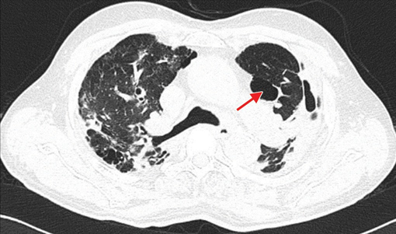
CT scan of the lungs showing cavitation in the left upper lobe—suggestive of pulmonary tuberculosis

Slide 29
Extrapulmonary Tuberculosis (EPTB)
Tuberculous lymphadenitis – MC form (35% of all EPTB)
  Posterior cervical and supraclavicular lymph nodes - painless swelling in neck region without warmth or color change
Pleural tuberculosis – (20%) - pleural effusion
Tuberculosis of the upper airways - larynx, pharynx, and epiglottis

Slide 30
Genitourinary tuberculosis:
  Renal tuberculosis
  Genital tuberculosis – Females: fallopian tubes & endometrium - infertility. Males: epididymis
Skeletal tuberculosis - Weight-bearing joints (spine, hips & knees)
  Complications - collapse of vertebral bodies - kyphosis & paravertebral ‘cold’ abscess

Slide 31
Extrapulmonary Tuberculosis (EPTB)
Tuberculosis of CNS – M/C in children, Tuberculous meningitis & tuberculoma are common forms
Tuberculous pericarditis - direct extension from adjacent lymph nodes or following hematogenous spread

Slide 32
Epidemiology
Quarter of the current world population is infected asymptomatically with M. tuberculosis, of which 5–10% develop the clinical disease.
World: 10 million new cases of TB occurred in 2018.
Deaths due to TB - 12 Lakh in HIV-negative and 2.5 Lakh in HIV-coinfected people in 2018.

Slide 33
WHO regions: South-East Asia (44%), followed by Africa (24%) and the Western Pacific (18%)
Countries: Eight countries accounted for two-third of the total TB burden, with India having the largest share.
India: In 2018 - 27 Lakh cases occurred India - highest burden from Uttar Pradesh

Slide 34
Laboratory diagnosis of Tuberculosis
Specimen collection
  In pulmonary TB: Sputum (2 specimens—spot and early morning), gastric aspirate (in children)
  In EPTB: Specimens vary depending on the site involved
Digestion, decontamination and concentration of specimen:
  Modified Petroff’s method (4% NaOH)
  NALC (N-acetyl-L-cysteine) + 2% NaOH

Slide 35
  Modified Petroff’s method (4% NaOH) : Sputum is throughly mixed with equal volumes of 4% sodium hydroxide, centrifuged and the sediment is neutralized with phosphate buffer saline of pH 6.8. This method is recommended for L J culture .

Slide 36
  NALC (N-acetyl-L-cysteine) + 2% NaOH : This is superior to Petroff’s method for isolation. NALC liquefies the sputum and NaOH kills the normal flora. This method is more compatible with automated culture systems.

Slide 37
Extrapulmonary specimens
Sterile site specimens collected aseptically
Optimum specimens |  | CSF, pericardial fluid, synovial fluid and ascitic fluid
Suboptimal specimens (organism load is less) |  | Pleural fluid (20–50 mL is collected and centrifuged) Blood (indicated only for disseminated TB and co- infected with HIV)
Specimens containing normal flora
Swabs | Considered suboptimal specimen. The only recommended swabs are: Laryngeal swabs: Collected early morning in empty stomach or Swab from discharging sinus
Urine | Three early morning specimens collected (500 mL/ specimen, centrifuged) on different days as TB bacilli in urine are shed intermittently
Stool | For disseminated TB in HIV infected patients and infants

Slide 38
Specimens containing normal flora
Other respiratory specimens | Bronchial secretions (2–5 mL) Bronchoalveolar lavage (20–50 mL) Transbronchial and other biopsies (collected in sterile normal saline)
Gastric lavage | Recommended for children (tend to swallow sputum), or ICU patients (aspiration) Early morning lavage should be collected and processed early (<4 hours)

Slide 39
Laboratory diagnosis of Tuberculosis
Direct microscopy by acid-fast staining:
  Ziehl-Neelsen (ZN) technique—long slender, beaded, less uniformly stained red color acid-fast bacilli
  Kinyoun’s cold acid-fast staining
  Fluorescent (auramine) staining—it is more sensitive and smears can be screened more rapidly than ZN stain

Slide 40
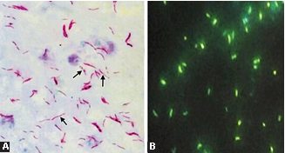
A. ZN staining of sputum smear showing long, slender and beaded red colored acid–fast bacilli; B. Auramine phenol staining of sputum smear—Tubercle bacilli appear bright brilliant green against the dark background.

Slide 41
RNTCP Guidelines for Grading of Sputum Smear
RNTCP grading is useful for - ZN stained sputum smears:
  Monitoring the treatment response of the patients
  Assessing the severity of disease
  Assessing the infectiousness of the patient: Higher the grade more is the infectiousness. Smear negative patients (<10,000 bacilli/mL of sputum) are less infectious.

Slide 42
RNTCP guidelines for grading of ZN stained sputum smears
No. of AFB seen | OIF to be screened | Grading | Result
No AFB in 100 OIF | 100 | 0 | Negative
1–9/ 100 OIF | 100 | Scanty | Positive
10–99/100 OIF | 100 | 1+ | Positive
1–10/ OIF | 50 | 2+ | Positive
>10/ OIF | 20 | 3+ | Positive

Slide 43
Conventional culture media—take 6–8 weeks
  Lowenstein Jensen (LJ) medium—shows rough, tough and buff colored colonies in 6–8 weeks
Automated culture methods—take 3–4 weeks
MGIT system: Detects growth as well as resistance to antitubercular drugs (ATDs)

Slide 44
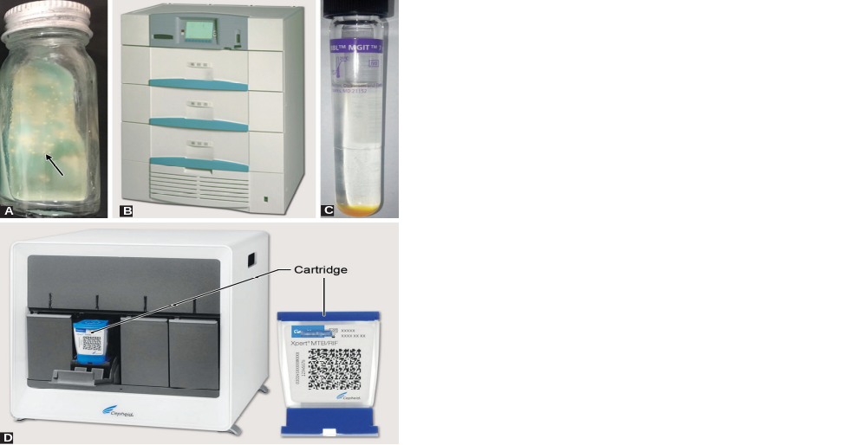
A. Lowenstein-Jensen medium (arrow showing rough, tough and
buff-colored colonies); B. BACTEC MGIT; C. MGIT liquid culture medium

Slide 45
Culture identification
  Automated identification—by MALDI-TOF
  MPT 64 antigen detection—by ICT

Slide 46
Molecular methods
  PCR detecting IS6110 gene
  CBNAAT (GeneXpert) and Truenat—for identification and detection of resistance to rifampicin; has a turnaround time 2 hours
  Line probe assay (e.g. Genotype TB)—for identification and detection of resistance to 1st and 2nd line ATDs; has a turnaround time of 2–3 days.

Slide 47

D. GeneXpert system with cartridge

Slide 48
Diagnosis of latent tuberculosis
  Tuberculin skin test (e.g. Mantoux test)
  Interferon gamma release assay (IGRA) : This uses highly specific. M. tuberculosis antigens such as CFP10 (culture filtrate protein) and ESAT6 (Early Secreted Antigenic Target-6); both coded by RD1 genes.
  Procedure: It is an in vitro test. Sensitized T lymphocytes collected from suspected individuals, are exposed to ESAT-6/CFP-10 antigens, which lead to release of high level of IFN_{y} from the T lymphocytes.

Slide 49
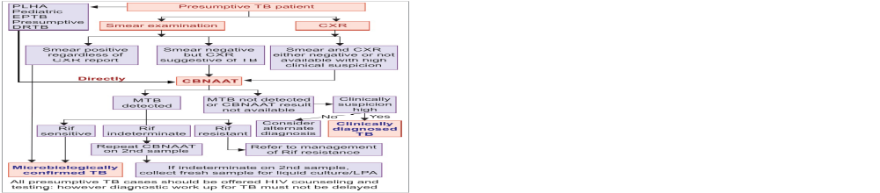
NTEP Diagnostic algorithm for pulmonary tuberculosis

Slide 50
DST (Drug Susceptibility Testing)
Phenotypic Methods
Genotypic Methods

Slide 51
Phenotypic Methods
MGIT (1st and 2nd line drugs): Resistance determined by growth of TB bacilli in drug containing tube as compared to the control tube (drug free) within
4–21 days of incubation.
Proportion method (1st and 2nd line drugs): Resistance - growth of 1% or more - observed in the drug containing LJ medium compared to the control
LJ medium without drug after 42 days of incubation.

Slide 52
Genotypic Methods
GeneXpert: Detection of resistance to rifampicin, targeting five different sequences of rpoB gene. Turnaround time - <2 hours
Line probe assay (LPA): Detects resistance to both first line (FL) and second-line (SL) drugs - turnaround time - 2–3 days.

Slide 53
U-DST
Universal-Drug Susceptibility Testing (U-DST) - testing all TB patients for resistance to at least rifampicin (by performing CBNAAT).
U-DST program has been rolled out across India since January 2018.

Slide 54
Treatment of Tuberculosis
Anti-tubercular drugs (ATDs):
  1. First-line drugs: Used for the treatment of drug susceptible-TB (DS-TB)
  2. Second-line drugs: Used for the treatment of drug resistant-TB (DR-TB)

Slide 55
Anti-tubercular drugs (ATDs) for treatment of drug-susceptible TB (DS-TB) and drug resistant TB (DR-TB)
ATDs for DS-TB | ATDs for DR-TB (Second-line agents)
First-line Agents Isoniazid (H) Rifampicin (R) Pyrazinamide (Z) Ethambutol (E) | Group A: Fluoroquinolones Levofloxacin (Lfx) Moxifloxacin (Mfx) Gatifloxacin (Gfx) | Group D: Add-on agents (not part of the core MDR-TB regimen) Group D1: First-line agents Pyrazinamide (Z) Ethambutol (E) High-dose isoniazid (Hh) Group D2: New agents Bedaquiline (Bdq) Delamanid (Dlm) Group D3: Other agents p-aminosalicylic acid (PAS) Imipenem-cilastatin (Ipm /Cls) Meropenem (Mpm) Amoxicillin-clavulanate (Amx-Clv) Thioacetazone (T)
 | Group B: Second-line injectable agents Amikacin (Am) Capreomycin (Cm) Kanamycin (Km) Streptomycin (S)
 | Group C: Other second-line agents Ethionamide/Prothionamide (Eto/Pto) Cycloserine/Terizidone (Cs/Trd) Linezolid (Lzd) Clofazimine (Cfz)

Slide 56
Treatment of tuberculosis aims to:
  Interrupt transmission by rendering patients non-infectious
  Prevent morbidity and death by curing patients
  Prevent the emergence of drug resistance
  Prevent relapse.

Slide 57
Multidrug therapy: Combination of more than one drugs
Short course chemotherapy lasting for 6 months (or longer for DR-TB)
Two phase chemotherapy: The short course is divided into—
  Intensive phase: Multiple ATDs that rapidly kill the bacilli making the smear negative, followed by:
  Continuation phase: Aims at killing the remaining dormant bacilli and prevents relapse

Slide 58
DOTS strategy (Directly Observed Treatment, Short course): Recommend by RNTCP and WHO. Here, the strategies used are:
  The entire treatment course is supervised to improve the patient’s compliance
  Treatment response - monitored by sputum smear microscopy at the end of each phase.

Slide 59
Universal-DST:
  If found as rifampicin-sensitive, then LPA is performed for other first-line ATDs (e.g. isoniazid)
  If found as rifampicin-resistant, then LPA is performed for second-line agents such as fluoroquinolones (FQs) and second-line injectable (SLI) agents.

Slide 60
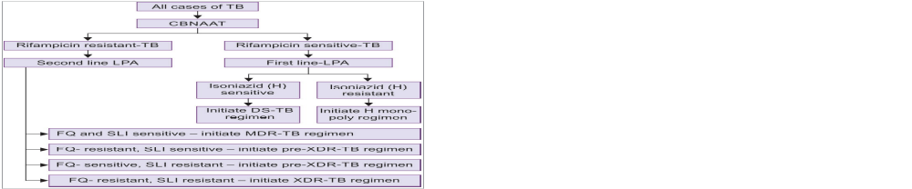
Treatment regimens based on drug susceptibility testing

Slide 61
Standard regimen for DS-TB: It is a six-month course - two phases.
  Intensive phase - four drugs (HRZE) for two months; followed by continuation phase, with three drugs (HRE) for four months
  FDC: All drugs - in fixed dose combination (FDC) tablets as per appropriate weight bands
  Daily-oral regimen: The FDC tablets - taken orally, once in a day.

Slide 62
Regimens for DR-TB:
  Use of higher numbers of second-line agents, given for longer duration.

Slide 63
Drug regimen for tuberculosis depending on the pattern of drug resistance
Type | Regimen name | Intensive phase1 | Continuation phase
DS-TB | No resistance | (2) H R E Z | (4) H R E
H mono/poly | H monopoly DR-TB regimen | (3-6) Lfx Km R E Z | (6) Lfx R E Z
MDR-TB or RR-TB | Shorter MDR-TB regimen4 | (4-6) Mfxh Km Eto Cfz Z Hh E | (5) Mfxh Cfz Z E
 | Conventional MDR-TB regimen5 | (6-9) Lfx Km Eto Cs Z E | (18) Lfx Eto Cs E
Pre-XDR-TB | Regimen for MDR/RR + R/FQ class | (6-9) Km Eto Cs Z Lzd Cfz + (6) Bdq | (18) Eto Cs Lzd Cfz
 | Regimen for MDR/RR+ R/ SLI class | (6-9) Lfx Cm7 Eto Cs Z Lzd Cfz + (6) Bdq | (18) Lfx Eto Cs Lzd
XDR-TB | Regimen for MDR/RR-TB plus R/FQ and SLI | (6-12) Mfxh Cm7 Eto Cs Lzd Cfz Z E | (18) Mfxh Eto Cs Lzd Cfz E

Slide 64
Drug regimen for tuberculosis depending on the pattern of drug resistance
Weight category | Number of tablets (FDCs)
 | Intensive phase (HRZE) | Continuation phase (HRE)
25–39 kg | 2 tablets | 2 tablets
40–54 kg | 3 tablets | 3 tablets
55–69 kg | 4 tablets | 4 tablets
≥70 kg | 5 tablets | 5 tablets

Slide 65
Follow-up of treatment:
  Clinical follow-up: Carried out at least monthly during treatment
  Follow-up laboratory investigation: For PTB – sputum smear - done at the end of intensive phase. At End of treatment - sputum smear + culture - done for every patient.

Slide 66
Follow-up of treatment:
  Long term follow-up - carried out up to 2 years of completion of treatment
  Follow-up for MDR TB: Sputum smear and culture - performed every month during intensive phase and every three months during continuation phase.

Slide 67
Newer Anti-tubercular Drugs
Bedaquiline and delamanid - only two drugs developed specifically for the treatment of TB in the last 40 years.

Slide 68
Bedaquiline
New second line ATD of diarylquinoline class, approved for use as second line ATD since 2015.
Acts by inhibiting mycobacterial ATP synthase
Strongly mycobactericidal - no cross resistance with other ATDs
Significant benefit in improving the time to culture conversion in MDR-TB patients

Slide 69
Indication: Recommended for MDR-TB or XDR-TB cases - resistant to fluoroquinolones and/or second-line injectable drugs.
Contraindicated in pregnancy and age <18 years
Regimen: Bedaquiline containing regimen should contain four other second-line ATDs depending upon the sensitivity.

Slide 70
Delamanid
Derived from nitroimidazole class.
Mechanism of action: Acts by inhibiting mycolic acid synthesis of bacterial cell wall
Indication: Approved for use in the treatment of DRTB (MDR, XDR or mixed pattern DR-TB) in a combination regimen

Slide 71
Exclusion criteria:
  (i) Children under 6 years,
  (ii) pregnant and breastfeeding women,
  (iii) patients with prolonged QT interval, and
  (iv) if hypersensitivity develops

Slide 72
Resistance to Antitubercular Drugs
Primary or pretreatment drug resistance:
  Infection of an individual by a drug resistant strain
  Not previously been treated
  Less common
Acquired resistance (secondary or post treatment):
  Initially sensitive, becomes resistant later
  Due to inappropriate or inadequate treatment
  More common

Slide 73
Mechanism of Drug Resistance
Due to point mutation in the genome of M. tuberculosis which occurs at a rate of once in 10⁸ cell divisions

Slide 74
Drug-resistant genes present in M. tuberculosis
Drugs | Drug-resistant genes
Isoniazid | Enoyl ACP reductase (inhA), Catalase-peroxidase (katG), Alkyl hydroperoxide reductase (AhpC)
Rifampicin | NA polymerase subunit B (rpoB)
Pyrazinamide | Pyrazinamidase (pncA)
Ethambutol | Ribosomal protein subunit 12 (rpsL)
Streptomycin | Rbosomal protein subunit 12 (rpsL), 16s ribosomal NA (rrs), Aminoglycoside phosphotransferase gene (strA)
Fluoroquinolones | DNA gyrase (gyr A and B)

Slide 75
Failure to adhere to the multidrug regimen
Prolonged duration of regimen
Poor compliance of the patient
Development of toxicity to the drugs
Improper supervision and follow-up.

Slide 76
Resistance to Antitubercular Drugs (ATDs)
Mono resistance - resistance to one first-line ATD only.
Poly resistance - resistance to >1 first-line ATD other than both isoniazid and rifampicin.
Rifampicin resistance (RR) - rifampicin resistance with or without resistance to other ATDs - includes any resistance to rifampicin, in the form of mono-resistance, poly-resistance, MDR or XDR.

Slide 77
Multidrug-resistant Tuberculosis (MDR-TB)
Resistance to isoniazid and rifampicin with or without resistance to other first line drugs.
In 2018, 3.4% of new and 18% of previously treated cases are MDR/RR-TB
In 2018, MDR-TB rate in India was 6.19% in all TB patients.

Slide 78
Treatment of MDR-TB: Intensive phase of 4–9 months with 6–7 second-line agents, followed by continuation phase of 5–18 months with 4 second-line agents.
DOTS-Plus program - initiated by RNTCP in the year 2000 - cover the diagnosis and treatment of MDR-TB cases.

Slide 79
Extensively drug-resistant tuberculosis (XDR-TB)
MDR-TB cases which are also resistant to:
  Fluoroquinolones (levofloxacin/moxifloxacin/gatifloxacin), and
  At least one second-line injectable agents (amikacin/ capreomycin/kanamycin).

Slide 80
Epidemiology: In India (2018), XDR-TB accounted for 1.3% in all MDR-TB patients (2.3% in new and 0.91% in previously treated patients)

Slide 81
Pre-XDR-TB
Refers to resistance to either fluoroquinolones (FQs) or second line injectable (SLI) agents, but not both.
In 2018 (India), among MDR-TB cases, 21.8% were resistant to any FQs and 3.6% were resistant to any SLI agent.

Slide 82
National TB Elimination Programmme (NTEP)
It was formerly known as the Revised National Tuberculosis Control Programme (RNTCP), and was initiated from 1 January 2020 by the Govt. of India.
The revised programme encompasses strategies to promote quality of life and health by preventing, controlling, and finally, eliminating TB.

Slide 83
In NTEP, the principle of TB treatment (except confirmed DR-TB) is to administer a daily fixed dose combination (FDC) of first-line ATT in appropriate weight bands, under direct observation.
For patients being treated in the private sector, FDCs may be provided by the NTEP upon request.

Slide 84
RNTCP was implemented in India in 1992 with the objectives of detecting new cases through designated microscopy centers (DMC) and providing standardized treatment and proper diagnostic facilities. This was based on the Directly observed Treatment, Short course (DOTS) strategy of the WHO:
The treatment is initiated following diagnosis made primarily by morning and spot sputum microscopy.

Slide 85
Standardized treatment regimen for drug sensitive TB as per NTEP
Under the NTEP, the following changes have been made in the DOTS strategy :
Injectable drugs have been removed from cat II
Newer drugs bedaquiline and delamanid have been included in DOTS Plus regimen
Treatment is given n two phases :

Slide 86
Intensive phase: Therapy for 8 weeks (56 doses) of isoniazid (H), rifampicin (R), pyrazinamide (Z), and ethambutol (E) given under direct observation in daily dosages as per weight band categories.
Continuation phase: It consists of 16 weeks (112 doses) dosages. Of isoniazid, rifampicin, and ethambutol in daily dosages. Only pyrazinamide will be stopped in the continuation phase.

Slide 87
It has to be extended to 24 weeks in certain forms of TB like CNS TB and skeletal TB.
TB meningitis requires the additon of steroids. In disseminated TB or in cases of slow response, the treating physician may extend the regimen on a case-to-case basis.

Slide 88
Treatment of drug-resistant TB
The 6-month treatment regimen is composed of bedaquiline, pretomanid, linezolid, and moxifloxacin (BpaLM)
The 9-month regimen comprises bedaquiline (used for 6 months) in combination with levofloxacin/moxiifloxacin,Ethionamide, ethambutol, isoniazid (high dose), pyrazinamide, and clofazimine (for four months)

Slide 89
With the possiblility of extending to 6 months I f the patient remains sputum smear positive at the end of four months), followed by treatment with levofloxacin/moxifloxacin, clofazimine, ethambutol, and pyrazinamide (for five months)

Slide 90
Global and National TB Programmes
The End TB Strategy (WHO)2016 : The WHO has launched “the End TB strategy by 2035” in order to end the global tuberculosis epidemic.
Revised National Tuberculosis Control Programme (RNTCP)1992 : The main strategies of RNTCP were :
Detecting>70% of estimated cases by quality sputum microscopy
Cure rate not less than 85%
Involvement of NGOs
Implementing DOTS, a community-based treatment and care of TB patients under supervision.
Implementing DOTS Plus for detection and treatment of MDR-TB
Every year, March 24th is observed as “World Tuberculosis Day”.

Slide 91
National Strategic Plan, India (2020–2025) – Aim to eliminate TB epidemic with a vision of TB-Free India with zero deaths, disease and poverty due to tuberculosis by 2025.
Nikshay : Is a web-portal introduced since 2018 for surveillance of TB. Government of India has made it mandate for all health care providers (both government and private sectors) to notify all new TB cases through this web

Slide 92
Vaccine Prophylaxis Against Tuberculosis -
Bacillus Calmette-Guérin Vaccine (BCG)
BCG strain: In India, WHO recommended Danish 1331 strain of BCG is used.
Reconstitution of BCG: Available in lyophilized form, should be reconstituted before administration.
Administration of BCG: 0.1 mL (0.1 mg TU) of BCG vaccine - administered above the insertion of left deltoid by intradermal route

Slide 93
Protection:
Efficacy: Variable efficacy of 0–80%
Duration of immunity - 15–20 years
Protection to infants and young children against the development of complications - tuberculous meningitis and disseminated tuberculosis.

Slide 94
Complications following BCG:
Most common complications - ulceration at the vaccination site and regional lymphadenitis
Rarely - keloid or lupus lesion, osteomyelitis, non-fatal meningitis, progressive tuberculosis and disseminated BCG infection (“BCGitis”).

Slide 95
Indications of BCG
Direct BCG: BCG is directly given to the newborn soon after birth.
Indirect BCG: BCG is given after performing tuberculin skin test.

Slide 96
Contraindications to BCG include:
HIV-positive child
Child born to AFB positive mother
Child with low immunity
Generalized eczema
Pregnancy.

Slide 97
Chemoprophylaxis
Treatment of selected high-risk tuberculin reactors (i.e. people with latent tuberculosis) aims at preventing active disease.
Isoniazid or ethambutol for six months - tried.
Chemoprophylaxis has several shortcomings such as—
(1) it is expensive, (2) risk of developing tuberculosis is minimal in tuberculin reactors, and (3) side effects of the drugs.

Slide 98
INH preventive therapy (IPT) - restricted to limited indications:
  Adults with HIV - unlikely to have active TB
  Children with HIV - no TB symptoms and unlikely to have active TB
  All children with HIV - successfully completed treatment for TB.
THANKS

Slide 99
NONTUBERCULOUS MYCOBACTERIA
INFECTIONS
Diverse group of mycobacteria isolated from birds, animals, environmental sources
Opportunistic pathogens, occasionally associated with human infection
Man-to-man transmission is not known.
Saprophytic mycobacteria - isolated from soil, water and other environmental sources. They do not cause any disease in humans

Slide 100
Runyon’s classification of nontuberculous mycobacteria
Runyon group | Property | Species
I. Photochromogens | Produce pigments only in light | M. marinum, M. asiaticum, M. simiae, M. kansasii, M. genavense
II. Scotochromogens | Produce pigments both in dark and light | M. scrofulaceum, M. szulgai, M. gordonae M. celatum, M. flavescens
III. Non-photochro- mogens | Do not produce pigments | M. avium-intracellulare complex (MAC), M. xenopi, M. ulcerans, M. paratuberculosis, M. malmoense
IV. Rapid growers | Grow within one week | M chelonae, M fortuitum, M. smegmatis, M. Abscessus

Slide 101
1. Photochromogens
M. marinum:
  Acquired from water sources (fish tanks, swimming) and enters through minor trauma
  Causes papules or ulcers known as swimming pool granuloma or fish tank granuloma.
M. asiaticum:
  Rarely associated with pulmonary disease and bursitis

Slide 102
M. simiae: Isolated from pulmonary lesions
M. kansasii: Causes chronic pulmonary disease resembling tuberculosis
M. genavense: Causes infection in patients with advanced HIV.

Slide 103
2. Scotochromogens
M. scrofulaceum: Causes scrofula (cervical lymphadenitis) in children
M. gordonae: Commensal in tap water - common contaminant of clinical specimens - rarely isolated from pulmonary specimens.
M. szulgai: Scotochromogen at 37°C and photochromogen at 25°C - occasionally cause pulmonary disease and bursitis
M. celatum: Rare cause of pulmonary infection.

Slide 104
3. Nonphotochromogens
M. avium-intracellulare complex (MAC):
  M. avium (Battey bacillus, isolated from birds) and M. intracelluare
  Opportunistic pathogens – HIV low CD4 T-cell count (<50/μL)
  Lymphadenitis, respiratory infection and disseminated disease

Slide 105
M. xenopi:
  Hospital water supplies, and associated with nosocomial outbreaks
  Rarely pulmonary disease in HIV-infected people.
M. ulcerans:
  Buruli ulcer - painless ulcers and nodules - necrotic later
  Osteomyelitis and limb deformities

Slide 106
4. Rapid Growers
M. fortuitum and M. chelonae: post-trauma injection abscess and catheter-related infections
M. abscessus: pulmonary infection

Slide 107
Clinical manifestations of nontuberculous mycobacteria (NTM)
Disease | Organisms
Pulmonary infection | M. avium-intracellulare (MAC), M. kansasii, M. xenopi, M. malmoense, M. szulgai, M. abscessus
Lymph node infection | M. avium-intracellulare (MAC) M. scrofulaceum—causes scrofula M. malmoense
Cutaneous infection | M. marinum—causes swimming pool or fish tank granuloma M. ulcerans—causes Buruli ulcer M. abscessus M. fortuitum and M. chelonae—cause injection abscess M. avium-intracellulare (MAC)
Disseminated infection | M. avium-intracellulare (MAC) M. kansasii

Slide 108
Laboratory Diagnosis
Specimens: Sputum, lymph node aspirate, pus or exudate, biopsy from skin lesions are the usual specimens - depending on type of infection
Microscopy by ZN staining: Shows red acid-fast bacilli
Culture on LJ media: Several species of NTM grow well on LJ medium.

Slide 109
Pigment production: LJ media - incubated in dark and light separately for distinguishing - photochromogens and scotochromogens
Identification:
  Negative for MPT64 antigen by ICT: differentiating it from M. tuberculosis.
  Newer methods: MALDI-TOF and PCR

Slide 110
Treatment of Nontuberculous mycobacteria infections
M. avium-intracellulare complex (MAC), M. kansasii and M. marinum infections - multidrug therapy with macrolide (clarithromycin or azithromycin), ethambutol, and a rifamycin (rifampin or rifabutin)
NTM - resistant to most of the first and second-line antitubercular drugs.

