Slide 1
Systemic Candidiasis
Dr. Ved Prakash
Professor & Head
PG Department of Microbiology

Slide 2
Learning objectives
At the end of the session, the students will be able to understand:
Pathogenesis, epidemiology, clinical manifestations, laboratory diagnosis and treatment of candidiasis,

Slide 3
SYSTEMIC CANDIDIASIS
Candidiasis - most common fungal disease in humans, affecting the skin, mucosa, and various internal organs; caused by Candida, a yeast like fungus that produces pseudohyphae.

Slide 4
Various species of Candida include:
Candida albicans: most pathogenic species of Candida infecting humans
Other Candida species which can also cause infections –
C. tropicalis (most common species), C. glabrata, C. krusei, C. parapsilosis, C. dubliniensis, C. kefyr, C. guilliermondii, C. viswanathii and C. auris.

Slide 5
Pathogenesis
Worldwide in distribution.
Accounts for the most common fungal infection in humans, both in HIV and non-HIV infected people.

Slide 6
Predisposing Factors
Physiological state: Extremes of age (infancy, old age), pregnancy
Low immunity: steroid or immunosuppressive drugs, post-transplantation, malignancy, HIV-infected people
Patients on broad spectrum antibiotics
Others: Diabetes mellitus, febrile neutropenia and zinc or iron deficiency

Slide 7
Virulence Factors
Adhesins
Enzymes - aspartyl proteinases and serine proteinases - tissue invasion
Toxins: Glycoprotein extracts of Candida cell wall are pyrogenic
Pseudohyphae: Presence of pseudohyphae indicates active infection
  Phenotypic switching - Ability to transform between three phenotypic forms in the tissue - yeast (blastospores), pseudohyphae, and true hyphae

Slide 8
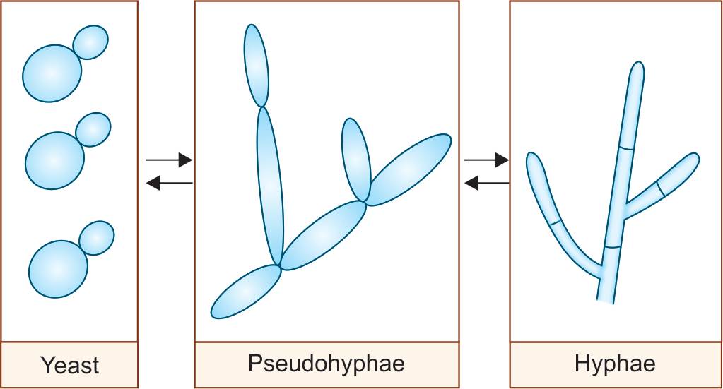
Phenotypic switching of Candida

Slide 9
Clinical Manifestations
Invasive candidiasis
Mucosal candidiasis
Cutaneous candidiasis
Allergic candidiasis

Slide 10
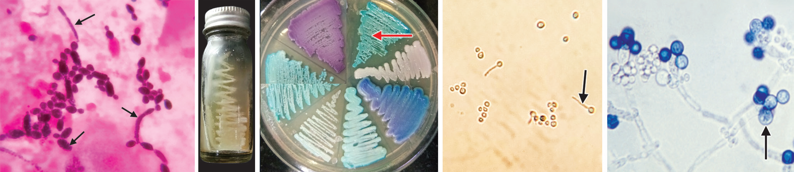
Laboratory diagnosis of Candidiasis
Direct microscopy: Gram-positive oval budding yeast cells with pseudohyphae,

Slide 11
Culture on SDA: Produces creamy white and pasty colonies

Slide 12
Tests for species identification:
Germ tube test (positive for C. albicans)
Dalmau plate culture for chlamydospore production
Colonies on CHROMagar
Growth at 45°C (positive for C. albicans)
Carbohydrate assimilation test and carbohydrate fermentation test
Molecular methods such as PCR

Slide 13
Candida albicans shows positive germ tube test (arrow showing)
Candida albicans shows thick walled chlamydospores (arrow showing)
CHROMagar showing colonies of various Candida species producing different colors (e.g. light-green color
by C. albicans, red arrow)

Slide 14
Immunodiagnosis:
Antibody detection against cell wall mannan antigen
  Antigen detection such as cell wall mannan and cytoplasmic antigens.
  Enzyme detection, e.g. enolase
Detection of metabolites, e.g. mannitol and arabinitol
β-d-Glucan assay: marker of invasive fungal infection.

Slide 15
Treatment of Candidiasis
Cutaneous candidiasis or oral thrush - topical azole
Esophageal and vulvovaginal candidiasis - oral fluconazole or caspofungin
Disseminated candidiasis – liposomal amphotericin B or caspofungin or voriconazole.

Slide 16
C. glabrata and C. krusei - intrinsic resistance to azoles and are refractory to treatment with azoles.
Note: Detection of Candida in urine and sputum may represent colonization; therefore, does not by itself warrant antifungal treatment.

Slide 17
Candida auris
Emerging species of Candida, increasingly reported in the recent past.
Manifestations: Cause outbreaks in healthcare settings; produces a wide range of clinical disease from asymptomatic colonization, to candidemia, abscesses, ear infections, etc.

Slide 18
Diagnosis:
Difficult to identify with standard laboratory methods, and it can be misidentified easily.
Specific technologies - molecular method or MALDI-TOF are useful for correct identification.

Slide 19
Treatment:
Multidrug resistant and often shows resistance to commonly used antifungal drugs to treat Candida infections.
Capsofungins or lipid-based amphotericin B are the antifungals given for treatment.

Slide 20
SYSTEMIC MYCOSES
Include the four important fungal diseases that involve multiple organs.
  1. Histoplasmosis, caused by Histoplasma capsulatum
  2. Blastomycosis, caused by Blastomyces dermatitidis
  3. Coccidioidomycosis, caused by Coccidioides immitis
  4. Paracoccidioidomycosis, caused by Paracoccidioides brasiliensis.

Slide 21
Saprophytic fungi - spread by inhalation of spores leading to pulmonary infection.
From lungs, they disseminate to cause various systemic manifestations.
All the four agents are dimorphic fungi, which exist as yeast at 37°C (inside human body) and mold at 25°C (in environment).

Slide 22
HISTOPLASMOSIS
Systemic granulomatous disease caused by a dimorphic fungus, Histoplasma capsulatum.
The species name is a misnomer - it is not capsulated.
Was first reported by Samuel Darling (1905) - also known as Darling’s disease.

Slide 23
It has three varieties:
  1. H. capsulatum var. capsulatum: Causes classical histoplasmosis (most common type)
  2. H. capsulatum var. duboisii: Causes African histoplasmosis
  3. H. capsulatum var. farciminosum: Causes epizootic histoplasmosis.

Slide 24
Epidemiology
Occurs worldwide - endemic in USA, particularly in states bordering the Ohio River valley and the lower Mississippi River.
In India - reported frequently from the region of West Bengal along the Ganga River.
Inhabits in the humid and acidic soil that contains large amount of bird or bat droppings.

Slide 25
Pathogenesis
Transmitted by inhalation of spores (i.e.microconidia) which usually circulate in the air after the contaminated soil is disturbed.
After the spores enter into the lungs – engulfed inside the alveolar macrophages and then transform into yeast forms.
The yeasts survive within the phagolysosome of the macrophage by producing alkaline substances, such as - bicarbonate and ammonia

Slide 26
Pathogenesis (Cont..)
Then, the intracellular yeasts travel to the lymph nodes and spread to the other parts of the body through bloodstream.
Majority of the infected people show strong cell-mediated immune response (CMI) within 2 weeks.
Granulomas are formed which later get healed with fibrosis and calcification.

Slide 27
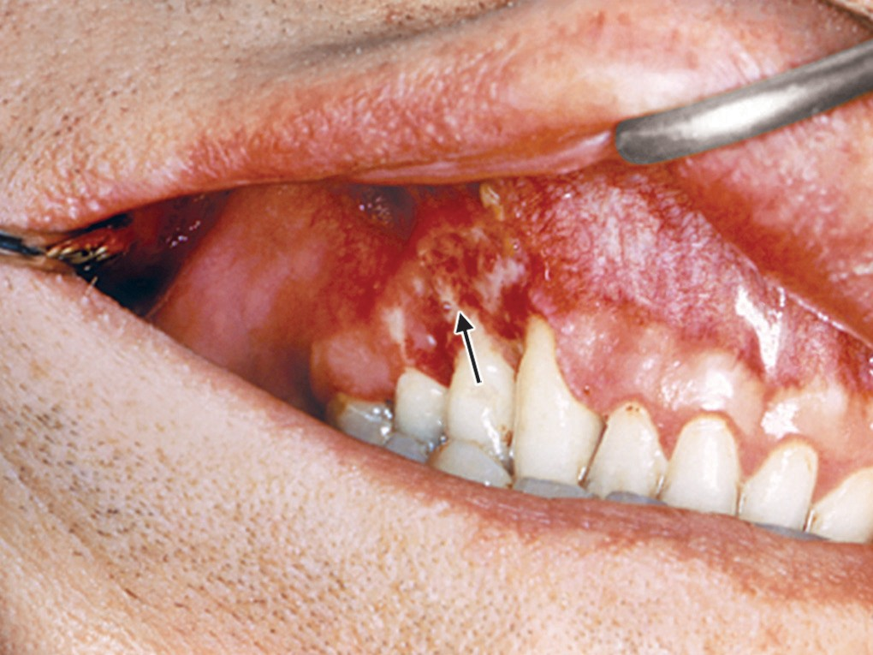
Clinical Manifestations
Pulmonary histoplasmosis
Mucocutaneous histoplasmosis
Disseminated histoplasmosis
Oral lesions of histoplasmosis (arrow showing)

Slide 28
Laboratory Diagnosis
Specimens: Useful specimens include sputum, aspirate from bone marrow and lymph node, blood and biopsies from skin and mucosa.
Direct microscopy: Histopathological staining (such as PAS, Giemsa or GMS stain) of the specimens reveals tiny oval yeast cells (2–4 μm size) with narrow-based budding within the macrophages with an underlying granulomatous response

Slide 29
Laboratory Diagnosis (Cont..)
Culture:
Gold standard method of diagnosis.
Specimens - inoculated onto media - SDA, blood agar and BHI agar in duplicate and incubated simultaneously at 25°C and 37°C

Slide 30
Laboratory Diagnosis (Cont..)
At 25°C:
Mycelial phase - white to buff brown colonies - consist of two types of conidia or spores:
  1. Tuberculate macroconidia - typical thick walls and finger-like projections which is a characteristic feature of this fungus.
  2. Microconidia are smaller, thin, and smooth walled.

Slide 31
Laboratory Diagnosis (Cont..)
At 37°C:
Gets converted into yeast form (creamy white colonies) - best developed in special media like Kelley’s media.

Slide 32
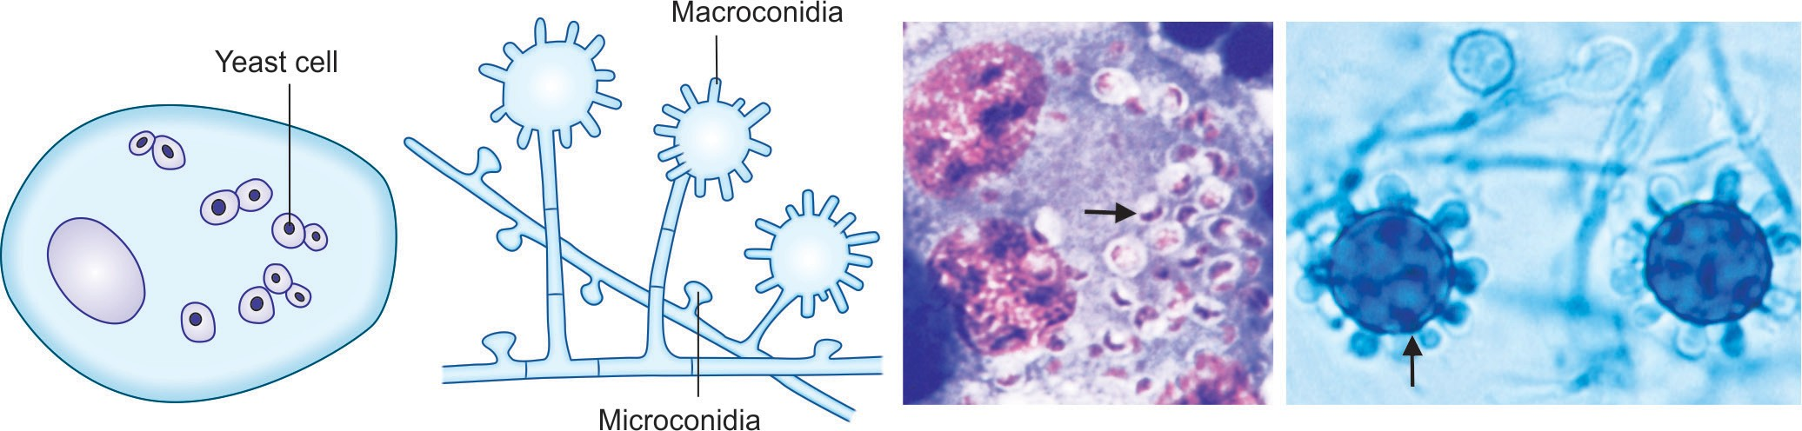
Laboratory Diagnosis (Cont..)
A B C D
A
B
C
D
A. Yeast form; B. Mycelial form; C. 2–4 μm yeast cells with narrow based budding (Giemsa stain) (arrow showing); D. Mold form, septate thin hyphae with tuberculate macroconidia (arrow showing).

Slide 33
Laboratory Diagnosis (Cont..)
Serology: Antibodies in serum can be detected by CFT and immunodiffusion test
Antibodies appear after 1 month of infection -are more useful in chronic stage; but are often negative in early course and in disseminated stage
False positive result - due to past infection or cross infection with Blastomyces.

Slide 34
Laboratory Diagnosis (Cont..)
Skin test: Done to demonstrate delayed type hypersensitivity response to histoplasmin antigen - indicates prior exposure
Molecular test: PCR targeting specific ITS D1/D2 gene (variable region of 28S rRNA) is available.

Slide 35
Treatment Histoplasmosis
Liposomal amphotericin B - antifungal agent of choice in acute pulmonary and disseminated histoplasmosis.
Itraconazole - recommended for chronic cavitary pulmonary histoplasmosis.

Slide 36
BLASTOMYCOSIS
Also known as North American blastomycosis or Gilchrist’s disease or Chicago disease.
Fungal infection of humans and other animals, notably dogs and cats, caused by the dimorphic fungus, Blastomyces dermatitidis.

Slide 37
Pathogenesis
Transmitted by inhalation of the conidia of B. dermatitidis.
The spores enter into the lungs, and are engulfed by alveolar macrophage - converted into yeast phase.
This yeast expresses a 120-kDa glycoprotein - BAD-1 (B. dermatitidis adhesin-1) - essential virulence factor - majorinducer of cellular and humoral immune responses.

Slide 38
Clinical Manifestations
Acute pulmonary blastomycosis - most common form.
Extrapulmonary manifestations may also occursuch as:
  Skin involvement - characterized by either verrucous (more common)or ulcerative type of skin lesions
  Osteomyelitis
  Prostate and epididymis involvement in men
  Central nervous system (CNS) involvement - AIDS patients.
  Brain abscess

Slide 39
Epidemiology
Like histoplasmosis, blastomycosis is also endemic in North America, particularly in states bordering the Ohio River and Mississippi River.

Slide 40
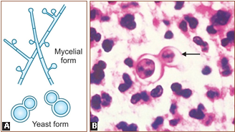
Laboratory Diagnosis
Histopathological staining of the tissue biopsy specimens - thick-walled round yeast cells of 8–15μm size with single broad-based budding (Figure of 8 appearance).
Schematic (Mycelial and yeast forms);
Histopathological stain (arrow showing) broad-base budding yeast cells (Figure of 8 appearance).

Slide 41
Laboratory Diagnosis (Cont..)
Culture media - SDA, blood agar and BHI agar are inoculated.
  At 25°C, mycelial form containing hyphae with small pear-shaped conidia are produced.
  At 37°C mold to yeast conversion takes place
Skin test: Done to demonstrate delayed type hypersensitivity to blastomycin antigen

Slide 42
Laboratory Diagnosis (Cont..)
Antibody detection: Immunodiffusion test specific for B. dermatitidis - developed against yeast phase antigens such as antigen—A, BAD-1 and ASWS antigen(alkali soluble water soluble).
Antigen detection assay - detect Blastomyces antigen in urine (more sensitive) and in serum is commercially available.

Slide 43
Laboratory Diagnosis (Cont..)
Molecular methods - DNA probe hybridization and real time PCR are available.

Slide 44
Treatment Blastomycosis
Liposomal amphotericin B - drug of choice in most of the cases.
Itraconazole - given in immunocompetent patients with mild pulmonary or non-CNS extrapulmonary blastomycosis

Slide 45
COCCIDIOIDOMYCOSIS
Coccidioidomycosis (also called desert rheumatism or Valley fever or California fever) - systemic fungal disease caused by a dimorphic soil dwelling fungus—Coccidioides which has two species, C. immitis and C. posadasii.

Slide 46
Coccidioidomycosis (also called desert rheumatism or Valley fever or California fever) - systemic fungal disease caused by a dimorphic soil dwelling fungus.
Coccidioides which has two species, C. immitis and C. posadasii.

Slide 47
Pathogenesis
Transmitted by inhalation of arthroconidia.
In lungs, they enlarge, become rounded, and develop internal septations to form large sac like structures of sizeup to 200 μm – spherules - encompass numerous endospores.
Spherules - rupture and release packets of endospores that can disseminate and develop intonew spherules.
If returned to artificial media or the soil - spherules revert back to the mycelial stage.

Slide 48
Clinical Manifestations
Skin lesions - rashes or erythema nodosum and arthritis with joint pain may appear secondary to pulmonary infection particularly in women
Disseminated form: Males and persons with low CMI (HIV infected patients with CD4+ T cell count <250/ μL) are at higher risk.
Common sites for dissemination include skin, bone, joints, soft tissues, and meninges.

Slide 49
Epidemiology
Endemic in certain parts of Arizona, California, Nevada,New Mexico, Texas, Utah and northern Mexico

Slide 50
Laboratory Diagnosis
Histopathological staining (H and E stain, PAS or GMS) of sputum or tissue biopsy specimens - spherules which are large sac like structures (20–80 μm size), have thick, double refractile wall, and are filled with endospores.

Slide 51
Laboratory Diagnosis (Cont..)
Cultures on SDA produces mycelial growth - as fragmented hyphae consisting of barrel-shaped arthrospores with alternate cells distorted (empty cells).
Coccidioides differs from other dimorphic fungi - grows as mold at both 25°C and 37°C in usual culture media.
It forms spherules at 37°C in certain special culture media only.

Slide 52
Laboratory Diagnosis (Cont..)
Serology: Antibodies are detected by immunodiffusion test and CFT
Skin test: Done by using fungal extracts (coccidioidin or spherulin); if produces at least a 5 mm induration within 48 hours after injection (delayed hypersensitivity reaction) indicates past infection.

Slide 53
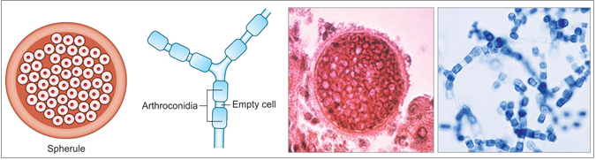
Laboratory Diagnosis (Cont..)
C
D
A
B
A. Spherules (schematic); B. Hyphae with arthroconidia (schematic);
C. Spherules (PAS staining); D. Hyphae with arthroconidia (LPCB mount).

Slide 54
Treatment of Coccidioidomycosis
Triazoles such as itraconazole - drug of choice to treat most cases of coccidioidomycosis, except for diffuse pneumonia with pulmonary sequelae where amphotericin B is recommended.

Slide 55
PARACOCCIDIOIDOMYCOSIS
Also known as South American blastomycosis - Lutz-Splendore-de Almeida disease is a systemic disease caused by the dimorphic fungus— Paracoccidioides brasiliensis.

Slide 56
Pathogenesis and Clinical Manifestations
Transmission is by inhalation of spores - transform into the yeast phase in lungs.
It occurs as two major forms:
  1. Acute form (or juvenile type)
  2. Chronic form (or adult form)

Slide 57
Epidemiology
Endemic in Brazil and other South American countries.

Slide 58
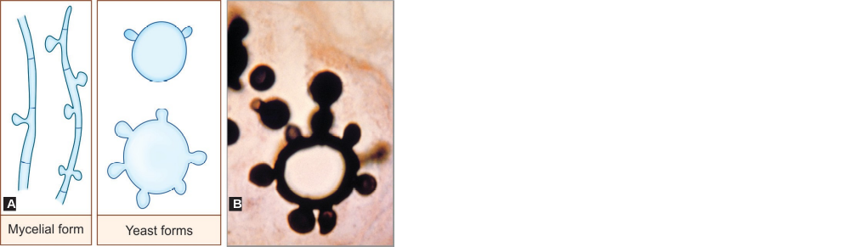
Laboratory Diagnosis
Histopathological staining of pus, tissue biopsies or sputum reveals round thick-walled yeasts, with multiple narrow-necked buds attached circumferentially giving rise to Mickey mouse or pilot wheel appearance
Schematic representation of mycelial and yeast forms;
Methenamine silver staining shows yeast from (pilot wheel appearance).

Slide 59
Treatment of Paracoccidioidomycosis
Itraconazole - treatment of choice for paracoccidioidomycosis, except for the seriously ill patients where amphotericin B is recommended.
Sulfonamides are effective, but the response is slow with frequent relapses.

Slide 60
Questions:
Q2. Barrel-shaped arthroconidia are seen in:
Histoplasmosis
Cryptococcosis
Coccidioidomycosis
Paracoccidioidomycosis

Slide 61
Questions:
Q2. Broad-based budding is seen in::
Histoplasma
Blastomyces
Cryptococcus
Penicillium

