Slide 1
Stress Management
Dr. Ved Prakash
Professor & Head
PG Department of Microbiology

Slide 2
Definition
Stress is a natural and adaptive response that your body experiences when faced with challenges, threats, or demands. It's your body's way of preparing to confront a situation, often referred to as the "fight or flight" response.
Stress can be physical, mental, or emotional and can have both positive and negative effects on your well-being.

Slide 3
There are three main types of stress:
Eustress (Positive Stress): This type of stress is characterized by a positive response to a situation or challenge. It can be motivating and energizing, helping you focus and achieve goals. Eustress often occurs when you feel excited or enthusiastic about something, like starting a new job or taking on a challenging project.

Slide 4
Acute Stress: Acute stress is the most common form of stress and is typically short-lived. It arises from the demands and pressures of everyday life, such as meeting deadlines, handling unexpected issues, or dealing with minor conflicts. When the stressor is removed or resolved, your body returns to its normal state.

Slide 5
Chronic Stress: Chronic stress is long-term and results from ongoing or recurring stressors. It can have harmful effects on your physical and mental health if not managed effectively. Chronic stressors may include persistent financial difficulties, relationship problems, or job dissatisfaction. It can lead to conditions like anxiety, depression, and various physical health issues.
In addition to these main types of stress, there are specific categories of stress that people commonly experience:

Slide 6
Workplace Stress: This arises from job-related pressures, such as high workloads, tight deadlines, conflicts with colleagues, or job insecurity.
Environmental Stress: Environmental stressors can include factors like noise, pollution, overcrowding, and natural disasters that impact your well-being.
Social Stress: Social stressors involve challenges related to relationships, such as family conflicts, social isolation, or peer pressure.

Slide 7
Traumatic Stress: Traumatic stress results from exposure to extreme and distressing events, such as accidents, natural disasters, violence, or military combat.
Financial Stress: This type of stress occurs due to financial challenges, including debt, unemployment, or financial insecurity.
Physiological Stress: Physiological stress can result from physical factors like illness, injury, or chronic health conditions, and it can exacerbate emotional and mental stress.

Slide 8
Stress Management
Stress is a normal part of life, but too much stress can have negative consequences for our physical and mental health. Stress management is the practice of techniques that can help us cope with stress in a healthy way.
There are many different stress management techniques, and what works for one person may not work for another. Some common stress management techniques include:

Slide 9

Exercise: Exercise is a great way to relieve stress and improve our overall health. When we exercise, our bodies release endorphins, which have mood-boosting effects.

Slide 10


Relaxation techniques: Relaxation techniques such as deep breathing, meditation, and yoga can help to calm our minds and bodies.

Slide 11

Time management: Learning to manage our time effectively can help us to reduce stress by reducing the feeling of being overwhelmed.

Slide 12
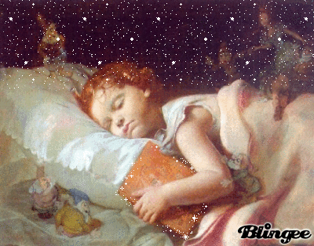
Sleep: Getting enough sleep is essential for our physical and mental health. When we are sleep-deprived, we are more likely to feel stressed and anxious.

Slide 13
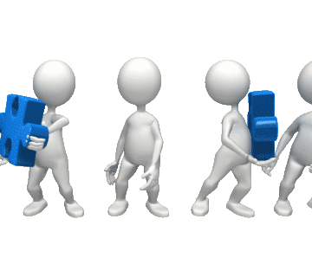
Social support: Spending time with loved ones and friends can help us to feel supported and less stressed.

Slide 14

Avoiding negative people and situations: When possible, we should try to avoid people and situations that make us feel stressed.

Slide 15

Gratitude: Practicing gratitude can help us to focus on the positive aspects of our lives and to feel less stressed

Slide 16


