Slide 1
Parasitic Infections of Hepatobiliary System/Liver
Dr. Ved Prakash
Professor & Head
PG Department of Microbiolgoy

Slide 2
Learning objectives
At the end of the session, the students will be able to understand:
Parasites causing hepatobiliary system infections - their pathogenesis, clinical manifestations, lab diagnosis and treatment of amoebic liver abscess, human echinococcosis, fascioliasis, clonorchiasis, opisthorchiasis, toxocariasis

Slide 3
INTRODUCTION
Parasites causing hepatobiliary infections include:
Protozoa: Entamoeba histolytica, causes amoebic liver abscess
Cestode: Echinococcus, causes human echinococcosis (e.g. hydatid disease)
Trematodes - Fasciola hepatica, F. gigantica, Clonorchis, Opisthorchis, Schistosoma mansoni and S. japonicum (rarely)
Nematode: Toxocara causing visceral larva migrans.

Slide 4
AMOEBIC LIVER ABSCESS
Amoebic liver abscess (ALA) - important cause of space occupying lesion of the liver.
Occurs mainly in developing countries - by a protozoan parasite, E. histolytica.

Slide 5
Pathogenesis
About 2–8% of patients with history of intestinal amoebiasis develop extraintestinal amoebiasis.
Transmission - ingestion of food and water contaminated with cysts of E. histolytica
Attachment: Cysts develop into trophozoites - adhere to intestinal mucosa by virtue of Gal/NAG lectin antigen (major virulence factor)

Slide 6
Invasion: Trophozoites secrete cysteine proteases and hydrolytic enzymes - help in the invasion of intestinal mucosa
Spread: In few cases, erosion and necrosis of small intestine - extensive that the trophozoites gain entry into the portal venous system - carried to extraintestinal sites

Slide 7
Survival: Resistance to complement-mediated lysis (mediated by Gal/NAG lectin antigen) - crucial property of E. histolytica, critical for its survival in the bloodstream
Liver - most common extraintestinal site; followed by lungs, brain, genitourinary tract and spleen

Slide 8
Most common hepatic site affected – posterior-superior surface of the right lobe of liver.
Abscess - usually single or rarely multiple.
The amoebic trophozoites occlude the hepatic venules - leads to anoxic necrosis of the hepatocytes

Slide 9
Inflammatory response surrounding the hepatocytes leads to the formation of abscess
Neutrophils recruited to the site - lysed by amoebae - release of mediators that contribute to hepatic necrosis

Slide 10
Microscopically, the abscess wall is comprised of:
  Inner central zone of necrotic hepatocytes without amoeba
  Middle zone of degenerative hepatocytes, RBC, few leukocytes and occasionally amoebic trophozoites
  Outer zone - healthy hepatocytes invaded with amoebic trophozoites

Slide 11
Anchovy sauce pus: Liver abscess pus is thick chocolate brown in color.
The fluid is acidic - pH 5.2–6.7 and is comprised of necrotic hepatocytes without any pus cells and occasionally amoebic trophozoites (mainly found in last few drops of pus) as amoebae multiply in the wall of abscess

Slide 12
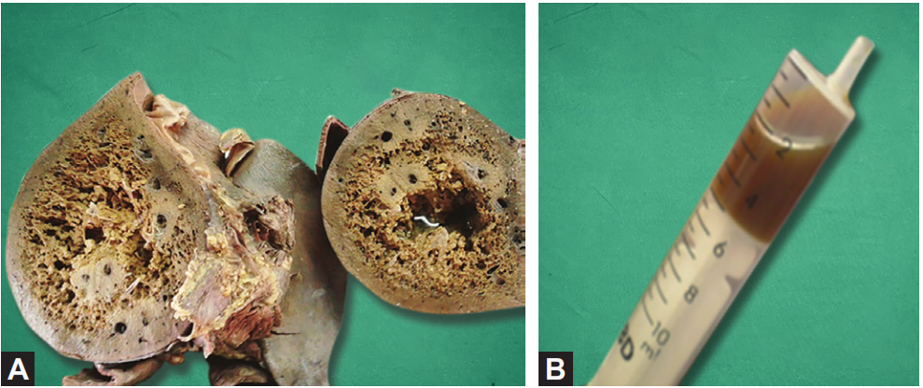
A. Cross section of the liver showing amoebic liver abscess (right side);
B. Anchovy sauce pus aspirated from amoebic liver abscess

Slide 13
Clinical Manifestations
ALA presents with tender hepatomegaly and fever (most consistent features) along with weight loss, sweating and weakness, very rarely jaundice, and cough.

Slide 14
Complications of Amoebic Liver Abscess
With continuous hepatic necrosis, abscess may grow in various direction of the liver discharging the contents into the neighboring organs.
Right-sided liver abscess - rupture externally to skin causing skin lesions on the abdominal wall - granuloma cutis (amoebiasis cutis).
Rupture into lungs (pulmonary amoebiasis with trophozoites in sputum) or into the right pleura (amoebic pleuritis, the most common complication).

Slide 15
Complications of Amoebic Liver Abscess
Rupture of liver abscess below the diaphragm - subphrenic abscess and generalized peritonitis
Left-sided liver abscess - rupture into the stomach or left pleura or pericardial cavity (amoebic pericarditis)
Hematogenous spread - from liver affecting brain (causing brain abscess and secondary amoebic encephalitis), lungs, spleen and genitourinary organs.

Slide 16
Epidemiology
Worldwide, approximately 40–50 million cases of ALA - reported annually, with the majority of infections - in developing countries.
Highest prevalence - developing countries in the tropics, particularly in Mexico, India, Central and South America, and tropical areas of Asia and Africa.
Most common group affected: Young adult males (male to female ratio is 9:1)

Slide 17
Risk factors associated with ALA include:
  Immigrants from endemic areas
  Crowding and poor hygiene
  Men who have sex with men (secondary to sexually acquired amebic colitis)
  Presence of immunosuppression.

Slide 18
Laboratory diagnosis of Amoebic liver abscess
Microscopy—detects trophozoites (<25% sensitive)
Antigen detection (in serum, liver pus and saliva)—by ELISA (170–kDA of lectin Ag)
Antibody detection—ELISA (Ab to 170-kDA lectin Ag)
Molecular diagnosis—nested multiplex PCR and real-time PCR (detecting18S rRNA)
Ultrasonography—detects the site of abscess and its extension

Slide 19
Treatment of Amoebic liver abscess
Treatment of ALA - tissue amoebicidal agent (acts on trophozoites in the liver), followed by luminal amoebicidal agent - eradicate the intestinal carriage.
Tissue agents: Metronidazole (750 mg PO or IV tid for 5–10 days); or tinidazole/ornidazole (2 g PO once); and
Luminal agents: Iodoquinol (for 20 days) or paromomycin (for 10 days)

Slide 20
Aspiration
Aspiration of the liver abscess content is indicated
(1) risk of impending rupture,
(2) left lobe liver abscess of >10 cm,
(3) no improvement after anti-protozoan therapy for 5–7 days.

Slide 21
Drug Resistance
Metronidazole resistance - reported in E. histolytica; mainly in patients with liver abscess.
Multidrug resistance - reported against iodoquinol, diloxanide furoate and emetine.

Slide 22
Prevention
Avoidance of ingestion of food and water contaminated with human feces.
Treatment of asymptomatic persons.

Slide 23
HUMAN ECHINOCOCCOSIS
Human echinococcosis - zoonotic disease – caused by a cestode of the genus Echinococcus.
Occurs in 4 forms:
Cystic echinococcosis - known as hydatid disease or hydatidosis, caused by Echinococcus granulosus
Alveolar echinococcosis, caused by E. multilocularis
Two forms of neotropical echinococcosis:
  Polycystic hydatid disease, caused by E. vogeli
  Unicystic hydatid disease, caused by E. oligarthrus.

Slide 24
Cystic Echinococcosis
Caused by Echinococcus granulosus; also called as dog tapeworm.

Slide 25
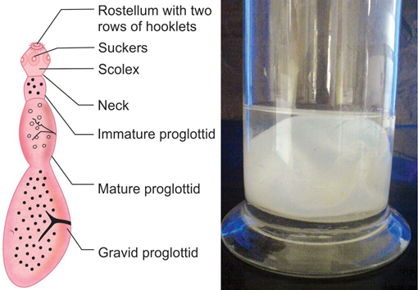
Morphology
It is a tissue cestode, exits in three morphological forms—
  Adult,
  Larva (called hydatid cyst), and
  Egg.
Echinococcus granulosus:
A. Adult worm(schematic);
B. Hydatid cyst, gross specimen.

Slide 26
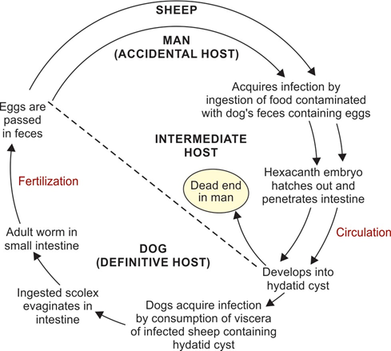
Life Cycle

Slide 27
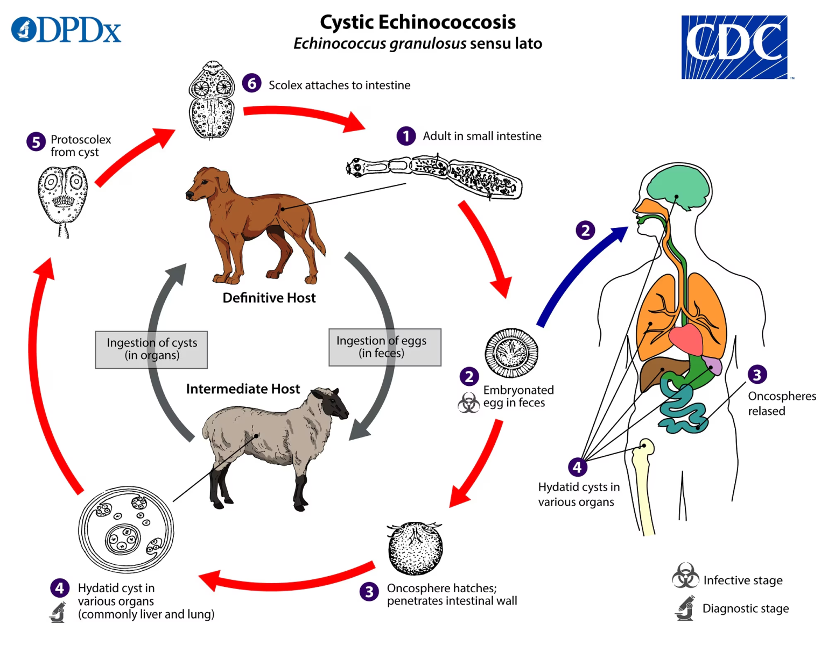

Slide 28
Pathogenicity
Pathogenicity is related to the deposition of the hydatid cysts (larval form of the parasite) in various organs.

Slide 29
Hydatid cyst
Fluid-filled bladder-like cyst - unilocular, subspherical in shape and average size measures 5–8 cm (from few mm to >30 cm).
Cyst wall - three layers: outer pericyst (host derived), middle ectocyst and inner endocyst
Brood capsule: Inner side of the endocyst gives rise to brood capsule - secretes the hydatid fluid - contains number of protoscolices (future head).

Slide 30
Hydatid fluid: Clear, pale yellow colored fluid - antigenic, toxic and anaphylactic
Hydatid sand: Some of the brood capsules and protoscolices break off - get deposited at the bottom as hydatid sand

Slide 31
Fate: The hydatid cyst may undergo—
  (i) spontaneous resolution, or
  (ii) rupture of the cyst, which may lead to either formation of secondary cysts (carried to other organs) or anaphylactic reaction to the hydatid fluid antigens.

Slide 32
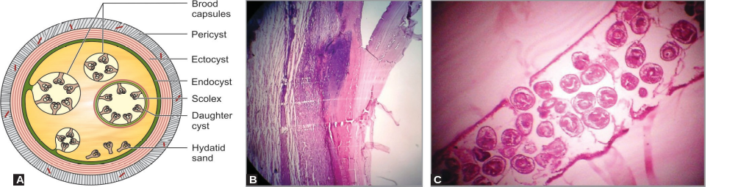

Slide 33
Clinical Features
Infection usually occurs in childhood but gets manifested in adult life.
Site: Most common site of the cyst is liver (60–70%, right lobe) or lung (20%)
Asymptomatic: The cysts grow up to 5–10 cm in size within the first year and can survive for years or even decades, without any symptoms

Slide 34
Symptoms: Few patients develop symptoms - may be due to:
    Pressure effect of the enlarging cyst
    Obstruction
    Secondary bacterial infection, causing pyogenic abscess in liver
    Anaphylactic reactions

Slide 35
Outcome of the disease: It depends on the cyst size and location
Younger children - more associated with extrahepatic cysts in lungs, brain and orbital sites and multi-organ involvement

Slide 36
Epidemiology
World: Higher incidence - reported from Central Asia (>10 per 1 Lakh population) - may be up to 27 per 1 lakh population in Tajikistan
India: Andhra Pradesh, Tamil Nadu, Chandigarh, Kashmir, Maharashtra and West Bengal
Genotypes: E. granulosus comprises of 10 genotypes - differ in their intermediate host, and geographic distribution.

Slide 37
Laboratory diagnosis of Hydatid Disease
Hydatid fluid microscopy (direct mount or staining with acid-fast stain)—detects brood capsules and protoscolices
Histological examination (H & E)—demonstrates cyst wall and attached brood capsules
Antibody detection—ELISA (using B2t antigen), DIGFA (dot immunogold filtration assay) and western blot

Slide 38
Imaging methods—X-ray, USG (demonstrates Water lily sign), CT scan, MRI
Molecular methods—PCR, PCR-RFLP and molecular typing (10 genotypes, most common in India is type 1)
Skin test (Casoni test)—demonstrates type I hypersensitivity reaction.

Slide 39
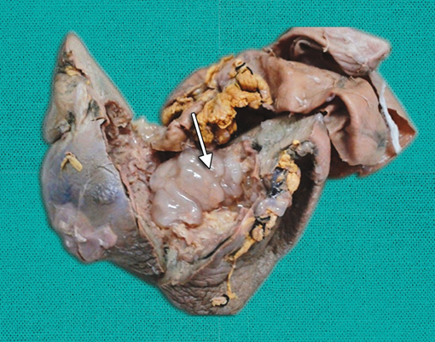
Surgically resected hydatid cyst from liver.

Slide 40

Microscopy of hydatid cyst
B and C. Histopathological section (hematoxylin and eosin stain) showing (B) all three layers of cyst wall—pericyst, ectocyst and endocyst, (C) endocyst with attached brood capsules.

Slide 41
WHO international classification of ultrasound images of hydatid cyst
Types | Activity | Usg finding
CL | Active | Cystic lesion and no visible cyst wall
CE1 | Active | Visible cyst wall and internal echoes (snowflake sign)
CE2 | Active | Visible cyst wall and internal septation (honeycomb appearance)
CE3 | Transitional | Have detached laminar membranes or may be partially collapsed, and floating within the cyst cavity (known as water lily sign)
CE4 | Inactive | Non-homogeneous mass
CE5 | Inactive | Cyst with a thick calcified wall

Slide 42
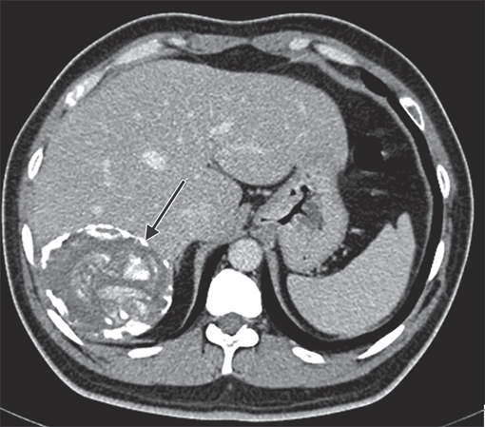
CT scan showing calcified hydatid cyst in the liver

Slide 43
Treatment of Hydatid Disease
PAIR (puncture, aspiration, injection and re-aspiration)
Alternative method recommended instead of surgery. It involves four basic steps:
  1. Percutaneous puncture of the cyst
  2. Aspiration of 10–15 mL of cyst fluid
  3. Infusion of scolicidal agents like hypertonic saline, cetrimide, or ethanol
  4. Re-aspiration of the fluid after 5 minutes

Slide 44
PAIR claims higher cure rate, less recurrence rate, less complications and hospitalization compared to surgery.
PAIR is recommended for a single hepatic cyst (CE1 lesion and uncomplicated CE3 lesion)

Slide 45
PAIR is contraindicated for:
  Superficially located cysts (because of the risk of rupture)
  CE2: Cyst with multiple thick internal septal division (honeycomb appearance)
  Inaccessible cyst or extrahepatic cysts
  Cysts communicating to the biliary tree
  CE4 and CE5 lesions: These are inactive lesions; should be managed with observation only

Slide 46
Surgery
  Cases where PAIR is contraindicated or refractory
  Secondary bacterial infection
  Advanced disease
Disadvantages of surgery - high recurrence rate (2–25%) and postoperative complications (10–25%)
Preoperative use of albendazole - effective in reducing size and to prevent recurrence

Slide 47
Antiparasitic agents
Albendazole - drug of choice - prevent recurrence and to reduce the size of the cyst before surgery or PAIR and is given at 15 mg/kg daily in two divided doses; 1 week before to 4 weeks after the procedure
Pulmonary cyst, preoperative albendazole - avoided; praziquantel is given alternatively

Slide 48
Percutaneous thermal ablation
It is a noninvasive method, involves percutaneous radiofrequency ablation of the germinal layer of the cysts.

Slide 49
Prevention
Administering praziquantel to infected dogs
To improve personal hygiene to reduce contamination of food and water with dog’s feces
Vaccinating the sheep
Limitation of stray dog population.

Slide 50
Alveolar Echinococcosis
Echinococcus multilocularis - agent of alveolar hydatid disease.
Life cycle: Similar to that of E. granulosus.
Only the hosts are different:
Definitive host: Foxes and wolves (and also dogs and cats)
Intermediate hosts: Small wild rodents like squirrels, voles, mice, etc. Man is an accidental intermediate host.

Slide 51
Clinical features: Produces alveolar (or multilocular) hydatid disease.
Cysts have multiple locules resembling lung alveoli.
Cysts - usually sterile, do not produce brood capsule and protoscolices
Liver - most common organ affected (98% of cases)
Symptoms developed are similar to that of E. granulosus - hepatomegaly and portal hypertension

Slide 52
Laboratory diagnosis: Similar to as described for cystic echinococcosis
  Imaging methods - detect the number and size of the cyst.
  Antibody detection tests
  Histopathology
  Molecular method

Slide 53
Neotropical Echinococcosis
Comprises of two forms—polycystic hydatid disease (caused by E. vogeli) and unicystic hydatid disease (caused by E. oligarthrus).
Host: Wild felids like wild cats, jaguars and pumas (E. oligarthrus) or bush dogs (E. vogeli) – definitive host.
Rodents - intermediate host

Slide 54
Clinical features: E. vogeli infects – liver (80%) followed by lungs and other viscera.
Symptoms are similar to cystic echinococcosis
Epidemiology: Till date - 200 cases of polycystic hydatid disease – South America. Only three cases of E. oligarthrus are reported so far
Laboratory diagnosis and treatment - similar to that of E. granulosus.

Slide 55
TREMATODE INFECTIONS OF LIVER
Fasciola, Clonorchis, Opisthorchis - together called as liver flukes.
Fasciola infect liver and bile duct.
Others infect only the bile duct.

Slide 56
Life Cycle
Morphology: Similar to other trematodes, they have adult worm (leaf-like), operculated eggs, and larvae (in five stages)
Hosts: Liver flukes have three hosts

Slide 57
Definitive host: Humans are the definitive host - Other animals - sheep for F. hepatica (also called as sheep liver fluke) and dogs and cats for Clonorchis and Opisthorchis.
Intermediate hosts: Snails - first intermediate host, whereas the second intermediate host – aquatic plant (for Fasciola) and cray fish (for Clonorchis, and Opisthorchis)

Slide 58
Transmission: Ingestion of second intermediate host carrying metacercaria larvae (infective form)
The larvae excyst and penetrate - intestinal wall - migrate to their habitat (liver or bile duct) - develop into adult worms.
Adult worms - fertilization - produce eggs. Eggs - passed from the bile duct or liver to intestine and excreted in feces (diagnostic form).

Slide 59
Fascioliasis
Fascioliasis (caused by Fasciola hepatica) - reported worldwide is particularly endemic in sheep-raising countries - Peru, Bolivia, and Chile.
In India - extremely rare.

Slide 60
Clinical Features
Liver: Migration of metacercaria larvae into liver - fever, right upper quadrant pain, hepatomegaly and eosinophilia.
Liver parenchyma - inflamed with formation of multiple subcapsular abscesses (called as liver rot)

Slide 61
Bile duct: The adult worm - cause obstruction of the bile duct - dilatation of the biliary tract and biliary cirrhosis.
Halzoun or Marrara syndrome: In endemic areas (e.g. Lebanon or Sudan) - uncooked goat and sheep livers may be eaten - the adult worms - attach to the pharyngeal wall - severe pharyngitis and laryngeal edema.

Slide 62
Laboratory Diagnosis
Stool microscopy - characteristic operculated eggs - 130–150 μm × 63–90 μm in size.
Concentration techniques - increase the sensitivity.
Floatation methods - not useful.
Egg of F. hepatica - similar to Fasciolopsis buski

Slide 63
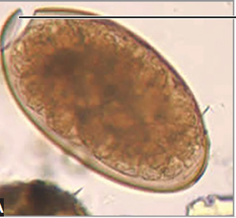

Slide 64
Antibody detection: ELISA or western blot
Molecular methods: Various PCR-based methods are available
Imaging methods - ultrasound, CT scan or MRI - employed to detect the lesions in the liver.

Slide 65
Fasciola gigantica
F. gigantica - closely related to F. hepatica.
Common parasite of herbivores - cattle; human infection is rare.
Eggs of F. gigantica - morphologically similar to that of F. hepatica but larger in size.
Rest of life cycle, clinical feature, laboratory diagnosis and treatment - similar to F. gigantica.

Slide 66
Clonorchiasis and Opisthorchiasis
Clonorchis sinensis (called as Chinese or oriental liver fluke) - found primarily in Eastern Asia like China, Korea, Japan and Malaysia.
Opisthorchis viverrini - reported from Southeast Asia, mainly from Laos, Thailand and Cambodia.
In India - not reported yet.
Opisthorchis felineus (cat liver fluke) - another species - limited to Central and Eastern Europe, Russia and Kazakhstan.

Slide 67
Clinical Features
In chronic infection with heavy worm burden – cause mechanical obstruction of the bile duct and irritation due to toxin released by the flukes - cholangitis, dilatation of the bile duct, marked ductal epithelial hyperplasia, and fibrosis leading to cholangiocarcinoma (bile duct carcinoma).
Inhibit tumor suppressor genes (P53) – release of cytokines - IL-6 and TNF-α (factors associated with carcinogenesis)

Slide 68
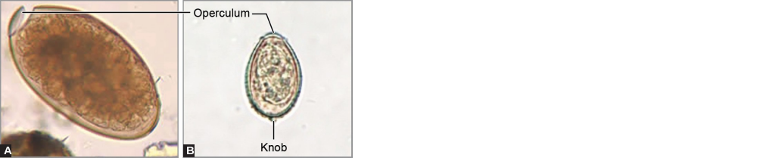
Laboratory Diagnosis
Stool microscopy: Flask-shaped eggs (measures 28–35 μm × 12–19 μm) .

Slide 69
Antibody detection: ELISA using recombinant propeptide of cathepsin L proteinase - available for detection of specific IgG4 antibodies against C. sinensis.
Antigen detection: ELISA - detection of circulating antigen in the serum.
Multiplex PCR

Slide 70
Treatment of Liver fluke infections
Triclabendazole (10 mg/kg once) - drug of choice for fascioliasis
Praziquantel (25 mg/kg, three doses in 1 day) - drug of choice for clonorchiasis and opisthorchiasis.

Slide 71
Prevention (Liver Fluke)
Sanitary disposal of sewage, and control of snail hosts
Fascioliasis - prevented by avoidance of consumption of alfalfa juice, raw water plants and cleaning them before use
Clonorchiasis and opisthorchiasis - prevented by avoidance of eating raw or undercooked fresh water fish.

Slide 72
Hepatosplenic Schistosomiasis
Lodging of Schistosoma mansoni and S. japonicum eggs in the liver - lead to granuloma formation and fibrosis (called as Symmers pipestem fibrosis).
Fibrosis impedes the portal blood flow – portal hypertension, hepatomegaly, splenomegaly (enlarged and hard) and gastric varices

Slide 73
S. mansoni - associated with hepatitis C virus; particularly in Egypt and accelerates the occurrence of chronic hepatitis and cirrhosis in these patients
Hepatitis B virus infection - associated with S. japonicum.

Slide 74
TOXOCARIASIS
Toxocariasis - caused by a less common zoonotic nematodes, Toxocara species - rarely infect humans - affecting the liver.
Two important species are T. canis (dog roundworm) and T. cati (cat roundworm)
They are the primary agents causing visceral larva migrans in man.

Slide 75
Larva Migrans
In lower animals:
The life cycle of most of these nematodes - ingestion or skin penetration by the larval stage (or eggs).
Eggs develop into larvae – larvae migrate to the intestine, lungs or other organs - develop into adult worms.

Slide 76
In humans:
Larvae of these lower animal nematodes - accidentally infect man, they are not able to complete their normal development (because humans are the unusual host for them) - life cycle gets arrested.
The larvae wander around aimlessly in the body - called as larva migrans (LM).

Slide 77
Two types of larva migrans exists:
1. Cutaneous larva migrans: Also called as creeping eruption. Larva migration occurs in skin and subcutaneous tissue.
2. Visceral larva migrans: Larva migrate to viscera, following which the life cycle gets arrested.

Slide 78
Life Cycle (Arrested) and Pathogenesis
Felines - natural host for Toxocara. Humans - abnormal host.
Transmission to man - ingestion of embryonated eggs (infective form) contaminated in soil
Larvae hatch out from the eggs in the intestine – penetrate the intestinal wall - carried via the portal circulation to the liver - larvae may remain in the liver or migrate to other organs like lungs or eye

Slide 79
Life Cycle (Arrested) and Pathogenesis
Since humans are the unusual host - further development of the larvae does not take place.
Instead, the larvae get encapsulated in the dense fibrous tissue in liver (most common site) or lungs or eyes - may continue to wander around the body producing granuloma.

Slide 80
Clinical Features
Visceral larva migrans (VLM):
Liver – most frequently involved organ (hepatosplenomegaly) – But any organ can be affected.
Usually younger children (around 3 years) - affected.
Other features - lymphadenopathy, lung involvement, skin lesions (urticaria and nodules) and seizures (result from cerebral involvement)

Slide 81
Ocular larva migrans (OLM):
Most common cause of OLM - Toxocara larva.
Unilateral painless chorioretinal granuloma in the posterior pole - most common presentation.

Slide 82
Laboratory Diagnosis
Diagnosis is often difficult and mainly stay on:
Serology: ELISA employing excretory secretory antigen of larva of T. canis - highly sensitive and specific.
Biopsy of the tissue from liver, lungs, brain - occasionally reveal the larvae; however, biopsy is usually not recommended
Blood eosinophilia.

Slide 83
Treatment of Toxocariasis
The recommended regimen - albendazole for 5 days or mebendazole for 21 days with glucocorticoid.

Slide 84
RARE PARASITIC INFECTIONS OF LIVER
Capillaria hepatica
C. hepatica - parasite of rodents.
Human infection is rare; reported from West Africa.
Transmission - accidental ingestion of contaminated soil containing eggs.
Clinical features: Ranges from hepatitis, hepatomegaly, peritonitis and eosinophilia

Slide 85
Laboratory diagnosis: Detection of characteristic barrel shaped in the liver parenchyma - similar to the eggs of Trichuris and other Capillaria species.
C. philippinensis and C. aerophila are the other species affecting GIT and respiratory systems respectively.

Slide 86
Other parasites that occasionally infect liver
Plasmodium
Visceral leishmaniasis
Enterocytozoon bieneusi
Balantidium coli
Enterobius
Disseminated strongyloidiasis
Occult filariasis
THANKS

