Slide 1

Major Healthcare-associated Infection Types
Dr. Ved Prakash
Professor & Head
PG Department of Microbiology

Slide 2
INTRODUCTION
Any infection developing in a patient after two days of hospitalization - healthcare-associated infection (HAI).
  Sources of infection : Endogenous & Exogenous

Slide 3
Microorganisms Implicated in HAIs
The ESKAPE pathogens-
  Enterococcus faecium
  Staphylococcus aureus
  Klebsiella pneumoniae
  Acinetobacter baumannii
  Pseudomonas aeruginosa
  Enterobacter species

Slide 4
Other infections that can spread in hospitals include:
  Escherichia coli
  SARS-CoV-2 (COVID-19)
  Nosocomially-acquired Mycobacterium tuberculosis
  Legionella pneumophila, Candida albicans, Clostridium difficile diarrhea.
  Blood-borne infections - HIV, hepatitis B and C viral infections.

Slide 5
Modes of Transmission
Contact transmission
Droplet transmission
Airborne transmission

Slide 6
There are four major types:
  1. Catheter-associated urinary tract infection (CAUTI) 33%
  2. Catheter related blood stream infection CRBSI/(CLABSI) 13%
  3. Ventilator-associated pneumonia (VAP) 15%
  4. Surgical site infection (SSI) 31%

Slide 7
PREVENTION OF HAIs
Standard Precautions
Hand hygiene
PPE
Spillage cleaning
Disinfection of patient care items
Environmental cleaning
Respiratory hygiene and cough etiquette
Safe use and disposal of sharp.
Management of Biomedical waste:

Slide 8
b) Transmission-Based Precautions
Contact Precautions
Droplet Precautions
Airborne Precautions
c) Environmental Cleaning : Surface and floor disinfection of OT and fogging (aerial disinfection)

Slide 9
Major HAI Types
CATHETER-ASSOCIATED URINARY TRACT INFECTION (CAUTI)
Most common HAI worldwide.
Accounting - 40% of nosocomial infections.
About 70–80% of healthcare–associated UTI - attributable to the presence of an indwelling urinary catheter.

Slide 10
Definitions
Catheter-associated bacteriuria (CA-bacteriuria) has been defined as presence of significant bacteriuria in a catheterized patient.
Classified as:
  Catheter-associated UTI (CAUTI)
  Catheter-associated asymptomatic bacteriuria (CA-ASB)

Slide 11
Epidemiology
Risk of developing CA-bacteriuria increases with time with an average risk of 3–10% per catheter day.
CAUTI rate varies from 0 to 5 per 1000 catheterized depending up on the hospital location (ward vs ICU)

Slide 12
Microbiology
In short-term catheterized patients:
Caused by the monomicrobial pathogens – GNB or enterococci.
E. coli - predominant agent.
Other GNB - Klebsiella, Pseudomonas and Acinetobacter
GPC - Enterococcus account for most of the other infections.

Slide 13
In long-term catheterized patients:
Usually polymicrobial.
Pathogens of short-term catheterization + Proteus, Providencia and Morganella

Slide 14
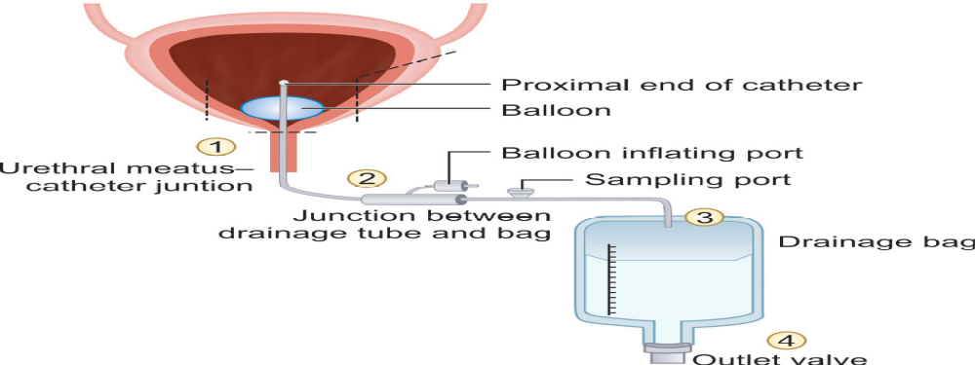
Pathogenesis
Entry points through which the microorganism may reach the bladder in a catheterized patient

Slide 15
Microorganisms may ascend to urinary tract by either:
Extraluminal spread - Patients endogenous flora or Hands of HCWs
Intraluminal spread - Open drainage bag or breach in closed drainage system.

Slide 16
Indwelling urinary catheter – Risk of UTI ??
Risk – directly proportional to duration of catheterization
Urethral pressure- decreased mucosal blood flow, mucosal disruption and impaired mucin secretion
Incomplete emptying

Slide 17
Risk factors for CAUTI
Device-related risk factors | Patient-related risk factors | Caregiver-related risk factors
Duration: Long-term (≥30 days) catheterization has a higher risk than short-term (<30 days) Type of catheter material: Latex catheter has higher CAUTI risk (causes more urethritis, stricture formation, and obstruction) than silicone catheters | Female gender Fatal underlying illness Older age (>50 years) Diabetes mellitus Poor personal hygiene Incomplete emptying of bladder Fecal incontinence | Failure in adherence to aseptic technique (and other care bundle components) both during insertion and maintenance of catheter. Emergency catheter insertion outside the operating room.

Slide 18
Laboratory Diagnosis
Urine should be collected through the catheter port using aseptic technique or by puncturing the catheter tubing with a needle and syringe.
Urine should never be collected from the urobag.

Slide 19
Clinical diagnosis of CAUTI is based on the following three criteria:
Catheter criteria | Catheterized or history of recent catheterization within 48 hours
Clinical criteria | Presence of at least one signs or symptoms of UTI: fever, suprapubic tenderness, costovertebral angle pain, urinary urgency, frequency or dysuria (pain during micturition)
Urine culture criteria | Presence of significant bacteriuria, defined as colony count exceeding: ≥10³ CFU/mL: in symptomatic patients ≥10⁵ CFU/mL: in asymptomatic patients

Slide 20
Treatment
Removal of catheter
Institution of appropriate antimicrobial therapy based on AST report
Treatment of CA-ASB not indicated except when:
  Bacteriuria persists for >48 hours after removal of the catheter
  Pregnancy(20–30fold increased risk of pyelonephritis and risk of premature delivery with LBW)
  Prior to traumatic urological procedures

Slide 21
CATHETER RELATED BLOOD STREAM
INFECTION (CRBSI)
Development of BSI in a hospitalized patients
  Attributed to the presence of a central line as a source of infection.
  Not associated with any other secondary cause of BSI.
CLABSI - strictly used only for surveillance purpose.

Slide 22
Central Line or Central Venous Catheter
Intravascular device that terminates in the great vessels.
Needed for various purposes such as:
  Central venous pressure monitoring
  Administration of drugs
  Total parenteral nutrition
  Hemodialysis access (hemodialysis catheters)

Slide 23
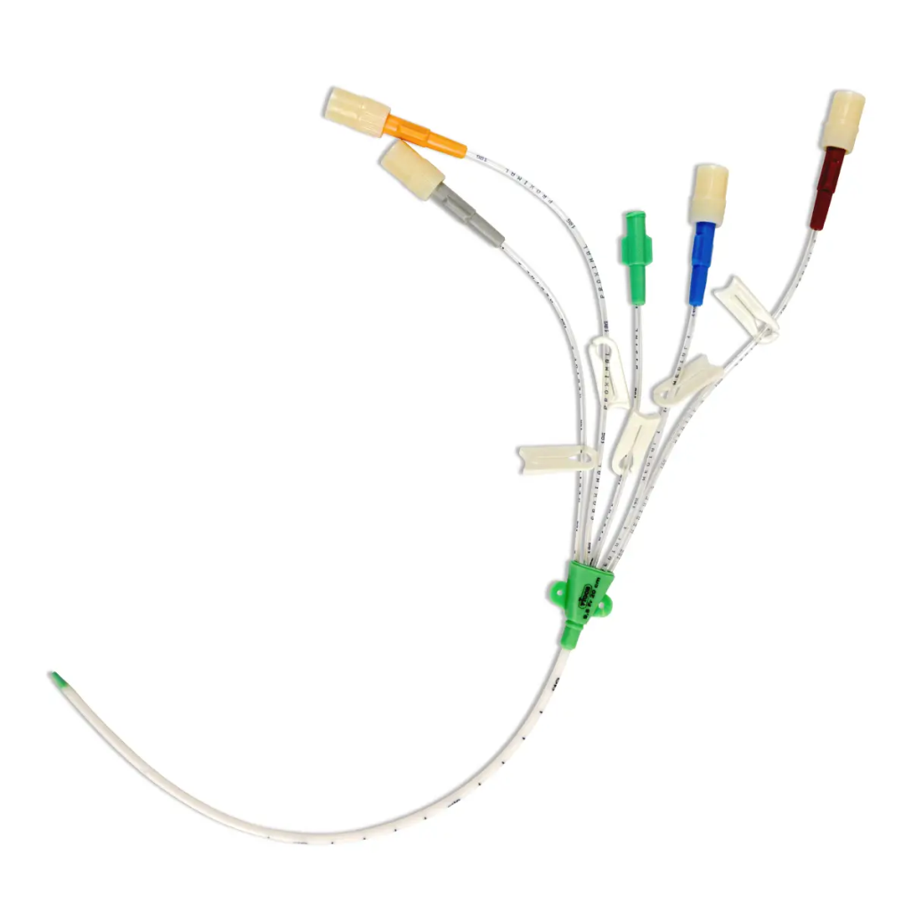
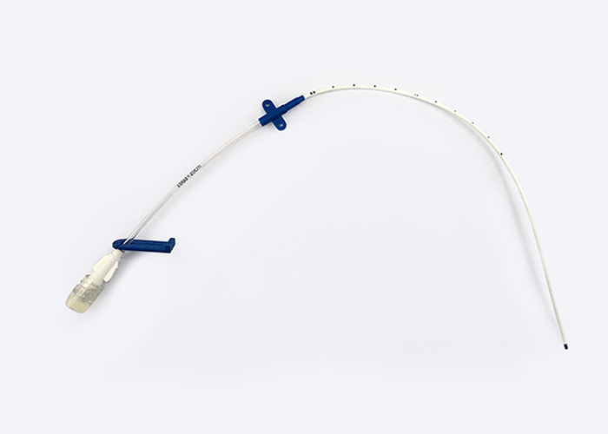
Multi Lumen central venous cannula
Single Lumen central venous cannula

Slide 24
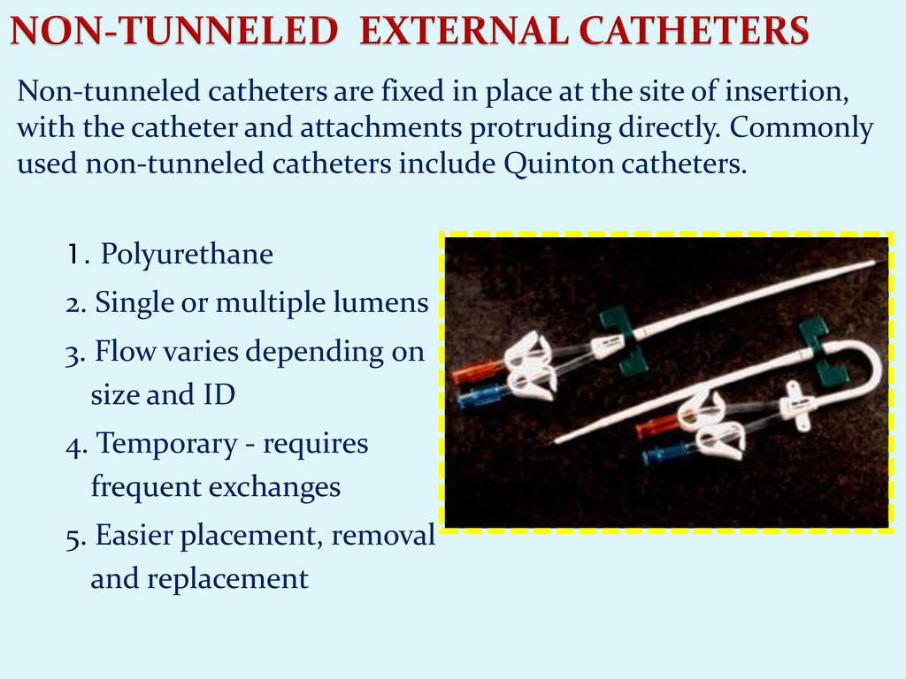

Slide 25
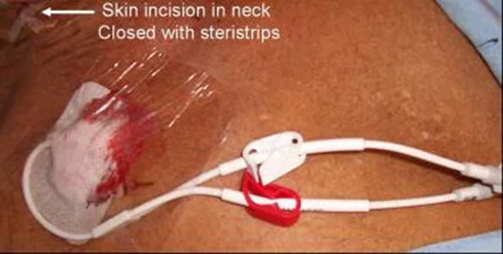
Unlike non-tunneled central venous catheters (CVCs), tunneled CVCs travel under the skin and terminate away from the venous access site. As such, tunneled CVCs can be in place for weeks to months, while the non-tunneled catheters must be exchanged every few days to a week.

Slide 26
Central venous catheters (CVC) can be classified in various ways :
  Intended life span e.g., temporary or short-term (<72h) versus permanent or long-term (≥72 hr)
  Site of insertion (e.g., subclavian, femoral, internal jugular and peripheral veins
  Pathway from skin to great vessel (e.g., tunneled versus non-tunneled)

Slide 27
Epidemiology
Approximately <3% of hospitalized patients require central line at some time during their stay.
Out of which 3-8 % develop CLABSI.
CLABSI rate varies from 0% to 2.9 % depending up on the location (wards or ICUs).

Slide 28
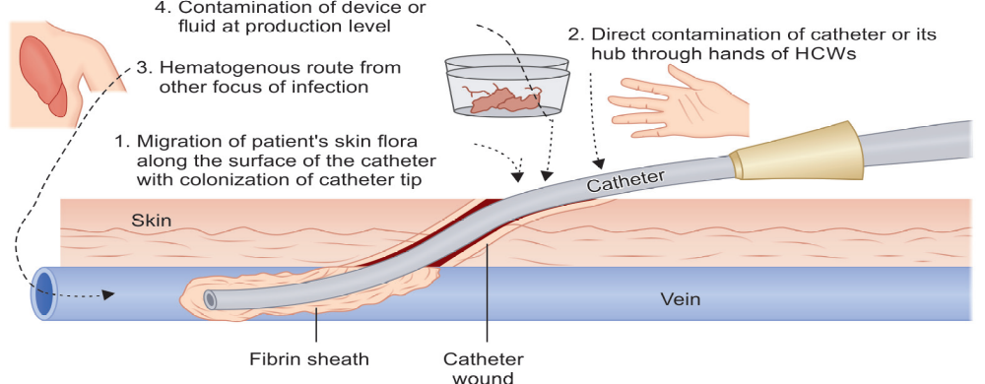
Pathogenesis
Routes of access of organisms to central line

Slide 29
Following events take place after the entry of the organism into the CL.
  Foreign body reaction
  Colonization of the organism by microbial adherence
  Biofilm formation on catheter surface

Slide 30
Risk factors for CRBSI/Centeral line Associated Blood stream infection
Device-related | Patient-related | Caregiver-related
Duration of CL: Longer duration (≥72 hrs) has higher risk than shorter duration (<72 hrs) Site: Femoral vein CL has higher risk than jugular vein and subclavian vein Catheter type: Non-tunneled catheters has higher risk than tunneled catheter Number of lumens: Multi-lumen CLs have a higher risk than single-lumen Insertion circumstances: Emergency insertion has a higher risk than elective insertion | Immunodeficiency Severe underlying illness Hematologic malignancy Loss of skin integrity (e.g., burns, psoriasis) Presence of distant infection Alteration in patient’s cutaneous microflora | Poor hand hygiene Lack of infection control practices (e.g. care bundle) Skin antisepsis: Use of alcohol has a higher risk than chlorhexidine

Slide 31
Intrinsic and extrinsic contamination of central line
Intrinsic contamination (intraluminal source) | Extrinsic contamination (extraluminal source)
Contamination during device or fluid production | Contamination at the time of insertion
Due to defect during manufacture May cause outbreaks | Poor sterile precautions during drug or IV fluid admixture
Most common causative agents include Klebsiella, Enterobacter or Pseudomonas | Most common causative agents include Skin commensals like CoNS and S. aureus

Slide 32
Diagnostic criteria of CRBSI
Catheter criteria : Presence of catheter in central line
Clinical criteria: Presence of fever, chills, rigor or hypotension after the CL is used and or signs of catheter site infection such as erythema, tenderness, warmth, swelling at the catheter exit site.
Microbiological criteria: Simultaneous blood culture from CL and PL is carried out and the CL blood culture bottle flags ≥2 hrs earlier to peripheral line blood culture (i.e. DTP ≥2 hrs)Differential time to positivity = culture of both central line and peripheral line blood specimens must reveal the same pathogen; with central line bottle flagged positive least 2 hours of more earlier, than the peripheral line bottle

Slide 33
Treatment
Appropriate systemic antimicrobial therapy and removal of the central line.
Systemic antimicrobial therapy (SAT) - empirical therapy and later should be modified later based on susceptibility report.

Slide 34
Antibiotic lock therapy (ALT)-
  Situations where salvage of the catheter is considered (e.g. infection with CoNS, those with limited venous access and a history of recurrent CLABSIs), ALT is given along with SAT.
  Involves instillation of a highly concentrated antibiotic solution into the CL lumen and is left to dwell within the lumen for a short period.

Slide 35
VENTILATOR ASSOCIATED PNEUMONIA
Second most common nosocomial infection (after CAUTI)
Accounts for 15–20% of the total HAIs.
Most common cause of death among HAIs, with a mortality rate of up to 40%.
Primary cause of death in ICUs.
VAP rate varies from 1.0 to 46.0 per 1000 mechanical ventilation (MV) days.

Slide 36
Microbiology
Early-onset VAP - Occurs in first 4 days of MV and caused by typical community organisms such as Pneumococcus, H. influenzae, MSSA etc.
Late-onset VAP - Develops ≥5 days after MV
  Commonly caused by typical MDROs P. aeruginosa, A.baumannii, E.coli, Klebsiella and by MRSA
  Source of infection – Endogenous (patients own flora) or Exogenous (Hospital environmental sources)

Slide 37
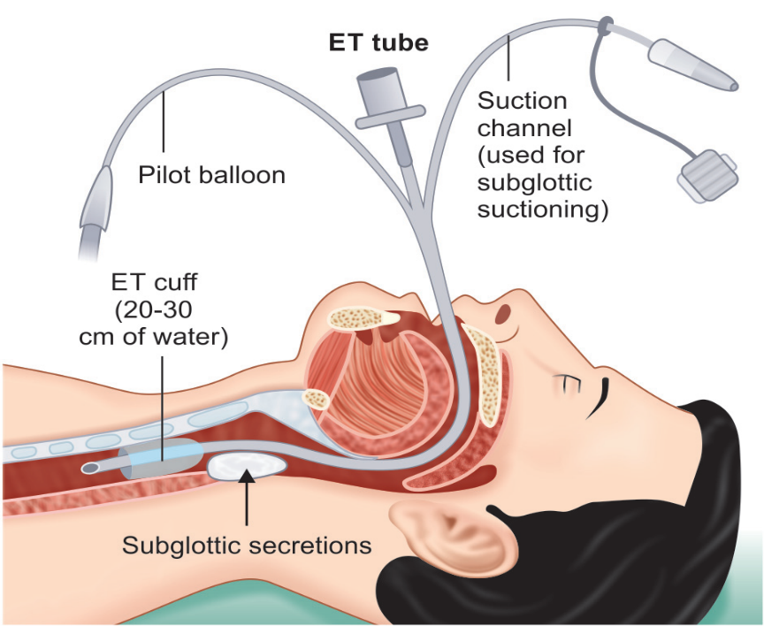
Pathogenesis
Colonization – with hospital MDROs
ET intubation – disrupts normal defense mechanisms
Biofilm – reservoir of infection
Subglottic secretion – microaspiration (prevented by maintaining cuff pressure 20-30 cmH2O & suctioning )

Slide 38
Sedation
Supine position – facilitates microaspiration
Nasogastric tubes – disrupts esophageal sphincter
Critical illness with comorbidities
Stress ulcer prophylaxis

Slide 39
Risk factors for VAP
Device- or intervention-related | Patient-related | Healthcare personnel-related
Device-related Duration of ventilation Nasogastric tube Frequent changes of ventilator circuit Failed subglottic aspiration Intra-cuff pressure <20 cm of H2O | Advanced age (>60 years) Prior hospitalization Patient position: Supine position Critically-ill with comorbidities Underlying condition such as COPD, ARDS, head trauma Patients with coma Immobilization Thermal injury (burns) | Improper adherence to aseptic techniques specially hand washing Contaminated environmental sources
Intervention-related Use of antibiotics or sedatives Stress ulcer prophylaxis Tracheostomy

Slide 40
Diagnosis
No gold standard criteria is available which can define VAP accurately.
Most popular and widely used criteria - CPIS system.
CPIS system - based on six parameters (clinical, radiological and microbiological) with each parameter given a score scale ranging from 0 to 2.
Maximum score -12 & a score >6 is diagnostic of VAP.

Slide 41
Modified Clinical Pulmonary Infection Score (CPIS)
CPIS points | 0 | 1 | 2
Temperature (°C) | ≥36.5°C and ≤38.4°C | ≥38.5°C and ≤38.9°C | ≥39°C or ≤36°C
Leukocyte count (per mm3) | 4,000–11,000 | <4,000 or >11,000 | <4,000 or >11,000 + band forms ≥50%
Tracheal secretions | Rare | Non-purulent | Abundant + purulent
Oxygenation PaO₂ /FiO₂ mm Hg | >240 with ARDS | - | ≤240 and no ARDS
Chest radiograph | No infiltrate | Diffuse or patchy infiltrate | Localized infiltrate
Tracheal aspirate culture report | Light growth or no growth | Moderate or heavy growth of pathogenic bacteria | Moderate or heavy growth of bacteria and presence of bacteria with similar morphology on Gram stain
Abbreviation: ARDS, acute respiratory distress syndrome; FiO2 Fraction of inspired oxygen:; PaO2 arterial partial pressure of oxygen.

Slide 42
Terminologies Used in Adult-VAE Algorithm
Fraction of Inspired Oxygen (FiO₂)
FiO₂ is the fraction of oxygen in the volume of air being measured. Atmospheric air contains 21% oxygen, which is equivalent to FiO₂ of 0.21.
Patients with difficulty in breathing are provided with oxygen-enriched air, i.e. FiO2 higher than that of atmospheric air.
In patients on MV, the FiO2 can be adjusted depending on the patient’s oxygenation needs, which ranges from 0.3 to 1.0 (30-100%)

Slide 43
An increase of ≥0.2(20%) is considered as worsening of oxygenation, which is used to meet VAC definition.
Positive End-Expiratory Pressure (PEEP)
PEEP is a pressure that is applied by a ventilator at the end of each breath (expiration) to maintain airway pressure greater than atmospheric pressure so as to prevent the collapse of the alveoli.
The PEEP values ranges from 0 cm H₂O to 15cm H₂O and any value between 0 to 5 cm H₂O is considered normal value.
An increase of ≥ 3 cm H₂O is considered as worsening of oxygenation, which is used to meet VAC definition.

Slide 44
SpO2 blood oxygen saturation level; Hypoxia <94%
PaO2/FiO2 ratio; ration of arterial oxygen partial pressure (in mm Hg) to fractional inspired oxygen. (Normal value ~ 500)
ARDS can be classified into –mild (<300), moderate (<200), and severe (<100); (when PEEP or CPAP is maintained at ≥5cm H₂O
CPAP (Continuous positive airway pressure)

Slide 45
Date of Event (DOE) is first day of worsening oxygenation after two days of base line period
VAE window Period is a 5 days period which includes the DOE, 2 days before, and 2 days after.
FiO2 (Fraction of Inspired Oxygen) : This setting determines the concentration of oxygen in the gas mixture delivered by the ventilator

Slide 46
PEEP (Positive End-Expiratory Pressure): This is the amount of pressure maintained in the airways at the end of each exhalation, PEEP helps keep the alveoli (air sacs in the lungs) open, especially during expiration .

Slide 47
Adult VAE surveillance algorithm.
Mechanical ventilation (MV) criteria | Patient has mechanical ventilator (MV) in place for 2 calendar day or more. If it is removed, then the DOE must be on the day of removal or on next day
Baseline period | Patient should have an initial period of stability or improvement of respiratory status: defined as ≥ 2 days of stable or decreasing daily minimum FiO₂ or PEEP
Ventilator-associated condition (VAC) | After a baseline period, the patient should have at least one of the following criteria of worsening of oxygenation: Daily minimum PEEP values ≥ 3 cm H₂O sustained for ≥ 2 days Daily minimum PEEP values of ≥ 3 cm H₂O sustained for ≥2 days

Slide 48
Infection-related ventilator associated complication (IVAC) | If VAC criteria is fulfilled, the IVAC can be met if the patient has both of the following criteria during the VAE window period, which is an indicator of associated infection or inflammation: Clinical criteria: any one of the following: Temperature>100.4°F Temperature <36.8°F WBC count≥12,000 cells/mm³ Antimicrobial agent criteria: A new antimicrobial agent is started, and continued for ≥4 days
Possible ventilator-associated pneumonia (PVAP) | Laboratory criteria: If IVAC criteria are fulfilled, the PVAP can be met if the patient fulfills one of the following criteria during the VAE window period, which indicates laboratory confirmation of the infection: Culture positive by quantitative or semi quantitative method Gram stain finding of purulent respiratory secretion with culture positive by qualitative method Non-culture methods (histopathology, immunofluorescence test for respiratory viruses, Legionella)

Slide 49
Modified Clinical Pulmonary Infection Score (CPIS)
CPIS points | 0 | 1 | 2
Temperature (°C) | ≥36.5°C and ≤38.4°C | ≥38.5°C and ≤38.9°C | ≥39°C or ≤36°C
Leukocyte count (per mm3) | 4,000–11,000 | <4,000 or >11,000 | <4,000 or >11,000 + band forms ≥50%
Tracheal secretions | Rare | Non-purulent | Abundant + purulent
Oxygenation PaO₂ /FiO₂ mm Hg | >240 with ARDS | - | ≤240 and no ARDS
Chest radiograph | No infiltrate | Diffuse or patchy infiltrate | Localized infiltrate
Tracheal aspirate culture report | Light growth or no growth | Moderate or heavy growth of pathogenic bacteria | Moderate or heavy growth of bacteria and presence of bacteria with similar morphology on Gram stain

Slide 50
Laboratory criteria to meet possible VAP criteria
Laboratory criteria
Criterion 1
Positive quantitative or semi quantitative culture yielding:
ET aspirate ≥ 10⁵ CFU/mL
BAL ≥ 10⁴ CFU/mL
Lung tissue ≥ 10⁴ CFU/g
Protected specimen brush (PSB) ≥ 10³ CFU/mL
Criterion 2
Positive quantitative culture on any of the samples of criterion 1 (ET aspirate, BAL, lung tissue or PSB) or sputum. (positive culture of any growth not meeting criteria 1)
plus
Gram stain showing purulent respiratory secretions (defined as ≥ 25 PMN, ≤ 10 squamous epithelial cells per ipf)
Criterion 3
One of the following positive tests:
Organism identified form pleural fluid
Lung histopathology
Diagnostic test for Legionella species
Diagnostic test for respiratory viruses

Slide 51
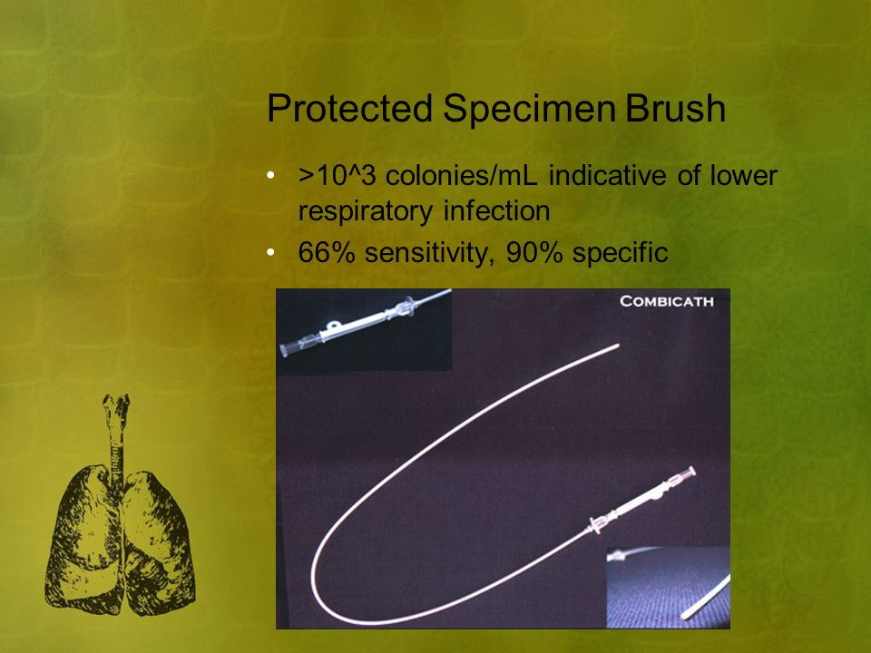
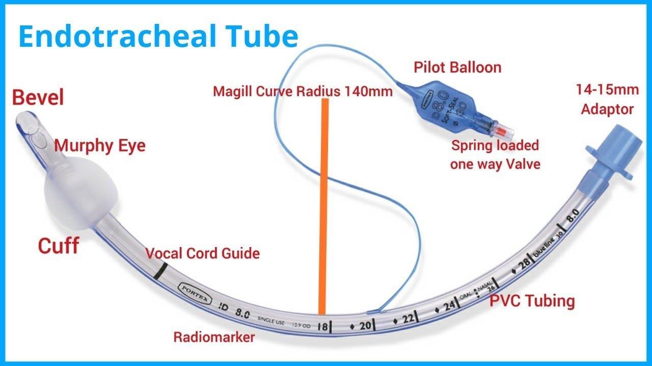

Slide 52
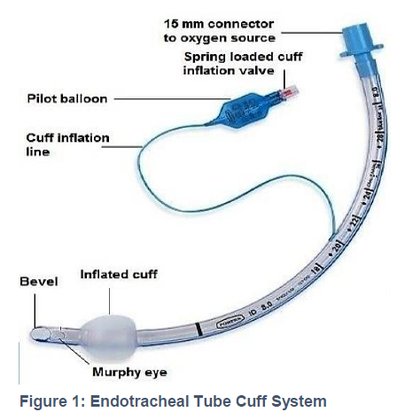
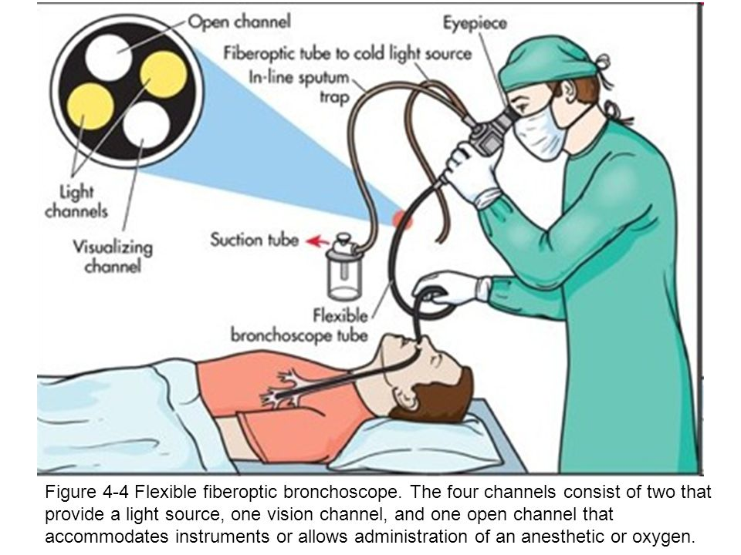

Slide 53
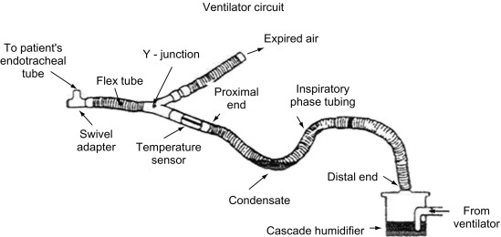

Slide 54
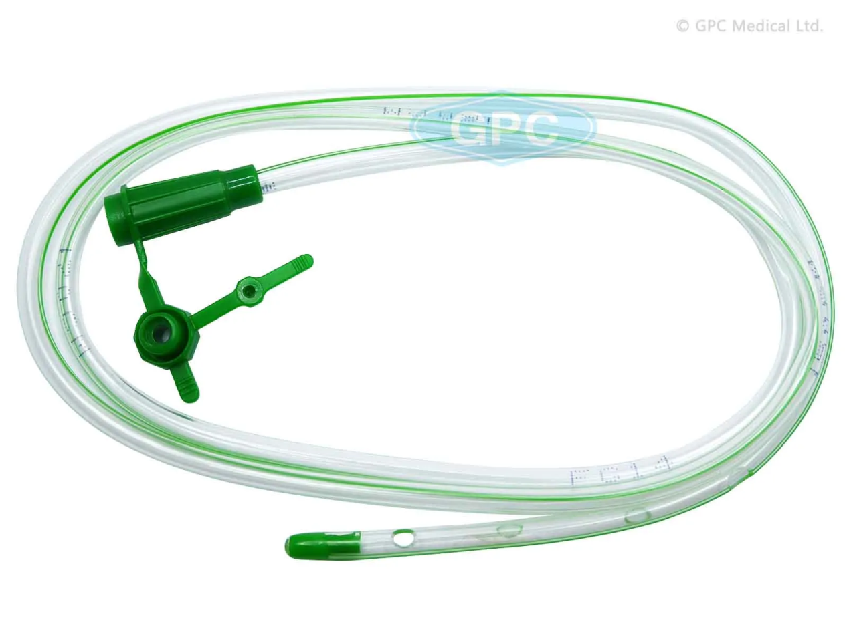
NASOGASTRIC TUBE

Slide 55
Microbiological Criteria
Specimens - endotracheal aspirate (most common), BAL, PSB or lung biopsy.
Gram staining- VAP likely with higher number of bacteria, intracellular bacteria and fibrin strands
Culture – Quantitative (significant if ≥10⁵ CFU/ml for ETA, ≥10⁴ for BAL, ≥10³ for PSB); Semi-quantitative(moderate to heavy growth)

Slide 56
Radiological Criteria
Highly subjective
Most accepted - chest X-ray or CT scan showing one of the following—infiltrate, consolidation or cavitation, in the absence of underlying pulmonary or cardiac disease.

Slide 57
Treatment
Empirical antimicrobial therapy once the clinical diagnosis of VAP is made - modified subsequently based on AST report.
Empirical regimen - combination of antimicrobial agents active against S. aureus, Pseudomonas and other GNB

Slide 58
SURGICAL SITE INFECTION
Defined as infections that develop at the surgical site within 30 days of surgery (or within 90 days for some surgeries such as breast, cardiac and joint surgeries including implants).
Affects up to one third of patients who have undergone a surgical procedure.
In India, several studies reported SSI rate ranging from 4 to 11 per 100 surgeries.

Slide 59
Microbiology
Type of etiological agents depends upon the site of surgical procedure and the source of infection from which they are acquired.
  Endogenous source – Patients own skin or mucosa
  Exogenous source – Operative personnel or instruments
Inoculum load (GI high risk) and virulence of the organism can determine risk

Slide 60
Risk factors for development of SSI
Patient-related | Procedure-related
Age >60 years | Improper surgical scrub
Malnutrition, diabetes | Inadequate skin antisepsis
Immunosuppression | Prolonged operative time
Skin colonization at the time of surgery (e.g. MRSA carrier) | Inadequate antimicrobial prophylaxis
Duration of hospital stay | Poor perioperative glycemic control
Smoking, obesity | Emergency procedure
Higher wound class | Preoperative shaving

Slide 61
Organism-related | Environmental-related
Inoculum size (e.g. bowel surgery) | Presence of blood/ clot, suture material and foreign bodies at the surgical site
Bacterial virulence | Inadequate ventilation
Ability to form biofilm | Contaminated medications

Slide 62
Wound Class Type
Depending up on the degree of microbial contamination, wounds are classified as:
Class I, Clean Wound – uninfected, no inflammation and hollow viscus is not entered
Class II, Clean-contaminated Wound – hollow viscus entered under controlled conditions and without unusual contamination
Class III, Contaminated Wound – Open fresh accidental wounds, major break in sterile technique during surgeries, colonic surgeries etc
Class IV, Dirty/infected Wound –Surgical procedure done when active infection already present

Slide 63
Classification and Diagnosis of SSI
Superficial SSI—develops at the level of superficial incisional site (skin and subcutaneous level) within 30 days regardless of type of surgery.
Deep SSI—develops at the level of deep incisional site (muscle and facial level) within 30 days for all surgeries except for breast, cardiac and implant surgeries (90 days)

Slide 64
Organ space SSI—develops at the level of organ space site within 30 days for all surgeries except breast, cardiac and implant surgeries (90 days).

Slide 65
Treatment of SSI
Suture removal plus incision and drainage
Systemic antimicrobial therapy.

Slide 66
Prevention of surgical site infection (SSI)
Preoperative measures
Preoperative bathing: with plain soap or an antimicrobial soap to reduce the bacterial load For MRSA carriers: Decolonization with mupirocin ointment for patients undergoing surgery Hair removal: should not be done or, if absolutely necessary, it should be removed only with a clipper. Shaving is strongly discouraged at all times

Slide 67
Intraoperative measures
SAP: Must be provided for all except clean surgeries ; 60–120 minutes before incision; choice depends upon local antibiotic policy ( cefazolin or cefuroxime); single dose. Surgical hand disinfection: antimicrobial soap (chlorhexidine) or with Alcohol based hand rub Surgical site preparation: alcohol-based chlorhexidine antiseptic solution Perioperative maintenance of oxygenation (target FiO2 80%), temperature (normothermia), blood glucose level (target level of <200 mg/dL), adequate circulating volume (normovolemia) and nutritional support

Slide 68
Postoperative measures
Wound dressing—Daily dressing and removal of any discharge present at the site OT disinfection—Performed with a high level disinfectant in between cases and after the last case (terminal disinfection) Periodic monitoring of the air quality of operation theater SAP prolongation is not recommended in any situation (e.g. presence of a wound drain)

Slide 69
PREVENTION OF DEVICE-ASSOCIATED INFECTIONS
Presence of device itself is a major risk factor for developing such infection.
Strict aseptic techniques must be followed while insertion and daily maintenance of the devices.
Preventive measures for each of the DAIs are grouped as care bundle approach

Slide 70
Care Bundle Approach
Comprises of 3 to 5 evidence-based elements with strong clinician agreement; each of the component must be followed during the insertion or maintenance of the device.
Compliance to the care bundle is calculated as all-or-none way, i.e. failure of compliance to any of the component leads to non-compliance to the whole bundle.

Slide 71
Care bundle for urinary catheter
Insertion bundle | Maintenance bundle
1. Catheter should be inserted only when appropriate indication is present (e.g. acute urinary retention) 2. Only the sterile items are used for insertion of catheter 3. Catheter is inserted by non-touch technique with strict asepsis 4. Closed drainage system must be used 5. Catheter of appropriate size must be used 6. Catheter must be properly secured after placement (by plaster-tube-plaster technique) | 1. Daily catheter care (vaginal or meatal care) must be given regularly and by strict aseptic measures such as hand hygiene and single use gloves 2. Catheter is properly secured all the time 3. Drainage bag must be always above the floor and below the bladder level 4. Closed drainage system is used all the time 5. While collection of urine from bag, the following steps must be followed — Hand hygiene, change of gloves between patients; use of separate jug for each bag, use of alcohol swabs for disinfection of outlet 6. Daily assessment of readiness for removal of catheter must be documented

Slide 72
Care bundle for central line
Insertion bundle | Maintenance bundle
1. Hand hygiene before and after insertion of central line 2. Use maximum sterile PPE: gloves, gown, drapes, cap and mask 3. Site of insertion—Subclavian preferred, avoid femoral 4. Skin preparation—by antiseptics such as chlorhexidine 5. Skin must be completely dry after use of antiseptics 6. Use semi-permeable dressing 7. Document data and time of insertion | 1. Daily aseptic central line care during handling: Hand hygiene must be performed Hub decontamination by alcohol 2. Daily documentation of local signs of infection 3. Change of dressing with 2% chlorhexidine 4. Daily assessment of readiness for removal of central line must be documented

Slide 73
Maintenance care bundle for mechanical ventilator
1. Adherence to hand hygiene 2. Elevation of the head of the bed to 30–45°—this is to prevent oropharyngeal aspiration to respiratory tract 3. Daily oral care with chlorhexidine 2% solution 4. Need of PUD (peptic ulcer disease) prophylaxis should be assessed daily; if needed only sucralfate should be used 5. DVT (deep vein thrombosis) prophylaxis should be provided if needed 6. Daily assessment of readiness to remove mechanical ventilator must be documented
THANKS

Slide 74
HAI SURVEILLANCE
System that monitors the HAIs in a hospital.
Main objectives:
  Provides endemic or baseline HAI rate and information on type of HAIs in the hospital
  Helps in comparing HAI rates within and between hospitals

Slide 75
Main objectives of HAI surveillance include:
  Identifies the problem area; based on which root cause analysis can be conducted to find out the breakdowns in infection control measures and then the appropriate corrective measures are implemented
  Provides timely feedback to the clinicians; thus, reinforces them to adopt best practices.

Slide 76
Targeted Surveillance
NHSN (National Health Care safety Network ) established by CDC provides guidelines for the surveillance of HAIs.
  Where to conduct: Only for high-risk locations such as ICUs.
  What type of HAIs to be monitored: CA-UTI, CLABSI, VAP and SSI.
  Who will conduct: ICNs under the supervision of the HICO

Slide 77
HAI surveillance diagnostic criteria
These criteria are made very objective -to maintain the uniformity of data collection between hospitals.
Surveillance criteria are different from clinical and diagnostic criteria

Slide 78
Method of Conducting HAI Surveillance
HAI surveillance cycle consists of data collection →data analysis → data interpretation → data dissemination.

Slide 79
NHSN surveillance diagnostic criteria for catheter associated urinary tract infection (CAUTI)
Device criteria | Presence of a urinary catheter for > 2 days.
Clinical criteria | Presence of any one symptom of UTI such as fever, suprapubic tenderness, urgency, frequency or dysuria.
Culture criteria | Isolation of significant count (≥ 10⁵/mL) of a UTI pathogen from urine.

Slide 80
NHSN surveillance diagnostic criteria for VAE
(Ventilator associated events)
Stage-1: VAC (ventilator associated condition)
Device criteria | Presence of a mechanical ventilator at least for two calendar 2 days.
Oxygenation criteria | Baseline period during which the daily minimum FiO₂ (fraction of inspired oxygen) and PEEP (positive end-expiratory pressure) values are stable or decreasing for 2 days followed by Period of worsening of oxygenation- increased FiO₂ (by ≥ 20%) or PEEP (≥ 3 cm water) for at least 2 days

Slide 81
Stage-2: IVAC (infection related ventilator associated complications)
Clinical criteria | Any one out of four- Fever or hypothermia Leucocytosis or leukopenia
Antibiotic criteria | New antimicrobial agent started and continued for ≥ 4 days
Stage-3: PVAP (Possible ventilator associated pneumonia)
Culture criteria | Isolation of significant count of a pneumonia pathogen from respiratory specimens such as tracheal aspirate, bronchoalveolar lavage etc.

Slide 82
Definition
Infections that develop at the surgical site within 30 days of surgery (within 90 days for breast, cardiac and joint surgeries).
Type of SSIs
Superficial SSI- Develops at the level of superficial incisional site (skin and subcutaneous level) within 30 days regardless of type of surgery. Deep SSI- Develops at the level of deep incisional site (muscle and fascial level) within 30 days for all surgeries except breast, cardiac and implant surgeries ( 90 days) Organ space SSI- Develops at the level of organ space site within 30 days for all surgeries except breast, cardiac and implant surgeries (90 days).

Slide 83
One among the following must be met:
Clinical criteria | (i) presence of purulent pus from the corresponding level of surgical site or (ii) presence of local signs of infections (pain/tenderness, swelling, erythema, heat etc).
Culture criteria | Positive culture from the discharge collected at the corresponding level of surgical site.
Other evidence | (i)For superficial SSI- Surgeon’s diagnosis is taken as diagnostic criteria (ii)For deep or organ space SSI- histopathological, imaging or gross anatomical evidence of abscess should be present.

Slide 84
Formulae of HAI infection rates
HAI infection rates | Formulae
CAUTI Rate | No. of CA-UTI cases/ total no. of urinary catheter days × 1000
CLABSI Rate | No. of CLABSI cases/ total no. of central line days × 1000
VAE Rate | No. of VAE cases/ total no. of ventilator days × 1000
SSI Rate | No. of SSI/No. of surgeries done × 100

Slide 85


Slide 86
Audits in Infection Prevention and Control
Dr. Ved Prakash
(Infection Control Officer)
Professor & Head
PG Department of Microbiology

Slide 87
Key points
Audit means checking practice against a standard. It examines the actual situation and compares it to written policies or another benchmark.
Audit can help to improve health care service by providing a blame-free mechanism for changes in practice. It can also be used for risk assessment, strategic planning, and root cause analysis.

Slide 88
An audit team is essential to carry out a proper audit through good planning, performance, and feedback of results.
Audit results may be provided to others through various types of reporting.

Slide 89
Introduction
Healthcare-associated infections are generally related to multiple factors. Prevention of these infections depends on daily vigilance and implementation of infection prevention and control (IPC) practices. These practices are outlined in written guidelines, policies, and procedures.

Slide 90

The PDSA cycle

Slide 91
Audit Method
Initially it is probably worth selecting a few areas to audit, preferably those that are most important to the organisation. These may include high-risk areas highlighted through surveillance results or occurrence of outbreaks.

Slide 92
An effective audit should include a description of the physical layout; review of traffic flow, protocols and policies, supplies and equipment; and observation of appropriate IPC practice.

Slide 93
Basic Principles
Bundles
A bundle is a multi-model structured way of improving processes of care and patient outcomes. A bundle is a collection of processes needed to effectively and safely care for patients undergoing particular treatments with inherent risks. Several interventions are “bundled” together and, when combined, significantly improve

Slide 94
patient care outcomes. Bundles are helpful and have been developed for ventilator-associated pneumonia, catheter-associated urinary tract infection, and central line-associated bloodstream infection prevention.⁶

Slide 95
A bundle pack includes:
A statement of commitment for the clinical team to sign.
A cause-effect chart describing the evidence for optimal practice and used also for root cause analysis of non-conformities, in reference to the standards.
Standard operating procedures for the bundle including specific criteria.
A data collection sheet.
Explanation of the bundle to the clinical staff (e.g., group discussion, slide presentation)

Slide 96
Types of Audits in Hospital Infection Control
Process Audits : To assess right polices & procedures to prevent infection
Outcome audits : To assess actual rates of infection in the Hospital.
Observational Audits : It involves watching staff members to see, if they are following infection control procedures correctly

Slide 97
What are to be audited
Hand hygiene (readiness and practice; supplies such as soap, paper towel, alcohol-based products).
Use of standard precautions/routine practices.
Use of isolation/precautions.
Use of personal protective equipment.
Monitoring of sterilisation equipment.

Slide 98
6. Cleaning, disinfection, and sterilisation of reusable equipment and devices, such as bronchoscopes and surgical instruments.
7. Health care environment cleaning.
8. Haemodialysis practices, equipment, facility.

Slide 99
9. Operating room IPC practices, asepsis and preoperative antisepsis, traffic control, patient skin preparation, hair removal, surgical scrub, and prophylactic antibiotics.
10.Practice and medical device reprocessing in clinics and physician offices.
11.Occupational health issues, such as, sharps injuries/needle sticks, vaccination rates.
12. Outbreak management.

Slide 100
How to Report Audits
Once the audit is completed, a draft, detailed report must be written and
reviewed with management and key staff in the audit area before it is finalised and distributed. The report should include information on why the audit was performed, method used, findings, and recommendations. Compliance data should be included as appropriate.

Slide 101
Reporting of audits could be in the form of:
Weekly reports: Providing rapid feedback on incidental issues while they are still fresh (e.g., during outbreaks or after occupational sharp injuries).
Monthly reports: A monthly report should include sections about surveillance, audit results, education, training, and consultations.
Quarterly reports: These are formal reports including recommendations and management of issues.

Slide 102
Annual reports: A summary of audits carried out during the year and the resulting improvement or changes during the rapid and annual audit plans, illustrated as appropriate with graphs.
Staff must learn to appreciate that the intent of audits is to promote good practice, improve patient care, and ensure safety. A key person must be identified in each area to help facilitate implementation of any recommendations within a specified time.

Slide 103
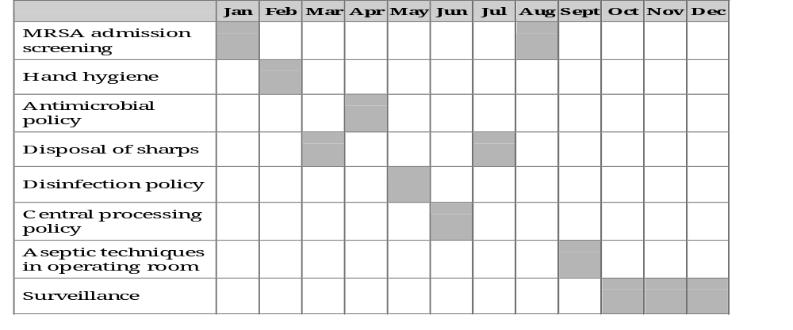
An Annual Audit Plan

Slide 104
Summary
(Take Home Message)
Health care requires an increased emphasis on the use of audits to measure the implementation of policies and procedures relating to IPC practices.
Development of audit plans based on a risk assessment strategy, preparation of the audit team, tailoring of the audit method, and audit assessment of knowledge are pillars of internal audits in health care organisations.

Slide 105
Duties of infection control officer
Program Development and Implementation:
Policy and Protocol Architects: ICOs are instrumental in crafting, implementing, and meticulously reviewing facility-wide policies and procedures related to infection control. They ensure these protocols align with the latest best practices and adhere to the stringent guidelines established by regulatory agencies.

Slide 106
Surveillance and Data-Driven Decisions: ICOs meticulously collect, analyze, and interpret infection data to identify trends and potential outbreaks. This intelligence-gathering approach empowers them to implement targeted interventions, effectively mitigating the spread of infections.

Slide 107
Education and Training Champions:
Empowering the Workforce: ICOs play a leading role in staff education. They design and deliver comprehensive training programs encompassing various aspects of infection control, including hand hygiene, aseptic technique, the proper use of Personal Protective Equipment (PPE), and effective outbreak management protocols.

Slide 108
Ensuring Competency: To safeguard patient safety, ICOs conduct competency assessments to verify that healthcare personnel possess the necessary knowledge and skills to effectively prevent HAIs.

Slide 109
Protecting Patients and Staff:
Outbreak Investigation and Control Specialists: When an HAI outbreak occurs, ICOs lead the investigation. They meticulously identify the root cause and implement robust control measures to prevent further transmission, safeguarding both patients and staff.

Slide 110
Auditing for Excellence: ICOs conduct regular audits and observations to monitor staff adherence to established IPC protocols. This ensures consistent application of best practices throughout the facility.

Slide 111
Communication and Collaboration:
Liaison and Advocate: They serve as crucial liaisons between the healthcare facility and external agencies such as the CDC or state health departments. This role encompasses communication regarding infection control matters and adherence to reporting requirements.

Slide 112
Fostering a Culture of Safety: ICOs collaborate with various departments within the healthcare facility, including nursing, sanitation, and administration. Their collaborative spirit is instrumental in fostering a culture of safety that prioritizes infection prevention at all levels.

Slide 113
Duties of Quality Manager in Hospital regarding IPC in NABH
Implementation and Monitoring:
Develop and implement hospital-wide IPC policies and procedures aligned with NABH standards. [This could involve collaborating with medical staff to define protocols for hand hygiene, waste management, use of personal protective equipment (PPE), etc.]

Slide 114
Oversee the IPC training and competency assessment of staff members at all levels. Conduct regular audits and monitor compliance with IPC protocols across departments. Analyze data from audits and reports to identify areas for improvement in IPC practices.

Slide 115
Communication and Collaboration:
Work closely with the IPC committee to ensure effective implementation of IPC programs.
Disseminate information and updates on IPC guidelines and best practices to staff.
Foster a culture of safety and quality by promoting IPC awareness among all hospital personnel.
Collaborate with other departments like housekeeping, engineering, and waste management to ensure proper infection control practices are followed.

Slide 116
Documentation and Reporting:
Maintain comprehensive documentation of IPC policies, procedures, training records, and audit reports.
Prepare reports on IPC performance indicators for NABH accreditation purposes.
Liaise with NABH officials during accreditation surveys and address any concerns regarding IPC compliance.

Slide 117
Continuous Improvement:
Analyze trends in hospital-acquired infections (HAIs) and identify areas for improvement in IPC strategies.
Implement corrective and preventive actions (CAPAs) to address identified deficiencies in IPC practices.
Stay updated on the latest IPC guidelines and best practices published by national and international healthcare organizations.

Slide 118
IPC performance Indicators for
NABH Accreditation Purposes
Hand Hygiene
Hand Hygiene Adherence Rate: Monitor how often staff properly wash hands or use hand sanitizer according to NABH guidelines.
Hand Hygiene Infrastructure: Ensure handwashing stations with soap and sanitizer are readily available at all points of care.

Slide 119
Personal Protective Equipment (PPE)
Appropriate PPE Utilization Rate: Track how often staff wear the correct PPE based on the procedure's risk assessment.
PPE Donning and Doffing Compliance: Monitor adherence to established procedures for safe putting on and taking off PPE.

Slide 120
Healthcare-Associated Infections (HAIs)
HAI Rates: Regularly monitor and analyze rates of specific HAIs like CAUTIs, CLABSIs, and VAP.
HAI Surveillance Program Effectiveness: Measure how well your system identifies and tracks HAIs for prompt intervention.

Slide 121
Antibiotic Stewardship
Antibiotic Prescribing Adherence: Track how often antibiotics are prescribed following established guidelines.
Antibiotic Resistance Monitoring: Implement systems to monitor antibiotic resistance patterns within the facility.

Slide 122
Environmental Cleaning and Disinfection
Cleaning and Disinfection Frequency: Establish a risk-based schedule for cleaning high-touch surfaces and frequently disinfected areas.
Cleaning and Disinfection Effectiveness Monitoring: Regularly evaluate the effectiveness of cleaning practices to ensure proper hygiene.

Slide 123
Waste Management
Medical Waste Segregation and Disposal Compliance: Monitor adherence to NABH guidelines for proper medical waste disposal based on its classification.
Waste Handling Staff PPE Utilization: Ensure staff handling medical waste wear the appropriate PPE.

Slide 124
Staff Education and Training
IPC Training Completion Rate: Track the number of staff who have completed comprehensive IPC training within a set timeframe.
IPC Training Regularity: Conduct regular IPC training sessions to keep staff updated on best practices and evolving guidelines.

Slide 125
Data Collection and Analysis
Standardized IPC Data Collection: Implement a system for consistent monitoring and recording of IPC data using standardized formats.
Data-Driven Improvement: Regularly analyze IPC data to identify areas for improvement and implement targeted interventions.

Slide 126
Communication and Reporting
Effective IPC Communication Strategy: Develop a clear communication plan to disseminate IPC policies and procedures to all staff.
HAI and IPC Incident Reporting: Establish a robust system for reporting HAIs and other IPC-related incidents.

Slide 127
Continuous Improvement
Corrective and Preventive Actions (CAPA): Implement a systematic approach to address identified IPC issues through CAPAs.
IPC Policy and Procedure Review: Regularly review and revise IPC policies and procedures based on best practices, new guidelines, and feedback. THANKS

Slide 129
Learning objectives
At the end of the session, the students will be able to understand:
Catheter-associated Urinary Tract Infection (CAUTI)
Catheter-related Blood Stream Infection (CRBSI)
Ventilator Associated Pneumonia (VAP)
Surgical Site Infection (SSI)
Prevention of Device-associated Infections
HAI Surveillance

