Slide 1

Major Healthcare-associated Infection Types
Dr. Ved Prakash
Professor & Head
PG Department of Microbiology

Slide 2
Learning objectives
At the end of the session, the students will be able to understand:
Catheter-associated Urinary Tract Infection (CAUTI)
Catheter-related Blood Stream Infection (CRBSI)
Ventilator Associated Pneumonia (VAP)
Surgical Site Infection (SSI)
Prevention of Device-associated Infections
HAI Surveillance

Slide 3
INTRODUCTION
Any infection developing in a patient after two days of hospitalization - healthcare-associated infection (HAI). Among them,
There are four major types:
  1. Catheter-associated urinary tract infection (CAUTI)
  2. Catheter related blood stream infection (CRBSI)
  3. Ventilator-associated pneumonia (VAP)
  4. Surgical site infection (SSI).

Slide 4
CATHETER-ASSOCIATED URINARY TRACT INFECTION (CAUTI)
Most common HAI worldwide.
Accounting - 40% of nosocomial infections.
About 70–80% of healthcare–associated UTI - attributable to the presence of an indwelling urinary catheter.

Slide 5
Definitions
Catheter-associated bacteriuria (CA-bacteriuria) has been defined as presence of significant bacteriuria in a catheterized patient.
Classified as:
  Catheter-associated UTI (CAUTI)
  Catheter-associated asymptomatic bacteriuria (CA-ASB)

Slide 6
Epidemiology
Risk of developing CA-bacteriuria increases with time with an average risk of 3–10% per catheter day.
CAUTI rate varies from 0 to 5 per 1000 catheterized depending up on the hospital location (ward vs ICU)

Slide 7
Microbiology
In short-term catheterized patients:
Caused by the monomicrobial pathogens – GNB or enterococci.
E. coli - predominant agent.
Other GNB - Klebsiella, Pseudomonas and Acinetobacter
GPC - Enterococcus account for most of the other infections.

Slide 8
In long-term catheterized patients:
Usually polymicrobial.
Pathogens of short-term catheterization + Proteus, Providencia and Morganella

Slide 9
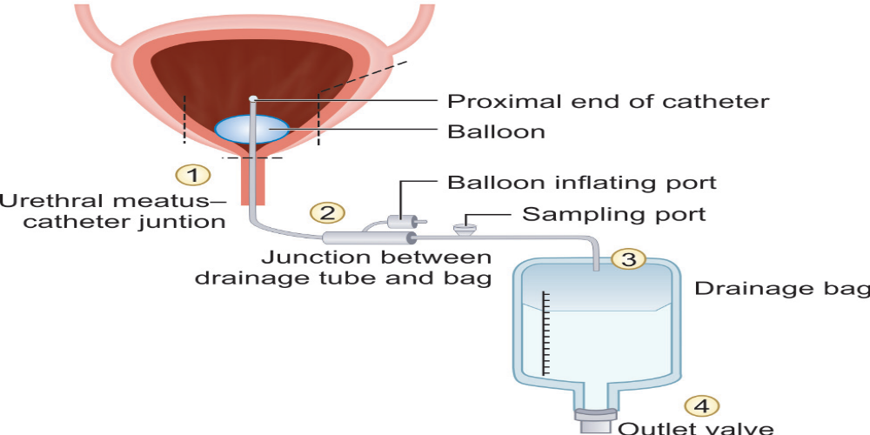
Pathogenesis
Entry points through which the microorganism may reach the bladder in a catheterized patient

Slide 10
Microorganisms may ascend to urinary tract by either:
Extraluminal spread - Patients endogenous flora or Hands of HCWs
Intraluminal spread - Open drainage bag or breach in closed drainage system.

Slide 11
Indwelling urinary catheter – Risk of UTI ??
Risk – directly proportional to duration of catheterization
Urethral pressure- decreased mucosal blood flow, mucosal disruption and impaired mucin secretion
Incomplete emptying

Slide 12
Risk factors for CAUTI
Device-related risk factors | Patient-related risk factors | Caregiver-related risk factors
Duration: Long-term (≥30 days) catheterization has a higher risk than short-term (<30 days) Type of catheter material: Latex catheter has higher CAUTI risk (causes more urethritis, stricture formation, and obstruction) than silicone catheters | Female gender Fatal underlying illness Older age (>50 years) Diabetes mellitus Poor personal hygiene Incomplete emptying of bladder Fecal incontinence | Failure in adherence to aseptic technique (and other care bundle components) both during insertion and maintenance of catheter. Emergency catheter insertion outside the operating room.

Slide 13
Laboratory Diagnosis
Urine should be collected through the catheter port using aseptic technique or by puncturing the catheter tubing with a needle and syringe.
Urine should never be collected from the urobag.

Slide 14
Clinical diagnosis of CAUTI is based on the following three criteria:
Catheter criteria | Catheterized or history of recent catheterization within 48 hours
Clinical criteria | Presence of at least one signs or symptoms of UTI: fever, suprapubic tenderness, costovertebral angle pain, urinary urgency, frequency or dysuria (pain during micturition)
Urine culture criteria | Presence of significant bacteriuria, defined as colony count exceeding: ≥10³ CFU/mL: in symptomatic patients ≥10⁵ CFU/mL: in asymptomatic patients

Slide 15
Treatment
Removal of catheter
Institution of appropriate antimicrobial therapy based on AST report
Treatment of CA-ASB not indicated except when:
  Bacteriuria persists for >48 hours after removal of the catheter
  Pregnancy(20–30fold increased risk of pyelonephritis and risk of premature delivery with LBW)
  Prior to traumatic urological procedures

Slide 16
CATHETER RELATED BLOOD STREAM
INFECTION (CRBSI)
Development of BSI in a hospitalized patients
  Attributed to the presence of a central line as a source of infection.
  Not associated with any other secondary cause of BSI.
CLABSI - strictly used only for surveillance purpose.

Slide 17
Central Line or Central Venous Catheter
Intravascular device that terminates in the great vessels.
Needed for various purposes such as:
  Central venous pressure monitoring
  Administration of drugs
  Total parenteral nutrition
  Hemodialysis access (hemodialysis catheters)

Slide 18
Central venous catheters (CVC) can be classified in various ways :
  Intended life span e.g., temporary or short-term (<72h) versus permanent or long-term (≥72 hr)
  Site of insertion (e.g., subclavian, femoral, internal jugular and peripheral veins
  Pathway from skin to great vessel (e.g., tunneled versus non-tunneled)

Slide 19
Epidemiology
Approximately <3% of hospitalized patients require central line at some time during their stay.
Out of which 3-8 % develop CLABSI.
CLABSI rate varies from 0% to 2.9 % depending up on the location (wards or ICUs).

Slide 20
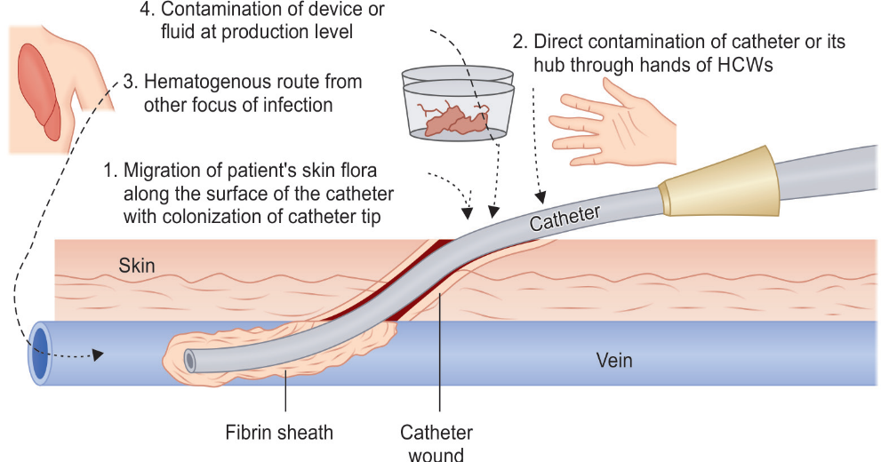
Pathogenesis
Routes of access of organisms to central line

Slide 21
Following events take place after the entry of the organism into the CL.
  Foreign body reaction
  Colonization of the organism by microbial adherence
  Biofilm formation on catheter surface

Slide 22
Risk factors for CRBSI
Device-related | Patient-related | Caregiver-related
Duration of CL: Longer duration (≥72 hrs) has higher risk than shorter duration (<72 hrs) Site: Femoral vein CL has higher risk than jugular vein and subclavian vein Catheter type: Non-tunneled catheters has higher risk than tunneled catheter Number of lumens: Multi-lumen CLs have a higher risk than single-lumen Insertion circumstances: Emergency insertion has a higher risk than elective insertion | Immunodeficiency Severe underlying illness Hematologic malignancy Loss of skin integrity (e.g., burns, psoriasis) Presence of distant infection Alteration in patient’s cutaneous microflora | Poor hand hygiene Lack of infection control practices (e.g. care bundle) Skin antisepsis: Use of alcohol has a higher risk than chlorhexidine

Slide 23
Intrinsic and extrinsic contamination of central line
Intrinsic contamination (intraluminal source) | Extrinsic contamination (extraluminal source)
Contamination during device or fluid production | Contamination at the time of insertion
Due to defect during manufacture May cause outbreaks | Poor sterile precautions during drug or IV fluid admixture
Most common causative agents include Klebsiella, Enterobacter or Pseudomonas | Most common causative agents include Skin commensals like CoNS and S. aureus

Slide 24
Diagnosis of CRBSI
Clinical criteria: Presence of fever, chills, rigor or hypotension after the CL is used and or signs of catheter site infection such as erythema, tenderness, warmth, swelling at the catheter exit site.
Microbiological criteria: Simultaneous blood culture from CL and PL is carried out and the CL blood culture bottle flags ≥2 hrs earlier to peripheral line blood culture (i.e. DTP ≥2 hrs)

Slide 25
Treatment
Appropriate systematic antimicrobial therapy and removal of the central line.
Systematic antimicrobial therapy (SAT) - empirical therapy and later should be modified later based on susceptibility report.

Slide 26
Antibiotic lock therapy (ALT)-
  Situations where salvage of the catheter is considered (e.g. infection with CoNS, those with limited venous access and a history of recurrent CLABSIs), ALT is given along with SAT.
  Involves instillation of a highly concentrated antibiotic solution into the CL lumen and is left to dwell within the lumen for a short period.

Slide 27
VENTILATOR ASSOCIATED PNEUMONIA
Second most common nosocomial infection (after CAUTI)
Accounts for 15–20% of the total HAIs.
Most common cause of death among HAIs, with a mortality rate of up to 40%.
Primary cause of death in ICUs.
VAP rate varies from 1.0 to 46.0 per 1000 mechanical ventilation (MV) days.

Slide 28
Microbiology
Early-onset VAP - Occurs in first 4 days of MV and caused by typical community organisms such as Pneumococcus, H. influenzae, MSSA etc.
Late-onset VAP - Develops ≥5 days after MV
  Commonly caused by typical MDROs P. aeruginosa, A.baumannii, E.coli, Klebsiella and by MRSA
  Source of infection – Endogenous (patients own flora) or Exogenous (Hospital environmental sources)

Slide 29
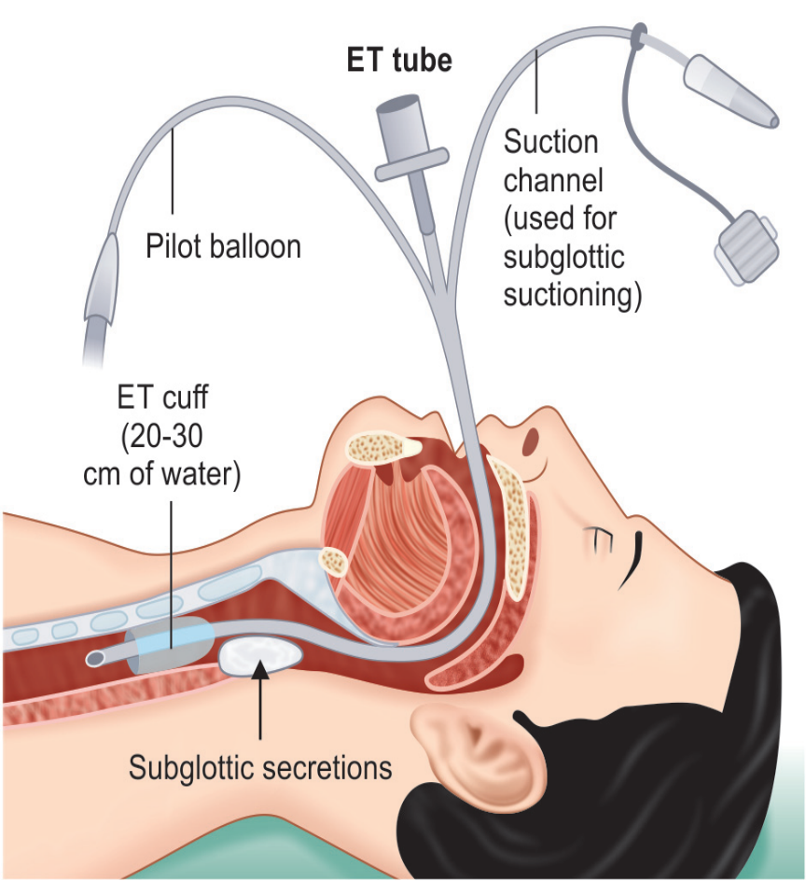
Pathogenesis
Colonization – with hospital MDROs
ET intubation – disrupts normal defense mechanisms
Biofilm – reservoir of infection
Subglottic secretion – microaspiration (prevented by maintaining cuff pressure 20-30 cmH2O & suctioning )

Slide 30
Sedation
Supine position – facilitates microaspiration
Nasogastric tubes – disrupts esophageal sphincter
Critical illness with comorbidities
Stress ulcer prophylaxis

Slide 31
Risk factors
Device- or intervention-related | Patient-related | Healthcare personnel-related
Device-related Duration of ventilation Nasogastric tube Frequent changes of ventilator circuit Failed subglottic aspiration Intra-cuff pressure <20 cm of H2O | Advanced age (>60 years) Prior hospitalization Patient position: Supine position Critically-ill with comorbidities Underlying condition such as COPD, ARDS, head trauma Patients with coma Immobilization Thermal injury (burns) | Improper adherence to aseptic techniques specially hand washing Contaminated environmental sources
Intervention-related Use of antibiotics or sedatives Stress ulcer prophylaxis Tracheostomy

Slide 32
Diagnosis
No gold standard criteria is available which can define VAP accurately.
Most popular and widely used criteria - CPIS system.
CPIS system - based on six parameters (clinical, radiological and microbiological) with each parameter given a score scale ranging from 0 to 2.
Maximum score -12 & a score >6 is diagnostic of VAP.

Slide 33
Modified Clinical Pulmonary Infection Score (CPIS)
CPIS points | 0 | 1 | 2
Temperature (°C) | ≥36.5°C and ≤38.4°C | ≥38.5°C and ≤38.9°C | ≥39°C or ≤36°C
Leukocyte count (per mm3) | 4,000–11,000 | <4,000 or >11,000 | <4,000 or >11,000 + band forms ≥50%
Tracheal secretions | Rare | Non-purulent | Abundant + purulent
Oxygenation PaO₂ /FiO₂ mm Hg | >240 with ARDS | - | ≤240 and no ARDS
Chest radiograph | No infiltrate | Diffuse or patchy infiltrate | Localized infiltrate
Tracheal aspirate culture report | Light growth or no growth | Moderate or heavy growth of pathogenic bacteria | Moderate or heavy growth of bacteria and presence of bacteria with similar morphology on Gram stain

Slide 34
Microbiological Criteria
Specimens - endotracheal aspirate (most common), BAL, PSB or lung biopsy.
Gram staining- VAP likely with higher number of bacteria, intracellular bacteria and fibrin strands
Culture – Quantitative (significant if ≥10⁵ CFU/ml for ETA, ≥10⁴ for BAL, ≥10³ for PSB); Semi-quantitative(moderate to heavy growth)

Slide 35
Radiological Criteria
Highly subjective
Most accepted - chest X-ray or CT scan showing one of the following—infiltrate, consolidation or cavitation, in the absence of underlying pulmonary or cardiac disease.

Slide 36
Treatment
Empirical antimicrobial therapy once the clinical diagnosis of VAP is made - modified subsequently based on AST report.
Empirical regimen - combination of antimicrobial agents active against S. aureus, Pseudomonas and other GNB

Slide 37
SURGICAL SITE INFECTION
Defined as infections that develop at the surgical site within 30 days of surgery (or within 90 days for some surgeries such as breast, cardiac and joint surgeries including implants).
Affects up to one third of patients who have undergone a surgical procedure.
In India, several studies reported SSI rate ranging from 4 to 11 per 100 surgeries.

Slide 38
Microbiology
Type of etiological agents depends upon the site of surgical procedure and the source of infection from which they are acquired.
  Endogenous source – Patients own skin or mucosa
  Exogenous source – Operative personnel or instruments
Inoculum load (GI high risk) and virulence of the organism can determine risk

Slide 39
Risk factors for development of SSI
Patient-related | Procedure-related
Age >60 years | Improper surgical scrub
Malnutrition, diabetes | Inadequate skin antisepsis
Immunosuppression | Prolonged operative time
Skin colonization at the time of surgery (e.g. MRSA carrier) | Inadequate antimicrobial prophylaxis
Duration of hospital stay | Poor perioperative glycemic control
Smoking, obesity | Emergency procedure
Higher wound class | Preoperative shaving

Slide 40
Organism-related | Environmental-related
Inoculum size (e.g. bowel surgery) | Presence of blood/ clot, suture material and foreign bodies at the surgical site
Bacterial virulence | Inadequate ventilation
Ability to form biofilm | Contaminated medications

Slide 41
Wound Class Type
Depending up on the degree of microbial contamination, wounds are classified as:
Class I, Clean Wound – uninfected, no inflammation and hollow viscus is not entered
Class II, Clean-contaminated Wound – hollow viscus entered under controlled conditions and without unusual contamination
Class III, Contaminated Wound – Open fresh accidental wounds, major break in sterile technique during surgeries, colonic surgeries etc
Class IV, Dirty/infected Wound –Surgical procedure done when active infection already present

Slide 42
Classification and Diagnosis of SSI
Superficial SSI—develops at the level of superficial incisional site (skin and subcutaneous level) within 30 days regardless of type of surgery.
Deep SSI—develops at the level of deep incisional site (muscle and facial level) within 30 days for all surgeries except for breast, cardiac and implant surgeries (90 days)

Slide 43
Organ space SSI—develops at the level of organ space site within 30 days for all surgeries except breast, cardiac and implant surgeries (90 days).

Slide 44
Treatment of SSI
Suture removal plus incision and drainage
Systemic antimicrobial therapy.

Slide 45
Prevention of surgical site infection (SSI)
Preoperative measures
Preoperative bathing: with plain soap or an antimicrobial soap to reduce the bacterial load For MRSA carriers: Decolonization with mupirocin ointment for patients undergoing surgery Hair removal: should not be done or, if absolutely necessary, it should be removed only with a clipper. Shaving is strongly discouraged at all times

Slide 46
Intraoperative measures
SAP: Must be provided for all except clean surgeries ; 60–120 minutes before incision; choice depends upon local antibiotic policy ( cefazolin or cefuroxime); single dose. Surgical hand disinfection: antimicrobial soap (chlorhexidine) or with ABHR Surgical site preparation: alcohol-based chlorhexidine antiseptic solution Perioperative maintenance of oxygenation (target FiO280%), temperature (normothermia), blood glucose level (target level of <200 mg/dL), adequate circulating volume (normovolemia) and nutritional support

Slide 47
Postoperative measures
Wound dressing—Daily dressing and removal of any discharge present at the site OT disinfection—Performed with a high level disinfectant in between cases and after the last case (terminal disinfection) Periodic monitoring of the air quality of operation theater SAP prolongation is not recommended in any situation (e.g. presence of a wound drain)

Slide 48
PREVENTION OF DEVICE-ASSOCIATED INFECTIONS
Presence of device itself is a major risk factor for developing such infection.
Strict aseptic techniques must be followed while insertion and daily maintenance of the devices.
Preventive measures for each of the DAIs are grouped as care bundle approach

Slide 49
Care Bundle Approach
Comprises of 3 to 5 evidence-based elements with strong clinician agreement; each of the component must be followed during the insertion or maintenance of the device.
Compliance to the care bundle is calculated as all-or-none way, i.e. failure of compliance to any of the component leads to non-compliance to the whole bundle.

Slide 50
Care bundle for urinary catheter
Insertion bundle | Maintenance bundle
1. Catheter should be inserted only when appropriate indication is present (e.g. acute urinary retention) 2. Only the sterile items are used for insertion of catheter 3. Catheter is inserted by non-touch technique with strict asepsis 4. Closed drainage system must be used 5. Catheter of appropriate size must be used 6. Catheter must be properly secured after placement (by plaster-tube-plaster technique) | 1. Daily catheter care (vaginal or meatal care) must be given regularly and by strict aseptic measures such as hand hygiene and single use gloves 2. Catheter is properly secured all the time 3. Drainage bag must be always above the floor and below the bladder level 4. Closed drainage system is used all the time 5. While collection of urine from bag, the following steps must be followed — Hand hygiene, change of gloves between patients; use of separate jug for each bag, use of alcohol swabs for disinfection of outlet 6. Daily assessment of readiness for removal of catheter must be documented

Slide 51
Care bundle for central line
Insertion bundle | Maintenance bundle
1. Hand hygiene before and after insertion of central line 2. Use maximum sterile PPE: gloves, gown, drapes, cap and mask 3. Site of insertion—Subclavian preferred, avoid femoral 4. Skin preparation—by antiseptics such as chlorhexidine 5. Skin must be completely dry after use of antiseptics 6. Use semi-permeable dressing 7. Document data and time of insertion | 1. Daily aseptic central line care during handling: Hand hygiene must be performed Hub decontamination by alcohol 2. Daily documentation of local signs of infection 3. Change of dressing with 2% chlorhexidine 4. Daily assessment of readiness for removal of central line must be documented

Slide 52
Care bundle for central line
Maintenance care bundle for mechanical ventilator
1. Adherence to hand hygiene 2. Elevation of the head of the bed to 30–45°—this is to prevent oropharyngeal aspiration to respiratory tract 3. Daily oral care with chlorhexidine 2% solution 4. Need of PUD (peptic ulcer disease) prophylaxis should be assessed daily; if needed only sucralfate should be used 5. DVT (deep vein thrombosis) prophylaxis should be provided if needed 6. Daily assessment of readiness to remove mechanical ventilator must be documented

Slide 53
HAI SURVEILLANCE
System that monitors the HAIs in a hospital.
Main objectives:
  Provides endemic or baseline HAI rate and information on type of HAIs in the hospital
  Helps in comparing HAI rates within and between hospitals

Slide 54
Main objectives of HAI surveillance include:
  Identifies the problem area; based on which root cause analysis can be conducted to find out the breakdowns in infection control measures and then the appropriate corrective measures are implemented
  Provides timely feedback to the clinicians; thus, reinforces them to adopt best practices.

Slide 55
Targeted Surveillance
NHSN division of CDC provides guidelines for the surveillance of HAIs.
  Where to conduct: Only for high-risk locations such as ICUs.
  What type of HAIs to be monitored: CA-UTI, CLABSI, VAP and SSI.
  Who will conduct: ICNs under the supervision of the HICO
  HAI surveillance diagnostic criteria

Slide 56
These criteria are made very objective -to maintain the uniformity of data collection between hospitals.
Surveillance criteria are different from clinical and diagnostic criteria

Slide 57
Method of Conducting HAI Surveillance
HAI surveillance cycle consists of data collection →data analysis → data interpretation → data dissemination.

Slide 58
NHSN surveillance diagnostic criteria for catheter associated urinary tract infection (CAUTI)
Device criteria | Presence of a urinary catheter for > 2 days.
Clinical criteria | Presence of any one symptom of UTI such as fever, suprapubic tenderness, urgency, frequency or dysuria.
Culture criteria | Isolation of significant count (≥ 10⁵/mL) of a UTI pathogen from urine.

Slide 59
NHSN Surveillance diagnostic criteria for CLABSI
(Central line-associated blood stream infection)
 | Age | Blood culture criteria |  | Clinical criteria
 |  | Organism isolated | No. of cultures positives
LCBI-1 | Any age | LCBI pathogen¹ | 1 | Symptoms not required
LCBI-2 | >1 year | LCBI commensal² | 2 | Any one symptom³
LCBI-3 | <1 year | LCBI commensal² | 2 | Any one symptom⁴
Device criteria = catheter present for > two calendar days
LCBI plus catheter criteria met = called as CLABSI; LCBI without catheter criteria met= called as non-CLABSI
LCBI- laboratory confirmed blood stream infection
¹LCBI pathogen- e.g. common healthcare associated pathogens , ²LCBI commensal- e.g. Coagulase negative staphylococci
³LCBI-2 symptoms- fever, chills, hypotension, ⁴LCBI-3 symptoms- fever, hypothermia, bradycardia, apnea

Slide 60
NHSN surveillance diagnostic criteria for VAE
(Ventilator associated events)
Stage-1: VAC (ventilator associated condition)
Device criteria | Presence of a mechanical ventilator at least for two calendar 2 days.
Oxygenation criteria | Baseline period during which the daily minimum FiO₂ (fraction of inspired oxygen) and PEEP (positive end-expiratory pressure) values are stable or decreasing for 2 days followed by Period of worsening of oxygenation- increased FiO₂ (by ≥ 20%) or PEEP (≥ 3 cm water) for at least 2 days
NHSN (National Health Care safety Network ) established by CDC

Slide 61
Stage-2: IVAC (infection related ventilator associated complications)
Clinical criteria | Any one out of four- Fever or hypothermia Leucocytosis or leukopenia
Antibiotic criteria | New antimicrobial agent started and continued for ≥ 4 days
Stage-3: PVAP (Possible ventilator associated pneumonia)
Culture criteria | Isolation of significant count of a pneumonia pathogen from respiratory specimens such as tracheal aspirate, bronchoalveolar lavage etc.

Slide 62
Definition
Infections that develop at the surgical site within 30 days of surgery (within 90 days for breast, cardiac and joint surgeries).
Type of SSIs
Superficial SSI- Develops at the level of superficial incisional site (skin and subcutaneous level) within 30 days regardless of type of surgery. Deep SSI- Develops at the level of deep incisional site (muscle and fascial level) within 30 days for all surgeries except breast, cardiac and implant surgeries ( 90 days) Organ space SSI- Develops at the level of organ space site within 30 days for all surgeries except breast, cardiac and implant surgeries (90 days).

Slide 63
One among the following must be met:
Clinical criteria | (i) presence of purulent pus from the corresponding level of surgical site or (ii) presence of local signs of infections (pain/tenderness, swelling, erythema, heat etc).
Culture criteria | Positive culture from the discharge collected at the corresponding level of surgical site.
Other evidence | (i)For superficial SSI- Surgeon’s diagnosis is taken as diagnostic criteria (ii)For deep or organ space SSI- histopathological, imaging or gross anatomical evidence of abscess should be present.

Slide 64
Formulae of HAI infection rates
HAI infection rates | Formulae
CAUTI Rate | No. of CA-UTI cases/ total no. of urinary catheter days × 1000
CLABSI Rate | No. of CLABSI cases/ total no. of central line days × 1000
VAE Rate | No. of VAE cases/ total no. of ventilator days × 1000
SSI Rate | No. of SSI/No. of surgeries done × 100

Slide 65


Slide 66
Sterilization and Disinfection

Slide 67
Learning objectives
At the end of the session, the students will be able to understand:
What is sterilant, high-level disinfectant, intermediate-level disinfectant, low-level disinfectant
Types of Cleaning Agent and Environmental Cleaning
Methods to Test Efficacy of Sterilant/ Disinfecant

Slide 68
Definitions
Sterilization is a process by which all living microorganisms including viable spores, are either destroyed or removed from an article, surface or medium .
Results in reduction of >=10⁶ log CFU and their microorganisms and their spores
Disinfection: refers to a process that destroys or removes most if not all pathogenic organisms but may or may not destroy bacterial spores.

Slide 69
Results in reduction of ≥10³ log CFU of mos microorganism but not spores.
Type of disinfectants:
High-level disinfectants (HLD): are capable of killing bacterial spores when used in sufficient concentration under suitable conditions. They can kill all other microorganisms
Intermediate-level disinfectants (ILD) : destroy all microorganisms but not bacterial spores.

Slide 70
Low-level disinfectants (LLD) : destroy vegetative bacteria and enveloped viruses variable action on none enveloped viruses, and fungi, but no action on tubercle bacilli and spores.
Antiseptics: Are a type of disinfectants which are safe to apply on body surfaces (skin and mucosa) resulting in the destruction of organisms present on the body surfaces. This type of disinfection is termed as asepsis.

Slide 71
Cleaning (Decontamination) : Cleaning refers to be reduction in the pathogenic microbial population to a level at which items are considered as safe without protective attire
Results in reduction of at least ≥1 log CFU of most of the microorganism but not spores.

Slide 72
Level of sterilant/ disinfectants according to their microbicidal action
Level of disinfectant/ sterilant | Bacterial spores | Tubercle bacilli | Non- enveloped viruses | Fungi | Vegetative bacteria | Enveloped viruses
Sterilant | Yes | Yes | Yes | Yes | Yes | Yes
Disinfectant
High level | +/- | Yes | Yes | Yes | Yes | Yes
Intermediate level | No | Yes | Yes | Yes | Yes | Yes
Low level | No | No | +/- | +/- | Yes | Yes

Slide 73
Agents used in the hospital for achieving sterilization, disinfection and cleaning
Agents | Physical methods | Chemical methods
Sterilant
Agents of sterilization | Steam sterilizer (autoclave) Dry heat sterilizer (hot air oven) Filtration Radiation: Ionizing and non-ionizing (infrared) Others: Incineration, microwave | Ethylene oxide sterilizer Plasma sterilizer

Slide 74
Agents | Physical methods | Chemical methods
Disinfectants
High-level disinfectants | No physical methods in this category | Aldehydes- glutaraldehyde, orthophthaldehyde, formaldehyde Peracetic acid Hydrogen peroxide
Intermediate–level disinfectants | Heat-based methods: Pasteurization, boiling and steaming Ultraviolet (non-ionizing) radiation | Alcohols–ethyl alcohol and isopropyl alcohol Phenolics–phenol, cresol, lysol Halogens–iodine and chlorine
Low-level disinfectants | No physical methods in this category | Quaternary ammonium compound (QAC) Chlorhexidine

Slide 75
Agents | Physical methods | Chemical methods
Cleaning
Agents of cleaning | Automated washers such as ultrasonic washers, washer-disinfector and automated cart washers | Enzymatic solution Detergent Soap (antimicrobial or plain soap)

Slide 76
Central Sterile Supply Department (CSSD)
Performs sterilization of medical devices, equipment and consumables
Processing area of CSSD - four unidirectional zones starting from an unsterile area to a sterile area separated by physical barrier.

Slide 77
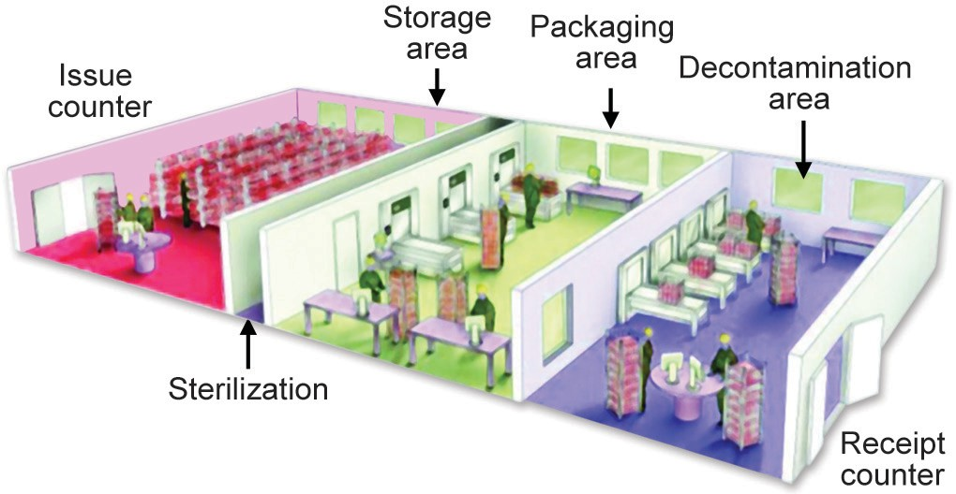
Central Sterile Supply Department (CSSD)
Decontamination area – washing by manual or automated washers
Packaging area –items are enclosed safely to allow penetration of sterilant
Sterilization area –steam sterilizer or ETO or plasma sterilizer
Sterile storage area

Slide 78
Factors Influencing Efficacy of Sterilant /
Disinfectant
Organism load: Larger microbial population requires a longer time to be destroyed.
Nature of organisms: decreasing order of resistance of microorganisms: Prions> bacterial spores > coccidian cyst> mycobacteria> non-enveloped viruses> fungi> vegetative bacteria> enveloped viruses

Slide 79
Concentration – optimal concentration is vital
Contact time –most crucial
Temperature, stability and relative humidity
Biofilm –prevents entry of disinfectant

Slide 80
STERILANTS
Property of an Ideal Sterilant/Disinfectant
Broader microbicidal activity
Fast acting
Not affected by environmental factors such as organic matter
Nontoxic
Compatible with surfaces /materials to which it is used
Odorless or pleasant odor
Economical and environmentally friendly.

Slide 81
Spaulding’s Classification of Medical Devices
Risk category | Definition | Recommended method | Medical equipment or surfaces
Critical device (high risk) | Items that enter a normally sterile site | Sterilization | Surgical instruments, implants/prosthesis, rigid endoscopes, syringes, needles
Semi-critical device (intermediate risk) | Items in contact with mucous membranes or body fluids | Disinfection (HLD) | Respiratory equipment, non-invasive flexible endoscopes, bedpans, urine bottles
Non-critical (low-risk) | Items in contact with intact skin | Disinfection (ILD or LLD) | Non-critical patient items Non-critical environmental surfaces

Slide 82
Steam Sterilizer (Autoclave)
Principle –Functions similar to pressure cooker.
Water boils when its vapor pressure equals that of the surrounding atmosphere.
When the atmospheric pressure is raised, the boiling temperature is also raised.
At normal pressure, water boils at 100°C but when pressure inside a closed vessel increases, the temperature at which water boils also increases.

Slide 83
Mechanism of action:
Moist heat destroys microorganisms by irreversible coagulation, denaturation of enzymes and structural proteins.

Slide 84
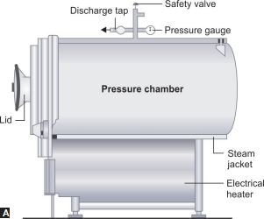
Components of Steam Sterilizer (Autoclave)
Pressure chamber – consists of large cylinder and steam jacket
Lid- bears discharge tap, pressure gauge and safety valve
Electrical heater.

Slide 85
Procedure:
Materials to be sterilized are placed inside the cylinder.
Steam jacket is filled with water, lid is closed & the electrical heater is put on.
Sterilization process can be divided into three phases:
  Conditioning phase- air is displaced by steam, at 15 pounds per sq inch, safety valve opens and excess steam escapes
  Exposure phase – holding period 15mins
  Exhaust phase –electric heater is switched off and allowed to cool

Slide 86
Sterilization Conditions
Cycle duration varies (3 to 18 min) depending on the sterilization temperature (121°C–135°C)
Most commonly used sterilization condition is 121°C for 15 min at pressure of 15 pounds (lbs) per square inch (psi).

Slide 87
Uses of Steam Sterilizer (Autoclave):
All critical and semi-critical items that are heat and moisture resistant (e.g. surgical instruments, anesthetic equipment, dental instruments etc)
Culture media preparation
Biomedical waste treatment of waste and sharps

Slide 88
Precautions:
It should not be used for sterilizing waterproof materials such as oil and grease or dry materials such as glove powder.
Chamber should not be overfilled
Separate steam sterilizers should be used for treatment of biomedical waste.

Slide 89
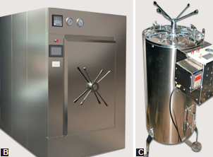
Steam Sterilizer (Autoclave)
Types of Steam Sterilizer :
Steam sterilizers are available in various sizes and dimensions.
  Horizontal type (large volume capacity)
  Vertical type (small volume capacity)

Slide 90
Advantages:
Low cost than ETO and plasma sterilizer
Sterilization cycles are fast compared to ETO
It is nontoxic and leaves no by-product behind (unlike ETO)

Slide 91
Disadvantages:
Heat can damage acrylics and styrene, PVC material and corrode some metals
Higher temperature for prolonged time can harm or shorten the life of instruments.
Moisture also can adversely affect electronics and can cloud the sensitive materials or leave water mark stains on them.

Slide 92
Sterilization Control :
Biological indicator: Spores of Geobacillus stearothermophilus are the best indicator (killed in 12 minutes at 121°C)
Chemical indicators: External pack control, e.g. autoclave tape; Bowie-Dick test and Internal pack control
Physical indicators: digital displays on the equipment displaying temperature, time and pressure.

Slide 93
Flash Sterilization
Modification of conventional steam sterilization, designed to be used at emergency or during unplanned procedures.
Involves fast sterilization (134°C for 3-10 minutes) of surgical instruments in an unwrapped condition in steam sterilizers located close to the operation theatre

Slide 94
This practice should only be restricted for emergency situations.
Not suitable for porous and cannulated instruments, implants and suction tubing
As the instruments are not packed, they remain wet following sterilization - there is a high-risk of recontamination.

Slide 95
Ethylene Oxide (ETO) Sterilizer
One of the widely used gaseous chemical sterilants in CSSD.
Mechanism of action:
Broad microbicidal action including spores; causes alkylation of cell components such as cell proteins, DNA and RNA

Slide 96
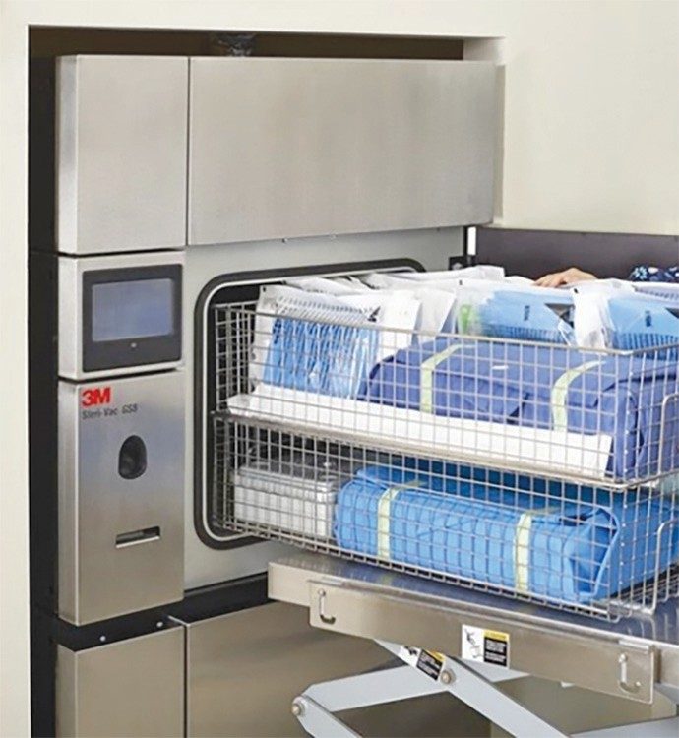
Sterilization cycle: Carried out in ethylene oxide sterilizer.
The process comprises of three stages:
Preconditioning- air is replaced by vacuum and physical conditions are set
Sterilization – ETO allowed in chamber (gas concentration, temperature, relative humidity and exposure time – crucial factors)
Aeration (Degassing) – Extensive aeration to remove residual ETO

Slide 97
Uses: Used by CSSD to sterilize critical items (and sometimes semi critical items) that are moisture or heat sensitive and cannot be sterilized by steam sterilization.
Examples include:
  Heart-lung machine components
  Sutures, catheters and stents
  Respirators and dental equipment
  Devices with electronic components

Slide 98
Advantages of ETO:
Large chamber capacity than plasma sterilization,
Suitable for heat sensitive items,
High penetration power- ETO is highly diffusible, penetrates areas that cannot be reached by steam,
Non-corrosive to plastic, metal and rubber materials

Slide 99
Disadvantages:
ETO is highly inflammable, irritant, explosive and carcinogenic,
ETO is usually supplied in a 10–20% concentration; mixed with inert gases like either CO2 ,
Long duration of cycle (12–14 hours),
High cost of instrument and consumables

Slide 100
Sterilization control:
Spores of Bacillus atrophaeus - biological indicator to check the effectiveness of sterilization.
Physical and chemical indicators are same as discussed for autoclave.

Slide 101
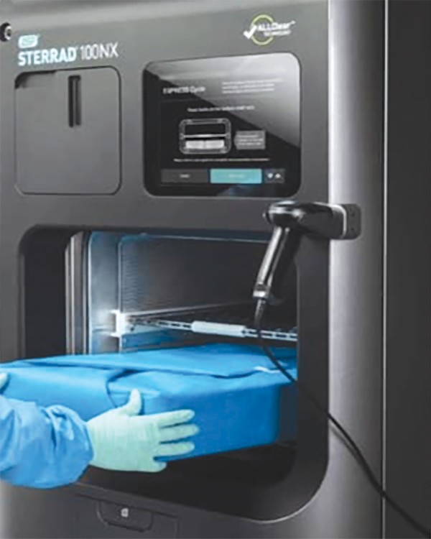
Plasma Sterilization
Refers to a gaseous state consisting of ions,
photons, free electrons and free radicals
(such as O and OH).
Plasma sterilizer is a special device used to
create the plasma state (commercial brands,
such as Sterrad).

Slide 102
Vacuum – chamber is evacuated and filled with vaccum
Chemical sterilant – chemical sterilant H2O2 is vaporized (50 mins); low temperature is maintained (37-44◦ C)
Gas plasma – electric field is applied to create gas plasma (OH- and HO2)
Last step – excess gas is removes. No aeration required as by-products are non-toxic
*Cycle duration: Cycle time of 75 min. The newer versions have shorter cycles 52 min and 24 min.

Slide 103
Sterilization control:
BI - Spores of Bacillus stearothermophilus
Physical and chemical indicators are the same as discussed for the autoclave.

Slide 104
Uses of Plasma Sterilizer:
Used by CSSD for sterilization of materials and devices that cannot tolerate high temperature and humidity of steam sterilizer – e.g. plastics, electrical devices, corrosion-susceptible metals such as arthroscope etc

Slide 105
Precautions/Disadvantages
Items should be totally dried before loading.
Linen or paper or cellulose or liquid cannot be processed
May not penetrate well, especially in channels or devices with long lumens.
Has small chamber, therefore cannot be used for bulk items
Expensive equipment and packing materials

Slide 106
Dry Heat Sterilizer (Hot Air Oven)
Used for materials that might be damaged by moist heat or that are impenetrable to moist heat (e.g., glass wares, powders, petroleum products, sharp instruments).

Slide 107
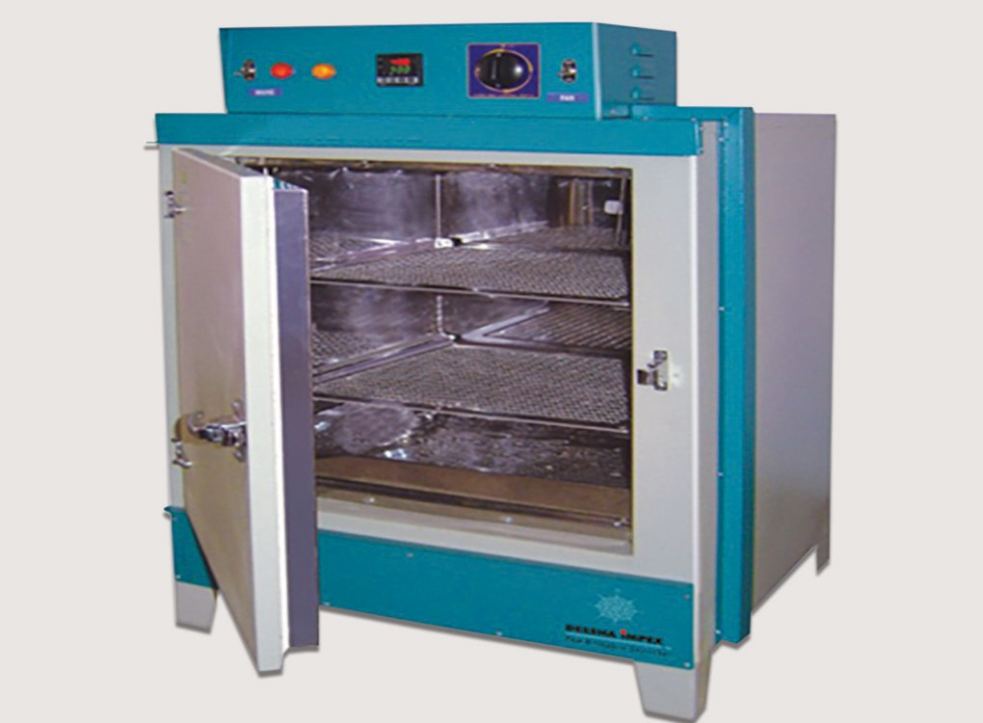
Procedure:
Has a sterilization chamber - electrically heated and has a fan or a motor to ensure adequate and even distribution of hot air in the chamber

Slide 108
Advantages:
It is nontoxic and does not harm environment
Low operating costs
Penetrates well into materials
Noncorrosive for metals.

Slide 109
Disadvantages:
High temperatures are not suitable for most materials.
Sterilization control:
BI - Spores of Bacillus atrophaeus

Slide 110
Filtration
Filtration acts by removing microorganisms, not by killing.
CDC considers filtration is a sterilization method, although some authors arguably disregard this as it does not kill the microorganisms, rather only filters them out.

Slide 111
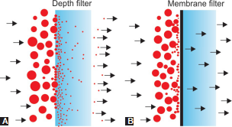
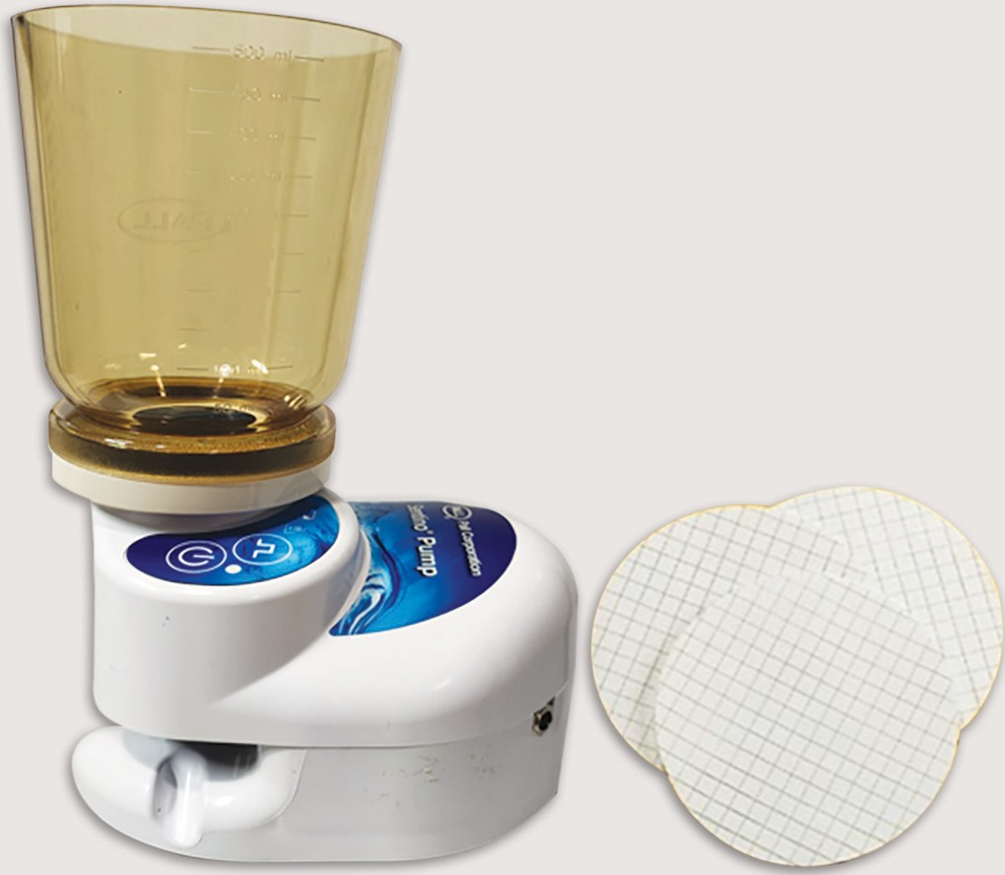
There are two types of filters:
  Depth Filters- used as drinking water purifiers
  Membrane filters – widely used in hospitals (bacterial filters – 0.22µm pore size)
Filter apparatus with membrane filter

Slide 112
Filtration of Air
Surgical (3-ply) mask and respirators
HEPA filters (High-efficiency particulate air filters) – removes 99.7% of particles that have size of 0.3µm or more
ULPA filters (Ultra-low particulate/ penetration air) – removes 99.999% of particles that have size of 0.12µm or larger

Slide 113
Filtration of Liquid
Used for bacteriological examination of water in hospital settings - dialysis water.
To remove bacteria from pharmaceutical fluids that are heat labile and cannot be purified by any other means.
Sterilization control of membrane filters -Brevundimonas diminuta and Serratia marcescens.

Slide 114
Radiation - Ionizing Radiation
Include cobalt 60 gamma rays or electron accelerators.
Use: Low-temperature sterilization method that has been used for a number of medical products (e.g., tissue for transplantation, pharmaceuticals, medical devices).
Mechanism: Causes ionization of the molecules in organisms leading to breakage of DNA

Slide 115
Advantages:
High penetrating power and rapidly acting
Temperature is not raised (cold sterilization)
Disadvantages:
High sterilization costs and
May have deleterious effects on equipment made up of polyethylene.
Sterilization control:
Efficacy of ionizing radiation - Bacillus pumilus.

Slide 116
Radiation - Non-ionizing Radiation
Infrared radiation technology - alternate method of sterilization for selected heat resistant instrument.
Ultraviolet radiation does not achieve sterilization, described under intermediate-level disinfectant.

Slide 117
Incineration
Used for the treatment of biomedical waste materials (for non-plastic infectious waste).
It burns (sterilizes) the waste and by providing a very high temperature 870–1,200°C and thereby converting the waste into ash, flue gas and heat.

Slide 118
Microwave
Used in hospitals for disinfection of soft contact lenses, dental instruments, dentures, and urinary catheters (for intermittent self-catheterization).
Mechanism of action:
Microwaves are radio-frequency waves - used at a frequency of 2450 MHz.
They produce friction of water molecules which generates heat.

Slide 119
Agents | Physical methods | Chemical methods
Disinfectants
High-level disinfectants | No physical methods in this category | Aldehydes- glutaraldehyde, orthophthaldehyde, formaldehyde Peracetic acid Hydrogen peroxide
Intermediate–level disinfectants | Heat-based methods: Pasteurization, boiling and steaming Ultraviolet (non-ionizing) radiation | Alcohols–ethyl alcohol and isopropyl alcohol Phenolics–phenol, cresol, lysol Halogens–iodine and chlorine
Low-level disinfectants | No physical methods in this category | Quaternary ammonium compound (QAC) Chlorhexidine

Slide 120
HIGH-LEVEL DISINFECTANT (HLD)
Capable of killing all microorganisms and bacterial spores when used in sufficient concentration under suitable conditions.

Slide 121
Aldehyde
Commonly used - Formaldehyde, glutaraldehyde and ortho-phthalaldehyde
MOA –Combine with nucleic acids, proteins and inactivate them, probably by cross-linking and alkylating the molecules.

Slide 122
Glutaraldehyde
Used for semicritical items (endoscope, cystoscope)
Also used for aerial disinfection and cleaning (fogging and cleaning of floor and surfaces of critical areas e.g., Bacillocid Extra)
Concentration - 2% or 2.4% (e.g. Cidex); available in inactive form and once activated - remains active only for 14 days.
Duration- 20 minutes (10–14 hrs for spores)

Slide 123
Advantages: Remains active in the presence of organic matter, has excellent material compatibility.
Disadvantages: Pungent odour, can produce eye irritation, occupational asthma and contact dermatitis.

Slide 124
Ortho-phthalaldehyde (0.55%)
Used for disinfection of semicritical items, has many advantages over glutaraldehyde—
  Does not require activation
  Better odor
  Less eye irritation
  Acts faster (5–10 min).
OPA does not kill spores effectively and stains skin gray.

Slide 125
Formaldehyde
Excellent HLD.
Health-care uses are limited:
  Irritating fumes and pungent odor.
  Potential carcinogen, corrosive (metals) and causes skin irritation and asthma (when inhaled).

Slide 126
Formaldehyde is largely restricted to non-patient care area only; used for—preservation of anatomical specimen and stool specimen and as an embalming agent.
Fumigation of closed areas(e.g.OT) is an obsolete practice.
Tablets and gaseous form of formaldehyde- used for sterilization of surgical instruments – is unreliable.

Slide 127
Peracetic Acid
Used in automated machines and for manual immersion(0.1–0.2%; 5–15 min)
Used to sterilize medical (e.g., endoscopes, arthroscopes), surgical, and dental instruments.
Disadvantages: Expensive, has material compatibility issues, causes chemical irritation and eye damage.

Slide 128
Hydrogen Peroxide (H2O2)
MOA- produces destructive hydroxyl free radicals that can attack various cell components.
H₂O₂can be degraded by catalase-producing organisms to water and oxygen, which can be overcome by using higher concentrations.

Slide 129
Uses- Sporicidal only at >4–5%.
3% H2O2 – Environmental surface disinfection, fogging & for wound cleaning
3–6% H2O2 – Disinfect soft contact lens, tonometer biprisms, ventilators, fabrics, and endoscopes, etc.
6–7.5% H2O2 - used as chemical sterilant in plasma sterilization
Vaporized H2O2 - Industrial sterilization of medical devices and for decontamination of large and small area.

Slide 130
Advantages:
It is rapid in action, nontoxic.
Has detergent properties with good cleaning ability.
Active in the presence of organic material.

Slide 131
Disadvantages:
Expensive
Material compatibility issue (contraindicated for use on Cu, brass, Zn2+ etc)
Can produce chemical irritation and corneal damage
Should be properly stored in dark containers

Slide 132
INTERMEDIATE-LEVEL DISINFECTANT
Alcohol
Ethyl alcohol and isopropyl alcohol - most popular alcohol used in hospitals.
Action: Rapidly bactericidal to most organisms except spores - act by denaturation of proteins.

Slide 133
Uses: Alcohol (60–80%) is used for various purposes.
  Alcohol based handrub (ABHR), e.g. Sterillium.
  Disinfecting smaller non-critical instruments e.g. thermometer
  Disinfection of small medical items/surfaces e.g. vaccine vials
  Disinfection of external surfaces of equipment e.g. stethecope
  Disinfection of non-critical surfaces e.g. lab bench area

Slide 134
Disadvantages:
Flammable and must be stored in a cool, well-ventilated area,
Evaporate rapidly
May damage tonometer tips and lenses,
Inactivated by organic matter

Slide 135
Phenolics
Phenol (carbolic acid) - first widely used antiseptic and disinfectant (Joseph Lister )
Phenol and its derivatives - produced by distillation of coal tar.
MOA: Act as protoplasmic poison, disrupt the cell wall and cell proteins

Slide 136
Used as disinfectants
Cresol & lysol - Disinfecting environmental surfaces (e.g., bedside tables, bedrails, and laboratory surfaces) and noncritical medical devices.
Toxic to skin - not used as antiseptics
5% phenol - Disinfection of sputum specimen (mycobactericidal)

Slide 137
Used as antiseptics
Chloroxylenol (active ingredient dettol) -Compatible with skin and are widely used as antiseptics.

Slide 138
Advantages: only ILD that retain activity in the presence of organic materials.
Disadvantages: can cause hyperbilirubinemia in infants

Slide 139
Halogens
Iodine and chlorine have antimicrobial activity.
Exist in free state, and form salt with sodium and other metals.

Slide 140
Iodine
MOA- acts by disruption of protein and nucleic acid.
Two preparations are available
  Tincture of iodine (2% iodine in potassium iodide)
  Iodophor (e.g. povidone iodine) - iodine with carrier (povidone) which helps in sustain release.
    Non staining and free of skin toxicity
    Brands- Wescodyne and betadine

Slide 141
Used as antiseptics:
5% topical solution and ointment for wound cleaning
7.5% is used for hand scrub
10% is used for surgical skin preparation
1% is used as oral antiseptic, for mouth wash
Used as disinfectant for medical equipment - hydrotherapy tanks.

Slide 142
Chlorine and Hypochlorite
MOA –All preparations yield hypochlorous acid (HClO) -causes oxidation of cellular materials and destruction of vegetative bacteria and fungi.
Preparations: Chlorine occurs as—
Free chlorine,
Hypochlorite—it is available in two preparations.
  Liquid form (sodium hypochlorite or household bleach)
  Powder form (calcium hypochlorite or bleaching powder)
  Other forms: sodium dichloroisocyanurate (NaDCC) tablets and chlorine dioxide

Slide 143
Uses (free chlorine):
Disinfection of municipal water supplies and swimming pool water.
Also employed in the dairy and food industries

Slide 144
Uses (sodium hypochlorite):
Available at 5.25– 6.15% - equivalent to 50,000 ppm of available chlorine.
It should be used in appropriate dilutions (by adding with water) for disinfection of various hospital supplies.
Contact time: 10-20 minutes.

Slide 145
Advantages:
Hypochlorites are broad spectrum (sporicidal)
Rapid in its action
Non-flammable
Low cost
Widely available.

Slide 146
Disadvantages:
Inactivated by organic matter
Toxic to skin and mucosa, & carcinogenic,
Daily preparation
Corrosive, damages fabrics, carpets,

Slide 147
Heat-based Methods
Pasteurization – Used for milk or juice preservation & in hospitals used to disinfect respiratory or anesthesia equipment (immersing in hot water 70° C, 30mins)
Boiling at 100°C – not suitable method of sterilization
Steaming at 100°C –used for heat sensitive items
Inspissation –To prepare egg based culture media

Slide 148
Ultraviolet (UV) Radiation
Non-ionizing radiation - emitted by the sun and artificial sources - mercury vapor bulbs.
MOA: Causes destruction of nucleic acid through induction of thymine dimers; bacteria and viruses more easily killed but not spores.

Slide 149
Uses:
Disinfection of drinking water, titanium implants and contact lenses.
Disinfection of air and/or surfaces - OT, isolation rooms, and lab BSC
Sun rays- disinfect organisms present on environmental surfaces.

Slide 150
Disadvantages:
Effectiveness is influenced by organic matter.
In isolation rooms, may cause skin erythema & keratoconjunctivitis in patients & visitors (hence UV lamps placed at least above 2-mts from floor level)

Slide 151
LOW-LEVEL DISINFECTANT
Destroy vegetative bacteria and enveloped viruses, variable action on non-enveloped viruses, and fungi, but no action on tubercle bacilli and spores.

Slide 152
Quaternary Ammonium Compound (QAC)
Commonly used in ordinary environmental sanitation of noncritical surfaces, such as floors, furniture's, and walls.
Disinfecting non-critical medical equipment (e.g., blood pressure cuffs).
QAC are also good cleaning agents as they have surfactant like action

Slide 153
MOA: Inactivation of energy producing enzymes, denaturation of essential cell proteins, and disruption of the cell membrane.
QAC formulations: Benzyl ammonium chloride - most popular QAC.
Does not act in the presence of hard water.
Newer generation of QACs (e.g. didecyl dimethyl ammonium bromide) -remain active in hard water and are better compatible.

Slide 154
Chlorhexidine Gluconate (CHG)
Biguanide disinfectant, acts by disruption of cytoplasmic membrane.
Uses: CHG is widely used in antiseptic products, at various concentrations:
  Hand hygiene product: Hand rub (0.5%), hand wash (4%)
  Mouthwash (0.1-0.2%)
  Body wash solutions (used before surgery)
  Skin disinfectant before surgery (2 %)

Slide 155
Advantages: Residual activity (prolonged action than alcohol hand rub) and is less irritant
Disadvantages: Slower in action, activity is pH dependent and is greatly reduced in the presence of organic matter, produces dermatitis on prolonged use as handrub.

Slide 156
CLEANING AGENT
Most disinfectants act well when instrument or surface - is free from organic matter
Therefore, cleaning is a very important step which need be performed before the disinfectants are applied.

Slide 157
An ideal cleaning agent should have the following properties:
  Easily emulsifiable
  Saponifiable
  Water softening
  Non-toxic
  Have surfactant like action.

Slide 158
Cleaning Products
Enzymatic (proteolytic) cleaners: Contain enzymes such as amylase, lipase, cellulase, protease which break down proteinaceous matter present on equipment.
Cleaning chemicals (detergents): Act by reducing surface tension and dissolving fat and organic matter.

Slide 159
Cleaning Methods
Manual cleaning
Automatic or mechanical cleaning (e.g. ultrasonic washers, washer disinfectors)– useful to clean hard-to reach parts of instruments

Slide 160
ENVIRONMENTAL CLEANING
(Housekeeping)
Environmental cleaning of floor and surface of hospitals play a vital role in controlling the spread of infections.

Slide 161
General principles of environmental cleaning are as follows:
  Cleaning followed by disinfection
  Cleaner to dirtier
  High to low
  Inward to outwards
  Frequency of cleaning depends up on: Probability of contamination , Vulnerability of population to infection, Frequency of hand contact

Slide 162
Frequency of cleaning for common situations:
Non-critical surfaces and floors - 2–3 times a day
Mattress used for patients - cleaned weekly and after discharge
Doors, windows, walls and ceiling - once a month and spot-cleaning when soiled
High touch areas - every 3–4 hours

Slide 163
Disinfection of Operation Theatre
Surface disinfection: Cleaning with a cleansing agent, followed by disinfection by using aldehyde-based disinfectant.
  First cleaning of the day (before cases begin)
  In between cases (cleaning 3 to 4 feet perimeter around the OT table)
  Terminal cleaning of OT after the last case
  Detailed wash-down of the OT complex once a week
  During renovation or construction of OT or nearby places

Slide 164
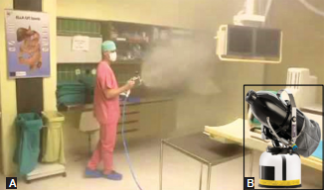
Disinfection of Operation Theatre
Fogging (aerial disinfection ):
Spraying of a disinfectant (e.g. glutaraldehyde,H2O2 or QAC based product) with the help of a fogger machine.
Fogging of operation theatre;
Fogger machine

Slide 165
METHODS TO TEST EFFICACY OF
STERILANT/DISINFECANT

Slide 166
Tests for Chemical Disinfectants
Chemical disinfectants used in hospitals and laboratories must be tested periodically to ascertain its potency and efficacy. Various methods are available:
  Rideal and Walker test or Phenol coefficient test
  Chick Martin test
  Capacity (Kelsey-Sykes) test
  In-use (Kelsey-Maurer) test

Slide 167
Tests for Sterilizers (Indicators)
Efficacy of sterilizers can be assessed by using:
  Physical indicators
  Chemical indicators
  biological indicators

Slide 168
Physical Indicator
Digital displays of the sterilizer equipment showing parameters such as:
  Temperature,
  Time,
  Pressure.

Slide 169
Chemical Indicator
They use heat or chemical sensitive materials which undergo a color change if the sterilization parameter (e.g., time, steam quality and temperature) for which it is issued is achieved.
Common types used are:
  Class I
  Class II
  Class IV and V

Slide 170

Chemical Indicator
A. Type-I (autoclave tape);
B. Type V (internal pack control indicator)

Slide 171
Biological Indicator (BI)
Most reliable indicator as it uses bacterial spores to check the effectiveness of sterilization.
Spores are highly resistant and will be destroyed only when the effective condition is achieved.
Geobacillus stearothermophilus for steam sterilizer, gas plasma (hydrogen peroxide) and liquid acetic acid sterilizer

Slide 172
Bacillus atrophaeus for ethylene oxide sterilizer and dry heat sterilizer (hot air oven).
Spore containing vials are incubated.
Depending upon the incubators used, the result is obtained in 24 min to 48 hrs time

Slide 173
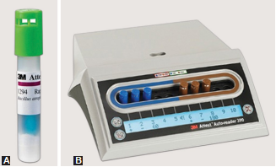
Biological Indicator (BI)
A. Vial; B. Incubator

Slide 174

THANK YOU

Slide 175
Environmental Surveillance

Slide 176
Learning objectives
At the end of the session, the students will be able to understand:
Water Surveillance
Air Surveillance
Surface Surveillance

Slide 177
INDICATIONS
Microbiological sampling of air, water, and inanimate surfaces (i.e., environmental sampling) is an expensive and time-consuming process.
Random, or periodic sampling is not recommended.

Slide 178
CDC recommends to perform targeted microbiological sampling of air, water and surfaces for defined indications:
  Outbreak investigation
  To evaluate the change in infection control practice
  Construction
  Research purpose

Slide 179
WATER SURVEILLANCE

Slide 180
Waterborne Pathogens
Hospital water and water-containing devices may serve as a reservoir of healthcare associated waterborne pathogens.
Microbial contamination of water in healthcare settings - two types:
  Category 1 (Enteric Pathogens)
  Category 2 (Common Hospital Pathogens)

Slide 181
Microbiological testing methods for water analysis
Bacteriological examination | Indications
Multiple-tube method | Extensively used for drinking water analysis For highly turbid samples
Membrane filtration method | For testing dialysis water For testing clean water, where the bacterial count in water is expected to be low For testing large volume of water
Presence/absence method | To monitor quality of drinking water where contamination is likely to be rare

Slide 182
Test for Drinking Water Contaminated with Enteric Pathogens
Hospital water supplies should be regularly tested to confirm that they are free from contamination.
However, it is impracticable to attempt directly to detect the presence of all types of enteric pathogen in water - they are usually present in minute quantity; such as Shigella, Salmonella, etc.

Slide 183
Instead, it is wise to test the water supplies for those microorganisms which indicate that fecal contamination has taken place.
These organisms are called as indicator organisms

Slide 184
Indicator organisms of fecal pollution of water
Indicator organisms | Interpretation
 | Presence in water indicates:
Coliform (other than Escherichia coli)) | Remote contamination—either by fecal (presumptive) or soil and vegetation
Fecal (thermotolerant) Escherichia coli | Confirms recent fecal contamination of water; most sensitive indicator
Fecal streptococci | Confirms remote fecal pollution
Clostridium perfringens | Remote contamination
Pseudomonas aeruginosa | Least reliable indicator , Useful in hospitals and food establishments
Bacteriophages | Phage specific for E.coli—indicate fecal pollution of water Indirectly indicates viral pollution

Slide 185
Indicator Organisms
They should be present in excess number than any pathogen so that they can be detected easily.
They should not be able to proliferate in water to any extent.
They should be more resistant than the pathogens to the stresses of aquatic environment and disinfection processes.

Slide 186
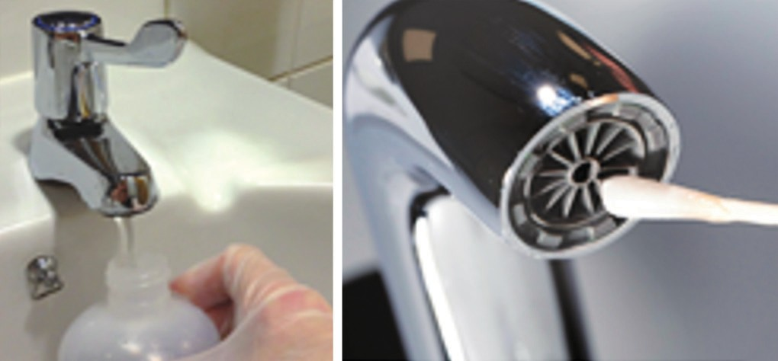
Collection and Transport of Water Sample
Collected in a screw-capped wide sterile container.
Volume: At least 150–200 mL of water should be collected.
Neutralizer: Sodium thiosulfate
Water sampling methods

Slide 187
Multiple-tube Method
Most common method used for water surveillance.
So named as it involves mixing of specific volume of water samples to multiple tubes containing MacConkey purple broth.

Slide 188
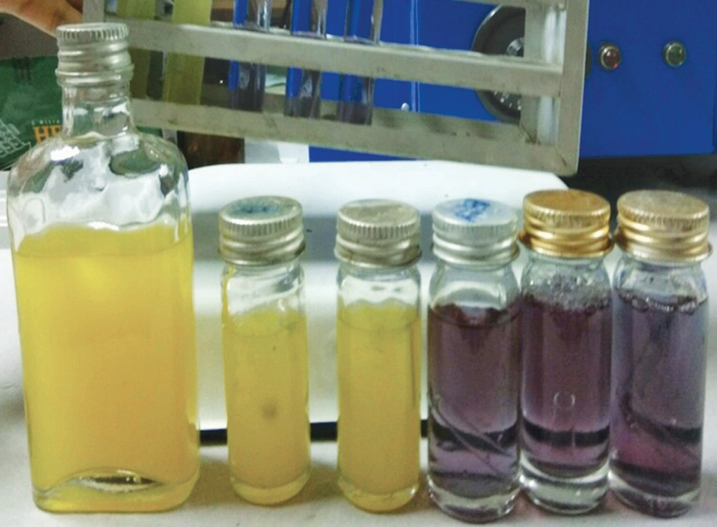
Multiple-tube Method
MacConkey purple broth for multiple tube method (one 50 mL and five 10 mL) tubes are necessary for testing unpolluted water; if negative, media appears purple, if positive, media turn yellow

Slide 189
Determination of MPN: The number of tubes giving positive reaction is compared with McCrady statistical table to determine the MPN/ 100 mL of water.
This is called as presumptive coliform count.

Slide 190
MPN values per 100 mL of sample for non-polluted/treated water samples (McCrady statistical table)
No. of tubes giving a positive reaction out of |  | MPN per 100 mL of water
1 of 50 mL | 5 of 10 mL
0 | 0 | <1
0 | 1 | 1
0 | 2 | 2
0 | 3 | 4
1 | 1 | 3
1 | 2 | 6
1 | 3 | 9
1 | 4 | 16
1 | 5 | >18

Slide 191
Classification of quality of drinking water supply
Quality of drinking water supply | Most probable number (MPN)/100 mL of water
 | Coliform count/100 mL | Thermotolerant E. coli count/100 mL
Excellent | 0 | 0
Satisfactory | 1 – 3 | 0
Intermediate | 4 – 9 | 0
Unsatisfactory | ≥10 | ≥1

Slide 192
Differential Coliform Count (Eijkman Test)
Done to confirm that the coliform bacilli detected in the presumptive test are fecal E.coli.
This is done by:
  Sub culturing - positive tubes on lactose containing medium such as brilliant green bile broth - detection of lactose fermentation with production of acid and gas at 440C and
  Demonstrating positive indole test at 44⁰C

Slide 193
Membrane Filtration Method
Filtration of a known volume (e.g. 100 mL) of water through a cellulose membrane of pore size 0.2 or 0.45 µm.
Procedure: The bacteria retained on the surface of the membrane filter are transferred into a petri dish containing suitable medium (e.g. membrane lauryl sulphate broth) and incubated

Slide 194
Result: Characteristic yellow colonies of coliforms develop, which can be counted directly to obtain CFU/100 mL of water.
Confirmation: The colonies are further processed for detection of lactose fermentation with production of acid and gas at 44°C to check for thermotolerant E. coli

Slide 195
Advantages: Membrane filtration is the recommended method for—
Testing dialysis water,
Testing clean water (bacterial count is expected to be low)
Testing large volume of water

Slide 196
Disadvantages:
Not suitable for turbid water.
Expensive than multiple tube method.

Slide 197
Presence Absence Method
Qualitative method, detects just the presence or absence of the organism in water.
Method: Various commercial kits are available such as Manjas method where H₂S coated strips used for detection of Salmonella in water.

Slide 198
Test for Water Contaminated with Healthcare Associated Pathogens
Most HAI pathogens are recovered by membrane filtration method→ followed by plating on to a suitable culture medium(e.g. Legionella, BCYE)

Slide 199
Endotoxin Detection
Endotoxins are the component of the cell wall of GNB.
Dialysis water, devices, etc. contaminated with endotoxin can elicit a variety of inflammatory responses in our body and thereby cause serious toxic effects.
Dialysis water used for hemodialysis –tested for presence of endotoxin.

Slide 200
Methods: Three methods are available:
  Gel clot assay (Limulus amebocyte lysate assay)
  Turbidimetric method
  Chromogenic technique
  Permissive level: Water used to prepare dialysate and to reprocess hemodialyzers should contain endotoxin unit <0.25 EU/mL

Slide 201
AIR SURVEILLANCE

Slide 202
Indication (CDC Recommendation)
Investigation of an outbreak
For research purpose
After reconstruction or newly constructed buildings
After fogging (to monitor the quality)
For short-term evaluation of a change in infection control practice.

Slide 203
Evaluation of the Quality of Air in OT
Microbiological Parameters:
  Passive Monitoring (Settle Plate) Method - 1,1,1 method
  Active Monitoring (Slit Sampler Method)
  Air Particle Counters
Non-microbiological Parameters

Slide 204
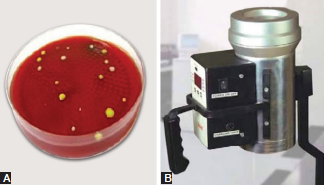
Evaluation of the Quality of Air in OT
Settle plate method showing blood agar with settled particles containing bacterial colonies;
Air sampler (HiMedia)

Slide 205
Properties | Recommendations
Air changes per hour | Minimum 20 numbers of air changes per hour; out of which four should be fresh air
Air velocity | 25–35 FPM (feet per minute) It is checked by anemometer Airflow direction should be unidirectional and downward from OT table
Positive pressure (PP) | Difference in positive pressure between OT and adjoining areas is required to prevent outside air entry into OT PP should be maintained in OT at all times (operational and non-operational hours) Minimum PP of 2.5 Pascal is recommended
Temperature | 21 +/– 3°C (general OT) (orthopedic theaters, 18°C +/– 2°C)
Relative humidity | 20 to 60% (ideal 55%)

Slide 206
Properties | Recommendations
Air handling in the OT | There should be dedicated AHU (air handling unit) for each OT and should not be linked to air conditioning of any other area/OT Window and split AC should never be used in OT as they are pure recirculating units and have pockets for microbial growth Air is supplied through terminal HEPA filters in the ceiling The minimum size of the filtration area should extend one feet on each side of the OT table to cover the entire OT table and surgical team Validation of HEPA filters is done biannually by DOP test. Air quality at the supply should be ISO Class 5 (at rest condition) for super specialty OT ISO Class 6 ( at rest condition) for general OT

Slide 207
Properties | Recommendations
Wall, floor and ceiling | Should be anti-static and made up of non-porous, smooth, seamless materials Paints used should have antibacterial, anti-fungal property
Occupancy | Maximum occupancy of 5–8 persons at any time inside the OT is allowed

Slide 208

THANK YOU

Slide 209
Environmental Surveillance

Slide 210
Learning objectives
At the end of the session, the students will be able to understand:
Water Surveillance
Air Surveillance
Surface Surveillance

Slide 211
INDICATIONS
Microbiological sampling of air, water, and inanimate surfaces (i.e., environmental sampling) is an expensive and time-consuming process.
Random, or periodic sampling is not recommended.

Slide 212
CDC recommends to perform targeted microbiological sampling of air, water and surfaces for defined indications:
  Outbreak investigation
  To evaluate the change in infection control practice
  Construction
  Research purpose

Slide 213
WATER SURVEILLANCE
Wholesome water” refers to the water that is fit to use for drinking, cooking, food preparation or washing without any potential danger to human health. Drinking water should have the following three properties to be labeled as wholesome water:
Biological quality: It should be free from potentially pathogenic microorganisms
Chemical quality: It should be free from harmful chemical substances such as metals, solvents, pesticides and hydrocarbons.
Physical quality: It should have pleasant taste, color and odor.

Slide 214
Waterborne Pathogens
Hospital water and water-containing devices may serve as a reservoir of healthcare associated waterborne pathogens.
Microbial contamination of water in healthcare settings - two types:
  Category 1 (Enteric Pathogens)
  Category 2 (Common Hospital Pathogens)

Slide 215
Microbiological testing methods for water analysis
Bacteriological examination | Indications
Multiple-tube method | Extensively used for drinking water analysis For highly turbid samples
Membrane filtration method | For testing dialysis water For testing clean water, where the bacterial count in water is expected to be low For testing large volume of water
Presence/absence method | To monitor quality of drinking water where contamination is likely to be rare

Slide 216
Test for Drinking Water Contaminated with Enteric Pathogens
Hospital water supplies should be regularly tested to confirm that they are free from contamination.
However, it is impracticable to attempt directly to detect the presence of all types of enteric pathogen in water - they are usually present in minute quantity; such as Shigella, Salmonella, etc.

Slide 217
Instead, it is wise to test the water supplies for those microorganisms which indicate that fecal contamination has taken place.
These organisms are called as indicator organisms

Slide 218
Indicator organisms of fecal pollution of water
Indicator organisms | Interpretation
 | Presence in water indicates:
Coliform (other than Escherichia coli)) | Remote contamination—either by fecal (presumptive) or soil and vegetation
Fecal (thermotolerant) Escherichia coli | Confirms recent fecal contamination of water; most sensitive indicator
Fecal streptococci | Confirms remote fecal pollution
Clostridium perfringens | Remote contamination
Pseudomonas aeruginosa | Least reliable indicator , Useful in hospitals and food establishments
Bacteriophages | Phage specific for E.coli—indicate fecal pollution of water Indirectly indicates viral pollution

Slide 219
Indicator Organisms
They should be present in excess number than any pathogen so that they can be detected easily.
They should not be able to proliferate in water to any extent.
They should be more resistant than the pathogens to the stresses of aquatic environment and disinfection processes.

Slide 220
Collection and Transport of Water Sample
Collected in a screw-capped wide sterile container.
Volume: At least 150–200 mL of water should be collected.
Neutralizer: Sodium thiosulfate
Water sampling methods

Slide 221
Multiple-tube Method
Most common method used for water surveillance.
So named as it involves mixing of specific volume of water samples to multiple tubes containing MacConkey purple broth.

Slide 222
MacConkey purple broth for multiple tube method (one 50 mL and five 10 mL) tubes are necessary for testing unpolluted water; if negative, media appears purple, if positive, media turn yellow

Slide 223
Determination of MPN: The number of tubes giving positive reaction is compared with McCrady statistical table to determine the MPN/ 100 mL of water.
This is called as presumptive coliform count.

Slide 224
MPN values per 100 mL of sample for non-polluted/treated water samples (McCrady statistical table)
No. of tubes giving a positive reaction out of |  | MPN per 100 mL of water
1 of 50 mL | 5 of 10 mL
0 | 0 | <1
0 | 1 | 1
0 | 2 | 2
0 | 3 | 4
1 | 1 | 3
1 | 2 | 6
1 | 3 | 9
1 | 4 | 16
1 | 5 | >18

Slide 225
Classification of quality of drinking water supply
Quality of drinking water supply | Most probable number (MPN)/100 mL of water
 | Coliform count/100 mL | Thermotolerant E. coli count/100 mL
Excellent | 0 | 0
Satisfactory | 1 – 3 | 0
Intermediate | 4 – 9 | 0
Unsatisfactory | ≥10 | ≥1

Slide 226
Differential Coliform Count (Eijkman Test)
Done to confirm that the coliform bacilli detected in the presumptive test are fecal E.coli.
This is done by:
  Sub culturing - positive tubes on lactose containing medium such as brilliant green bile broth - detection of lactose fermentation with production of acid and gas at 440C and
  Demonstrating positive indole test at 440C

Slide 227
Membrane Filtration Method
Filtration of a known volume (e.g. 100 mL) of water through a cellulose membrane of pore size 0.2 or 0.45 µm.
Procedure: The bacteria retained on the surface of the membrane filter are transferred into a petri dish containing suitable medium (e.g. membrane lauryl sulphate broth) and incubated

Slide 228
Result: Characteristic yellow colonies of coliforms develop, which can be counted directly to obtain CFU/100 mL of water.
Confirmation: The colonies are further processed for detection of lactose fermentation with production of acid and gas at 44°C to check for thermotolerant E. coli

Slide 229
Advantages: Membrane filtration is the recommended method for—
Testing dialysis water,
Testing clean water (bacterial count is expected to be low)
Testing large volume of water
Disadvantages:
Not suitable for turbid water.
Expensive than multiple tube method.

Slide 230
Presence Absence Method
Qualitative method, detects just the presence or absence of the organism in water.
Method: Various commercial kits are available such as Manjas method where H2S coated strips used for detection of Salmonella in water.

Slide 231
Test for Water Contaminated with Healthcare Associated Pathogens
Most HAI pathogens are recovered by membrane filtration method→ followed by plating on to a suitable culture medium(e.g. Legionella, BCYE)

Slide 232
Endotoxin Detection
Endotoxins are the component of the cell wall of GNB.
Dialysis water, devices, etc. contaminated with endotoxin can elicit a variety of inflammatory responses in our body and thereby cause serious toxic effects.
Dialysis water used for hemodialysis –tested for presence of endotoxin.

Slide 233
Methods: Three methods are available:
  Gel clot assay (Limulus amebocyte lysate assay)
  Turbidimetric method
  Chromogenic technique
  Permissive level: Water used to prepare dialysate and to reprocess hemodialyzers should contain endotoxin unit <0.25 EU/mL

Slide 234
AIR
SURVEILLANCE

Slide 235
Indication (CDC Recommendation)
Investigation of an outbreak
For research purpose
After reconstruction or newly constructed buildings
After fogging (to monitor the quality)
For short-term evaluation of a change in infection control practice.

Slide 236
Evaluation of the Quality of Air in OT
Microbiological Parameters:
  Passive Monitoring (Settle Plate) Method - 1,1,1 method
  Active Monitoring (Slit Sampler Method)
  Air Particle Counters
Non-microbiological Parameters

Slide 237
Settle plate method showing blood agar with settled particles containing bacterial colonies;
Air sampler (HiMedia)

Slide 238
Quality of air in OT (non-microbiological parameters)
Properties | Recommendations
Air changes per hour | Minimum 20 numbers of air changes per hour; out of which four should be fresh air
Air velocity | 25–35 FPM (feet per minute) It is checked by anemometer Airflow direction should be unidirectional and downward from OT table
Positive pressure (PP) | Difference in positive pressure between OT and adjoining areas is required to prevent outside air entry into OT PP should be maintained in OT at all times (operational and non-operational hours) Minimum PP of 2.5 Pascal is recommended
Temperature | 21 +/– 3°C (general OT) (orthopedic theaters, 18°C +/– 2°C)
Relative humidity | 20 to 60% (ideal 55%)

Slide 239
Quality of air in OT (non-microbiological parameters)
Properties | Recommendations
Air handling in the OT | There should be dedicated AHU (air handling unit) for each OT and should not be linked to air conditioning of any other area/OT Window and split AC should never be used in OT as they are pure recirculating units and have pockets for microbial growth Air is supplied through terminal HEPA filters in the ceiling The minimum size of the filtration area should extend one feet on each side of the OT table to cover the entire OT table and surgical team Validation of HEPA filters is done biannually by DOP test. Air quality at the supply should be ISO Class 5 (at rest condition) for super specialty OT ISO Class 6 ( at rest condition) for general OT

Slide 240
Quality of air in OT (non-microbiological parameters)
Properties | Recommendations
Wall, floor and ceiling | Should be anti-static and made up of non-porous, smooth, seamless materials Paints used should have antibacterial, anti-fungal property
Occupancy | Maximum occupancy of 5–8 persons at any time inside the OT is allowed

Slide 241
SURFACE
SURVEILLANCE

Slide 242
SURFACE SURVEILLANCE
Environmental surface sampling has been used to determine
  (a) reservoirs of potential environmental pathogens,
  (b) survival of microorganisms on surfaces, and
  (c) the sources of the environmental contamination

Slide 243
Locations: It is required for high risk locations such as operation theatres and ICU settings.
Sites for sampling (high touch areas)
Indications (CDC recommendation)- Indicated for research, as a part of an epidemiologic investigation, or during an outbreak investigation.
  Routine periodic surface surveillance is not recommended.

Slide 244
Method: Moistened sterile swabs (soaked in sterile saline) are used to take the samples from high risk areas as mentioned above and then inoculated on to non-selective, nutrient-rich agar (e.g. blood agar) for the recovery of aerobic bacteria.

Slide 245
Reporting: Only pathogenic organisms isolated are reported.
Newer techniques such as luminometer (expresses bacterial contamination as CFU/ml) and glow gel techniques are available which are easy to perform though expensive.

Slide 246
Antimicrobial Stewardship
Dr. Ved Prakash
Professor & Head
PG Department of Microbiology

Slide 247
Learning objectives
At the end of the session, the students will be able to understand:
Implementation of Antimicrobial Stewardship Program
Monitoring the Compliance to Antimicrobial Stewardship Program
Rational Use of Antimicrobial Agents
Hospital Antibiogram

Slide 248
Introduction
Antimicrobial stewardship program (AMSP) provides strategies for rationalizing the use of antimicrobials in the hospital.

Slide 249
Definition
CDC has defined “Antimicrobial stewardship” as-
The right antibiotic
for the right patient,
at the right time,
with the right dose, and
the right route, causing
the least harm to the patient and future patients

Slide 250
Why AMSP is Needed?
Antimicrobial Resistance (AMR)
Misuse and Over-use of Antimicrobials
Widespread Use of Antimicrobials in Other Sectors
Poor Antimicrobial Research

Slide 251
IMPLEMENTATION OF ANTIMICROBIAL
STEWARDSHIP PROGRAM
Administrative Support (Leadership)
Formulating AMS Team
Infrastructure Support
Framing Antimicrobial Policy
Implementing AMS strategies
Education and Training

Slide 252
Administrative Support (Leadership)
Should be publicly committed to the program.
Provide necessary funding and infrastructure support.

Slide 253
Formulating AMS Team
Multidisciplinary committee - responsible for framing, implementing and monitoring the compliance to antimicrobial policy of the hospital.
Led by the antimicrobial steward - infectious disease physician or infection control officer or clinical microbiologist.
Other members of AMS team - stewardship nurses, clinical pharmacists and officer in-charge of pharmacy.

Slide 254
Infrastructure Support
Support from Microbiology laboratory
Automations:
  Automated culture (e.g. BACTEC or BacT/ALERT),
  Automated identification (MALDI-TOF)
  Automated sensitivity (e.g. VITEK)
Biomarkers: Procalcitonin and CRP
Rapid Molecular tests
Emergency lab

Slide 255
Other supports
Hospital information System (HIS)
Supporting manpower availability

Slide 256
Framing Antimicrobial Policy
Pocket hand book
Prepared by AMS team
Compliant to the standard national and international antibiotic guidelines and local antibiogram pattern.

Slide 257
Implementing AMS strategies
Two types of strategy are available for implanting AMSP.
  Front end strategies (formulary restriction)
  Back end strategies (prospective audit and feedback)

Slide 258
Proposed formulary restriction
Restricted antimicrobials | Semi restricted antimicrobials | Unrestricted antimicrobials
Pharmacy supply of >1 days requires prior approval by AMS team | Pharmacy supply of >3 days requires prior approval by AMS team | Pharmacy supply does not require AMS team approval.
Colistin Carbapenem Tigecycline | Teicoplanin, Vancomycin, Daptomycin, Linezolid, Third and fourth generation cephalosporins | First & second generation cephalosporins, Cotrimoxazole, Azithromycin, Clarithromycin, Fluoroquinolones

Slide 259
Back end strategies (prospective audit and feedback)
Difficult to perform, but it is the most effective strategy to implement AMSP.
The AMS team goes for stewardship round during which they discuss with the clinical team in detail about the compliance to the antimicrobial policy.
Mutually agreed upon constructive discussion between AMS team and clinical team.

Slide 260
More labor-intensive.
More widely practiced
More easily accepted by clinicians
Provides a higher opportunity for educating and training the health care professionals
Impact is delayed but sustainable

Slide 261
Education and Training
Continuous education, training, motivation and assessment of the health care providers.

Slide 262
MONITORING THE COMPLIANCE TO
ANTIMICROBIAL STEWARDSHIP PROGRAM
Policy adherence (process indicator)
  Indicators of prescription and administrative compliance
Antibiotic Usage outcome indicator
  DDDs (Daily Defined Dose) /100 bed days
  Days of Therapy/100 bed days
Antimicrobial resistance outcome indicator- analysed by AMR surveillance
Clinical outcome indicators - Morbidity and Mortality
Financial outcome indicators

Slide 263
Indicators of prescription compliance
Percentage of time the empirical antibiotic given, is according to the infective syndrome suspected.
Percentage of time the empirical antibiotic is modified to according to antimicrobial susceptibility report.
Percentage of time cultures are taken before the start of antibiotics.
Percentage of time the choice of SAP given is according to the policy.

Slide 264
Indicators of administrative compliance
Percentage of time the antibiotic is administrated in correct dose, correct frequency, correct route (IV, oral or infusion)
Percentage of time the surgical antimicrobial prophylaxis is administrated in correct dose, correct time and frequency

Slide 265
Calculation of DDDs
No. of DDDs = Therapeutic dose (No. of tablets/vials used * gm per tablet/vials)
WHO
defined DDD of the antimicrobial agent
Example
Levofloxacin is administered as 750 mg PO daily for 7 days. The WHO assigned DDD for levofloxacin is 0.5 g.
Therefore the number of DDD is calculated as:
= (0.75 g dose × 7 days/0.5 g DDD) = 10.5 DDDs

Slide 266
Days of Therapy (DOT)
DOT of an antibiotic is the number of days that patient receives at least one dose of that antibiotic.
Examples include:
-A patient has received meropenem 1 g, twice daily for 3 days; the DOT is 3
-A patient has received meropenem 0.5 g, thrice daily for 3 days; the DOT is 3
-A patient has received meropenem 1 g, twice daily and vancomycin 1g thrice daily for 3 days;
the DOT is 3+3=6

Slide 267
RATIONAL USE OF ANTIMICROBIAL AGENTS
Prescribe Only when Indicated
  Conditions where antibiotics are not required – Diarrhea, URTI, when alternative diagnosis like dengue or chikungunya is suspected, as routine antibiotic prophylaxis
Culture of Cultures
  Antibiotics should be initiated only after sending site-specific cultures

Slide 268
Empirical vs Targeted Therapy
  Empirical therapy – should be based on three important elements.
    Infective syndrome likely to be present
    Common etiological bacterial agents for that infective syndrome
    Local antibiogram for those organisms, indicating the AMR pattern.
  Targeted or pathogen-directed therapy: Empirical therapy should be modified subsequently, based on AST report (escalation or de-escalation)

Slide 269
Escalation vs De-escalation Approach
  For example; In hospital X, the antibiotics given for GNB such as E. coli are ranked according to decreasing order of susceptibility: colistin (rank-1) → tigecycline → carbapenems → piperacillin-tazobactam → cefoperazone sulbactam → amikacin → cefepime → ceftazidime → cotrimoxazole → ceftazidime → ciprofloxacin → ceftriaxone (lowest rank).
  Escalation Approach
  De-escalation Approach

Slide 270
Site-specific Antimicrobials:
  Lungs: Daptomycin is not active at respiratory site(inactivated by surfactants)
  CSF: Any oral antibiotic, 1st & 2nd gen cephalosporins, tetracyclines, macrolides, quinolones and clindamycin are not active in CSF
  Urine: Antibiotics such as chloramphenicol, macrolide and clindamycin should be avoided in UTI; as they do not achieve adequate urinary concentrations

Slide 271
Avoid Administration Errors- Antimicrobials should be administrated - correct dose (as per the age/body weight), and frequency and duration of therapy.
Loading dose: Concentration dependent- aminoglycoside, vancomycin and colistin
Infusion: Vancomycin - better when mixed with saline and given as an IV infusion
Renal adjustment: Dosage of the nephrotoxic drugs - aminoglycoside, vancomycin, and colistin - adjusted according to the creatinine clearance.

Slide 272
MIC-guided Therapy
AST - performed by DD or by MIC - latter more accurate and reliable.
Certain situations - antibiotic treatment is MIC-guided.
  Clinical conditions - endocarditis, pneumococcal meningitis/pneumonia
  Vancomycin for S. aureus: Vancomycin – avoided if MIC is >1 μg/mL.

Slide 273
MIC helps to select the most appropriate antibiotic:
  Lower - MIC, better - therapeutic efficacy.
  If >1 antimicrobial agents – susceptible - antibiotic having lowest MIC (when compared with the susceptibility breakpoint) - chosen for therapy.
  Better guided by calculating the therapeutic index.

Slide 274
Therapeutic index
Ratio of susceptibility breakpoint divided by MIC of the test isolate.
Therapeutic index= Susceptible breakpoint/Test MIC
Higher the therapeutic index, better is the efficacy of the antimicrobial agent.

Slide 275
Therapeutic index
For example, if a clinical isolate of E.coli is susceptible to both meropenem (MIC 1 μg/ml) and amikacin (MIC 8 μg/ml), then meropenem falsely appears to be more efficacious as its absolute MIC value is lower than amikacin.
However, the MIC value compared with the standard susceptibility breakpoint (and not the absolute MIC value) determines therapeutic efficacy.

Slide 276
Therapeutic index
Susceptible breakpoints of meropenem and amikacin for E.coli are 1 μg/mL and 16 μg/mL respectively, according to CLSI guideline 2020.
The therapeutic index is calculated as:
  Therapeutic index of meropenem= 1/1=1
  Therapeutic index of meropenem= 16/8=2
  Therefore, in this case amikacin is superior to meropenem.

Slide 277
Therapeutic Drug Monitoring
Therapeutic efficacy - not only relies on in vitro susceptibility result (MIC), but also dependent on in vivo activity - in turn dependent on PK/PD parameters of the antimicrobial agent.
Therapeutic drug monitoring - necessary to find out how the drug behaves in vivo - important for antibiotic - vancomycin, amikacin and colistin.

Slide 278
Depending up on PK/PD parameters, antibiotics are classified as:
  Concentration dependent antibiotics, e.g. aminoglycosides (better if the drug concentration in serum is much higher than the MIC of the drug)
  Time-dependent antibiotics, e.g. beta-lactams: Efficacy of the drug is dependent upon how much time the drug concentration remains higher than the MIC. Given in frequent intervals (e.g. thrice daily)

Slide 279
Timely Stoppage of Antimicrobial- stopped at appropriate time - determined by clinical improvement or after obtaining negative culture or by use of biomarkers.

Slide 280
Biomarkers - procalcitonin (PCT) or C-reactive protein (CRP) - used for predicting bacterial infection.
PCT is more reliable marker than CRP.

Slide 281
Procalcitonin (PCT)
Peptide precursor of the hormone calcitonin, secreted at very low level (<0.05 ng/mL) normally by the body, but the level goes up by manifolds in bacterial infection.

Slide 282
Applications of PCT
Differentiate bacterial vs viral infection
Predicting bacterial infections such as local or systemic infection
  0.05–2.0 ng/mL indicates possible local infection
  2-10 ng/mL indicates systemic infection
  >10 ng/mL indicates septic shock
Helps to decide whether to continue antibiotics in culture negative cases and to stop antibiotics
Severity

Slide 283
Avoid overlapping spectra
  Meropenem and piptaz combination therapy for double GN coverage - avoided as both these drugs belong to beta-lactam group of antimicrobials

Slide 284
Redundant antibiotic
  Meropenem and metronidazole combination therapy for suspected GN/ anaerobic sepsis - avoided as meropenem is active against anaerobes in addition to gram-negative bacteria.
  Metronidazole can be withdrawn from therapy

Slide 285
Ineffective antibiotic: Cloxacillin in MRSA is ineffective and therefore should be avoided. Vancomycin is the drug of choice for MRSA
Inferior antibiotic: Vancomycin is an inferior cell wall acting agent compared to cloxacillin for MSSA infection.

Slide 286
HOSPITAL ANTIBIOGRAM
Overall profile of antimicrobial susceptibility testing results of a specific microorganism to a battery of antimicrobial agents.
Responsibility of the department of Microbiology to construct ahospital antibiogram and share it with clinicians

Slide 287
HOSPITAL ANTIBIOGRAM - USES
Guide the clinicians in selecting the best empirical antimicrobial treatment in the event of pending microbiology culture and susceptibility results.
Detecting and monitoring trends in antimicrobial resistance within the hospital
Compare susceptibility rates across institutions and track resistance trends and thereby contributing to national AMR surveillance database.

Slide 288
Hospital antibiogram of gram-negative bacteria for the year 2020, expressed in terms of susceptibility rate
 | Ciprofloxacin | Amikacin | Ceftazidime | Piperacillin- tazobactam | Meropenem | Colistin
E. coli | 25 | 85 | 55 | 75 | 82 | 99
Klebsiella | 15 | 75 | 35 | 65 | 70 | 85
Pseudomonas | 32 | 80 | 60 | 80 | 80 | 99
Acinetobacter | 29 | 70 | 10 | 18 | 20 | 99

Slide 289

THANK YOU

