Slide 1
Lymphatic Filariasis
Dr. Ved Prakash
Professor & Head
PG Department of Microbiology

Slide 2
Learning objectives
At the end of the session, the students will be able to understand:
Epidemiology, life cycle, pathogenesis, clinical manifestations, laboratory diagnosis and treatment of Wuchereria bancrofti, Brugia malayi and B. timori.
Differences between various filarial nematodes causing lymphatic filariasis

Slide 3
FILARIAL NEMATODE
Filarial nematodes - vector-borne parasites - reside in the lymphatic system, skin, subcutaneous tissue and rarely in body cavities and accordingly they cause various types of clinical manifestations in man.

Slide 4
Classification of Filarial Worm Based on Location in Body
Lymphatic filariasis | Subcutaneous filariasis | Serous cavity filariasis
Wuchereria bancrofti | Loa loa | Mansonella perstans
Brugia malayi | Onchocerca volvulus | Mansonela ozzardi (They are virtually nonpathogenic)
Brugia timori | Mansonella streptocerca | Zoonotic Filariasis
 |  | Brugia Pahangi
 |  | Dirofilaria Immitis
 |  | Dirofilaria Repens

Slide 5
Lymphatic filariasis: Filarial worms reside in lymphatics; produce chronic obstruction and fibrosis of lymphatics.
Agents –
  Wuchereria bancrofti
  Brugia malayi
  Brugia timori

Slide 6
Cutaneous and ocular filariasis: Include Loa loa, Onchocerca volvulus and Mansonella species - reside in skin, subcutaneous tissues and some in eyes and serous cavity.
They produce various cutaneous and ocular manifestations

Slide 7
Differences between various filarial nematodes causing lymphatic filariasis
Parasite/disease | Location of adult | Location of microfilaria | Microfilaria periodicity | Vector | Epidemiology
Wuchereria bancrofti (Bancroftian filariasis) | Lymphatic tissue | Blood, rarely hydrocele fluid and chylous urine | Nocturnal (mostly) | Culex—Worldwide Anopheles in rural Africa | Cosmopolitan, (South America, Africa, South Asia)
 |  |  | Subperiodic (rare) | Aedes | Pacific islands Andaman and Nicobar
Brugia malayi (Brugian filariasis) | Lymphatic tissue | Blood | Nocturnal (mostly) | Mansonia Anopheles | SouthEast Asia, Indonesia and India
 |  |  | Subperiodic (rare) | Coquillettidia and Mansonia | Southeast Asia
Brugia timori | Lymphatic tissue | Blood | Nocturnal | Anopheles barbirostris | Indonesia

Slide 8
Morphology and Habitat
Filarial nematodes - viviparous; exist in two morphological forms: adult worm and larvae - no egg stage.
Adult worm: Slender, round measuring 2–10 cm in length.
Some adult filarial worms can survive for many years in humans, causing chronic obstructive and inflammatory conditions - elephantiasis and hydrocele - a condition known as lymphatic filariasis.

Slide 9
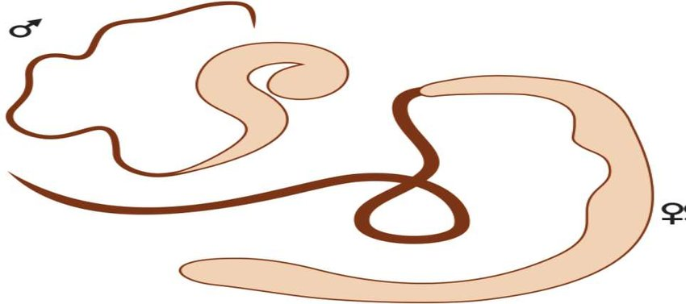
Adult worms of W.bancrofti

Slide 10
Microfilariae: colorless translucent body with a blunt head & pointed tail size 250-300 mm x 6-10 µl Nonpathogenic, but sometimes hypersensitivity reactions can occur against the microfilarial antigen, resulting in tropical pulmonary eosinophilia (TPE).

Slide 11
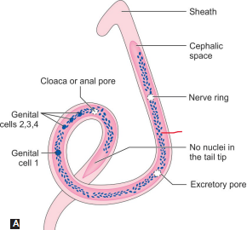
Microfilaria of Wuchereria bancrofti

Slide 12
Larvae:
First stage larva - microfilaria.
Third stage larva - filariform larva - infective form to man.

Slide 13
Microfilarial periodicity
Defined as the time when most of the microfilariae are found in the peripheral blood.
Microfilariae - reside in pulmonary blood vessels and occasionally come to the peripheral blood at different time (e.g. day time or night time), depending upon the species.

Slide 14
Periodicity occurs due to biological and evolutionary co-adaptation of the microfilariae to the feeding habit of the mosquito (Culex bites in the night, Aedes bites in daytime)
However, other factors like sleeping pattern of the individual, temperature and other climatic conditions also contribute.

Slide 15
Microfilarial periodicity of filarial nematodes
Periodicity | Microfilaria in blood | Examples
Nocturnal | Peak at night (9 pm to 4 am) | Wuchereria, Brugia
Diurnal | Present throughout the day and night, peaks at mid-day (12 noon–2.00 pm) | Loa loa
Subperiodic | Present throughout; with slight increase in the afternoon (3–5 pm, diurnal sub-periodic) or slight increase in the night (7–9 pm, nocturnal sub-periodic) | Wuchereria transmitted through Aedes
Nonperiodic | No periodicity is noticed | Onchocerca , Mansonella

Slide 16
LYMPHATIC FILARIAL NEMATODES
Lymphatic filariasis is caused by Wuchereria bancrofti (90%), Brugia malayi (10%)and B. timori (rare).
It is characterized by chronic obstruction and fibrosis of lymphatics leading to lymphedema, hydrocele and elephantiasis.

Slide 17
Epidemiology
About 893 million people in 49 countries worldwide are at risk of developing lymphatic filariasis.
In 2000, over 120 million people were infected, with about 40 million disfigured and debilitated by the disease.

Slide 18
Southeast Asia - for highest burden; comprises of 50% of globally infected lymphatic filariasis (LF) cases; followed by Sub-Saharan Africa, Pacific Island, some areas of South America and the Caribbeans.
Globally, 90% of lymphatic filariasis are caused by Wuchereria bancrofti and the remainder by Brugia species and in India, the ratio is 99.4 and 0.6% respectively.

Slide 19
India:
650 million people are at risk, residing in 256 districts of 21 states in India; accounting for 40% of global burden.
Highly endemic states - Uttar Pradesh, Jharkhand, Bihar and West Bengal - two-thirds of the lymphatic filariasis burden in India.

Slide 20
BANCROFTIAN FILARIASIS
W. bancrofti - most widely distributed filarial parasite of humans; accounts for >90% of cases of lymphatic filariasis.
Named after the scientists Wucherer and Bancroft who contributed to its discovery.

Slide 21
W. bancrofti - nocturnally periodic
Except in Pacific Islands - subperiodic.
Lifecycle : Definite Host-man, no reservoir
Intermediate Host : Culex fatigans
Infective form : L3 filariform larva
Mode of transmission : Bite of Mosquito

Slide 22
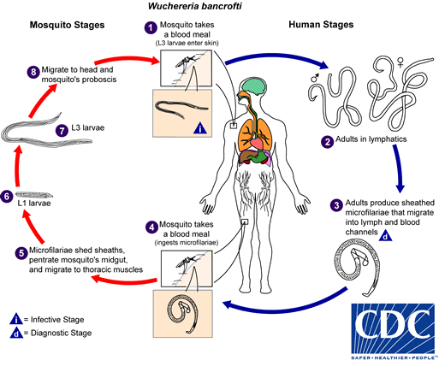
Life cycle of W.bancrofti

Slide 23
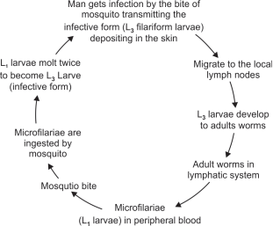
Life Cycle

Slide 24
Parasite/Disease | Location of adult | Location of Microfilaria | Microfilaria periodicity | Vector | Epidemiology
Wuchereia bancrofti (filariasis) | Lymphatic tissue | Blood, rarely hydrocele fluid and chylous urine | Nocturnal (mostly) | Culex –worldwide Anopheles in rural Africa | Cosmoplitan, (South America, Africa, South Asia)
 |  |  | Subperiodic (rare)
Brugia malayi (brugian filariasis) | Lymphatic tissue | Blood | Nocturnal (mostly) Subperiodic (rare) | Mansaonia Anopheles | Southeast Asia, Indonesia and India
 |  |  |  | Coquillettidia and Mansonia | Southeasst Asia
Brugia timori | Lymphatic tissue | Blood | Nocturnal | Anopheles barbirostris | Indonnesia

Slide 25
Pathogenesis and Pathology
Tissue alterations related to migration of live adult worms such as lymphatic dilatation and thickening of the vessel walls
Tissue alterations related to antigen and toxic metabolites released from dead adult worm
Secondary bacterial and fungal infections
Host’s inflammatory response to both live and dead parasite

Slide 26
Pathogenesis
The disease occurs due to blockage lymph vessels and lymph nodes by the adult worms. And present as classical filariasis
Classical filariasis
Occult filariasis.

Slide 27
Difference Between Classical and Occult Filariasis
 | Classical filariasis | Occult filariasis
Cause | Due to adult and developing worms | Hypersensitivity to microfilarial antigen
Basic lesion | Lymphangitis, Lymphadenitis | Eosinophilic granuloma formation
Organs involved | Lymphatic vesseis and lymph node | Lymphatic system, lung, liver, spleen, joints
Mmicrofilaria | Present in blood | Present in tissues but not in blood
Serological test | CFT (not so sensitive) | CFT (highly sensitive
Therapeutic response | No response | Prompt response to DEC

Slide 28
As long as the worm remains viable, the lymphatic vessels though damaged, still remains patent.
However, the death of the worm leads to enhanced granulomatous reaction, and fibrosis of the lymph vessels
Results in severe lymphatic obstruction - lymphatic function is severely compromised

Slide 29
Endosymbiosis: Pathogenic W. bancrofti is found to be infected with a Rickettsia group of bacteria called Wolbachia and maintain an endosymbiotic relationship.
It is proved that this symbiosis is essential for the parasite survival, and pathogenesis

Slide 30
Age and gender: Microfilaremia increases with age; starts at 5 years and peaks at >30 years.
Males are more commonly affected than females.
Hormonal factors in females may be attributed to their higher resistance to infection.

Slide 31
Host Immune Response
Both cellular and humoral immune response are altered.
Antigens of both adult worms and microfilariae are processed by the antigen- presenting cells (macrophages) and presented to T helper cells (TH cells).
TH cells are stimulated and differentiated into TH 1 cells and or TH 2 cells.

Slide 32
Clinical Features
Incubation period is about 8–16 months.
Clinical manifestations
High grade fever with sudden in onset associated with rigors and last for 2 or 3 days
Lymhangitis
Lymphadenitis
Lymphoagiovarix
Hydrocoele
Lymphorrhagia
Elephantiasis

Slide 33
Lymphatic Filariasis
Lymphatic filariasis passes through four stages.
  Endemic Normal
  Asymptomatic Microfilaremia
  Acute Filariasis (Acute Adenolymphangitis)
  Chronic Filariasis

Slide 34
Endemic Normal
Normal people residing in endemic area.
Prevalence ranges from 0 to 50%.
They are not infected by the parasite.
This might be due to various reasons - insufficient exposure, immunological resistance or in the prepatent period at the time of study.

Slide 35
Asymptomatic Microfilaremia
Microfilaremia demonstrated in their peripheral blood
Microscopic hematuria and/or proteinuria
Dilated and tortuous lymphatics (visualized by imaging)
Filarial dance sign (ultrasound showing motile adult worm in scrotal lymphatics).

Slide 36
Acute Filariasis (Acute Adenolymphangitis)
Filarial fever (high-grade fever)
Lymphatic inflammation (lymphangitis and lymphadenitis): Lower extremities are more commonly affected than the upper limbs
Transient local edema
Dermatolymphangitis

Slide 37
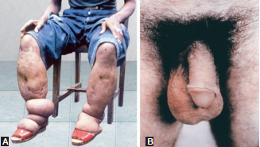
Chronic Filariasis
Severe lymphatic obstruction and pedal edema
Hydrocele
Elephantiasis
Chronic funiculitis and epididymitis
Chyluria
A. Elephantiasis;
B. Hydrocele of scrotum

Slide 38
Tropical Pulmonary Eosinophilia (TPE)
TPE - also called as occult filariasis.
Represents a hypersensitivity reaction to microfilaria antigen.
Microfilariae are rapidly cleared from the bloodstream and filtered, lodged and destroyed in the lungs initiating an allergic response.
Hence, microfilariae are not detected in peripheral blood.

Slide 39
Immune Complex Mediated Manifestations
Circulating immune complexes containing microfilarial antigens are found to be deposited in various organs such as:
Kidney (causes nephrotic syndrome, hematuria and proteinuria)
Joints (causes filarial arthritis of knee or ankle).

Slide 40
Laboratory Diagnosis of Wuchereria Bancrofti
Direct Evidence
Detection of micro-filariae
By examination of a thick and thin blood smear, stained with Giemsa stain
Indirect Evidence
Eosinophilia in blood
Elevated serum IgE levels
Immunodiagnosis
Antigen Test : ELISA and ICT card test, using mab against og4c3 and ADI2
Antibody test (useful for seroprevalence)
Flow-through assay: Detects total IgG antibodies to WbSXP-1 antigen
Luciferese immunoprecipitation system: using W.bancrofti Wb123 antigen.
Molecular diagnosis
PCR & RT PCR
Adv: * Can detect low level of parasitemia
* Can differentiate from Past to present infection
*Can differentiate between various filarial worms
*Useful for monitoring treatment response
Detection of Adult worm Lymph nodebiopsy
On X-ray : (if worms are calcified)
USG : filaria dance sign) within the lymphatic vessel by adult worm

Slide 41
Laboratory diagnosis of Bancroftian filariasis
Demonstration of microfilariae by thin or thick smear stained with Giemsa or by QBC examination—blood collected during night hours (or day time after DEC provocation test).
  W. bancrofti - tail tip pointed, free of nuclei
  B. malayi - tail tip blunt, nuclei extended upto tail tip

Slide 42
Microfilaria of Wuchereria bancrofti

Slide 43
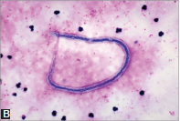
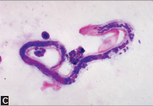
Thick blood smears stained with Giems stain showing microfilariae of
(B) Wuchereria bancrofti;
(C) Brugia species

Slide 44
Antigen detection (ELISA, ICT)— detects Ag by using mAb to Og4C3 Ag and AD12 Ag
Antibody detection
  Flow-through assay using WbSXP-1 Ag
  Luciferase immunoprecipitation system using Wb123 Ag

Slide 45
Imaging methods - filarial dance sign in USG, indicates serpentine movement of adult worms in lymphatics
Molecular methods - real-time PCR detecting genes such as SspI repeat, pWb12 repeat, pWb-35, etc.
Other methods - eosinophilia, elevated IgE.

Slide 46
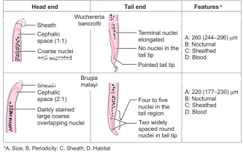
Differences between the microfilaria of Wuchereria bancrofti and Brugia malayi

Slide 47
Treatment of Bancroftian filariasis
Diethylcarbamazine (DEC)
Drug of choice for the treatment of filariasis
Given 6 mg/kg daily for 12 days
Can kill both adult worms and microfilariae - adult worms are cleared slowly.

Slide 48
Albendazole:
Given as 400 mg twice daily for 21 days.
It has also demonstrated efficacy against adult worms and microfilariae
Ivermectin:
0.4mg/kg single dose -can kill microfilariae but has no effect on adult worms.

Slide 49
Doxycycline: 200 mg x bd x 6 weeks
Given to target the intracellular Wolbachia.
It also shows significant microfilaricidal activity like DEC
Penicillin:
Secondary infections due to bacteria - streptococci can be treated with systemic antibiotics like penicillin till the infection subside.

Slide 50
Prevention
Vector Control
National Vector Borne Disease Control Programme
Elimination of Lymphatic Filariasis (ELF)

Slide 51
Vector Control
Anti-larval measures:
Highly expensive hence mainly restricted to urban areas.
Chemicals used are - mosquito larvicidal oil, pyrethrum-based oil (pyrosene oil-E), organo-phosphorus larvicides like fenthion, temephos.

Slide 52
Anti-adult measures:
Pyrethrum spray can be used.
DDT and hexachlorocyclohexane (HCH) are not effective.

Slide 53
National Vector Borne Disease Control Programme
The National Filariasis Control Programme in India - active since 1955 - integrated with National Vector Borne Disease Control Programme (NVBDCP) in 2006.
Hathipaon Mukt Bharat: India (under NVBDCP) has launched a massive campaign in 2015 for achieving filaria free India named “Hathipaon Mukt Bharat” - aims at assisting the filariasis elimination program of India.

Slide 54
Elimination of Lymphatic Filariasis (ELF)
Global program to eliminate lymphatic filariasis (ELF) - launched by WHO in 2000 aiming at global elimination by the year 2020.
In India, ELF is in operation since 2004 in parallel with global strategy.
MDA strategy: WHO recommends mass drug administration (MDA) once in a year to all people at-risk in the endemic areas for a period of five years

Slide 55
MDA regimen: Single dose of DEC (6mg/kg) + albendazole (400 mg) is the MDA regimen of choice in all endemic areas of the World including India except:
In onchocerciasis endemic areas - ivermectin + albendazole is given
In Loa loa endemic area - Albendazole is given twice per year

Slide 56
Triple drug regimen: WHO recently recommended IDA regimen (ivermectin + DEC+ albendazole).
It is implemented in selected districts of India.

Slide 57
Assessment: The impact of MDA is assessed by conducting:
  Microfilaria survey (by peripheral blood smear examination) once in a year; one month prior to the next MDA, followed by:
  Transmission assessment survey (by antigen/antibody detection) during post-MDA period

Slide 58
Global LF elimination status: Till date, 16 countries achieved the LF elimination status. Seven additional countries are in the verge of elimination. Preventive chemotherapy is still required in 49 countries
India LF elimination status: In India, five states (Assam, Tamil Nadu, Goa, Puducherry, Daman and Diu) stopped MDA after achieving elimination status.

Slide 59
Brugia malayi
Brugia malayi accounts for 10% of lymphatic filariasis named after its discoverer Brug (1927), who described a new type of microfilaria in the blood of natives in sumatra.
In India , Kerala is the largest endemic area, particularly the districts of quilon, Alleppey, Kottayam, Ernakulam, and Trichur. Endemic pockets occur in Assa, Orissa, MP and West Bengal.

Slide 60
Epidemiology
There is considerable overlapping in the geographical distribution of brugian filariasis and bancroftian filariasis.
B. malayi occurs - Eastern India, Indonesia, Malaysia, Thailand and Philippines
It shows two types of periodicity of microfilaremia.
Nocturnal form - more common - transmitted in areas of coastal rice fields.

Slide 61
Subperiodic form - rare - found in the forests of Malaysia and Indonesia
In India, the major states involved are Kerala, Odisha, Assam and West Bengal.

Slide 62
Life Cycle
Life cycle of B. malayi - similar to W. bancrofti except:
Vector: Mansonia - main vector for the nocturnal strains, Anopheles and Aedes can also transmit the infection.

Slide 63
Reservoir: Humans - main reservoir; except for the subperiodic strains of B. malayi where monkeys, cats and dogs are the animal reservoirs.

Slide 64
Distinguishing Features of Mf. Bancrofti and Mf. malayi.
Features | Mf. Bancrofti | Mf.malayi
Length | 250-300 µm | 175-230 µm
Appearance | Graceful, sweeping curves | Kinky, with secondary curves
Cephalic space | Length and breadth equal | Almost twice as long as broad
Stylet at anterior end | Single | Double
Excretory pore | Not prominent | Prominent
Nuclear | Discrete nuclei | Blurred
Tail tip | Pointed; free of nuclei | 2 distinct nuclei, are at tip, the other subterminal
Sheath | Faintly-stained | Well-stained

Slide 65
Clinical Features
Clinical features - similar to bancroftian filariasis except:
  More frequent episodes of acute adenolymphangitis, adenitis (femoral nodes), and filarial abscesses
  Chronic manifestations (lymphedema and elephantiasis) - less frequent
  Genital involvement is not seen
  Elephantiasis: Swelling is limited to leg below the knee
  Chyluria does not occur.

Slide 66
Laboratory Diagnosis
Microscopy: Microfilaria in blood - detected by peripheral blood smear.
Antibody detection methods: Two methods are available - ICT for screening and ELISA for confirmation
  Brugia rapid: ICT detecting parasite-specific IgG-4 antibodies against recombinant BmR1 antigen of B. malayi
  Bm14 ELISA employing recombinant B. malayi antigen (Bm-14) is available.

Slide 67
There is no antigen detection method is available
Imaging methods - ultrasound can be employed
Molecular methods: PCR and other molecular methods can differentiate between B. malayi and W. bancrofti.

Slide 68
Treatment
Same as for bancroftian filariasis; except that frequency of adverse effects following DEC medication is more.
Therapy should be started with lower dose.

Slide 69
Prevention
Same as for bancroftian filariasis (i.e. both chemoprophylaxis and vector control
Removal of pistia plants: In South India and Sri Lanka where the Mansonia is the main vector, breeding is best controlled by removing/destroying the supporting plant Pistia stratiotes from all water collections by herbicidal agents like phenoxylene 30 and shell weed killer-D.l).

Slide 70
Brugia timori
B. timori infection is limited to the Timor islands of Southeastern Indonesia.
Transmitted by Anopheles barbirostris
Morphologically microfilariae - similar to that of B. malayi except that it is longer (310 µm), and more nuclei at tail region.
Clinical features, laboratory diagnosis and treatment are similar to that of B. malayi.

Slide 71
The lesions produced by B.timori are milder than those of bancroftian or malayan filariasis. A characteristic lesion is the development of draining abscesses caused by worms in lymph nodes and vessels along the saphenous vein, leading to scarring.

Slide 72
THANKS

Slide 73
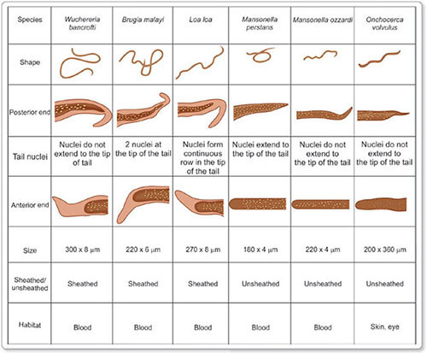
Identifying features Filarial Worms

Slide 74
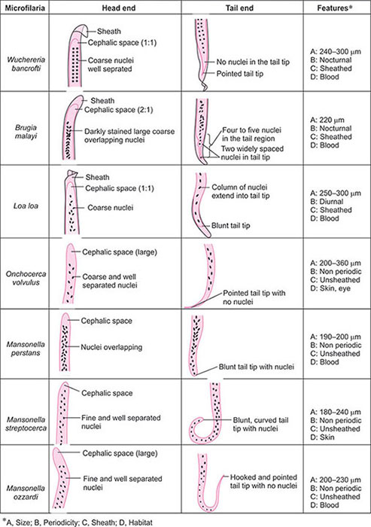

Slide 75
Subcutaneous filariasis
Causative agents
Loa Loa (African eye worm) : Calabar swellings
Onchocerca volvulus : river blindness
Key points of Loa Loa:
Loa loa is also known as African eye worm and causes loiasis.
Vectors: Day-biting flies (Chrysops)
Microfilaria are sheathed and nuclei extend upto tail tip.

Slide 76
Microfilaria appears during the day (diurnal periodic).
Clinical features: Subcutaneous swellings (calabar swellings) ocular granuloma, edema of eyelid, and proptosis.
Diagnosis: Demonstration of adult worm from skin and conjunctiva. Demonstration of microfilaria in peripheral blood during day. High eosinophil count.
Treatment: DEC with simultaneous administration of corticosteroid and other drugs which may be used Ivermectin or albendazole.

Slide 77
Key point of Onchocerca Volvulus :
Life Cycle is completed in 2 hosts.
Definitive host: Humans
Intermediate hosts: Day –biting female black flies of the genus simulium (black flies).
The vector simulium species breed in fast-flowing rivers; and therefore, the disease is most common along the course of rivers. Hence, the name river blindness.

Slide 78
Clinical features : Subcutaneous nodule
Onchodermatitis called as sowdah,
Ocular manifestations range from conjuctivitis with photophobia. Other ocular lesions include punctate or sclerosing keratitis, iridocyclitis, secondary glaucoma, choroidoretinitis, and optic atrophy.
Diagnosis: Demostration of microfilaria from skin snips and aspirated material form subcutaneous nodules. Demonstration of IgG4 antibody and PCR.
Treatment : ivermectin is the drug of choice

Slide 79
Serous Cavity Filariasis
Mansonella Ozzardi : seen only in central and south America and West Indies.
Vectors : Culicoides species
Adult worms are found in the peritoneal and pleural cavities of humans. Infections does not cause any illness.
Diagnosis is made by demonstrating microfilariae in blood
Treatment : Ivermectin (single dose 6 mg) Mansonella Perstans : Distributed in tropical Africa and coastal South America.

Slide 80
Adult worms live in the body cavities of humans, mainly in peritoneum, less often in pleura, and rarely in pericardium. .
Infection is generally asymptomatic, but may cause transient abdominal pain, rashes, angioedema and malaise.
Diagnosis is by demostration of the microfilariae in peripheral blood or serosal effusion.
Treatment : Doxyycline 200 mg twice a day for 6 weeks targeting the wolbachia endosymbiont in M. perstans is the first effective treatment.

Slide 81
Zoonotic Filariasis
Brugia Pahangi : Parasite of dogs and cats in Malaysia may infect man and cause lymphangitis and lymphadenitis.
Dirofilaria immitis (dog heart-worm): caused pulmonary infarct which may appear as coin lesion on chest radiography and can be mistaken for malignancy. Pulmonary infarct. Is due to blockeg of a smalll branch of pulmonary artery by an embolus due to dead worm .

Slide 82
Dirofilaria Repens : Natural parasite of dogs , it may sometimes infect humans, causing subcutaneous and subconjuctival nodules. Many Dirofilaria species may form nodules in human conjunctiva and are collectively called dirofilaria conjunctivae.
THANKS

Slide 83
Lymphatic Filariasis
Dr. Ved Prakash
Professor & Head
PG Department of Microbiology

Slide 84
Learning objectives
At the end of the session, the students will be able to understand:
Epidemiology, life cycle, pathogenesis, clinical manifestations, laboratory diagnosis and treatment of Wuchereria bancrofti, Brugia malayi and B. timori.
Differences between various filarial nematodes causing lymphatic filariasis

Slide 85
Neglected Tropical Diseases (NTDs)
They are referred to as neglected tropical diseases because they are largely eradicated in developed countries and affects only the world’s poorest population. They includes :
Lymphatic filariasis
Leishmaniasis
Guniea worm disease
Echinococcosis
Chagas disease
African sleeping sickness
Fascioliasis
Paragonimiasis
Schistosomiasis
Soil transmitted helminths (Ascris, Hookworm, Trichura)
Onchocerciasis
Buruli ulcer
Laprosy
Rabies
Trachoma
Yaws

Slide 86
Life cycle & investigations of lymphatic filariasis (LF)
Filarial worms that reside in the lymphatics , produce chronic obstruction and fibrosis of lymphatics
Essentials of diagnosis:
Episodic attacks of lymphangitis, lymphadenitis & fever
Chronic progressive swelling of extremities and genitals, hydrocele, chyluria, lymphedema
Microfilariae in blood, chyluria or hydrocele fluid

Slide 87
Life cycle of W.bancrofti

Slide 88
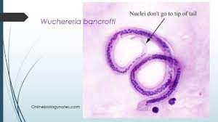
Laboratory Diagnosis
Demonstration of microfilariae by thin or thick smear stained Giemsa or by QBC examination-blood collected during night hours(9pm to 4am) (or day time after DEC provocation test) by giving DEC tablet orally (2mg/kg) and smear is made after 15 min. to 1 hour
QBC test using acridine orange stain

Slide 89
Microfilariae can be found in blood, and occasionally in hydrocele fluid, urine or other body fluids.
Direct wet mount: Demonstrates serpentine movement of microfilariae
Thick and thin smears: Leishman’s or Giemsa staining can be performed to observe the sheath and muclei of microfilaria
Concentration techniques: to increase sensitivity
Membrane filtration technique
Knott’s centrifugation technique

Slide 90
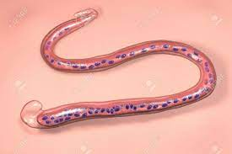
W. bancrofti-tail tip pointed, free of nuclei
B.malayi-tail tip blunt, nuclei extended upto tail tip
Antigen detection (ELISA, ICT)-detects Ag by using mAb to Og4C3 AG and AD 12 Antigens
Sensitivity and specificity 95-100%
Advantages of antigen detection more: more sensitive than microscopy ,can be detected in urine & even in day time

Slide 91
Antibody detection : has better diagnostic value because Parasite specific IgG4 is increased in active filariasis and IgG2 level is delevated in elephantiasis. It is done by following methods
Flow-through assay using WbSXP-1Ag
Luciferase immonoprecipitation system using Wb 123 Ag
Imaging methods- USG show filarial dance sign and indicates serpentine movement of adult worms in lymphatics. X-ray can detect dead and calcified worms. Lymphoscintigraphy demonstrate functional abnormalities of lymphatics

Slide 92
Molecular methods-real time PCR detecing genes such as Sspl repeat, pWb12repeat, pWb-35.
Advantages of RT-PCR :
1.Can detect low level of parasitemia
2.Can differentiate past from present infection
3.Can distinguish between filarial parasites
4.Useful for monitoring treatment response
5.Detects parasites in carriers.
Other mehtods- Eosinophilia (AEC>3000/uL,
Elevated S. serum IgE.concn > 1000ng/mL
Biopsy of enlarged lymph node to demonstrate adult worm
Urine examination reveals microscopic hematuria, proteinuria and chyluria

Slide 93
Pathogenesis : The pathologic changes occur as a result of inflammatory/allergic damage to lymphatics and thickening of the vessel
Clinical Features :
1.Lymphatic filariasis
2.Occult filariasis or TPE
3.Immune complex mediated manifestationsin kidny (nephrotic syndrome hematuria and joints (filarial arthritis of knee or ankle)

Slide 94
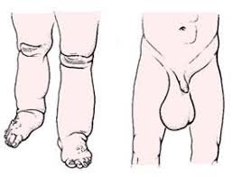
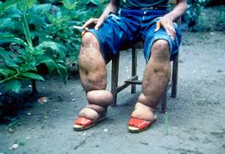

Slide 95
Lymphatic Filariasis
Passes through four stages.
Endemic Normal : These are the normal people residing in endemic area, who are not infected by the parasite due to insufficient exposure immunological resistance or in the prepatent period at the time of study.
Asymptomatic Microfilaremia :Characterised by :-
Microscopic hematuria and/or proteinuria
Dilated and tortous lymphatics (visualized by imaging)
Filarial dance sign (ultrasound showing motile adult worm in scrotal lymphatics)

Slide 96
3. Acute Filariasis (Acute Adnolymphangitis): Characterized by recurrent episodes of high-grade fever, lymphangitis and lymphadenitis.
Transient local early pitting edema, which is reversible on limb elevation
Dermatolymphangitis: Presents as plaque like lesion
4. Chronic Filariasis : Present as
Hydrocele (clear straw colored fluid in the cavity of tunica vaginalis of testes
Elephantiasis of lower limb, arm, vulva or breast
Chronic funiculitis and epididymitis
Chyluria: due to rupture of lymph vessels into the urinary system

Slide 97
Treatment
Diethylcarbamazine 2mg /kg orally TDS 10-14 days for asymptomatic infection & acute lymphangitis
Doxycycline (100-2000mg per day orally 4-6 weeks to kill wolbachia bacteria, leading to death of adult filarial worms
Prevention: W.H.O recommends single dose of DEC plus albendazole

Slide 98
Learning objectives
At the end of the session, the students will be able to understand:
Epidemiology, life cycle, pathogenesis, clinical manifestations, laboratory diagnosis and treatment of Wuchereria bancrofti, Brugia malayi and B. timori.
Differences between various filarial nematodes causing lymphatic filariasis

Slide 99
FILARIAL NEMATODE
Filarial nematodes - vector-borne parasites - reside in the lymphatic system, skin, subcutaneous tissue and rarely in body cavities and accordingly they cause various types of clinical manifestations in man.

Slide 100
Lymphatic filariasis: Filarial worms reside in lymphatics; produce chronic obstruction and fibrosis of lymphatics.
Agents –
  Wuchereria bancrofti
  Brugia malayi
  Brugia timori
Cutaneous and ocular filariasis: Include Loa loa, Onchocerca volvulus and Mansonella species - reside in skin, subcutaneous tissues and some in eyes and serous cavity.
They produce various cutaneous and ocular manifestations

Slide 101
Differences between various filarial nematodes causing lymphatic filariasis
Parasite/disease | Location of adult | Location of microfilaria | Microfilaria periodicity | Vector | Epidemiology
Wuchereria bancrofti (Bancroftian filariasis) | Lymphatic tissue | Blood, rarely hydrocele fluid and chylous urine | Nocturnal (mostly) | Culex—Worldwide Anopheles in rural Africa | Cosmopolitan, (South America, Africa, South Asia)
 |  |  | Subperiodic (rare) | Aedes | Pacific islands Andaman and Nicobar
Brugia malayi (Brugian filariasis) | Lymphatic tissue | Blood | Nocturnal (mostly) | Mansonia Anopheles | SouthEast Asia, Indonesia and India
 |  |  | Subperiodic (rare) | Coquillettidia and Mansonia | Southeast Asia
Brugia timori | Lymphatic tissue | Blood | Nocturnal | Anopheles barbirostris | Indonesia

Slide 102
Morphology and Habitat
Filarial nematodes - viviparous; exist in two morphological forms: adult worm and larvae - no egg stage.
Adult worm: Slender, round measuring 2–10 cm in length.
Some adult filarial worms can survive for many years in humans, causing chronic obstructive and inflammatory conditions - elephantiasis and hydrocele - a condition known as lymphatic filariasis.

Slide 103
Larvae:
Four larval stages.
First stage larva - microfilaria.
Third stage larva - filariform larva - infective form to man.
Microfilariae: Nonpathogenic, but sometimes hypersensitivity reactions can occur against the microfilarial antigen, resulting in tropical pulmonary eosinophilia (TPE).

Slide 104
Microfilarial periodicity
Defined as the time when most of the microfilariae are found in the peripheral blood.
Microfilariae - reside in pulmonary blood vessels and occasionally come to the peripheral blood at different time (e.g. day time or night time), depending upon the species.

Slide 105
Periodicity occurs due to biological and evolutionary co-adaptation of the microfilariae to the feeding habit of the mosquito (Culex bites in the night, Aedes bites in daytime)
However, other factors like sleeping pattern of the individual, temperature and other climatic conditions also contribute.

Slide 106
Microfilarial periodicity of filarial nematodes
Periodicity | Microfilaria in blood | Examples
Nocturnal | Peak at night (9 pm to 4 am) | Wuchereria, Brugia
Diurnal | Present throughout the day and night, peaks at mid-day (12 noon–2.00 pm) | Loa loa
Subperiodic | Present throughout; with slight increase in the afternoon (3–5 pm, diurnal sub-periodic) or slight increase in the night (7–9 pm, nocturnal sub-periodic) | Wuchereria transmitted through Aedes
Nonperiodic | No periodicity is noticed | Onchocerca , Mansonella

Slide 107
LYMPHATIC FILARIAL NEMATODES
Lymphatic filariasis is caused by Wuchereria bancrofti (90%), Brugia malayi (10%)and B. timori (rare).
It is characterized by chronic obstruction and fibrosis of lymphatics leading to lymphedema, hydrocele and elephantiasis.

Slide 108
Epidemiology
About 893 million people in 49 countries worldwide are at risk of developing lymphatic filariasis.
In 2000, over 120 million people were infected, with about 40 million disfigured and debilitated by the disease.

Slide 109
Southeast Asia - for highest burden; comprises of 50% of globally infected lymphatic filariasis (LF) cases; followed by Sub-Saharan Africa, Pacific Island, some areas of South America and the Caribbeans.
Globally, 90% of lymphatic filariasis are caused by Wuchereria bancrofti and the remainder by Brugia species and in India, the ratio is 99.4 and 0.6% respectively.

Slide 110
India:
650 million people are at risk, residing in 256 districts of 21 states in India; accounting for 40% of global burden.
Highly endemic states - Uttar Pradesh, Jharkhand, Bihar and West Bengal - two-thirds of the lymphatic filariasis burden in India.

Slide 111
BANCROFTIAN FILARIASIS
W. bancrofti - most widely distributed filarial parasite of humans; accounts for >90% of cases of lymphatic filariasis.
Named after the scientists Wucherer and Bancroft who contributed to its discovery.
W. bancrofti - nocturnally periodic
Except in Pacific Islands - subperiodic.

Slide 112
Life Cycle

Slide 113
Pathogenesis and Pathology
Tissue alterations related to migration of live adult worms such as lymphatic dilatation and thickening of the vessel walls
Tissue alterations related to antigen and toxic metabolites released from dead adult worm
Secondary bacterial and fungal infections
Host’s inflammatory response to both live and dead parasite

Slide 114
As long as the worm remains viable, the lymphatic vessels though damaged, still remains patent.
However, the death of the worm leads to enhanced granulomatous reaction, and fibrosis of the lymph vessels
Results in severe lymphatic obstruction - lymphatic function is severely compromised

Slide 115
Endosymbiosis: Pathogenic W. bancrofti is found to be infected with a Rickettsia group of bacteria called Wolbachia and maintain an endosymbiotic relationship.
It is proved that this symbiosis is essential for the parasite survival, and pathogenesis
Age and gender: Microfilaremia increases with age; starts at 5 years and peaks at >30 years.
Males are more commonly affected than females.
Hormonal factors in females may be attributed to their higher resistance to infection.

Slide 116
Host Immune Response
Both cellular and humoral immune response are altered.
Antigens of both adult worms and microfilariae are processed by the antigen- presenting cells (macrophages) and presented to T helper cells (T_{H} cells).
T_{H} cells are stimulated and differentiated into T_{H} 1 cells and or T_{H} 2 cells.

Slide 117
Clinical Features
Incubation period is about 8–16 months.
Clinical manifestations can be categorized into:
  Lymphatic filariasis
  Tropical pulmonary eosinophilia (TPE)/(Occult filariasis)
  Immune complex mediated mani fes tations.

Slide 118
Lymphatic Filariasis
Lymphatic filariasis passes through four stages.
  Endemic Normal
  Asymptomatic Microfilaremia
  Acute Filariasis (Acute Adenolymphangitis)
  Chronic Filariasis

Slide 119
Endemic Normal
Normal people residing in endemic area.
Prevalence ranges from 0 to 50%.
They are not infected by the parasite.
This might be due to various reasons - insufficient exposure, immunological resistance or in the prepatent period at the time of study.

Slide 120
Asymptomatic Microfilaremia
Microfilaremia demonstrated in their peripheral blood
Microscopic hematuria and/or proteinuria
Dilated and tortuous lymphatics (visualized by imaging)
Filarial dance sign (ultrasound showing motile adult worm in scrotal lymphatics).

Slide 121
Acute Filariasis (Acute Adenolymphangitis)
Filarial fever (high-grade fever)
Lymphatic inflammation (lymphangitis and lymphadenitis): Lower extremities are more commonly affected than the upper limbs
Transient local edema
Dermatolymphangitis

Slide 122
Chronic Filariasis
Severe lymphatic obstruction and pedal edema
Hydrocele
Elephantiasis
Chronic funiculitis and epididymitis
Chyluria
A.Elephantiasis;
B. Hydrocele of scrotum

Slide 123
Tropical Pulmonary Eosinophilia (TPE)
TPE - also called as occult filariasis.
Represents a hypersensitivity reaction to microfilaria antigen.
Microfilariae are rapidly cleared from the bloodstream and filtered, lodged and destroyed in the lungs initiating an allergic response.
Hence, microfilariae are not detected in peripheral blood.

Slide 124
Immune Complex Mediated Manifestations
Circulating immune complexes containing microfilarial antigens are found to be deposited in various organs such as:
Kidney (causes nephrotic syndrome, hematuria and proteinuria)
Joints (causes filarial arthritis of knee or ankle).

Slide 125
Laboratory diagnosis of Bancroftian filariasis
Demonstration of microfilariae by thin or thick smear stained with Giemsa or by QBC examination—blood collected during night hours (or day time after DEC provocation test).
  W. bancrofti - tail tip pointed, free of nuclei
  B. malayi - tail tip blunt, nuclei extended upto tail tip

Slide 126
Laboratory diagnosis of Bancroftian filariasis
Thick blood smears stained with Giems stain showing microfilariae of
(B) Wuchereria bancrofti; (C) Brugia species

Slide 127
Laboratory diagnosis of Bancroftian filariasis
Antigen detection (ELISA, ICT)— detects Ag by using mAb to Og4C3 Ag and AD12 Ag
Antibody detection
  Flow-through assay using WbSXP-1 Ag
  Luciferase immunoprecipitation system using Wb123 Ag

Slide 128
Laboratory diagnosis of Bancroftian filariasis
Imaging methods - filarial dance sign in USG, indicates serpentine movement of adult worms in lymphatics
Molecular methods - real-time PCR detecting genes such as SspI repeat, pWb12 repeat, pWb-35, etc.
Other methods - eosinophilia, elevated IgE.

Slide 129
Differences between the microfilaria of Wuchereria bancrofti and Brugia malay

Slide 130
Treatment of Bancroftian filariasis
Diethylcarbamazine (DEC)
Drug of choice for the treatment of filariasis
Given 6 mg/kg daily for 12 days
Can kill both adult worms and microfilariae - adult worms are cleared slowly.

Slide 131
Treatment of Bancroftian filariasis
Albendazole:
Given as 400 mg twice daily for 21 days.
It has also demonstrated efficacy against adult worms and microfilariae
Ivermectin:
0.4mg/kg single dose -can kill microfilariae but has no effect on adult worms.

Slide 132
Treatment of Bancroftian filariasis
Doxycycline:
Given to target the intracellular Wolbachia.
It also shows significant microfilaricidal activity like DEC
Penicillin:
Secondary infections due to bacteria - streptococci can be treated with systemic antibiotics like penicillin till the infection subside.

Slide 133
Prevention
Vector Control
National Vector Borne Disease Control Programme
Elimination of Lymphatic Filariasis (ELF)

Slide 134
Vector Control
Anti-larval measures:
Highly expensive hence mainly restricted to urban areas.
Chemicals used are - mosquito larvicidal oil, pyrethrum-based oil (pyrosene oil-E), organo-phosphorus larvicides like fenthion, temephos.
Anti-adult measures:
Pyrethrum spray can be used.
DDT and hexachlorocyclohexane (HCH) are not effective.

Slide 135
National Vector Borne Disease Control Programme
The National Filariasis Control Programme in India - active since 1955 - integrated with National Vector Borne Disease Control Programme (NVBDCP) in 2006.
Hathipaon Mukt Bharat: India (under NVBDCP) has launched a massive campaign in 2015 for achieving filaria free India named “Hathipaon Mukt Bharat” - aims at assisting the filariasis elimination program of India.

Slide 136
Elimination of Lymphatic Filariasis (ELF)
Global program to eliminate lymphatic filariasis (ELF) - launched by WHO in 2000 aiming at global elimination by the year 2020.
In India, ELF is in operation since 2004 in parallel with global strategy.
MDA strategy: WHO recommends mass drug administration (MDA) once in a year to all people at-risk in the endemic areas for a period of five years

Slide 137
MDA regimen: Single dose of DEC (6mg/kg) + albendazole (400 mg) is the MDA regimen of choice in all endemic areas of the World including India except:
In onchocerciasis endemic areas - ivermectin + albendazole is given
In Loa loa endemic area - Albendazole is given twice per year

Slide 138
Triple drug regimen: WHO recently recommended IDA regimen (ivermectin + DEC+ albendazole).
It is implemented in selected districts of India.

Slide 139
Elimination of Lymphatic Filariasis (ELF)
Assessment: The impact of MDA is assessed by conducting:
  Microfilaria survey (by peripheral blood smear examination) once in a year; one month prior to the next MDA, followed by:
  Transmission assessment survey (by antigen/antibody detection) during post-MDA period

Slide 140
Global LF elimination status: Till date, 16 countries achieved the LF elimination status. Seven additional countries are in the verge of elimination. Preventive chemotherapy is still required in 49 countries
India LF elimination status: In India, five states (Assam, Tamil Nadu, Goa, Puducherry, Daman and Diu) stopped MDA after achieving elimination status.

Slide 141
BRUGIAN FILARIASIS

Slide 142
Brugia malayi
Brugia malayi accounts for 10% of lymphatic filariasisnamed after its discoverer Brug (1927).

Slide 143
Epidemiology
There is considerable overlapping in the geographical distribution of brugian filariasis and bancroftian filariasis.
B. malayi occurs - Eastern India, Indonesia, Malaysia, Thailand and Philippines
It shows two types of periodicity of microfilaremia.
Nocturnal form - more common - transmitted in areas of coastal rice fields.

Slide 144
Subperiodic form - rare - found in the forests of Malaysia and Indonesia
In India, the major states involved are Kerala, Odisha, Assam and West Bengal.

Slide 145
Life Cycle
Life cycle of B. malayi - similar to W. bancrofti except:
Vector: Mansonia - main vector for the nocturnal strains, Anopheles and Aedes can also transmit the infection.
The subperiodic strains are transmitted by Coquillettidia and Mansonia

Slide 146
Reservoir: Humans - main reservoir; except for the subperiodic strains of B. malayi where monkeys, cats and dogs are the animal reservoirs.

Slide 147
Clinical Features
Clinical features - similar to bancroftian filariasis except:
  More frequent episodes of acute adenolymphangitis, adenitis (femoral nodes), and filarial abscesses
  Chronic manifestations (lymphedema and elephantiasis) - less frequent
  Genital involvement is not seen
  Elephantiasis: Swelling is limited to leg below the knee
  Chyluria does not occur.

Slide 148
Laboratory Diagnosis
Microscopy: Microfilaria in blood - detected by peripheral blood smear.
Antibody detection methods: Two methods are available - ICT for screening and ELISA for confirmation
  Brugia rapid: ICT detecting parasite-specific IgG-4 antibodies against recombinant BmR1 antigen of B. malayi
  Bm14 ELISA employing recombinant B. malayi antigen (Bm-14) is available.

Slide 149
Laboratory Diagnosis
There is no antigen detection method is available
Imaging methods - ultrasound can be employed
Molecular methods: PCR and other molecular methods can differentiate between B. malayi and W. bancrofti.

Slide 150
Treatment
Same as for bancroftian filariasis; except that frequency of adverse effects following DEC medication is more.
Therapy should be started with lower dose.

Slide 151
Prevention
Same as for bancroftian filariasis (i.e. both chemoprophylaxis and vector contro
Removal of pistia plants: In South India and Sri Lanka where the Mansonia is the main vector, breeding is best controlled by removing/destroying the supporting plant Pistia stratiotes from all water collections by herbicidal agents like phenoxylene 30 and shell weed killer-D.l).

Slide 152
Brugia timori
B. timori infection is limited to the Timor islands of Southeastern Indonesia.
Transmitted by Anopheles barbirostris
Morphologically microfilariae - similar to that of B. malayi except that it is longer (310 µm), and more nuclei at tail region.
Clinical features, laboratory diagnosis and treatment are similar to that of B. malayi.

Slide 153
Identifying features Filarial Worms

Slide 155
Subcutaneous filariasis
Causative agents
Loa Loa (African eye worm) : Calabar swellings
Onchocerca volvulus : river blindness
Key points of Loa Loa:
Loa loa is also known as African eye worm and causes loiasis.
Vectors: Day-biting flies (Chrysops)
Microfilaria are sheathed and nuclei extend upto tail tip.

Slide 156
Microfilaria appears during the day (diurnal periodic).
Clinical features: Subcutaneous swellings (calabar swellings) ocular granuloma, edema of eyelid, and proptosis.
Diagnosis: Demonstration of adult worm from skin and conjunctiva. Demonstration of microfilaria in peripheral blood during day. High eosinophil count.
Treatment: DEC with simultaneous administration of corticosteroid and other drugs which may be used Ivermectin or albendazole.

Slide 157
Key point of Onchocerca Volvulus :
Life Cycle is completed in 2 hosts.
Definitive host: Humans
Intermediate hosts: Day –biting female black flies of the genus simulium (black flies).
The vector simulium species breed in fast-flowing rivers; and therefore, the disease is most common along the course of rivers. Hence, the name river blindness.

Slide 158
Clinical features : Subcutaneous nodule
Onchodermatitis called as sowdah,
Ocular manifestations range from conjuctivitis with photophobia. Other ocular lesions include punctate or sclerosing keratitis, iridocyclitis, secondary glaucoma, choroidoretinitis, and optic atrophy.
Diagnosis: Demostration of microfilaria from skin snips and aspirated material form subcutaneous nodules. Demonstration of IgG4 antibody and PCR.
Treatment : ivermectin is the drug of choice

Slide 159
Serous Cavity Filariasis
Mansonella Ozzardi : seen only in central and south America and West Indies.
Vectors : Culicoides species
Adult worms are found in the peritoneal and pleural cavities of humans. Infections does not cause any illness.
Diagnosis is made by demonstrating microfilariae in blood
Treatment : Ivermectin (single dose 6 mg) Mansonella Perstans : Distributed in tropical Africa and coastal South America.

Slide 160
Adult worms live in the body cavities of humans, mainly in peritoneum, less often in pleura, and rarely in pericardium. .
Infection is generally asymptomatic, but may cause transient abdominal pain, rashes, angioedema and malaise.
Diagnosis is by demostration of the microfilariae in peripheral blood or serosal effusion.
Treatment : Doxyycline 200 mg twice a day for 6 weeks targeting the wolbachia endosymbiont in M. perstans is the first effective treatment.

Slide 161
Zoonotic Filariasis
Brugia Pahangi : Parasite of dogs and cats in Malaysia may infect man and cause lymphangitis and lymphadenitis.
Dirofilaria immitis (dog heart-worm): caused pulmonary infarct which may appear as coin lesion on chest radiography and can be mistaken for malignancy. Pulmonary infarct. Is due to blockeg of a smalll branch of pulmonary artery by an embolus due to dead worm .

Slide 162
Dirofilaria Repens : Natural parasite of dogs , it may sometimes infect humans, causing subcutaneous and subconjuctival nodules. Many Dirofilaria species may form nodules in human conjunctiva and are collectively called dirofilaria conjunctivae.
THANKS

