Slide 1
Introduction and History of Microbiology
Dr. Ved Prakash
Professor & Head
PG Department of Microbiology

Slide 2
RECOMMENDED BOOKS
Essentials of Medical Microbiology: Apurba Sankar Sastry
Essentials of Practical Microbiology: Apurba Sankar Sastry
Ananthanarayan and Paniker’s Textbook of Microbiology :
Reba Kanungo
Textbook of Microbiology: C.P. Baveja
Essentials of Microbiology : V.S. Randhawa
Medical Microbiology: David Greenwood

Slide 3
Learning objectives
At the end of the session, the students will be able to know:
Clinical Microbiology – Terminologies
Classification of Microorganisms
Brief History

Slide 4
Medical microbiology is a branch of medicine that deals with the study of microorganisms Such as bacteria, viruses, parasites or and fungi
Clinical a Microbiology: is a branch of medical science concerned with the prevention, diagnosis and treatment of infectious disease. The various branches of clinical microbiology include
General Microbiology:
Immunology:

Slide 5
Systemic Microbiology (infectious diseases): Infectious diseases are classified into various clinical syndromes
Bloodstream and cardiovascular system infections
Gastrointestinal and hepatobiliary system infections
Skin, soft tissue and musculoskeletal system infections
Central nervous system infections
Respiratory tract infections
Urinary tract infections
Genital tract infections
Infectious of eye, ear and others.

Slide 6
Hospital infection control: It deals with the study of various control measures to prevent the transmission of healthcare associated infections. it includes
Healthcare-associated infections
Major Healthcare-associated infections types
Sterilization and Disinfection
Biomedical waste management
Needle stick injury
Antimicrobial stewardship
Environmental surveillance (Bacteriology of water, Air and surface)

Slide 7
Areas of Medical Microbiology:
Bacteriology: The study of bacteria, their structure, function, and role in disease.
Virology: The study of viruses, their structure, function, and role in disease.
Mycology: The study of fungi, their structure, function, and role in disease.
Parasitology: The study of parasites, their structure, function, and role in disease.

Slide 8
Introduction to Clinical Microbiology
Clinical microbiology is a subfield of medical microbiology that focuses on the practical application of microbiological techniques to the diagnosis, treatment, and prevention of infectious diseases in humans. It plays a crucial role in healthcare by providing accurate and timely diagnoses, guiding antimicrobial therapy, and implementing strategies to control the spread of infections.

Slide 9
Objectives of Medical Microbiology:
Diagnosis of infectious diseases: This involves isolating and identifying the organism causing the infection.
Treatment of infectious diseases: This involves developing and administering effective antimicrobial agents or other therapies.
Prevention of infectious diseases: This involves developing and implementing strategies to prevent the transmission of infectious agents.

Slide 10
Understanding the pathogenesis of infectious diseases: This involves studying the mechanisms by which microorganisms cause disease.
Development of new vaccines and antimicrobial agents: This involves researching and developing new ways to prevent and treat infectious diseases.
Medical microbiology plays a vital role in protecting human health by:

Slide 11
Providing accurate diagnoses of infectious diseases, leading to appropriate treatment.
Developing new vaccines and antimicrobial agents to prevent and treat infectious diseases.
Implementing strategies to control the spread of infectious diseases.
Contributing to our understanding of the human immune system and its response to infection.

Slide 12
Key aspects of clinical microbiology include:
Specimen collection and processing: Collecting and processing clinical specimens such as blood, urine, wound swabs, and respiratory secretions for microbial analysis.
Microbial identification: Identifying the specific microorganism causing the infection using various techniques, including microscopy, culturing, biochemical testing, and molecular methods like polymerase chain reaction (PCR).
Antimicrobial susceptibility testing: Determining the susceptibility of the identified microorganism to various antimicrobial agents to guide the selection of appropriate therapy.

Slide 13
Serotyping and antimicrobial resistance monitoring: Identifying the serotype of the microorganism and monitoring trends in antimicrobial resistance to inform public health interventions.
Quality control and assurance: Implementing and maintaining strict quality control procedures to ensure the accuracy and reliability of laboratory testing.
Consultation and collaboration: Providing consultation to healthcare providers on the diagnosis, treatment, and prevention of infectious diseases, and collaborating with other healthcare professionals, such as epidemiologists and infectious disease specialists, to manage outbreaks and control infections.

Slide 14
Benefits of clinical microbiology:
Early and accurate diagnosis: Enables prompt and appropriate treatment, leading to improved patient outcomes.
Targeted therapy: Guides the selection of effective antimicrobial agents, minimizing unnecessary use and promoting antibiotic stewardship.
Infection control: Helps prevent the spread of infections through identification of outbreaks, implementation of control measures, and patient education.
Public health surveillance: Provides data for monitoring trends in infectious diseases, informing public health interventions and vaccine development.

Slide 15
HISTORY OF MICROBIOLOGY
Varo and Columella named Animalia minuta to invisible microorganisms
M Microscopic
I Independent units
C less complex
R Rapidily multiplying
O Omnipresent (present everywhere)

Slide 16
CLASSIFICATION OF MICROORGANISMS
Characteristics | Prokaryotes | Eukaryotes
Major groups | Bacteria, blue green algae | Fungi, parasites, other algae, plants and animals
Nucleus | Diffuse | Well defined
Nuclear membrane | Absent | Present
Nucleolus | Absent | Present
Ribonucleoprotein | Absent | Present
Cell division | Binary fission | Mitosis, meiosis
Chromosome | One, circular | Many, linear

Slide 17
Characteristics | Prokaryotes | Eukaryotes
Extrachromosomal DNA | Found in plasmid | Found in mitochondria
Cell membrane | Does not contain sterols except in Mycoplasma | Contain sterols
Cellular organelles like mitochondria, etc. | Absent (except ribosome) | Present
Ribosome | 70S | 80S
Site of respiration | Mesosome | Mitochondria
Pinocytosis | Absent | Present

Slide 18
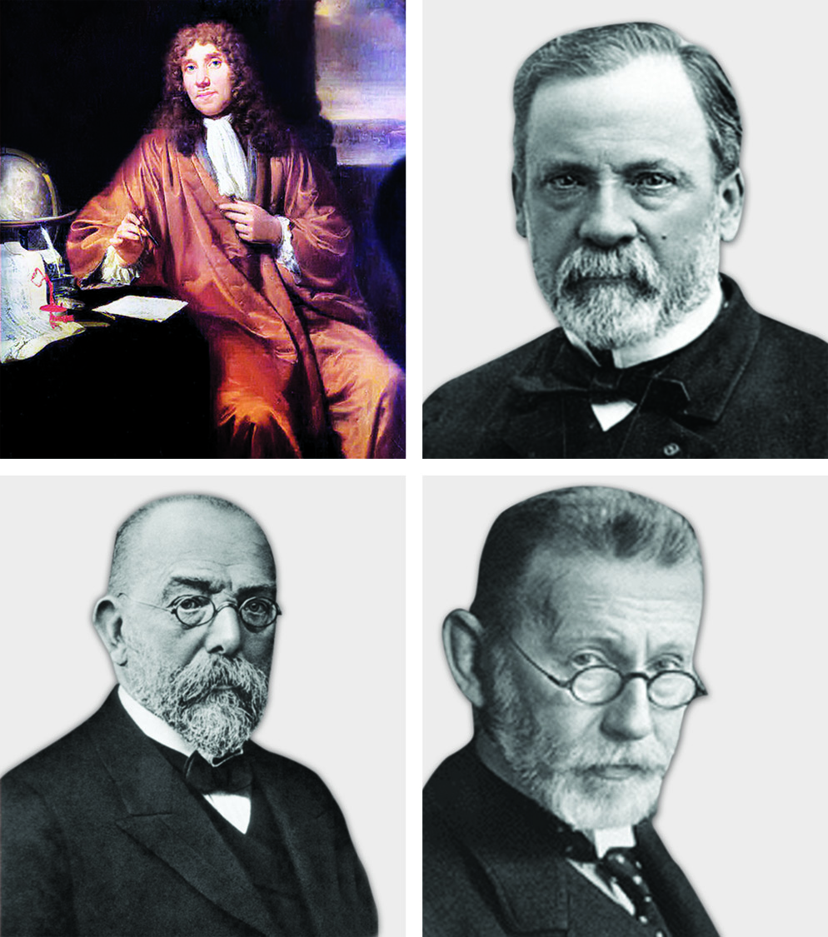
Antonie Philips van Leeuwenhoek (1676)
First scientist to observe bacteria and other microorganisms - using single-lens microscope.
Named - small organisms as ‘Little animalcules’

Slide 19
Edward Jenner (1796)
Developed first vaccine - smallpox vaccine.
Used cowpox virus (Variolae vaccinae) to immunize children against smallpox.
Hence the term - ‘vaccine’ was derived.

Slide 20
Louis Pasteur (1822–1895)
Father of microbiology.
Professor of chemistry in France.

Slide 21
Contributions of Louis Pasteur
Proposed - principles of fermentation.
Introduced - sterilization techniques.
Described - pasteurization of milk.
Vaccine development against - anthrax, fowl cholera and rabies.

Slide 22
Disproved - theory of spontaneous generation and postulated - ‘germ theory of disease’
Liquid media concept – for growth of microorganisms.
Founder of the Pasteur Institute, Paris.

Slide 23
Joseph Lister (1867)
Father of antiseptic surgery.
Observed that postoperative infections were reduced by using diluted carbolic acid to sterilize the instruments and to clean wounds during surgery

Slide 24
Robert Koch (1843–1910)
German general practitioner.
First to use agar (solidifying agent) for preparation of solid media
Introduced concept of pure culture.

Slide 25
Described - hanging drop method for testing motility.
Discovered anthrax bacilli, tubercle bacilli and cholera bacilli.
Introduced staining techniques using aniline dye.

Slide 26
Koch’s phenomenon:
Guinea pigs previously infected with tubercle bacillus developed a hypersensitivity reaction when injected with tubercle bacilli or its protein.

Slide 27
Koch’s postulates:
1. Microorganism - constantly associated with the lesions of the disease.
2. Isolate the organism in pure culture.
3. Same disease must result - when isolated microorganism is inoculated into a suitable laboratory animal.
4. Possible to re-isolate the organism in pure culture.
An additional fifth criterion was introduced subsequently - states that antibody to the causative organism should be demonstrable in the patient’s serum.

Slide 28
Exceptions to Koch’s postulates:
Mycobacterium leprae and Treponema pallidum - cannot be grown in vitro; but - maintained in experimental animals
Neisseria gonorrhoeae - no animal model, but - grown in vitro.

Slide 29
Paul Ehrlich (1854–1915)
Father of chemotherapy
1st to report - acid-fast nature of tubercle bacillus.
Proposed - toxin-antitoxin interaction - called Ehrlich phenomenon.

Slide 30
Proposed - ‘side chain theory for antibody production’.
Chemotherapy- Discovered salvarsan - an arsenical compound (also called as the ‘magic bullet’) - first effective medicinal treatment for syphilis.

Slide 31
Bacteria ‘Ehrlichia’ - named after him.
Nobel prize (1908) in Physiology or Medicine –Immunology
Founder and first director of - Paul Ehrlich Institute, Germany.

Slide 32
Other Important Contributors
Scientist | Contributions
Hans Christian Gram (1884) | Developed - ‘Gram stain’
Ernst Ruska (1931) | Founder of electron microscope
Alexander Fleming (1929) | Discovered penicillin
Goodpasture | Described - viral culture technique in chick embryo
Barbara McClintock | Described - mobile genetic elements in bacteria - transposons
Walter Gilbert and Frederick Sanger (1977) | DNA sequencing
Karry B Mullis (1993) | Discovered PCR and was awarded noble prize

Slide 33
Microorganisms named after discoverer
Discoverer | Organism
Ogston | Staphylococcus aureus
Neisser | Neisseria gonorrhoeae
Weichselbaum | Neisseria meningitidis
Loeffler | Corynebacterium diphtheriae
Frenkel | Streptococcus pneumoniae
Bruce | Brucella melitensis
Kitasato | Clostridium tetani

Slide 34
Microorganisms named after discoverer
Discoverer | Organism
Hansen | Mycobacterium leprae
Yersin & Kitasato | Yersinia pestis
Schaudinn & Hoffman | Treponema pallidum
Daniel Carrion | Bartonella bacilliformis
d’Herelle | Bacteriophages
W.H. Welch | Clostridium perfringens
Anthony Epstein and Yvonne Barr | Epstein-Barr virus

Slide 35
Bacteria named after the discoverers
Common name | Scientific name
Kleb-Loeffler bacillus | Corynebacterium diphtheriae
Preisz Nocard bacillus | Corynebacterium pseudotuberculosis
Koch Week bacillus | Haemophilus aegyptius
Pfeiffer’s bacillus | Haemophilus influenzae
Whitmore bacillus | Burkholderia pseudomallei
Battey bacillus | Mycobacterium intracellulare
Johne’s bacillus | Mycobacterium paratuberculosis
Eaton’s agent | Mycoplasma pneumoniae
Gaffky Eberth bacillus | Salmonella Typhi

Slide 36
Nobel laureates – For contributions in microbiology
Nobel laureate | Year | Research
Emil A von Behring | 1901 | Development of antitoxin against diphtheria
Sir Ronald Ross | 1902 | Life cycle of malarial parasite in mosquitoes
Robert Koch | 1905 | Discovery of the causative agent of tuberculosis
Charles LA Laveran | 1907 | Discovery of malarial parasite in unstained preparation of blood
Paul Ehrlich and Elie Metchnikoff | 1908 | Discovered selective theory of antibody formation
Charles Richet | 1913 | Discovered anaphylaxis
Jules Bordet | 1919 | Discovered complement and developed complement fixation test

Slide 37
Nobel laureates – For contributions in microbiology
Nobel laureate | Year | Research
Karl Landsteiner | 1930 | Described ABO blood group
Sir Alexander Fleming | 1945 | Discovery of penicillin
F Enders, FC Robbins, TH Weller | 1954 | Cultivation of polio viruses in tissue culture
J Lederberg and EL Tatum | 1958 | Discovery of conjugation in bacteria
Sir M Burnet and Sir PB Medawar | 1960 | Postulated immunological tolerance
Watson and Crick | 1962 | Discovered double helix structure of DNA

Slide 38
Nobel laureates – For contributions in microbiology
Nobel laureate | Year | Research
Peyton Rous | 1966 | Discovered viral oncogenesis
Holley, Khurana and Nirenberg | 1968 | Discovered genetic code
BS Blumberg | 1976 | Discovered Australia antigen (HBsAg)
Rosalyn Yallow | 1977 | Developed radioimmunoassay
B Benacerraf, F Dausset and G Snell | 1980 | Discovered HLA antigen
Barbara McClintoch | 1983 | Discovered mobile genetic elements (transposon)
Georges Kohler | 1984 | Developed hybridoma technology for monoclonal antibodies

Slide 39
Nobel laureates – For contributions in microbiology
Nobel laureate | Year | Research
Niels Jerne | 1984 | Postulated idiotype network hypothesis (Jerne hypothesis)
S Tonegawa | 1987 | Elucidated the nature of antibody diversity
Kary B Mullis | 1993 | Invented polymerase chain reaction
Stanley B Prusiner | 1997 | Described Prions
J Robin Warren and Barry J Marshal | 2005 | Discovery of Helicobacter pylori and its role in peptic ulcer disease
Luc Montagnier and F Barre-Sinoussi | 2008 | Discovery of human immunodeficiency virus (HIV)

Slide 40
Nobel laureates – For contributions in microbiology
Nobel laureate | Year | Research
Harald zur Hausen | 2008 | Human papilloma viruses causing cervical cancer
Bruce A Beutler and Jules A Hoffmann | 2011 | For their discoveries concerning the activation of innate immunity
Ralph M Steinman | 2011 | For his discovery of dendritic cell and its role in adaptive immunity
Sir John B. Gurdon and Shinya Yamanaka | 2012 | ‘Mature cells can be reprogrammed to become pluripotent"
William C Campbell | 2015 | Anti-parasitic effect of ivermectin in filariasis
Youyou Tu | 2015 | Artemisinin, a novel drug used for malaria

Slide 41

THANKS

