Slide 1
Intestinal Protozoan Infections
Dr. Ved Prakash
Professor & Head
PG Department of Microbiology

Slide 2
Learning objectives
At the end of the session, the students will be able to understand:
Intestinal amoebiasis
Amoebae resembling E.histolytica
Opportunistic intestinal coccidian parasitic infections
Giardiasis, balantidiasis, Microsporidiosis

Slide 3
Intestinal Protozoan Infections
The protozoan parasites which cause intestinal infection include:
Intestinal amoebae: Entamoeba histolytica
Intestinal flagellate: Giardia lamblia
Opportunistic intestinal coccidian parasites: Cryptosporidium, Cyclospora, and Cystoisospora
Others: Balantidium coli, Blastocystis hominis, Sarcocystis and Microsporidia (now considered as fungi).

Slide 4
INTESTINAL AMOEBIASIS

Slide 5
INTESTINAL AMOEBIASIS
Amoebae (meaning “change”) - single-celled protozoan parasites that constantly change their shape - due to presence of an organ of locomotion called as “pseudopodium”.
Based on the habitat they are of two types -
  (i) intestinal amoebae, and
  (ii) free-living amoebae.

Slide 6
ENTAMOEBA HISTOLYTICA INFECTIONS

Slide 7
ENTAMOEBA HISTOLYTICA INFECTIONS
E. histolytica causes amoebic dysentery and a wide range of other invasive diseases, including amoebic liver abscess.
There are three other species of Entamoeba such as E. dispar, E. moshkovskii and E. bangladeshi which are morphologically similar to E. histolytica.

Slide 8
Epidemiology
E. histolytica is worldwide in distribution but more common in tropical and subtropical countries.
Largest burden of the disease - tropics of China, Central and South America, and Indian subcontinents affecting 10% of the world’s population (500 million)
Third most common parasitic cause of death in the world.

Slide 9
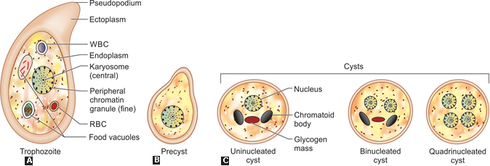
Morphology

Slide 10
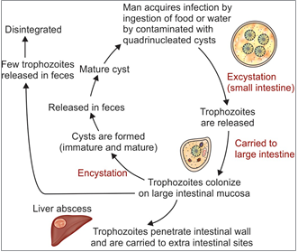
Life Cycle

Slide 11
Virulence Factors
Trophozoite of E. histolytica - invasive form and possesses many virulence factors that play an important role in the pathogenesis.
  Amoebic lectin antigen
  Amoebapore
  Cysteine proteases and hydrolytic enzymes
  Neuraminidase and metallocollagenase

Slide 12
Pathogenesis
Colonization: Trophozoites first colonize the intestinal mucosa.
Adhesion: Then the trophozites penetrate the mucus layer and adhere to the large intestinal mucosa by - Gal/GalNAc lectin molecules
Flask-shaped ulcers
Invasion: Amoebae then invade the large intestinal wall - migrate to extraintestinal sites.
Intestinal complications

Slide 13
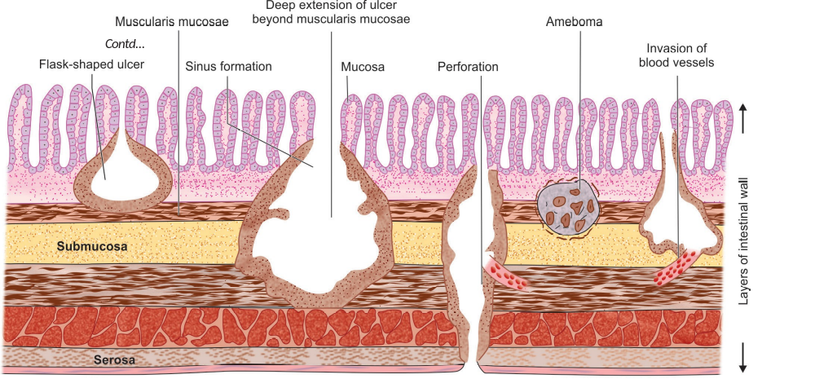
Complications of intestinal amoebiasis

Slide 14
Clinical Manifestations
Incubation period - one to four weeks.
Males and females are affected equally.
Majority of infections (90%) result in asymptomatic cyst passers.
The remaining (10%), develop intestinal amoebiasis

Slide 15
Clinical Manifestations (Cont..)
Amoebic dysentery
Amoebic appendicitis
Amoeboma
Fulminant colitis

Slide 16
Differences in stool characters between amoebic dysentery and bacillary dysentery
Character | Amoebic dysentery | Bacillary dysentery
Pathology
Ulcer | Deep | Shallow
Margin | Ragged and undermined | Uniform
Intervening mucosa | Normal | Inflamed
Cellular response | Mononuclear | Polymorphonuclear

Slide 17
Differences in stool characters between amoebic dysentery and bacillary dysentery (Cont..)
Character | Amoebic dysentery | Bacillary dysentery
Stool macroscopic feature
Number of motion | 6–10/day | > 10/day
Amount | Copious amount | Small quantity
Color | Dark red | Bright red
Odor | Offensive | Odorless
Reaction | Acidic | Alkaline
Consistency | Not adherent to the container | Adherent to the container

Slide 18
Differences in stool characters between amoebic dysentery and bacillary dysentery (Cont..)
Character | Amoebic dysentery | Bacillary dysentery
Stool microscopic feature
Red blood cells (RBCs) | In clumps | Discrete or in rouleaux
Pus cells | Few | Numerous
Macrophages | Few | Numerous*
Eosinophils | Present | Absent or rare
Charcot-Leyden crystal | Present | Absent
Pyknotic body** | Present | Absent
Organism detected | E. histolytica cyst or trophozoite | Bacteria (e.g. Shigella)

Slide 19
Laboratory diagnosis of Intestinal amoebiasis
Stool microscopy by wet mount, permanent stains, etc.— detects cysts (round, 1–4 nuclei) and trophozoites (with finger like pseudopodia)
Histology—Intestinal biopsies stained with PAS or H&E stains reveal trophozoites
Stool culture—Polyxenic and axenic culture

Slide 20
Laboratory diagnosis of Intestinal amoebiasis (Cont..)
Stool antigen detection (copro-antigen)—ELISA (detecting 170-kDa of lectin Ag) and ICT (detecting 29-kDa surface Ag).
Serology
  Amoebic antigen—ELISA (170-kDa of lectin Ag)
  Amoebic antibody—ELISA
Isoenzyme (zymodeme) analysis

Slide 21
Laboratory diagnosis of Intestinal amoebiasis (Cont..)
Molecular diagnosis—Nested multiplex PCR and real time PCR (18S rRNA) and Biofire FilmArray

Slide 22
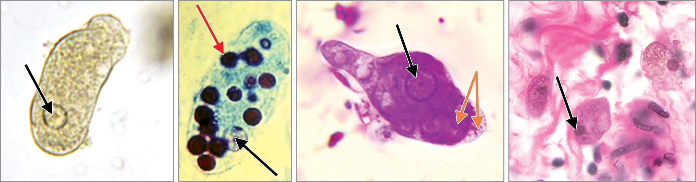
Laboratory diagnosis of Intestinal amoebiasis (Cont..)
A
B
C
D
Entamoeba histolytica trophozoites: A. Saline mount; B and C. Trichrome stain, note the single nucleus (black arrow) RBCs (red arrow) and ectoplasm and endoplasm (orange arrows);
D. Trophozoites in colon tissue stained with H&E.

Slide 23
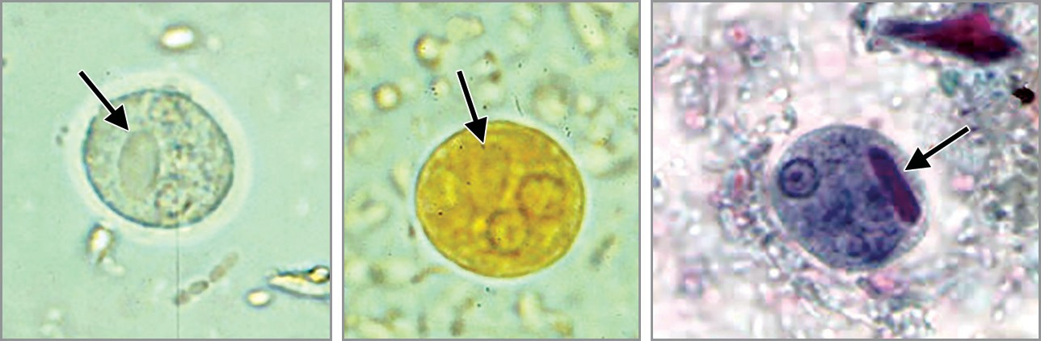
Laboratory diagnosis of Intestinal amoebiasis (Cont..)
A
B
C
Cyst of E. histolytica: A. Saline mount; B. Iodine mount;
C. Trichrome stained smear. Note the chromatoid body with blunt ends (arrow).

Slide 24
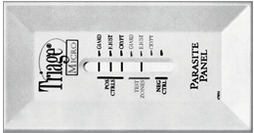
Laboratory diagnosis of Intestinal amoebiasis (Cont..)
Triage parasite panel, positive for E. histolytica/E. dispar antigen

Slide 25
Treatment of Intestinal amoebiasis
Asymptomatic carriage: Treatment helps in reducing passage of cysts in stool and thereby preventing the disease transmission.
Luminal agents are used for treatment.
  Iodoquinol (for 20 days) or
  Paromomycin (for 10 days)

Slide 26
Treatment of Intestinal amoebiasis (Cont..)
Amoebic dysentery: Treatment consists of:
  Tissue agents: Metronidazole (for 5–10 days) or tinidazole (for 3 days) plus
  Luminal agents as above
Other measures include fluid and electrolyte replacement and symptomatic treatment.

Slide 27
Prevention
Preventive measures are as follows:
Avoiding ingestion of food and water contaminated with human feces
Treatment of asymptomatic carriers.

Slide 28
AMOEBAE MORPHOLOGICALLY RESEMBLING
E. HISTOLYTICA

Slide 29
AMOEBAE MORPHOLOGICALLY RESEMBLING E. HISTOLYTICA
E. dispar, E. moshkovskii and E. bangladeshi - amoebae which are morphologically (both cyst and trophozoite) similar to that of E. histolytica.
E. dispar - non-pathogenic commensal found in human intestine

Slide 30
AMOEBAE MORPHOLOGICALLY RESEMBLING E. HISTOLYTICA (Cont..)
E. moshkovskii - primarily a free-living amoeba, found in polluted water, may cause occasionally non-invasive diarrhea in infants
E. bangladeshi have been recovered from asymptomatic individuals, as well as those with diarrhea

Slide 31
AMOEBAE MORPHOLOGICALLY RESEMBLING E. HISTOLYTICA (Cont..)
Diagnosis: They can be differentiated from E. histolytica by various methods
  PCR amplifying small subunit rRNA gene—most reliable method
  Detection of lectin antigen in stool
  RBC inside trophozoites—present only in E. histolytica (maker of invasiveness)
  Zymodeme study.

Slide 32
NONPATHOGENIC AMOEBAE

Slide 33
AMOEBAE MORPHOLOGICALLY RESEMBLING E. HISTOLYTICA (Cont..)
Entamoeba coli,
E. hartmanni,
E. gingivalis,
E. polecki,
Endolimax nana
Iodamoeba butschlii.

Slide 34
Differences between Entamoeba histolytica and
Entamoeba coli
 | Entamoeba histolytica | Entamoeba coli
Trophozoite
Size | 15–20 mm | 20–25 mm
Motility | Very active and unidirectional purposeful motility Pseudopodia with finger-like projection | Sluggish, nonpurposeful and aimless motility in any direction Blunt pseudopodia
Cytoplasm | Clearly differentiated to ectoplasm and endoplasm | Not differentiated
Cytoplasmic inclusions | RBC, leukocytes, tissue debris and bacteria | Same except it does not contain RBC
Nucleus | Karyosome is small and central Nuclear membrane is thin and lined by fine chromatin granules | Karyosome is large and eccentric Nuclear membrane is thick and lined by coarse chromatin granules

Slide 35
Differences between Entamoeba histolytica and
Entamoeba coli (Cont..)
 | Entamoeba histolytica | Entamoeba coli
Cyst
Size | 12–15 mm | 15–25 mm
Nucleus | Same as trophozoite | Same as trophozoite
Nuclei | 1–4 in number | 1–8 in number
Chromatoid body | Thick bars with rounded ends | Filamentous and thread like ends

Slide 36
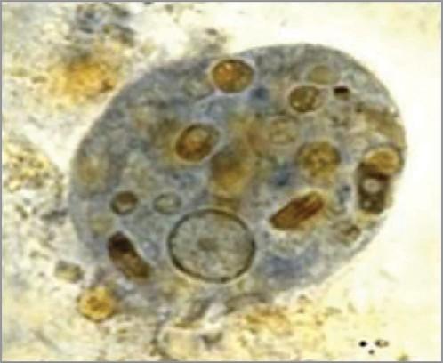
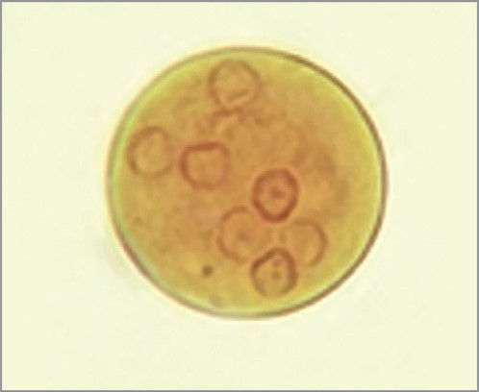
Entamoeba coli
A
B
A. Trophozoite (iron hematoxylin stain) shows nucleus with coarse peripheral chromatin and abundant food vacuoles in the cytoplasm containing fecal debris;
B. Cyst (iodine mount) containing several nuclei.

Slide 37
INTESTINAL FLAGELLATE INFECTIONS

Slide 38
GIARDIASIS
Giardiasis - caused by Giardia lamblia, also known as G. intestinalis or G. duodenalis.
It was first observed by AV Leeuwenhoek in 1681 while examining his own stool.
Later it was described and named after Dr F Lambl and Professor A Giard (1859).

Slide 39
Epidemiology
G. lamblia - worldwide in distribution.
Considered as one of the most common parasite—causes both endemic and epidemic intestinal disease and diarrhea.
Geographical area: Warm climate of tropics and subtropics.
Genotypes: A and B - further classified into eight assemblages (A to H).

Slide 40
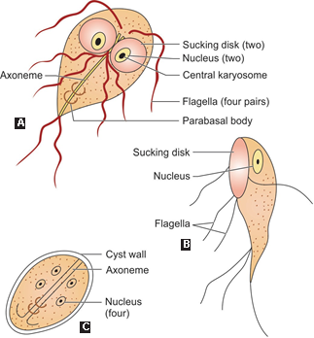
Morphology
A. Trophozoite front view; B. trophozoite lateral view; C. Cyst.

Slide 41
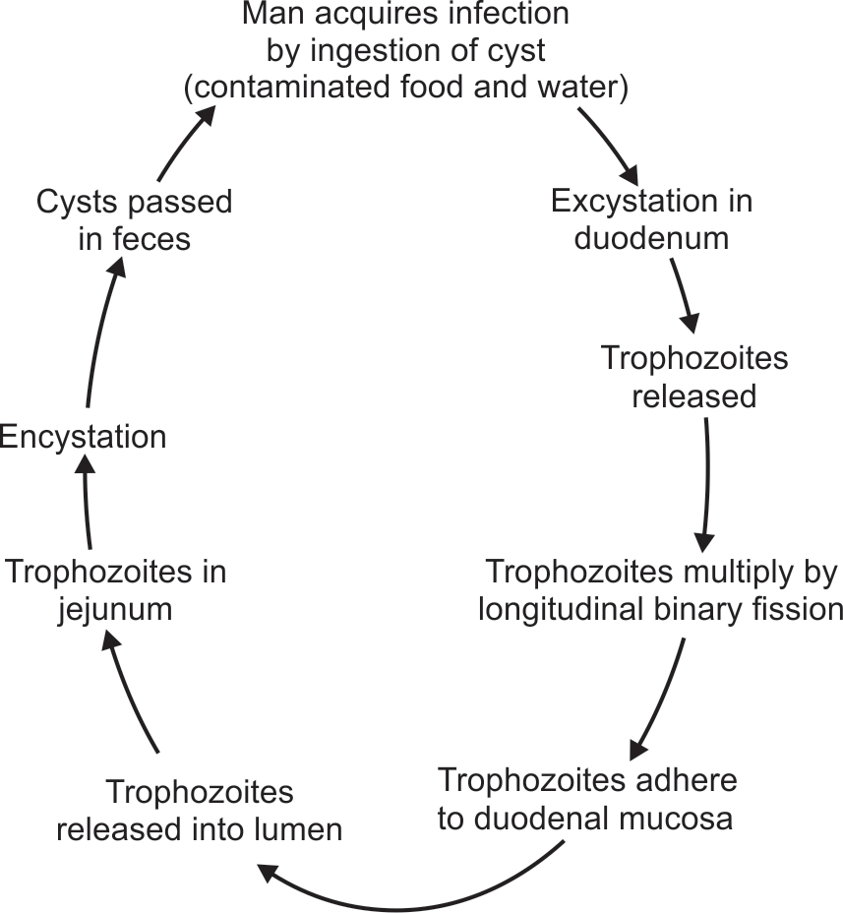
Life Cycle
Host: Giardia completes its life cycle in one host.
Infective form: Cysts are the infective form.

Slide 42
Pathogenicity
Infective dose: As few as 10–25 cysts can initiate the infection
Risk factors: Children are more commonly affected. Other high-risk groups - elderly debilitated persons, poor hygiene, and immunodeficient individuals.
It does not appear to be associated with HIV/AIDS

Slide 43
Pathogenicity (Cont..)
Pathogenic form: Trophozoites - adhere to the duodenal mucosa, cause disruption of the intestinal epithelium that leads to increased permeability and malabsorption.
Trophozoites do not invade the mucosa, but feed on mucus secretions

Slide 44
Pathogenicity (Cont..)
Malabsorption may be of various types such as:
  Malabsorption of fat (steatorrhea)—leads to foul smelling profuse frothy diarrhea
  Disaccharidase deficiencies (lactose, xylose)— leading to lactose intolerance
  Malabsorption of vitamin A, B12 and iron
  Protein loosing enteropathy.

Slide 45
Pathogenicity (Cont..)
Antigenic variation: Giardia undergoes frequent antigenic variations due to a cysteine rich protein on its surface called variant surface protein (VSP).

Slide 46
Clinical Features
1. Asymptomatic carriers: Most infected persons are asymptomatic, harbor the cysts in the gut and spread the infection
2. Acute giardiasis: Incubation period varies from 1 week to 3 weeks
3. Chronic giardiasis: It may present with or without a previous acute symptomatic episode

Slide 47
Laboratory Diagnosis
Stool Examination:
Gold standard for diagnosis of giardiasis.
Detects cysts and trophozoites
Pus cells or blood (RBCs) - never be seen in stool microscopy in case of giardiasis. If found; suggests alternative diagnosis.

Slide 48
Laboratory Diagnosis (Cont..)
Entero-test (or String Test) – duodenal sampling – with the help of gelatin capsule attached to thread.
Histopathology - Endoscopy-guided duodenal biopsy tissue can be processed by touch preparation and stained by Giemsa stain to demonstrate the trophozoites

Slide 49
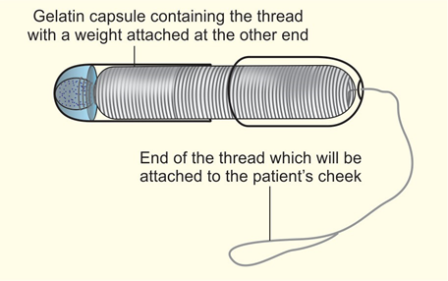
Laboratory Diagnosis (Cont..)
Entero-test equipment showing duodenal capsule

Slide 50
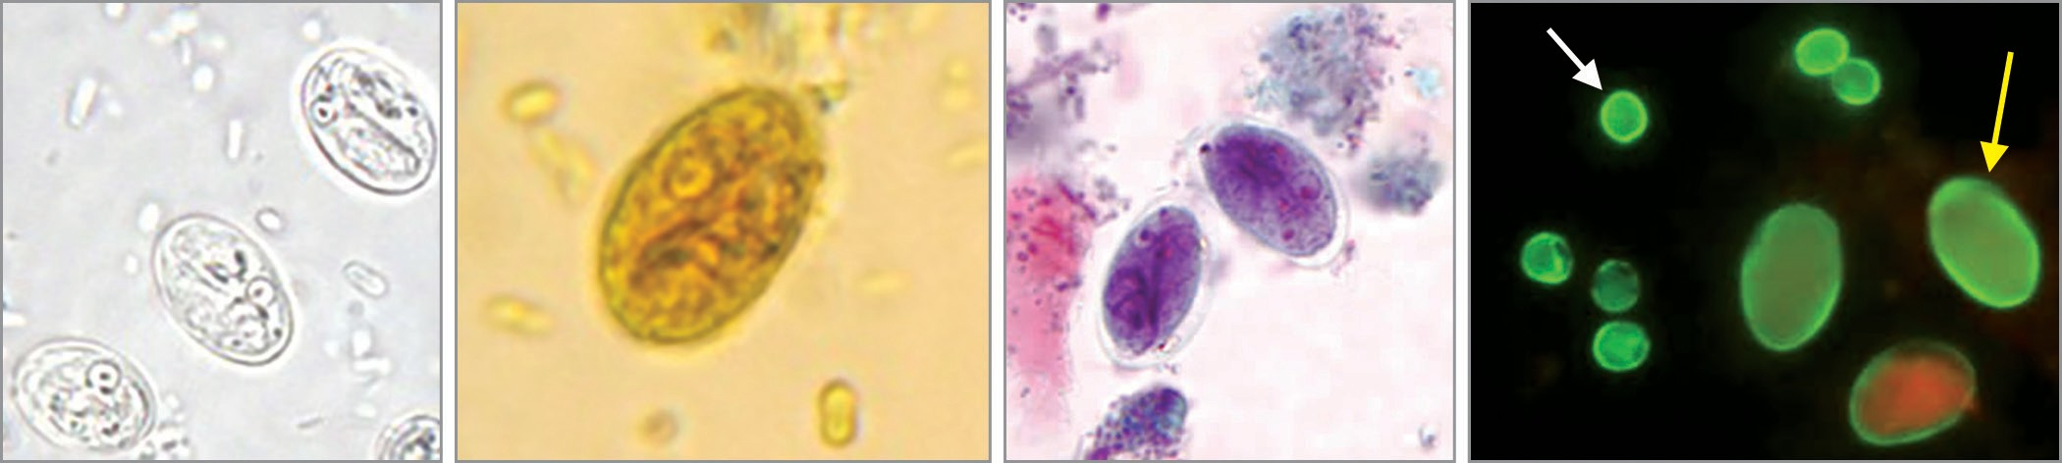
Laboratory Diagnosis (Cont..)
A
B
C
D
Cysts of Giardia lamblia: A. Saline mount; B. Iodine mount; C. Trichrome stain;
D. Direct immunofluorescence assay.

Slide 51
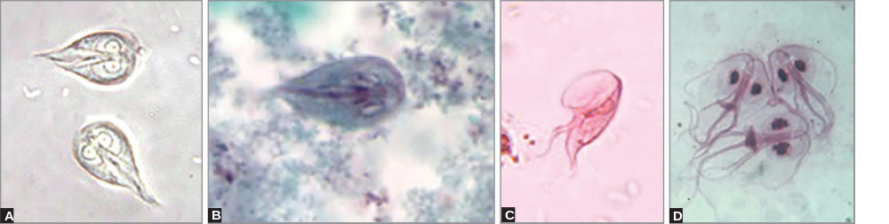
Laboratory Diagnosis (Cont..)
Trophozoites of Giardia lamblia: A. Saline mount front view; B. Trichrome stain front view; C. Merthiolate iodine formalin (MIF) stain lateral view (spoon shaped); D. Giemsa stained mucosal imprint (front view).

Slide 52
Laboratory Diagnosis (Cont..)
Antigen Detection in Stool (Coproantigen) - ELISA and direct fluorescent antibody tests (DFA), Rapid ICT (e.g. triage parasite panel).
Antibody Detection - Indirect fluorescent antibody (IFA) and ELISA.
Culture - Cultivated in axenic media - Diamond’s media used for E. histolytica. Culture is done for research purpose and to prepare the antigens

Slide 53
Laboratory Diagnosis (Cont..)
Molecular Methods – PCR, Biofire Filmarray.
Radiological Finding - Fluoroscopy , X-ray after barium meal

Slide 54
Treatment of Giardiasis
Tinidazole (2g once orally) - drug of choice
Metronidazole (for 5 days) or nitazoxanide (for 3 days) is given alternatively
Furazolidone is given to children and auranofin, paromomycin can be given in pregnancy

Slide 55
Treatment of Giardiasis (Cont..)
In patients with AIDS and hypogammaglobulinemia, giardiasis is often refractory to treatment.
Prolonged therapy with metronidazole (for 21 days) has been successful
Metronidazole resistance has been reported in Giardia.
Auranofin is shown to be effective

Slide 56
Prevention
Improved food and personal hygiene.
Boiling or filtering of potentially contaminated water
Treatment of asymptomatic carriers
No vaccine is currently available.

Slide 57
OTHER INTESTINAL FLAGELLATES OF MINOR
IMPORTANCE

Slide 58
OTHER INTESTINAL FLAGELLATES OF MINOR IMPORTANCE
Trichomonas tenax (mouth)
Pentatrichomonas hominis (large intestine)
Chilomastix mesnili (large intestine)
Enteromonas hominis (large intestine)
Retortamonas intestinalis (large intestine)
Dientamoeba fragilis

Slide 59
OPPORTUNISTIC INTESTINAL COCCIDIAN
PARASITIC INFECTIONS

Slide 60
OPPORTUNISTIC INTESTINAL COCCIDIAN
PARASITIC INFECTIONS
Cryptosporidium, Cyclospora, and Cystoisospora are the intestinal coccidian parasites - cause opportunistic infections in HIV infected patients producing profuse watery diarrhea.
Diagnosed by detection of acid fast oocysts in stool microscopy

Slide 61
OPPORTUNISTIC INTESTINAL COCCIDIAN
PARASITIC INFECTIONS (Cont..)
Cryptosporidium species infecting man – classified as two separate species, C. parvum (mammals, including humans) and C. hominis (primarily humans).
Other species infect wide range of mammals, but not man

Slide 62
OPPORTUNISTIC INTESTINAL COCCIDIAN
PARASITIC INFECTIONS (Cont..)
Cyclospora cayetanensis - recently described coccidian parasite, as human intestinal pathogen.
Isospora belli - recently renamed as Cystoisospora belli - only species that infects man.
No other animal reservoir is known.

Slide 63
MORPHOLOGY
The life cycle of coccidian parasites passes through various stages - oocyst, trophozoite, schizont (meront), merozoite, and zygote.
Oocyst is the infective form to man as well as the diagnostic form excreted in the feces.

Slide 64
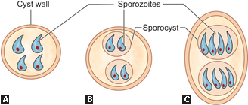
Sporulated oocysts
A. Cryptosporidium; B. Cyclospora; C. Cystoisospora.

Slide 65
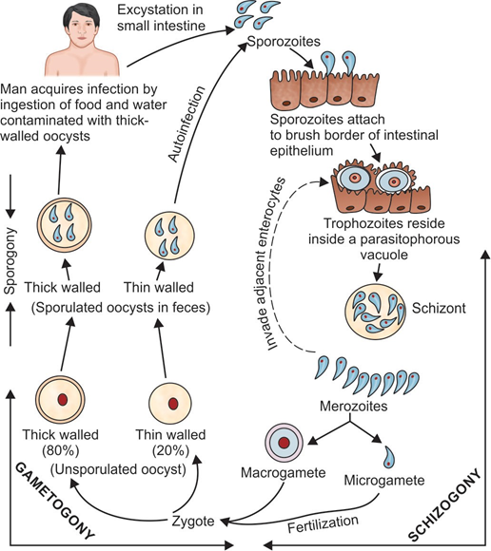
LIFE CYCLE

Slide 66
EPIDEMIOLOGY
Seen worldwide - more prevalent in tropical and subtropical climates of developing countries from South America, Africa, and Southeast Asia including India.
Highest prevalence - Haiti.

Slide 67
EPIDEMIOLOGY (Cont..)
Risk factors - More common in area with poor sanitation and HIV infected individuals
Peak age: Infants and children are commonly affected
Source of infection - rainwater lodges and swimming pool recreational water, or contaminated food (e.g. imported foods including raspberries, basil and mesclun lettuce)

Slide 68
PATHOGENESIS
Excystation: Oocyst secretes proteases and aminopeptidases - facilitate excystation in small intestine, releasing sporozoites
Attachment: Sporozoites attach to the brush border epithelium of the small intestine (ileum) -CP47 (47 kDa Cryptosporidium protein)
Penetration: Discharges from the apicomplex present in the anterior end of the sporozoites help in invasion

Slide 69
PATHOGENESIS (Cont..)
Vacuole: Parasitophorous vacuole near the microvilli surface of the host cells
Cytokines: Release cytokines like tumor necrosis factor (TNF)-α, IL-8, prostaglandins, etc. which induce Inflammation
These factors increase intestinal secretion of chloride and water and decrease the sodium absorption leading to fluid loss and diarrhea.

Slide 70
CLINICAL FEATURES
Immunocompetent Hosts:
Majority of infections - asymptomatic.
Some individuals develop symptoms - average incubation period of about 1 week.
Watery non-bloody diarrhea - common presentation.
Abdominal pain, nausea, anorexia, fever, and/or weight loss may be present
Self-limiting - subsides within 1–2 weeks

Slide 71
CLINICAL FEATURES (Cont..)
Immunocompromised Hosts (e.g. AIDS):
Chronic, persistent profuse diarrhea (1–25 L/day).
Severe weight loss, wasting and abdominal pain .
Extraintestinal manifestations - biliary tract infection (sclerosing cholangitis), respiratory tract infection, and pancreatitis
Disease is more severe in patients with AIDS when CD4+ T cell counts become <100/μL

Slide 72
CLINICAL FEATURES (Cont..)
Immunocompromised Hosts (e.g. AIDS) (Cont..):
Other immunocompromised conditions – severe combined immunodeficiency syndrome, hematological malignancies and solid organ transplant recipient
Disease - more severe in Cryptosporidium than Cyclospora and Cystoisospora - attributed to autoinfection seen in the former—a key factor for maintaining the infection, resulting in chronic persistent diarrhea.

Slide 73
LABORATORY DIAGNOSIS

Slide 74
Direct Microscopy (Stool Examination)
Sample collection: Three stool samples should be collected. Rarely (in HIV positive patients), sputum, bronchial wash, duodenal or jejunal aspirate can be collected
Direct wet mount: Highly refractile, double-walled oocyst

Slide 75
Direct Microscopy (Stool Examination) (Cont..)
Concentration technique: If the oocyst load is less, then various techniques are used to concentrate the stool sample
Acid-fast staining: Oocysts are acid-fast to 0.5–1% sulfuric acid or acid alcohol and appear as red color oocysts against blue back ground

Slide 76
Direct Microscopy (Stool Examination) (Cont..)
Concentration technique: If the oocyst load is less, then various techniques are used to concentrate the stool sample
Acid-fast staining: Oocysts are acid-fast to 0.5–1% sulfuric acid or acid alcohol and appear as red color oocysts against blue back ground

Slide 77
Direct Microscopy (Stool Examination) (Cont..)
Direct fluorescent antibody staining: Available for cryptosporidiosis - oocysts can be detected by using fluorescent labeled monoclonal antibody directed against cyst wall antigens.
Autofluorescence: Oocysts of Cyclospora fluoresce when viewed under ultraviolet epifluorescence microscopy.
Phase contrast microscopy

Slide 78
Differences between Cryptosporidium, Cyclospora and Cystoisospora
Property | Cryptosporidium | Cyclospora | Cystoisospora
Infective form | Sporulated oocyst | Sporulated oocyst | Sporulated oocyst
Diagnostic form | Sporulated oocyst | Unsporulated oocyst | Unsporulated oocyst
Outbreaks | Frequent, large | Common, large | Occasional, small
Zoonotic potential | Yes | Uncertain | No
Oocyst size | 4–6 mm | 8–10 mm | 20–33 mm
Oocyst shape | Round | Round | Oval
Sporulated oocyst contain | Four sporozoites | Two sporocysts, each having two sporozoites | Two sporocysts, each having four sporozoites

Slide 79
Differences between Cryptosporidium, Cyclospora and Cystoisospora (Cont..)
Property | Cryptosporidium | Cyclospora | Cystoisospora
Acid-fastness | Uniformly acid-fast | Variable acid-fast | Uniformly acid-fast
Autofluorescence | No, but can be stained with fluorescent dye | Autofluorescence ++ | Autofluorescence +/-
Sporulation of the oocyst | Occurs inside the host cells (enterocytes) | Occurs in soil (environment) | Occurs in soil (environment)
Treatment | Nitazoxanide | Cotrimoxazole | Cotrimoxazole

Slide 80
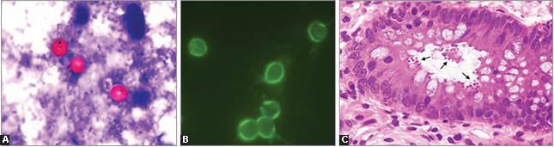
Cryptosporidium species
A. Acid-fast stain shows red color oocysts against blue back ground; B. Direct fluorescent antibody staining shows brilliant green fluorescent oocysts; C. Hematoxylin and eosin stain of intestinal biopsy shows numerous oocysts
at the luminal surface of the intestinal crypts (marked by arrows).

Slide 81
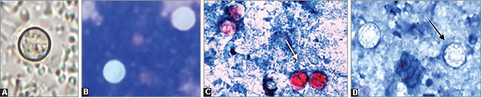
Cyclospora species
A. Saline mount preparation showing unsporulated oocyst; B. Epifluorescence microscopy
showing autofluorescent oocysts; C. Acid-fast oocysts; D. Non-acid fast oocysts (variable acid-fastness).

Slide 82
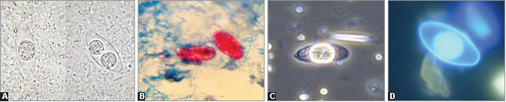
Cystoisospora belli
A. Saline mount preparation shows left—unsporulated oocyst and right—sporulated oocyst; B. Modified acid-fast stain showing unsporulated oocysts; C. Phase contrast microscopy showing unsporulated oocyst; D. Fluorescent stained smears showing unsporulated oocyst.

Slide 83
Histopathology
When stained by H&E stain, Cryptosporidium appears as 1–3 μm basophilic round bodies within the cell membrane of enterocytes called as “blue beads”

Slide 84
Antigen Detection from Stool
ELISA
ICT

Slide 85
Antibody Detection
ELISA are available detecting antibodies in patient’s serum against oocyst antigens of Cryptosporidium or Cyclospora.
Useful for sero-epidemiological purpose, not for routine diagnosis.

Slide 86
Molecular Diagnosis
PCR or real-time PCR can be performed to detect specific genes from both clinical and environmental samples targeting genes such as 18S rRNA or small subunit rRNA.
BioFire FilmArray

Slide 87
Other Methods
Low CD4-T lymphocyte count (especially in HIV positive patient)
Fecal leukocyte marker—lactoferrin is increased in 75% of cases indicating increase pus cells in feces.

Slide 88
Treatment of Intestinal coccidian parasitic infections
Mild cases
Self-limiting, requires fluid replacement like ORS.
Lactose-free glutamine supplemented diet is preferred for cryptosporidiosis.

Slide 89
Treatment of Intestinal coccidian parasitic infections (Cont..)
Severe cases
Cryptosporidiosis: Nitazoxanide is given to adults (for 3 days - not effective in HIV-infected patients. Paromomycin - alternate
Cyclosporiasis and cystoisosporiasis: Cotrimoxazole (for 7-10 days). Patients who cannot tolerate cotrimoxazole may be treated with ciprofloxacin or nitazoxanide.

Slide 90
Prevention
Requires minimizing exposure to infectious oocysts in human or animal feces
Proper hand washing, use of submicron water filters, use of appropriate disinfectants/sterilants to kill the oocysts (such as hydrogen peroxide, steam sterilization), improved personal hygiene are some of the efforts to prevent transmission.

Slide 91
OTHER INTESTINAL
PROTOZOAN INFECTIONS

Slide 92
OTHER INTESTINAL PROTOZOAN INFECTIONS
Balantidium coli, Sarcocystis spp., and Blastocystis hominis.
Involvement of intestinal muscles occurs in chronic Chagas’s disease caused by Trypanosoma cruzi.

Slide 93
BALANTIDIASIS

Slide 94
BALANTIDIASIS
Balantidiasis - intestinal infection caused by a protozoan parasite Balantidium coli. It is the
Largest protozoan and the only ciliated parasite of humans. It
Produces intestinal disease similar to amoebic dysentery.
Habitat: Resides in the large intestine.

Slide 95
BALANTIDIASIS (Cont..)
Host: Pig (main reservoir) and other animals - primary hosts.
Man - accidental host
Morphology: Exists in two forms -
  (1) trophozoite (found in the dysenteric stool),
  (2) cyst (found in carriers and chronic cases).
Both forms are binucleated having a large macronucleus and a small micronucleus

Slide 96
BALANTIDIASIS (Cont..)
Life cycle: Man gets infection - ingestion of food and water contaminated with cysts (infective form)
Cysts transform into trophozoites - multiply in the large intestine by both asexual mode and sexual mode (conjugation)
Both trophozoites and cysts - excreted in the feces.
Trophozoites disintegrate - cysts are resistant and are infective to man and pig.

Slide 97
BALANTIDIASIS (Cont..)
Clinical features: Majority of infected individuals - asymptomatic carriers. A
Small number of people develop acute dysenteric disease - Characterized by profuse diarrhea and dysentery with mucous and blood, weeks to months later.
Other features - fever, nausea, vomiting and abdominal pain

Slide 98
BALANTIDIASIS (Cont..)
Laboratory diagnosis: Repeated stool examination - as the parasite is excreted intermittently.
Trophozoites - appreciated in the saline mount.
Internal structures of cysts - seen more clearly in iodine mount.

Slide 99
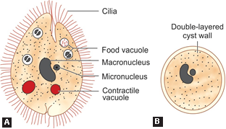
BALANTIDIASIS (Cont..)
Morphology of Balantidium coli (schematic diagram):
A. Trophozoite; B. cyst.

Slide 100
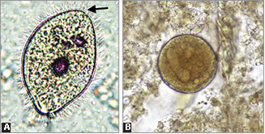
BALANTIDIASIS (Cont..)
Balantidium coli: A. Saline wet mount preparation shows trophozoite with cilia; B. Iron hematoxylin stain shows cyst with prominent macronucleus.

Slide 101
BALANTIDIASIS (Cont..)
Histopathology: Histopathological staining of the biopsy tissue or scrapping of the ulcers taken by sigmoidoscopy - cluster of trophozoites, cysts and lymphocytic infiltration in the submucosa.
Treatment: Tetracycline - drug of choice, given for 10 days.
Alternatively, metronidazole can be given

Slide 102
BLASTOCYSTOSIS

Slide 103
BLASTOCYSTOSIS
Blastocystosis - infection caused by a protozoan parasite Blastocystis hominis.
Resides in the intestine of many animals including humans.
Considered - most common commensal protozoa of intestine

Slide 104
BLASTOCYSTOSIS (Cont..)
Morphology: Occur in six forms—vacuolar, avacuolar, multi-vacuolar, amoeboid, granular and cyst forms
Life cycle: Cysts - infective form, transmitted by feco-oral route
Cysts develop into vacuolar forms in the intestine - multiply and transform into other forms and vice versa.
Vacuolar forms transform back to cysts
All forms - shed in the feces - only cysts can survive in the environment.

Slide 105
BLASTOCYSTOSIS (Cont..)
Pathogenesis: Most infected individuals - asymptomatic carriers.
Few present with symptoms of irritable bowel syndrome and diarrhea.
Ruling out other enteric parasites is necessary before attributing symptoms to Blastocystis

Slide 106
BLASTOCYSTOSIS (Cont..)
Laboratory diagnosis: Stool microscopy by permanent stained smear (trichrome stain) – procedure of choice.
Vacuolar forms - most common forms seen in stool microscopy. They measure 5–15 μm in size with 1–4 nuclei and a large vacuole in the cytoplasm .
Other diagnostic methods – antibody detection by ELISA and molecular methods - PCR targeting small subunit rDNA.

Slide 107
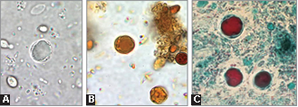
BLASTOCYSTOSIS (Cont..)
Blastocystis species showing vacuolar forms: A. Saline wet mount; B. Iodine mount; C. Trichrome stain.

Slide 108
BLASTOCYSTOSIS (Cont..)
Treatment: Metronidazole is found to be effective used alone or in combination with paromomycin or nitazoxanide.

Slide 109
INTESTINAL SARCOCYSTOSIS

Slide 110
INTESTINAL SARCOCYSTOSIS
Zoonotic parasitic infection caused by Sarcocystis hominis (infects cattle) and S. suihominis (infects pigs).
Human infection - extremely rare.
Host: Dogs and cats (and accidentally man)- definitive hosts.
Cattle and pigs - intermediate hosts

Slide 111
INTESTINAL SARCOCYSTOSIS (Cont..)
Life cycle: Infection - transmitted to man by ingestion of beef or pork infected with sarcocysts - transform to oocysts in the intestine - released in feces
Clinical features: Usually asymptomatic but patient may develop nausea, vomiting, abdominal pain and diarrhea

Slide 112
INTESTINAL SARCOCYSTOSIS (Cont..)
Diagnosis: Diagnosed by stool examination demonstrating the oocysts
Treatment: No specific treatment is available. Infection is generally self-limited.

Slide 113
CHAGAS’ DISEASE

Slide 114
CHAGAS’ DISEASE
In chronic Chagas’ disease, the causative agent, Trypanosoma cruzi multiplies in the muscles of GIT, leading to megaesophagus (manifested as dysphagia, chest pain, and regurgitation) and megacolon (manifested as abdominal pain and chronic constipation)

Slide 115
FUNGI CAUSING
INTESTINAL INFECTIONS

Slide 116
MICROSPORIDIOSIS

Slide 117
MICROSPORIDIOSIS
Microsporidia - lower eukaryotic, spore forming obligate intracellular parasites, cause opportunistic infection in HIV-infected patients.
Taxonomic status: Microsporidia were once classified under parasite - now considered to be evolved from the fungi, being most closely related to zygomycetes

Slide 118
Classification and clinical manifestations of microsporidia
Genus | Species | Habitat and infections
Enterocytozoon | E. bieneusi | Most common species infecting man Small intestine: Enteric infection (diarrhea, acalculous cholecystitis) Rarely cause nasal polyp, infections of bile duct, liver and respiratory system It has zoonotic potential. More than 90 genotypes are described; only 17 infect humans, most common being group 1
Encephalitozoon | E. intestinalis | Second most common species infecting man Small intestine: Enteric infection
 | E. cuniculi | Extraintestinal infections such as: Disseminated systemic infection Eye: Keratoconjunctivitis Sinuses: Chronic sinusitis CNS: Brain abscess Heart: Myocarditis and endocarditis Respiratory and genitourinary tract infections

Slide 119
Classification and clinical manifestations of microsporidia (Cont..)
Genus | Species | Habitat and infections
Encephalitozoon | E. hellem | Disseminated infection involving eyes (keratoconjunctivitis), urinary tract and respiratory tract, Transmission is from birds
Pleistophora | P. ronneafiei | Skeletal muscle (myositis)
Trachipleistophora | T. hominis | Myositis, sinusitis and conjunctivitis
 | T. anthropophthera | Infects brain, heart and kidney
Brachiola | B. vesicularum | Skeletal muscle and corneal stroma (corneal ulcer)
Anncaliia | A. connori | Eye: Corneal stroma Smooth and cardiac muscle infections
 | A. algerae | Eyes, muscle and possible disseminated infection Mosquito-borne transmission documented

Slide 120
Classification and clinical manifestations of microsporidia (Cont..)
Genus | Species | Habitat and infections
Nosema | N. ocularum | Eye: Corneal stroma
Vittaforma | V. corneae | Eye: Corneal stroma and rarely urinary tract (UTI) Water-borne transmission has been documented
Tubulinosema | T. acridophagus | Systemic disseminated infection Grasshoppers are the non-human host
Microsporidium | M. ceylonensis | Eye: Corneal stroma (corneal ulcer)
 | M. africanum | Eye: Corneal stroma (corneal ulcer)

Slide 121
MICROSPORIDIOSIS (Cont..)
Spore: Microsporidia exist in nature as spores.
Spore - highly resistant extracellular form; survives in the environment.
It is also the infective stage.
Enters into the host cell via a polar tube within a spore

Slide 122
MICROSPORIDIOSIS (Cont..)
Life cycle: Humans acquire infection by ingestion of spores of microsporidia
Spores come in contact with the host cell (e.g. enterocyte) and inject its cytoplasm (called sporoplasm) with help of polar tube
They multiply inside host cells first by asexual mode producing meronts, and then by sexual mode (sporogony) producing sporonts - subsequently develop into spores.

Slide 123
Pathogenesis and Clinical Feature
Microsporidia mainly cause opportunistic infections
In HIV-infected patients, when their CD4 T cell count falls below 100 μL or
In any other patients with immunosuppression - recipients of organ transplant.

Slide 124
Pathogenesis and Clinical Feature (Cont..)
Depending up on the species causing infection, clinical presentation of microsporidiosis may be of various types:
  Enteric infections
  Ocular infections
  Myositis

Slide 125
Laboratory Diagnosis - Light Microscopy for the Spore Detection
Various samples can be collected - stool, small intestinal contents (collected by Entero-test), corneal smear or small intestinal biopsies, sputum, urine, etc.
Modified trichrome stain (MTS)
Modified acid fast stain
Gram stain
Other stains: Giemsa stain, periodic acid Schiff stain (PAS), Gram chromotrope stain and fluorochrome stain like calcofluor white stain.

Slide 126
Laboratory Diagnosis - Electron Microscopy
Considered as the gold standard method for the diagnosis of microsporidiosis
Helps in identifying microsporidia to the genus and species level
Highly specific, but lacks sensitivity.
Time consuming, labor-intensive and expensive.

Slide 127
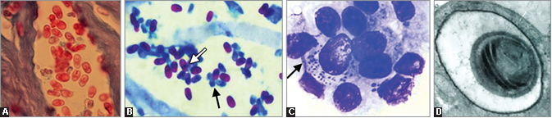
Microsporidia spores
A. Modified trichrome stain; B. Acid-fast stain (showing red stained mature spores and blue stained (nonacid-fast) immature or degenerating spores; C. Duodenal biopsy (Giemsa stain) shows numerous spores inside the enterocyte (marked by arrow);
D. Electron microscopic picture.

Slide 128
Laboratory Diagnosis - Other Methods
Cell culture
Antibody assays
Antigen assays
Molecular methods
In situ hybridization

Slide 129
Treatment of Microsporidiosis
Albendazole - effective for the treatment of enteric, muscular and ocular microsporidiosis.
Given 400 mg twice daily for 2–4 weeks.
Relapse may be seen in some cases
Other alternative drugs : Octreotide, nitazoxanide, fumagillin and itraconazole

Slide 130
Treatment of Microsporidiosis
Nutritional therapy: To reduce malabsorption in case of enteric microsporidiosis
Topical agents - applied for the corneal lesions like topical itraconazole, metronidazole and topical propamidine
Control of AIDS by antiretroviral therapy (ART)

Slide 131
Questions:
Q1. Infective form and invasive form of Entamoeba histolytica are:
Trophozoite and quadrinucleated cyst
Quadrinucleated cyst and trophozoite
Both trophozoite
Both quadrinucleated cyst

Slide 132
Questions:
Q2. Sporulated oocyst of Cystoisospora belli contains::
One sporocyst and two sporozoites
One sporocyst and four sporozoites
Two sporocysts and four sporozoites
Two sporocysts and eight sporozoites

Slide 133
Questions:
Q3. Intermediate host for Sarcocystis suihominis is:
Pig
Dog
Cattle
Man

