Slide 1
Intestinal Helminthic Infections
Dr. Ved Prakash
Professor & Head
PG Department of Microbiology

Slide 2
Learning objectives
At the end of the session, the students will be able to understand:
Morphology, life cycle, pathogenesis, clinical features, laboratory diagnosis and treatment of various types of intestinal cestode, trematode and nematode infections.
Examples of intestinal nematodes causing infections in lower animals

Slide 3
INTRODUCTION
Intestinal cestodes: Diphyllobothrium, Taenia saginata, T. solium, Hymenolepis nana and Dipylidium caninum
Intestinal trematodes:
  Intestinal flukes, e.g. Fasciolopsis buski
  Blood flukes - Schistosoma mansoni and S. japonicum reside in mesenteric venous plexus of GIT, and cause various GI symptoms including dysentery.

Slide 4
INTRODUCTION (Cont..)
Intestinal nematodes:
  Small intestinal nematodes - Ascaris, hookworm and Strongyloides
  Large intestinal nematodes - Trichuris and Enterobius.
Intestinal nematodes of lower animals rarely infect man. Examples - Toxocara, Angiostrongylus, etc.

Slide 5
INTESTINAL CESTODE INFECTIONS

Slide 6
INTESTINAL CESTODE INFECTIONS
Cestodes - long, segmented, flattened dorsoventrally, tape like worms - also called as tapeworms.
Based on habitat, they are classified into two groups:
  1. Intestinal cestodes
  2. Somatic/tissue cestodes

Slide 7
INTESTINAL CESTODE INFECTIONS (Cont..)
Cestodes - long, segmented, flattened dorsoventrally, tape like worms - also called as tapeworms.
Based on habitat, they are classified into two groups:
  1. Intestinal cestodes
  2. Somatic/tissue cestodes

Slide 8
Life cycle of various cestodes
Cestodes | Host |  | Mode of transmission | Infective form | Diagnostic form | Organs affected
 | Definitive | Intermediate
Taenia saginata | Man | Cattle | Ingestion | Cysticercus bovis | Embryonated eggs | GIT
Taenia solium (intestinal taeniasis) | Man | Pig | Ingestion | Cysticercus cellulosae | Embryonated eggs | GIT
Taenia solium (cysticercosis) | Man | Man | Ingestion, autoinfection | Embryonated eggs | Cysticercus larvae | CNS, muscle, eye
Echinococcus granulosus | Dog | Man | Ingestion | Embryonated eggs | Hydatid cyst (larva) | Liver
Hymenolepis nana | Man | - | Ingestion, autoinfection | Embryonated eggs | Embryonated eggs | GIT
Diphyllobothrium latum | Man | 1st- Cyclops, 2nd- Fish | Ingestion | Plerocercoid larvae | Operculated eggs | GIT

Slide 9
MORPHOLOGICAL FORMS

Slide 10
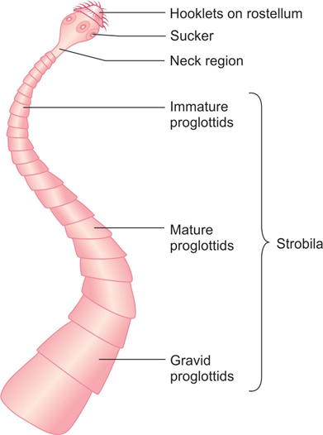
Adult Worm
Adult worm - long, segmented, dorsoventrally flattened; varies in length from few millimeters to several meters.
Inhabits in the intestine of men and animals.
Adult worm consists of three parts
  1. Head or scolex
  2. Neck
  3. Strobila

Slide 11
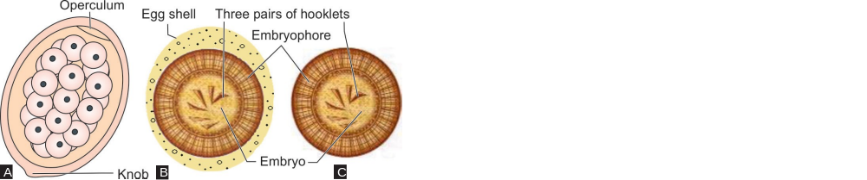
Eggs
Eggs are formed following fertilization, fill the gravid proglottids and are subsequently released in feces - considered as the diagnostic form.
Schematic diagrams of eggs of cestodes: A. D. latum; B. Other cestodes; C. Other cestodes after the loss of egg shell.

Slide 12
Larva
Embryonated eggs undergo further development to form larvae.
Most cestodes have only one larval stage except D. latum.
  In Taenia, the larval stage - called as cysticercus
  In Hymenolepis, the larval stage - called as cysticercoid
  In Echinococcus - called as hydatid cyst
  In Diphyllobothrium there are three larval stages - coracidium (first stage), procercoid (second stage) and plerocercoid (third stage).

Slide 13
INTESTINAL TAENIASIS

Slide 14
INTESTINAL TAENIASIS
Two important pathogenic species - T. saginata and T. solium.
They cause two types of manifestations in humans:
  Intestinal taeniasis—caused by both T. saginata and T. solium
  Cysticercosis—caused by only T. solium. - infects various tissues such as CNS, eyes and muscles

Slide 15
Morphology
Taenia exists in three morphological forms.
  1. Adult worm
  2. Eggs
  3. Larvae

Slide 16
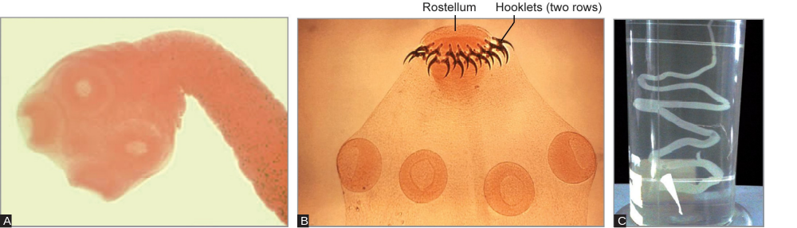
Morphology
A. Carmine-stained scolex of T. saginata; B. Carmine-stained scolex of T. solium; C. Adult worm of Taenia species.

Slide 17
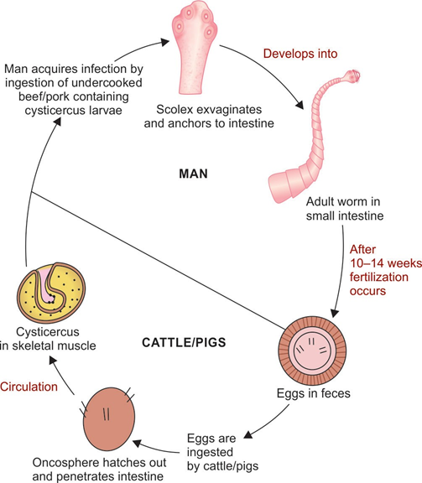
Life Cycle (Intestinal taeniasis)

Slide 18
Epidemiology
T. saginata infection - common in cattle breeding areas of the world.
Areas with the highest prevalence (up to 27%) - Central Asia, Central and East Africa.
T. solium intestinal infection - endemic in Mexico, Central America, South America, Africa, Southeast Asia, India, Philippines, and Southern Europe.

Slide 19
Clinical Manifestations
Majority of cases - asymptomatic; patients may become aware of infection by noticing the passage of proglottids in their feces.
Common symptoms - mild abdominal pain, nausea, loss of appetite and change in the bowel habit
Perianal discomfort or pruritus may be felt (when proglottids are discharged).

Slide 20
Laboratory Diagnosis - Stool Examination
Wet mount - demonstrate the characteristic eggs and less often proglottids of Taenia species.
Multiple stool examination and concentration techniques (formol-ether sedimentation) - to increase the detection rate.
Anal swabs (cellophane swabs used for Enterobius) - used to collect fecal matter - superior for the detection of eggs than in the stool

Slide 21
Laboratory Diagnosis - Stool Examination (Cont..)
Egg - round 31–43 μm size and consists of an embryo with six hooklets surrounded by an embryophore.
Eggs are bile-stained; do not float in saturated salt solution.

Slide 22
Differences between Taenia saginata and T. solium.
Features | Taenia saginata | Taenia solium
Adult worm
Length | 4–6 meters | 2–4 meters
Head/scolex | Large and quadrangular Four suckers present No rostellum, No hooklets | Small and globular Four suckers present Bears rostellum with two rows of hooklets Hence called as armed tapeworm

Slide 23
Differences between Taenia saginata and T. solium (Cont..)
Features | Taenia saginata | Taenia solium
Proglottids
No. of proglottids | 1,000–2,000 | 800–1,000
Uterus | Bears in 15–20 lateral branches | Bears in 7–13 lateral branches
Lobes of ovary | Two, no accessory lobe | Three–two lobes with an accessory lobe
Vaginal sphincter | Present | Absent
Expulsion of segments | Expelled singly in the feces | Expelled in chain of 5–6 segments

Slide 24
Differences between Taenia saginata and T. solium (Cont..)
Features | Taenia saginata | Taenia solium
Larva
 | Cysticercus bovis present in cattle’s muscle, but not in man | Cysticercus cellulosae present in pig’s muscle and also in man (muscle, eye and brain)
Egg
 | Acid fast, 31–43 µm size | Non-acid fast, 31–43 µm size

Slide 25
Differences between Taenia saginata and T. solium (Cont..)
Features | Taenia saginata |  | Taenia solium
Life cycle
Disease | Causes intestinal taeniasis | Causes intestinal taeniasis and cysticercosis
Host | Definitive host: Man Intermediate host: Cattle | For intestinal taeniasis— definitive host is man, intermediate host is pig For cysticercosis—man acts both as definitive and intermediate hosts
Infective form | Larva (cysticercus bovis) | For intestinal taeniasis— larva (C. cellulosae) For cysticercosis—egg
Diagnostic form | Egg | For intestinal taeniasis— egg For cysticercosis—larva (deposited in tissue)
Mode of transmission | Ingestion of contaminated beef | For intestinal taeniasis— ingestion of contaminated pork For cysticercosis— (i) contaminated food and water and (ii) auto- infection

Slide 26
Laboratory Diagnosis - Taenia Specific Antigen Detection in Stool
ELISA - to detect Taenia specific antigen (coproantigen) in stool by using polyclonal Taenia antibodies.
Advantages:
More sensitive than stool examination
Detect Taenia carriers

Slide 27
Laboratory Diagnosis - Taenia Specific Antigen Detection in Stool (Cont..)
Disadvantage:
Cannot differentiate between T. saginata and T. solium.

Slide 28
Laboratory Diagnosis - Molecular Methods
PCR targeting mitochondrial DNA followed by sequencing is available; which can distinguish between Taenia species.

Slide 29
Treatment of Intestinal taeniasis
Praziquantel (drug of choice): Single dose of (10 mg/kg) is highly effective
Niclosamide (2 g) - also effective - not widely available.

Slide 30
Prevention
Adequate cooking of beef or pork viscera
Thorough cooking at 65°C for 5 minutes
Refrigeration at 4°C for >30 days
Salting and pickling are not effective.
Effective fecal disposal to prevent infection to cattle and pigs.

Slide 31
Taenia saginata asiatica (Asian Tapeworm)
Intermediate host - pig (not cow) - cysticerci are located primarily in the liver (not in the muscle).
Man acquires infection - ingestion of pig liver containing infected cysticerci
Human infection - reported from Taiwan and other Asian countries- but not reported from India.

Slide 32
HYMENOLEPIASIS

Slide 33
HYMENOLEPIASIS
Caused by Hymenolepis nana - the smallest cestode (2.5–4 cm in length) infecting man.
Also called as dwarf tapeworm.

Slide 34
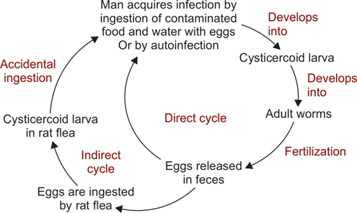
Life cycle of Hymenolepis nana.

Slide 35
Clinical manifestations
H. nana infection - usually asymptomatic.
When the worm burden exceeds, patients develop symptoms - anorexia, abdominal pain, headache, dizziness and diarrhea with mucus

Slide 36
Epidemiology
H. nana - considered as the most common tapeworm infection throughout the world infecting 50–75 million of people.
The overall prevalence ranges from 0 to 4% with higher prevalence in children (16%)

Slide 37
Laboratory diagnosis
Stool microscopy detecting the characteristic eggs confirms the diagnosis.
Stool concentration can be done if the egg load is less.
PVA (polyvinyl-alcohol) should not be used for preservation as it distorts the morphology

Slide 38
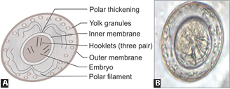
Eggs of H.nana
A. Schematic;
B. In saline mount (non-bile stained).

Slide 39
Treatment
Praziquantel (25 mg/kg once) - treatment of choice, since it acts against both the adult worms and the cysticercoid larvae.
Nitazoxanide or niclosamide may be used alternatively

Slide 40
Prevention
Good personal hygiene.
Improved sanitation can control the disease.

Slide 41
Hymenolepis diminuta Infection
Also called as rat tape worm.
Rodents - definitive host and insects - intermediate host.
Human infection is rare, occurs through indirect cycle (as described for H. nana).
Eggs are larger 70–85 × 60–80 μm, do not bear polar filaments and are bile stained.

Slide 42
DIPYLIDIUM CANINUM INFECTION

Slide 43
DIPYLIDIUM CANINUM INFECTION
D. caninum - common tapeworm of dogs and cats - rarely infects man producing GI symptoms - loss of appetite, diarrhea, pruritus ani, abdominal pain, etc.
Host: Definitive hosts - dogs and cats (rarely men).
Intermediate hosts - insects (fleas)

Slide 44
DIPYLIDIUM CANINUM INFECTION (Cont..)
Transmission: Ingestion of flea containing cysticercoid larva
Diagnosis: Eggs are detected in feces, 25–40 μm size, present in groups of 15 (egg packets).
Proglottids - typically barrel-shaped and contain two genital pores - also called as double pored tapeworm.

Slide 45
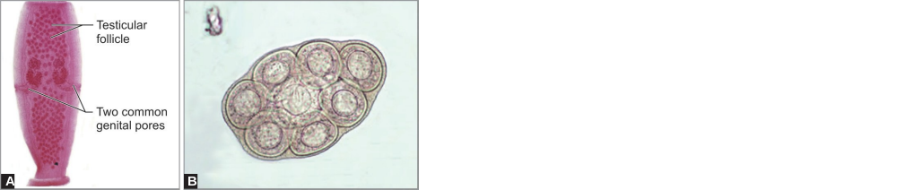
DIPYLIDIUM CANINUM INFECTION (Cont..)
A. Proglottids with two genital pores (carmine stained); B. Egg packets (in saline mount).

Slide 46
DIPHYLLOBOTHRIASIS

Slide 47
DIPHYLLOBOTHRIASIS
Diphyllobothriasis - intestinal parasitic infection, caused by a cestode Diphyllobothrium latum, also known as fish tapeworm.
Largest known parasite found in human intestine.

Slide 48
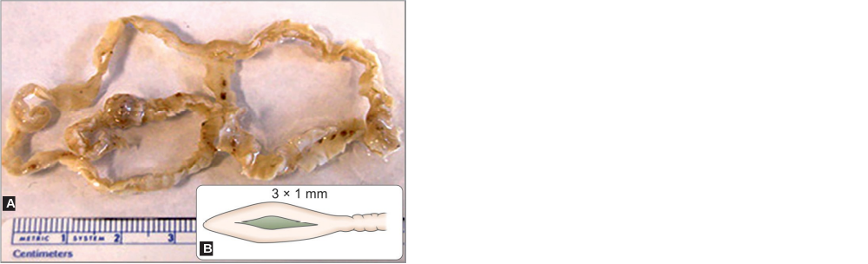
Morphology
D. latum has three morphological forms:
1. Adult worm
2. Operculated egg
3. Larvae: Three stages - first stage (coracidium), second stage (procercoid larva) and third stage (plerocercoid larva).
A. Section of an adult worm containing many proglottids; B. Scolex (schematic) with two bothria (or grooves).

Slide 49
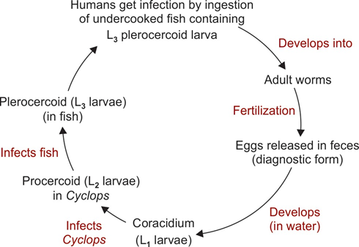
Life Cycle

Slide 50
Clinical Features
Most of D. latum infections are asymptomatic.
Few individuals develop symptoms.
Minor manifestations – abdominal discomfort, diarrhea, vomiting, weakness and weight loss or rarely acute abdominal pain due to intestinal obstruction, cholangitis or cholecystitis

Slide 51
Clinical Features (Cont..)
Vitamin B12 deficiency: The adult worm causes dissociation of the vitamin B12-intrinsic factor complex within the gut lumen - leads to a decrease in absorption of B12 at ileum.
Vitamin B12 deficiency leads to development of megaloblastic anemia and some people may exhibit neurologic sequelae like paresthesia

Slide 52
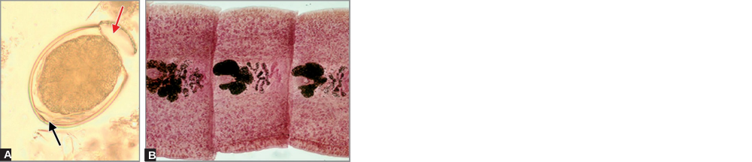
Laboratory Diagnosis
Stool examination - Characteristic eggs and sometime segments of adult worm.
A. Egg—note the operculum (red arrow) and posterior knob (black arrow); B Carmine-stained gravid proglottids—note broader than longer, rosette-shaped ovaries).

Slide 53
Laboratory Diagnosis (Cont..)
Molecular method: PCR followed by sequencing
Blood examination - eosinophilia and evidence of megaloblastic anemia such as:
  ↑ Mean corpuscular volume and mean corpuscular hemoglobin
  Normal mean corpuscular hemoglobin concentration
  Macrocytes (enlarged RBCs).

Slide 54
Treatment of Diphyllobothriasis
Praziquantel (5–10 mg/kg once) - highly effective (drug of choice)
Niclosamide - given alternatively
Parenteral vitamin B12 - given if B12 deficiency is manifested.

Slide 55
Prevention
Preventive measures - thorough cooking of fish or freezing.
D. latum infection - called the Jewish housewives’ disease, as they acquire infection by tasting the uncooked fish while preparing.
Proper cooking of fish (5 minutes at 55°C)
Deep freezing (−20°C for 7 days, or −35°C for 15 hours) of fish should be followed for people who eat raw fish.

Slide 56
INTESTINAL TREMATODE INFECTIONS

Slide 57
INTRODUCTION
Trematodes (or flukes) - unsegmented, leaf-like and flat worms.
Based on the habitat, trematodes are classified as follows:
  Intestinal flukes
  Blood flukes
  Hepatic flukes
  Lung flukes

Slide 58
INTRODUCTION (Cont..)
Intestinal flukes—e.g. Fasciolopsis buski.
Blood flukes—e.g. Schistosoma - S. mansoni , S. japonicum and S.haematobium.
Hepatic flukes—e.g. Fasciola hepatica and F. gigantica in liver, Clonorchis and Opisthorchis in bile duct.
Lung flukes—e.g. Paragonimus westermani

Slide 59
Morphology
Trematodes exist in three morphological forms—adult worm, egg and larva.
Adult worm: Unsegmented and flattened dorsoventrally, but some have thick fleshy bodies (schistosomes).
Eggs: Trematodes are oviparous, i.e. they lay eggs; which develop into larvae later in the environment
Larvae: Most trematodes have five larval forms - miracidium, sporocyst, redia, cercaria, and metacercaria

Slide 60
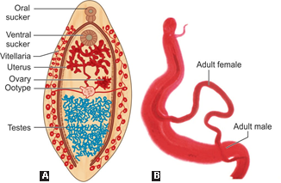
Morphology (Cont..)
Adult worm of: A. Fasciolopsis buski (schematic); B. Schistosoma (The thin female worm resides in the gynecophoric canal of the thicker male worm)

Slide 61
Life Cycle
Trematodes | Organ affected | Host |  | Mode of transmission | Infective form | Diagnostic form
 |  | Definitive | Intermediate
Schistosoma |  | Man | Snail | Skin penetration | Cercaria larvae | Non-operculated eggs with spine
S. haematobium | Bladder
S. mansoni | Intestine
S. japonicum | Intestine

Slide 62
Life Cycle (Cont..)
Trematodes | Organ affected | Host |  | Mode of transmission | Infective form | Diagnostic form
 |  | Definitive | Intermediate
Fasciolopsis buski | Intestine | Man | 1st- Snail 2nd- Aquatic plants | Ingestion | Metacercaria larvae | Operculated eggs
Fasciola hepatica | Liver
Clonorchis spp., Opisthorchis spp. | Bile duct | Man | 1st- Snail, 2nd- Fish | Ingestion | Metacercaria larvae | Operculated eggs
Paragonimus spp. | Lungs | Man | 1st- Snail, 2nd- Crab | Ingestion | Metacercaria larvae | Operculated eggs

Slide 63
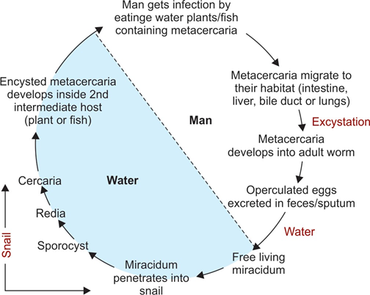
Life Cycle of All Trematodes Except
Schistosomes

Slide 64
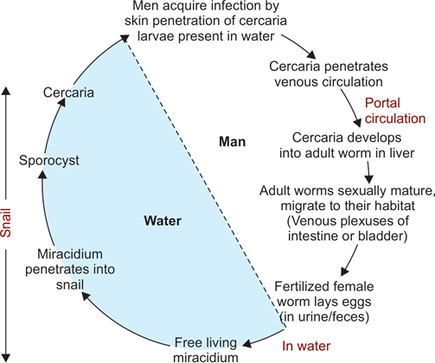
Life Cycle of Schistosomes

Slide 65
Treatment of Trematode infections
Praziquantel - drug of choice for all trematode infections except for Fasciola, where triclabendazole is recommended.

Slide 66
SCHISTOSOMIASIS

Slide 67
SCHISTOSOMIASIS
Schistosomiasis - second most devastating tropical parasitic disease (after malaria), affecting more than 200 million people residing in rural and agricultural areas.
Schistosomes - known as blood flukes as they live in vascular system of humans and other vertebrate hosts

Slide 68
SCHISTOSOMIASIS (Cont..)
The important schistosomes that parasitize humans are:
S. mansoni and S. japonicum—reside in mesenteric venous plexus (of GIT), cause various GI symptoms including dysentery.
S. haematobium: Found in Africa - resides in venous plexus of bladder and causes urinary schistosomiasis and carcinoma of bladder

Slide 69
Morphology and Life Cycle

Slide 70
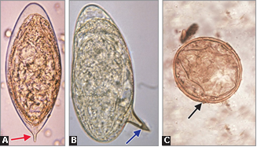
Morphology and Life Cycle (Cont..)
Schistosoma (The thin female worm resides in the gynecophoric canal of the thicker male worm).
Schistosoma eggs: A. S. haematobium;
B. S. mansoni; C. S. japonicum.

Slide 71
Schistosoma mansoni
S. mansoni produces intestinal schistosomiasis in humans, first identified by Sir Patrick Manson in West Indies.

Slide 72
Pathogenesis and Clinical Features
Pathogenesis of mansonian schistosomiasis occurs in three stages:
  Cercarial Dermatitis
  Acute Schistosomiasis (Katayama Syndrome)
  Chronic Schistosomiasis

Slide 73
Laboratory Diagnosis
Stool Microscopy:
In acute cases, eggs can be detected in stool by microscopy.
In chronic cases - with low worm burden, the number of eggs excreted - is less. The following ways can be employed to increase the sensitivity.
  Multiple stool specimens should be examined
  Stool concentration techniques by centrifugal sedimentation.
  Hatching test
  Quantitation of eggs in stool specimens - by Kato thick smear technique.

Slide 74
Laboratory Diagnosis (Cont..)
Other methods include:
Histopathological demonstration of lateral spined eggs in biopsy material from rectal mucosa - confirms the diagnosis of schistosomiasis
Egg shell of S. mansoni is acid-fast - can be stained by modified Ziehl-Neelsen stain.

Slide 75
Laboratory Diagnosis (Cont..)
Antigen Detection:
ELISA - to detect circulating cathodic (CCA) and circulating anodic antigens (CAA) of schistosomes in the serum and urine
Dipstick test is available for detecting CCA in urine; showed sensitivity of 92%.

Slide 76
Laboratory Diagnosis (Cont..)
Antibody Detection:
Less useful as they cross react with other helminth infections, become positive slowly and remain positive even after successful treatment.
Various tests available cercaria-Huller reaction, ELISA and western blot
They detect antibodies by employing antigens - soluble adult worm or egg antigens.

Slide 77
Treatment of S. mansoni infection
Praziquantel - drug of choice; given 20 mg/kg/dose, two doses in single day.
Oxamniquine is also very effective.

Slide 78
Prevention
Proper disposal of human excreta
Eradication of snails by using molluscicides such as metal salts (iron or aluminum sulfate), metaldehyde, methiocarb and acetylcholine esterase inhibitors
Treatment of infected persons

Slide 79
Schistosoma japonicum
Most pathogenic species among the schistosomes.
It is the only schistosome species that shows zoonotic transmission.

Slide 80
Pathogenesis and Clinical Features
Pathogenesis - almost similar to that caused by S. mansoni.
However, the disease is more severe because of the higher egg production and smaller size of the eggs .
The manifestations seen are as follows.
Cercarial dermatitis and Katayama fever, intestinal and hepatosplenic disease.
Left lobe of liver is the most common site involved.

Slide 81
Pathogenesis and Clinical Features (Cont..)
Cerebral schistosomiasis: CNS involvement is more marked in infection with S. japonicum than other schistosomes - involves brain, causing acute encephalitis.
Carcinoma: Both colorectal carcinoma and liver carcinoma (and cirrhosis) - reported from people of China and Japan infected with S. japonicum

Slide 82
Laboratory Diagnosis
Stool microscopy reveals characteristic eggs.
Pyrosequencing assay - designed to detect DNA specific to S. japonicum and S. mekongi in fecal samples and in infected snails
Magnetic fractionation method

Slide 83
Treatment of S. japonicum infection
Praziquantel is given 20 mg/kg/dose, three doses in single day.

Slide 84
Elimination of Schistosomiasis
WHO is currently moving towards elimination of schistosomiasis as a public health problem in Africa by 2020 and globally by 2025.
This may be achieved through treatment of cases using praziquantel to prevent morbidity in later life and also through mass drug administration in some places (Egypt and China).

Slide 85
FASCIOLOPSIASIS

Slide 86
FASCIOLOPSIASIS
Fasciolopsiasis - infection with the intestinal fluke.
Fasciolopsis buski—also known as giant intestinal fluke.
Largest and the most common intestinal fluke infecting man.

Slide 87
Epidemiology
F. buski - mainly endemic in Southeast Asian countries such as India, China, Pakistan, Bangladesh, Thailand and Malaysia.
India: In India, most of the cases have been reported from Eastern Uttar Pradesh, Bihar, West Bengal and Assam and Maharashtra

Slide 88
Life Cycle
The life cycle of F. buski is similar to other trematodes (except Schistosoma).
Host: It has one definitive host (pig or man) and two intermediate hosts (first—snail, second—aquatic plants)
Modes of transmission: Humans acquire infection by eating contaminated water plants, carrying the infective form, the metacercaria larvae.

Slide 89
Pathogenesis
The main pathogenesis is due to the traumatic and obstructive damage to the intestine.
Light infection: May be asymptomatic or its attachment to intestinal mucosa leads to local inflammation, ulcerations with mucus and blood in stool
In severe infection: There may be partial obstruction of intestinal tract

Slide 90
Pathogenesis (Cont..)
Malabsorption and protein losing enteropathy - seen with profuse yellowish green stool
Marked eosinophilia and leukocytosis are commonly observed.

Slide 91
Laboratory Diagnosis
Detection of large number of operculated eggs in the stool sample - probable diagnosis of F. buski.
Eggs are large (130–140 μm × 80–85 μm size), operculated and bile stained; morphologically similar to the eggs of F. hepatica

Slide 92
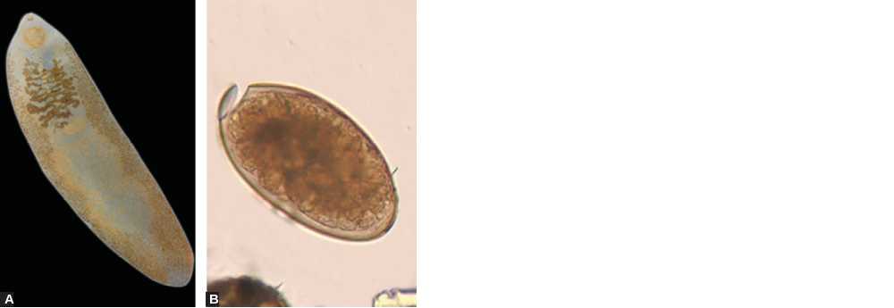
Laboratory Diagnosis (Cont..)
Sedimentation methods - recommended for stool concentration when worm load is less
Definitive diagnosis - done only after identification of the adult worm
Fasciolopsis buski: A. Adult worm;
B. Egg (saline mount).

Slide 93
Treatment of Fasciolopsiasis
Praziquantel - drug of choice - given as 25 mg/kg, three doses in 1 day
Niclosamide is given alternatively.

Slide 94
INTESTINAL NEMATODE INFECTIONS

Slide 95
Classification based on Habitat
Intestinal Nematodes
Tissue or Somatic Nematodes

Slide 96
Intestinal Nematodes
Small intestinal nematodes—Ascaris, hookworm and Strongyloides
Large intestinal nematodes—Trichuris and Enterobius.

Slide 97
Tissue or Somatic Nematodes
Filarial nematodes:
Wuchereria bancrofti and Brugia malayi cause lymphatic filariasis (Chapter 37)
Loa loa, Onchocerca volvulus, and Mansonella cause cutaneous filariasis
Dracunculus medinensis: Causes Guinea-worm disease.
Trichinella spiralis: Produces profuse watery diarrhea, followed by myalgia due to deposition of encysted larvae in muscles

Slide 98
Classification based on they Lay Egg or Larva
1. Oviparous: Following fertilization, the female worms produce eggs that take some time to hatch out to form larvae in the environment
Most of the intestinal nematodes are oviparous except for Strongyloides.
Examples - hookworm, Ascaris, Trichuris, Enterobius, etc.
Diagnosis is made by detection of eggs in feces.

Slide 99
Classification based on they Lay Egg or Larva (Cont..)
2. Viviparous: Female worms directly give birth to larvae; there is no egg stage
Most of the somatic nematodes are viviparous.
Examples - filarial worms, Trichinella and Dracunculus
Diagnosis is made by detection of larvae in tissues or blood.

Slide 100
Classification based on they Lay Egg or Larva (Cont..)
3. Ovoviviparous: Female worms lay eggs containing larvae; which immediately hatch out
Example - Strongyloides species
Larvae - diagnostic form detected in stool examination.

Slide 101
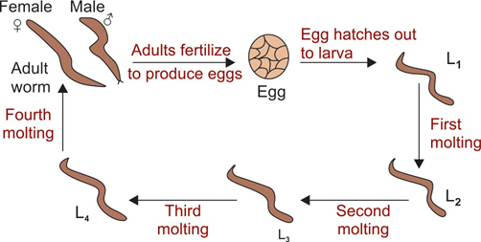
Morphology (Nematodes)
Developmental stages of nematodes

Slide 102
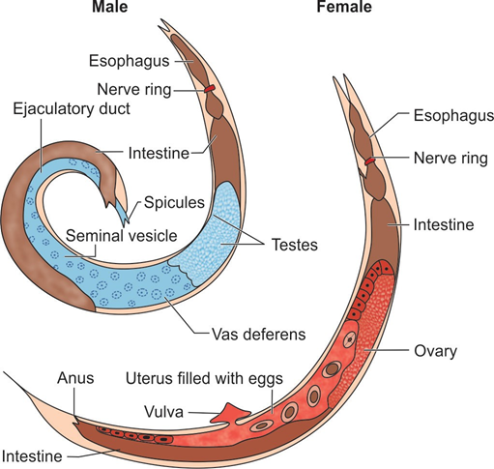
Adult Worm
Adult male and female nematode

Slide 103
TRICHURIASIS

Slide 104
TRICHURIASIS
Trichuriasis - also known as whipworm infection; caused by the intestinal nematode Trichuris trichiura.
It is a soil transmitted helminth.
Trichuris has several other species, which rarely infect animals.

Slide 105
Epidemiology
Trichuriasis is worldwide in distribution, mainly in warm and moist climate similar to ascariasis.
Children are commonly affected
Global prevalence in humans is about 604 million.

Slide 106
Morphology
T. trichiura exists in three forms:
  Adult, larvae (four stages) and egg.
  The adult worm resembles to a handle of a whip, (therefore called as whipworm).

Slide 107
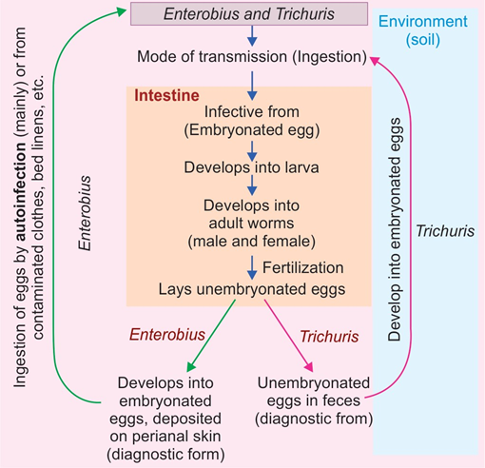
Life Cycle

Slide 108
Pathogenicity and Clinical Feature
Incubation period - 70 to 90 days.
Most infected individuals are asymptomatic, with or without having eosinophilia.

Slide 109
Pathogenicity and Clinical Feature (Cont..)
In people with heavy infections: Adult female worms get buried in the large intestinal mucosa, that leads to:
Mechanical distortion: Leading to inflamed, edematous, and friable mucosa
Allergic response by the host : Large number of macrophages infiltrate in the lamina propria that produce tumor necrosis factor-α (TNF-α).

Slide 110
Pathogenicity and Clinical Feature (Cont..)
Common manifestations include:
  Abdominal pain, anorexia, etc.
  Trichuris dysentery syndrome
  Iron deficiency anemia
  Recurrent rectal prolapse
  Malnutrition leading to growth retardation and impaired cognitive function

Slide 111
Laboratory Diagnosis
Stool Examination:
Stool examination is carried out either by direct wet mount or following concentration of the stool, which reveals characteristic egg and occasionally adult worm.
Single stool specimen is sufficient for diagnosis of symptomatic cases as the level of egg output is usually high.

Slide 112
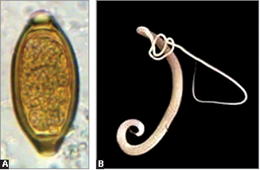
Laboratory Diagnosis (Cont..)
Trichuris trichiura: A. Egg in saline mount (bile stained); B. Adult female worm.

Slide 113
Laboratory Diagnosis (Cont..)
Other Findings:
  Peripheral blood eosinophilia (<15%)
  Increased serum IgE level.

Slide 114
Treatment of Trichuriasis
Mebendazole (500 mg once) or albendazole (400 mg daily for three doses) is safe and moderately effective for treatment, with cure rates of 70–90%
Ivermectin (200 mg/kg daily for three doses) is also safe but is less effective.

Slide 115
ENTEROBIASIS

Slide 116
ENTEROBIASIS
Enterobiasis - common parasitic infection in children caused by the intestinal nematode, Enterobius vermicularis.
It is also called as pinworm or threadworm infection (as the adult worm of Enterobius is small, white and thread-like).

Slide 117
Epidemiology
Globally, around 209 million people are infected by pinworms; most common age group - school children.
People carry the infection for years together due to autoinfective Cycles.
Factors promoting infection: Overcrowding and impaired hygiene, poor personal care (nail biting or inadequate hand washing).

Slide 118
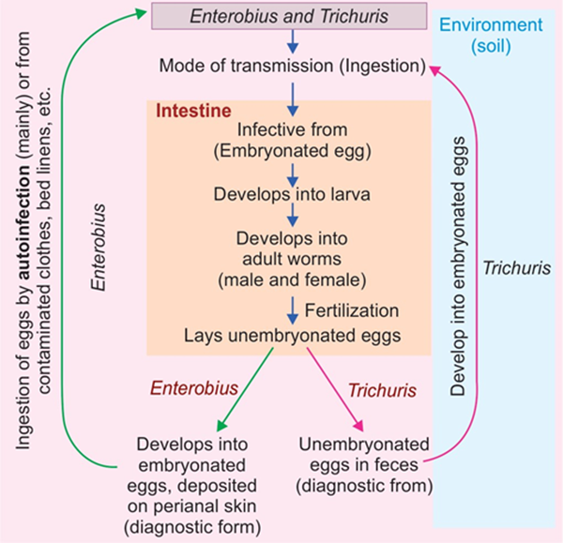
Life Cycle

Slide 119
Life Cycle (Cont..)
Mode of transmission: Infection occurs via:
  Autoinfection: Two types—(i) exogenous autoinfection, by transferring eggs to the mouth with hands that have scratched the perianal area, (ii) endogenous autoinfection, by retrograde migration of the larva hatched from the eggs in the perianal skin.
  Through ingestion of eggs in the environment (e.g. surfaces, clothes, bed linens, etc.) through contaminated fingers.

Slide 120
Pathogenicity and Clinical Features
Most of the infections are asymptomatic. Few develop clinical disease.
Age and sex: Females, children and young adults are often symptomatic than males and older people
Cardinal symptoms: Perianal pruritus often worse at night as a result of the nocturnal migration of the female worm.
Migration of the worm: Rarely, pinworms invade the female genital tract, causing vulvovaginitis and pelvic or peritoneal granulomas.
Eosinophilia is inconsistent.

Slide 121
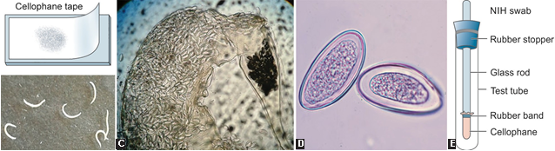
Laboratory Diagnosis
Microscopy of perianal skin samples is the test of choice which detects characteristic eggs. Specimen is collected by two methods.
  Cellophane tape
  NIH swab

Slide 122
Laboratory Diagnosis (Cont..)
There are few other points to consider while specimen collection:
Number of specimens: A series of 4–6 consecutive tapes - necessary as the female worms migrate intermittently
Timing: Samples should be collected when the chance of egg deposition is more - late in the evening, when the patient has been sleeping for several hours, or first thing in the morning

Slide 123
Laboratory Diagnosis (Cont..)
The female worms lay eggs in the perianal area; not in the rectum.
Hence, eggs are rarely detected by stool examination; around 5% of cases
The adult female worms may occasionally be found in the feces or crawling onto the perianal skin.

Slide 124
Laboratory Diagnosis (Cont..)
B
B. Adult worms (actual size); C. Adult female worm containing
numerous eggs; D. Planoconvex eggs

Slide 125
Treatment of Enterobiasis
One of the following drugs can be given:
  Mebendazole (100 mg once) or
  Albendazole (400 mg once) or
  Pyrantel pamoate (11 mg/kg once; maximum, 1 g)
The same treatment should be repeated after 2 weeks
Treatment of household members is advocated to eliminate asymptomatic reservoirs of potential reinfection.

Slide 126
Prevention
Improving personal hygiene - proper washing of bed clothes, keeping nail short and clean, frequent hand washing - key measures to contain the transmission.

Slide 127
ASCARIASIS

Slide 128
ASCARIASIS
Ascariasis - infection of the small intestine caused by Ascaris lumbricoides.
It is the largest nematode parasitizing the human intestine.
Commonly called as roundworm.
It is a soil-transmitted helminth

Slide 129
Epidemiology
A. lumbricoides - cosmopolitan in distribution, mainly affecting tropical countries including India.
Transmission typically occurs through fecally contaminated soil and is due to either lack of sanitary facilities or use of human feces as fertilizer
Clay soils - most favorable for the development of Ascaris eggs (in contrast to moist porous soil required for hookworm)
Risk factors: Children and malnutrition.

Slide 130
Morphology
Ascaris exists in three forms: adult, larvae (four stages) and egg.
Adult worm is cylindrical and measures 15–31 cm.
The female worms liberate two types of eggs—(1) fertilized eggs, and (2) unfertilized eggs.

Slide 131
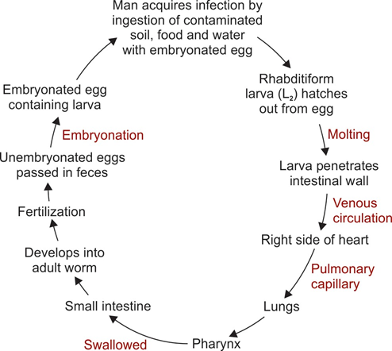
Life Cycle

Slide 132
Pathogenesis and Clinical Feature
Pathogenesis caused by Ascaris infection is attributed to:
(i) the host immune response,
(ii) migration of larva,
(iii) mechanical obstruction by the adult worms, and
(iv) nutritional deficiencies due to the presence of adult worms.
Incubation period is about 60–70 days - pulmonary symptoms can be earlier

Slide 133
Pulmonary Phase
Results from migrating larvae in the lungs – provoke an immune-mediated hypersensitivity response.
Symptoms - observed in the second week after the ingestion of eggs; characterized by non-productive cough, chest discomfort and fever
Eosinophilic pneumonia (Loeffler’s syndrome)

Slide 134
Intestinal Phase
Results due the effect of adult worm in the intestine.
  Asymptomatic
  Malnutrition and growth retardation
  Intestinal complications
  Extraintestinal complications
  Allergic manifestations like fever, urticaria, angioneurotic edema and conjunctivitis

Slide 135
Laboratory Diagnosis - Detection of the Parasite
Egg Detection (Stool Examination):
Both fertilized and unfertilized eggs - detected by stool examination by saline and iodine wet mount.
Concentration techniques by sedimentation method.
Floatation method for stool concentration - not preferred as unfertilized eggs do not float on saturated salt solution.

Slide 136
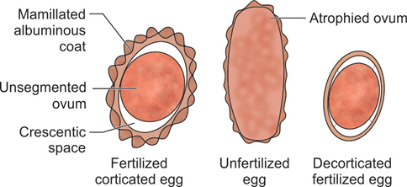
Laboratory Diagnosis - Detection of the Parasite (Cont..)

Slide 137
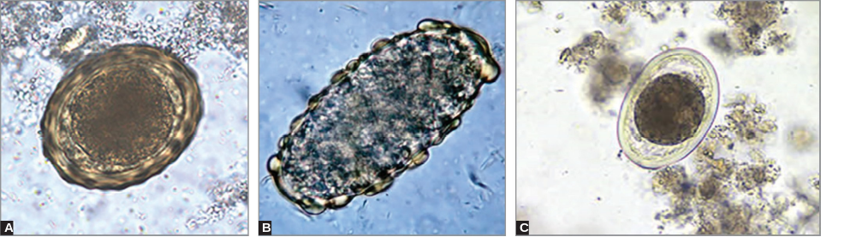
Laboratory Diagnosis - Detection of the Parasite (Cont..)
Eggs of Ascaris lumbricoides: A. Fertilized eggs; B. Unfertilized eggs;
C. Decorticated eggs

Slide 138
Laboratory Diagnosis - Detection of the Parasite (Cont..)
Adult worm detection:
Occasionally, adult worms - detected in stool or sputum of the patients by naked eye .
Barium meal X-ray of the GIT - demonstrate the adult worms in the intestine.
When two worms are lying parallel - trolley car lines appearance in X-ray
Ultrasound or cholangiopancreatography - done to detect the adult worms in extraintestinal sites.

Slide 139
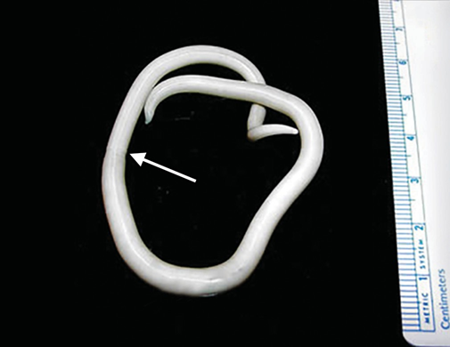
Laboratory Diagnosis - Detection of the Parasite (Cont..)
Adult worm detection:

Slide 140
Laboratory Diagnosis - Detection of the Parasite (Cont..)
Larva detection:
During the early pulmonary migratory phase, larvae can be found in sputum or gastric aspirates before the eggs appear in the stool.

Slide 141
Laboratory Diagnosis – Serology (Cont..)
Antibody detection (by ELISA and other formats) though sensitive; cannot differentiate between recent and past infection.
It also cross-reacts with other helminthic infections. It is
Mainly useful for seroepidemiological purposes and for assessing transmission in areas aiming for elimination.

Slide 142
Laboratory Diagnosis – Molecular Method (Cont..)
PCR - developed targeting internal transcribed spacer region (ITS1) or cytochrome oxidase-1 of Ascaris egg in the stool.
Multiplex PCR – simultaneously differentiate Ascaris, Trichuris and hookworm.
Real-time PCR - used for quantitation of the parasite load in the stool.

Slide 143
Laboratory Diagnosis – Other Methods(Cont..)
Eosinophilia is prominent during the early lung stage, but disappears later
Presence of Charcot-Leyden crystals in sputum and stool, a nonspecific finding seen in ascariasis.

Slide 144
Treatment of Ascariasis
Antiparasitic drugs:
Albendazole (400 mg once) or mebendazole (100 g twice daily for 3 days or 500 mg once) is recommended - effectively kills the adult worm, but has limited effect on larval migration phase
Alternatively, drugs like ivermectin (150–200 mg/kg once) and nitazoxanide are also effective
In pregnancy, pyrantel pamoate is safe

Slide 145
Treatment of Ascariasis (Cont..)
Symptomatic treatment:
Partial intestinal obstruction - managed with nasogastric suction, intravenous (IV) fluid administration.
Complete obstruction and its severe complications like intussusception require immediate surgical intervention.

Slide 146
HOOKWORM INFECTION

Slide 147
HOOKWORM INFECTION
Hookworm - one of the important causes of iron deficiency anemia in both tropics and temperate countries.
It is one of the soil-transmitted helminths

Slide 148
Classification
Ancylostoma duodenale or old world hookworm
Necator americanus or new world hookworm or American hookworm.
There are several animal parasites that rarely infect man, cause cutaneous larva migrans—Ancylostoma braziliensis, A. caninum and A. ceylanicum

Slide 149
Epidemiology
World: Hookworm infection is widespread.
  Necator infection (835 million) is more common than Ancylostoma (135 million)
India: Hookworm infection is widely prevalent in India.
  N. americanus - predominant in South India and A. duodenale - North India
  Heavily infected areas are: Assam (tea gardens), West Bengal, Bihar, Odisha, Andhra Pradesh, Tamil Nadu, Kerala and Maharashtra.

Slide 150
Epidemiology (Cont..)
Age and sex distribution: Males and young adults - commonly affected - anemia due to iron loss - more severe in children and pregnant women
Endemic index: Chandler’s index - used in the epidemiological studies of hookworm disease to estimate the morbidity and mortality in the community due to hookworm infection (which depends much upon the worm load).

Slide 151
Morphology
Hookworm has three morphological forms: adult, larvae (four stages) and egg.
Ancylostoma and Necator - differentiated by the morphology of adult worm and third stage larva.
Eggs and first stage larvae of both are morphologically indistinguishable

Slide 152
Morphology (Cont..)
Adult worm is small (7–13 mm) in size, has a bent in the anterior end (hence called as hookworm)
The adult worm of Ancylostoma and Necator - differentiated by buccal capsule with teeth or cutting plate (present in the anterior end) and copulatory bursa (present in the posterior end)
L1 larva - called as rhabditiform larva whereas L3 stage larva -- called as filariform larva.

Slide 153
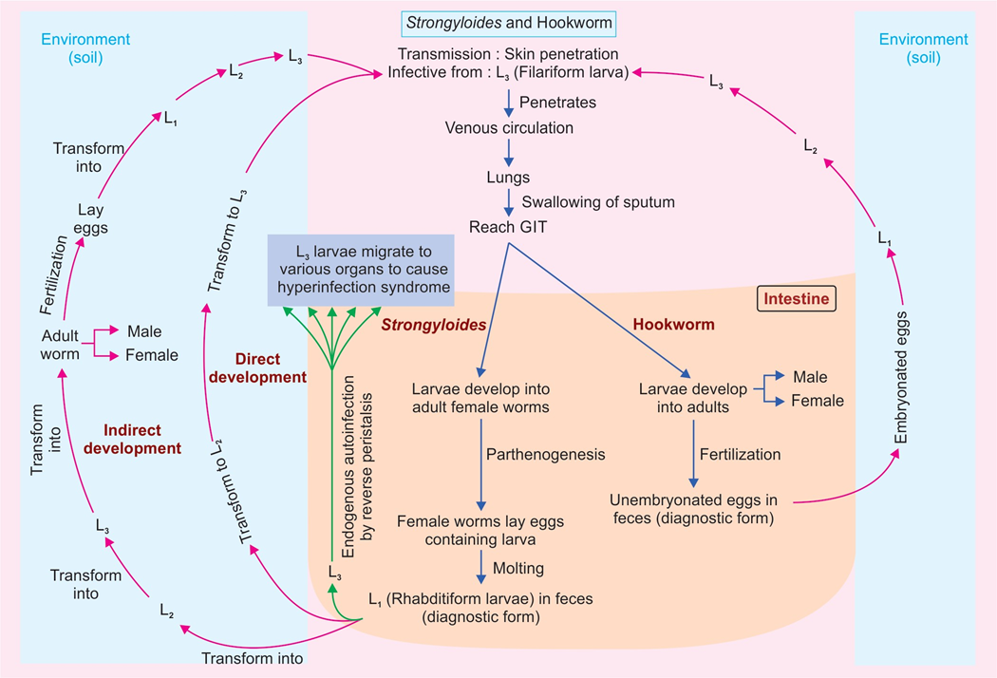
Life Cycle

Slide 154
Pathogenicity
Hookworm has ability to suck blood from the intestinal vessels, which occurs by several ways:
Attaching and making cuts in the intestinal wall by buccal capsule and teeth followed by sucking the blood through contraction of their muscular esophagus
Secreting hydrolytic enzymes
Releasing anticoagulants – maintain continuous oozing of blood from the attachment site.

Slide 155
Pathogenicity (Cont..)
Ancylostoma is more pathogenic than Necator - because of its larger size, armed with teeth and more migratory.
Blood loss in Ancylostoma infection is 0.15–0.26 mL/worm/day, compared to Necator (0.03 mL/worm/ day).
There is an increased TH2 response leading to increased antibodies such as IgG4 or IgE levels.

Slide 156
Clinical Features - Affect due to Migrating Larva
Cutaneous lesions
  Ground itch - at the site of skin penetration
  Serpiginous tracks
Mild transient pneumonitis

Slide 157
Clinical Features - Affect due to Adult Worm in Intestine
Asymptomatic
Early intestinal phase (less worm load)
Late intestinal phase (chronic infection with heavy worm load)
Wakana disease

Slide 158
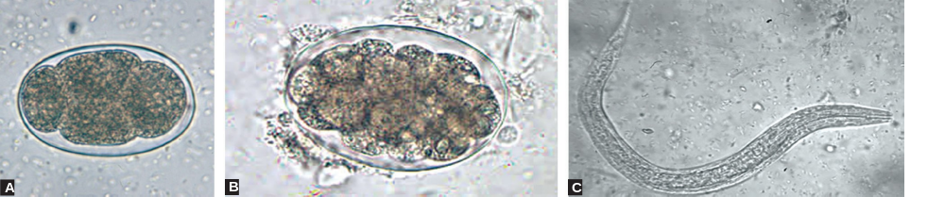
Laboratory Diagnosis - Stool Microscopy
Stool concentration procedures - required to detect lighter infections
In a stool sample that is not fresh, the eggs may hatch out to release rhabditiform larvae - which need to be differentiated from that of Strongyloides.

Slide 159
Laboratory Diagnosis - Stool Microscopy (Cont..)
Egg counting: To estimate the disease burden in the individual as well as in the community.
Various methods are:
  Kato Katz technique
  Direct smear method of beaver
  Modified Stoll’s dilution egg count method.

Slide 160
Laboratory Diagnosis - Stool Microscopy (Cont..)
A. Egg with four blastomeres; B. Egg with many blastomeres; C. Rhabditiform larva.

Slide 161
Classification of intensity of infection based on WHO guidelines (eggs per gram of stool)
 | LIGHT | MODERATE | HEAVY
TRICHURIS | 1–999 | 1000–9999 | ≥10000
ASCARIS | 1–4999 | 5000–49999 | ≥50000
HOOKWORM | 1–1999 | 2000–3999 | ≥4000

Slide 162
Laboratory Diagnosis - Stool Culture
Freshly passed stool samples - cultured - eggs hatch out to develop to L3 stage filariform larvae in 5–7 days - differentiate A. duodenale from N. americanus.
Various culture techniques used are:
  Harada-Mori filter paper tube method
  Baermann funnel technique
  Charcoal culture method
  Agar plate technique (more sensitive).

Slide 163
Laboratory Diagnosis - Molecular Diagnosis
PCR and real-time PCR – developed targeting genes - mitochondrial cytochrome oxidase genes.
Molecular methods have the advantages such as:
Species specific; can differentiate between Ancylostoma and Necator
More sensitive, can detect as low as one copy per 200 mg of stool.

Slide 164
Laboratory Diagnosis - Other Findings
(i) hypochromic microcytic anemia,
(ii) eosinophilia, and
(iii) hypoalbuminemia.

Slide 165
Treatment of Hookworm disease
Antiparasitic:
Antiparasitic drugs - albendazole (400 mg once) or mebendazole (500 mg once) or pyrantel pamoate (11 mg/kg for 3 days) can be given
Resistance to albendazole and mebendazole has also been reported

Slide 166
Treatment of Hookworm disease (Cont..)
Symptomatic treatment:
Mild iron-deficiency anemia - treated with oral iron and folic acid
Severe hookworm disease with protein loss and malabsorption - nutritional support and oral or parenteral iron replacement

Slide 167
Prevention
Improved personal hygiene
Proper disposal of feces
Improved nutrition with dietary iron
Treatment of infected persons

Slide 168
Soil-transmitted helminth infection
Soil-transmitted helminth (STH) infections – intestinal worms infecting humans - transmitted through contaminated soil - Ascaris, Trichuris and hookworm.
Global situation: Worldwide >1.5 billion people (i.e. 24% of the world’s population) are infected with STH infection - tropical and subtropical areas, with the greatest numbers occurring in sub-Saharan Africa, the America, China and East Asia

Slide 169
Soil-transmitted helminth infection (Cont..)
High-risk group - preschool children, school-age children, women of childbearing age (including pregnant women) and adults in certain high-risk occupations - tea-pickers or miners
Presentation: Infected children - nutritionally, intellectually and physically impaired - suffer from malabsorption of nutrients, anemia, diarrhea and dysentery - depending upon the type of helminths infected

Slide 170
Soil-transmitted helminth infection (Cont..)
Deworming: Periodic prophylactic measure to prevent high-risk people from worm infestation; initiated by World Health Organization (WHO)
  The National Deworming Day: Every year, 10th February and 10th August
  Deworming - once in a year if the prevalence of STH infection is >20% in the community and twice a year if >50%
  In this day, single-dose albendazole (400 mg) - all children aged 1–19 years.

Slide 171
Soil-transmitted helminth infection (Cont..)
Elimination: WHO aim is to eliminate the morbidity due to STH infection in children by 2030.
The global target is kept as <2% of children have STH infections of moderate and heavy intensity by 2030.

Slide 172
STRONGYLOIDIASIS

Slide 173
STRONGYLOIDIASIS
Strongyloidiasis caused by an intestinal nematode Strongyloides stercoralis. It
Was known as the “military worm” - first found in the feces of French soldiers in Cochin-China in 1876.
Human infection is mainly caused by S. stercoralis and rarely by S. fuelleborni.

Slide 174
Morphology
Similar to other nematodes, S. stercoralis exists in three forms: adult, larvae (four stages) and egg.
Adult worm: Only female worms - seen in the small intestine of man - 2–3 mm long.
Male worms - free-living - present in environment, but not in human intestine
Eggs: Strongyloides are ovoviviparous, i.e. eggs once laid, immediately hatch out to larvae.

Slide 175
Life Cycle

Slide 176
Pathogenesis and Clinical Feature
Effect due to Migrating Larva:
  Asymptomatic infection
  Rashes: Recurrent maculopapular or urticarial rashes
  Cutaneous larva migrans: Migrating larvae - serpiginous urticarial rash
  (commonly on thigh) - larva currens .
  Pulmonary symptoms - uncommon - occurs only secondary to underlying chronic obstructive lung disease.

Slide 177
Pathogenesis and Clinical Feature (Cont..)
Effect due to Adult Worm and Filariform Larva:
  Mild to moderate worm load: Adult worms and larvae traversing the upper small bowel mucosa may produce epigastric pain (resembling peptic ulcer), nausea, diarrhea, constipation, and blood loss
  Heavy larva load: Hyperinfection syndrome and disseminated strongyloidiasis – important complications, observed in heavy larva load.

Slide 178
Complications of strongyloidiasis
Hyperinfection syndrome The underlying cause of hyperinfection syndrome is the repeated autoinfection cycles; which leads to generation of large number of filariform larvae. The larvae penetrate the GIT and migrate to various organs. Risk factors: Impaired host immunity favors larva multiplication Glucocorticoid therapy is the main risk factor Other risk factors include immunosuppressive conditions such as transplant recipients, hematologic malignancies, and intake of immunosuppressive drugs Hyperinfection syndrome is common in patients coinfected with human T cell lymphotropic virus type (HTLV-1) Coinfection of Strongyloides with HIV is common. However, it is not associated with disseminated strongyloidiasis.

Slide 179
Complications of strongyloidiasis (Cont..)
Features: Colitis, enteritis, or malabsorption, and in severe cases disseminated strongyloidiasis may develop. Disseminated strongyloidiasis: Larvae may invade the GIT and migrate to various organs including CNS, peritoneum, liver, and kidneys Moreover, the passage of enteric flora through disrupted mucosa lead to gram-negative bacterial sepsis, pneumonia, or meningitis which may dominate the clinical course CNS invasion, brain abscess and meningitis are common. Larvae can be seen in the CSF occasionally. CSF examination show pleocytosis, elevated protein, normal glucose and negative for bacterial culture. Eosinophilia is often absent in severely infected patients The mortality rate in untreated patients approaches 100% and even with treatment it may exceed 25%.

Slide 180
Laboratory Diagnosis - Stool Microscopy
Stool microscopy - characteristic rhabditiform larvae (diagnostic form).
Concentration techniques - performed to increase the yield.
Single stool examination - less sensitive (30%) due to irregular and low output of larvae.
Repeated stool examination (four samples) is required

Slide 181
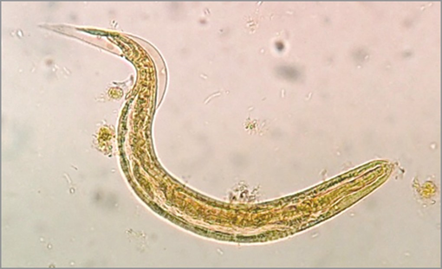
Laboratory Diagnosis - Stool Microscopy (Cont..)
Rhabditiform larva of Strongyloides stercoralis (Iodine mount).

Slide 182
Differences between rhabditiform larva of hookworm and Strongyloides stercoralis
Rhabditiform larva | Hookworm | Strongyloides
Size | 100–150 µm long × 16 µm width | 108–380 µm long × 14–20 µm width
Mouth (buccal cavity) | Three times longer | Shorter
Genital primordium | Less prominent and small | Prominent and large
Anal pore (subterminal) | 80 µm from the posterior end | 50 µm from the posterior end

Slide 183
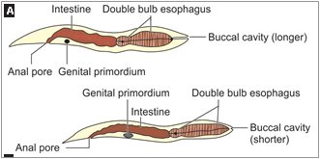
Rhabditiform larva
B
A. Hookworm; B. Strongyloides stercoralis

Slide 184
Laboratory Diagnosis - Microscopy of
Specimens other than Stool
Entero-test
Disseminated strongyloidiasis – diagnosed by examining stool, sputum, other body fluids, and tissue biopsies - contain high numbers of filariform larvae

Slide 185
Laboratory Diagnosis - Stool Culture
Harada-Mori filter paper tube method
Baermann funnel technique
Agar plate technique (more sensitive)
Charcoal culture method.

Slide 186
Laboratory Diagnosis - Serology
ELISA using crude larval antigens
LIP assay (Luciferase immunoprecipitation)

Slide 187
Laboratory Diagnosis - Coproantigen Detection in Stool
Antigen capture ELISA - developed using polyclonal rabbit antiserum raised against Strongyloides ratti excretory/secretory antigen

Slide 188
Laboratory Diagnosis - Molecular Diagnosis
Real-time PCR assays - targeting various genes of S. stercoralis - cytochrome C oxidase gene, 18S rRNA gene in fecal samples.

Slide 189
Treatment of Strongyloidiasis
Even in the asymptomatic stage, strongyloidiasis must be treated because of the potential for subsequent fatal hyperinfection
Ivermectin (200 mg/kg daily for 2 days) - more effective than albendazole (400 mg daily for 3 days)
For disseminated strongyloidiasis: Prolonged course of Ivermectin - 5–7 days or until the parasites are eradicated.

Slide 190
Strongyloides fuelleborni
Zoonotic parasite affecting monkeys, occasionally causes human infection, called as swollen belly syndrome.
Serious life-threatening condition - diarrhea, respiratory distress and protein losing enteropathy, leading to hypoalbuminemia and edema.
Diagnosed by detecting the eggs but not larvae in the stool.
Thiabendazole is used for treatment

Slide 191
INTESTINAL NEMATODES OF LOWER
ANIMALS THAT RARELY INFECT MAN

Slide 192
INTESTINAL NEMATODES OF LOWER
ANIMALS THAT RARELY INFECT MAN
Angiostrongylus costaricensis
Anisakiasis species
Capillaria philippinensis—eggs resemble with that of Trichuris trichiura
Trichostrongylus species—also called as pseudo-hookworm as eggs resemble with that hookworm
Oesophagostomum species
Ternidens deminutus (or African colon worm).

Slide 193
Questions:
Q1. Which of the following cestode does not have a rostellum and hooks:
Echinococcus granulosus
Taenia solium
Taenia saginata
Hymenolepis nana

Slide 194
Questions:
Q2. Which of the following cestode eggs are NOT bile stained:
Echinococcus granulosus
Taenia solium
Diphyllobothrium latum
Hymenolepis nana

Slide 195
Questions:
Q3. All of the following intestinal nematodes are oviparous, except:
Roundworm
Strongyloides
Hookworm
Enterobius

