Slide 1
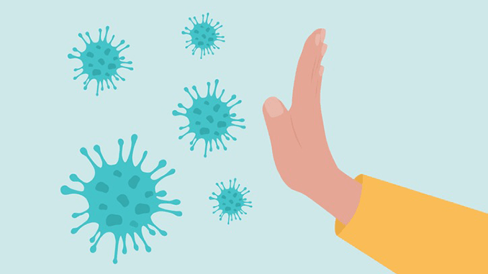
Infection prevention and control programme
Dr. Ved Prakash
Professor & Head
Secretory HICC
PG Department of Microbiolgy

Slide 2
Introduction
Infection Prevention and Control Is expected to be at the heart of good management and clinical practice, to ensure effective protection of the public’s health and minimise the risk of healthcare associated infections (HCAIs). Effective prevention and control must be embedded into everyday practice and applied consistently by everyone. All staff, both clinical and non-clinical, must be able to demonstrate good infection control and hygiene practice.

Slide 3
HAI DEFINITION
Infections acquired in hospital by a patient - admitted for a reason other than the infection.
Infection - not be present or incubating at the time of admission
Symptoms should appear at least after 48 hours of admission. This also includes infection that acquired in the hospital but symptoms appear after discharge.

Slide 4
Microorganisms Implicated in HAIs
The ESKAPE pathogens-
  Enterococcus faecium
  Staphylococcus aureus
  Klebsiella pneumoniae
  Acinetobacter baumannii
  Pseudomonas aeruginosa
  Enterobacter species

Slide 5
MAJOR HAI TYPES- 4 common types
Catheter-associated urinary tract infection (CAUTI, 33%)
Central line-associated blood stream infection (CLABSI, 13%)
Ventilator-associated pneumonia (VAP, 15%)
Surgical site infection (SSI, 31%).

Slide 6

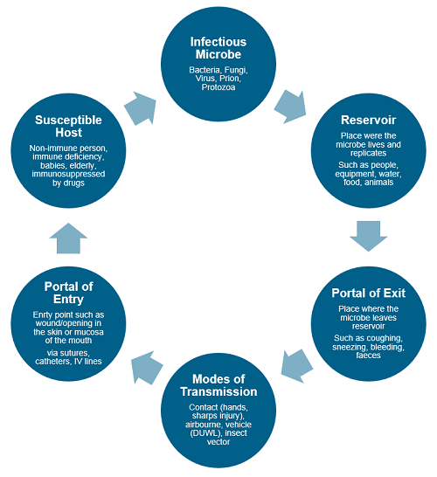
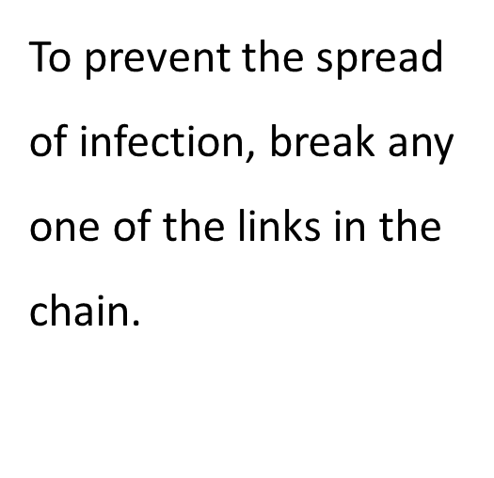
The Chain of Infection

Slide 7
Components of standard precautions
Hand hygiene
Personal protective equipment
Biomedical waste management
Spillage cleaning
Disinfection of patient care items
Environmental cleaning
Respiratory hygiene and cough etiquette
Safe use and disposal of sharp

Slide 8
Hand Hygiene
Hands of the HCWs - main source of transmission of infections in healthcare facilities.
Hand hygiene - most important measure to prevent healthcare-associated infections.

Slide 9
Types of Hand Hygiene Methods
Hand Rub:
Alcohol based (70–80% ethyl alcohol) or chlorhexidine (0.5–4%) based
Duration - 20–30 seconds
Advantage: After contact, it gets evaporated on its own
Indications: During routine patient care activities or taking rounds

Slide 10
Hand Wash- Antimicrobial soaps (liquid, gel or bars) or ordinary soap and water
Duration - 40–60 seconds.
Indications:
  When hands are visibly soiled with blood, excreta, pus, etc.
  Before & after eating, after going to toilet and before & after duty
  When caring for diarrhea patient

Slide 11
Surgical Hand Scrub
4% chlorhexidine
Duration – 3-5 mins
Prior to any surgical procedure and in-between cases

Slide 12
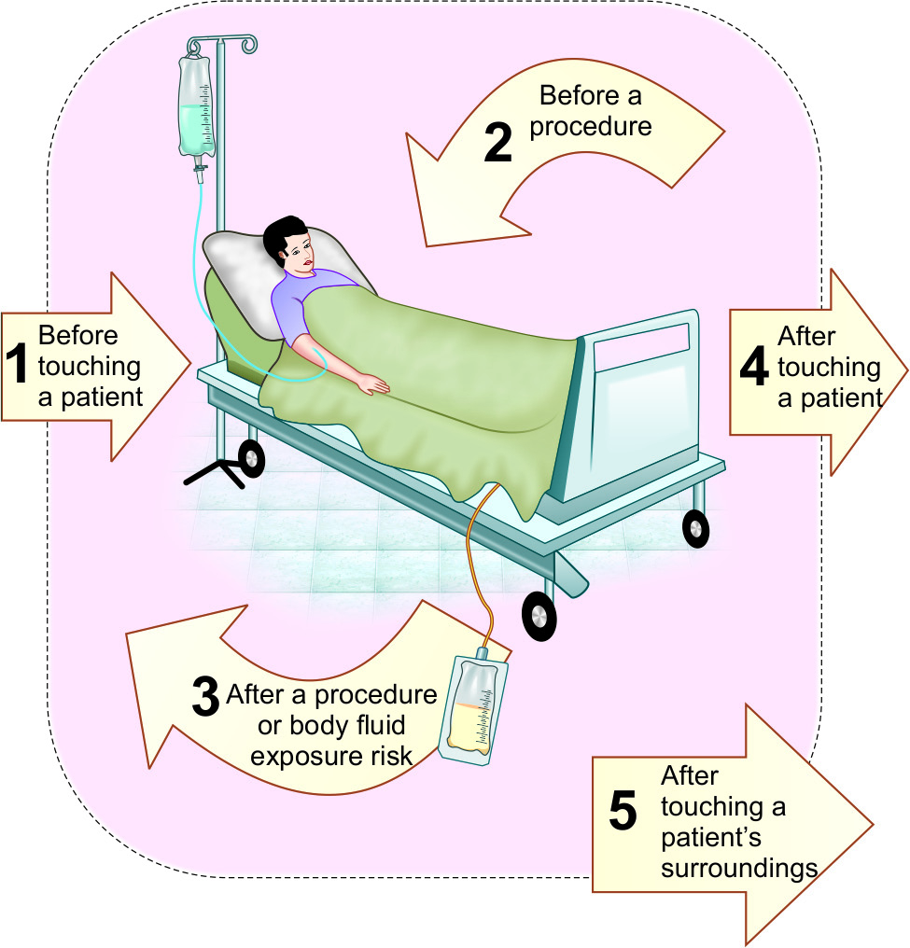
Indications (Five Moments for Hand Hygiene)

Slide 13
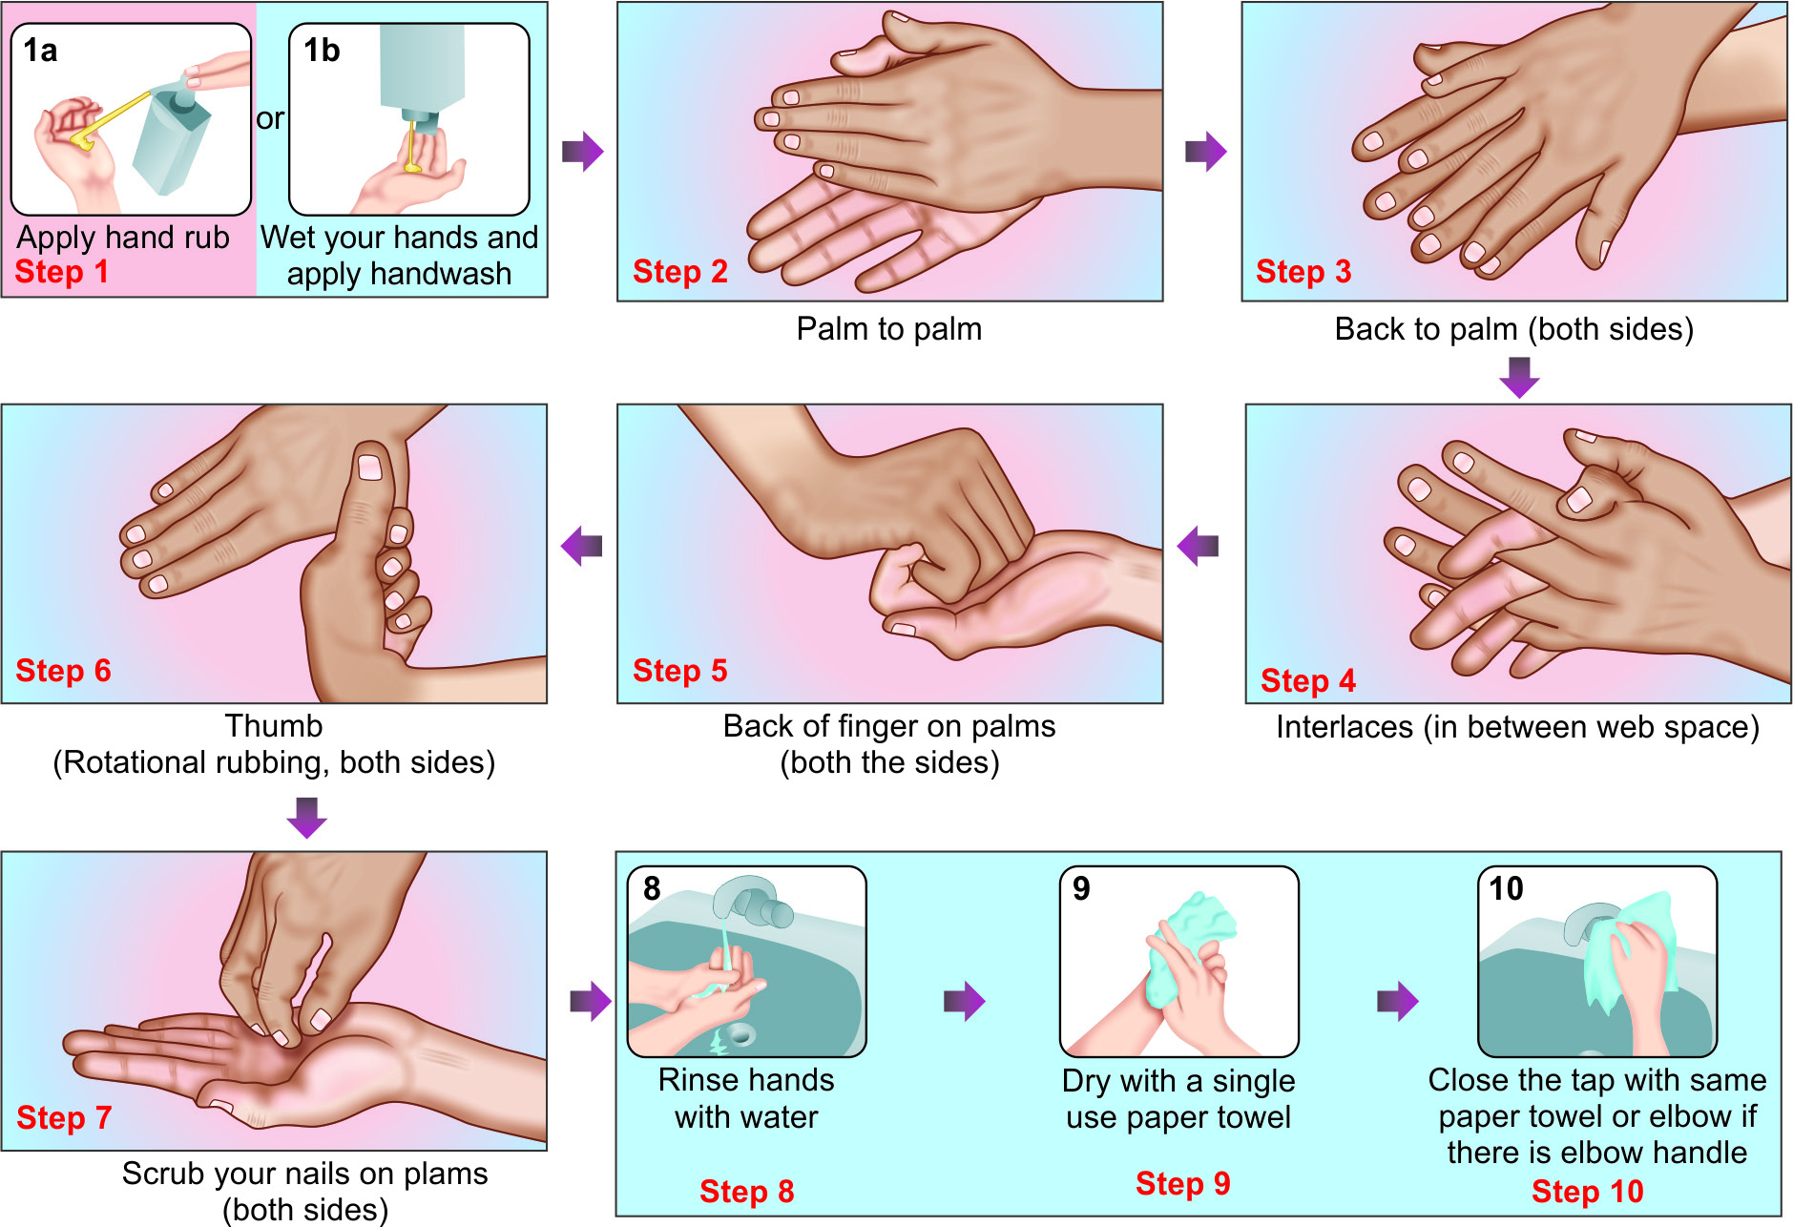
Steps of Hand Rubbing and Hand Washing

Slide 14
Personal Protective Equipment (PPE)
Used to protect the skin and mucous membranes of HCWs from exposure to blood and/or body fluids
From the HCW to the patient during sterile and invasive procedures.

Slide 15
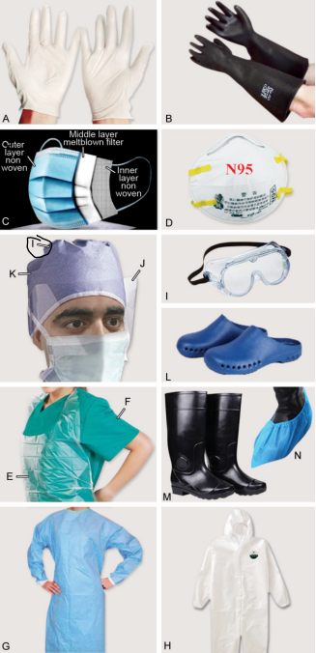
Personal protective equipment (PPE):
A. Gloves;
B. heavy duty gloves; C. Surgical mask;
D. N95 respirator;
E. Plastic apron;
F. Linen gown;
G. Disposable gown;
H. Coverall;
I. Goggles;
J. Face shield;
K. Cap;
L. Shoes;
M. Gum boot;
N. Shoe cover

Slide 16
Selection of appropriate PPE is based on:
Level of risk associated with contamination of skin, mucous membranes, and clothing by blood and body fluids
Route of transmission of suspected organisms
** PPE must be removed immediately after the indication of its use

Slide 17
Gloves
Indications for glove use
As a part of standard precautions Before a sterile procedure Anticipation of a contact with blood or bo dy fluid, regardless of the existence of sterile conditions and including contact with non-intact skin and mucous membrane As a part of contact precautions: Contact with a patient (and his/her immediate surroundings) Heavy duty gloves: To protect from sharp injuries, mainly used by biomedical waste handlers
Indications for glove removal
As soon as gloves are damaged Gloves are meant for single-use, must be changed in-between patients or patient care activities When there is an indication for hand hygiene

Slide 18
Clinical situations where use of gloves is not recommended
For routine patient care activities if there is no anticipated risk to blood/body fluid or no indication for contact precaution Examples: Measuring blood pressure, temperature, and pulse, While administering medications (oral or injections), During maintenance of IV cannula, During dressing and transporting patient, Writing in the patient’s case sheet, etc.

Slide 19
Hand Hygiene and Glove Use
Glove is not a substitute for hand hygiene.
The following measures should be adapted during gloves use:
  Hand hygiene before gloves use
  Hand wash after glove use
  Change: Gloves should be worn for a single patient care activity. Gloves must be changed between patient contacts.
  No hand hygiene over the gloved hand

Slide 20
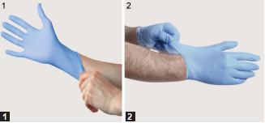
Steps of gloves donning (wearing)
1. Donning of the first glove : Wear by touching and pulling only the edge of the cuff
2. Donning of the second glove: Avoid touching the forearm skin by pulling external surface of second glove by the finger of gloved hand

Slide 21
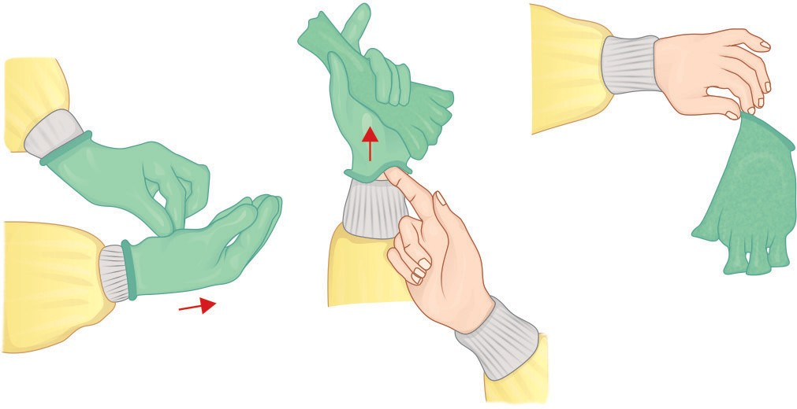
Steps of gloves removal (doffing)
Do not touch the outside of the gloves (contaminated):
Using a gloved hand, grasp the palm area of the other gloved hand peel off first glove.
Hold removed glove in gloved hand slide fingers of ungloved hand under the other glove at wrist and peel off second glove over first glove
First glove will remain inside the pouch of the second glove
Perform hand hygiene after removal

Slide 22
Surgical (3-ply) Mask and Respirators
Respiratory protection is essential when there is a risk of transmission of droplets and aerosols.
There are two type of PPEs available for respiratory protection:
  Surgical mask
  Respirators.

Slide 23
Surgical Mask (3-ply or medical mask)
Loose fitting, single-use item that cover the nose and mouth.
Used as part of standard precautions to prevent splashes or sprays from reaching the mouth and nose of the person wearing them.
Provide some protection from respiratory secretions and are worn when caring for patients on droplet precautions.

Slide 24
Composition:
Filter pore size of surgical mask is not standardized. It has three layers:
  1. Outer fluid repellent layer
  2. Middle filter layer
  3. Inner hydrophilic layer

Slide 25
Instructions:
Shelf-life: Disposable after 4-6 hours of use or earlier if become soiled or wet
Donning: Place the mask carefully - ensure it covers the mouth and nose, adjust to the nose bridge, and tie it securely

Slide 26
Hanging mask syndrome - Strongly discouraged
Touching the front of the mask while wearing should be avoided
Mask should not be worn with beard and unshaven face
Hand hygiene - performed before donning the mask, upon touching or discarding a used mask

Slide 27
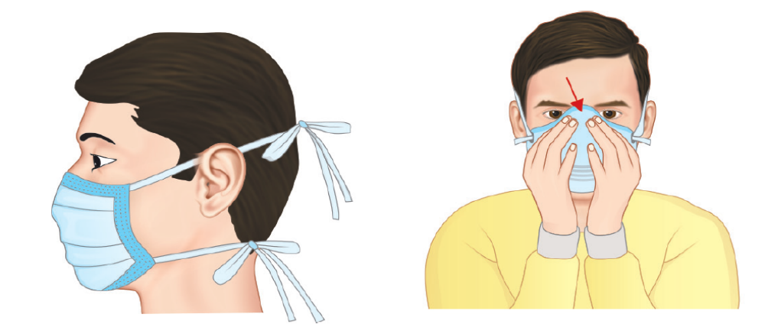
Steps of mask donning (wearing)
Pull the straps tight and pull the mask to below chin and then apply knots
Press on the nasal bridge part of the mask to seal tightly and for N95 respirator, perform fit check

Slide 28
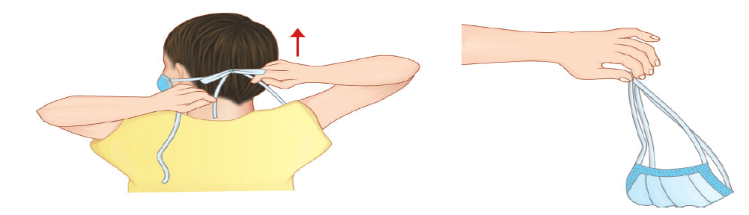
Steps of mask doffing (removal)
Do not touch front part of the mask
Untie the lower knot first, then the upper knot and remove the mask by holding its straps, without touching the front, hand wash after removal

Slide 29
Respirator (N95 Mask)
Device designed to protect the wearer from airborne microorganisms (e.g. M. tuberculosis).
N 95 respirator- most commonly used
N95 - ‘not resistance to oil and ability to filter of 95% of airborne particle’

Slide 30
Composition: The N95 respirator is
Comprised of four layers of material:
  Outer and inner layers of spun bond polypropylene
  Middle two layers of cellulose/ polyester, melt-blown polypropylene filter

Slide 31
Negative-pressure- pressure inside the facepiece is negative during inhalation
Single-use- should not be reused as it cannot be cleaned or disinfected.
Removal:
Should be removed or changed - in 8 hours or earlier if it gets clogged, wet or dirty on the inside, or deformed, or torn.

Slide 32
Fit checking - To ensure if it is properly fitted. Includes the following steps.
  Sealing- across face, cheeks and nasal bridge
  Positive pressure seal- done by gently exhaling
  Negative pressure seal- done by gently inhaling

Slide 33
Fit testing:
Done to identify size and style
To train the HCW on how to don and doff
Should be done at the time of joining and thereafter annually

Slide 34
Protective Body Clothing
Worn when there is a risk that clothing may become exposed to blood or body fluids.
  Laboratory coats
  Plastic aprons
  Disposable gowns
  Coverall

Slide 35
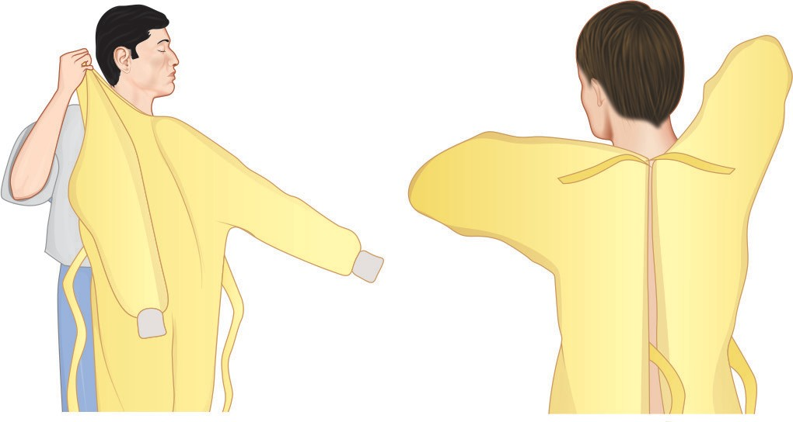
Steps of gown donning (wearing)
Fully cover torso from neck to knees, arms to end of wrists, and wrap around the back. Fasten it in the back of neck and waist

Slide 36
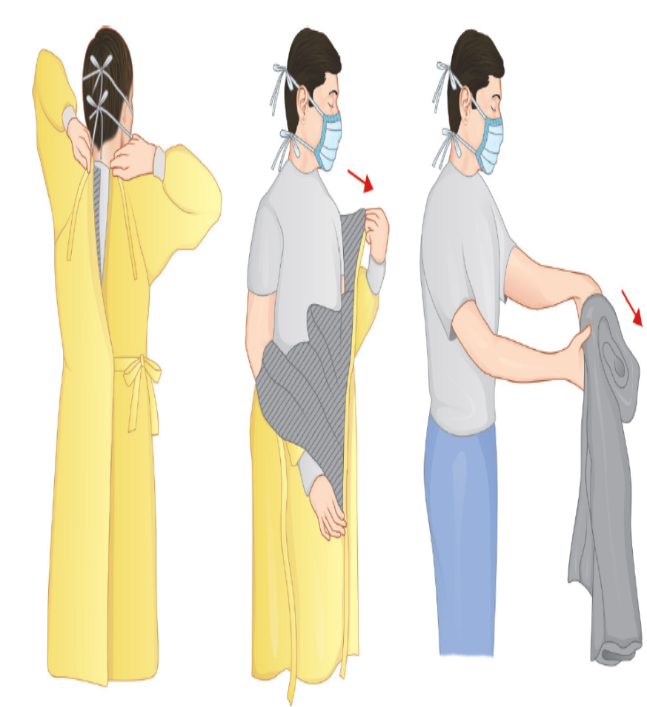
Steps of gown doffing (removal)
Do not touch front part of the gown
Unfasten gown ties, taking care that sleeves don’t touch the body when reaching for ties
Pull the gown away from neck and shoulders, touching inside of gown only
Turn gown inside out and roll into a bundle and discard.
Perform hand hygiene after removal

Slide 37
Protective Eye/Face Wear
Goggles, or face-shields – used to protect the mucous membranes of the eyes, nose, and mouth.
Eyewear - worn during procedures that are likely to generate droplets or aerosols of blood and/or high-risk body fluids.

Slide 38
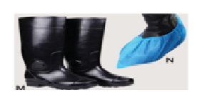
Head Cover and Shoe Cover
Used when spillage of blood is suspected.
Shoe covers include:
  (1) Surgical shoes (slippers) and shoe covers
  (2) Gum boots – When anticipated risk of sharp injury exisits

Slide 39
Donning and Doffing
Donning (wearing): Gown first → Mask or respirator → Goggles or face shield → Gloves
Doffing (removing): Gloves first → Face shield or goggles → Gown → Mask or respirator
* Discard PPE in appropriate BMW bins
**All PPE should be removed just before exiting the patient room except a respirator, which should be removed after leaving the patient room and closing the door

Slide 40
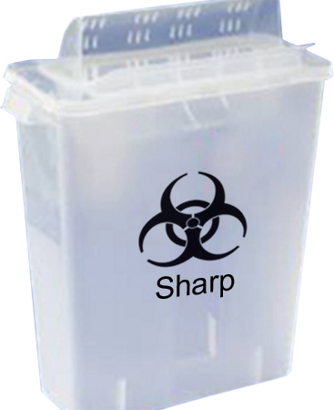
Category | Type of waste | Type of Bag/ container | Treatment/ Disposal options
White (Translucent) | Waste sharps including metal sharps: Needles, syringes with fixed needles, needles from needle tip cutter or burner, scalpels, blades, or any other contaminated sharp (used or discarded) | Puncture-proof, leak-proof, tamper-proof containers | Autoclaving/dry heat sterilization followed by: Shredding or mutilation or encapsulation in metal container or cement concrete or Sanitary landfill or Designated concrete waste sharp pit

Slide 41
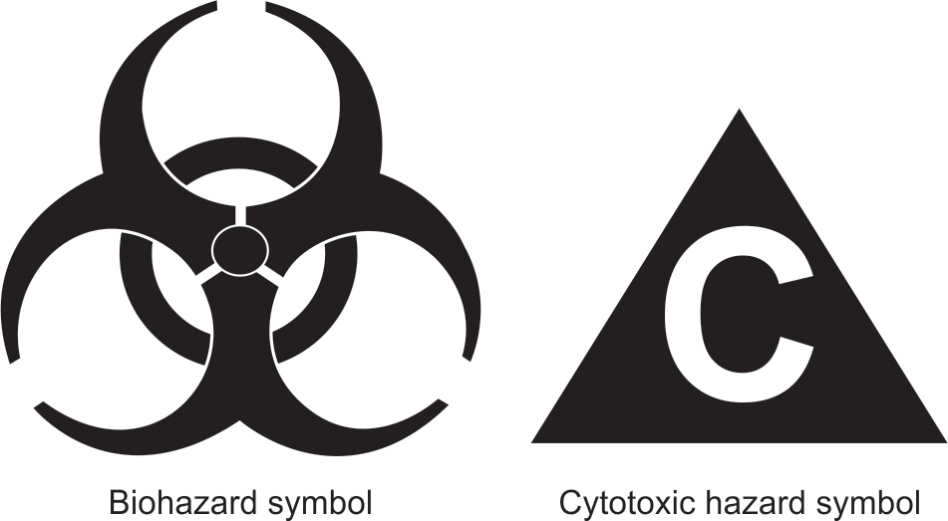
Logos used for segregation of biomedical waste

Slide 42
TRANSMISSION-BASED PRECAUTIONS
Set of infection control practices which should be followed over and above standard precautions.
Should be practiced – handling patients infected with infectious agents having specific mode of transmission
TBPs include - contact, droplet and airborne

Slide 43
Contact Precautions
Followed when there is evidence of HAI transmission by direct or indirect contact during patient care.
Direct transmission - from one person to another person without a contaminated intermediate object or person.
Indirect transmission - through a contaminated intermediate object (clothes, patient-care devices, environmental surfaces, fomite) or person

Slide 44
Agents transmitted through contact
MDROs – MRSA, CRE, VRE, MDR-NFGNB
Enterically transmitted hepatitis viruses (HAV and HEV)
Agents of conjunctivitis (e.g. adenovirus, gonococcus, Chlamydia)
Contagious skin lesions (abscess, infected ulcers) - GAS, Staphylococcus, HSV
Skin infestations (e.g. scabies)
Agents of diarrhea such as rotavirus, cholera, Clostridium difficile

Slide 45
Infection control measures Contact Precautions
Hand hygiene
PPEs –gloves, gowns; ± surgical mask/protective eye wear
Single use- patient dedicated equipment
Patient placement – single isolation room/cohorting
Transfer of patients
Disinfection of the rooms
*Cohorting – Patient with similar infections & with min 3 feet spatial bed separation

Slide 46
Droplet Precautions
Prevent the spread of infectious agents - transmitted through droplet.
Respiratory droplets - large-particles (>5 µm in size) - generated by a patient who is coughing, sneezing or talking.
Transmission via large droplets requires close contact (<3 feet) – do not remain suspended in the air - travel shorter distances.

Slide 47
Agents transmitted through droplets
Diphtheria, Hib, N.meningitidis (meningitis, sepsis, pneumonia), pertussis, pneumonic plague, Mycoplasma pneumonia
Influenza viruses, seasonal
SARS-CoV2 (COVID-19)
Viral hemorrhagic fevers - Lassa, Ebola, Marburg viruses
Other viruses: Mumps, Parvovirus B19, Rhinovirus, Rubella, Adenovirus

Slide 48
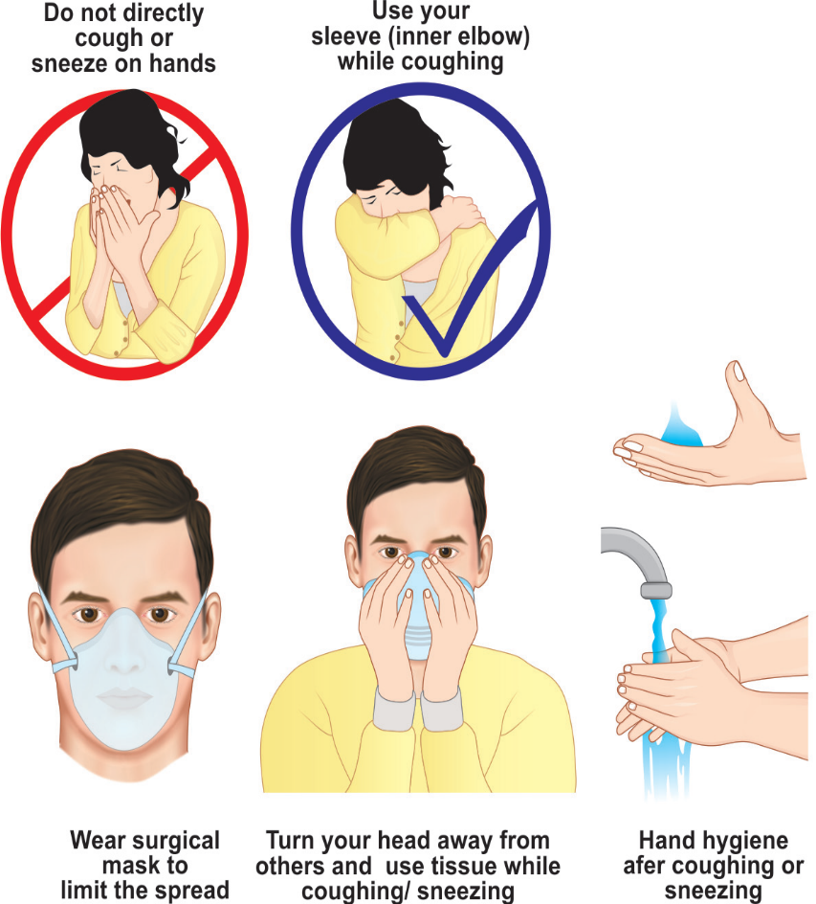
Infection control Measures- Droplet Precautions
Hand hygiene
PPEs – Surgical mask or N95 when AGPs
are performed
Respiratory Hygiene/Cough Etiquette
Patient placement – Single isolation room
or cohorting
Transfer of patients
Disinfection of the rooms

Slide 49
Airborne Precautions
Prevent the spread of infectious agents - transmitted through aerosols.
Aerosols are small-particles (<5µm) generated by an infectious person during certain aerosol generating procedures (e.g. intubation)
These smaller droplets remain suspended in air for long periods of time and may disperse to a distant place along the air current.

Slide 50
Agents transmitted through aerosols
Mycobacterium tuberculosis
Measles virus
Varicella (chickenpox and zoster disseminated or in an immunocompromised host)
Smallpox (variola) and monkeypox virus
Aerosolizable spore-containing powders - Bacillus anthracis
Aspergillus (pulmonary aspergillosis)

Slide 51
Aerosol-generating Procedures (AGPs)
AGPs - generate much higher concentrations of aerosols and are associated with higher risk of pathogen transmission.
Examples: Endotracheal intubation, open respiratory and airway suctioning, tracheostomy care, cardiopulmonary resuscitation, sputum induction and bronchoscopy

Slide 52
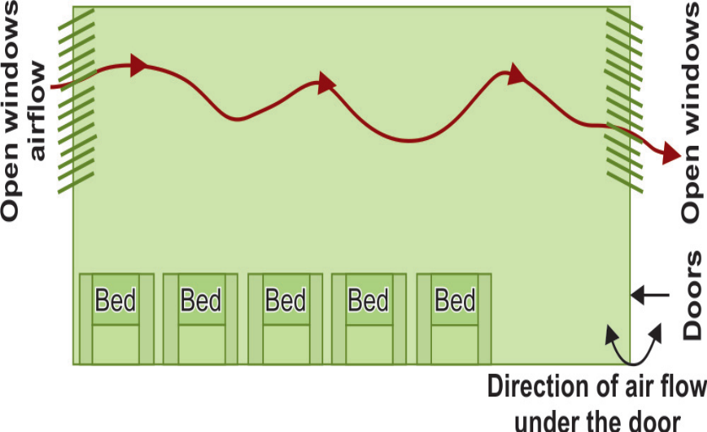
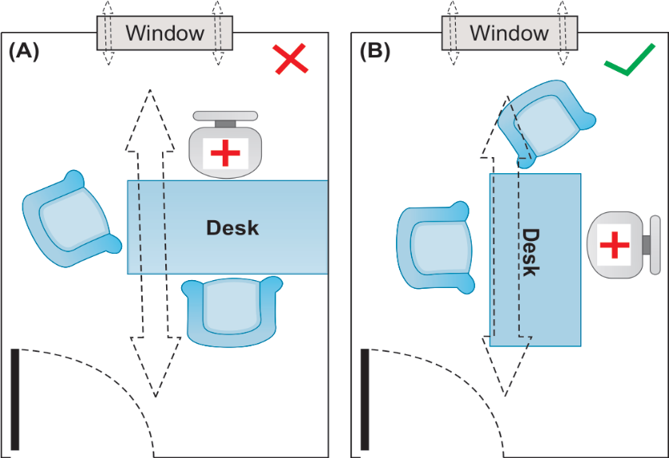
IC Measures – Airborne precautions
PPE – N95 respirator
Patient Placement – Airborne isolation room (AIIR)
Ventilation
  Natural Ventilation
In room (A), the seating arrangement is along with direct of natural ventilation of air flow, so that the doctor has higher risk of exposure to the potentially infected air.
In room (B), doctor is sitting away from the direction of natural airflow, thus has lesser risk of exposure.

Slide 53
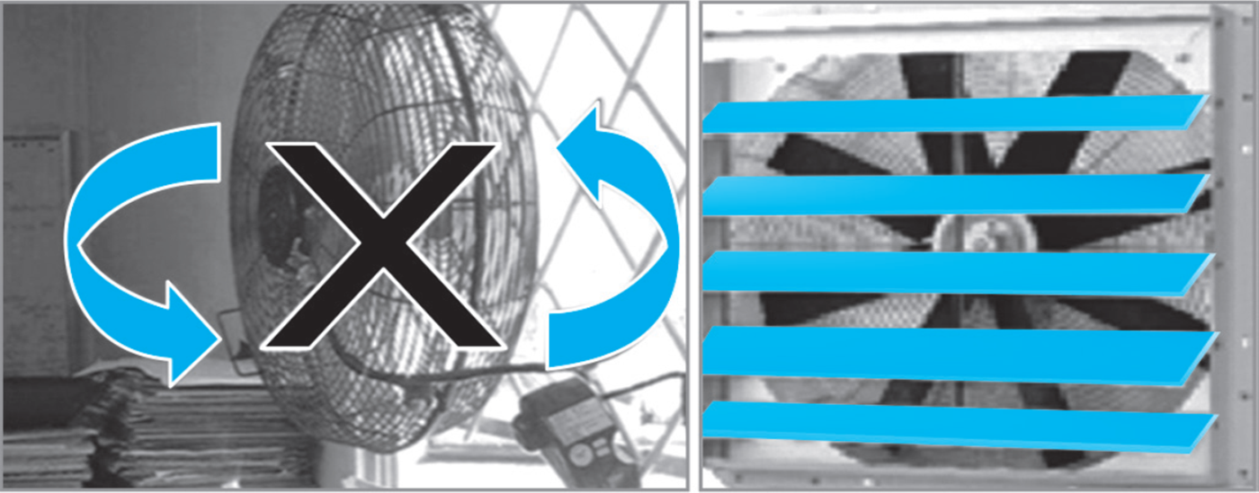
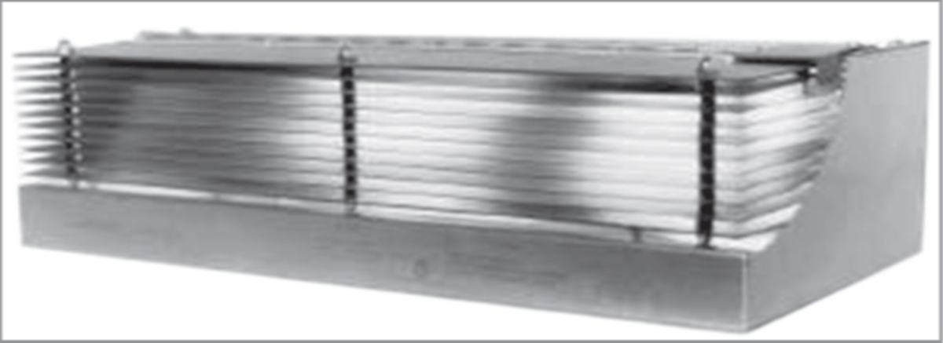
IC Measures – Airborne precautions
  Mechanical Ventilation(Negative pressure room)
    Minimum 12 ACH per hour in high risk area and 6 in low risk area
    Negative pressure differential of >2.5Pascal
    Door should be kept closed always
    Anteroom should be present
Ultraviolet Germicidal Irradiation (UVGI) - >8 feet from floor
Filtration – Exhaust or HEPA
Exhaust fan:
(A) Poorly-installed in an open window space;
(B) well-installed, closely fitted.

Slide 54
IC Measures – Airborne precautions
Transfer of Patients- patient should wear surgical mask
Respiratory Hygiene and Cough Etiquette
Visitors and Staff – restricted access

Slide 55
Decontamination
Clean equipment regularly with appropriate products i.e. beds, baths, commodes, hoist (lifting device), bins, mattresses, computers, phones,
keyboards, reusable patient equipment
Nobody is too posh to wash!
Clean after use – stethoscopes etc

Slide 56
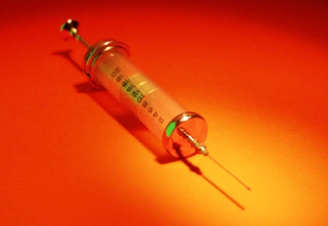
Management of Sharps
Dispose of sharps immediately in the correct receptacle
Safe assembly and use
Report needlestick injuries immediately
First aid – irrigate, bleed, cover
Risk assess situation – Inform Occupational Health
Complete an incident form
Notes:
SHARPS – Any sharp object that could break the skin – needles, scalpels, etc. All sharps must be discarded into an authorised kite marked bin of appropriate size at the point of care. Dispose directly into the bin. Put in gently sharp end first. Do not put sharps into plastic bags. Once 2/3rds full remove the bin. Close securely and sign the label. Do not seal with tape. Do not attempt to retrieve items out of sharps bins. Do not empty out the contents of sharps bins. Do not place sharps bins inside clinical waste bags. All incidents regarding Sharps must be reported to the Manager on duty and an incident form completed.

Slide 57
Biomedical Waste Management
Definition :
Biomedical wastes (BMW) are defined as wastes that are generated during the laboratory diagnosis, treatment or immunization of human beings or animal, or in research activities pertaining thereto, or in the production of biologicals.

Slide 58
Types of waste generated in the Hospitals:
General (non-harardous solid waste, 80%)
Biomedical waste: This includes infectious waste (10%) and chemical/radioactive waste(5%)
Waste management Hierarchy: The waste management hierarchy is largely based on the concept of the “3Rs” namely reduce, recycle and recover.

Slide 59
Steps of BMW Management :
Waste segregation (at the point of generation) into color coded containers.
Pre-treatment for laboratory liquid waste
Transport of waste from generation site to central storage area of the hospital.
Transport of waste from central storage are to common bio-medical waste treatment facility (CBMWTF).
Treatment and/or disposal (within 48 hours of generation).

Slide 60
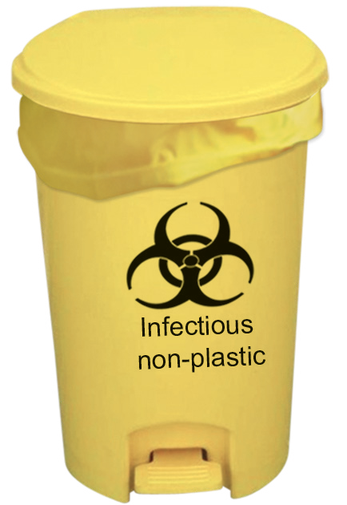
Biomedical Waste Management Rule, India, 2016 (including the amendment added in 2018 and 2019)
Category | Type of waste | Type of Bag/ container | Treatment/ Disposal options
Yellow infectious non- plastic waste | Human anatomical waste including placenta and dead foetus | Yellow coloured non chlorinated plastic bags | Incineration/ Plasma pyrolysis/ deep burial
 | Animal anatomical waste
 | Soiled waste |  | Incineration/plasma pyrolysis/ deep burial/autoclaving or hydroclaving + shredding/mutilation
 | Expired/discarded medicines — pharmaceutical waste, cytotoxic drugs | Yellow colored containers/non- chlorinated plastic bags with cytotoxic label | Sent back to manufacturer/ CBMWTF for incineration (cytotoxic drugs at temperature >1200°C)

Slide 61
Category | Type of waste | Type of Bag/ container | Treatment/ Disposal options
Yellow infectious non- plastic waste | Chemical solid waste | Yellow colored containers/ nonchlorinated plastic bags | Incineration or plasma pyrolysis or encapsulation
 | Chemical liquid waste such as discarded disinfectants, infected body fluids and secretions, liquid from house-keeping related activities | To be discharged into separate collection system, which leads to effluent treatment system Not to be discarded into yellow bag | Pre-treated before mixing with other wastewater
Non-chlorinated chemicals include 5% phenol, 5% cresol or 5% lysol.
Chemical treatment: Hypochlorite should be used at 1-2% concentration
having 30% residual chlorine with contact time of 20 minutes

Slide 62
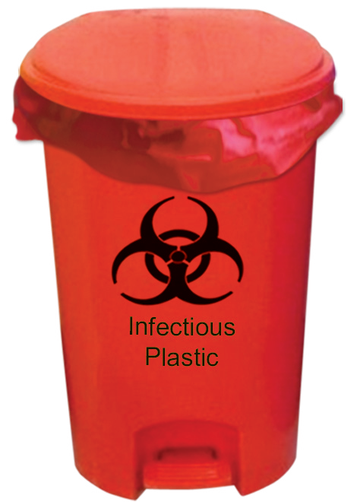
Category | Type of waste | Type of Bag/ container | Treatment/ Disposal options
Red | Infectious plastic waste Disposable items such as tubing, bottles, intravenous tubes and sets, catheters, urine bags, syringes (without needles and fixed needle syringes) and vacutainer with their needles cut), gloves, plastic apron and goggles | Red colored non-chlorinated plastic bags or containers | Autoclaving/microwaving/ hydroclaving + shredding Mutilation/sterilization+ shredding Treated waste sent to authorized recyclers or for energy recovery

Slide 63
Infection prevention and control programme
Objectives of the IPC programme
The objective is to minimize the risk of HAIs to patients, HCWs and visitors. This is achieved by:
enabling and assisting all categories of HCWs to adhere to comprehensive IPC practices at all levels of care; and
providing safe and quality healthcare and improving outcomes by reducing morbidity and mortality.

Slide 64
Spill management for blood and body fluids
Spill management of blood and body fluids: Bring the spill kit to the site of spillage, war appropriate PPE (gloves and gown); put no entry’ sign board near the spill area. If spillage is small (<10mL); Wipe up spill immediately with absorbent material and discard into appropriate bin. Wipe the area with 10% sodium hypochlorite and allow to dry Remove PPE and perform hand hygiene If spillage is large (>10mL); Place disposable paper towels over spill to absurd the spillage and then purr 10% sodium hypochlorite on top of absorbent paper towels and leave for 15 minutes. Remove the absorbent papers: put fresh disposable paper towels to clean the area and then discard these into appropriate waste bin.

Slide 65
Prerequisites for an effective IPC programme
Policies and guidelines including best practices and standard operating procedures (SOPs)
Adequately trained and motivated human resources
Continuous and adequate supply of personal protective equipment (PPE)
Antimicrobial use policy and links with the antimicrobial stewardship programme(AMSP)
Integration with activities of the quality and safety department
HAI surveillance and outbreak investigation
Microbiology laboratory support
Environmental protection Links with other patient safety programmes in the healthcare facility (HCF)
Evaluation of the programme activities: monitoring and feedback
Budget allocation for all the above
Implementation through a multimodal approach

Slide 66
Hospital infection control committee
Structure of IPC Programme
Chairperson: head of the institute
Member-secretary/ infection control officer
Members
  Representation from management/ administration: Dean/ Director of hospital; nursing services; medical services; operations
  Representation from relevant medical and surgical disciplines
  Representation from support services: operation theatre (OT), central sterile supply department (CSSD), housekeeping/ sanitation, laundry, engineering, pharmacology/ pharmacy, stores/ materials department R
  Infection control nurse (ICN)

Slide 67
Responsibilities
1. Establish the IPC programme in the HCF and ensure the following.
Develop an action plan for strengthening IPC measures for the facility and individual units within the facility with priorities based on the risk matrix for that unit and appropriate review.
Constitute an infection control team.
Review and revise annually infection control guidelines with policies, recommendations and working protocols, including activities and practices under the programme, with standard precautions and hand hygiene as key components.
Organize training programmes on recommendations of the guidelines and IPC practices for staff and other HCWs.
Develop an antibiotic policy and antibiotic stewardship programme.
Conduct surveillance of AMR and HAI.

Slide 68
2. Analyse the surveillance data for HAI (including identification of common sources and routes of entry of infectious microorganisms) on a monthly basis (or more frequently in case an outbreak is suspected) and identify at-risk patients. Take appropriate action and implement recommendations where necessary.
Monitor the trends of HAI regularly and compare the rates of infections within the HCF and with other facilities wherever feasible.
Monitor and assess, on a regular basis, compliance with recommended practices such as hand hygiene, cleaning and decontamination, disinfection and sterilization through audits and quality control of IPC activities.
Investigate outbreaks of HAIs in collaboration with medical, nursing and other staff.
Evaluate the effectiveness of interventions for IPC.

Slide 69
Participate in the selection of equipment and material and provide advice and focus on IPC measures.
Help control environmental risks for infection by liaising with appropriate departments such as healthcare waste management, CSSD, provision of safe water (testing of water sources), pharmacy, housekeeping services, laundry and kitchen services.
Establish links with related health programmes in the HCF such as injection safety programme, TB control programme and control of HIV/ AIDS.
  Ensure a multimodal approach for implementation of IPC, integrate 3–5 different activities for behaviour change.
  Introduce system change (equipment/ infrastructure), education, monitoring, communication as well as culture change (through champions/ leaders).
  Use tools such as care bundles or checklists

Slide 70
Roles and responsibilities
Responsibilities of the infection control officer
Develop policies, guidelines and standard operating procedures (SOPs) on Infection prevention and control programme in collaboration with other members of the HICC and the IPC team. Initiate and maintain activities for HAI surveillance and analyse surveillance data.
Provide trends of HAI to different patient care units.
Advise staff on all aspects of IPC and maintain a safe environment for patients and staff.
Liaise with microbiology department for analysis of antibiograms (data regarding organisms isolated and their resistance pattern.

Slide 71
Monitor rational use of antimicrobials.
Oversee sterilization and disinfection.
Investigate an outbreak, and advise on control measures and isolation procedures.
Coordinate microbiological surveillance as decided by the HICC (testing of drinking water, dialysis water, biological monitoring of sterilization, and investigation of sources and modes of transmission in outbreak situations).
Organize and conduct regular IPC educational and training activities for HCWs.
Audit infection control procedures, worker safety and antimicrobial usage.
Organize regular HICC meetings (Monthly/quarterly).

Slide 72
Infection control nurse
Responsibilities
Visit the microbiology laboratory and conduct infection control rounds daily and tracks all infected cases and maintain surveillance data.
Monitor implementation of IPC practices and SOPs, including hand hygiene, preventive bundles, sterilization and disinfection and antimicrobial stewardship.
Impart education and training to HCWs under the supervision of the infection control officer.

Slide 73
Ensure compliance with hospital’s biomedical waste (BMW) management policy.
Maintain data of sharps/ needle-stick injuries and post-exposure prophylaxis (PEP).
Initiate and facilitate immunization for hepatitis B virus (immunoglobulin use if needed after exposure, and hepatitis B vaccine), and vaccination for the staff, especially in high-risk areas.
Facilitate provision of first aid and appropriate consultation in case of suspected exposure of any hospital worker.

Slide 74
Head of the healthcare facility/hospital administrator
Establish and support a multidisciplinary HICC and chair the committee.
Identify appropriate resources for the IPC programme.
Ensure availability of appropriate infrastructure, financial and human resources.
Ensure implementation of the HAI surveillance system, and periodically review the status of HAI and effectiveness of interventions.

Slide 75
Approve and review policies and guidelines for IPC.
Support educational and training activities for all categories of staff.
Establish an antibiotic stewardship programme.
Establish a safety programme for HCWs – immunization, PPE and PEP.
Ensure availability of safe food and drinking water, and sound waste management according to the BMW rules.

Slide 76
Microbiologist and microbiology department
(Responsibilities)
The microbiology laboratory contributes to the IPC programme by fulfilling its technical responsibilities and performing quality microbiology investigations through :
Handling clinical specimens to maximize the likelihood of a microbiological diagnosis;
Developing guidelines for clinical departments for appropriate selection, collection, handling and transport of specimens;
Ensuring safe laboratory practices to prevent infections among laboratory staff;

Slide 77
Ensuring rapid diagnosis of infections, identifi cation of pathogens and antimicrobial susceptibility testing of isolated pathogens by standardized procedures;
Communicating promptly about suspected cases of HAI to the HICC;
Analysing and reporting the antibiogram of relevant pathogens in different units and in different specimens; and
In accordance with the microbiological surveillance policy of the HICC, microbiological testing of drinking water, dialysis water, biological testing of sterilizers, and epidemiologically investigating outbreaks including the typing of organisms to detect the source, reservoirs and transmission of infection.

Slide 78
Environmental cultures :
Environmental cultures, including personnel cultures, should be done only when clear epidemiological evidence indicates an environmental source of the pathogen.

Slide 79
Responsibilities of Doctors
Provide quality patient-care services to minimize infection in accordance with the recommended IPC practices as per HCF policy and guidelines (e.g. hand hygiene, standard precautions, aseptic procedures, isolation).
Support the IPC team.
Ensure collection of appropriate microbiological specimens when an infection is suspected.
Notify infected/ HAI cases to the IPC team.
Comply with the antibiotic policy and support the antibiotic stewardship programme.
Advise patients, visitors and staff on measures to prevent the transmission of infection.

Slide 80
Responsibilities of Pharmacist and pharmacology department
Dispense antiseptics and disinfectants and maintain relevant records (potency, incompatibility, conditions of storage and deterioration).
Obtain and store vaccines or sera, and make them available as appropriate.
Maintain records of antibiotics distributed to all departments, and the analysis of antibiotic consumption.
Provide the HICC with summary reports and trends of antimicrobial use.
Provide information on activity and side-effects of disinfectants and antiseptics.

Slide 81
Nursing staff
Responsibilities of the nursing administrator
Participate in the meetings of the HICC.
Promote the development and improvement of nursing techniques, and ongoing review of aseptic nursing policies, approved by the HICC.
Develop and mandate continuing medical education (CME) and training
programmes for members of the nursing staff.
Supervise the implementation of nursing compliance with ICP policies and practices.
Document, report and maintain suspected HAI cases based on records and information collected in routine visits and discussions with the staff.
Empower the nurse in-charge of ward/ unit/ OT for implementation, monitoring and adherence to HICC practices in the ward/ unit/ OT.

Slide 82
Responsibilities of the nurse in-charge of ward/unit
Maintain hygiene, consistent with hospital policies and good nursing practices.
Monitor aseptic techniques, including hand hygiene, standard precautions and other precautions.
Report promptly any evidence of infection in patients to the attending physician.
Initiate patient isolation and order culture specimens from any patient showing signs of a communicable disease, when the physician is not immediately available.
Limit patient exposure to infections from visitors, hospital staff, other patients or devices/ equipment used for diagnosis or treatment.
Maintain adequate supply of ward equipment, drugs and patient-care supplies.

Slide 83
Ensure safe storage of medicines and blood products in the ward. Such refrigerators should not be used for storing food and drinks.
Participate in the training of HCWs and patient education and awareness programmes.
Participate in investigation of outbreaks.
A nurse in every patient-care unit is designated as an infection control liaison or “link nurse”.
She/ he is a useful adjunct to the ICN to implement infection control practices in the ward and to assist in surveillance of HAI by informing the ICN about suspected cases. The link nurse does not replace an ICN as the link nurse’s primary responsibility and area of work are the patients under her care in the ward.

Slide 84
Responsibilities of the link nurse
Implement IPC practices in the ward and assist HAI surveillance by informing
The ICN about suspected cases.
Increase awareness about infection control at the unit level.
Implement IPC practice in the ward.
Receive training in basic infection control and be in regular touch with the ICN.
Maintain primary role as a ward nurse in the unit.

Slide 85
Responsibilities of the CSSD (central sterile supply department )
CSSD is an integrated place in hospitals that performs sterilization of medical devices, equipment and consumables; that are used in the operating theater (OT) of the hospital and also for other aseptic procedures.
The processing area of CSSD consists of four unidirectional zones starting from an unsterile area to a sterile area separated by physical barrier. Part of CSSD are
Decontamination area → Packaging area→Sterilization area→ Sterile storage area

Slide 86
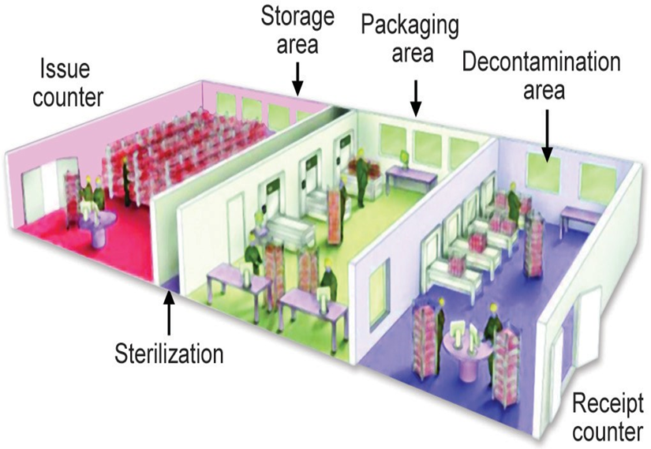

Slide 87
Receive clean, decontaminated packages, sterilize and distribute medical devices.
Work in collaboration with the HICC and other relevant departments in the facility to develop and monitor policies on cleaning, decontamination and sterilization of reusable and contaminated devices for patient care including:
wrapping procedures, according to the type of sterilization; and sterilization methods, according to the type of device/equipment;
sterilization conditions (e.g. temperature, duration, pressure, humidity); and
Monitoring of sterilization procedures.
An appropriately qualified individual must be responsible for managing the CSSD. The responsibility for day-to-day management may be delegated to an individual with appropriate qualifications or experience, and knowledge of medical device sterilization.

Slide 88
Responsibilities of the CSSD manager
Develop a procedure manual to document SOPs for all processes carried out in the CSSD. The manual should be approved by the HICC and reviewed at regular intervals.
Oversee the various processes carried out in the department, namely cleaning, decontamination, disinfection, wrapping, sterilization, storage and distribution.
Monitor the processes by use of different methods such as physical, chemical and bacteriological according to the policy of the HCF. Ensure technical maintenance of the equipment according to national standards and manufacturers’ recommendations.

Slide 89
Report any defect to the administration, maintenance, infection control and other appropriate personnel.
Ensure appropriate separation of “clean” and “dirty” areas.
Maintain complete records of each sterilizer run and preserve records as per standard recommendations.
Communicate, as needed, with the IPC team, the nursing service, the OT,

Slide 90
Laundry service
With the approval of the HICC and in accordance with policies of the HCF, the laundry is responsible for:
Selection of fabrics for use in different hospital areas, working clothes for staff in different areas, and maintaining appropriate supplies;
Distribution of working clothes and, if necessary, managing changing rooms
Collection and transport of soiled/ dirty linen;
Providing appropriate containers/ bags to the wards for segregation of used and dirty/ soiled linen;

Slide 91
Disinfection of soiled linen, either before it is taken to the laundry or in the laundry itself;
Protection of clean linen from contamination during transport from the laundry to the area of use;
Ensuring appropriate flow of linen, separation of “clean” and “dirty” areas;
Maintaining and monitoring the recommended washing conditions (e.g. temperature, duration); and
Ensuring safety of the laundry staff through prevention of exposure to sharps or laundry contaminated with potential pathogens.

Slide 92
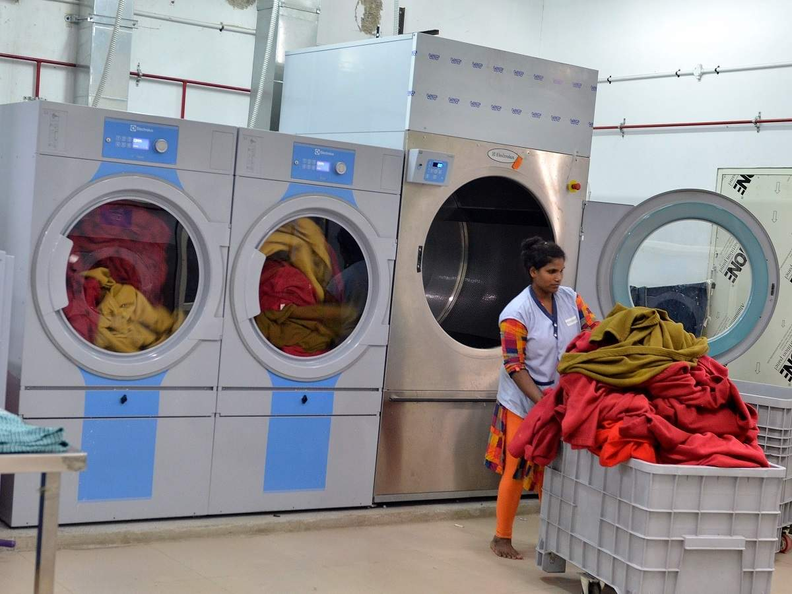
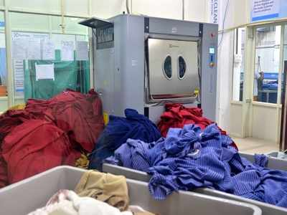
Laundry Services in a trauma center

Slide 93
Housekeeping service
The housekeeping service is responsible for the regular and routine cleaning of all surfaces and maintaining a high level of hygiene in the facility in accordance with the policies defined by the HICC and HCF. The policies include the collection and transportation, treatment and disposal of waste generated in the facility.

Slide 94
General rules for housekeeping policy :
Adequate base materials beckets, detergent, disinfectant should be available to maintain a proper housekeeping policy.
Washing of mop should done in between cleaning .
PEP : should be provided to the housekeeping workers.
Use a single damp cloth per patient, if damp cloth is reusable,
Soak the damp cloth in detergent/disinfectant and dry before use
Damp dusting the other than dry dusting/sweeping should be perform
Man power should be adequate for regular cleaning of walls, ceiling fans, once in a month.

Slide 95
Wet mopping should be done by double bucket mopping technique.
Triple bucket mopping technique/method is advised during pandemics.
Classification of housekeeping areas
Very high risk areas : Outbreak in high risk areas.
High risk areas: ICU, HDU, burn unit, transplant units, operating suits (OT), post op wards and laboratories
Moderate risk areas: General wards & OPDs
Low risk areas : Rehabilitation center, long term care area, and office based area.
Detergent used for housekeeping : Soap chips/liquid soap.
Disinfection of use : Benzalkonium chloride or lysol

Slide 96

Housekeeping

Slide 97
Responsibilities of the housekeeping services manager
Identify the varying needs for cleaning in different hospital areas.
Implement the appropriate cleaning techniques as defined in the policy.
Organize the collection, transport (treatment and disposal) of different types of waste according to the waste management policy.

Slide 98
Ensure availability of soap and towel at all times.
Inform the maintenance service of any building problems requiring repair.
Organize pest control in the facility.
Provide appropriate training for all new housekeeping staff and, periodically, for other employees, and specific training when a new technique is introduced.
Training should stress on personal hygiene and adherence to SOPs.
Report to the concerned authority if any cleaning staff has illness of respiratory tract, digestive tract or skin infection including wounds and cuts.

Slide 99
Facility/ building maintenance committee/ agency
Ensure regular building maintenance including plumbing, heating, refrigeration equipment, electrical fittings, heating ventilation and air-conditioning systems (HVAC) and high-efficiency particulate air (HEPA) filters; and record-keeping of the same.

Slide 100
Infection prevention and control manual
IPC practices
Control of environment Surveillance of HAIs and management of outbreaks
Guidelines for IPC in special areas/ situations (depending upon the services provided by the facility)
Preventing infections among HCWs
Monitoring and evaluation

Slide 101
Antimicrobial use and management
Appropriate antimicrobial use may be achieved through the following:
Formulate standard treatment guidelines (STGs)or hospital antibiotic policy
with a multidisciplinary approach using the local antibiogram.
Provide ongoing education on rational use of antibiotics to clinicians and ensuring implementation of antibiotic policies.
Restrict use of selected antibiotics.
Before initiating antibiotic treatment, submit appropriate specimens for bacteriological examination to the laboratory and select an antibiotic based on

Slide 102
the clinical spectrum of disease, sensitivity pattern, patient tolerance and cost (Empirical therapy).
Based on culture results, use an agent with as narrow a spectrum as possible with appropriate dosage, frequency, administration time and duration of antimicrobial therapy.
Discontinue antimicrobial therapy based on predefined criteria.
Monitor surveillance of AMR and antimicrobial use.
Carry out periodic prescription audits.
Create hospital formulary through pharmacy and revise periodically.
Develop strategic interventions through a collaborative approach to improve infection control and rational antibiotic use.

Slide 103
Role of the microbiology laboratory
The microbiology laboratory has a major role in the containment of AMR, which include:
Performing antibiotic susceptibility testing of signify cant microbial isolates as per SOPs, including the antimicrobials to be tested and following cascade reporting.
Supporting the AMSP committee/drugs and therapeutic committee.
Monitoring and reporting trends in prevalence of bacterial resistance to antimicrobial agents in a hospital antibiogram; and Providing microbiological support for IPC including prompt notification to the IPC team of any unusual AMR patterns in organisms isolated from relevant clinical specimens.

Slide 104
Role of biomarkers in infections
Biomarkers play a useful role in the managements of infections.
C-reactive protein (CRP) and procalcitonin (PCT) are useful biomarkers that
are often used in the management of infections, especially in children under-5 years and critically ill patients.
Elevated serum lactate levels (>2.0 mmol/L) are a good risk stratification for mortality.
Serial levels correlate with septic shock and multiorgan failure.
Routine arterial blood gas analysis is done in ICUs, as an important test.
Absolute polymorphous clear (PMN) count, immature vs mature PMN (shift to the left) and toxic granules in neutrophils in peripheral smear are relatively low cost methods to detect sepsis, but need trained human resources

Slide 105
Educational programmes and strategies
Appropriate educational material on IPC should be made available to all HCWs, patients and visitors.
Continuing educational interactive programmes and awareness drives should be conducted periodically.
Awareness programmes should be organized on the prevention and control of specific infectious diseases for different levels of staff of the HCF and for the community.

Slide 106
Risk assessment and risk management
A risk-based approach should be used in formulating the annual action plan. Procedures and processes associated with a risk of infection to patients and staff should be evaluated to assess the risk in the HCF, shown in the following table.
Semi-quantification of the magnitude of impact of a given event needs to be done, e.g. mild, moderate, severe or catastrophic

Slide 107
RA-RM for IPC in a healthcare facility in a medical college
 | Frequency | Impact | Cumulative effect/score | Action Plan
IPC system not in place | Imminent (present) | Severe | Present/severe | Constitute HICC within 1 month; organize meeting within 2 months
Fire | Rare | Catastrophic | Rare/catastrophic | Mandatory fire safety audit and fire safety training
Flood | Rare | Catastrophic | Rare/catastrophic | Strategic plan for evacuation of staff, patient, visitors; mock drill
Inadequate microbiology laboratory support | Frequent | Severe | Frequent/severe | Better funding application; better inventory management; use of low-cost tests
Inadequate number of human resources for IPC | Frequent | Severe | Frequent/severe | Multi-tasking; application for HR planning/recruitment
Inadequate supply of PPE | Frequent | Severe | Frequent/severe | Better inventory management; staff education about appropriate use of PPE; PPE wastage audit; application for funding.
Inadequate supply of essential medicines (e.g. antibiotics) | Frequent | Severe | Frequent/severe | Hospital formulary development; AMSP; emphasis on IPC; staff training
Inadequate training for IPC | Frequent | Severe | Frequent/severe | Training of trainers programme; mandatory training in IPC; staff promotion/incentives based on IPC compliance

Slide 108
Evaluation and feedback of the programme
Evaluate the IPC programme periodically to assess the extent to which the objectives have been met.
Ascertain whether the activities are being performed in accordance with the requirements.
Identify aspects that need improvement.

Slide 109
  Evaluation can be done using indicators, e.g.
  Process indicators: compliance with hand hygiene, care bundles.
  Outcome indicators: HAI rates, mortality and morbidity.
  The results of the evaluation should be shared with the HICC.
  Care Bundle Approach :
  Care bundle Comprises of 3 to 6 evidence-based elements with strong clinical agreement; each of the component must be followed during the insertion or maintenance of device

Slide 110
Care bundle for urinary catheter
Insertion bundle | Maintenance bundle
1. Catheter should be inserted only when appropriate indication is present (e.g. acute urinary retention) 2. Only the sterile items are used for insertion of catheter 3. Catheter is inserted by non-touch technique with strict asepsis 4. Closed drainage system must be used 5. Catheter of appropriate size must be used 6. Catheter must be properly secured after placement (by plaster-tube-plaster technique) | 1. Daily catheter care (vaginal or meatal care) must be given regularly and by strict aseptic measures such as hand hygiene and single use gloves 2. Catheter is properly secured all the time 3. Drainage bag must be always above the floor and below the bladder level 4. Closed drainage system is used all the time 5. While collection of urine from bag, the following steps must be followed — Hand hygiene, change of gloves between patients; use of separate jug for each bag, use of alcohol swabs for disinfection of outlet 6. Daily assessment of readiness for removal of catheter must be documented

Slide 111
Care bundle for central line
Insertion bundle | Maintenance bundle
1. Hand hygiene before and after insertion of central line 2. Use maximum sterile PPE: gloves, gown, drapes, cap and mask 3. Site of insertion—Subclavian preferred, avoid femoral 4. Skin preparation—by antiseptics such as chlorhexidine 5. Skin must be completely dry after use of antiseptics 6. Use semi-permeable dressing 7. Document data and time of insertion | 1. Daily aseptic central line care during handling: Hand hygiene must be performed Hub decontamination by alcohol 2. Daily documentation of local signs of infection 3. Change of dressing with 2% chlorhexidine 4. Daily assessment of readiness for removal of central line must be documented

Slide 112
Maintenance care bundle for mechanical ventilator
1. Adherence to hand hygiene 2. Elevation of the head of the bed to 30–45°—this is to prevent oropharyngeal aspiration to respiratory tract 3. Daily oral care with chlorhexidine 2% solution 4. Need of PUD (peptic ulcer disease) prophylaxis should be assessed daily; if needed only sucralfate should be used 5. DVT (deep vein thrombosis) prophylaxis should be provided if needed 6. Daily assessment of readiness to remove mechanical ventilator must be documented

Slide 113
Take home message
Key points
Hand Hygiene: Recommendations for proper handwashing and hand sanitization techniques to prevent the transmission of pathogens.
Personal Protective Equipment (PPE): Guidance on the appropriate use of gloves, masks, gowns, and other PPE to protect both healthcare workers and patients.
Isolation Precautions: Recommendations for isolating patients with infectious diseases to prevent the spread of infections to other patients and healthcare workers.

Slide 114
4. Environmental Cleaning and Disinfection
5. Safe Injection Practices : Clean work place, hand hygiene use sterile safety engineered syringe, sterile vial for medication and diluent, skin cleaning and antiseptics use, appropriate collection of sharps and appropriate waste management of sharps
6. Standard and Transmission-Based Precautions. (Contact, Droplet and airborne precautions. (Aerosol-generating procedures)
7. Respiratory Hygiene and Cough Etiquette
8. Visitor Policies : Recommendations for visitor screening, restrictions, and education to prevent the introduction and spread of infections.
9. Antimicrobial stewardship : Is defined as use of the right antimicrobial agent, for the right patient, at the right time, with the right dose, route and frequency, causing the least harm to the patient and future patients. (CDC)

Slide 115
It is Implemented by two strategies
Front end strategies (formulary restriction)
Back end strategies (prospective audit and feedback)
10. Management of Sharps: Proper handling and disposal of sharp objects, such as needles and scalpels, to prevent accidental injuries and exposure to bloodborne pathogens.
11. Surveillance and Reporting: Procedures for monitoring and reporting healthcare-associated infections to track trends and implement appropriate interventions. The HAI surveillance cycle consists of : data collection →data analysis → data interpretation→ data dissemination.

Slide 116
12. Patient Placement: Recommendations for placing patients with infectious diseases in appropriate settings to prevent transmission.
13. Vaccination: Guidance on healthcare worker immunizations to reduce the risk of vaccine-preventable infections.

Slide 117
14. Training and Education: Training programs for healthcare workers to ensure they are knowledgeable about infection prevention and control practices.
15. Risk Assessment : assessing the risk associated with specific patient populations, procedures, and environments to tailor infection prevention strategies according to National healthcare safety network (NHSN) Diagnostic criteria (CDC)

Slide 118


