Slide 1
Healthcare-associated Infections
Dr. Ved Prakash
Professor & Head
PG Department of Microbiology

Slide 2
Learning objectives
At the end of the session, the students will be able to understand:
Healthcare-associated Infections
Major HAI Types
Prevention of HAIs
Hospital Infection Control Committee

Slide 3
HAI DEFINITION
Infections acquired in hospital by a patient - admitted for a reason other than the infection.
Infection - not be present or incubating at the time of admission
Symptoms should appear at least after 48 hours of admission.

Slide 4
Also include:
Infections acquired in the hospital but symptoms appearing after discharge
Occupational infections among staff of the HCF (e.g. needle stick injury transmitted infections)

Slide 5
Burden of HAI
According to WHO, on average at any given time
  7% of patients in developed countries and
  10% in developing countries - acquire at least one HAI.
Mortality- 10% of affected patients.

Slide 6
Factors Affecting HAIs
Immune status
Hospital environment
Hospital organisms
Diagnostic or therapeutic interventions
Transfusion
Poor hospital administration

Slide 7
Sources of Infection
Endogenous source- involves patient’s own flora
Exogenous source
  Environmental sources- Inanimate objects, air, water or food
  Health care workers- e.g. Hands of HCWs harboring MRSA
  Other patients

Slide 8
Microorganisms Implicated in HAIs
The ESKAPE pathogens-
  Enterococcus faecium
  Staphylococcus aureus
  Klebsiella pneumoniae
  Acinetobacter baumannii
  Pseudomonas aeruginosa
  Enterobacter species

Slide 9
Other infections that can spread in hospitals include:
  Escherichia coli
  SARS-CoV-2 (COVID-19)
  Nosocomially-acquired Mycobacterium tuberculosis
  Legionella pneumophila, Candida albicans, Clostridium difficile diarrhea.
  Blood-borne infections - HIV, hepatitis B and C viral infections.

Slide 10
Modes of Transmission (discussed later)
Contact transmission
Droplet transmission
Airborne transmission

Slide 11
MAJOR HAI TYPES

Slide 12
MAJOR HAI TYPES- 4 common types
Catheter-associated urinary tract infection (CAUTI, 33%)
Central line-associated blood stream infection (CLABSI, 13%)
Ventilator-associated pneumonia (VAP, 15%)
Surgical site infection (SSI, 31%).

Slide 13
PREVENTION OF HAIs

Slide 14
PREVENTION OF HAIs
The preventive measures for HAIs can be broadly categorized into:
  Standard precautions
  Transmission-based or specific precautions.

Slide 15
STANDARD PRECAUTIONS
IPC practices - to prevent transmission of diseases
These measures should be followed when providing care to:
  All individuals
  All specimens (blood or body fluids)
  All needles and sharps
  * Universal Precautions – Term no longer used

Slide 16
Components of standard precautions
Hand hygiene
Personal protective equipment
Biomedical waste management
Spillage cleaning
Disinfection of patient care items
Environmental cleaning
Respiratory hygiene and cough etiquette
Safe use and disposal of sharp

Slide 17
Hand Hygiene
Hands of the HCWs - main source of transmission of infections in healthcare facilities.
Hand hygiene - most important measure to prevent healthcare-associated infections.

Slide 18
Types of Hand Hygiene Methods
Hand Rub:
Alcohol based (70–80% ethyl alcohol) or chlorhexidine (0.5–4%) based
Duration - 20–30 seconds
Advantage: After contact, it gets evaporated on its own
Indications: During routine patient care activities or taking rounds

Slide 19
Types of Hand Hygiene Methods (Cont..)
Hand Wash- Antimicrobial soaps (liquid, gel or bars) or ordinary soap and water
Duration - 40–60 seconds.
Indications:
  When hands are visibly soiled with blood, excreta, pus, etc.
  Before & after eating, after going to toilet and before & after duty
  When caring for diarrhea patient

Slide 20
Types of Hand Hygiene Methods (Cont..)
Surgical Hand Scrub
4% chlorhexidine
Duration – 3-5 mins
Prior to any surgical procedure and in-between cases

Slide 21
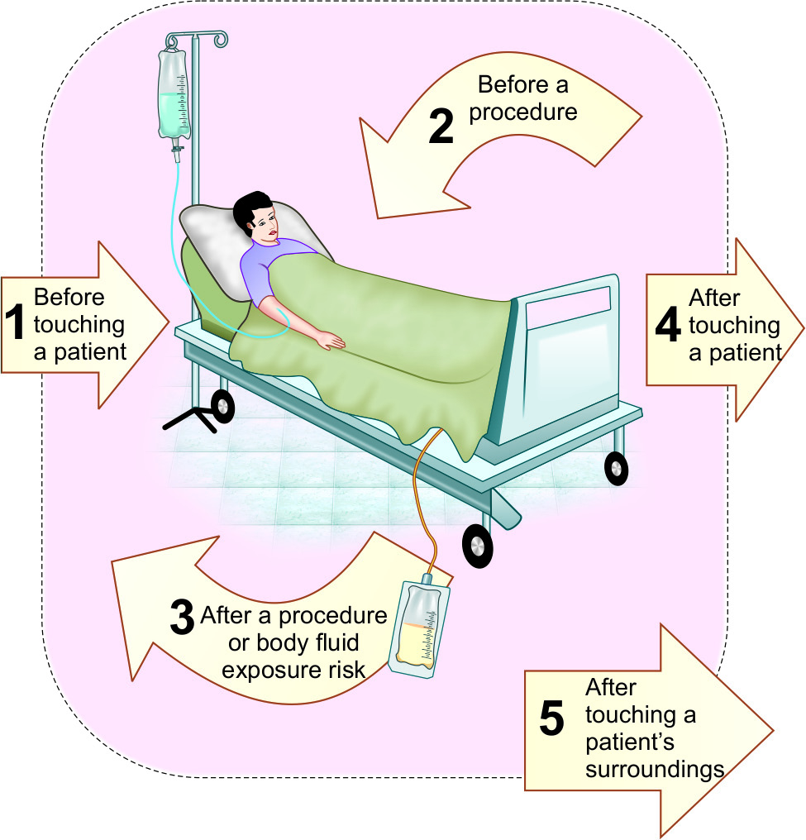
Indications (Five Moments for Hand Hygiene)

Slide 22
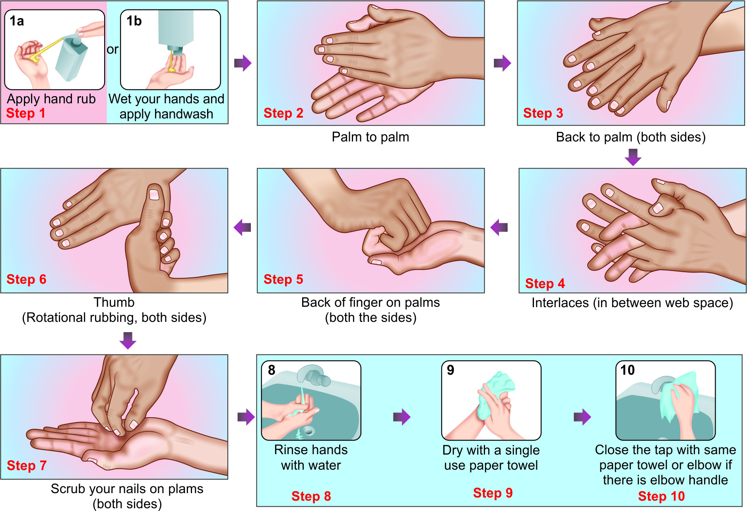
Steps of Hand Rubbing and Hand Washing

Slide 23
Personal Protective Equipment (PPE)
Used to protect the skin and mucous membranes of HCWs from exposure to blood and/or body fluids
From the HCW to the patient during sterile and invasive procedures.

Slide 24
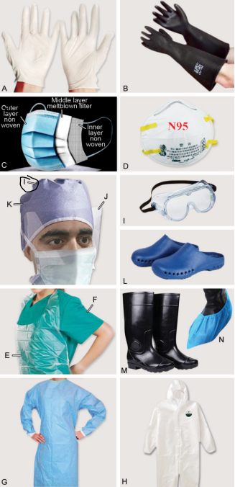
Personal Protective Equipment (PPE)
(Cont..)
Personal protective equipment (PPE):
A. Gloves; B. heavy duty gloves; C. Surgical mask; D. N95 respirator; E. Plastic apron; F. Linen gown; G. Disposable gown; H. Coverall; I. Goggles; J. Face shield; K. Cap; L. Shoes; M. Gum boot; N. Shoe cover

Slide 25
Personal Protective Equipment (PPE)
(Cont..)
Selection of appropriate PPE is based on:
Level of risk associated with contamination of skin, mucous membranes, and clothing by blood and body fluids
Route of transmission of suspected organisms
** PPE must be removed immediately after the indication of its use

Slide 26
Gloves
Protect both patients and HCWs from exposure to microorganisms that have colonized on their hands.
Used as part of standard, contact and droplet precautions.

Slide 27
Gloves (Cont..)
Indications for glove use
As a part of standard precautions Before a sterile procedure Anticipation of a contact with blood or bo dy fluid, regardless of the existence of sterile conditions and including contact with non-intact skin and mucous membrane As a part of contact precautions: Contact with a patient (and his/her immediate surroundings) Heavy duty gloves: To protect from sharp injuries, mainly used by biomedical waste handlers
Indications for glove removal
As soon as gloves are damaged Gloves are meant for single-use, must be changed in-between patients or patient care activities When there is an indication for hand hygiene

Slide 28
Gloves (Cont..)
Clinical situations where use of gloves is not recommended
For routine patient care activities if there is no anticipated risk to blood/body fluid or no indication for contact precaution Examples: Measuring blood pressure, temperature, and pulse, While administering medications (oral or injections), During maintenance of IV cannula, During dressing and transporting patient, Writing in the patient’s case sheet, etc.

Slide 29
Hand Hygiene and Glove Use
Glove is not a substitute for hand hygiene.
The following measures should be adapted during gloves use:
  Hand hygiene before gloves use
  Hand wash after glove use
  Change: Gloves should be worn for a single patient care activity. Gloves must be changed between patient contacts.
  No hand hygiene over the gloved hand

Slide 30
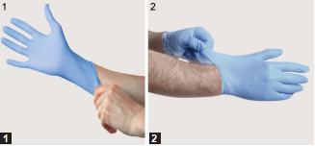
Steps of gloves donning (wearing)
1. Donning of the first glove : Wear by touching and pulling only the edge of the cuff
2. Donning of the second glove: Avoid touching the forearm skin by pulling external surface of second glove by the finger of gloved hand

Slide 31
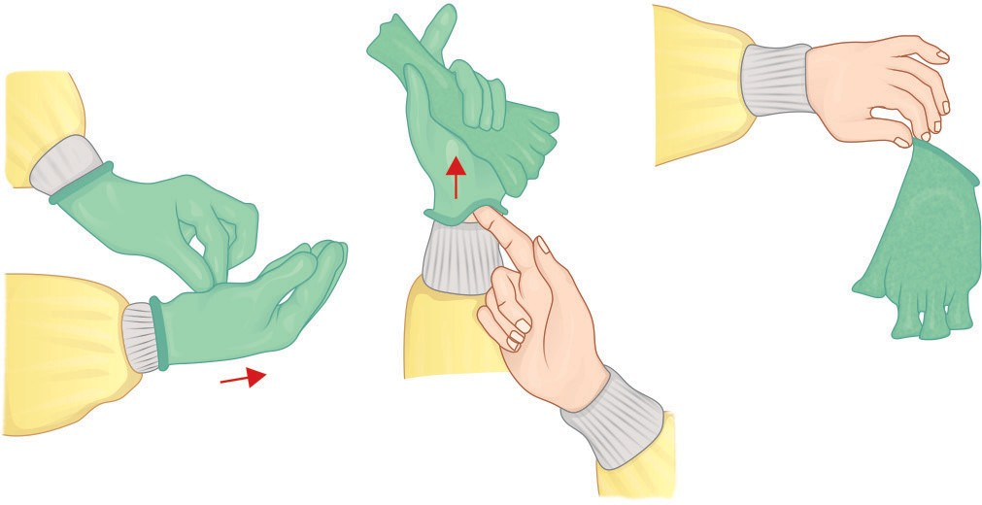
Steps of gloves removal (doffing)
Do not touch the outside of the gloves (contaminated):
Using a gloved hand, grasp the palm area of the other gloved hand peel off first glove.
Hold removed glove in gloved hand slide fingers of ungloved hand under the other glove at wrist and peel off second glove over first glove
First glove will remain inside the pouch of the second glove
Perform hand hygiene after removal

Slide 32
Surgical (3-ply) Mask and Respirators
Respiratory protection is essential when there is a risk of transmission of droplets and aerosols.
There are two type of PPEs available for respiratory protection:
  Surgical mask
  Respirators.

Slide 33
Surgical Mask (3-ply or medical mask)
Loose fitting, single-use item that cover the nose and mouth.
Used as part of standard precautions to prevent splashes or sprays from reaching the mouth and nose of the person wearing them.
Provide some protection from respiratory secretions and are worn when caring for patients on droplet precautions.

Slide 34
Surgical Mask (3-ply Mask) (Cont..)
Composition:
Filter pore size of surgical mask is not standardized. It has three layers:
  1. Outer fluid repellent layer
  2. Middle filter layer
  3. Inner hydrophilic layer

Slide 35
Surgical Mask (3-ply Mask) (Cont..)
Instructions:
Shelf-life: Disposable after 4-6 hours of use or earlier if become soiled or wet
Donning: Place the mask carefully - ensure it covers the mouth and nose, adjust to the nose bridge, and tie it securely

Slide 36
Surgical Mask (3-ply Mask) (Cont..)
Instructions (Cont..):
Hanging mask syndrome - Strongly discouraged
Touching the front of the mask while wearing should be avoided
Mask should not be worn with beard and unshaven face
Hand hygiene - performed before donning the mask, upon touching or discarding a used mask

Slide 37
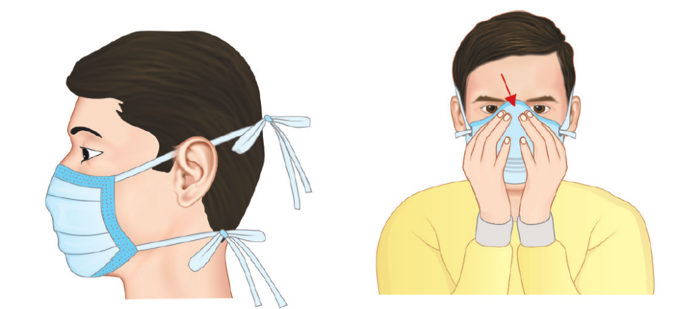
Steps of mask donning (wearing)
Pull the straps tight and pull the mask to below chin and then apply knots
Press on the nasal bridge part of the mask to seal tightly and for N95 respirator, perform fit check

Slide 38
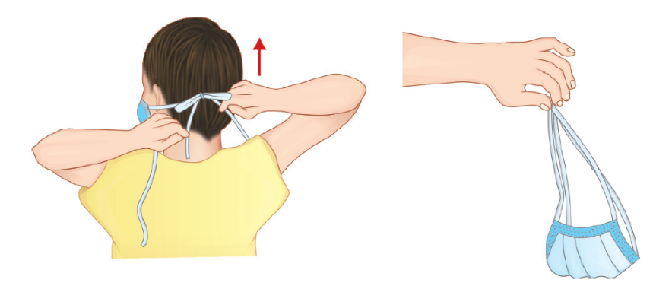
Steps of mask doffing (removal)
Do not touch front part of the mask
Untie the lower knot first, then the upper knot and remove the mask by holding its straps, without touching the front, hand wash after removal

Slide 39
Respirator (N95 Mask)
Device designed to protect the wearer from airborne microorganisms (e.g. M. tuberculosis).
N 95 respirator- most commonly used
N95 - ‘not resistance to oil and ability to filter of 95% of airborne particle’

Slide 40
Respirator (N95 Mask) (Cont..)
Composition: The N95 respirator is
Comprised of four layers of material:
  Outer and inner layers of spun bond polypropylene
  Middle two layers of cellulose/ polyester, melt-blown polypropylene filter

Slide 41
Respirator (N95 Mask) (Cont..)
Negative-pressure- pressure inside the facepiece is negative during inhalation
Single-use- should not be reused as it cannot be cleaned or disinfected.
Removal:
Should be removed or changed - in 8 hours or earlier if it gets clogged, wet or dirty on the inside, or deformed, or torn.

Slide 42
Respirator (N95 Mask) (Cont..)
Fit checking - To ensure if it is properly fitted. Includes the following steps.
  Sealing- across face, cheeks and nasal bridge
  Positive pressure seal- done by gently exhaling
  Negative pressure seal- done by gently inhaling

Slide 43
Respirator (N95 Mask) (Cont..)
Fit testing:
Done to identify size and style
To train the HCW on how to don and doff
Should be done at the time of joining and thereafter annually

Slide 44
Protective Body Clothing
Worn when there is a risk that clothing may become exposed to blood or body fluids.
  Laboratory coats
  Plastic aprons
  Disposable gowns
  Coverall

Slide 45
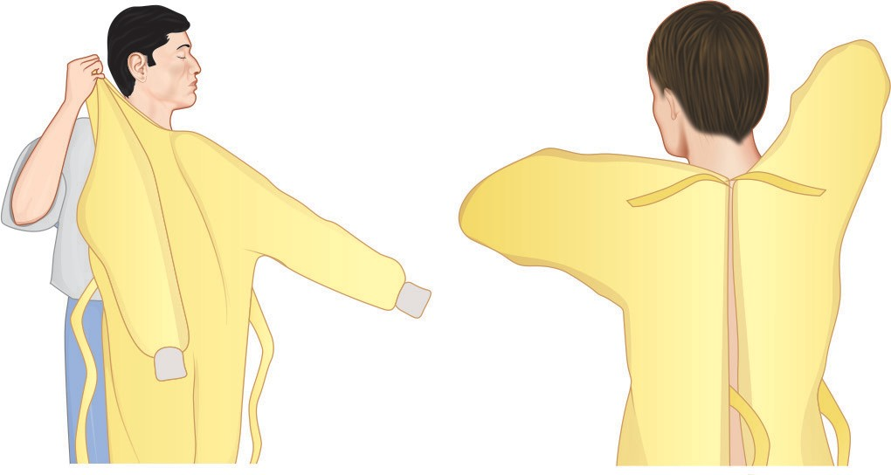
Steps of gown donning (wearing)
Fully cover torso from neck to knees, arms to end of wrists, and wrap around the back. Fasten it in the back of neck and waist

Slide 46
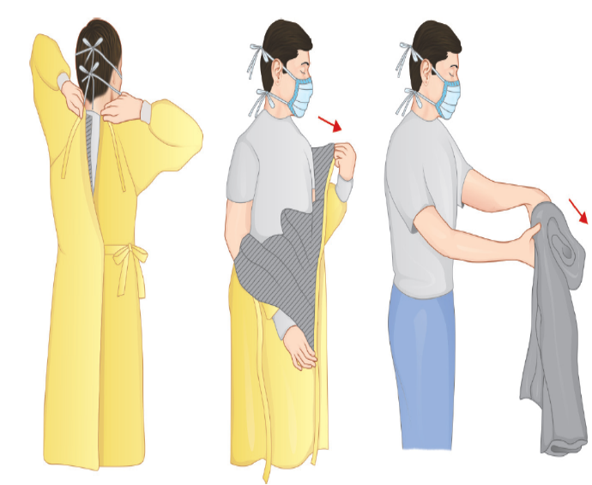
Steps of gown doffing (removal)
Do not touch front part of the gown
Unfasten gown ties, taking care that sleeves don’t touch the body when reaching for ties
Pull the gown away from neck and shoulders, touching inside of gown only
Turn gown inside out and roll into a bundle and discard.
Perform hand hygiene after removal

Slide 47
Protective Eye/Face Wear
Goggles, or face-shields – used to protect the mucous membranes of the eyes, nose, and mouth.
Eyewear - worn during procedures that are likely to generate droplets or aerosols of blood and/or high-risk body fluids.

Slide 48
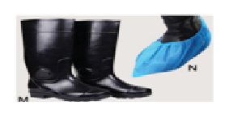
Head Cover and Shoe Cover
Used when spillage of blood is suspected.
Shoe covers include:
  (1) Surgical shoes (slippers) and shoe covers
  (2) Gum boots – When anticipated risk of sharp injury exisits

Slide 49
Donning and Doffing
Donning (wearing): Gown first → Mask or respirator → Goggles or face shield → Gloves
Doffing (removing): Gloves first → Face shield or goggles → Gown → Mask or respirator
* Discard PPE in appropriate BMW bins
**All PPE should be removed just before exiting the patient room except a respirator, which should be removed after leaving the patient room and closing the door

Slide 50
Blood Spill Management
Spillage of blood and body fluid - substantial risk for the transmission of BBV
Any spillage (small, few drops to large, few mL) should be considered infectious - need to be cleaned at the earliest.

Slide 51
Steps of Spill Management (CDC)
Any spillage, should be attended immediately
Mark the spill area, place the wet floor signage
Wear appropriate PPE (gloves and gown) as mentioned in the spill kit
Confine the spill and wipe immediately with an absorbent towel or cloth

Slide 52
Steps of Spill Management (CDC) (Cont..)
Clean with hypochlorite (freshly prepared)
For large spills (≥10 cm size): 0.5%
For small spill (<10 cm size): 0.05%
Allow the disinfectant at least for a contact time of 10 min
Rinse the area with clean water to remove the disinfectant residue.

Slide 53
TRANSMISSION-BASED PRECAUTIONS

Slide 54
TRANSMISSION-BASED PRECAUTIONS
Set of infection control practices which should be followed over and above standard precautions.
Should be practiced – handling patients infected with infectious agents having specific mode of transmission
TBPs include - contact, droplet and airborne

Slide 55
Contact Precautions
Followed when there is evidence of HAI transmission by direct or indirect contact during patient care.
Direct transmission - from one person to another person without a contaminated intermediate object or person.
Indirect transmission - through a contaminated intermediate object (clothes, patient-care devices, environmental surfaces, fomite) or person

Slide 56
Agents transmitted through contact
MDROs – MRSA, CRE, VRE, MDR-NFGNB
Enterically transmitted hepatitis viruses (HAV and HEV)
Agents of conjunctivitis (e.g. adenovirus, gonococcus, Chlamydia)
Contagious skin lesions (abscess, infected ulcers) - GAS, Staphylococcus, HSV
Skin infestations (e.g. scabies)
Agents of diarrhea such as rotavirus, cholera, Clostridium difficile

Slide 57
IC Measures – Contact Precautions
Hand hygiene
PPEs –gloves, gowns; ± surgical mask/protective eye wear
Single use- patient dedicated equipment
Patient placement – single isolation room/cohorting
Transfer of patients
Disinfection of the rooms
*Cohorting – Patient with similar infections & with min 3 feet spatial bed separation

Slide 58
Droplet Precautions
Prevent the spread of infectious agents - transmitted through droplet.
Respiratory droplets - large-particles (>5 µm in size) - generated by a patient who is coughing, sneezing or talking.
Transmission via large droplets requires close contact (<3 feet) – do not remain suspended in the air - travel shorter distances.

Slide 59
Agents transmitted through droplets
Diphtheria, Hib, N.meningitidis (meningitis, sepsis, pneumonia), pertussis, pneumonic plague, Mycoplasma pneumonia
Influenza viruses, seasonal
SARS-CoV2 (COVID-19)
Viral hemorrhagic fevers - Lassa, Ebola, Marburg viruses
Other viruses: Mumps, Parvovirus B19, Rhinovirus, Rubella, Adenovirus

Slide 60
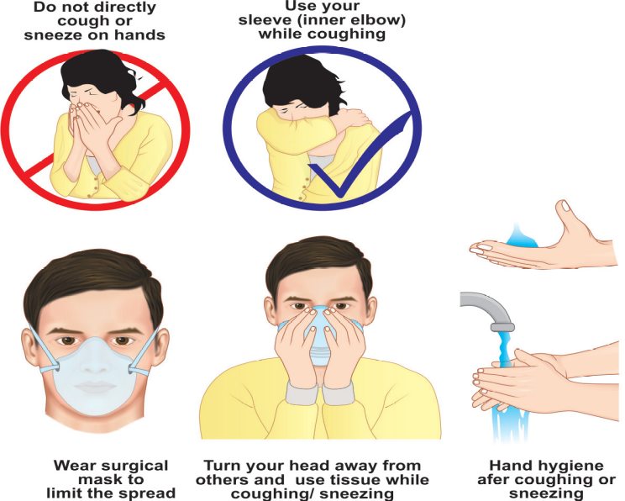
IC Measures- Droplet Precautions
Hand hygiene
PPEs – Surgical mask or N95 when AGPs
are performed
Respiratory Hygiene/Cough Etiquette
Patient placement – Single isolation room
or cohorting
Transfer of patients
Disinfection of the rooms

Slide 61
Airborne Precautions
Prevent the spread of infectious agents - transmitted through aerosols.
Aerosols are small-particles (<5µm) generated by an infectious person during certain aerosol generating procedures (e.g. intubation)
These smaller droplets remain suspended in air for long periods of time and may disperse to a distant place along the air current.

Slide 62
Agents transmitted through aerosols
Mycobacterium tuberculosis
Measles virus
Varicella (chickenpox and zoster disseminated or in an immunocompromised host)
Smallpox (variola) and monkeypox virus
Aerosolizable spore-containing powders - Bacillus anthracis
Aspergillus (pulmonary aspergillosis)

Slide 63
Aerosol-generating Procedures (AGPs)
AGPs - generate much higher concentrations of aerosols and are associated with higher risk of pathogen transmission.
Examples: Endotracheal intubation, open respiratory and airway suctioning, tracheostomy care, cardiopulmonary resuscitation, sputum induction and bronchoscopy

Slide 64
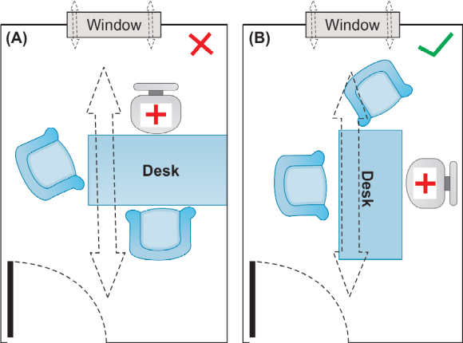
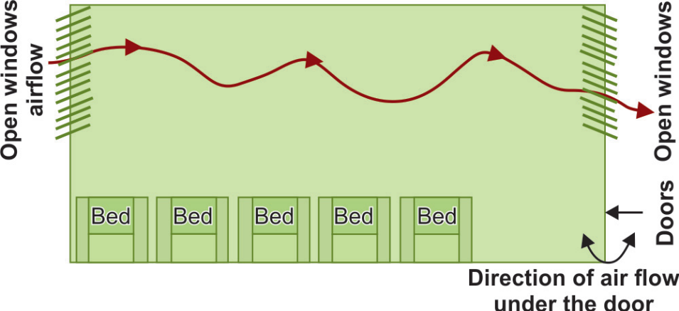
IC Measures – Airborne precautions
PPE – N95 respirator
Patient Placement – Airborne isolation room (AIIR)
Ventilation
  Natural Ventilation
In room (A), the seating arrangement is along with direct of natural ventilation of air flow, so that the doctor has higher risk of exposure to the potentially infected air.
In room (B), doctor is sitting away from the direction of natural airflow, thus has lesser risk of exposure.

Slide 65
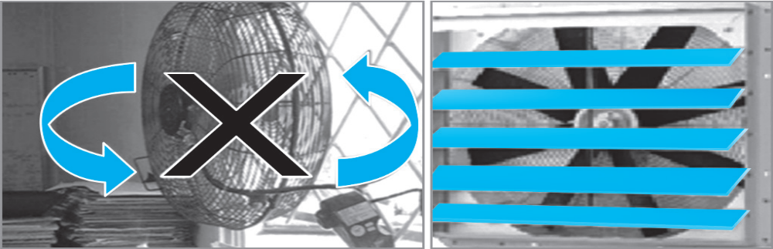
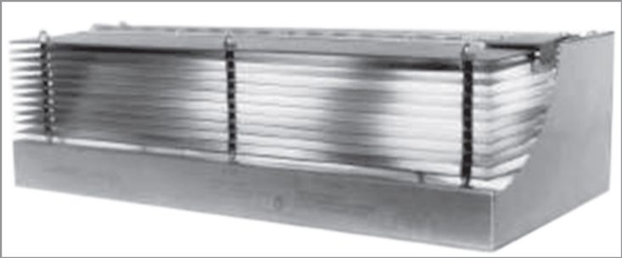
IC Measures – Airborne precautions
  Mechanical Ventilation(Negative pressure room)
    Minimum 12 ACH per hour in high risk area and 6 in low risk area
    Negative pressure differential of >2.5Pascal
    Door should be kept closed always
    Anteroom should be present
Ultraviolet Germicidal Irradiation (UVGI) - >8 feet from floor
Filtration – Exhaust or HEPA
Exhaust fan:
(A) Poorly-installed in an open window space;
(B) well-installed, closely fitted.

Slide 66
IC Measures – Airborne precautions
Transfer of Patients- patient should wear surgical mask
Respiratory Hygiene and Cough Etiquette
Visitors and Staff – restricted access

Slide 67
Summary of Measures - Standard and TBP
Type | Isolation room or cohorting | Hand hygiene | Gloves | Apron or gown | Mask | Eye protection | Handling of equipment | Visitors
Standard | Not required | Yes | As required | If soiling likely | As required | As required | Single use or reprocessed | No additional precautions
Contact | Essential | Yes | Essential | Essential | As required | As required | Same as standard | Same precautions as for HCWs

Slide 68
Summary of Measures - Standard and TBP
(Cont..)
Type | Isolation room or cohorting | Hand hygiene | Gloves | Apron or gown | Mask | Eye protection | Handling of equipment | Visitors
Droplet | Essential | Yes | As required | If soiling likely | Surgical mask is essential | As required | Same as standard | Restricted. Precautions same as for HCWs
Airborne | Essential (negative pressure) | Yes | As required | If soiling likely | N95 respirator Is essential | As required | Same as contact | Same as for droplet

Slide 69
HOSPITAL INFECTION CONTROL COMMITTEE

Slide 70
HOSPITAL INFECTION CONTROL COMMITTEE
Provides a forum for multidisciplinary input and cooperation, and information sharing, required for hospital infection control and prevention.
HICC is advisory to the MS and makes its recommendations to the MS.

Slide 71
HICC Constitution
Chairperson, MS
Secretary, HOD, Microbiology
HICO, representative from the Dept of Microbiology
HICN - Hospital Infection Control Nurses
Head of all the clinical (all medical and all surgical) departments
Nursing Superintendent
Head of the staff clinic

Slide 72
HICC Constitution (Cont..)
Operation Room Supervisor
In-charge of Central Sterile Supplies Department (CSSD)
In-charge of pharmacy
In-charge of hospital linen and laundry
In-charge of hospital kitchen
Epidemiologist

Slide 73
Functions of HICC
HAI surveillance
Develops a system for identifying, reporting, analyzing, investigating and controlling hospital-acquired infections.
Antimicrobial stewardship program (AMSP)
Policies: Reviews and updates the hospital infection control policies and guidelines from time to time.
Education
Staff health
Outbreak management

Slide 74
Functions of HICC (Cont..)
Other departments: Communicates and cooperates with other departments of the hospital (e.g. pharmacy, CSSD)
Reviews risks associated with new technologies, and monitor infectious risks of new devices and products, prior to their approval for use.
HICC Meetings: HICC shall meet regularly - not less than once a month and as often as required.

Slide 75
Questions:
Q1. Hand rub should not be used in which scenario:
Before touching patient
After touching patient
After touching patient’s surrounding
Hands are visibly soiled

Slide 76
Questions:
Q2. How many moments of hand hygiene have been laid down by WHO:
5
6
7
8

Slide 77
Questions:
Q3. Hand wash should be performed for a minimum duration of :
20 seconds
40 seconds
50 seconds
2 minutes

Slide 78
Questions:
Q3. Which is not an ESKAPE pathogen:
Enterococcus faecium
Staphylococcus aureus
Klebsiella pneumoniae
Proteus mirabilis

