Slide 1
ENVIRONMENTAL CLEANING
Environmental cleaning of floor and surface of hospitals play a vital role in controlling the spread of infections.

Slide 2
General principles of environmental cleaning are as follows:
  Cleaning followed by disinfection
  Cleaner to dirtier
  High to low
  Inward to outwards
  Frequency of cleaning depends up on: Probability of contamination , Vulnerability of population to infection, Frequency of hand contact

Slide 3
Frequency of cleaning for common situations:
Non-critical surfaces and floors - 2–3 times a day
Mattress used for patients - cleaned weekly and after discharge
Doors, windows, walls and ceiling - once a month and spot-cleaning when soiled
High touch areas - every 3–4 hours

Slide 4
Disinfection of Operation Theatre
Surface disinfection: Cleaning with a cleansing agent, followed by disinfection by using aldehyde-based disinfectant.
  First cleaning of the day (before cases begin)
  In between cases (cleaning 3 to 4 feet perimeter around the OT table)
  Terminal cleaning of OT after the last case
  Detailed wash-down of the OT complex once a week
  During renovation or construction of OT or nearby places

Slide 5
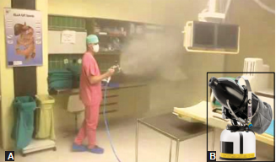
Fogging (aerial disinfection ):
Spraying of a disinfectant (e.g. glutaraldehyde,H2O2 or QAC based product) with the help of a fogger machine.
Fogging of operation theatre;
Fogger machine

