Slide 1
Diarrheogenic E. coli
Dr. Ved Prakash
Professor & Head
PG Department of Microbiology

Slide 2
Diarrhea (Diarrheagenic E. coli)
Antigenically distinct from the commensal E. coli which colonize the intestine.
Only few serotypes of E. coli which express the enterotoxin or other virulence mechanisms can cause diarrhea.
WHO estimated that >300 million illnesses and nearly 200,000 deaths are caused by diarrheagenic E. coli globally each year
There are six pathotypes of diarrheagenic E. coli.

Slide 3
Enteropathogenic E. coli (EPEC)
EPEC frequently causes infantile diarrhea (outbreaks) and occasionally cause sporadic diarrhea in adults.
Person-to-person spread is seen
Nontoxigenic and noninvasive

Slide 4
Enteropathogenic E. coli
destruction of surface microvilli
fever
diarrhea
vomiting
nausea
non-bloody stools (not generally seen as dysentery)
Gut lumen

Slide 5
Mechanism of diarrhea includes:
Adhesion to intestinal mucosa, mediated by plasmid coded bundle-forming pili, which form cup-like projections called pedestals.
A/E lesions (attaching and effacing lesions): Typical lesions produced on the intestinal epithelium - leads to disruption of brush border epithelium causing increased secretion and watery diarrhea.

Slide 6
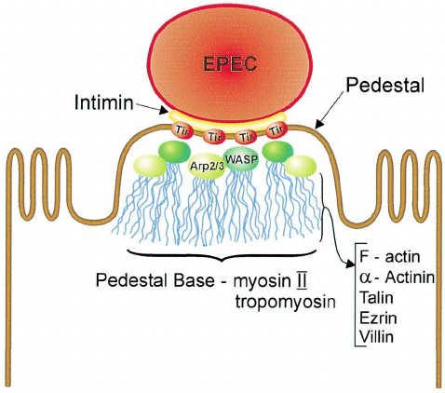

Slide 7
Enterotoxigenic E. coli (ETEC)
ETEC is the most common cause of traveler’s diarrhea causing 25–75% of cases.
It causes acute watery diarrhea in infants and adults
It is toxigenic, but not invasive

Slide 8
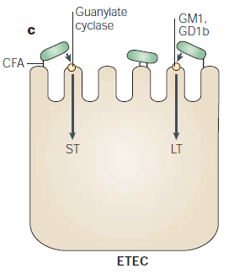
ETEC adhere to small bowel enterocytes and induce watery diarrhoea by the secretion of heat-labile (LT) and/or heat-stable (ST) enterotoxins.

Slide 9
Pathogenesis of ETEC is by:
Attachment to intestinal mucosa is mediated by fimbrial protein called CFA (colonization factor antigen)
Toxin production—(1) heat-labile toxin (acts by ↑cAMP), (2) heat-stable toxin (acts by ↑cGMP).
Diagnosis: Detection of toxins is the mainstay of diagnosis

Slide 10
Enteroinvasive E. coli (EIEC)
EIEC is biochemically, genetically and pathogenically closely related to Shigella.
Pathogenesis: EIEC is not toxigenic, but invasive.
The epithelial cell invasion is mediated by a plasmid-coded antigen called virulence marker antigen (VMA)

Slide 11
Enteroinvasive E. coli (EIEC )
Dysentery
  - resembles shigellosis
Gut lumen

Slide 12
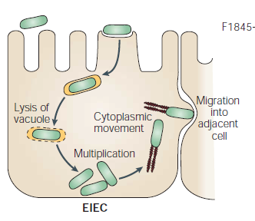
EIEC invades the colonic epithelial cell, lyses the phagosome and moves through the cell by nucleating actin microfilaments. The bacteria might move laterally through the epithelium by direct cell-to-cell spread or might exit and re-enter the baso-lateral plasma membrane.

Slide 13
Manifestations: Ulceration of bowel, dysentery (diarrhea with mucus and blood, called bacillary dysentery resembling shigellosis)
Diagnosis:
  Detection of VMA by ELISA
  HeLa cell invasion assay
  Biochemically atypical being nonmotile, and lactose nonfermenters.

Slide 14
Enterohemorrhagic E. coli (EHEC)
EHEC is prevalent mainly in industrialized countries.
Serotypes associated with EHEC: O157:H7 is the most common serotype.
However other strains may account for up to 50% of EHEC infections; among which O104:H4 strain of EAEC is important

Slide 15
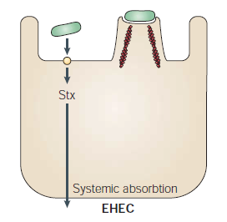
EHEC also induce the attaching and effacing lesion, but in the colon. The distinguishing feature of EHEC is the elaboration of Shiga toxin (Stx), systemic absorption of which leads to potentially life-threatening complications.

Slide 16
Transmitted by contaminated food, i.e. consumption of lettuce, spinach, sprouts and undercooked ground beef.
The recent outbreak of EHEC (in 2020), was reported in United States, was due to consumption of clover sprouts contaminated with E. coli O103
Low infective dose: Only few organisms (<10² bacilli) are required to initiate the infection

Slide 17
Pathogenesis: EHEC secretes a toxin called verocytotoxin or Shiga toxin; therefore - called Shiga toxin producing E. coli (STEC)
Resembles with Shiga toxin produced by Shigella dysenteriae type 1
Acts by inhibiting the protein synthesis by inhibiting 60S ribosome.
It is of two types—Stx1 and Stx2.

Slide 18
Manifestations: Shiga toxin has a predilection for endothelial cells causing capillary microangiopathy which leads to:
  HC (hemorrhagic colitis)
  Hemorrhagic uremic syndrome (HUS)

Slide 19
Diagnosis:
Special culture media - Sorbitol MacConkey agar (does not ferment sorbitol) and Rainbow agar are used for EHEC
Toxin detection:
  Demonstration of cytotoxicity in Vero cell lines (gold standard method)
  Fecal toxin detection by ELISA or rapid tests.

Slide 20
Enteroaggregative E. coli (EAEC)
So named because it adheres to HEp-2 cells in a distinct pattern, layering of the bacteria aggregated in a stackedbrick fashion.
Most strains are “O” untypeable but “H” typeable.

Slide 21
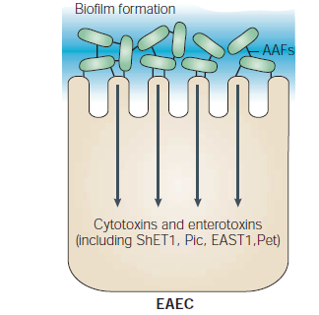
EAEC adheres to small and large bowel epithelia in a thick biofilm and elaborates secretory enterotoxins and cytotoxins.
Shortening of microvilli, mononuclear infiltration and Haemmorhage.

Slide 22
Pathogenesis:
  Intestinal colonization is mediated by aggregative adhesion fimbriae I (regulated by aggR gene)
  It also produces EAST 1 toxin (enteroaggregative heat stable enterotoxin 1).

Slide 23
Manifestations: Persistent and acute diarrhea are commonly seen; especially in developing countries - can also cause traveler’s diarrhea and persistent diarrhea in infants
Diagnosis is made by - (i) detection of aggR and aatA gene by PCR, and (ii) HEp-2 adherence test (gold standard).

Slide 24
E. coli O104: H4
It is an enteroaggregative strain that has caused major outbreaks in Germany in 2011.
One peculiar feature of this strain is, it produces Shiga toxin and can cause HUS.

Slide 25
Diffusely-adherent E. coli (DAEC)
Ability to adhere to HEp-2 cells in a diffuse pattern
Expresses diffuse adherence fimbriae which contribute to the pathogenesis
DAEC is capable of causing diarrheal disease, primarily in children aged 2–6 years.

Slide 26
Treatment of Diarrheagenic E. coli
The mainstay of treatment is fluid replacement - use of antimicrobials should generally be avoided.
The following are the situations where antibiotics may be considered.
  Traveler’s diarrhea (ETEC or EAEC)
  EIEC
  EHEC and E. coli O104: H4
  EAEC

Slide 27
Traveler’s diarrhea (ETEC or EAEC): Only for severe traveler’s diarrhea, azithromycin is indicated. Rifaximin, an oral nonabsorbable antibiotic can also be given
EIEC: Although the infection is self-limited, antibiotics such as azithromycin is indicated as it fastens the recovery, particularly in severe cases

Slide 28
EHEC and E. coli O104: H4: Cotrimoxazole, beta-lactams, metronidazole should be avoided as they precipitate HUS. If treatment has to be started (e.g. if positive blood culture), azithromycin is the preferable option
EAEC: Only in immunocompromised patients, ciprofloxacin for 3-7 days is recommended.

Slide 29
Causative agents of infective diarrhea
A. Bacteria | C. Protozoa
Vibrio cholerae | Entamoeba histolytica
V.Parhaemolyticus | Giardia lamblia
Escherichia coli (ETEC, EPEC) | Cryptosporidium parvum
Salmonella Enteritidis | Isospora belli
S.Typhimurium | D. Cestodes
Other Salmonella sp. | Hymenolepis nana
Campylobacter sp. | E.Nematodes
Yersinia enterocolitica | Trichuris trichiura
Shigella sp. | Strongyloides stercoralis
Clostridium perfringens | Ascaris lumbricoides
C.Difficile | Hookworms
Staphylococcus aureus | F. Trematodes
Bacillus cereus | Schistosoma mansoni
Aeromonas hydrophilia

Slide 30
Plesiomonas shigelloides
B. Viruses
Rotavirus
Astrovirus
Calicivirus
Norwalk virus
Adenovirus

Slide 31
Types of bacterial diarhea
i. Invasive bacterial pathogens Salmonella species
Shigella species
Enteroinvasive Esch. Coli (EIEC)
Enterohemorrhagic Esch. Coli (EHEC)
Vibrio Parhaemolyticus
Campylobacter jejuni
Yersinia enterocolitica
ii. Noniasive bactrial pathogens
These organisms cause gastroenteritis or food poisoning by production of toxin.
Enterotoxigenic Esch. Coli (ETEC)
Enteropathogenic Esch. Coli (EPEC)
Vibrio cholerae
Shigella dysentriae tpe1
Staphylococus aereu
Bacillus cereus
Clostridiu perfringens
Clostridum difficile

Slide 32
Microbial agents of food poisoning
Organisms | Symptoms | Common food sources
1–6 h incubation period
Staphylococcus aureus | Vomiting, diarrhea, abdominal cramps | Ham, poultry, salad, mayonnaise, pastries, dairy products
Bacillus cereus | Vomiting, diarrhea, abdominal cramps | Fried rice
8–16 h incubation period
Clostridium perfringens | Abdominal cramps, diarrhea | Beef, poultry, legumes, gravies
B. cereus | Abdominal cramps, diarrhea | Meats, vegetables, dried beans, cereals

Slide 33
Organisms |  | Symptoms |  | Common food sources
>16 h incubation period
Vibrio cholerae | Watery diarrhea |  | Shellfish, water
Enterotoxigenic E. coli | Watery diarrhea |  | Salads, cheese, meat, water
Enterohemorrhagic E. coli | Bloody diarrhea |  | Ground beef, salami, milk, raw vegetables, apple juice
Non-typhoidal salmonellae | Inflammatory diarrhea |  | Meat, eggs, milk, juice, raw fruits and vegetables
Shigella species | Dysentery |  | Potato, egg salad, lettuce, raw vegetables
Vibrio parahaemolyticus | Dysentery |  | Raw or undercooked shellfish, particularly oysters

Slide 34
Organisms | Symptoms | Common food sources
>16 h incubation period
Campylobacter jejuni | Inflammatory diarrhea | Poultry, raw milk or water
Clostridium botulinum | Flaccid paralysis, diplopia, dysphagia | Homemade improperly canned food, and honey (infants)
Listeria monocytogenes | Fever and myalgia (pregnant women) | Soft cheeses, raw sprouts, meats, seafood, and milk
Norovirus | Watery diarrhea, vomiting, abdominal cramps | Salads, fresh fruits, shellfish (such as oysters), or water
Cyclospora | Watery diarrhea, abdominal cramps | Raw fruits or vegetables and herbs
Mycotoxicoses (6-24h) | Depends on type of fungal toxins, e.g. aflatoxin- causes hepatoma | Nuts, maize, wheat, cereals, etc.

Slide 35
Treatment of Food poisoning
The mainstay of treatment is adequate rehydration and electrolyte supplementation - either an oral rehydration solution (ORS) or intravenous solutions (e.g. isotonic sodium chloride solution, Ringer lactate solution).
Other symptomatic treatment - absorbents (e.g. aluminum hydroxide) and antisecretory agents (e.g. bismuth subsalicylate)

Slide 36
Antitoxin such as heptavalent botulism equine serum antitoxin can be given if food botulism is suspected
Antibiotics - penicillin or metronidazole may be attempted for botulism
Diet: During episodes of acute diarrhea, patients often develop an acquired disaccharidase deficiency due to washout of the brush-border enzymes - avoiding milk, dairy products, and other lactose-containing foods are advisable

Slide 37
Antibiotics: Usually antibiotics do not play much role.
It is mainly indicated for shigellosis, where fluoroquinolone (e.g. ciprofloxacin) is the first-line agent.
In suspected cholera, azithromycin is the drug of choice.

Slide 38
CHEMICAL CAUSES OF FOOD POISONING
There are several non-microbial agents that can cause food poisoning such as capsaicin (found in hot peppers), variety of toxins found in fish and shellfish, ciguatera, histaminefish poisoning (scombroid), and some chemical poisons (e.g. heavy metals).

Slide 39
Scombroid Food Poisoning
Morganella morganii, a commensal in sea fish can breakdown histidine present in sea fish into histamine, which can cause food poisoning following seafood intake.
Proper storage of fish in freezer (<16°C) can prevent this condition.
It is a gram-negative bacillus, belongs to Enterobacteriaceae family.

Slide 40
MYCOTOXICOSES
Mycotic poisoning is a rare cause of food poisoning, caused by fungi.
The disease can be classified into two varieties:
  1. Mycotoxicosis: Disease produced by consumption of food contaminated with toxins liberated by certain fungi
  2. Mycetism: Toxic effects produced by eating poisonous fleshy fungi; usually different types of mushrooms.

Slide 41
Features of common mycotoxicosis
Mycotoxin | Produced by fungal species | Source | Clinical condition
Aflatoxin | Aspergillus flavus Aspergillus parasiticus, A. nomius Penicillium puberulum | Nuts, maize | Hepatoma,hepatitis Indian childhood cirrhosis Reye’s syndrome
Fumonisins | Fusarium moniliforme | Maize | Equine leukoencephalomalacia Porcine pulmonary edema Carcinoma esophagus
Trichothecenes | Fusarium graminearum | Maize, wheat, sorghum | Alimentary toxic aleukia Biological warfare (yellow rain)

Slide 42
Mycotoxin | Produced by fungal species | Source | Clinical condition
Ochratoxin | Aspergillus ochraceus, A. niger Penicillium verrucosum | Cereals, bread | Nephropathies (Balkan endemic nephropathy)
Cyclopiazonic acid | Aspergillus flavus, A. versicolor, A. oryzae Penicillium cyclopium | Groundnut, corn | Kodua poisoning Co-contaminant with aflatoxin
Zearalenones | Fusarium graminearum | Wheat, maize | Genital disorder in pigs

Slide 43
Features of common mycetism
Mushroom poisoning | Produced by fungal species | Source | Clinical condition
Ergot alkaloid | Claviceps purpurea | Rye flour | St. Anthony’s fire
Coprine poisoning | Coprine atramentarius | Butter | Antabuse like reaction
Muscarine | Inocybe fastigiata | Food | Cholinergic effect
Ibotenic acid, muscimol | Amanita pantherina | Edible mushroom | Abdominal pain, vomiting, diarrhea
Cyclopeptide | Amanita phalloides | Edible mushroom | Hepatocellular failure, green death cap

Slide 44
Thanks

