Slide 1
Cholera, Halophilic Vibrio and Aeromonas Infections
Dr. Ved Prakash
Professor & Head
PG Department of Microbiology

Slide 2
Learning objectives
At the end of the session, the students will be able to understand:
Classification, pathogenesis, clinical manifestations, lab diagnosis and treatment of Vibrio cholerae
Halophilic vibrios
Aeromonas infections

Slide 3
INTRODUCTION
Vibrios - curved gram-negative bacilli that are actively motile by means of single polar flagellum.
The name ‘Vibrio’ is derived from its characteristic vibratory motility.
Robert Koch isolated the organism in 1886, and named it as Komma bacillus; due to its characteristic curved or comma-shaped appearance

Slide 4
Habitat: Vibrios are ubiquitous, found worldwide.
Being salt loving - natural habitat of vibrio is the marine environments (sea water and sea food), surface waters, river and sewage
Most important - V. cholerae - causes a devastating acute diarrheal disease ‘cholera’ and has been responsible for seven global pandemics and several epidemics over the past two centuries

Slide 5
CHOLERA

Slide 6
Classification of Vibrio
Based on Salt Requirement:
  Nonhalophilic vibrios - Grow without salt, but 1% salt is optimum for their growth - cannot grow at higher salt concentrations. Examples - V. cholera and V. mimicus
  Halophilic vibrios - Cannot grow in the absence of salt - can tolerate and grow at higher salt concentration of up to 7–10%. Examples - V. parahaemolyticus, V. alginolyticus and V. vulnificus.

Slide 7
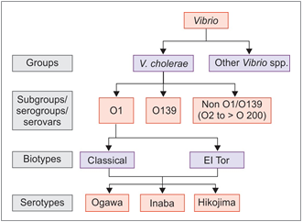
Gardner and Venkatraman Classification:

Slide 8
Gardner and Venkatraman Classification
O1 serogroup
  Agglutinated by O1 antisera
  Responsible for all pandemics & most of the epidemics of cholera
Nonagglutinable (NAG) vibrios
  Not agglutinated by O1 antiserum
  Initially thought to be non-pathogenic (non-cholera vibrios –NCV)

Slide 9
Gardner and Venkatraman Classification
O139 serogroup
  Since 1992 has caused several epidemics and outbreaks - coastal India & Bangladesh.
Non O1/O139 serogroups - occasional sporadic outbreaks of diarrhea & extraintestinal manifestations, but never epidemic cholera

Slide 10
Differences between classical and El Tor V. cholerae.
Biotypes of V. cholerae o1 | Classical biotype | El tor biotype
β-hemolysis on sheep blood agar | Negative | Positive
Chick erythrocyte agglutination | Negative | Positive
Polymyxin B (50 IU) | Susceptible | Resistant
Group IV phage susceptibility | Susceptible | Resistant
El Tor Phage V susceptibility | Resistant | Susceptible
VP (Voges-Proskauer) test | Negative | Positive
Cholera toxin gene | CTX-1 | CTX-2

Slide 11
Pathogenesis of Cholera
Pathogenesis of cholera - toxin-mediated.
Both V. cholera O1 and O139 - capable of producing cholera toxin - resulting in cholera.
Mode of transmission - Ingestion of contaminated water or food
Infective dose - Acid-labile - high infective dose of 10⁸ bacilli - required to bypass the gastric barrier

Slide 12
Factors promoting transmission - Conditions where gastric acidity is reduced - hypochlorhydria, use of antacids, etc.
Crossing of the protective layer of mucus:
  Its highly active motility
  Secreting mucinase and other proteolytic enzymes
  Secreting hemagglutinin protease (cholera lectin) - Cleaves the mucus and fibronectin.

Slide 13
Adhesion and colonization - Facilitated by a special type IV fimbria called toxin-coregulated pilus (TCP)
Cholera toxin (CT) - Resembles heat-labile toxin (LT) of E. coli in its structure and function - more potent than the latter

Slide 14
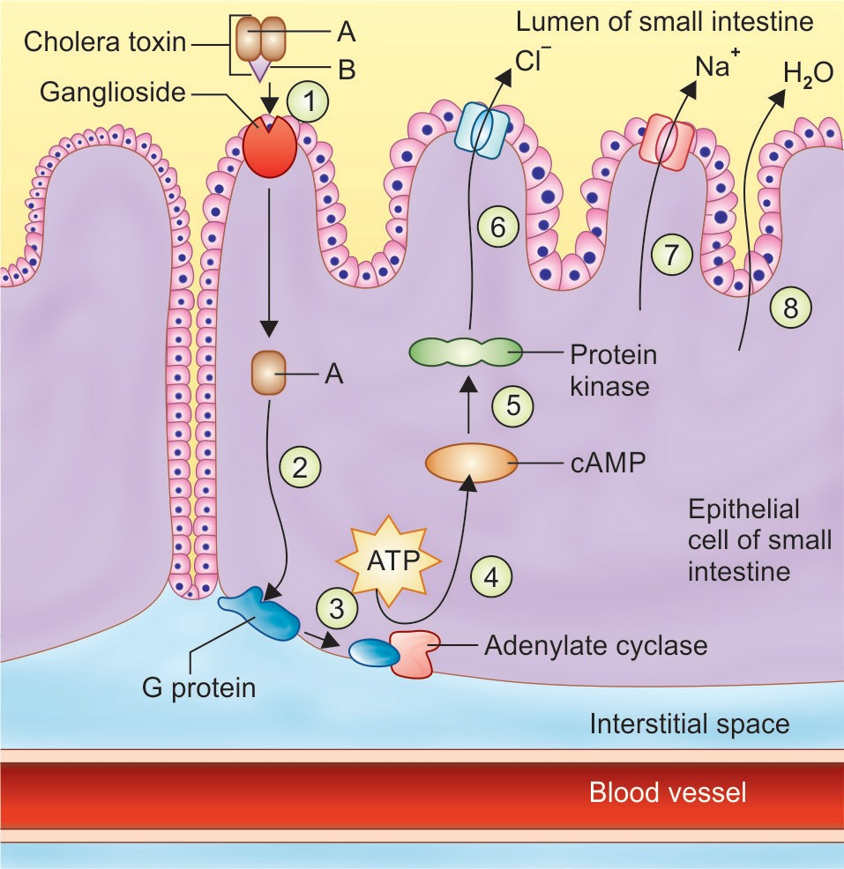
Mechanism of Action of Cholera Toxin
The toxin molecule consists of two peptide fragments—A and B.
Fragment B is the binding fragment.
Fragment A is the active fragment, causes ADP ribosylation of G protein - accumulation of cyclic adenosine monophosphate (cAMP).

Slide 15
Increase in cyclic AMP - accumulation of sodium chloride in intestinal lumen → Water moves passively into the bowel lumen → accumulation of isotonic fluid (watery diarrhea)
Loss of fluid and electrolytes →shock (due to profound dehydration) and acidosis (due to loss of bicarbonate)

Slide 16
Gene for cholera toxin (CTX): Cholera toxin is phage coded - encoded by genome of a filamentous bacteriophage (CTX) - integrated as prophage into the V. chlolerae chromosome.
This phage genome also encodes for TCP, accessory colonization factors, and other regulator genes
Other virulence factors include:
  Zona occludens toxin
  Accessory colonization factors
  Bacterial endotoxin (LPS)

Slide 17
Clinical Manifestations of Cholera
1. Asymptomatic infection (75% of cases)
2. Mild diarrhea or cholera (20% of cases)
3. Sudden onset of explosive and life-threatening diarrhea (cholera gravis – 5%)
IP - 24 to 48 hours
Watery diarrhea - sudden onset of painless watery diarrhea
Rice water stool - watery with mucus flakes & inoffensive odor
Vomiting may be present but fever is usually absent

Slide 18
Progression of clinical manifestations in relation to fluid loss
Fluid loss | Symptoms
<5% | Increased thirst
At 5–10% | Postural hypotension Weakness Tachycardia Decreased skin turgor
At >10% | Renal failure (due to acute tubular necrosis) and fluid loss result in: Oliguria Weak or absent pulses Sunken eyes Sunken fontanelles in infants Wrinkled (“washerwoman”) skin Somnolence and coma

Slide 19
Epidemiology
History of Pandemics:
Cholera can occur—sporadic, limited outbreaks, endemic, epidemic or pandemic
Till 19th century – confined to its home land (West bengal & Bangladesh)
1817 -1923 – 6 pandemics originating from Bengal – Claasical Vibrio
1923 – 1961 – Restricted to homeland

Slide 20
History of Pandemics
Seventh pandemic - Started in 1961 and it differed from the first six pandemics in many ways
Was the only pandemic that originated outside India, i.e. from Indonesia (Sulawesi, formerly Celebes Island) in 1961.
India was affected in 1964 and the whole world was encircled by 1991
Only pandemic to be caused by El Tor

Slide 21
Epidemiology - O139 (Bengal Strain)
Isolated first from Chennai in 1992
O139 – Not agglutinated by any of the antisera available at that time (O1 to O138)
Bengal strain - spread rapidly along the coastal region of Bay of Bengal
Derivative of O1 El Tor – differs in having a distinct LPS & capsulated
Invasive → bacteremia and extraintestinal manifestations
No cross protection between O1 and O139
By 1994 - O1 El Tor replaced O139

Slide 22
Epidemiology - Current Situation - World
Cholera is a notifiable disease, often under reported
Annual cases >1.3-4 million
Annual deaths - 21 000 to 1.4 Lakh
Majority of cases are due to O1 El Tor

Slide 23
Situation has greatly changed
West Bengal is no longer the home land, all states affected
Both morbidity and mortality have greatly reduced.
National Institute of Cholera and Enteric Diseases (NICED), Kolkata - National reference Center for cholera in India

Slide 24
Reservoir - Humans the only reservoir
Source - asymptomatic cases or carriers
Carriers: Asymptomatic carriers play an important role in transmitting cholera over long distances
Biotype El Tor has more carrier rate than classical.
Cholera season - high temperatures, heavy rainfall & flooding

Slide 25
Other factors - promote transmission include poor sanitation, poverty, overcrowding, population mobility (as occurs in pilgrimages, fairs, festivals and marriages).
Factors determining severity disease:
  Lack of pre-existing immunity
  Blood group - ‘O’ greater risk ; AB - least risk
  Malnutrition, People with low immunity
Age - during epidemics - children

Slide 26
Persistence of V. Cholerae
  Epidemics - maintained by carriers & subclinical cases
  Inter epidemic period - maintained in sea water
Resistance
  Acid-labile but stable to alkali
  Heat-labile but stable to refrigeration
  Easily killed by drying and sunshine & disinfectants

Slide 27
Laboratory diagnosis of Cholera
Specimens: Watery stool or rectal swab (for carriers)
Transport media: VR medium, Cary-Blair medium
Direct microscopy
  Gram-negative rods, short curved comma-shaped (fish in stream appearance)
  Hanging drop-demonstrates darting motility

Slide 28
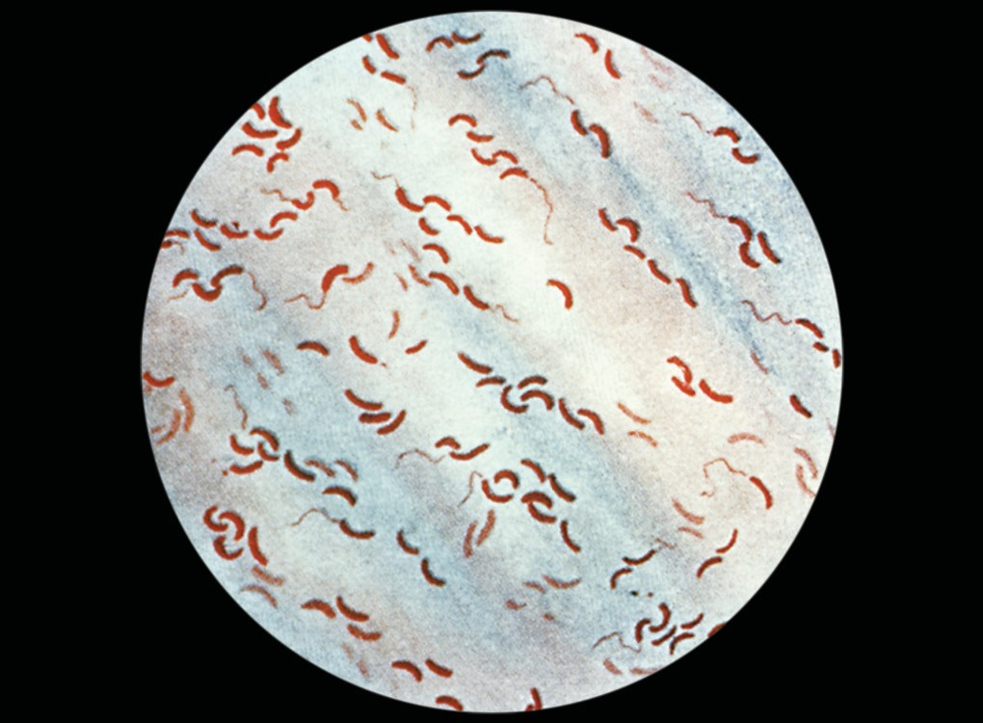
Vibrio cholerae (Gram stain): Curved comma-shaped gram-negative rods (fish in stream appearance).

Slide 29
Culture
  Enrichment broth: Alkaline peptone water, Monsur’s taurocholate tellurite peptone water
  Selective media: Bile salt agar, Monsur’s GTTT agar, TCBS agar (yellow colonies)
  MacConkey agar-produces translucent NLF colonies

Slide 30
Culture smear and motility testing—reveals
  Short curved gram-negative bacilli and
  Darting motility

Slide 31
Identification
  Catalase and oxidase positive
  ICUT: Indole (+), Citrate (+/–), Urease (–), TSI:A/A, gas (–), H2S (–)
  String test positive
  It produces hemodigestion on blood agar
  Automated systems such as MALDI-TOF and VITEK

Slide 32
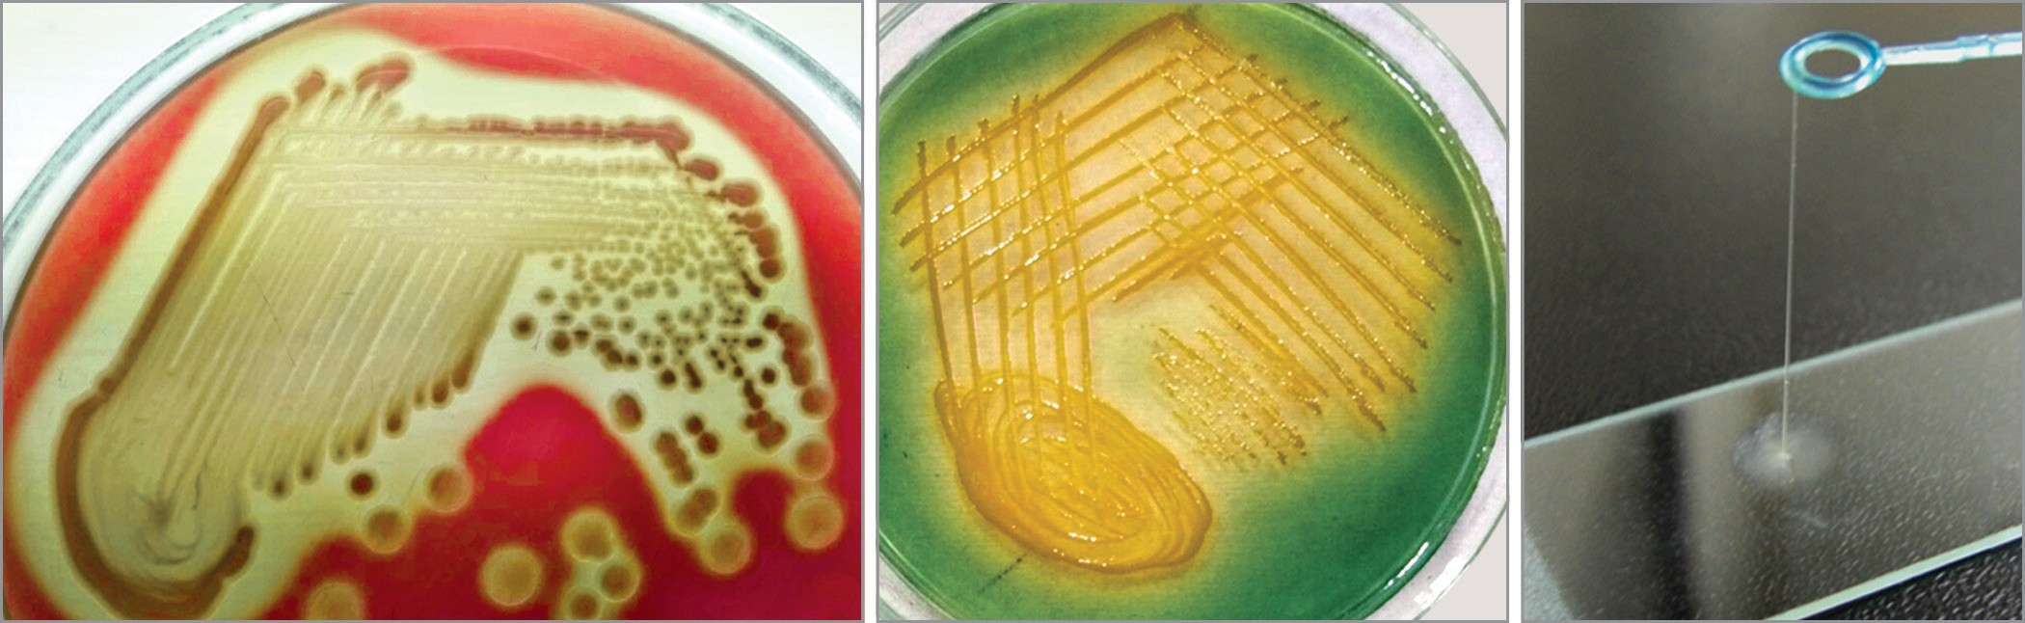
Laboratory diagnosis of Cholera
A
B
C
A. Vibrio cholerae on blood agar (hemodigestion); B. TCBS agar with yellow colored colonies of Vibrio cholerae; C. String test.

Slide 33
Laboratory diagnosis of Cholera
Biotyping: To differentiate classical and El Tor
Serogrouping: To differentiate O1 and O139
Serotyping: To differentiate Ogawa, Inaba and Hikojima serotypes of serogroup O1

Slide 34
Laboratory diagnosis of Cholera
Antigen detection by cholera dipstick assay
Molecular method—multiplex PCR detecting common diarrheal pathogens
Antimicrobial susceptibility testing.

Slide 35
Treatment of Cholera
Fluid replacement - Most important measure for management of the cholera patient.
In mild to moderate fluid loss: oral rehydration solution (ORS) should be given
In severe cases: Intravenous fluid replacement with Ringer’s lactate (or normal saline) should be carried out till the consciousness arrives, thereafter replaced by ORS.

Slide 36
Antibiotics - minor role as the pathogenesis is mainly toxin mediated
Use of antibiotic may decrease the duration and volume of fluid loss and hastens clearance of the organism from the stool.
WHO recommends the use of antibiotics - only severely dehydrated patients.

Slide 37
Drug of choice: Macrolides such as azithromycin or erythromycin are the drugs of choice for adults, children and also in pregnancy.
Alternatively for adults – doxycycline or tetracycline or ciprofloxacin can be given in areas with confirmed susceptibility.

Slide 38
Prevention
General Measures
  Safe water, sanitary disposal of feces
  Proper food sanitation
  Prompt outbreak investigation and steps to reduce transmission
  Notification
  Health education.
Chemoprophylaxis - Tetracycline - Household contacts, only during epidemics

Slide 39
Prevention - Vaccine
Injectable Killed Vaccines:
No longer in use, as they provide little protection, cause adverse effects and fail to induce a local intestinal mucosal immune response.
Oral Cholera Vaccines:
1. Killed whole-cell vaccine:
  Whole-cell (WC) vaccine
  Whole-cell recombinant B subunit vaccine (WC/rBS)

Slide 40
Oral Cholera Vaccines
Whole-cell (WC) vaccine: Composed of killed whole cells of V. cholerae O1 and O139
  Formulations: Shanchol (India) and Euvichol (South Korea)
  Schedule: Two doses are given orally, with minimum of two weeks gap, for all individuals >1 year age
  Protection: For 3 years.

Slide 41
Whole-cell recombinant B subunit vaccine (WC/rBS): WC vaccine + recombinant cholera toxin B subunit
  Formulation: Dukoral
  Schedule: Two doses are given orally, with minimum of one week gap. A third dose is given for children aged 2-5 years.
  Protection: 2 years.

Slide 42
2. Oral live attenuated vaccines (OCV)
  CVD 103-HgR : Commercially available as Vaxchora; given as single oral dose
  Indication: Recommended for adults of age 18-64 years, traveling to an area with active cholera transmission.
  Protection: Gives 90% protection at 10 days after vaccination; which lasts for 3-6 months.

Slide 43
Non O1/O139 V. cholerae
Biochemically resemble V. cholerae O1/O139, but do not agglutinate with O1 or O139 antisera.
Gastroenteritis: Sea food consumption (raw oysters)
  Stool – watery/partly formed & bloody/ mucoid
  Abdominal cramps, nausea, vomiting and fever
  Treatment is same as that of cholera

Slide 44
Extraintestinal manifestations: Otitis media, wound infection & bacteremia
  Acquired by - occupational or recreational exposure to seawater
  Sensitive to - Tetracycline, ciprofloxacin and third generation cephalosporins

Slide 45
HALOPHILIC VIBRIO INFECTIONS
Can withstand higher salt concentration (>6%) in contrast to V. cholerae, which can tolerate up to 6%
Widespread in marine environments
Cases tend to occur during late summer and early rain fall, when the bacterial counts are highest in the water

Slide 46
Vibrio parahaemolyticus infections
Was first reported from Japan (1953), the incidence of infection has greatly increased in several countries including Japan since 1993.
In India, it has been reported from Kolkata.

Slide 47
Clinical Manifestations
Food-borne gastroenteritis - most common presentation, occurs following raw or uncooked sea food (e.g. oyster) intake.
Commonly presents as watery diarrhea or rarely as dysentery with abdominal cramps
Extraintestinal manifestations - wound infection, otitis and sepsis are rare.

Slide 48
Laboratory Diagnosis
Morphology - Capsulated - bipolar staining in fresh isolates and pleomorphism in older cultures
Motile - peritrichous flagella (but it does not show darting motility)
On TCBS agar - produces green colonies (sucrose nonfermenter)

Slide 49
Laboratory Diagnosis (Cont..)
Kanagawa phenomenon: It causes β-hemolysis on Wagatsuma agar (a special type of high salt blood agar)
Swarming: Swarms on blood agar
Urease test - positive in few strains
Salt tolerance test: Can resist maximum of 8% NaCl
Identification - MALDI-TOF and VITEK.

Slide 50
Treatment of V. parahaemolyticus infections
Most of the gastroenteritis - self-limiting and treatment is same as that of cholera
Indications for antibiotic use:
  Severe gastroenteritis or
  Extraintestinal manifestations associated with underlying diseases - diabetes, pre-existing liver disease, iron overload states, or immunosuppression

Slide 51
Treatment of V. parahaemolyticus infections (Cont..)
Doxycycline or macrolide - drug of choice
For proven bacteremia, doxycycline plus ceftriaxone is recommended.

Slide 52
Vibrio vulnificus infections
Though rare, V. vulnificus produces the most severe infection among the Vibrio species

Slide 53
Clinical Manifestations
1. Primary sepsis: Occurs in patients with underlying liver disease and iron overload or rarely in renal insufficiency and immunosuppression
2. Primary wound infection: Characterized by painful erythematous swelling or cellulitis or even vesicular, bullous or necrotic lesions - affects people without underlying disease (Vulnificus is Latin word for “wound maker”).

Slide 54
Laboratory Diagnosis
V. vulnificus - cultured from blood or cutaneous lesions. It
Ferments lactose - differentiates it from all other vibrios.
Identification can also be made by automated methods such as MALDI-TOF and VITEK

Slide 55
Treatment of Vibrio vulnificus infections
Early antibiotic institution, wound debridement, and general supportive care - keys to recovery.
V. vulnificus - sensitive in vitro to a number of antibiotics, including tetracycline, fluoroquinolones, and third-generation cephalosporins.

Slide 56
Vibrio alginolyticus infections
V. alginolyticus - occasionally cause eye, ear and wound infections.
Few cases of otitis externa, otitis media and conjunctivitis have been reported
Rarely causes bacteremia in immunocompromised hosts
Most salt-tolerant Vibrio - grow at salt concentrations of more than 10%
Self-limiting - severe infections respond well to antibiotics (tetracycline) and drainage.

Slide 57
AEROMONAS INFECTIONS
Aeromonas - earlier placed in the family Vibrionaceae - now been assigned to a separate family - Aeromonadaceae.
A. hydrophila causes red leg disease in frog.

Slide 58
AEROMONAS INFECTIONS (Cont..)
Pathogenicity of Aeromonas in humans is mainly related to:
  Tissue adherence mediated by adhesions such as S-layer and fimbriae
  Capsular polysaccharide (prevents the bacilli from phagocytosis)
  Exotoxins - aerolysin, phospholipases, hemolysins, enterotoxin and cytotoxin similar to Shiga toxin
  Endotoxin or LPS.

Slide 59
AEROMONAS INFECTIONS (Cont..)
Clinical manifestations: Over 85% of the human infections - caused by A. hydrophila, A. caviae and A. veronii .
  Gastroenteritis and peritonitis
  Musculoskeletal and wound infections
  Bacteremia in immunocompromised adults and infants
  Respiratory tract infections

Slide 60
AEROMONAS INFECTIONS (Cont..)
Laboratory diagnosis:
  Identification of Aeromonas up to species level from colonies - made either by automated identification systems such as MALDI-TOF and VITEK or by various conventional biochemical tests (e.g. oxidase and catalase positive).

Slide 61
Treatment of Aeromonas infections
Aeromonas - susceptible to ciprofloxacin and levofloxacin.
Alternatively, cotrimoxazole and cefepime can be given.
Plasmid mediated drug resistance - reported including β-lactamase production.

