Slide 1
Cholera, Halophilic Vibrio and Aeromonas Infections
Dr. Ved Prakash
Professor & Head
PG Department of Microbiology

Slide 2
Learning objectives
At the end of the session, the students will be able to understand:
Classification, pathogenesis, clinical manifestations, lab diagnosis and treatment of Vibrio cholerae
Halophilic vibrios
Aeromonas infections

Slide 3
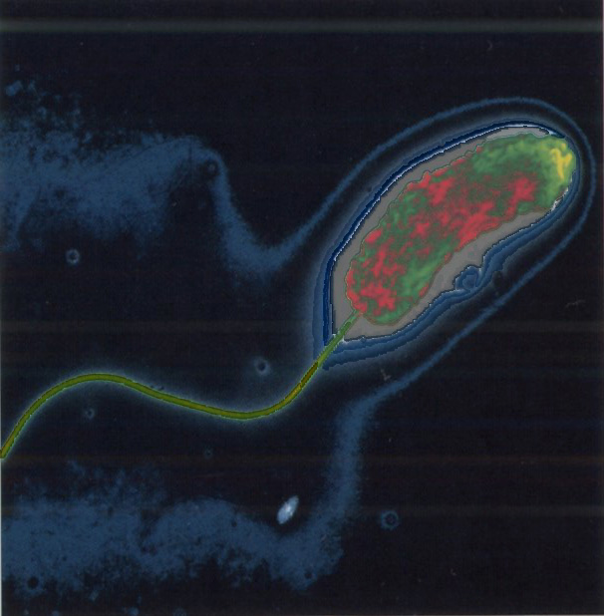
What is Cholera?
Intestinal infection
Severe diarrhea
Caused by Cholera Toxin of bacterium, Vibrio cholerae

Slide 4
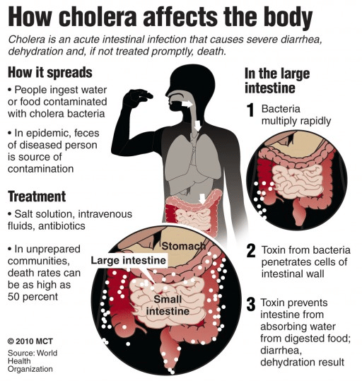

Slide 5
Vibrio Cholarae
GNB, actively motile by single polar flagellum
First described and named by Filippo Pacini in 1854.
1886- Robert Koch isolated the bacteria
Transmitted to humans via contaminated food and water
Part of normal flora of brackish water and estuaries
Notes:
associated with algal blooms (plankton), which are influenced by the temperature of the water. ⁸
http://www.cobblestoneconcepts.com/ucgis2summer/chow//chow.htm
- lots of pictures
Human beings are also one of the reservoirs of the pathogenic form of Vibrio cholerae.”⁸

Slide 6
General Characteristics of Vibrio
  Similarities to Enterobacteriaceae
    Gram-negative
    Facultative anaerobes
    Fermentative bacilli
  Differences from Enterobacteriaceae
    Polar flagella
    Oxidase positive
  Comma-shaped bacilli
  pH range for growth on media
    pH 7.0 - 9.0
  V. cholerae grow without salt, Most other vibrios are halophilic

Slide 7
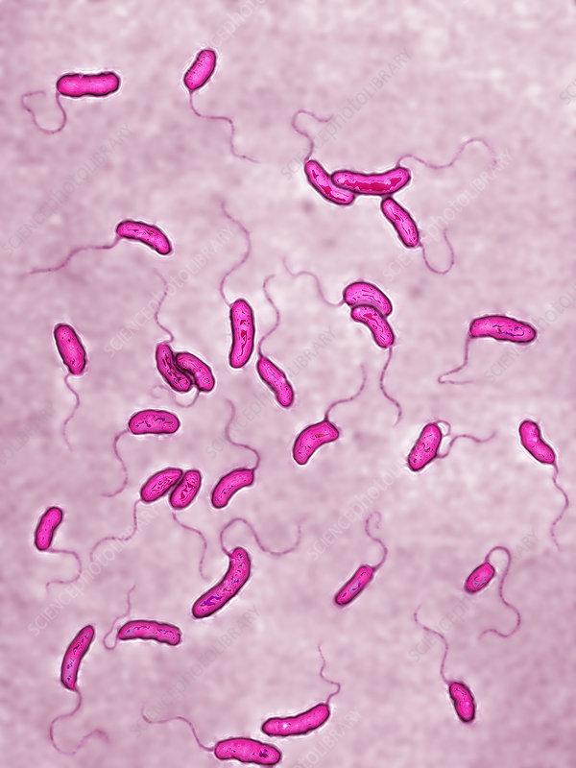
V.Cholerae

Slide 8
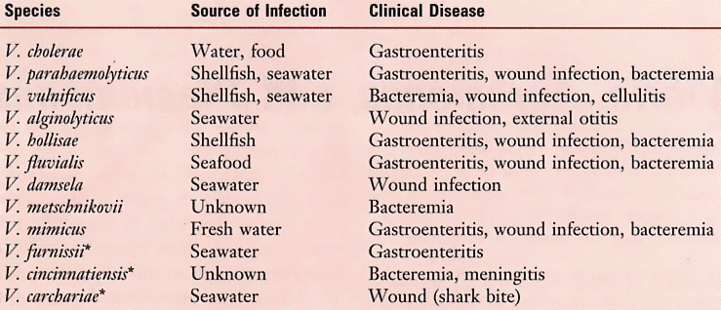
Vibrio spp. (Family Vibrionaceae) Associated with Human Disease

Slide 9
Classification of Vibrio cholerae
Based on Salt Requirement
  Nonhalophilic vibrios
  Halophilic vibrios:- V. parahaemolyticus, V. alginolyticus and V. vulnificus
  2. Heiberg Classification (1934) classified vibrios into eight groups based on fermentation of three sugars- mannose, sucrose, and arabinose.
  3. Gardner and Venkatraman Classification
>200 serogroups based on somatic O-antigen
O1 and O139 serogroups are responsible for epidemic cholera
O1 serogroup subdivided into
  Two biotypes: El Tor and classical
  Three serotypes: ogawa, inaba, hikojima

Slide 10
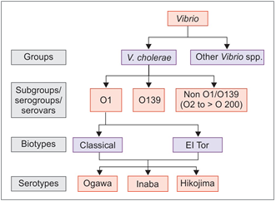
Gardner and Venkatraman Classification

Slide 11
Antigenic Structure
Flageller antigen (H antigen): Many vibrios share a signle heat-labile flagellar antigen. Antibodies to the H antigen are not involved in the protection of susceptible host.
Somatic O antigen (LPS, endotoxin): V. cholerae has O lipopolysaccharides that confer serologic specificity and plays no role in pathogenecity of cholera but is responsible for the immunity induce by Killed vaccines.
There are at least more than 200 “O” antigen groups. V. cholerae strains of O group 1 and O139 cause Classic cholera. Occasionally, non-O1/non0139V. Cholerae causes cholera-like disease.

Slide 12
Serogrouping
Based on somatic O antigen, V. chlorae can be grouped into more than 200 serogmups or serovars ( updated by the most widely used Sakazaki typing scheme).
serogroup: Among all serogroups, O1 was
responsible for all pandemics and most of die epidemics of cholera. Strains belonging to O1 serogroup are agglutinated by O1 antisera
NAG vibrios: Serogroups other than O1 were not
agglutinated by O1 antiserum and were called nonagglutinable or NAG vibrios. Uiey were thought to be non-pathogenic, hence also named as non-cholera vibrios (NCV). Later on, it was observed diat many odier serogroups are padiogenic to man and are agglutinable with dieirrespective antisera. Hence these cerms such as NAG or NCV are no longer in use.

Slide 13
0139 serogroup: It was identified in 1992 and since than it has caused several epidemics and outbreaks of cholera in the coastal regions of India and Bangladesh.
Non Ol /0139 serogroups: They have occasionally caused sporadic outbreaks of diarrhea and extraintestinal manifesrations, but have never caused epidemic cholera so far.
Serotyping
O1 serogroup can further be divided into chree serotypesJnaba, Ogawa, and Hikojima; based on minor antigenic differences of O antigen.
Ogawa is die mosc common serotype isolated from clinical samples followed by Inaba.
However, during epidemics, shifting between serocypes can take place, more common being Ogawa to Inaba shift which occurs due to mutations in rjbTgene.
Hikojima represents an unstable transitional state; where bodi Inaba and Ogawa antigens are expressed.

Slide 14
Biotyping
Serogroup 1 has two biotypes- classical and El Tor; differentiated by various biochemical reactions and their susceptibility to polymyxin B and bacteriophages

Slide 15
Differences between El Tor & classical Vibrio Biotypes
Biotypes of V. cholerae o1 | Classical biotype | El tor biotype
β-hemolysis on sheep blood agar | Negative | Positive
Chick erythrocyte agglutination | Negative | Positive
Polymyxin B (50 IU) | Susceptible | Resistant
Group IV phage susceptibility | Susceptible | Resistant
El Tor Phage V susceptibility | Resistant | Susceptible
VP (Voges-Proskauer) test | Negative | Positive
Cholera toxin gene | CTX-1 | CTX-2

Slide 16
Pathogenesis of V.cholerae
  Incubation period: 2-3 days
  High infectious dose:- 10⁸ organism
  Abrupt onset of life-threatening watery diarrhea
  Rice-water stools:
    Colorless
    Odorless
    Speckled with mucus
  Cholera toxin leads to profuse loss of fluids and electrolytes (Na, K HCO3)
  A-B type of toxin, receptor GM1, increase intracellular cAMP
  Death attributable to:
    Hypovolemic shock
    Metabolic acidosis

Slide 17
  Pathogenesis of cholera is toxin-mediated.
  Mode of transmission:- by ingestion of contaminated water and food.
  Infective dose: 10⁸ bacilli is required to bypass the gastric barrier.
  Factors promoting transmission:- reduced gastric acidity such as hypochlorhydria and use of antacids.
  Crossing of the protective layer of mucus:- is achieved by
    Its high active motility
    Secreting mucinase and other proteolytic enzymes.
    Secreting hemagglutinin protease (cholera lectin) It cleaves the mucus and fibronectin and helps in spread to other parts of the intestine and also their fecal shedding.

Slide 18
Adhesion and colonization:- to the intestinal epithelium by a special type IV fimbria called toxin coregulated pilus (TCP). It is so named because the synthesis of TCP, cholera toxin and other virulence factors are co-regulated by a single gene called ToxR.

Slide 19
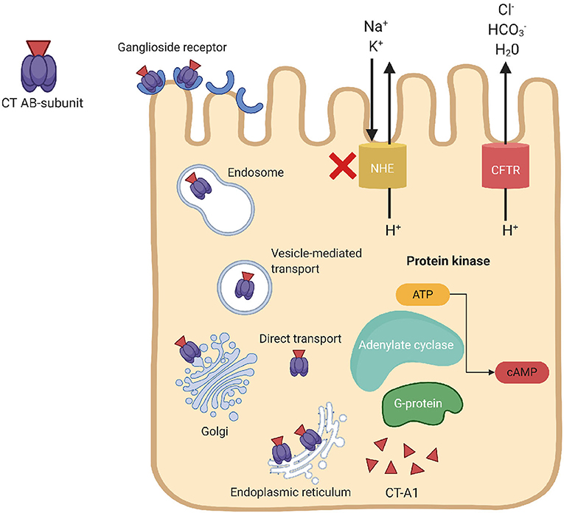
Pathogenesis

Slide 20
Pathogenetic mechanismof V.cholerae
  Cholera toxin 84 KDa polypepdide consists of two fragments – A(2 subunits A1 & A2) & fragments B (5 subunits). It binds to GM1 ganglioside receptors present on the intestinal epithelium, following which A fragment is internalized and cleaved into A1 and A2 peptides, A2 helps in tethering A and B subunits together. A1 upregulates the activity of adenylate cyclase resulting in increase in intracullular accumulation of cyclic AMP which leads to profuse loss of fluids and electrolytes (Na, K HCO3).,that leads to accumulation of isotonic fluid in intestine resulting in watery diarrhea, electrolytes profound dehydration and acidosis (due to loss of bicarbonate)

Slide 21
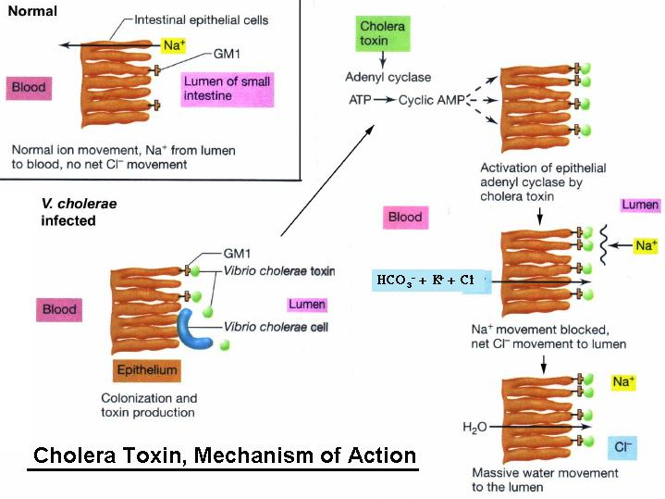
Pathogenesis: Mechanism of Action: Overview

Slide 22
Clinical Manifestations
Occur 2-3 days after consumption of contaminated food/water
Usually mild, or no symptoms at all
    75% asymptomatic
    20% mild disease
    2-5% severe
Vomiting
Cramps
Watery diarrhea (1L/hour)
Without treatment, death in 18 hours-several days

Slide 23
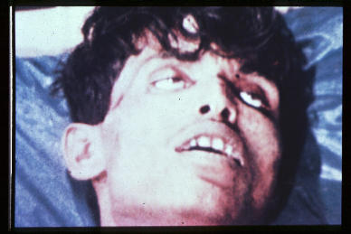
Consequences of Severe Dehydration
Intravascular volume depletion
Severe metabolic acidosis
Hypokalemia
Cardiac and renal failure
Sunken eyes, decreased skin turgor
Almost no urine production
Notes:
1)Fluid and electrolyte loss
2)Hypokalemia—low levels of K+ in blood
a)necessary for proper nerve, muscle, heart function
b)cramping, cardiac arrest
2)why sunken eyes?
3)Phosphates move out of cells

Slide 24
Mortality Rate
Causes 120,000 deaths/year worldwide
With prompt rehydration: <1%
Without treatment: 50%-60%
Notes:
1)Disease runs its course in 2-7 days

Slide 25
Laboratory Diagnosis of Vibrio cholerae
Specimens: Watery stool or rectal swab (for carriers)
Direct microscopy
  Gram-negative rods, short curved comma-shaped (fish in stream appearance)
  Hanging drop-demonstrates darting motility
  Culture
  Oridinary media
  1. Nutrient Agar
  2. MacConkey Agar
  3. Blood Agar
  4. Gelatin Stab Culture
  5. Peptone Water

Slide 26
  Special Media
1. Transport media: VR medium, Cary-Blair medium, Autoclaved Sea water
Venkataman-Ramakrishan Medium: Prepared by dissolving 20g crude sea salt and 5 g peptone in one liter of distilled water and adjusting the pH to 8.6-8.8, dispensed in screw capped bottles in 10-15ml amounts & 1-30ml stool may be added to each bottle for transport to lab.
Cary-Blair Medium:- is a buffered solution of disodium hydrogen phosphate (1.1 g) , Sodium thioglycollate (1.5g), Sodium chloride (5g) and agar (5g) to 1 liter of distilled water and pH is 8.4.

Slide 27
Enrichment Media
Alkaline Peptone water (pH 8.6)
Monsur’s taurocholate tellurite peptone water (PH 9.2)
Plating Media
  Alkaline Bile Salt Agar (pH 8.2)
  Monsur’s Gelatin Taurocholate Trypticase Tellurite Agar (GTTA) Medium (pH 8.5)
  Thisosulhate-Citrate-Bile-Sucorse Agar (pH 8.6)
  Culture smear and motility testing- reveals
  Short curved gram-negative bacilli and
  Darting motility

Slide 28
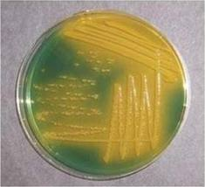
Yellow colonies on TCBS
Selective/differential culture medium - TCBS agar
V. cholerae grow as yellow colonies
  Gram stain
  Biochemical and serological tests
  Motility- Darting motility on hanging drop preparation

Slide 29
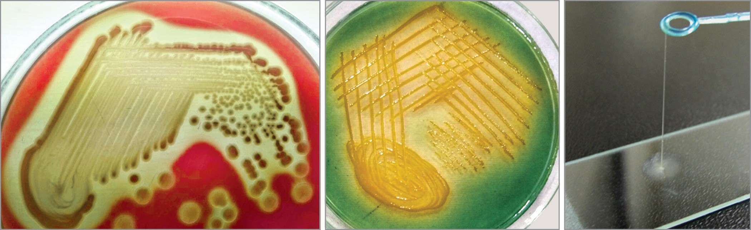
A
B
C

Slide 30
Biochemical identification
Catalase and oxidase positive
ICUT: Indole(+), Citrate (+/-), Urease(-), TSI:A/A, gas(-), H2s(-)
It decarboxylates lysine and ornithine but dose not utilize arginine.
Gelatin is liquefied.
Methyl red test is negative
Cholera red reaction: V. cholerae is strongly indole postive and reduces nitrates to nitrites. These tow properties contribute to the cholera red reaction which is tested by adding a few drops of concentrated sulfuric acid to a 24 hour peptone water culture at 37oC. A reddish pink color is developed due to the formation of nitroso-indole with cholera vibrios.

Slide 31
String test: A loopful of the growth is mixed with a drop of 0.5 precent sodium deoxycholate in saline on a slide. If the test is positive, the suspension loses its turbidity, becomes mucoid and forms a string when the loop is drawn slowly away from the suspenion.
Salt tolerance test positive
Ferments glucose sucrose, mannitol, maltose, mannose and is late latose fermenter after several days. Arabinose and dulcitol are not fermented.
Biotyping: To differentiate Classical and EI Tor
Serogrouping: To differentiate O1 and O139
Serotyping: To differentlate Ogawa, Inaba and Hikojima serotypes of serotypes of serogroup O1
Antimicrobial susceptibility testing

Slide 32
Historical Perspective:
1854- John Snow hypothesized water as primary reservoir for transmission
  Broad Street pump incident
  56 deaths in 2 days
First Pandemic (1817-1820)
spread out of India to Europe
spread from India -> Middle
East (reaching Turkey &
Persia) -> Far East
(Singapore, Japan, Philippines)
Second pandemic (1829-1851)
  Entered US through NY and New Orleans -> proceeded through entire country
Notes:
PICTURE: It offers his views on cholera and other epidemic diseases that were troublesome during the mid-1800s. The writings illustrate his manner of epidemiologic thinking, and how he used available clinical and population-based evidence to address the potential etiology of selected infectious diseases.

Slide 33
  First six pandemics 1817 and 1923 & all were caused by classical biotypes of V. cholera were largely restricted to It’s homeland (delta region of the Ganges and Brahmaputra in West Bengal (India) & Bangladesh.
  Seventh pandemic:- Started in 1961 and differed from first six pandemics in many ways as follows
    Originated outside India( from Indonesia in 1961 & affected India in 1964 & the whole world was in encircled by 1991.
    It was caused by El Tor biotype and largely replaced the classical biotypes by that time.(V. cholerae O1 biotype El Tor)
    EI Tor produced milder cholera and associated with more carrier rate than the classical.

Slide 34
Epidemiology of Vibrio cholerae
  Cholera recognized for more than two millennia with sporadic disease and epidemics
  Endemic in communities with poor sanitation
  Seven pandemics (possible beginning of 8th) since 1817
  Human carriers and environmental reservoirs
  Incubatory carrier:- Has short incubation period of 1-2 days
  Convalescent carriers: bacilli recovered 2-3 weeks
  Contact or healthy carriers:- Subclinical cases and shed bacilli for <10 days
  Chronic carriers:- Minority of convalescent carriers become chronic carriers.

Slide 35
Epidemiological Determinants
Reservoir:- Human
Source:- either asymptomatic cases or carriers.
Carriers
  Incubatory carrier:- 1 to 2 days of infections
  Convalescent carrier:- bacilli shed for 2-3 weeks.
  Contact or healthy carrier:- shed bacilli for less than 10 days.
  Chronic carrier:- More than years
  Cholera season:- June to September during with temperature, heavy rainfall and flooding.
  Other factors promoting transmission are:- Poor sanitation, overcrowding, poverty and population mobility (pilgrimages, haz fairs, festivals and marriages).

Slide 36
Detection of Carrier
As Vibrio excretion is intermittent, repeated stools Examination will yield better results. Examination of the stool after a purgative (magnesium sulfate 15-20g or Mannitol 30g) or of bile after duodenal intubation is of special value.
Carrier detection is done by followed methods
Examination of Water Samples: For examination of water samples for vibrios, enrichment or filtration methods may be employed.
Enrichment Method:- In this method, 900ml of water added to 100ml ten fold concentrated peptone water at pH 9.2, incubated at 37oC for 6-8 hours and a second enrichment done before plating on selective media.
Filtration Method:- We use Millipore membrane filter which is for filtration of water and then It is placed directly on to the surface of a selective medium and incubated. Colonies appear after overnight incubation.
Sewage should be diluted in saline, filtered through gauze and treated as for water.

Slide 37
O139 (Bangal strain)
  It was isolated first from Chennai in 1992. Since it was not agglutinated by any of the antisera availabe at that time (O1 to 0138), it was designated as a new serogroup 0139 or the Bengal strain as it spread rapidly along the coastal region of Bay of Bengal up to West Bengal, then to the adjacent areas of Bangladesh.
  Epidemiological Determinants
  Reservoir:- Only Human
  Source:- From asymptomatic cases or carriers
  Cholera season:- After heavy rainfall and flodding
  Other factors:- Poor sanitation, poverty, overcrowding, population mobility (as occurs in pilgrimages, fairs, festivals and marriages).

Slide 38
CHEMOPROPHYLAXIS: Tetracycline is the drug of choice
Antibiotic therapy for Cholera
 | Drug of choice | Alternate drugs
Treatment of acute cases
Adult | Doxycycline (single dose of 300mg) or Tetracycline (12.5 mg/kg four times a day for 3 days) | Ciprofloxacin Erythromycin Azithromycin
Children/pregnancy | Erythromycin or Azithromycin (10mg/kg) | Cotimoxazole
Chemoprophylaxis
 | Tetracycline (12.5 mg/kg four times a day for 3 days) | Doxycycline (single dose of 300 mg)

Slide 39
Prevention
General Measures
  Safe water, sanitary disposal of feces
  Proper food sanitation
  Prompt outbreak investigation and steps to reduce transmission
  Notification
  Health education.
Chemoprophylaxis - Tetracycline - Household contacts, only during epidemics

Slide 40
Prevention - Vaccine
Injectable Killed Vaccines:
No longer in use, as they provide little protection, cause adverse effects and fail to induce a local intestinal mucosal immune response.

Slide 41
Prevention - Vaccine
Oral Cholera Vaccines:
1. Killed whole-cell vaccine:
  Whole-cell (WC) vaccine
  Whole-cell recombinant B subunit vaccine (WC/rBS)

Slide 42
Prevention – Vaccine
Oral Cholera Vaccines
Whole-cell (WC) vaccine: Composed of killed whole cells of V. cholerae O1 and O139
  Formulations: Shanchol (India) and Euvichol (South Korea)
  Schedule: Two doses are given orally, with minimum of two weeks gap, for all individuals >1 year age
  Protection: For 3 years.

Slide 43
Prevention - Vaccine
Oral Cholera Vaccines
Whole-cell recombinant B subunit vaccine (WC/rBS): WC vaccine + recombinant cholera toxin B subunit
  Formulation: Dukoral
  Schedule: Two doses are given orally, with minimum of one week gap. A third dose is given for children aged 2-5 years.
  Protection: 2 years.

Slide 44
Prevention - Vaccine
Oral Cholera Vaccines
2. Oral live attenuated vaccines (OCV)
  CVD 103-HgR : Commercially available as Vaxchora; given as single oral dose
  Indication: Recommended for adults of age 18-64 years, traveling to an area with active cholera transmission.
  Protection: Gives 90% protection at 10 days after vaccination; which lasts for 3-6 months.

Slide 45

THANKS

Slide 46
VACCINES
    Injectable Killed Vaccines: not in use
    Oral Cholera Vaccines (OCV)
    Killed whole-cell vaccines:- Two preparations are available
        Whole-cell vaccines: It is composed of killed whole cells of V. cholerae O1 (classical and El Tor, Inaba and Ogawa).
        Whole-cell recombinant clorerae vaccine (WC/rBS): Composition is same as that of WC vaccine, in addition it has recombinant cholera toxin B subunit.

Slide 47
        Schedule: Two doses are given orally at 7 days gap except in children 2-5 years (3 doses)
        Protection is short lived and is around 58% for WC vaccine and 85% WC/rBS vaccine. However it falls rapidly to 50% by 3 years of vaccination.
        Children are better protected than adults.
        WHO recommends for using vaccine during epidermics and out breaks in the community but not during inter epidemic period.

Slide 48
        b. Oral live attenuated vaccine (OCV): They use mutant strains that lack the gene encoding for cholera toxin.
        Several live OCV are under trail such as:
          CVD 103-HgR, Peru-15 and V. cholerae 638 for classical and EI Tor biotypes of V. cholerae O1.
          CVD 112 and Bengal-15 vaccine trials are ongoing for V. cholerae O139.
          CVD 103-Hgr vaccine (Orochol) contains a live attenuated strain derived from reference strain 569 B (classical, O1, Inaba) given as single dose. It protection starts after 18 days.
          Use of OCV is recommended to limit the risk of:
          Occurrence of cholera outbreaks in displaced populations in endemic areas.
          Spread and incidence of cholera during an outbreak.

Slide 49
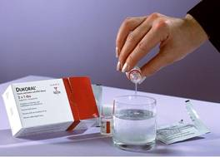
Preventing Cholera: Vaccines
Orochol
  Contains 2x108 viable cells of attenuated strain CVD 103-HgR in a lyophilized form
  Oral immunization of children older than 2
  Subunit A of the cholera toxin (CT) has been removed
Dukoral
  Protects against O1 Inaba
  and Ogawa, Classical & El
  Tor strains
  Contains 1x10 heat/formalin
  killed cells of strain WC/rBS
Notes:
Current cholera vaccines are effective in only 50% of recipients, and immunity lasts only 3 to 6 months (Crowcroft, 1994)
Orochol is an attenuated live oral cholera vaccine, containing the genetically manipulated V. cholerae strain CVD 103-HgR. For more information, http://www.bernabiotech.com/products/orochol/infosheet/oro_2001_e.pdf/
Dukoral is a killed whole-cell V. cholerae O1 in combination with purified recombinant B subunit of cholera toxin. For more information, Dukoral - http://www.pharmeragroup.com/dukoralb.htm
According to WHO (http://www.who.int/mediacentre/factsheets/fs107/en/print.html), both vaccines are suitable for use by travelers but not for use as a large scale public health measure: Use of these vaccines to prevent or control cholera outbreaks is not recommended because it gives, according to WHO, a false sense of security to vaccinated subjects and to health authorities who often neglect more effective measures.
As of 1973, no country requires proof of cholera vaccination as a condition for entry.
These vaccines only target O1 strains. Now, the appearance of the O139 strain has redirected efforts to develop an effective and practical cholera vaccine.

Slide 50
Killed Whole-cell Vaccines: Disadvantages
50% protection for 6 months to adults
Gives less than 25% protection to children aged 2-5
Need for multiple doses of nonliving antigens

Slide 51
Prevention
Disrupt fecal-oral transmission
Water Sanitation (Provision of safe water)
Water treatment
Improved sanitary disposal of feces
Proper food sanitation
Prompt outbreak investigation and taking necessary steps to reduce transmission
Notification: Cholera is a notifiable disease locally and nationally, hence the cases should be notified.
Health education.

Slide 52
Halophilic Vibrios
Virbio parahamolyticus:- Cause Food borne gastroenterits ,wound infections, otitis & sepsis.
Vibrio vulnificus:- Cause primary sepsis and primary wound infection.
Vibrio alginolyticus:- Cause eye, ear & wound infection

Slide 53
Halophilic Vibrios
Halophilic vibrios can withstand higher salt concentration (>6%) in contrast to V. cholerae. Widespread in marine environments, and are
Vibrio parahaemolyticus:- First reported from Japan in 1953.
Clinical manifestations
  Food-borne gastroenteritis
  Extraintestinal manifestations such as wound infection, otitis and sepsis
  Lab diagnosis
    Culture on TCBS Agar which produces green colonies (sucrose non-fermenter).
    Kanagawa phenomenon: It causes Beta hemolysis on Wagatsuma agar ( a special type of high salt blood agar)
    Swarming:- It swarms on blood agar
    Urease test is positive in few strains
    Salt tolerance test: It can resist maximum of 8% NaCl.

Slide 54
Halophilic Vibrios
Vibrio vulinficus: causes
Primary sepsis in patients with liver disease and iron overload and immunosuppressed patients.
Primary wound Infection:- Chr. By painful erythematous swelling or cellultis (Vulnificus is Latin for word for “wound maker”).
Lab Diagnosis:- Late lactose fermenter and Arginine is not dhydrolyzed.
Treatment:- tetracycline, fluoroquinolones, and third-generation cephalosporins.
Vibrio algnolytus: can occasionally cause eye (conjunctivitis), ear (otitis externa), & Wound infections & rarely bactermia in immunocompromised hosts.
Treatment:- tetracycline and drainage of wound.
3. Other Vibrio Species:- V. hollisae, V. mimicus, V. fluvialis, V. furnissii & V. damsela are responsible for causing gastroenteritis, wound infections and bacterima.

Slide 55
Aeromonas
Gram Negative, faculatative anaerobic baccillus having a total 16 species but important pathogegenic species are A. hydrophila, A. caviae, A. veran. It causes two major disease: gastroenteritis and wound infections with or without bactermia)
There are susceptible to tetracylines, aminoglycosides, and cephalosporins.
Plelsomonas
P. Shigelloides is only pathogenic species which is now placed in family Enterobacteriaceae. They are oxidase positive, motlie have multiple polar flagella gram-ngative bacilli. It is ubiquitous in surface water and soil. Man is infected primarily by ingesting contaminated water and food. It causes
Gastroenteritis:- Which manifests as a mild, watery diarrhea in which stools are fee of blood and mucin.
Extraintestinal lesions:- Includes septicoemia endophthalamitis, septic arthritis, meningitis, cell-ulitis and acute cholecytitis.

Slide 56
Diarrheal Diseases
Diarrhea:- Diarrhea is defined as passage of three or more loose or liquid stools per day, in excess than the usual habit for that person (WHO)
Gastroenteritis:- Gastroenteritis or infectious diarrhea may be defined as inflammation of the mucous membrane of stomach and intestine resulting in combination of diarrhea, vomiting and pain abdomen with or without mucus/blood/fever/dehydration.
Dysentery:- Dysentery is charactised by diarrhea with increased blood and mucus, often associated with fever, abdominal pain, and tenesmus (a feeling of incomplete defecation)
Food poisoning:- Food poisoning refers to an illness acquired through consumption of food or drink contaminated either with microorganisms, or their toxins.

Slide 57
Causative agents of infective diarrhea
Bacteria | Viruses | Protozoa | Cestodes |  |  | Nematodes |  | Trematodes
Vibrio cholerae | Rotavirus | Entamoeba histolytica | Hymenolepis nana |  |  | Trichuris trichiura |  | Schistosoma mansoni
V. Parahaemolyticus | Astrovirus | Giardia lamblia |  |  |  | Strongyloides stercoralis
Escherichia coli (ETEC,EPEC) | Calicivirus | Crytosporidium parvum |  |  |  | Ascaris lumbricoides
Salmonella Enteritidis | Norwalk virus | Isospora belli |  |  |  | Hookworms
S. Typhimurium | Adenovirus | Balantidium coli
Other Salmonella sp. | Other Bacteria
Campylobacter sp. | Shigella sp. | Clostridium perfringens |  | C. difficile | Staphylococcus aureus |  | Bacillus cereus
Yersinia enterocolitica | Aeromonas hydrophilia | Plesiomonas shigelloides

Slide 58
Laboratory Diagnosis
Specimen Collection
Microscopy
  Wet mount preparation
  Hanging drop preparation
  Gram stained smear
  Acid fast staining
  Electron microscopy for viruses
  Bacterial Culture for bacterial identification and AST
  Tissue Culture for Viruses
  Antigen Detection by ELISA and LAT
  Molecular Methods use in PCR and DNA probes
  Toxin Detection by ELISA and PCR

