Slide 1
Audits in Infection Prevention and Control
Dr. Ved Prakash
(Infection Control Officer)
Professor & Head
PG Department of Microbiology

Slide 2
Key points
Audit means checking practice against a standard. It examines the actual situation and compares it to written policies or another benchmark.
Audit can help to improve health care service by providing a blame-free mechanism for changes in practice. It can also be used for risk assessment, strategic planning, and root cause analysis.

Slide 3
An audit team is essential to carry out a proper audit through good planning, performance, and feedback of results.
Audit results may be provided to others through various types of reporting.

Slide 4
Introduction
Healthcare-associated infections are generally related to multiple factors. Prevention of these infections depends on daily vigilance and implementation of infection prevention and control (IPC) practices. These practices are outlined in written guidelines, policies, and procedures.

Slide 5
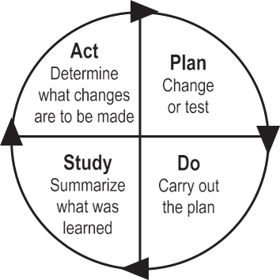
The PDSA cycle

Slide 6
Audit Method
Initially it is probably worth selecting a few areas to audit, preferably those that are most important to the organisation. These may include high-risk areas highlighted through surveillance results or occurrence of outbreaks.

Slide 7
An effective audit should include a description of the physical layout; review of traffic flow, protocols and policies, supplies and equipment; and observation of appropriate IPC practice.

Slide 8
Basic Principles
Bundles
A bundle is a multi-model structured way of improving processes of care and patient outcomes. A bundle is a collection of processes needed to effectively and safely care for patients undergoing particular treatments with inherent risks. Several interventions are “bundled” together and, when combined, significantly improve

Slide 9
patient care outcomes. Bundles are helpful and have been developed for ventilator-associated pneumonia, catheter-associated urinary tract infection, and central line-associated bloodstream infection prevention.⁶

Slide 10
A bundle pack includes:
A statement of commitment for the clinical team to sign.
A cause-effect chart describing the evidence for optimal practice and used also for root cause analysis of non-conformities, in reference to the standards.
Standard operating procedures for the bundle including specific criteria.
A data collection sheet.
Explanation of the bundle to the clinical staff (e.g., group discussion, slide presentation)

Slide 11
Types of Audits in Hospital Infection Control
Process Audits : To assess right polices & procedures to prevent infection
Outcome audits : To assess actual rates of infection in the Hospital.
Observational Audits : It involves watching staff members to see, if they are following infection control procedures correctly

Slide 12
What are to be audited
Hand hygiene (readiness and practice; supplies such as soap, paper towel, alcohol-based products).
Use of standard precautions/routine practices.
Use of isolation/precautions.
Use of personal protective equipment.
Monitoring of sterilisation equipment.

Slide 13
6. Cleaning, disinfection, and sterilisation of reusable equipment and devices, such as bronchoscopes and surgical instruments.
7. Health care environment cleaning.
8. Haemodialysis practices, equipment, facility.

Slide 14
9. Operating room IPC practices, asepsis and preoperative antisepsis, traffic control, patient skin preparation, hair removal, surgical scrub, and prophylactic antibiotics.
10.Practice and medical device reprocessing in clinics and physician offices.
11.Occupational health issues, such as, sharps injuries/needle sticks, vaccination rates.
12. Outbreak management.

Slide 15
How to Report Audits
Once the audit is completed, a draft, detailed report must be written and
reviewed with management and key staff in the audit area before it is finalised and distributed. The report should include information on why the audit was performed, method used, findings, and recommendations. Compliance data should be included as appropriate.

Slide 16
Reporting of audits could be in the form of:
Weekly reports: Providing rapid feedback on incidental issues while they are still fresh (e.g., during outbreaks or after occupational sharp injuries).
Monthly reports: A monthly report should include sections about surveillance, audit results, education, training, and consultations.
Quarterly reports: These are formal reports including recommendations and management of issues.

Slide 17
Annual reports: A summary of audits carried out during the year and the resulting improvement or changes during the rapid and annual audit plans, illustrated as appropriate with graphs.
Staff must learn to appreciate that the intent of audits is to promote good practice, improve patient care, and ensure safety. A key person must be identified in each area to help facilitate implementation of any recommendations within a specified time.

Slide 18
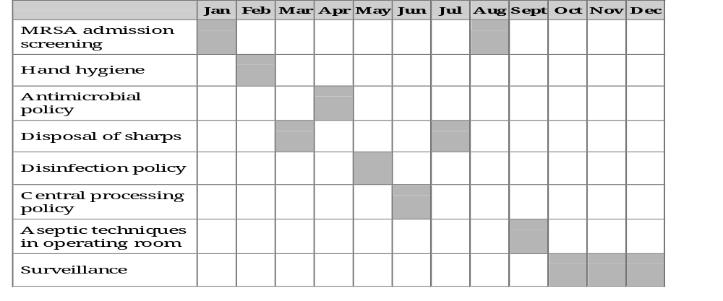
An Annual Audit Plan

Slide 19
Summary
(Take Home Message)
Health care requires an increased emphasis on the use of audits to measure the implementation of policies and procedures relating to IPC practices.
Development of audit plans based on a risk assessment strategy, preparation of the audit team, tailoring of the audit method, and audit assessment of knowledge are pillars of internal audits in health care organisations.

Slide 20
THANKS

