Slide 1
Antigen
Dr. Ved Prakash
Professor & Head
PG Department of Microbiology

Slide 2
Learning objectives
At the end of the session, the students will be able to understand:
Definition of Antigen and Hapten
Factors Influencing Immunogenicity
Biological Classes of Antigens
Superantigens

Slide 3
ANTIGEN
Any substance that induce an immune response in a host is called an antigen.
Such a substance stimulates the production of an antibody in a specific and observable manner.

Slide 4
Antigens can be of the following types:
Complete antigens: They are able to evoke an immune response independently. Partial antigens or haptens: They require an additional carrier protein to be able to stimulate immune response .

Slide 5
HAPTEN
Low molecular weight molecules that lack immunogenicity (cannot induce immune response) but retain antigenicity or immunological reactivity (i.e. can bind to their specific antibody or T cell receptor).
Haptens can become immunogenic when combined with a larger protein molecule called carrier.

Slide 6
Haptens can be categorised as follows:
Complex haptens are polyvalent and can precipitate with specific antibodies.
Simple haptens are univalent and non precipitating

Slide 7
Thus Antigen is defined as any substance that satisfies two distinct immunologic properties-
  Immunogenicity
  Antigenicity.

Slide 8
Immunogenicity:
Ability of an antigen to induce immune response in the body (both humoral and/or cell mediated).
  B cells + antigen → effector B cells (plasma cell) + memory B cells
  T cells + antigen → effector T cells (helper T cell or cytotoxic T cell) + memory T cells
  Substance that satisfies immunogenicity - more appropriately called as ‘immunogen’ rather than ‘antigen’.

Slide 9
Antigenicity (immunological reactivity):
Ability of an antigen to combine specifically with the final products antibodies and/or T cell-surface receptors.
All molecules having immunogenicity property, also show antigenicity, but the reverse is not true
  E.g. Haptens- which are antigenic but not immunogenic.

Slide 10
Epitope or antigenic determinant
Epitope is the Smallest unit of an antigen responsible for antigenicity.
Types of epitope:
Sequential or linear epitope- Present as a single linear sequence of few amino acid residues.
Conformational or non sequential epitopes:
  Found on the flexible region of complex antigens having tertiary structures.
Paratope: This is the area on the antibody molecule that corresponds to the epitope.

Slide 11
ANTIGEN-HOST RELATIONSHIP
Based on the antigen-host relationship, antigens can be grouped into two groups:
  Self or auto antigens : They belong to the host itself and hence they are not immunogenic. Hosts do not react to their own antigens by exhibiting a mechanism called immunological tolerance.
  Immunological tolerance is a state in which an individual is incapable of developing an immune response against his own tissue antigens. It is mediated by tow broad his own tissue antigens. It is mediated by two broad mechanisms- central tolerance and peripheral tolerance.

Slide 12
  Non-self or foreign antigens :
  They are immunogenic and are of three types based on their phylogenetic distance to the host.
Alloantigens are species specific. Tissues of all individuals in species contain species-spcific antigens.
Isoantigens are type of antigens which are present only in subsets of a species e.g. blood group antigens and histocompatibility antigens .

Slide 13
Heteroantigens: Antigens belonging to two different species but they share epitopes with each other, are called heteroantigens. e.g. antigens of plant or animal or microorganisms, etc.
Forssman antigen : It is heterophile antigen having a lipid-carbohydrate complex which is widely distributed in many animals, birds, plants and bacteria. It is however, absent in rabbits. For this reason, anti-Forssman antibodies can be prepared in these animals.

Slide 14
Diagnostic Application of heterophile antigens
Heterophile antigens can be used in various serological tests.
Antibody against one antigen can be detected in patient’s serum by employing a different antigen which is heterophile (cross reactive) to the first antigen. Examples:
  Weil-Felix reaction
  Paul-Bunnell test
  Cold agglutination test and Streptococcus MG test

Slide 15
Histocompatibility antigens: are cellular determinates that are specific to each individual of a species. They are recognized by genetically different individuals of the same species when attempts are made to transfer or transplant cellular material including organs from one individual to another.
These antigens participates in graft rejection and a part of human HLA system (major histocompatibility complex system)

Slide 16
FACTORS INFLUENCING IMMUNOGENICITY
Size of the antigen
Chemical nature of the antigen
Susceptibility of antigen to tissue enzymes
Structural complexity
Foreignness to the host
Genetic factor

Slide 17
Optimal dose of antigen
Route of antigen administration:
Repeated Number of doses of antigens
Multiple antigens
Effect of prior administration of antibody

Slide 18
Size of the antigen:
Larger is the size (>10,000 Dalton molecular weight, e.g. hemoglobin); more potent is the molecule as an immunogen
Chemical nature of the antigen:
Proteins are stronger immunogens than carbohydrates followed by lipids and nucleic acids

Slide 19
Susceptibility of antigen to tissue enzymes :
Only substances that are susceptible to the action of tissue enzymes are immunogenic.
Degradation of the antigen by the tissue enzymes produces several immunogenic fragments having more number of epitopes exposed.

Slide 20
Structural complexity:
Simple homopolymers made up of single amino acid lack immunogenicity.
Polymers made up of two or more amino acids are immunogenic.
Foreignness to the host :
Key factor which determines immunogenicity.
Higher is the phylogenetic distance between the antigen and the host; more is the immunogenicity.

Slide 21
Genetic factor:
Different individuals of a given species show different types of immune responses towards the same antigen.
  Responders
  Slow responders
  Non-responders

Slide 22
Optimal dose of antigen:
An antigen is immunologically active only in the optimal dose range.
Route of antigen administration:
Immune response is better induced following parenteral administration of an antigen.
Depends on the type of antibody produced.

Slide 23
Repeated doses of antigens:
Repeated doses of antigens over a period of time are needed to generate an adequate immune response.
This is due to the role of memory cells in secondary immune response.

Slide 24
Multiple antigens:
When two or more antigens are administered simultaneously, the effects may vary.
Antibody response to one or the other antigen may be equal or diminished (due to antigenic competition) or enhanced (due to adjuvant like action).

Slide 25
Effect of prior administration of antibody:
Primary immune response is more susceptible to get suppressed than the secondary immune response.
Therapeutic application

Slide 26
Adjuvant
Any substance that enhances the immunogenicity of an antigen.
Added to vaccines to increase the immunogenicity of the vaccine antigen.
Examples:
  Alum (aluminium hydroxide or phosphate)
  Mineral oil (liquid paraffin)
  Freund's incomplete adjuvant- It is a water-in-oil emulsion containing a protein antigen in the aqueous phase.
  Freund's complete adjuvant is the mixture of Freund's incomplete adjuvant & suspension of killed tubercle bacilli in the oil phase.

Slide 27
Examples:
  Lipopolysaccharide (LPS) fraction of Gram-negative bacilli
  Other bacteria or their products-
    Mycobacterium bovis
    Toxoid (diphtheria toxoid and tetanus toxoid act as adjuvant for Haemophilus influenzae-b vaccine)
  Nonbacterial products: Silica particles, beryllium sulfate, squalene, and thimerosal.

Slide 28
Mechanism of adjuvant action:
Delaying the release of antigen
By activating phagocytosis
By activating T_{H} cells
By granuloma formation

Slide 29
BIOLOGICAL CLASSES OF ANTIGENS
Depending on the mechanisms of inducing antibody formation, antigens are classified as:
  T cell dependent (TD) antigens.
  T cell independent (TI) antigens.
  Superantigens

Slide 30
T-dependent (TD) Antigens
Most natural proteins are T-dependent antigens. B cells cannot respond to these antigens without a co-stimulatory signal from T_{H} Cells
Most of the normal antigens are T cell dependent, they are processed and presented by APCs to T cells which leads to T cell activation.
Activated T cells secrete cytokines that in turn stimulate the B cells to produce antibodies.

Slide 31
T-independent (TI) Antigens
Some antigens can directly stimulate antibody production by B cell without the apparent participation of T cells. Such antigens are called TI antigens.
Antigens such as bacterial capsule, flagella and LPS (lipopolysaccharide) that do not need the help of T cells and APCs.
Directly bind to immunoglobulin receptors present on B cells and stimulate B cells polyclonally.
Leads to increased secretion of non- specific antibodies (hypergamma-globulinemia).

Slide 32
Differences between T-independent antigens and T-dependent antigen
T Independent Antigen | T dependent Antigen
Structurally simple- LPS, capsular polysaccharide, flagella | Structurally complex- protein in nature
Dose dependent Immunogenicity | Immunogenic over wide range of dose
No memory | Memory present
No antigen processing | Antigen processing step is needed
Slowly metabolized | Rapidly metabolized

Slide 33
T Independent Antigen | T dependent Antigen
Activate B cells polyclonally | Activate B cells monoclonally
Activate both mature and immature B cells | Activate mature B cells only
B cells stimulated against T independent antigen do not undergo- Affinity maturation Class switch over | B cells stimulated against T dependent antigen undergo Affinity maturation Class switch over
Antibody response is restricted to IgM and IgG3 | Antibodies of all classes can be produced

Slide 34
Superantigens
Super antigens are antigen that evoke an excessive immune response.
Unique feature of superantigens is, they can activate T cells directly without being processed by antigen presenting cells (APCs).
The variable β region of T cell receptor (vβ of TCR) appears to be the receptor for superantigens.

Slide 35
Bacterial superantigen
Staphylococcal toxin- Toxic shock syndrome toxin-1(TSST-1); Exfoliative toxin; Enterotoxins
Streptococcal toxin- Streptococcal pyrogenic exotoxin (SPE)-A and C
Mycoplasma arthritidis mitogen-I
Yersinia enterocolitica Yersinia pseudotuberculosis

Slide 36
Viral superantigen
 | Epstein-Barr virus associated superantigen
 | Cytomegalovirus associated superantigen
 | Rabies nucleocapsid
 | HIV encoded superantigen (nef- negative regulatory factor)
Fungal superantigen
 | Malassezia furfur

Slide 37
Diseases Associated with Superantigens
Conditions associated with staphylococcal toxins are as follows-
  Toxic shock syndrome
  Food poisoning
  Scalded skin syndrome
  Rare conditions such as- Atopic dermatitis, Kawasaki syndrome, psoriasis, acute disseminated encephalomyelitis.

Slide 38

THANKS

Slide 39
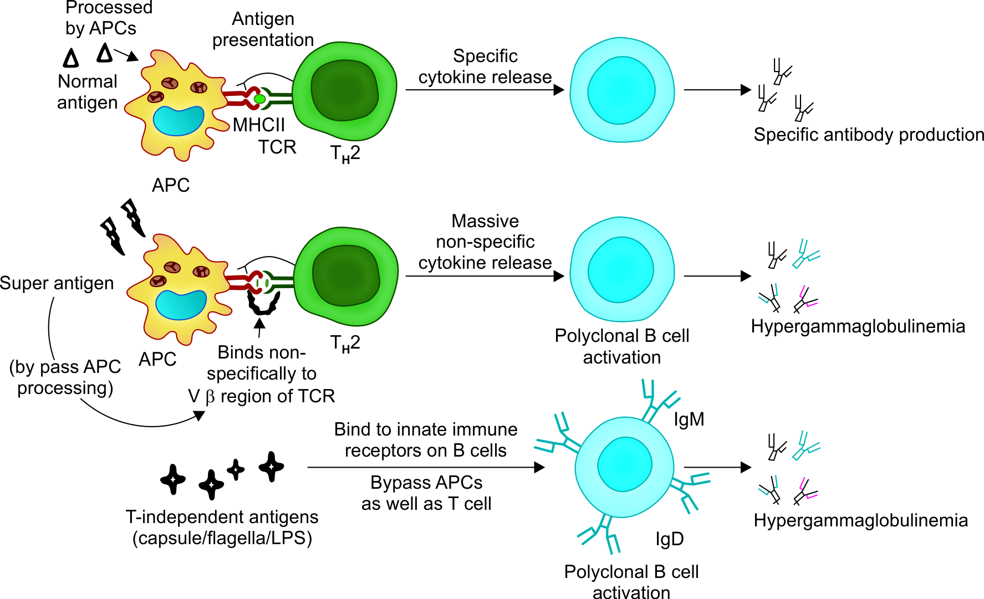

Slide 40
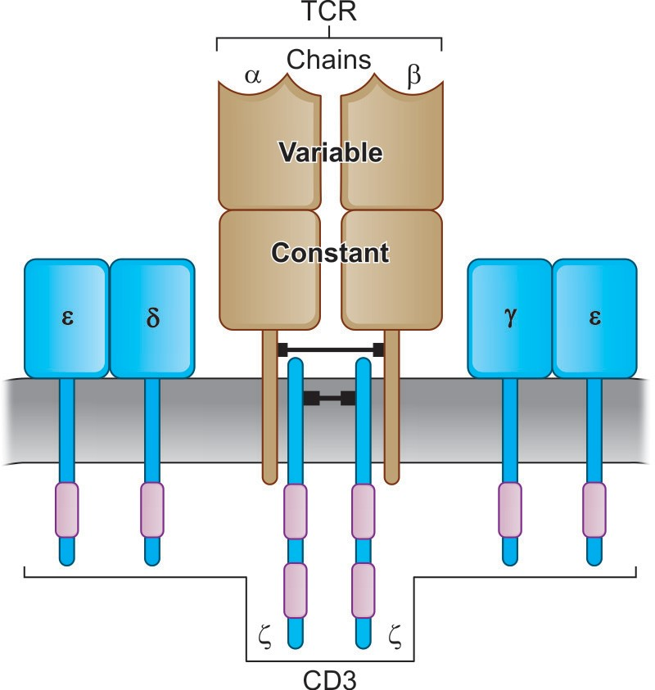
Structure of T.cell Receptor–CD3 Complex
TCR-CD3 Complex has three region extracellular domain, Transmembrane domain,Cytoplasmic domain,
CD3 complex consists of three pairs of polypeptide chains zeta-homodiamer, delta-epsilon heterodimer and gamma-epsilon heterodimer .
TCR is active only when both the chains (α & β) complexes with CD3 molecule.

Slide 41
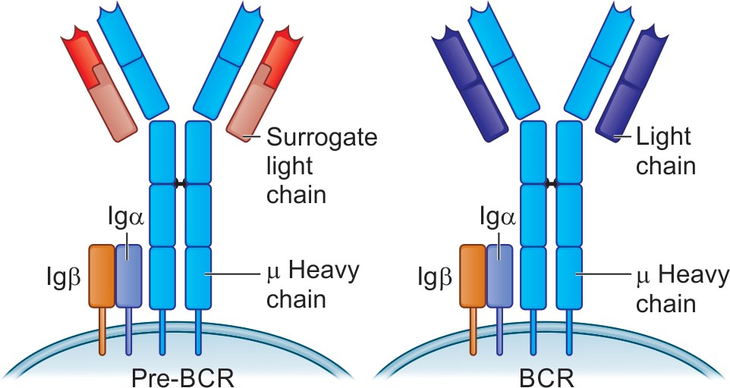
B Cell Receptor

Slide 42
The B cell receptor (BCR) is a crucial molecule in the immune system, acting as a highly specific sensor on the surface of B cells. It plays a vital role in recognizing and responding to foreign invaders like viruses and bacteria, initiating the production of antibodies to neutralize them.
Structure of the BCR:
The BCR is a complex protein composed of two main parts:
Antigen-binding fragment (Fab): This Y-shaped region is made up of two heavy chains and two light chains linked by disulfide bonds. Each chain has two distinct regions:
Constant region (C): This region remains relatively unchanged between different B cells and provides structural support.

Slide 43
Variable region (V): This region is highly diverse and unique to each B cell. It forms the antigen-binding site, also known as the paratope, with remarkable specificity for a specific antigen.
B cell receptor structure
Signal transduction unit: This transmembrane portion consists of two proteins, Igα and Igβ, which are linked together. These proteins transmit signals to the B cell's interior upon antigen binding, triggering its activation.

Slide 44
