Slide 1
Antibody
Dr. Ved Prakash
Professor & Head
PG Department of Microbiology

Slide 2
Learning objectives
At the end of the session, the students will be able to understand:
Structure of antibody
Immunoglobulin classes
Antigenic determinants of immunoglobulins
Monoclonal Antibody
Antibody Diversity

Slide 3
ANTIBODY
Specialized glycoprotein, produced from activated B cells (plasma cells) in response to an antigen.
Capable of combining with the antigen that triggered its production.

Slide 4
ANTIBODY (Cont..)
A.Tiselius in 1939 subjected the serum to electrophoresis, the serum proteins are separated into four fragments- albumin, globulin α, β and γ.
Antibodies are located in the γ-globulin fraction; because they immunologically react with the antigen; they were given the name as immunoglobulin.

Slide 5
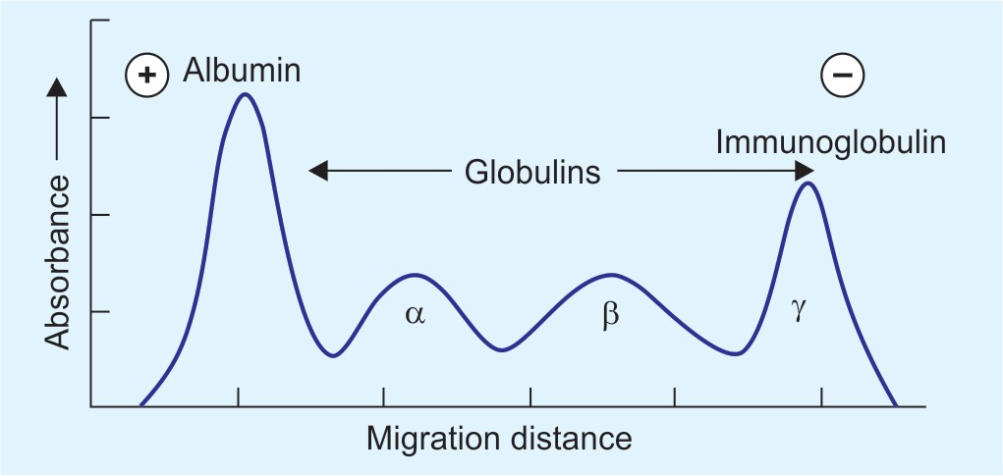
ANTIBODY (Cont..)

Slide 6
ANTIBODY (Cont..)
Both the terms, immunoglobulin (Ig) and antibody are used interchangeably; representing the physiological &functional properties of same molecule respectively.
Immunoglobulin (Ig) constitutes 20-25 per cent of total serum proteins.
There are five classes (or isotypes) of immunoglobulins recognised-IgG, IgA, IgM, IgD and IgE.

Slide 7
STRUCTURE OF ANTIBODY

Slide 8
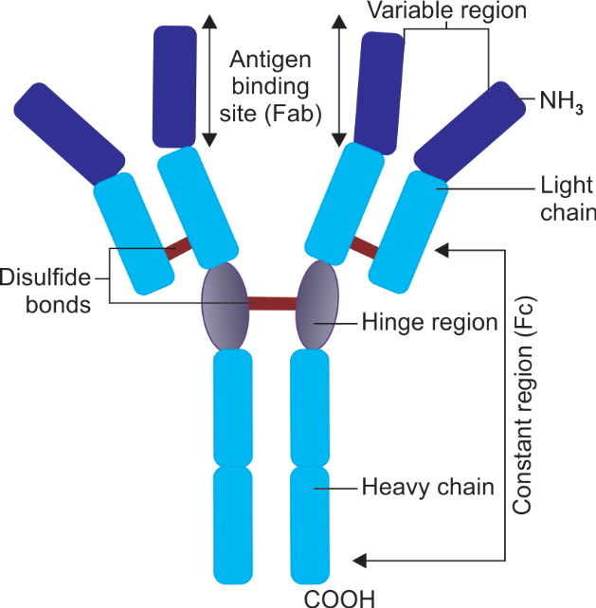
STRUCTURE OF ANTIBODY
An antibody molecule is a ‘Y-shaped’ heterodimer; composed of four polypeptide chains.
Two identical light (L) chains, of molecular weight 25,000 Da each and
Two identical heavy (H) chains each having molecular weight 50,000 Da or more.

Slide 9
H and L Chain
All four H and L chains are bound to each other by disulfide bonds, and by noncovalent interactions such as salt linkages, hydrogen bonds, and hydrophobic bonds.
All the chains have two ends- an amino terminal end (NH3) and a carboxyl terminal end (COOH).

Slide 10
H and L Chain (Cont..)
There are five classes of H chains and two classes of light chains.
Immunoglobulin class | Heavy chain type
IgG | γ(gamma)
IgA | α (alpha)
IgM | µ(mu)
IgD | δ(delta)
IgE | ε(epsilon)

Slide 11
H and L Chain (Cont..)
L chains are of two types- kappa (κ) and lambda (λ), named after Korngold and Lapari who originally described them.

Slide 12
Variable and Constant Regions
Each H and L chain comprises of two regions- variable and constant region.

Slide 13
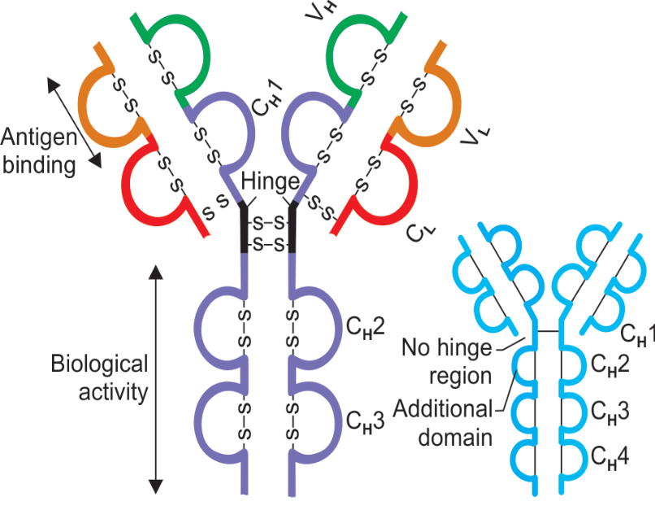
Variable Region
Represents the antigen binding site of the antibody.

Slide 14
Variable Region
Hyper variable region:
Within the variable region, there are some zones (hot spots) that show relatively higher variability in the amino acid sequences.
Called as hypervariable regions or complementarity determining regions (CDRs).
Form the antigen-binding site.
There are three hot spots in the L and four in the H chain respectively.

Slide 15
Variable Region
Paratope:
The site on the hypervariable regions that make actual contact with the epitope of an antigen is called as paratope.

Slide 16
Constant Region
Constitutes the remaining part of an Ig molecule other than that of variable region.
Length of the constant regions is approximately 104 amino acids for light chain, 330 amino acids for γ, α and δ heavy chains and 440 amino acids for µ and ε heavy chains.
Amino acid sequence of constant region shows uniform pattern.
A single antibody molecule has two identical heavy chains and two identical light chains; H2L2

Slide 17
Heavy and Light Chain Domains
Light chain contains one variable domain (VL) and one constant domain (CL).
Heavy chains possess one variable domain (VH) and 3 or 4 numbers of constant domains (CH)-
  Heavy chains γ, α and δ have three constant domains-CH1, CH2 and CH3.
  Heavy chains µ and ε have four constant domains- CH1 to CH 4.

Slide 18
Hinge Region
Rich in proline and cysteine.
Quite flexible, allowing the Ig molecule to assume different positions, thus helps the antibody in reaching towards the antigen.
Hinge region is sensitive to various enzymatic digestions.

Slide 19
Enzymatic Digestion
When an immunoglobulin molecule is subjected to enzymatic digestion, it generates various fragments.
Types:
  Papain digestion
  Pepsin digestion
  Mercaptoethanol reduction

Slide 20
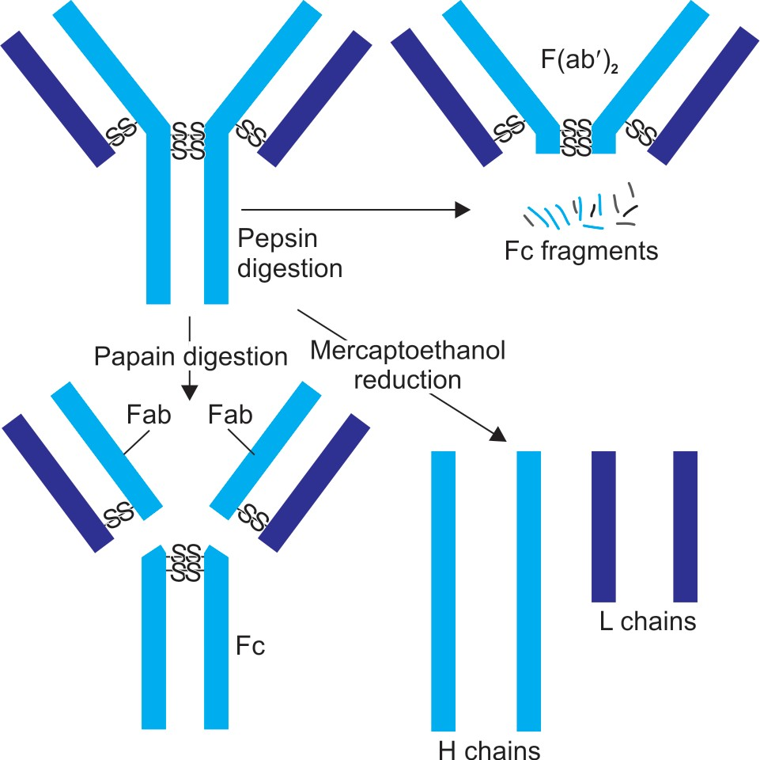
Enzymatic Digestion (Cont..)

Slide 21
FUNCTIONS OF IMMUNOGLOBULINS

Slide 22
Antigen Binding (by Fab Region)
Protection of the host.
Interaction with the antigen.
Valency of an antibody refers to the number of Fab regions it possesses. Thus, a simple monomeric antibody molecule has a valency of two.

Slide 23
Effector Functions (by Fc Region)
Fixation of complement:
  Antibody coating the target cell binds to complement through its Fc receptor which leads to complement mediated lysis of the target cell.

Slide 24
Effector Functions (by Fc Region) (Cont..)
  Binding to various cell types
    Phagocytic cells, lymphocytes, platelets, mast cells, NK cell, eosinophils and basophils bear Fc receptors (FcR) that bind to Fc region of immunoglobulins.
    Binding can activate the cells to perform some biological functions.
    Some immunoglobulins (e.g. IgG) also bind to receptors on placental trophoblasts, which results in transfer of the immunoglobulin across the placenta.

Slide 25
IMMUNOGLOBULIN CLASSES

Slide 26
IMMUNOGLOBULIN CLASSES
Based on five types of heavy chains, there are five classes of immunoglobulins (lgG, IgA, IgM, IgD and IgE).

Slide 27
Immunoglobulin G (IgG)
Constitutes about 70-80% of total Igs of the body.
IgG has maximum daily production.
Longest half-life of 23 days.
Highest serum concentration.

Slide 28
Immunoglobulin G (IgG) (Cont..)
IgG has four subclasses- IgG1, IgG2, IgG3 and IgG4; all differ from each other in the amino acid sequences of the constant region of their γ-heavy chain.
Subclasses vary in their biological functions, length of hinge region and number of disulphide bridges.
IgG3 has longest hinge region with 11 inter-chain disulphide bonds.

Slide 29
Functions of IgG
IgG can cross placenta - hence provide immunity to the fetus and new born.
  Among subclasses, IgG2 has the poorest ability to cross placenta.
Complement fixing: Complement fixing ability of subclasses varies - IgG3> IgG1> IgG2. IgG4 does not fix complements.
Phagocytosis

Slide 30
Functions of IgG (Cont..)
Mediates precipitation and neutralization reactions.
IgG plays a major role in neutralization of toxins as it can easily diffuse into extravascular space.
IgG is raised after long time following infection and represents chronic or past infection (recovery).
Coagglutination

Slide 31
Immunoglobulin M (IgM)
Among all Igs, IgM has highest molecular weight, and maximum sedimentation coefficient (19S).
Present only in intravascular compartment, not in body fluids or secretions.

Slide 32
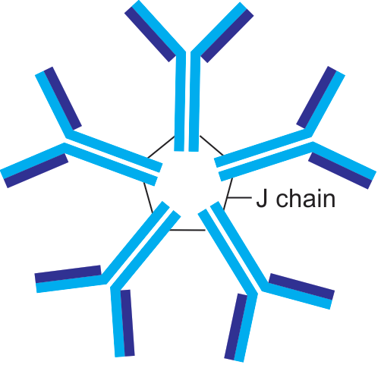
Immunoglobulin M (IgM) (Cont..)
IgM exists in both monomeric and pentameric forms:
  When present as membrane-bound antibody on B cells, it exists in monomeric form.
  When present in secreted form, it is pentameric in nature

Slide 33
Functions of IgM
Acute infection
Complement fixing
Antigen receptor.
Acts as an opsonin
Fetal immunity
Protection against intravascular organisms
Mediate agglutination

Slide 34
Immunoglobulin A (IgA)
IgA is the second most abundant class of Ig next to IgG, constituting about 10-15% of total serum Ig.
Exists in both monomeric and dimeric forms.

Slide 35
Serum IgA
IgA in serum is predominantly in monomeric form
Functions: Serum IgA interacts with the Fc receptors expressed on immune effector cells, to initiate various functions - antibody-dependent cell-mediated cytotoxicity (ADCC), degranulation of immune cells, etc.

Slide 36
Secretory IgA
Dimeric in nature; two IgA monomeric units joined by a J chain.
Secretory component location-Predominant antibody found in body secretions like milk, saliva, tears, intestinal & respiratory tract mucosal secretions.
Secretory component is derived from poly Ig receptor present on the serosal surfaces of the epithelial cells.

Slide 37
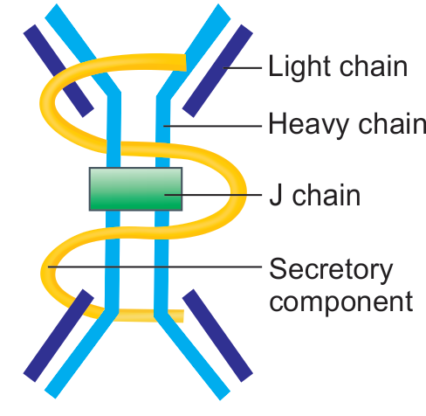
Secretory IgA (Cont..)

Slide 38
Function of secretory IgA
Local or mucosal immunity
Effective against bacteria like Salmonella, Vibrio, Neisseria, and viruses like polio and influenza.
Breast milk is rich in secretory IgA and provides good protection to the immunologically immature infant gut.

Slide 39
Formation of secretory IgA
Dimeric secretory IgA is synthesised by plasma cells situated near mucosal epithelium. J chain is also produced in the same cell.
Secretory component protects IgA from denaturation by bacterial proteases produced by intestinal flora.

Slide 40
Subclasses of IgA
Depending upon the amino acid sequences in the constant region of heavy chain, IgA exists in two isotypes:
  IgA1
  IgA2

Slide 41
Immunoglobulin E (IgE)
Lowest serum concentration.
Shortest half life.
Minimum daily production.
Only heat labile antibody (inactivated at 56º C in one hour).
Has affinity for the surface of tissue cells (mainly mast cells) of the same species (homocytotropism).
Extravascular in distribution.

Slide 42
Functions of IgE
Mediator of type I hypersensitivity reactions
IgE is elevated in helminthic infections.

Slide 43
Immunoglobulin D (IgD)
IgD is found as membrane Ig on the surface of B cells and acts as a B cell receptor along with IgM.
Has the highest carbohydrate content among all the Igs.
No other function is known for IgD so far.

Slide 44
Properties of various immunoglobulins
Property | IgG | IgA | IgM | IgD | IgE
Usual form | Monomer | Monomer,dimer | Monomer,Pentamer | Monomer | Monomer
Valency | 2 | 2 or 4 | 2 or 10 | 2 | 2
Other chains | None | J chain, secretory component | J chain | None | None
Subclasses | G1, G2, G3, G4 | A1, A2 | None | None | None
Molecular weight (kDa) | 150 | 150-600 | 900 | 150 | 190
Serum level mg/mL | 9.5–12.5 | IgA1- 3.0 IgA2 - 0.5 | 1.5 | 0.03 | 0.0003
% of total serum Ig | 75–85% | 10–15% | 5–10% | 0.3% | 0.019%
Half-life, days | 23* | 6 | 5 | 3 | 2.5
Daily production mg/kg | 34 | 24 | 3.3 | 0.4 | 0.0023

Slide 45
Properties of various immunoglobulins (Cont..)
Property | IgG | IgA | IgM | IgD | IgE
Intravascular distribution (%) | 45% | 42% | 80% | 75% | 50%
Sedimentation coefficient | 7 | 7 | 19 | 7 | 8
Binds to Fc receptors of phagocytes | ++ | - | ? ** | - | -
Placental transfer | Yes (except IgG2) | - | - | - | -
Mediates coagglutination | Yes (except IgG3) | - | - | - | -
Mucosal transport | - | Yes | - | - | -
Mast cell degranulation | - | - | - | - | yes
Marker for B cells | - | - | + | + | -
Heat stability | + | + | + | + | -

Slide 46
ANTIGENIC DETERMINANTS OF
IMMUNOGLOBULINS

Slide 47
ANTIGENIC DETERMINANTS OF
IMMUNOGLOBULINS
Entire Ig molecule is not immunogenic, but it contains antigenic determinants at specific sites.
Based on the location of antigenic determinants, the Ig molecules are divided into- isotypes, idiotypes and allotypes.

Slide 48
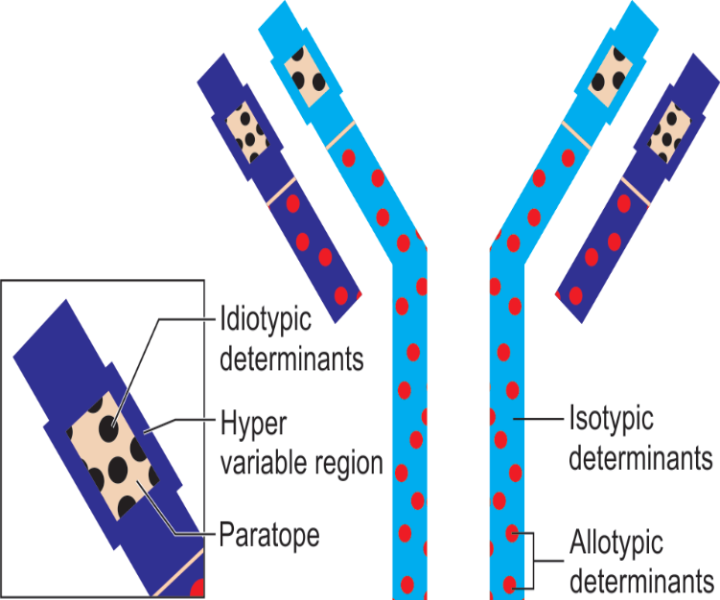
Isotypes
The five classes of Igs and their subclasses are called as isotypes.
Vary from each other in the amino acid sequences of the constant region of their heavy chains.
Such variation is called as isotypic variation

Slide 49
Idiotypes
Unique amino acid sequence present in paratope region (in VH and VL regions) of one member of a species acts as antigenic determinant to other members of the same species.
Such antigenic determinants are called as idiotopes and the sum total of idiotopes on an Ig molecule constitutes its idiotypes.

Slide 50
Idiotypes (Cont..)
Idiotypes in an individual arise continuously from mutations (somatic hypermutations) in the genes of variable region.
Idiotypes may act as foreign to the host itself; however do not evoke autoimmune response because they are present in small numbers.

Slide 51
Allotypes
Antigenic determinants present in the isotype genes in the constant region of H and L chains, encoded by multiple alleles.
Although all members of a species inherit the same set of isotype genes, multiple alleles exist for some of the allele genes.

Slide 52
Allotypes (Cont..)
To date, three systems of allotypic markers have been characterized for humans:
  Kappa light chain (Km system)—has three Km allotypes.
  γ heavy chain (Gm system)—has 25 Gm types.
  α heavy chain (Am system).
Antibody to allotype determinants can be produced by injecting antibodies containing these determinants from one member to another within a given species.

Slide 53
ABNORMAL IMMUNOGLOBULINS

Slide 54
Bence Jones Proteins
Produced in a neoplastic condition of plasma cells called multiple myeloma.
This condition - also called as light chain disease as the cancerous plasma cells produce excess of light chains (Bence Jones proteins) which are accumulated in patient’s serum and excreted in urine.
Such proteins have a unique property of getting coagulated at 50°C and redissolving again at 70°C.

Slide 55
Other abnormal immunoglobulins
Waldenstrom’s Macroglobulinemia: B cell lymphoma, producing excess IgM.
Heavy chain disease: characterized by an excessive production of heavy chains that are short and truncated.
Cryoglobulinemia: Seen in multiple myeloma and hepatitis C infection.

Slide 56
MONOCLONAL ANTIBODY

Slide 57
MONOCLONAL ANTIBODY
Antibodies derived from a single clone of plasma cell; all having the same antigen specificity- i.e. produced against a single epitope of an antigen.

Slide 58
Polyclonal vs Monoclonal Nature of Antibody
Antigen having multiple epitopes enters the body → each epitope may stimulate one clone of B cells producing one type of antibody → Serum contains mixture of antibodies derived from different clones of B cells → polyclonal.

Slide 59
Polyclonal vs Monoclonal Nature of Antibody (Cont..)
When only one clone of B cell is stimulated by a single epitope of an antigen and then is allowed to proliferate and produce antibodies; such antibodies are referred to as monoclonal antibodies (mAb).

Slide 60
Production of mAb (Hybridoma Technique)
Produced by Hybridoma technique, developed by G Kohler and C Milstein (1975), for which they were awarded Nobel Prize in 1984.

Slide 61
Principle
Clone of B cell stimulated against a single epitope of antigen is fused with an immortal cell, e.g. myeloma cell (capable of multiplying indefinitely) to produce a hybridoma cell.
Hybridoma cell has two unique properties:
  1. Produces monoclonal antibody of same antigen specificity (due to B cell component).
  2. Multiplies indefinitely producing clone of identical cells (due to immortal myeloma cell component).

Slide 62
Procedure
Mouse splenic B cells:
  Mouse is injected with an antigen containing the desired epitope(s).
  After an interval, the mouse splenic B cells are obtained which would contain mixture of B cells activated against the epitope(s) of the antigen injected.

Slide 63
Procedure (Cont..)
Myeloma cells:
  Used as a source of immortal cells.
  Myeloma cells are cancerous plasma cells, closely resemble mouse B cells; hence are compatible for fusion.
  Have capacity to produce their own antibodies.
  Hence myeloma cells are genetically modified with two mutations (double mutated myeloma cells) so that they lose the ability to produce their own antibody but retain immortal property.

Slide 64
Procedure (Cont..)
Fusion- The mouse splenic B cells and mutated myeloma cells are fused in polyethylene glycol broth. In the reaction chamber, three types of cells will be generated-
  Unfused myeloma cells
  Unfused mouse splenic B cells
  Fused hybridoma cells

Slide 65
Procedure (Cont..)
Purification (by sub culturing on HAT media)- The next step is to remove the unwanted cells and to propagate the clone of hybridoma cells. This is carried out by subculturing the cells in reaction chamber onto a special medium called HAT medium.

Slide 66
Procedure (Cont..)
HAT medium contains hypoxanthine, aminopterin and thymidine.
  Purine synthesis in mammalian cell (e.g. splenic B cell) occurs by either de novo or salvage pathways.
  Aminopterin blocks the de novo pathway so that the cell has to perform the salvage pathway to synthesize purines for its survival.
  Salvage pathway requires two important enzymes- HGPRT (hypoxanthine guanine phosphoribosyl transferase) and thymidine kinase.
  So any cell (e.g. myeloma cell) that lacks HGPRT cannot grow on HAT medium.

Slide 67
Procedure (Cont..)
Fate of three type of cells on HAT media-
  Unfused splenic B cells- Can grow but do not survive long as they are not immortal.
  Unfused myeloma cells- Cannot grow as they lack HGPRT enzyme to perform the salvage pathway of purine synthesis.
  Hybridoma cells- Can grow and survive long.

Slide 68
Procedure (Cont..)
Selection of individual hybridoma cells:
  If the original antigen used has multiple epitopes, many B cells would fuse with myeloma cells to produce a mixture of hybridoma cells each having specificity for one epitope.
  Medium containing hybridoma cells is then diluted into multi-well plates to such an extent that each well contains only one cell.
  Hybridoma cells producing the desired monoclonal antibodies are selected by radioimmunoassay or ELISA techniques using the specific antigen fragments, and are selectively proliferated.

Slide 69
Procedure (Cont..)
Maintenance of mAb- The selected hybridoma cells can be maintained in two ways-
  Hybridoma cell is cultured to generate a clone of identical cells; producing pure form of monoclonal antibodies at a concentration of 10-60 µg/ml.
  Desired hybridoma cell is injected into the peritoneal cavity of mouse where it can multiply and produce mAb in ascitic fluid at a concentration of 1-10 mg/ml.
    Such mAb obtained from mouse ascitic fluid and serum may not be in pure form, mixed with other antibodies.
    Purified by chromatography or by immunoprecipitation test.

Slide 70
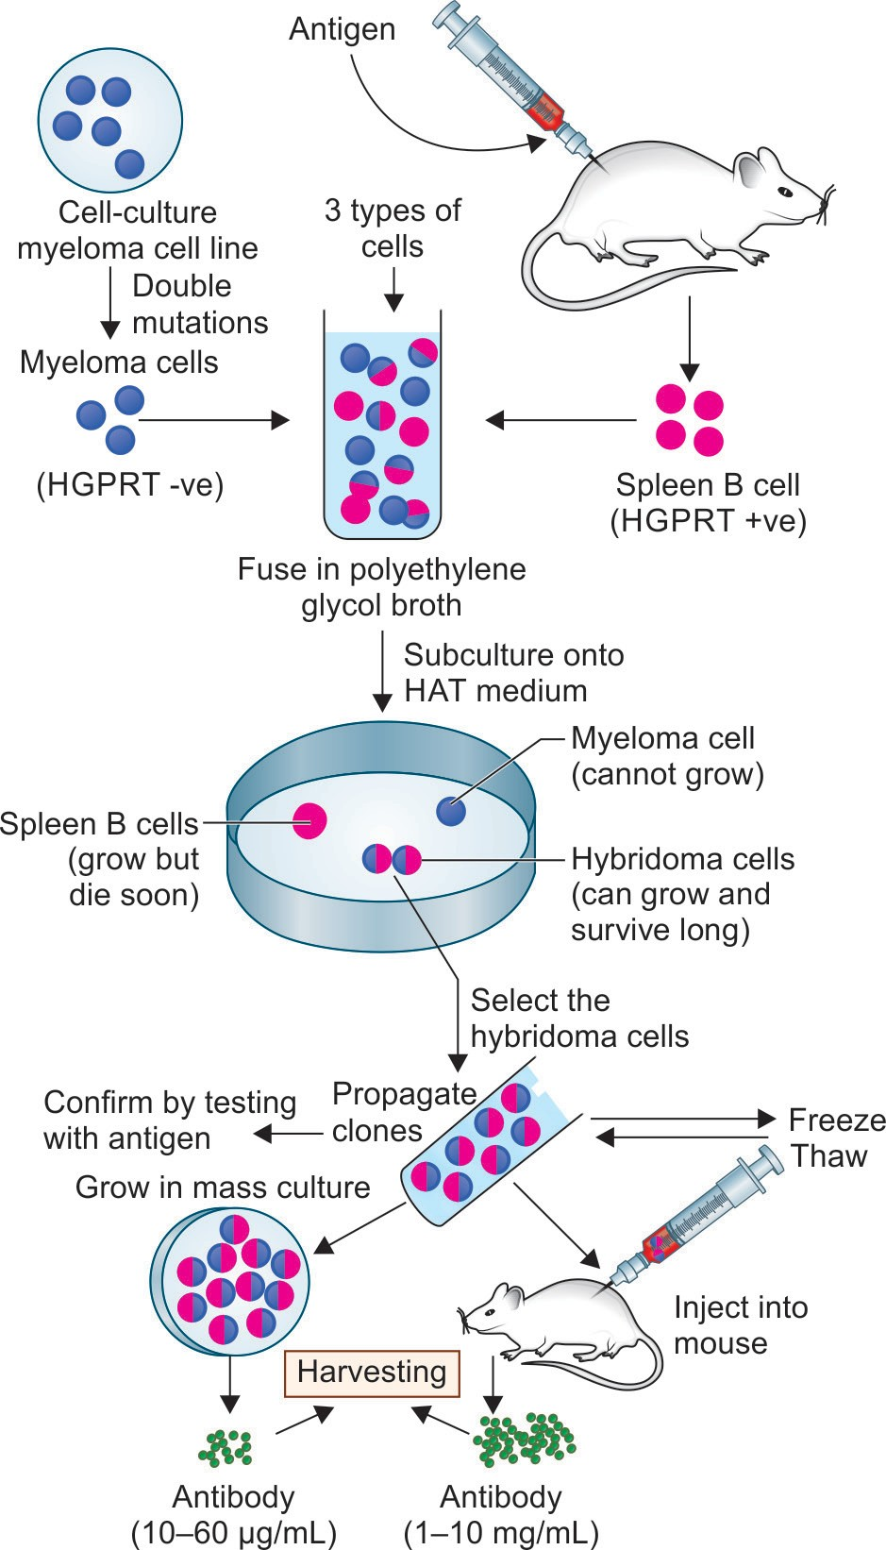
Procedure (Cont..)

Slide 71
Types of Monoclonal Antibodies
Problem of mouse monoclonal antibody is, the mouse proteins being foreign; can induce immune response in humans producing human anti-mouse antibody (HAMA);
Eliminate the monoclonal antibodies faster from the body.
Hence mouse derived monoclonal antibodies are not the best for human use.

Slide 72
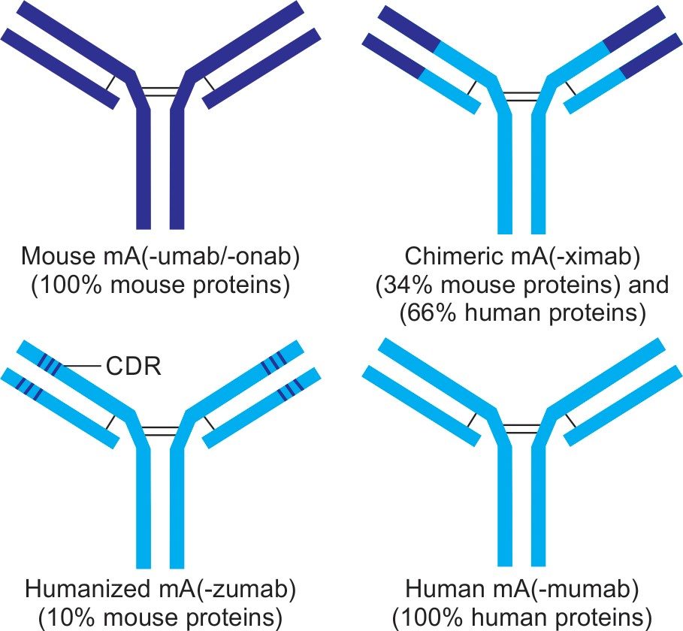
Types of Monoclonal Antibodies (Cont..)

Slide 73
Types of Monoclonal Antibodies (Cont..)
Mouse mAb - 100% mouse derived proteins
Chimeric mAb is prepared by recombination of 34% mouse proteins (variable region) and 66% human proteins (constant region).
Humanized mAb- Only the antigen binding site (i.e. CDR-complementarity determining regions) is mouse derived (10%) and the remaining part of mAb is human derived.
Human mAb- 100% of amino acids are human derived. It is the best accepted mAb in humans.

Slide 74
Applications of Monoclonal Antibodies
Isolation and purification- Monoclonal antibodies can be used to purify individual molecule from a mixture even when they are present in low concentration. E.g. interferon and coagulation factor VIII.
Identification of cells and clones- TH and TC cells are identified by using anti-CD4 and anti-CD8 mAb.

Slide 75
Applications of Monoclonal Antibodies (Cont..)
Diagnostic reagents: antigen detection kits employ various mAb tagged with detection molecules, such as fluorescent dye or enzyme to detect the specific antigens in the clinical specimen using various formats like ELISA, rapid tests, etc. Examples include detection of hepatitis B surface antigen, serogrouping of Streptococci, etc.

Slide 76
Applications of Monoclonal Antibodies (Cont..)
Monitoring proteins and drug level in serum
Passive immunity:
  Post exposure prophylaxis against various infections, mAb targeting specific antigens of the infecting organism can be administered.
  Examples include- immunoglobulins against hepatitis B, rabies, and tetanus.

Slide 77
Applications of Monoclonal Antibodies (Cont..)
Monoclonal antibody | Targeted against | Used in treatment of
Suppress immune system
Adalimumab and Infliximab | TNF-α | Rheumatoid arthritis, Crohn's disease
Omalizumab | IgE | Asthma
Daclizumab | IL-2 receptor | Rejection of kidney transplants
Muromonab | CD3
Anticancer
Trastuzumab | HER-2 | Breast cancer
Rituximab | CD20 | Lymphoma
Inhibit angiogenesis
Bevacizumab | VEGF(Vascular endothelial growth factor) | Colorectal cancers
Abciximab | Platelet receptor GpIIb/IIIa | Coronary artery disease

Slide 78
Applications of Monoclonal Antibodies (Cont..)
Used as immunotoxin
  mAb conjugated with bacterial/chemical toxins (e.g. diphtheria toxin) can be used to kill the target cells such as cancer cells.
  Monoclonal antibody against surface receptors helps in binding to the target cells and the toxin helps in target cell killing.
Used as enzymes- Abzyme is a monoclonal antibody with catalytic activity.

Slide 79
ANTIBODY DIVERSITY

Slide 80
ANTIBODY DIVERSITY
Mechanism by virtue of which human immune system is capable of producing vast number of antibodies (108 or even more) corresponding to various epitopes of different antigens.

Slide 81
ANTIBODY DIVERSITY (Cont..)
Several postulates - explain the mechanism of antibody diversity.
Multiple chromosomes:
Ig chains are coded on different chromosomes;
  H chain on chromosome 14
  Light chain kappa and lambda on chromosome 2 and 22 respectively.

Slide 82
ANTIBODY DIVERSITY (Cont..)
Several postulates - explain the mechanism of antibody diversity (Cont..)
Multiple genes exist for each segment:
(VH, CH, VL and CL ) of Ig chain.
Example - there are 51 VH genes known to exist in nature and out of which any one gene would code for VH chain of an Ig - there are many possible combinations of joining of the Ig gene segments.

Slide 83
Questions:
Q1. Which antibody crosses placenta:
IgA
IgG
IgE
IgM

Slide 84
Questions:
Q2. Which antibody mediates type I hypersensitivity reaction:
IgA
IgG
IgE
IgM

Slide 85
Questions:
Q3. Correct about monoclonal antibodies:
Mouse mAb contains 90% mouse derived proteins
Chimeric mAb prepared by recombination of 66% mouse proteins (variable region) and 34% human proteins (constant region)
Humanized mAb is 100% human derived
Human mAb contains 100% human derived amino acids.

Slide 86
Questions:
Q4. Which antibody is elevated in acute infection:
IgA
IgG
IgE
IgM

