Slide 1
Antimicrobial Stewardship Program
Dr. Ved Prakash
Professor & Head
PG Department of Microbiology

Slide 2
Learning objectives
At the end of the session, you will be able to understand:
Implementation of Antimicrobial Stewardship Program
Monitoring the Compliance to Antimicrobial Stewardship Program
Rational Use of Antimicrobial Agents
Hospital Antibiogram

Slide 3
Introduction
Antimicrobial stewardship program (AMSP) provides strategies for rationalizing the use of antimicrobials in the hospital.

Slide 4
Definition of Antimicrobial Stewardship
CDC defined has defined “Antimicrobial stewardship” as-
The right antibiotic
for the right patient,
at the right time,
with the right dose, and
the right route, causing
the least harm to the patient and future patients

Slide 5
Why AMSP is Needed?
To combat Antimicrobial Resistance (AMR)
To avoid misuse and over-use of antimicrobials
To restrict Widespread Use of Antimicrobials in Other Sectors
Due to poor antimicrobial research

Slide 6
IMPLEMENTATION OF ANTIMICROBIAL STEWARDSHIP PROGRAM
Administrative Support (Leadership)
Formulating AMS Team
Infrastructure Support
Framing Antimicrobial Policy
Implementing AMS strategies
Education and Training

Slide 7
Administrative Support (Leadership)
Should be publicly committed to the program.
Provide necessary funding and infrastructure support.

Slide 8
Formulating AMS Team
Multidisciplinary committee - responsible for framing, implementing and monitoring the compliance to antimicrobial policy of the hospital.
Led by the antimicrobial steward - infectious disease physician or infection control officer or clinical microbiologist.
Other members of AMS team - stewardship nurses, clinical pharmacists and officer in-charge of pharmacy.

Slide 9
Infrastructure Support
Support from Microbiology laboratory
Automations:
  Automated culture (e.g. BACTEC or BacT/ALERT),
  Automated identification (MALDI-TOF)
  Automated sensitivity (e.g. VITEK)
Biomarkers: Procalcitonin and CRP
Rapid Molecular tests
Emergency lab

Slide 10
CRP and its interpretation
CRP stands for C-reactive protein. It is a substance produced by the liver in response to inflammation in the body. CRP is a commonly used marker of inflammation and is measured through a blood test. Its interpretation can provide important information about a person's health.

Slide 11
Elevated CRP Levels: Elevated CRP levels (greater than 10 mg/L) can indicate the presence of inflammation or infection. The higher the CRP level, the more severe the inflammation may be. CRP is a nonspecific marker, so it doesn't pinpoint the exact cause of inflammation but indicates that there is an issue that needs further investigation.

Slide 12
Procalcitonin (PCT)
It is a peptide precursor of the hormone caitonin, secreted at very low level (<0.05 ng/mL) normally by the body, but the level goes up by manifolds in bacterial infection.
Interpretation :
0.05-2.0 ng/mL indicates possible local infection
2-10 ng/mL indicates systemic infection
>10ng/mL indicates septic shock

Slide 13
Bactec (BD Diagnostics) System for Blood Culture
BACTEC bottle contains soybean-casein digest broth added with polymeric resin beads .
It uses an oxygen sensitive fluorescent compound, dissolved in the broth. In uninoculated broth, the large amount of dissolved oxygen quenches the fluorescence dye.
Later, actively dividing microorganisms consume the oxygen , removing the quenching effect and allowing the fluorescence to be detected

Slide 14
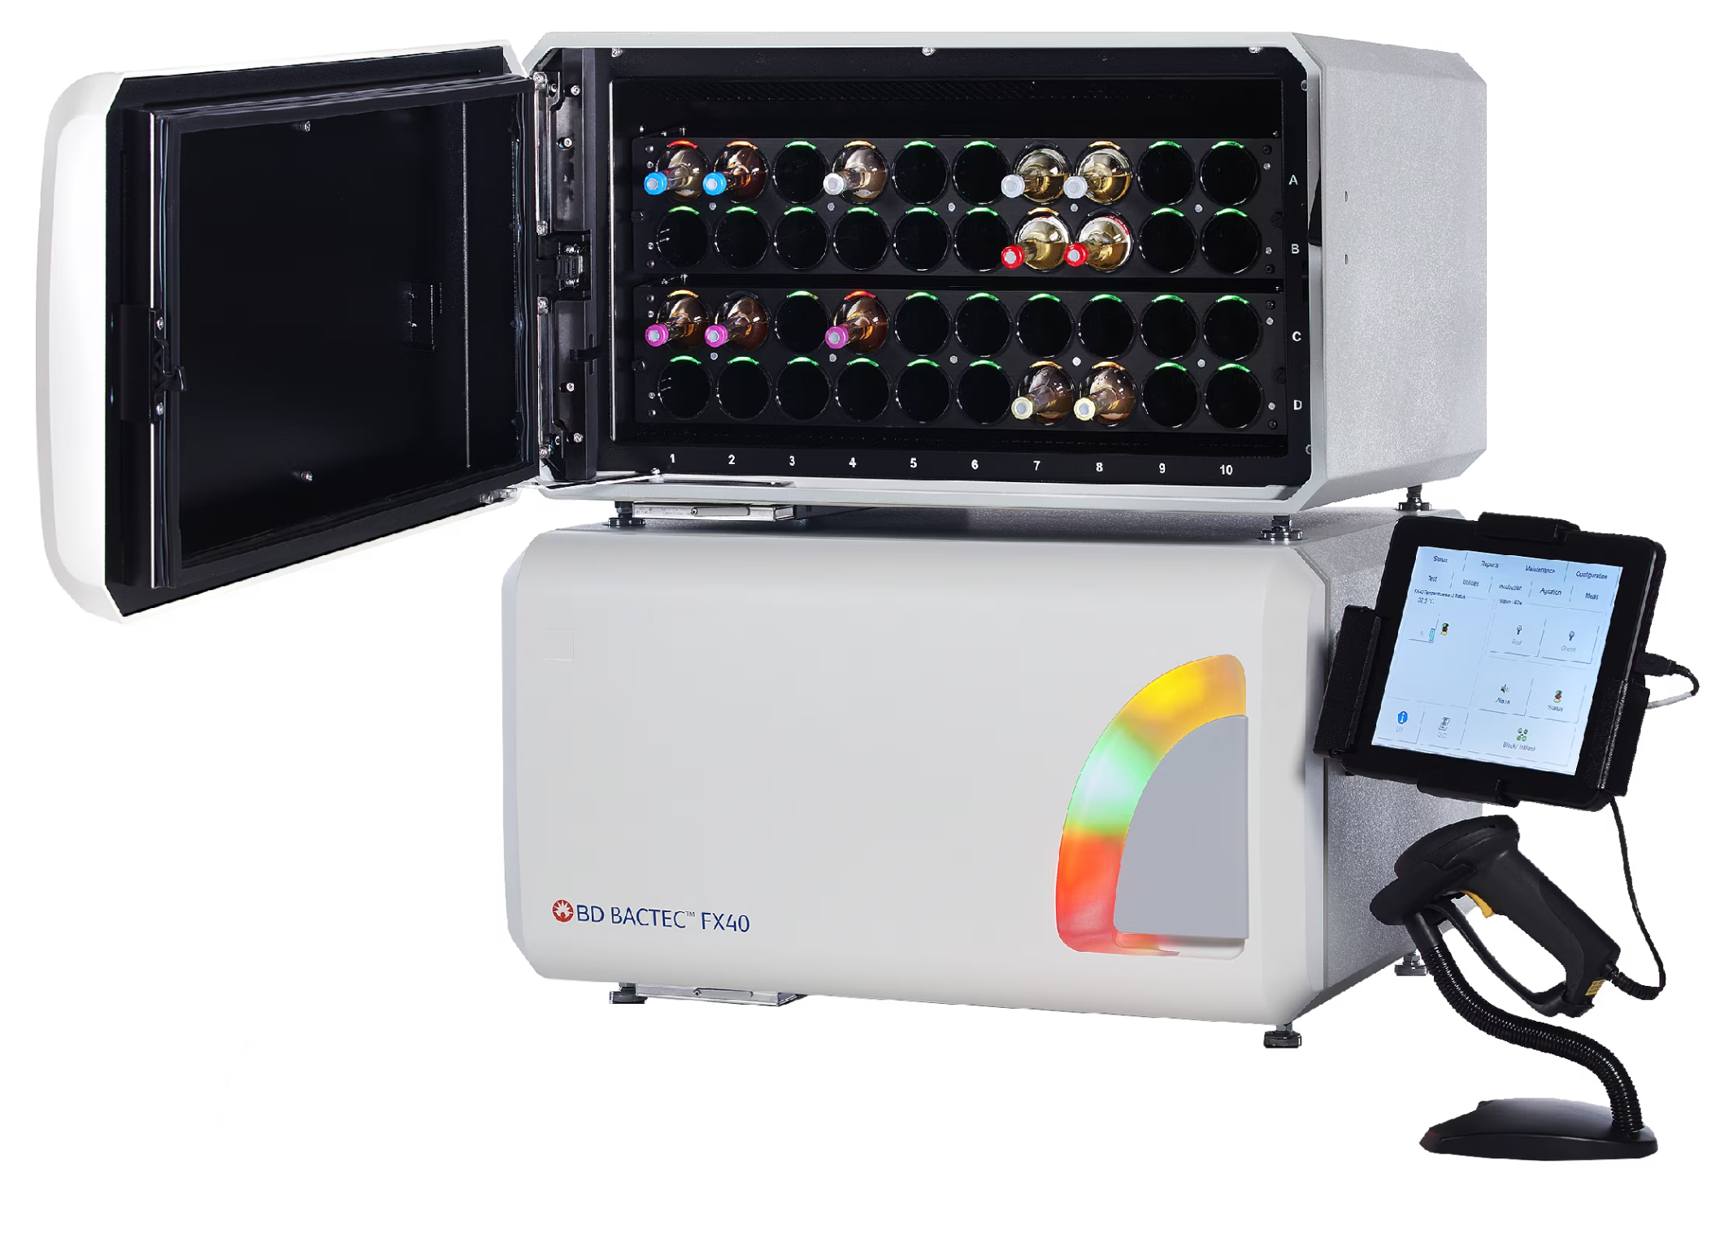

Slide 15
MALDI-TOF examines the patterns of ribosomal proteins present in the organism.
Sample preparation : The colony of an organism is mixed with a matrix solution (composed of cyano-hydroxy-cinnamic acid). The mixture is applied to the wells of the target slide and then the slide is loaded in the system. The slide passes through Ionization chamber , analyzer and Detector which converts the received ion into electrical current which is amplified and digitized (D) to generate a characteristic spectrum which is unique to a species. Identification is done by comparing the spectrum of the test organism with the database.

Slide 16
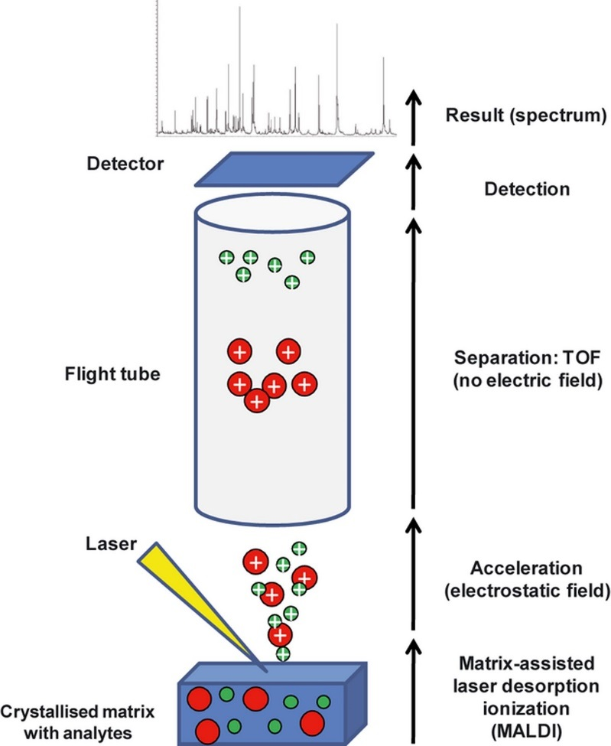
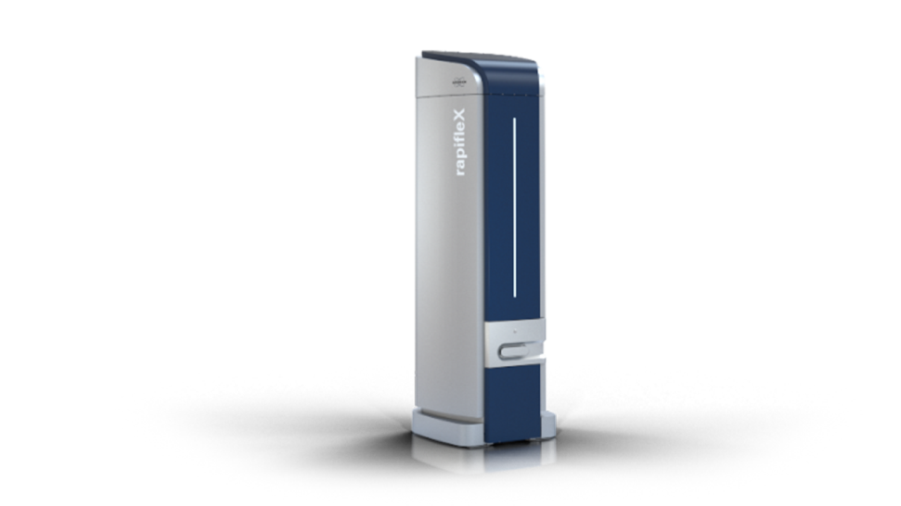
MALDI-TOF-MS

Slide 17
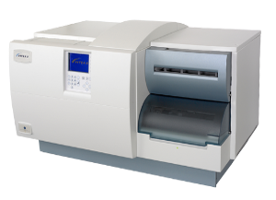
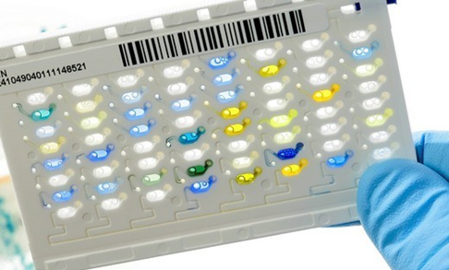
  Automated sensitivity (e.g. VITEK2 Automated system)
The VITEK 2 is an automated system used for identification and antimicrobial susceptibility testing (AST) of bacteria and yeast.

Slide 18
It uses colorimetric reagent card containing 64 wells; each well contains an individual test substrate . Separate cards are available for gram-negative, gram-positive bacteria fastidious bacteria and yeasts.
Substrates in the well measure various metabolic activities such as acidification, alkalinization, enzyme hydrolysis, etc. which helps in identification of the organism. AST work on the principle of microbroth dilution. And determines MIC .
The result of identification is usually available within 4-6 hours and AST within 16-18 hours.

Slide 19
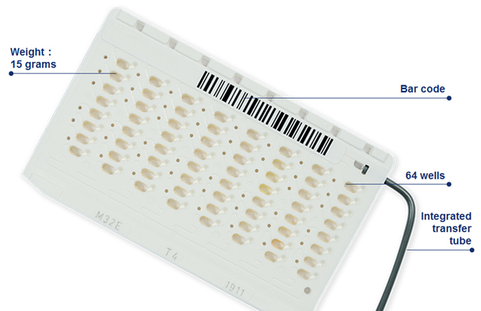
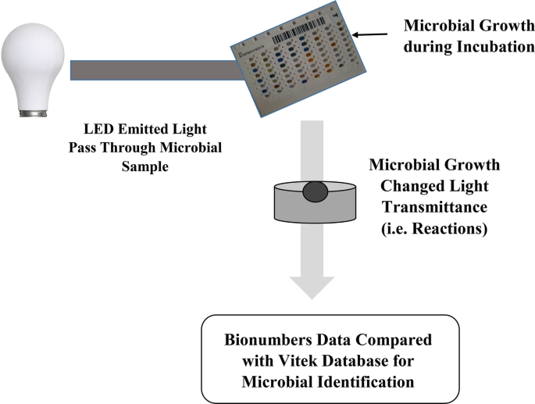
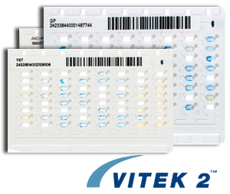

Slide 20
Molecular tests useful in antimicrobial stewardship
Antibiotic Resistance Gene Detection:
PCR-Based Tests: Polymerase Chain Reaction (PCR) assays can identify specific antibiotic resistance genes within bacterial genomes. This helps in selecting appropriate antibiotics by determining whether a pathogen carries resistance genes.

Slide 21
Pathogen Identification:
PCR and Multiplex PCR: These techniques can rapidly identify the causative agents of infections, enabling targeted therapy.
Next-Generation Sequencing (NGS): NGS can identify multiple pathogens and their resistance profiles in a single test, aiding in tailored treatment.

Slide 22
Minimum Inhibitory Concentration (MIC) Determination:
  E-Tests: These are plastic strips with predefined antibiotic gradients placed on agar plates with bacterial isolates. They help determine the MIC, which is useful in selecting the most effective antibiotic dose.
Viral Load Monitoring:
  PCR-based assays: For viral infections like HIV and hepatitis, monitoring viral load helps determine treatment efficacy and the need for adjustment.

Slide 23
Point-of-Care Testing (POCT):
  Rapid Molecular Tests: Some POCT devices use molecular techniques like PCR to detect specific pathogens or resistance markers, providing quick results at the bedside or in outpatient settings.
Pharmacogenetic Testing:
  Pharmacogenetic Tests: These tests assess a patient's genetic makeup to predict how they will metabolize certain antibiotics. This information can guide dosing decisions and prevent adverse drug reactions.

Slide 24
Urinary Tract Infection (UTI) Testing:
  PCR-Based UTI Panels: These panels can quickly identify the pathogens causing UTIs and their antibiotic resistance profiles, allowing for more targeted therapy.
Respiratory Tract Infection Panels:
  Multiplex PCR Panels: These panels can detect various respiratory pathogens, including bacteria and viruses, helping clinicians choose appropriate antimicrobial treatment.

Slide 25
The use of these molecular tests in antimicrobial stewardship programs
Helps healthcare providers to -
Identify infections more quickly and accurately.
Choose the most effective antibiotics, reducing the use of broad-spectrum antibiotics when narrower options are appropriate.
Prevent the unnecessary use of antibiotics, which can contribute to antibiotic resistance.
Tailor treatment to individual patients based on their infection and resistance profiles.

Slide 26
Other supports
Hospital information System (HIS)
Supporting manpower availability

Slide 27
Framing Antimicrobial Policy
Pocket hand book ,Prepared by AMS team
Compliant to the standard national and international antibiotic guidelines and local antibiogram pattern.

Slide 28
Implementing AMS strategies
Two types of strategy are available for implanting AMSP.
  Front end strategies (formulary restriction)
  Back end strategies (prospective audit and feedback)

Slide 29
Proposed formulary restriction
Restricted antimicrobials | Semi restricted antimicrobials | Unrestricted antimicrobials
Pharmacy supply of >1 days requires prior approval by AMS team | Pharmacy supply of >3 days requires prior approval by AMS team | Pharmacy supply does not require AMS team approval.
Colistin Carbapenem Tigecycline | Teicoplanin, Vancomycin, Daptomycin, Linezolid, Third and fourth generation cephalosporins | First & second generation cephalosporins, Cotrimoxazole, Azithromycin, Clarithromycin, Fluoroquinolones

Slide 30
Back end strategies (prospective audit and feedback)
Difficult to perform, but it is the most effective strategy to implement AMSP.
The AMS team goes for stewardship round during which they discuss with the clinical team in detail about the compliance to the antimicrobial policy.
Mutually agreed upon constructive discussion between AMS team and clinical team.

Slide 31
More labor-intensive.
More widely practiced
More easily accepted by clinicians
Provides a higher opportunity for educating and training the health care professionals
Impact is delayed but sustainable

Slide 32
Education and Training
Continuous education, training, motivation and assessment of the health care providers.

Slide 33
MONITORING THE COMPLIANCE TO
ANTIMICROBIAL STEWARDSHIP PROGRAM
Policy adherence (process indicator)
  Indicators of prescription and administrative compliance
Antibiotic Usage outcome indicator
  DDDs (Daily Defined Dose) /100 bed days
  Days of Therapy/100 bed days
Antimicrobial resistance outcome indicator- analysed by AMR surveillance
Clinical outcome indicators - Morbidity and Mortality
Financial outcome indicators

Slide 34
Indicators of prescription compliance
Percentage of time the empirical antibiotic given, is according to the infective syndrome suspected.
Percentage of time the empirical antibiotic is modified to according to antimicrobial susceptibility report.
Percentage of time cultures are taken before the start of antibiotics.
Percentage of time the choice of SAP given is according to the policy.

Slide 35
Indicators of administrative compliance
Percentage of time the antibiotic is administrated in correct dose, correct frequency, correct route (IV, oral or infusion)
Percentage of time the surgical antimicrobial prophylaxis is administrated in correct dose, correct time and frequency

Slide 36
Calculation of DDDs (Daily Defined Doses)
WHO defined DDD of the antimicrobial agent
No. of DDDs = Therapeutic dose (No. of tablets/vials used * gm per tablet/vials)
Example
Levofloxacin is administered as 750 mg PO daily for 7 days. The WHO assigned DDD for levofloxacin is 0.5 g.
Therefore the number of DDD is calculated as:
= (0.75 g dose × 7 days/0.5 g DDD) = 10.5 DDDs

Slide 37
Days of Therapy (DOT)
DOT of an antibiotic is the number of days that patient receives at least one dose of that antibiotic.
Examples include:
-A patient has received meropenem 1 g, twice daily for 3 days; the DOT is 3
-A patient has received meropenem 0.5 g, thrice daily for 3 days; the DOT is 3
-A patient has received meropenem 1 g, twice daily and vancomycin 1g thrice daily for 3 days;
the DOT is 3+3=6

Slide 38
RATIONAL USE OF ANTIMICROBIAL AGENTS
Prescribe Only when Indicated
  Conditions where antibiotics are not required – Diarrhea, URTI, when alternative diagnosis like dengue or chikungunya is suspected, as routine antibiotic prophylaxis
Culture of Cultures
  Antibiotics should be initiated only after sending site-specific cultures

Slide 39
RATIONAL USE OF ANTIMICROBIAL AGENTS
Empirical vs Targeted Therapy
  Empirical therapy – should be based on three important elements.
    Infective syndrome likely to be present
    Common etiological bacterial agents for that infective syndrome
    Local antibiogram for those organisms, indicating the AMR pattern.
  Targeted or pathogen-directed therapy: Empirical therapy should be modified subsequently, based on AST report.

Slide 40
MIC-guided Therapy
AST - performed by DD or by MIC - latter more accurate and reliable.
Certain situations - antibiotic treatment is MIC-guided.
  Clinical conditions - endocarditis, pneumococcal meningitis/pneumonia
  Vancomycin for S. aureus: Vancomycin – avoided if MIC is >1 μg/mL.

Slide 41
MIC helps to select the most appropriate antibiotic:
  Lower - MIC, better - therapeutic efficacy.
  If >1 antimicrobial agents – susceptible - antibiotic having lowest MIC (when compared with the susceptibility breakpoint) - chosen for therapy.
  Better guided by calculating the therapeutic index.
Therapeutic drug monitoring - necessary to find out how the drug behaves in vivo - important for antibiotic - vancomycin, amikacin and colistin.

Slide 42
HOSPITAL ANTIBIOGRAM
A hospital antibiogram is a valuable tool in the field of healthcare and medicine. It is a document or database that provides information about the susceptibility of bacteria and other pathogens to various antibiotics. The primary uses of a hospital antibiogram include:

Slide 43
Antibiotic Selection: Doctors and healthcare providers use antibiograms to guide them in selecting the most appropriate antibiotic treatment for patients with bacterial infections. By knowing which antibiotics are effective against specific pathogens, they can make more informed treatment decisions, helping to improve patient outcomes.

Slide 44
2. Empirical Therapy: In some cases, healthcare providers need to initiate antibiotic treatment before they have the results of a specific pathogen's susceptibility testing. Antibiograms can help guide these empirical therapy choices by indicating which antibiotics are likely to be effective against the prevalent bacteria in the hospital or community.

Slide 45
3. Resistance Monitoring: Hospitals can use antibiograms to track patterns of antibiotic resistance among the pathogens they encounter. This information is crucial for infection control and for identifying emerging resistance trends that may require changes in antibiotic prescribing practices.

Slide 46
4. Quality Improvement: Hospitals can use antibiograms as a quality improvement tool. By regularly analyzing data on antibiotic resistance and susceptibility, healthcare institutions can identify areas for improvement in infection control practices and antibiotic stewardship programs.

Slide 47
5. Guiding Antibiotic Stewardship: Antibiograms are an essential component of antibiotic stewardship programs, which aim to promote the responsible use of antibiotics. These programs help reduce antibiotic overuse and misuse, which can contribute to the development of antibiotic resistance.

Slide 48
6. Tailored Treatment Plans: In cases where patients have recurrent or chronic infections, knowledge of antibiotic susceptibility patterns can help tailor treatment plans to maximize effectiveness while minimizing the risk of resistance development.

Slide 49
7. Public Health Surveillance: Aggregated antibiogram data can be shared with public health agencies to monitor antibiotic resistance trends at a regional or national level. This information can inform public health policies and strategies for combating antibiotic resistance.

Slide 50
8. Education and Training: Antibiograms can be valuable educational tools for healthcare professionals, helping them stay up-to-date on local resistance patterns and best practices for antibiotic use.

Slide 51
9. Research: Researchers in the fields of microbiology, infectious diseases, and epidemiology can use antibiogram data to study antibiotic resistance trends, identify novel resistance mechanisms, and develop new antibiotics.

Slide 52
Hospital antibiogram of gram-negative bacteria for the year 2022, expressed in terms of susceptibility rate
 | Ciprofloxacin | Amikacin | Ceftazidime | Piperacillin- tazobactam | Meropenem | Colistin
E. coli | 25 | 85 | 55 | 75 | 82 | 99
Klebsiella | 15 | 75 | 35 | 65 | 70 | 85
Pseudomonas | 32 | 80 | 60 | 80 | 80 | 99
Acinetobacter | 29 | 70 | 10 | 18 | 20 | 99

Slide 53
Therapeutic Drug Monitoring (TDM)
Therapeutic drug monitoring (TDM) is a medical practice that involves measuring the concentration of specific drugs in a patient's blood to ensure that they are within the therapeutic range – the range of drug concentrations that provides the desired therapeutic effect while minimizing the risk of adverse effects.
TDM is commonly used for medications that have a narrow therapeutic window, meaning that there is a small margin between the minimum effective dose and the dose that could be toxic.

Slide 54
Objective: The primary goal of TDM is to personalize medication dosages for individual patients. It ensures that each patient receives the right amount of a drug to achieve the desired therapeutic outcome.

Slide 55
Optimizing Drug Dosages: TDM helps healthcare providers tailor drug dosages to the individual patient's needs. By measuring drug levels in the blood, doctors can adjust doses to ensure that patients receive the right amount of medication for their specific physiology and condition.

Slide 56
Preventing Toxicity: For drugs with a narrow therapeutic window, TDM helps prevent drug toxicity. By monitoring drug concentrations, healthcare providers can identify and address situations where drug levels become too high, potentially causing harm.

Slide 57
Individualized Treatment: TDM allows for individualized treatment plans, taking into account factors like metabolism, drug interactions, and variations in drug absorption among patients.

Slide 58
Antiepileptic Drugs: TDM is frequently used for antiepileptic medications because maintaining consistent drug levels is crucial for controlling seizures.
Antibiotics: TDM is also used for certain antibiotics, especially in cases of severe infections or when a patient isn't responding to standard dosages.

Slide 59
Immunosuppressants: In transplant medicine, TDM is essential for medications that suppress the immune system to prevent organ rejection. It helps ensure the patient receives enough immunosuppression to prevent rejection but not so much that it leads to infections or other adverse effects.

Slide 60
Psychiatric Medications: Some psychiatric medications, like lithium for bipolar disorder, require TDM to maintain safe and effective blood levels.
Monitoring Compliance: TDM can be used to check if a patient is taking their medication as prescribed. Consistently low drug levels may indicate non-compliance.
Research and Clinical Trials: TDM can be valuable in clinical research and drug development to assess drug pharmacokinetics and pharmacodynamics.

Slide 61
Golden Rules of Antimicrobial Prescribing (MINDME)
M Microbiology guides therapy, where ever possible
I Indications should be evidence based
N Narrowest spectrum of antibiotics required
D Dosage appropriate to the site & type of Infection
M Minimise duration of therapy
E Ensure Monotherapy in most cases

Slide 62


Slide 63
Methods for TDM
Therapeutic Drug Monitoring (TDM) involves specific methods and procedures to measure drug concentrations in a patient's biological fluids (usually blood) accurately. The exact method and procedure can vary depending on the drug being monitored and the laboratory's capabilities, but here is a general overview of the steps involved in TDM:

Slide 64
Sample Collection:
Selection of Biological Fluid: The choice of biological fluid (typically blood, but sometimes urine or saliva) depends on the drug and its pharmacokinetics.
Timing: The timing of sample collection relative to drug administration is critical and varies by drug. Samples may be collected just before the next dose (trough level), at a specific time after dosing (peak level), or at other specified intervals.

Slide 65
  Anticoagulants: Blood samples are typically collected in tubes containing anticoagulants to prevent clotting.
Sample Preparation:
  Centrifugation: After collection, the blood samples may be centrifuged to separate the plasma or serum from the cellular components.

Slide 66
Assay Selection:
Immunoassays: Many drugs are measured using immunoassays, which rely on antibodies that specifically bind to the drug or its metabolites.
Chromatographic Techniques: High-performance liquid chromatography (HPLC) and liquid chromatography-mass spectrometry (LC-MS) are commonly used for more complex drugs with smaller therapeutic windows.
Radioimmunoassay (RIA): Although less common today, some drugs may be measured using RIA.

Slide 67
Calibration and Quality Control:
  The assay equipment must be regularly calibrated using known standards of the drug to ensure accurate measurements.
  Quality control samples are tested to verify the precision and accuracy of the assay.
Sample Analysis:
  The collected samples are analyzed using the selected assay method.

Slide 68
Data Interpretation:
The measured drug concentration is compared to established reference ranges or therapeutic targets to assess if the drug level is within the desired therapeutic range.
The healthcare provider interprets the results in the context of the patient's clinical condition.

Slide 69
Clinical Decision-Making:
  Based on the TDM results, healthcare providers make decisions about whether to adjust the drug dosage. They may increase the dose if the drug concentration is too low or reduce it if it's too high.
Documentation and Reporting:
  Results are documented in the patient's medical records, and a report is typically generated and sent to the healthcare provider for review and action.

Slide 70
Follow-Up Monitoring:
  In cases where dosage adjustments are made, follow-up TDM may be necessary to ensure that the new dosage achieves the desired therapeutic level.
Patient Education:
  Patients may be educated about the importance of adhering to their medication regimen and the potential need for periodic TDM.

Slide 71
Communication:
Effective communication between the laboratory, healthcare provider, and patient is essential to ensure the appropriate use of TDM results in clinical practice.

Slide 72
RATIONAL USE OF ANTIMICROBIAL AGENTS
Therapeutic Drug Monitoring
Therapeutic efficacy - not only relies on in vitro susceptibility result (MIC), but also dependent on in vivo activity - in turn dependent on PK/PD parameters of the antimicrobial agent.

Slide 73
RATIONAL USE OF ANTIMICROBIAL AGENTS
Depending up on PK/PD parameters, antibiotics are classified as:
  Concentration dependent antibiotics, e.g. aminoglycosides (better if the drug concentration in serum is much higher than the MIC of the drug)
  Time-dependent antibiotics, e.g. beta-lactams: Efficacy of the drug is dependent upon how much time the drug concentration remains higher than the MIC. Given in frequent intervals (e.g. thrice daily)

Slide 74
RATIONAL USE OF ANTIMICROBIAL AGENTS (Cont..)
Timely Stoppage of Antimicrobial- stopped at appropriate time - determined by clinical improvement or after obtaining negative culture or by use of biomarkers.

Slide 75
RATIONAL USE OF ANTIMICROBIAL AGENTS (Cont..)
Biomarkers - procalcitonin (PCT) or C-reactive protein (CRP) - used for predicting bacterial infection.
PCT is more reliable marker than CRP.

Slide 76
Procalcitonin (PCT)
Peptide precursor of the hormone calcitonin, secreted at very low level (<0.05 ng/mL) normally by the body, but the level goes up by manifolds in bacterial infection.

Slide 77
Applications of PCT
Differentiate bacterial vs viral infection
Predicting bacterial infections such as local or systemic infection
  0.05–2.0 ng/mL indicates possible local infection
  2-10 ng/mL indicates systemic infection
  >10 ng/mL indicates septic shock
Helps to decide whether to continue antibiotics in culture negative cases and to stop antibiotics
Severity

Slide 78
RATIONAL USE OF ANTIMICROBIAL AGENTS (Cont..)
Avoid overlapping spectra
  Meropenem and piptaz combination therapy for double GN coverage - avoided as both these drugs belong to beta-lactam group of antimicrobials

Slide 79
RATIONAL USE OF ANTIMICROBIAL AGENTS (Cont..)
Redundant antibiotic
  Meropenem and metronidazole combination therapy for suspected GN/ anaerobic sepsis - avoided as meropenem is active against anaerobes in addition to gram-negative bacteria.
  Metronidazole can be withdrawn from therapy

Slide 80
RATIONAL USE OF ANTIMICROBIAL AGENTS (Cont..)
Ineffective antibiotic: Cloxacillin in MRSA is ineffective and therefore should be avoided. Vancomycin is the drug of choice for MRSA
Inferior antibiotic: Vancomycin is an inferior cell wall acting agent compared to cloxacillin for MSSA infection.

Slide 81
HOSPITAL ANTIBIOGRAM

Slide 82
Principles of Empirical Antimicrobial Therapy
Specific steps of required when considering antimicrobial therapy for patients, that are
Etiologic Diagnosis:- Based on the organ system involved, the organism causing infection can often be predicted.
Bast Guess basis:- Select an empiric regimen that is likely to be effective against the suspected pathogens.
Laboratory Control:- Specimens for laboratory examination should be obtained before institution of therapy to determine antibiotics suscibility.

Slide 83
Principles of Empirical Antimicrobial Therapy
4. Clinical Response:- Based on clinical response & other data, the laboratory reports are evaluated & then the desirability of changing the regimen is considered.
5. Drug susceptibility tests:- Some organisms are predictably inhibited by the certain drugs; if such organisms are isolated, they need not to be tested for drug susceptibility for e.g. all group a hemolytic streptococci are inhibited by penicillin. Enteric gram negative rods are variable susceptible & generally require A.S.T., whenever they are isolated.

Slide 84
Principles of Empirical Antimicrobial Therapy
When there is marked discrepancies between A.S.T. & clinical response, the following possibility must be considered.
Selection of an inappropriate drug, drug dosage or route of administration
Failure to drain a collection of pus or to remove a foreign body.
Superinfection in the course of prolonged antibiotic therapy.
Failure of a poorly diffusing drug to reach the site of infection e.g. CNS or to reach intracellular phagocytosed bacteria.
Emergence of drugs resistance in the original pathogenic or superinfection with a new more resistant organism.

Slide 85
Principles of Empirical Antimicrobial Therapy
Participation of two or more microorganisms in the infectious process, of which only one was originally detected & used for drug selection.
Inadequate host defenses, including immunodeficencies & diabetes mellitus
Non-infectious causes, including drug fever, malignanly & auto immune diseases.
6. Promptness of response:- Depends on
Immune status of patients.
Site of infection :- Deep seated infections such as osteomylitis & endocardis responded more slowly than superficial infections such as cellulitis etc.
Virulence of pathogen:- Virulent organism such as step. Aureus responds for slowly than viridans streptococci. Mycobacterial & fungal infections responds shower than bacterial infection.
Duration of illness:- In a general longer the symptoms are present, the longer it takes to respond.

Slide 86
Principles of Empirical Antimicrobial Therapy
7. Duration of antimicrobial therapy:- Variable period of treatment may be required for cure for various diseases.
8. Adverse drug reactions & toxicity:- They include hypersitivity reaction, direct toxicity of drug and superinfection by drug resistance microorganism.
9. Route of drug administration:- I.V. therapy is preferred in acutely ill patients with serious infections such as Endocarditis, menigitis, sepsis, severe pneumonia
10. Cost of Antibiotics:- Is very important while considering drug administration specially for poor patients.

Slide 87
Few Examples of Empirical Therapy
Site of Infection | Likely Organisms | Empirical Tx.
Meningitis | S. pneumoniae, N. meningitidis, H. influenzae | Cefotaxime 2g 4hourly (+/- Vancomycin) + rifampicin 600mg bd po/iv
Endocarditis (native valve) | Streptococci, S. aureus,(MSSA) Enterococci | Benzylpenicillin 2.4G 4 hourly I/v+ Flucloxacillin 2g 4 hourly I/v+ I/v Gentamicin1mg/kg tds I.v
Abdominal Sepsis | GNBs, Anaerobes, enterococci | Amoxicillin-clavulanate + ciprofloxacin +metronidazole( all I/v)

Slide 88
Few Examples of Empirical Therapy
Site of Infection | Likely Organisms | Empirical Tx.
Community Acquired Infection | S. pneumoniae, H. influenzae, consider atypicals | Amoxicillin-clavulanate +/-Clarithromycin(I/v or po)
Cellulitis | Group A Streptococcus S. Aureus | Benzylpenicillin I/v + Flucloxacillin I/v
Osteomyelitis | S. Aureus(MSSA) | Flucloxacillin I/v + Fusidic acid p/o
Simple cystitis (no catheter) | E. coli, other GNB, coag neg staph | Trimethoprim or Nitrofurantoin

Slide 89
RATIONAL USE OF ANTIMICROBIAL AGENTS
Empirical vs Targeted Therapy
  Empirical therapy – should be based on three important elements.
    Infective syndrome likely to be present
    Common etiological bacterial agents for that infective syndrome
    Local antibiogram for those organisms, indicating the AMR pattern.
  Targeted or pathogen-directed therapy: Empirical therapy should be modified subsequently, based on AST report (escalation or de-escalation)

