Slide 1
VIRAL HAEMORRHAGIC FEVER-II
Dr. Priyanka Chaturvedi
Assistant professor
Deptt. Of Microbiology

Slide 2
Laboratory diagnosis of Dengue
NS1 Antigen Detection
ELISA and ICT
Becomes detectable from day 1 of fever and remains positive up to 18 days

Slide 3
Laboratory diagnosis of Dengue
Antibody Detection
In primary infection: IgM appears first. IgG is detectable at 14–21 days of illness, and then it slowly increases.
In secondary infection: IgG antibody titers rise rapidly.
In past infection: Low levels of IgG remain detectable for over 60 years and in the absence of symptoms, is a useful indicator of past infection

Slide 4
Laboratory diagnosis of Dengue
Antibody Detection
MAC-ELISA (IgM antibody capture ELISA)
RDT for dengue IgM antibodies or NS1 antigen has poor sensitivity and specificity. Government of India had passed an order in 2016, that a positive RDT for dengue NS1 or IgM should be considered as probable diagnosis; must be confirmed by ELISA.

Slide 5
Laboratory diagnosis of Dengue
Virus Isolation - mosquito cell line .
Molecular Method
  Real time RT-PCR
  Genotype detection

Slide 6
Dengue vaccine (CYD-TDV)
Chimeric Yellow Fever-Dengue, Live-Attenuated, Tetravalent Dengue Vaccine (CYD-TDV); commercially available as DENGVAXIA.
Schedule: 3 injections of 0.5 mL administered subcutaneously at 6 month intervals

Slide 7
CHIKUNGUNYA
Re-emerging disease characterized by acute fever with severe arthralgia.
Enveloped virus, containing ssRNA.

Slide 8
History
The name is derived from the word “kungunyala” meaning “that which bends up or gets folded” - stooped posture which develops as a result of the severe joint pain - occurs during the course of illness.

Slide 9
Transmission
Human Transmission occurs by: Aedes aegypti
Transmission cycle: Urban cycle (between human and Aedes aegypti) and Jungle cycle (between monkeys and Aedes).

Slide 10
Clinical Manifestations
Incubation period is about 5 days (3–7 days).
Acute stage:
  Arthritis - polyarticular, migratory and edematous (joint swelling), predominantly affecting the small joints of wrists and ankles
  Rashes
  Chik sign (also called brownie nose appearance)

Slide 11
Clinical Manifestations
Chronic stage (10–15%):
  Most patients recover within a week.
  High-risk group: Newborns, older adults (≥65 years), and persons with underlying hypertension, diabetes, or heart disease.

Slide 12
Manifestations of chikungunya and dengue
Features | Chikungunya | Dengue
Fever (onset, duration) | Acute, 2–4 days | Gradual, 5–7 days
Polyarthritis | Frequent, May last longer (>1 month) | Less common Short duration
Tenosynovitis | Common | None
Rashes appear on | Day 1–4, maculopapular | Day 3–7, Petechiae or maculopapular
Myalgia | Possible | Common
Thrombocytopenia | Infrequent | Common

Slide 13
Laboratory Diagnosis
Viral isolation - mosquito cell lines
Serum antibody detection – MAC ELISA
Molecular method
Hematological finding - leukopenia with lymphocyte predominance, elevated ESR and C-reactive protein

Slide 14
KYASANUR FOREST DISEASE
Was identified in 1957 from monkeys from the Kyasanur Forest in a district of Karnataka, India.
Enveloped virus, containing ssRNA.

Slide 15
Epidemiology
Vector: Hard ticks
Hosts: Monkeys, rodents and squirrels
Monkeys are the amplifier hosts, where the virus multiplies exponentially

Slide 16
Clinical Manifestation in Humans
Incubation period varies from 3–8 days
  First stage - hemorrhagic fever
  Second stage - meningoencephalitis

Slide 17
Laboratory Diagnosis
Virus isolation from blood
IgM antibody detection by ELISA.
Nested RT-PCR and real time RT-PCR

Slide 18
Treatment of KFD
Only by supportive measures.
No specific antiviral drugs are available.

Slide 19
FILOVIRUS INFECTIONS
Family Filoviridae contains two antigenically distinct genera - Ebolavirus and Marburg virus

Slide 20
FILOVIRUS INFECTIONS
Morphology - Pleomorphic, long filamentous threads, ranging from 80–1000 nm, the average size being 665 nm (Marburg) to 805 nm (Ebola)
Highly fatal: Marburg and Ebola viruses have the highest mortality rates (25–90%).

Slide 21
Geographical Distribution
India: There is no confirmed case documented yet.

Slide 22
West African Epidemic (2014–16)
The largest outbreak occurred in 2014 - 16; reported 28,616 cases with 11,310 deaths (40% mortality).

Slide 23
Reservoir
Unknown, but are suspected to be infected animals - fruit bat or primates (apes and monkeys).

Slide 24
Clinical Manifestations
Incubation period is about 2–12 days
Common symptoms - fever, headache, muscle pain and sore throat
Diffuse erythematous maculopapular rash, petechiae, ecchymosis/bruising, often leading to shock and death.

Slide 25
Transmission
In every outbreak, Ebola virus is introduced to human population through close contact
  Human-to-human transmission – direct contact
  Health-care workers and close contacts/family members of infected individuals

Slide 26
Laboratory Diagnosis of Ebola virus disease
Serum antibody detection
Serum antigen is detected by capture ELISA
Molecular methods such as RT-PCR
Electron microscopy
Virus isolation in Vero cell line

Slide 27
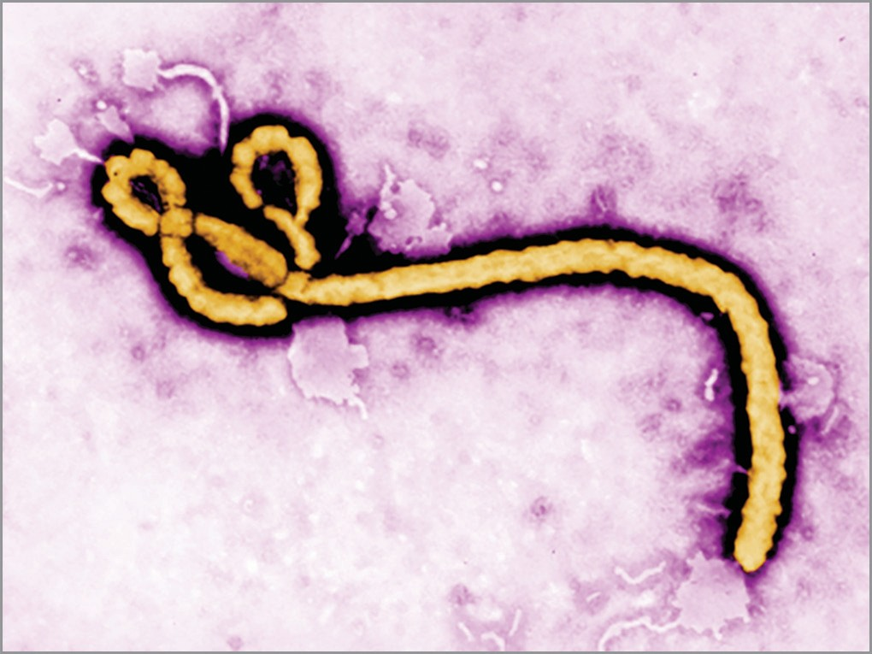
Filamentous shaped (Electron micrograph)

Slide 28
Treatment of Ebola virus disease
Supportive care - rehydration and symptomatic treatment improves survival.
No proven treatment or vaccine is available yet.

Slide 29
Prevention (General Measures)
Practice proper infection control and sterilization measures such as strict hand hygiene and personal protective equipment (PPE such as coverall and N95 mask)
Isolate patients with Ebola from other patients
Avoid direct or indirect contact (clothes, bedding, needles) with blood or body fluids or other secretions of suspected Ebola cases

Slide 30
Marburg Virus Disease
First reported in Germany and Yugoslavia (1967) among laboratory workers exposed to tissues of African green monkeys imported from Africa.
Since then, over 450 cases have been reported in various African countries.

Slide 31
RODENT BORNE VIRUS INFECTIONS
Rodent-borne viruses or roboviruses are transmitted from rodents to man by contact with infected body fluids or excretions.
Major rodent-borne viruses - Hantaviruses and Arenaviruses.

Slide 32
Hantavirus Disease
Morphology: They are spherical, enveloped viruses; contain triple-segmented, negative-sense ssRNA
Clinical manifestations: They cause two categories of manifestations.
  Hemorrhagic fever with renal syndrome (HFRS)
  Hantavirus pulmonary syndrome (HPS)

Slide 33
Hantavirus Disease
Diagnosis is made by detection of viral RNA by RT-PCR
Treatment: There is no specific antiviral therapy for hantaviral diseases. Only supportive symptomatic treatment is given.

Slide 34
THANK YOU!!!

