Slide 1
Intestinal helminthic Infection: Cestodes I
Dr. Priyanka Chaturvedi
Assistant Professor
Department of Microbiology

Slide 2
Difference between Cestodes, Trematodes & Nematodes
Properties | Cestodes | Trematodes | Nematodes
Shape | Tape-like and segmented | Leaf-like and unsegmented | Elongated, cylindrical and unsegmented
Head end | Suckers present, some have attached hooklets | Suckers present No hooklets | No sucker, no hooklets. Some have well developed buccal capsule
Alimentary canal | Absent | Present but incomplete | Complete from mouth to anus
Body cavity | Absent | Absent | Present
Sexes | Monoecious | Monoecious (except schistosomes) | Diecious

Slide 3
Difference between Cestodes, Trematodes & Nematodes
Properties | Cestodes | Trematodes | Nematodes
Life cycle | Require two hosts | Require three hosts | Require one host (except filarial worms—require two hosts)
Larva forms | Most cestodes have one stage larva such as—cysticercus, hydatid cyst, coenurus, cysticercoid | Five larval stages: Cercaria, metacercaria, redia, miracidium and sporocyst | Four larval stages: known in various name such as Rhabditiform larva, filariform larva and microfilaria

Slide 4
Difference between Cestodes, Trematodes & Nematodes
Cestodes | Trematodes | Nematodes*
Intestinal cestodes Diphyllobothrium Taenia solium and T. saginata -­ cause intestinal taeniasis Hymenolepis nana Dipylidium caninum | Blood flukes (Schistosomes) Schistosoma haematobium S. mansoni S. japonicum | Intestinal nematodes Trichuris trichiura Enterobius vermicularis Hookworm: Necatorand Ancylostoma Ascaris lumbricoides Strongyloides
 | Hepatic flukes Fasciola hepatica Clonorchis sinensis Opisthorchis

Slide 5
Difference between Cestodes, Trematodes & Nematodes
Cestodes | Trematodes | Nematodes*
Somatic/tissue cestodes Taenia solium­cause cysticercosis T. multiceps Echinococcus Spirometra | Intestinal flukes Fasciolopsis buski | Filarial nematodes Wuchereria bancrofti Brugia malayi Loa loa Onchocerca Mansonella species Trichinella Dracunculus
 | Lung flukes Paragonimus westermani

Slide 6
INTESTINAL CESTODE INFECTIONS
Cestodes - Long, segmented, flattened dorsoventrally, tape like worms - also called as TAPEWORMS.
Based on habitat, they are classified into two groups:
  1. Intestinal cestodes
  2. Somatic/tissue cestodes

Slide 7
Life cycle of various cestodes
Cestodes | Host |  | Mode of transmission | Infective form | Diagnostic form | Organs affected
 | Definitive | Intermediate
Taenia saginata | Man | Cattle | Ingestion | Cysticercus bovis | Embryonated eggs | GIT
Taenia solium (intestinal taeniasis) | Man | Pig | Ingestion | Cysticercus cellulosae | Embryonated eggs | GIT
Taenia solium (cysticercosis) | Man | Man | Ingestion, autoinfection | Embryonated eggs | Cysticercus larvae | CNS, muscle, eye

Slide 8
MORPHOLOGICAL FORMS: Adult Worm
Adult worm - long, segmented, dorsoventrally flattened; varies in length from few millimeters to several meters.
Inhabits in the intestine of men and animals.
Adult worm consists of three parts
  1. Head or scolex
  2. Neck
  3. Strobila

Slide 9
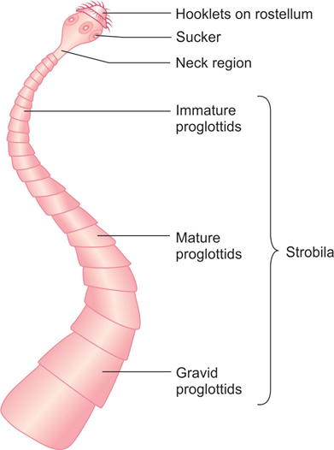
Adult Worm

Slide 10
Eggs
Eggs are formed following fertilization, fill the gravid proglottids and are subsequently released in feces - considered as the diagnostic form.

Slide 11
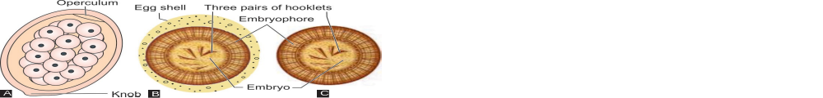
Eggs
Schematic diagrams of eggs ofTaenia

Slide 12
Larva
Embryonated eggs undergo further development to form larvae.
  IN TAENIA, THE LARVAL STAGE - CALLED AS “CYSTICERCUS”

Slide 13
INTESTINAL TAENIASIS
Two important pathogenic species - T. saginata and T. solium.
They cause two types of manifestations in humans:
  Intestinal taeniasis—caused by both T. saginata and T. solium
  Cysticercosis—caused by only T. solium. - infects various tissues such as CNS, eyes and muscles

Slide 14
Morphology
Taenia exists in three morphological forms.
  1. Adult worm
  2. Eggs
  3. Larvae

Slide 15
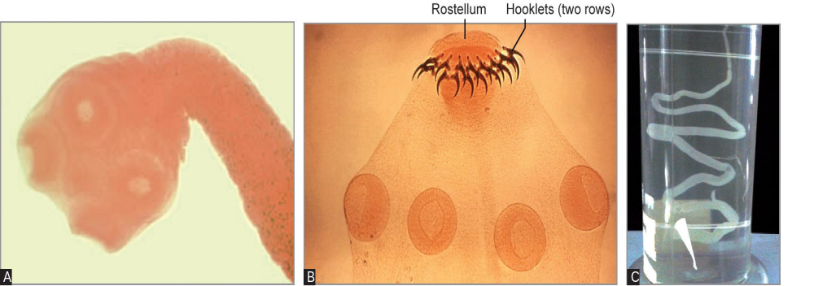
Morphology
Scolex of T. saginata; B. Scolex of T. solium;
C. Adult worm of Taenia species.

Slide 16
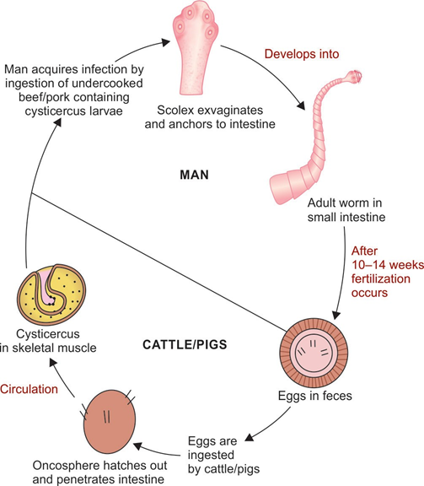
Life Cycle (Intestinal taeniasis)

Slide 17
Epidemiology
T. saginata infection - common in cattle breeding areas of the world.
Areas with the highest prevalence (up to 27%) - Central Asia, Central and East Africa.
T. solium intestinal infection - endemic in Mexico, Central America, South America, Africa, Southeast Asia, India, Philippines, and Southern Europe.

Slide 18
Clinical Manifestations
Majority of cases - asymptomatic; patients may become aware of infection by noticing the passage of proglottids in their feces.
Common symptoms - mild abdominal pain, nausea, loss of appetite and change in the bowel habit
Perianal discomfort or pruritus may be felt (when proglottids are discharged).

Slide 19
Laboratory Diagnosis - Stool Examination
Wet mount - demonstrate the characteristic eggs and less often proglottids of Taenia species.
Multiple stool examination and concentration techniques (formol-ether sedimentation) - to increase the detection rate.

Slide 20

Laboratory Diagnosis - Stool Examination
Egg - round 30–45 μm size and consists of an embryo with six hooklets surrounded by an embryophore.
Eggs are bile-stained; do not float in saturated salt solution

Slide 21
Differences between Taenia saginata and T. solium
Features | Taenia saginata | Taenia solium
Adult worm
Length | 4–6 meters | 2–4 meters
Head/scolex | - Large and quadrangular - Four suckers present - No rostellum, No hooklets | - Small and globular - Four suckers present - Bears rostellum with two rows of hooklets - Hence called as ARMED TAPEWORM

Slide 22
Differences between Taenia saginata and T. solium
Features | Taenia saginata | Taenia solium
Proglottids
No. of proglottids | 1,000–2,000 | 800–1,000
Uterus | Bears in 15–20 lateral branches | Bears in 7–13 lateral branches
Lobes of ovary | Two, no accessory lobe | Three–two lobes with an accessory lobe
Vaginal sphincter | Present | Absent
Expulsion of segments | Expelled singly in the feces | Expelled in chain of 5–6 segments

Slide 23
Differences between Taenia saginata and T. solium
Features | Taenia saginata | Taenia solium
Larva
 | Cysticercus bovis present in cattle’s muscle, but not in man | Cysticercus cellulosae present in pig’s muscle and also in man (muscle, eye and brain)
Egg
 | Acid fast, 30–45 µm size | Non-acid fast, 30–45 µm size

Slide 24
Differences between Taenia saginata and T. solium
Features | Taenia saginata | Taenia solium
Life cycle
Disease | Causes INTESTINAL TAENIASIS | Causes INTESTINAL TAENIASIS AND CYSTICERCOSIS
Host | Definitive host: man Intermediate host: cattle | For intestinal taeniasis— definitive host is man, intermediate host is pig For cysticercosis—man acts both as definitive and intermediate hosts

Slide 25
Differences between Taenia saginata and T. solium
Features | Taenia saginata | Taenia solium
Life cycle
Infective form | Intestinal taeniasis- Larva (cysticercus bovis) | For intestinal taeniasis— larva (Cysticercus cellulosae) For cysticercosis—egg
Diagnostic form | Egg | For intestinal taeniasis— egg For cysticercosis—larva (deposited in tissue)
Mode of transmission | Ingestion of contaminated beef | For intestinal taeniasis— ingestion of contaminated pork For cysticercosis— (i) contaminated food and water and (ii) auto- infection

Slide 26
Laboratory Diagnosis –
Taenia Specific Antigen Detection in Stool
ELISA - to detect Taenia specific antigen (coproantigen) in stool by using polyclonal Taenia antibodies.
-Advantages:
More sensitive than stool examination
Detect Taenia carriers
-Disadvantage:
Cannot differentiate between T. saginata and T. solium.

Slide 27
Laboratory Diagnosis - Molecular Methods
PCR targeting mitochondrial DNA followed by sequencing is available; which can distinguish between Taenia species.

Slide 28
Treatment of Intestinal taeniasis
Praziquantel (drug of choice): Single dose of (10 mg/kg) is highly effective
Niclosamide (2 g) - also effective - not widely available.

Slide 29
Prevention
Adequate cooking of meat
Effective fecal disposal to prevent infection to cattle and pigs.

Slide 30
MCQs

Slide 31
1. The definitive host for Taenia solium is
Pig
Man
Cow
Dog

Slide 32
2. The intermediate host for Taenia solium is
Pig
Man
Cow
Dog

Slide 33
3. The definitive host for Taenia saginata is
Cattles
Man
Pig
Dog

Slide 34
4. The intermediate host for Taenia saginata is
Cattles
Man
Pig
Dog

Slide 35
5. The definitive & intermediate host for Taenia solium (cysticercosis) is:
Man & Pig
Man & Cow
Pig & Man
Man & Man

Slide 36
6. The Infective form in case of cysticercosis
Ingestion of Enryonated Egg
Ingestion of Pork
Ingestion of beef
All of the above

Slide 37
7. The Infective form in case of intestinal taeniasis (Taenia solium):
Ingestion of Enryonated Egg
Ingestion of Pork
Ingestion of beef
All of the above

Slide 38
8. The Infective form in case of intestinal taeniasis (Taenia saginata):
Ingestion of Enryonated Egg
Ingestion of Pork
Ingestion of beef
All of the above

Slide 39
9. Which of the following is not a bile stained Egg:
Ascaris lumbricoides
Taenia solium
Trichuris trichura
Entrobius vermicularis

Slide 40
10. Which of the following are non bile stained Eggs:
Necator americanus
Entrobius vermicularis
Hymenolepis nana
Ancylostoma duodenale
All of the above

Slide 41
Thank you

