Slide 1
SYSTEMIC CANDIDIASIS
Dr. Priyanka Chaturvedi

Slide 2
Morphological classification of fungus
Yeast: Cryptococcus
Yeast like: Candida
Molds: Aspergillus, Mucor, Rhizopus, Rhizomucor
Dimorphic: Penicillium, Histoplasma capsulatum

Slide 3
SYSTEMIC CANDIDIASIS
Candidiasis is the most common fungal disease in humans.
Candida affects the skin, mucosa, various internal organs and blood.
Caused by Candida, a yeast like fungus that produces pseudohyphae.

Slide 4
SYSTEMIC CANDIDIASIS
CANDIDA
Candida albicans
Non-albicans candida
(NAC)

Slide 5
Non-albicans candida (NAC)
Candida tropicalis
Candida auris
Candida parapsilosis
Candida glabrata
Candida krusie
Candida kefyr
Candida dublinensis
Candida gullerimondii
Candida haemulonii

Slide 6
Pathogenesis
It is worldwide in distribution.
Candidiasis accounts for the most common fungal infection in humans, both in HIV and non-HIV infected people.

Slide 7
Predisposing Factors
Physiological state: Extremes of age (infancy, old age), pregnancy
Low immunity: steroid or immunosuppressive drugs, post-transplantation, malignancy, HIV-infected people

Slide 8
Predisposing Factors
Patients on broad spectrum antibiotics
Others: Diabetes mellitus, febrile neutropenia and zinc or iron deficiency

Slide 9
Virulence Factors
Adhesins
Enzymes: Aspartyl proteinases and Serine proteinases – helps in tissue invasion
Toxins: Glycoprotein extracts of Candida cell wall are pyrogenic

Slide 10
Virulence Factors
Pseudohyphae: Presence of pseudohyphae indicates active infection
  Phenotypic switching - Ability to transform between phenotypic forms in the tissue: YEAST AND PSEUDOHYPHAE.

Slide 11
Clinical Manifestations
Invasive candidiasis
Mucosal candidiasis
Cutaneous candidiasis
Allergic candidiasis

Slide 12
Laboratory diagnosis of Candidiasis
Sample collection:
Blood
Sputum
Urine
Endotracheal aspirate
Pus swab

Slide 13
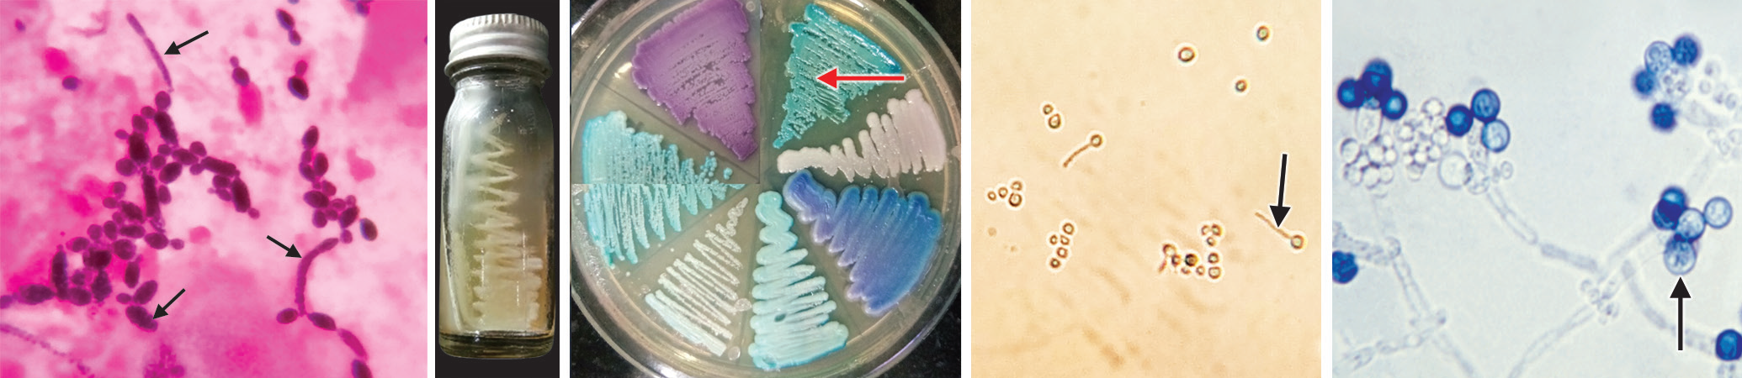
Laboratory diagnosis of Candidiasis
Direct microscopy:
Gram-positive oval budding yeast cells with pseudohyphae

Slide 14
Laboratory diagnosis of Candidiasis
Culture on SDA: Produces creamy white and pasty colonies

Slide 15
Laboratory diagnosis of Candidiasis
Tests for species identification:
Germ tube test (positive for Candida albicans)
Dalmau plate culture for chlamydospore production
Colonies on CHROMagar

Slide 16
Laboratory diagnosis of Candidiasis
Candida albicans shows positive germ tube test

Slide 17
Laboratory diagnosis of Candidiasis
Candida albicans shows thick walled chlamydospores

Slide 18
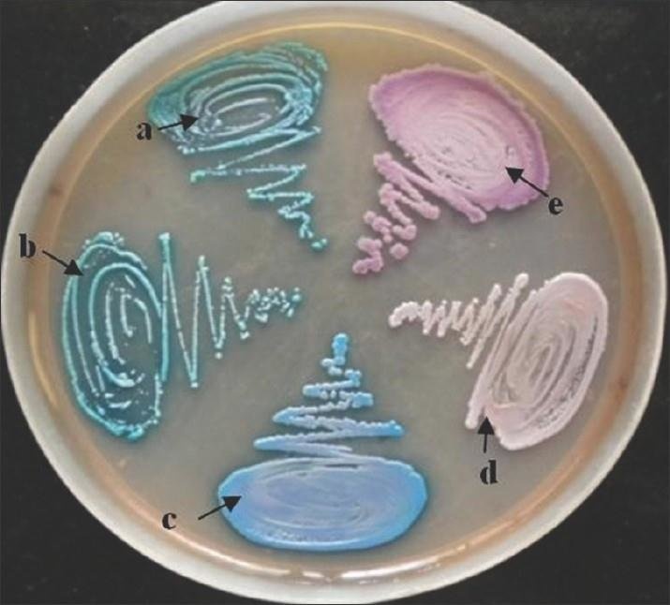
Laboratory diagnosis of Candidiasis
Colonies on CHROMagar
S.no. | CANDIDA SPECIES | COLOUR OF THE COLONY ON HICHROME AGAR
a. | Candida albicans | LIGHT GREEN
b. | Candida dubliniensis | LIGHT GREEN
c. | Candida tropicalis | BLUISH GREEN/ METALLIC BLUE
d. | Candida glabrata | CREAM TO WHITE
e. | Candida krusei | PURPLE FUZZY COLONY

Slide 19
Laboratory diagnosis of Candidiasis
Tests for species identification:
Growth at 45°C (positive for C. albicans)
Carbohydrate assimilation test and carbohydrate fermentation test
Molecular methods such as PCR

Slide 20
Laboratory diagnosis of Candidiasis
Tests for species identification:
Carbohydrate assimilation test and carbohydrate fermentation test
CANDIDA SPECIES | GLUCOSE | MALTOSE | SUCROSE | LACTOSE
Candida albicans | AG | AG | - | -
Candida tropicalis | AG | AG | AG | -
Candida kefyr | AG | AG | AG | -
Candida guilliermondii | AG | - | AG | -
Candida parapsilosis | AG | - | - | -
Candida krusei | AG | - | - | -
Candida glabrata | AG | - | - | -

Slide 21
Laboratory diagnosis of Candidiasis
Immunodiagnosis:
Antibody detection against CELL WALL MANNAN ANTIGEN
Antigen detection such as cell wall mannan and cytoplasmic antigens.

Slide 22
Laboratory diagnosis of Candidiasis
Enzyme detection, e.g. Enolase
Detection of metabolites, e.g. Mannitol and Arabinitol
Β-D-GLUCAN ASSAY: MARKER OF INVASIVE FUNGAL INFECTION.

Slide 23
Treatment of Candidiasis
Cutaneous candidiasis or oral thrush - Topical azole
Esophageal and vulvovaginal candidiasis - oral fluconazole or caspofungin
Disseminated candidiasis – Liposomal Amphotericin B or Caspofungin or voriconazole.

Slide 24
Treatment of Candidiasis
C. glabrata and C. krusei - Intrinsic resistance to azoles and are refractory to treatment with azoles.

Slide 25
Candida auris
Emerging species of Candida, increasingly reported in the recent past.
Manifestations: Cause outbreaks in healthcare settings; produces a wide range of clinical disease from asymptomatic colonization, to candidemia, abscesses, ear infections, etc.

Slide 26
Candida auris
Diagnosis:
Difficult to identify with standard laboratory methods, and it can be misidentified easily as Candida haemulonii
MALDI-TOF are useful for correct identification.

Slide 27
Candida auris
Treatment:
Multidrug resistant candida
Echinocandins are the antifungals given for treatment.

Slide 28
Thank you

