Slide 1
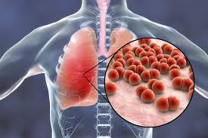
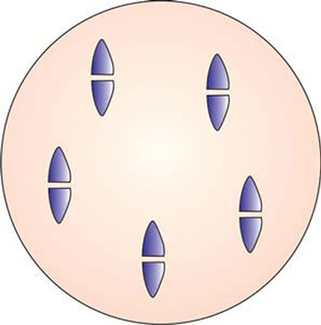
Streptococcus pneumoniae:
Pneumococcal pneumonia
Dr Priyanka Chaturvedi

Slide 2
A 16-months-old boy was admitted with high grade fever, lethargy, productive cough with purulent sputum and shortness of breath. On examination, dull note on percussion and consolidation on auscultation were noted. Sputum and blood specimens were obtained, and sent for bacteriological culture.

Slide 3
On the basis of:
Area of lungs involved, and
Type of cough produced
  Typical (lobar) pneumonia
  Atypical or (interstitial) pneumonia

Slide 4
INTERSTITIAL OR ATYPICAL PNEUMONIA
Occurs in the interstitial space of lungs
Non-productive cough
Caused by bacteria –
Mycoplasma
Chlamydia
Legionella species

Slide 5
LOBAR OR TYPICAL PNEUMONIA
Infection of the lung parenchyma and its alveoli
Characterized by consolidation
Productive cough
Caused by:
  Streptococcus pneumoniae
  Haemophilus influenzae
  Staphylococcus aureus
  Gram-negative bacilli.

Slide 6
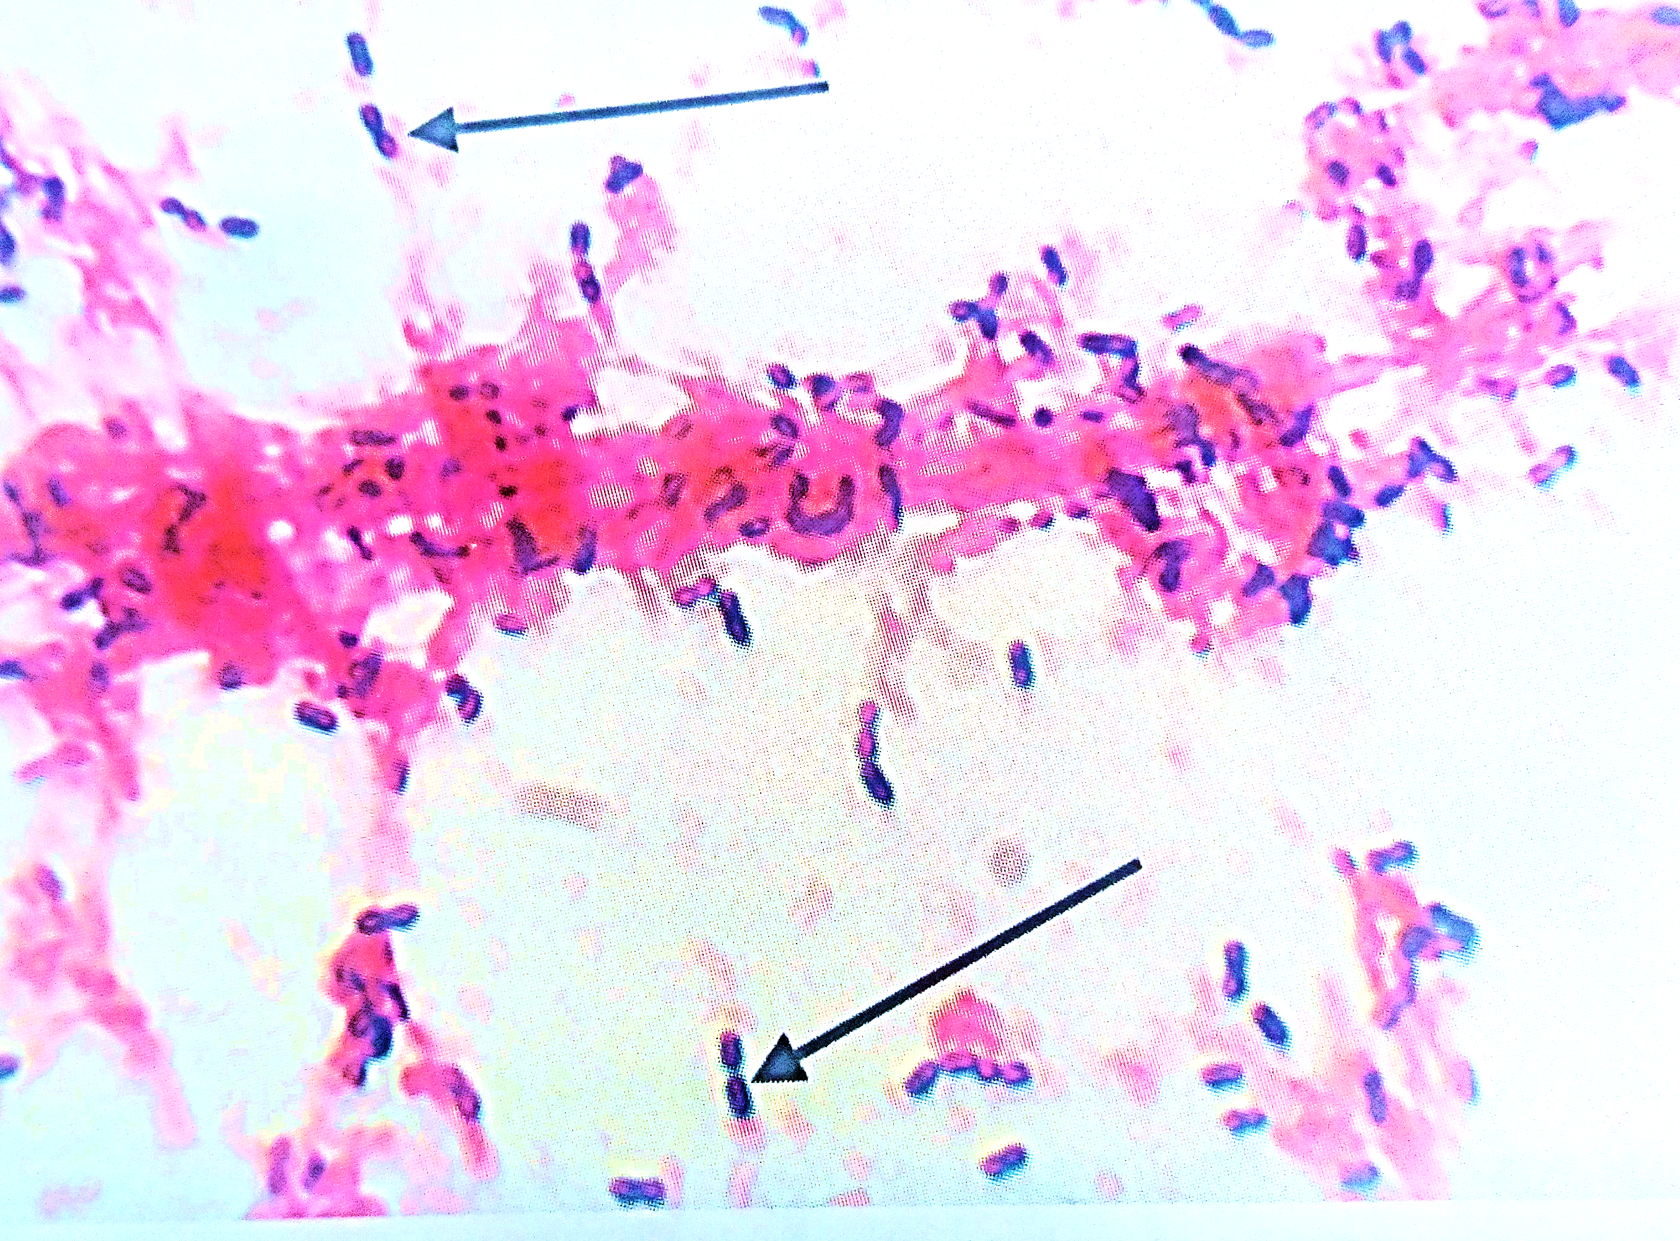
Streptococcus pneumoniae
Gram positive cocci
Flame shaped or lanceolate
Arranged in pairs with broad ends in apposition
Capsulated

Slide 7
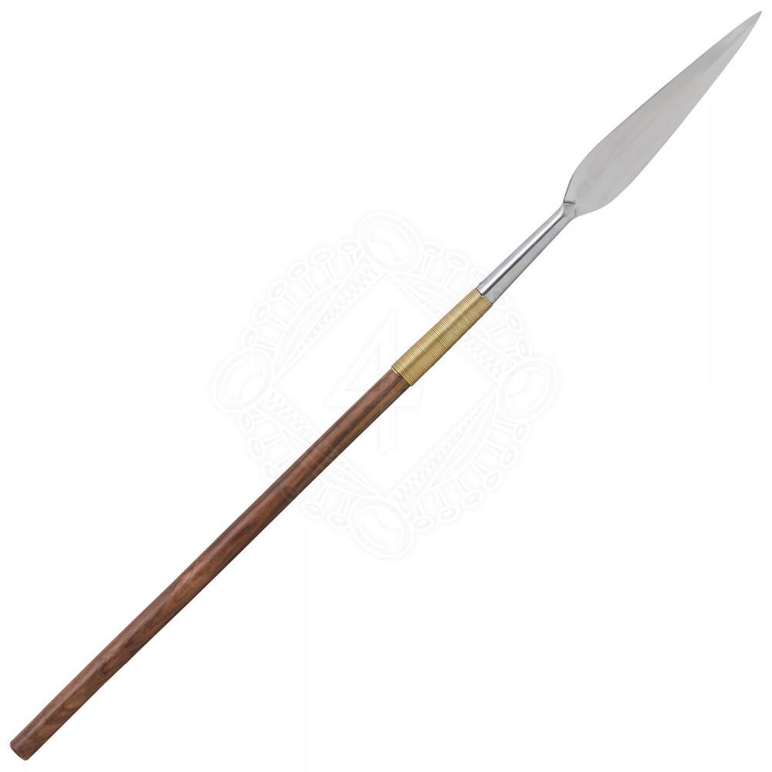
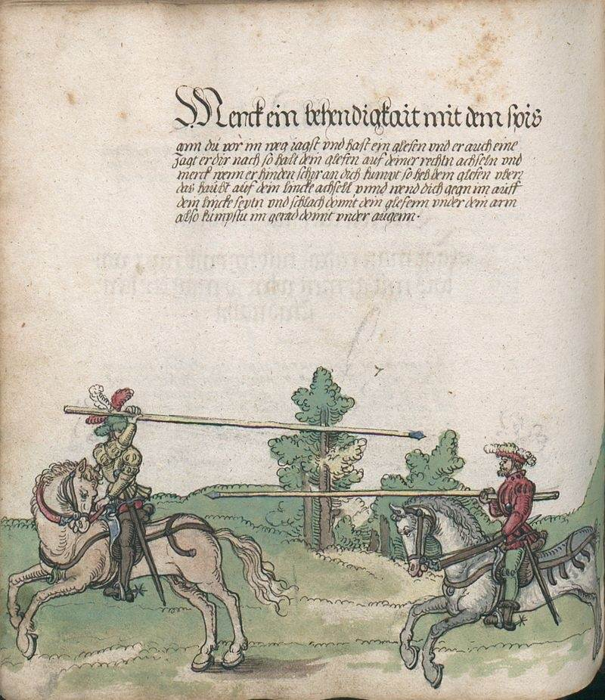
Streptococcus pneumoniae

Slide 8
Streptococcus pneumoniae
FLAME SHAPED OR LANCEOLATE

Slide 9
CHARACTERISTICS | S. PNEUMONIAE | VIRIDANS streptococcus
MORPHOLOGY | Capsulated, lanceolate diplococci | Non capsulated, oval or round cocci in chain
COLONIES ON BLOOD AGAR | Dome shaped with α-hemolytic, later becomes draughtsman colonies | Dome shaped with alpha hemolytic
BILE SOLUBILITY | Positive | Negative
INULIN FERMENTATION | Positive | Negative
OPTOCHIN SENSITIVITY | Positive | Negative
ANIMAL PATHOGENICITY | Pathogenic | Non pathogenic

Slide 10
Virulence factor & Pathogenesis
Capsular polysaccharide:
Principal virulence factor
Anti-phagocytic activity
Serotyping is done on the basis of Capsular polysachharide

Slide 11
Virulence factor & Pathogenesis
C carbohydrate antigen
Pneumolysin:
Membrane damaging toxin
Inhibits neutrophil chemotaxis

Slide 12
Virulence factor & Pathogenesis
Autolysin:
Amidase enzyme
Cleaves the peptidoglycan layer of cell wall
Responsible for characteristic bile solubility & draughtsman appearance of Pneumococcal colonies

Slide 13
Epidemiology
Source: Upper respiratory tract of carriers
Carrier state: Up to 5 years. 90% of children harbour S. Pneumoniae in the nasopharynx
Mode of transmission: Inhalation of contaminated droplet nuclei
Disease only occurs in immunocompromised state

Slide 14
Clinical manifestations
Lobar Pneumonia
Empyema
Invasive pneumococcal disease (IPD)
Blood steam infection
Pyogenic meningitis
Osteomyelitis
Septic arthritis
Endocarditis
Pericarditis
Non-invasive manifestations
Otitis media & sinusitis

Slide 15
Clinical features of pneumococcal pnuemonia
Symptoms:
Fever with chills
Productive cough
Tachypnea
Dyspnea
Signs:
Dull note on percussion
Crackles on Auscultation

Slide 16
Laboratory diagnosis
Sample
Collection & transport
All sample should be collected in sterile container under aseptic condition.
Sputum

Slide 17
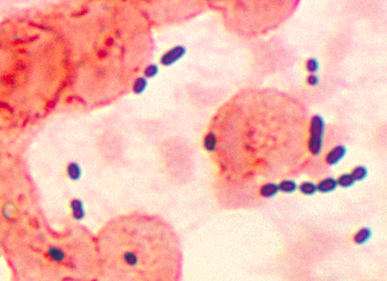
DIRECT MICROSCOPY
Gram stain : Gram positive diplococci

Slide 18
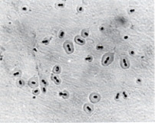
DIRECT MICROSCOPY
Quellung reaction : suspension of Pneumococci is mixed on slide with drop of specific antiserum & methylene blue. In presence of antiserum, capsule is swollen, sharply delineated & refractile under microscope.

Slide 19
CULTURE
Aerobes & facultative anaerobes
Grow in enriched media
Growth is improved by 5-10% of CO₂
Optimum temperature for growth is 37ºC.

Slide 20
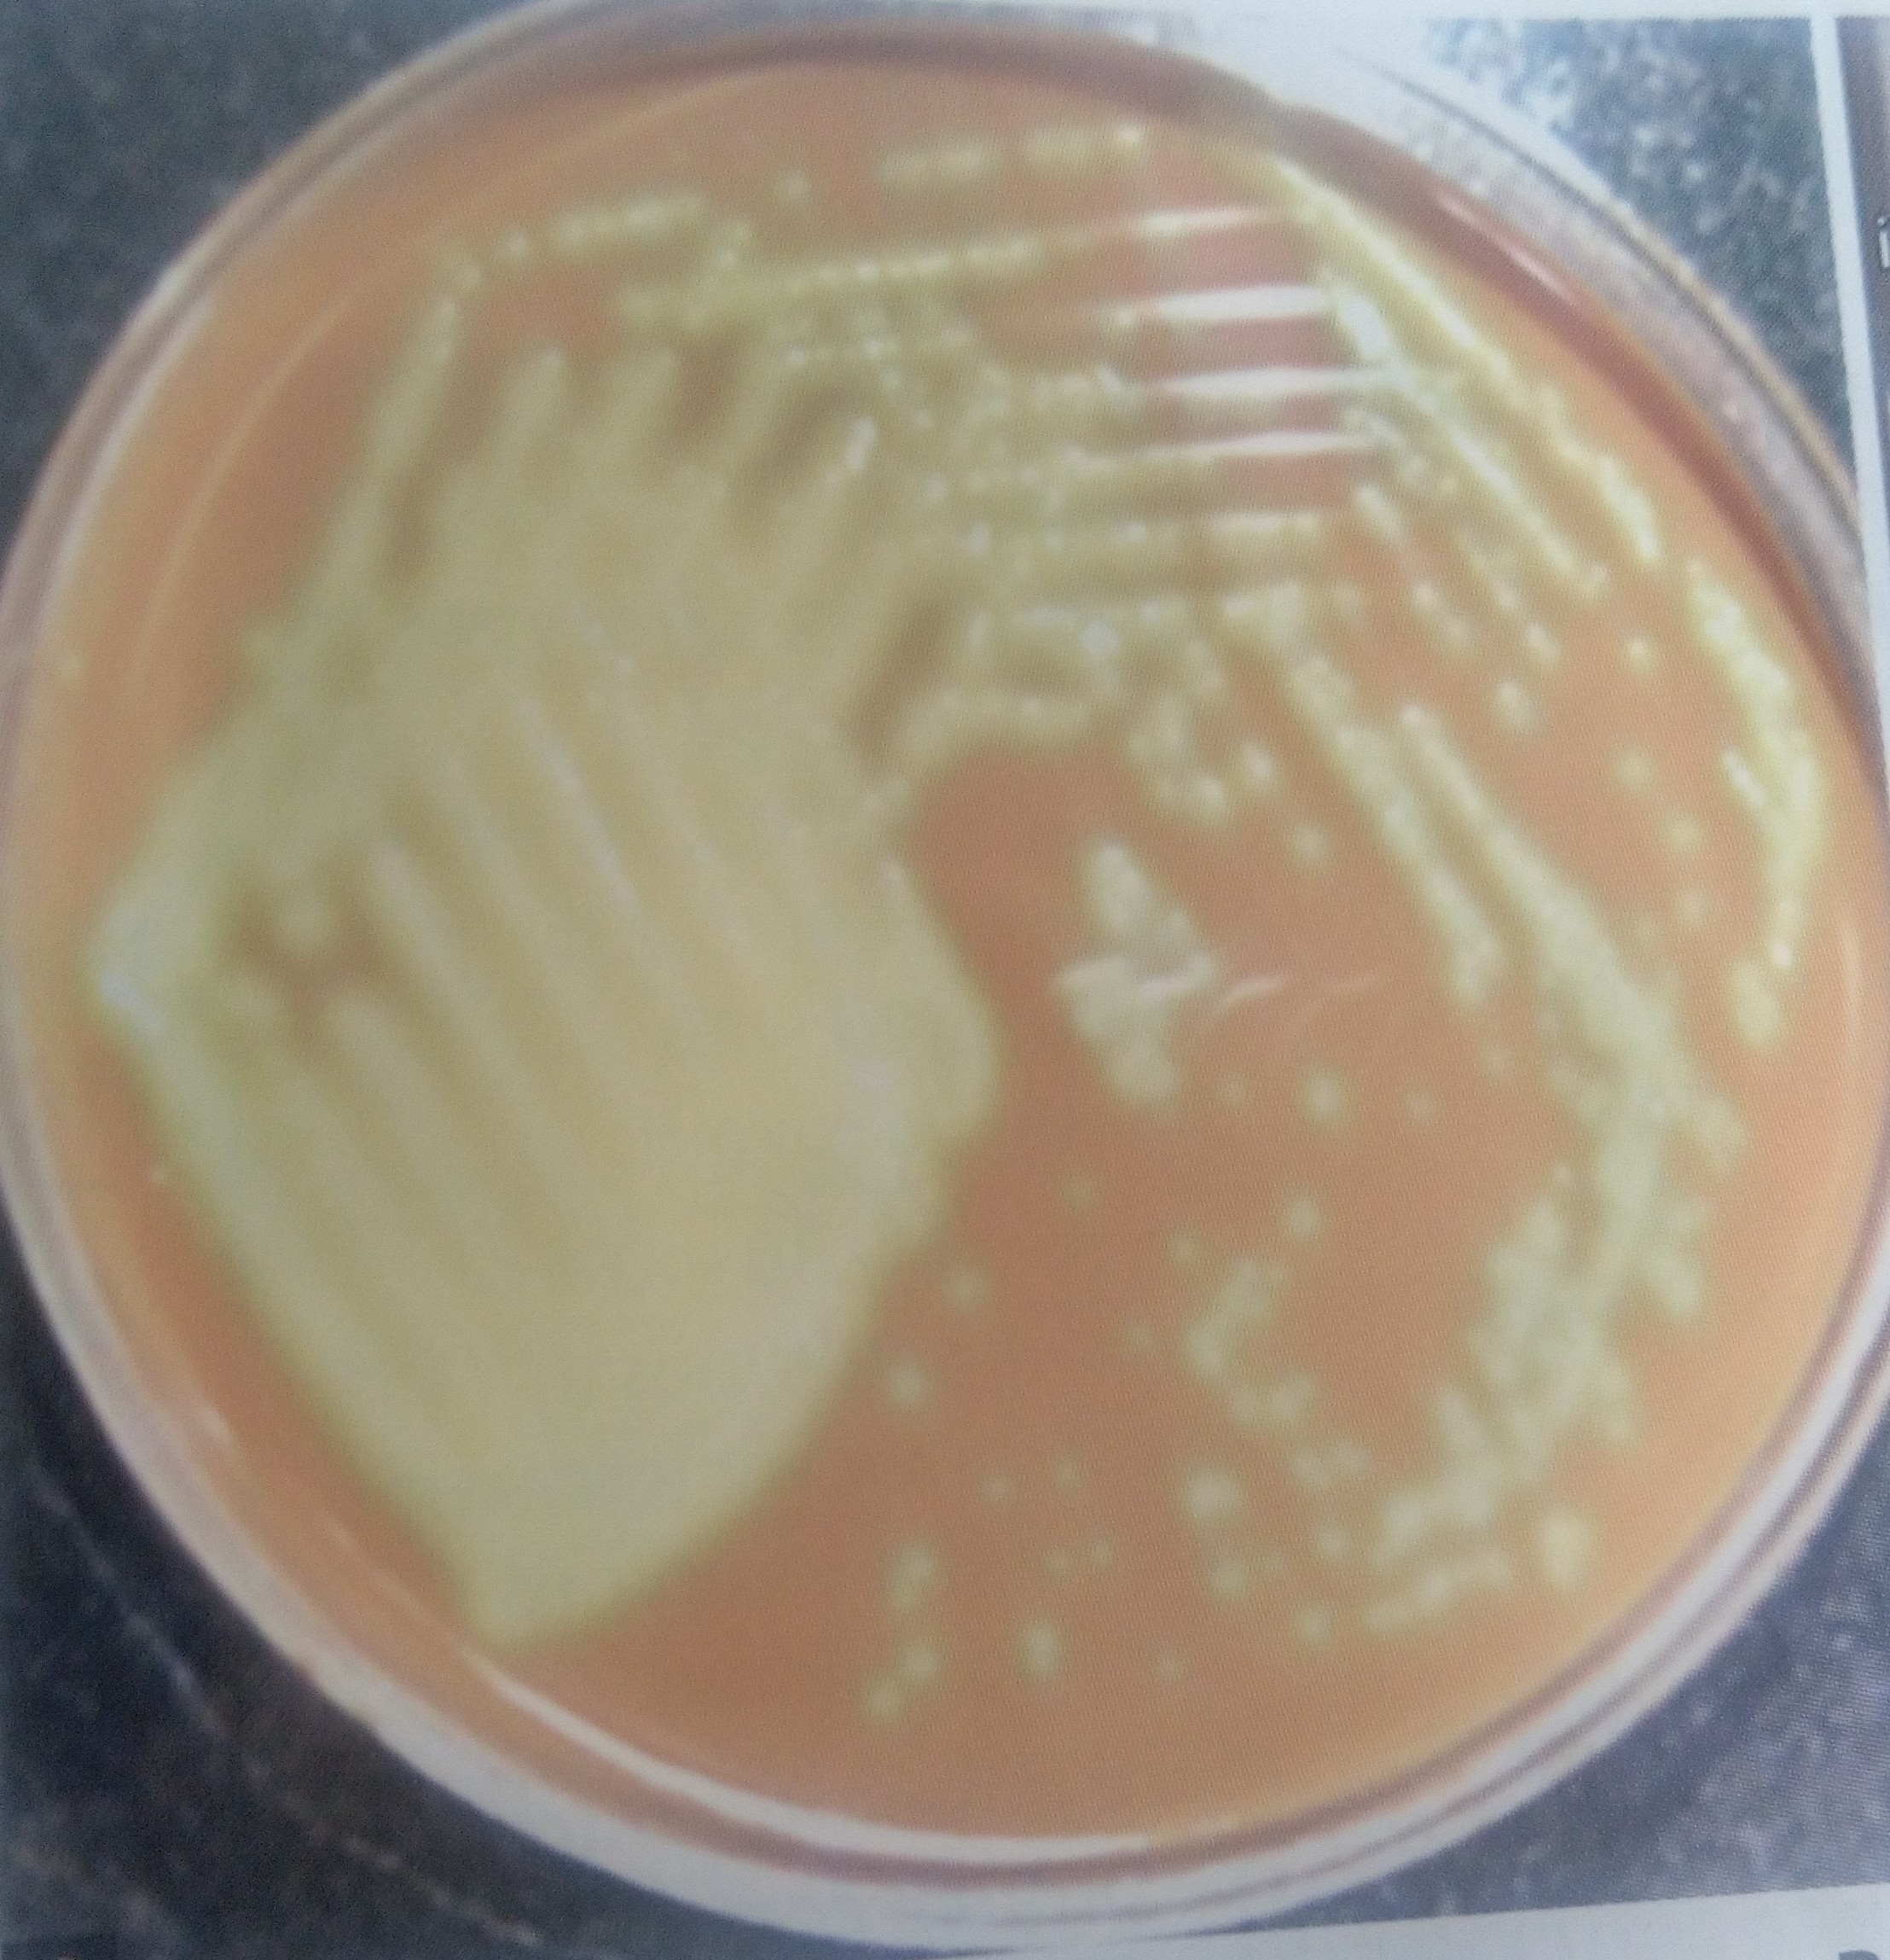
BLOOD AGAR : After 20-24 hours of incubation, colonies are small, dome shaped, alpha hemolytic (greenish discolouration).
On further incubation of 24 hours, colonies become flat with raised edges & central umbonation, results in draughtsman or carrom coin appearance.

Slide 21
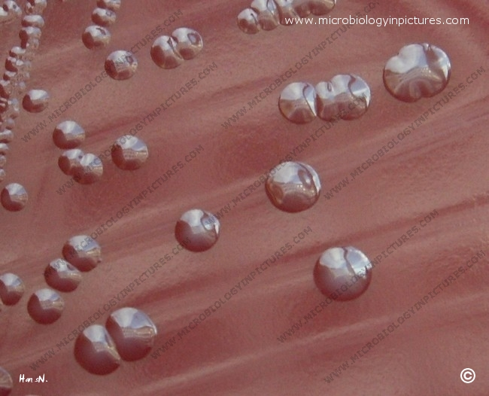
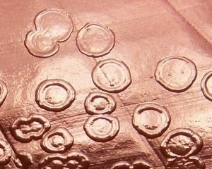
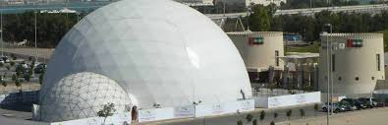
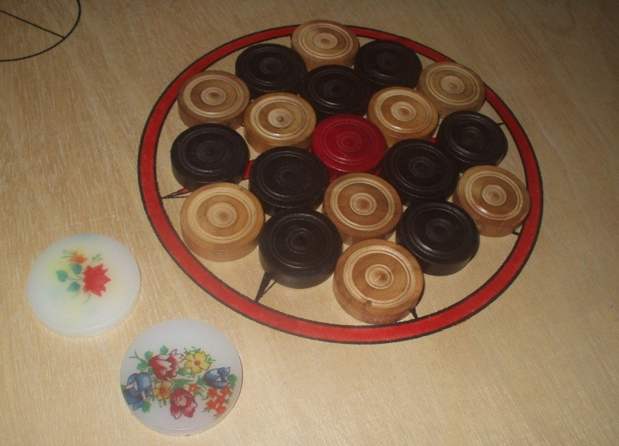
After 24 hours of incubation
After 48 hours of incubation

Slide 22
Biochemical test
CATALASE : NEGATIVE
FERMENT : INULIN
BILE : SOLUBLE
OPTOCHIN : SENSITIVE

Slide 23
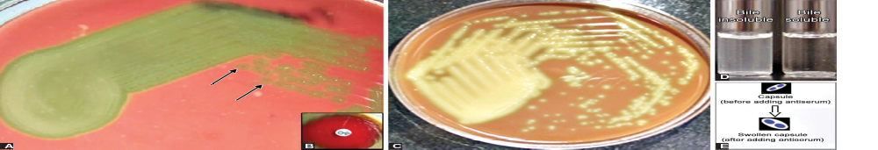
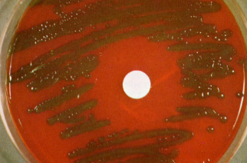
BILE SOLUBILITY TEST
2% sodium deoxycholate solution is added to broth culture , culture clears due to lysis of cocci (tube method).
If 10% sodium deoxycholate is placed on colony, lysis occurs in few minutes. (plate method)
OPTOCHIN SENSITIVITY TESTING
When optochin disc is applied on blood agar plate inoculated with Pneumococci, 14 mm or more of inhibition occurs on inoculation.

Slide 24
BIOMARKERS
MOLECULAR METHODS
CRP : latex agglutination test
Procalcitonin
PCR
AUTOMATED SYSTEMS
AST
VITEK
MALDI-TOF
Mueller Hinton blood agar

Slide 25
TREATMENT
Oral therapy with amoxicillin for five days - standard treatment.
Alternative drugs - IV penicillin or ceftriaxone, oral quinolone (levofloxacin or moxifloxacin), clindamycin or azithromycin

Slide 26
PNUEMOCOCCAL VACCINE
 | PPSV23 | PCV13
Name | 23-valent pneumococcal polysaccharide vaccine | Pneumococcal conjugate vaccine
Brand | Pneumovax 23 | Prevnar13
Serotypes included | Contains 23 serotypes of S. pneumoniae | Contains 13 serotypes of S. pneumoniae

Slide 27
PNUEMOCOCCAL VACCINE
 | PPSV23 | PCV13
Coverage | Covers 70–80% of invasive serotypes in adults | Covers only 30–40% of invasive serotypes in adults, however it covers most of the serotypes infecting children
Immuno- genicity | Less immunogenic | More immunogenic

Slide 28
PNUEMOCOCCAL VACCINE
 | PPSV23 | PCV13
Duration | Provides short-term immunity (3–5 years) | Provides longer immunity
Herd | Promotes herd immunity | Does not promote herd immunity
Effect on carriers | Does not provide mucosal immunity, hence no effect on carriers | Provides mucosal immunity; hence, it can eradicate carriage from nasopharynx
Cost | Less expensive | More expensive
Indication | Adults ≥65 years Adults 19–64 years age with underlying risk factors | Indications in adults same as PPSV23 Children (as primary immunization)

Slide 29
THANK YOU !

