Slide 1
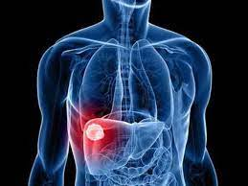
PARASITIC INFECTIONS OF LIVER
DR. PRIYANKA CHATURVEDI
ASSISTANT PROFESSOR
DEPT OF MICROBIOLOGY

Slide 2
INTRODUCTION
Parasites causing hepatobiliary infections include:
Protozoa:
Entamoeba histolytica, causes AMOEBIC LIVER ABSCESS
Cestode:
Echinococcus, causes HUMAN ECHINOCOCCOSIS
(HYDATID DISEASE)

Slide 3
INTRODUCTION
Parasites causing hepatobiliary infections include:
Trematodes: Fasciola hepatica, F. gigantica, Clonorchis, Opisthorchis, Schistosoma mansoni and S. japonicum
Nematode: Toxocara causing visceral larva migrans.

Slide 4
AMOEBIC LIVER ABSCESS
Amoebic liver abscess is the most important differential diagnosis of SPACE OCCUPYING LESION of the liver.
It is caused by Entamoeba histolytica.

Slide 5
Pathogenesis
Amoebic liver abscess is one of the most important extraintestinal complications of Amoebic dysentery caused by E. histolytica.
Transmission - Ingestion of food and water contaminated with cysts of E. histolytica

Slide 6
Pathogenesis
Attachment: Ingested cysts of E. histolytica develop into trophozoites in gut. These trophozoites adhere to intestinal mucosa with the help of Gal/NAG lectin antigen
Invasion: Trophozoites secrete cysteine proteases and hydrolytic enzymes which help them to invade of intestinal mucosa

Slide 7
Pathogenesis
Spread: In few cases, the trophozoites gain entry into the portal venous system and hence carried to extraintestinal sites.
Liver is most common extraintestinal site; followed by lungs, brain and spleen
Most common hepatic site affected is Posterior-superior surface of the right lobe of liver.

Slide 8
Pathogenesis
Amoebic Liber Abscess is usually single or rarely multiple.
The amoebic trophozoites occlude the hepatic venules that leads anoxic necrosis of the hepatocytes
Neutrophils lysed by Trophozoite leads to release of mediators that also contribute to hepatic necrosis
Inflammatory response surrounding the necrosed hepatocytes leads to the formation of abscess

Slide 9
Pathogenesis
Microscopically, the abscess wall is comprised of:
  Inner central zone of necrotic hepatocytes without amoeba.
  Middle zone of degenerative hepatocytes, RBC, WBC and amoebic trophozoites
  Outer zone of healthy hepatocytes invaded with amoebic trophozoites

Slide 10
Pathogenesis
Anchovy sauce pus: Liver abscess pus is thick chocolate brown in color.
The fluid is acidic - pH 5.2–6.7 and is comprised of necrotic hepatocytes without any pus cells and occasionally amoebic trophozoites as amoebae multiply in the wall of abscess

Slide 11
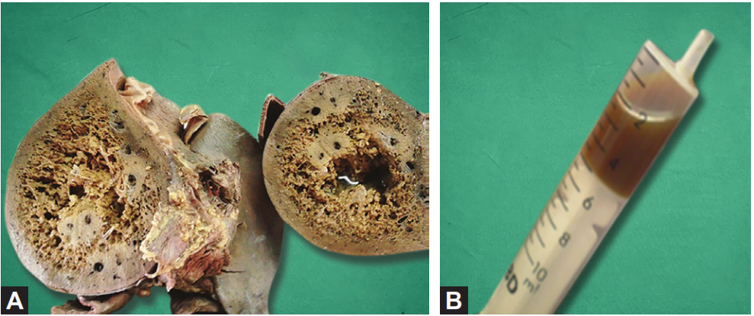
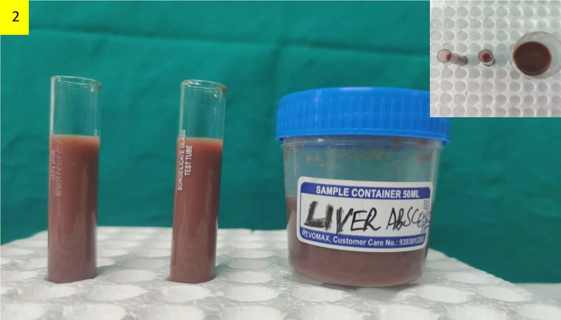
Pathogenesis
Cross section of the liver showing amoebic liver abscess (right side);
Anchovy sauce pus aspirated from amoebic liver abscess

Slide 12
Clinical Manifestations
ALA presents with tender hepatomegaly and fever (most consistent features)
Along with weight loss, sweating and weakness, very rarely jaundice, and cough.

Slide 13
Complications of Amoebic Liver Abscess
Abscess may grow in various direction of the liver discharging the contents into the neighboring organs.
Right-sided liver abscess –
1. Rupture externally to skin causing skin lesions on the abdominal wall - Granuloma cutis (amoebiasis cutis).
2. Rupture into lungs (pulmonary amoebiasis with trophozoites in sputum) or into the right pleura (amoebic pleuritis, the most common complication).

Slide 14
Complications of Amoebic Liver Abscess
3. Rupture of liver abscess below the diaphragm - Subphrenic abscess and generalized peritonitis
Left-sided liver abscess –
1. Rupture into the stomach or left pleura or pericardial cavity (amoebic pericarditis)
Hematogenous spread - from liver affecting brain (causing brain abscess and secondary amoebic encephalitis), lungs, spleen and genitourinary organs.

Slide 15
Epidemiology
Highest prevalence - developing countries in the tropics, particularly in Mexico, India, Central and South America, and tropical areas of Asia and Africa.
Most common group affected: Young adult males (male to female ratio is 9:1)

Slide 16
Laboratory diagnosis of Amoebic liver abscess
Sample: Aspirated Pus
Microscopy—Detects trophozoites
Antigen detection (in serum, liver, pus and saliva)—by ELISA (170–kDA of lectin Ag)
Antibody detection—ELISA (Ab to 170-kDA lectin Ag)
Molecular diagnosis—nested multiplex PCR and real-time PCR (detecting18S rRNA)
Ultrasonography—detects the site of abscess and its extension

Slide 17
Treatment of Amoebic liver abscess
1. Tissue amoebicidal agent (acts on trophozoites in the liver), followed by
2. Luminal amoebicidal agent - eradicate the intestinal carriage.
Tissue agents: Metronidazole (750 mg PO or IV tid for 5–10 days); or tinidazole/ornidazole (2 g PO once); and
Luminal agents: Iodoquinol (for 20 days) or paromomycin (for 10 days)

Slide 18
Treatment of Amoebic liver abscess (Cont..)
Aspiration
Aspiration of the liver abscess content is indicated
(1) Risk of impending rupture,
(2) Left lobe liver abscess of >10 cm,
(3) No improvement after anti-protozoan therapy for 5–7 days.

Slide 19
Prevention
Avoidance of ingestion of food and water contaminated with human feces.
Treatment of asymptomatic persons.

Slide 20
HUMAN ECHINOCOCCOSIS

Slide 21
HUMAN ECHINOCOCCOSIS
Human echinococcosis is a zoonotic disease that is caused by a cestode of the genus Echinococcus.
Occurs in 4 forms:
Cystic echinococcosis - known as HYDATID DISEASE, caused by Echinococcus granulosus
Alveolar echinococcosis, caused by E. multilocularis
Two forms of neotropical echinococcosis:
  Polycystic hydatid disease, caused by E. vogeli
  Unicystic hydatid disease, caused by E. oligarthrus

Slide 22
Cystic Echinococcosis
Caused by Echinococcus granulosus; also called as DOG TAPEWORM.

Slide 23
Morphology
It is a tissue cestode, exits in three morphological forms—
  Adult,
  Larva (called hydatid cyst), and
  Egg.

Slide 24
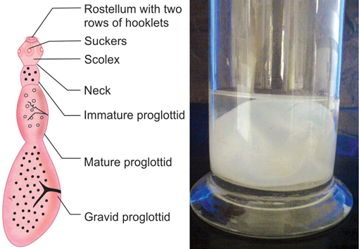
Echinococcus granulosus: A. Adult worm; B. Hydatid cyst, gross form

Slide 25
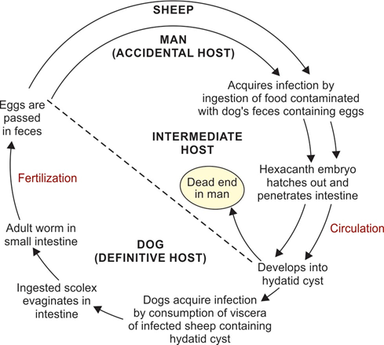
Life Cycle

Slide 26
Pathogenicity
Pathogenicity is related to the deposition of the hydatid cysts (larval form of the parasite) in various organs.

Slide 27
Hydatid cyst
Fluid-filled bladder-like cyst - unilocular, spherical in shape and average size measures 5–8 cm (from few mm to >30 cm).
Cyst wall - Three layers: outer pericyst (host derived), middle ectocyst and inner endocyst
Brood capsule: Inner side of the endocyst gives rise to brood capsule - secretes the hydatid fluid - contains number of protoscolices (future head).

Slide 28
Hydatid cyst
Hydatid fluid: Clear, pale yellow colored fluid - antigenic, toxic and anaphylactic
Hydatid sand: Some of the brood capsules and protoscolices break off - get deposited at the bottom as hydatid sand.

Slide 29
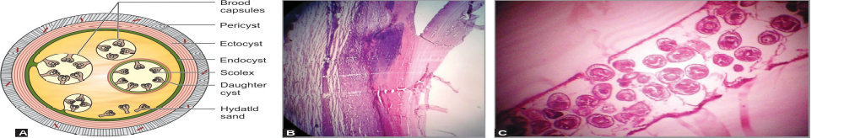
Hydatid cyst

Slide 30
Hydatid cyst
Fate: The hydatid cyst may undergo—
  (i) spontaneous resolution, or
  (ii) rupture of the cyst, which may lead to either formation of secondary cysts (carried to other organs) or anaphylactic reaction to the hydatid fluid antigens.

Slide 31
Clinical Features
Infection usually occurs in childhood but gets manifested in adult life.
Site: Most common site of the cyst is liver (60–70%, right lobe) or lung (20%)
Asymptomatic: The cysts grow up to 5–10 cm in size within the first year and can survive for years or even decades, without any symptoms

Slide 32
Clinical Features
Symptoms: Few patients develop symptoms - may be due to:
    Pressure effect of the enlarging cyst
    Obstruction
    Secondary bacterial infection, causing pyogenic abscess in liver
    Anaphylactic reactions

Slide 33
Clinical Features
Outcome of the disease: It depends on the cyst size and location
Younger children - more associated with extrahepatic cysts in lungs, brain and orbital sites and multi-organ involvement

Slide 34
Laboratory diagnosis of Hydatid Disease
Hydatid fluid microscopy (direct mount or staining with acid-fast stain)—detects brood capsules and protoscolices
Histological examination (H & E)—demonstrates cyst wall and attached brood capsules
Antibody detection—ELISA

Slide 35
Laboratory diagnosis of Hydatid Disease
Imaging methods—USG (demonstrates Water lily sign)

Slide 36
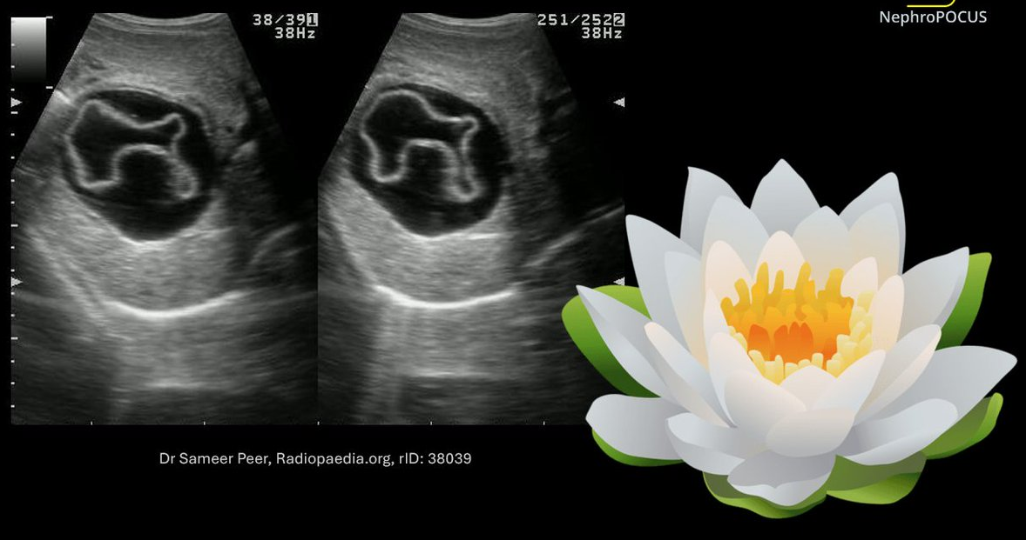

Slide 37
Laboratory diagnosis of Hydatid Disease
Molecular methods—PCR
Skin test (Casoni test)—demonstrates type I hypersensitivity reaction

Slide 38
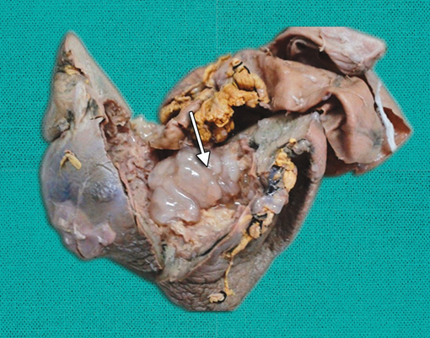
Surgically resected hydatid cyst from liver.

Slide 39
WHO international classification of ultrasound images of hydatid cyst
Types | Activity | Usg finding
CL | Active | Cystic lesion and no visible cyst wall
CE1 | Active | Visible cyst wall and internal echoes (snowflake sign)
CE2 | Active | Visible cyst wall and internal septation (honeycomb appearance)
CE3 | Transitional | Have detached laminar membranes or may be partially collapsed, and floating within the cyst cavity (known as water lily sign)
CE4 | Inactive | Non-homogeneous mass
CE5 | Inactive | Cyst with a thick calcified wall

Slide 40
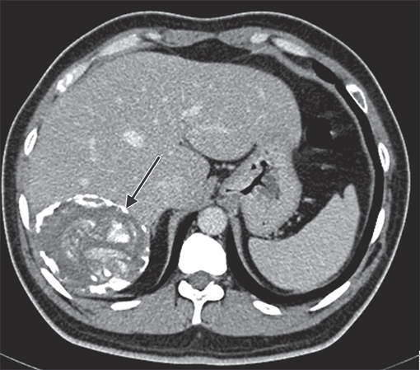
CT scan showing calcified hydatid cyst in the liver

Slide 41
Treatment of Hydatid Disease
PAIR (puncture, aspiration, injection and re-aspiration)
It is alternative method recommended instead of surgery. It involves four basic steps:
  1. Percutaneous puncture of the cyst
  2. Aspiration of 10–15 mL of cyst fluid
  3. Infusion of scolicidal agents like hypertonic saline, cetrimide, or ethanol
  4. Re-aspiration of the fluid after 5 minutes

Slide 42
Treatment of Hydatid Disease
PAIR claims higher cure rate, less recurrence rate, less complications and hospitalization compared to surgery.
PAIR is recommended for a single hepatic cyst.

Slide 43
Treatment of Hydatid Disease
PAIR is contraindicated for:
  Superficially located cysts (because of the risk of rupture)
  CE2: Cyst with multiple thick internal septal division (honeycomb appearance)
  Inaccessible cyst or extrahepatic cysts
  Cysts communicating to the biliary tree

Slide 44
Treatment of Hydatid Disease
Surgery
  Cases where PAIR is contraindicated
  Secondary bacterial infection
  Advanced disease
Disadvantages of surgery - high recurrence rate (2–25%) and postoperative complications (10–25%)
Preoperative use of albendazole - effective in reducing size and to prevent recurrence

Slide 45
Treatment of Hydatid Disease
Antiparasitic agents
Albendazole - Given at 15 mg/kg daily in two divided doses; 1 week before to 4 weeks after the procedure (PAIR)
Pulmonary cyst: praziquantel is given alternatively

Slide 46
Prevention
Administering praziquantel to infected dogs
To improve personal hygiene to reduce contamination of food and water with dog’s faeces
Vaccinating the sheep
Limitation of stray dog population

Slide 47
TREMATODE INFECTIONS OF LIVER
Fasciola, Clonorchis, Opisthorchis - together called as LIVER FLUKES.
FASCIOLA infect liver and bile duct.
Others infect only the bile duct

Slide 48
MCQs

Slide 49
1. The most common extra intestinal manifestation of Amoebic dysentery is:
A) Hydatid Cyst
B) Primary Liver abscess
C) Amoebic liver abscess
D) Neurocycticercosis

Slide 50
2. Most common hepatic site affected in Amoebic liver abscess
A) Posterior surface of the right lobe of liver.
B) Posterior-superior surface of the left lobe of liver.
C) Superior surface of the right lobe of liver.
D) Posterior-superior surface of the right lobe of liver.

Slide 51
3. Hydatid Cyst is
A) Egg of Ecchinococcus granulosus
B) Larva of Ecchinococcus granulosus
C) Egg of Taenia Solium
D) Larva of Fasciola hepatica

Slide 52
4. PAIR is….
A) Percutaneous Aspiration Injection Resection
B) Puncture Aspiration Injection Resection
C) Puncture Aspiration Injection Resolution
D) Puncture Aspiration Injection Reaspiration

Slide 53
THANK YOU

