Slide 1
PARAMYXOVIRIDAE INFECTIONS

Slide 2
PARAMYXOVIRIDAE INFECTIONS
Group of viruses, which are transmitted via the respiratory tract following which-
  Cause localized respiratory infection in children
  Disseminate to other sites

Slide 3
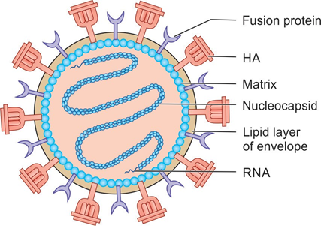
Morphology
Larger (100–300 nm) in size
Linear non-segmented RNA
Contain six structural proteins (compared to 8 in Influenza virus)

Slide 4
Morphology
HA and NA antigens:
Parainfluenza and mumps - both HA and NA antigens
Measles virus possess HA, but lack NA
RSV and metapneumo viruses lack both HA and NA

Slide 5
PARAINFLUENZA

Slide 6
PARAINFLUENZA
Major causes of LRTI in young children
It has five serotypes (1-4):
  Types 1 & 3 belong to the genus Respirovirus
  Types 2, 4a & 4b belong to the genus Rubulavirus

Slide 7
Clinical Manifestations
Transmission is by respiratory route (by direct salivary contact or by large-droplet aerosols)
The incubation period appears to be 5–6 days.
Mild common cold syndrome: Rhinitis and Pharyngitis

Slide 8
Clinical Manifestations
Croup (laryngo-trachea-bronchitis)
Pneumonia or bronchiolitis
Otitis media : most common complication

Slide 9
Epidemiology
Worldwide in distribution
Type 3 - most prevalent serotype
Types 1 and 2 - less common
Type 4a & 4b - milder illness

Slide 10
Laboratory Diagnosis
Antigen detection - Viral antigens in the infected exfoliated epithelial cells of the nasopharynx are directly detected by immunofluorescence test by using specific monoclonal antibodies.

Slide 11
Laboratory Diagnosis
Viral isolation:
  Specimens - nasal washes, broncho-alveolar lavage fluid and lung tissue can be used.
  Primary monkey kidney cells - most sensitive

Slide 12
Laboratory Diagnosis
Serum antibodies - measured by
Neutralization test
Hemagglutination inhibition test
ELISA.
Presence of IgM or fourfold rise of IgG titer - active infection.

Slide 13
Laboratory Diagnosis
Reverse transcriptase PCR assays are highly specific and sensitive
BioFire FilmArray respiratory panel (RP) tests simultaneously 20 respiratory pathogens.

Slide 14
Avian Parainfluenza Viruses
(Newcastle Disease Virus or NDV)
Also called *Ranikhet virus in India.
Produces pneumoencephalitis in young chickens

Slide 15
MUMPS

Slide 16
MUMPS
Most common cause of parotid gland enlargement in children.
In severe cases - cause orchitis and aseptic meningitis.

Slide 17
Pathogenesis
Transmission - respiratory route via droplets, saliva, and fomites.
Primary replication - nasal mucosa or upper respiratory mucosa →infects mononuclear cells and regional lymph nodes → spill over to blood stream resulting in viremia→ dissemination.
Target sites – Glandular epithelium. The classic sites include - salivary glands, testes, pancreas, ovaries, mammary glands, and CNS.

Slide 18
Clinical Manifestation
Incubation period is about 19 days *(range, 7–23 days).
In-apparent infection- Up to half of the infected people - either asymptomatic or present with non-specific symptoms - fever, myalgia and anorexia

Slide 19
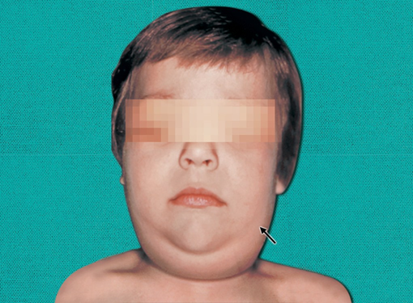
Clinical Manifestation
Bilateral parotitis
Epididymo-orchitis
Aseptic meningitis
Oophoritis
Pancreatitis
Atypical mumps
Parotitis in a mumps virus-infected patient

Slide 20
Epidemiology
Endemic worldwide
Peak in cases typically seen in winter and spring

Slide 21
Epidemiology (Cont..)
*Period of communicability- Patients are infectious from 1 week before to 1 week after the onset of symptoms
*Most contagious period - within 1–2 days before the onset of symptoms.
Infective material- Mumps virus is shed in saliva, respiratory droplets, and urine.

Slide 22
Epidemiology
Source- Cases (both clinical and subclinical cases) are the source of infection.
  There is no carrier state
  Subclinical cases (30-40% of all cases)
Reservoir- Humans

Slide 23
Epidemiology
Age- 5-9 years age - most commonly affected.
Disease - more severe in adults.
Immunity- One attack (either by vaccine or infection) gives lifelong immunity.
Secondary attack rate is high (86%)

Slide 24
Laboratory diagnosis of Mumps
Specimen: Buccal or oral swab
Antigen detection by direct IF test
Viral isolation: By using primary monkey kidney cell lines or by shell vial technique
Serum antibodies by ELISA, neutralization test, HAI test
RT PCR: Detects viral RNA.

Slide 25
Treatment of Mumps
There is no specific antiviral drug available - mostly symptomatic
Mumps immunoglobulin is available, but not effective.

Slide 26
Prevention (Live Attenuated Vaccine)
Live attenuated *Jeryl Lynn strain - recommended strain used worldwide.
Mumps vaccine is available as:
  Trivalent MMR vaccine (live attenuated measles-mumps-rubella vaccine)
  Quadrivalent MMR-V vaccine (additional live attenuated varicella vaccine)
  Monovalent mumps vaccine (not commonly used)

Slide 27
RESPIRATORY SYNCYTIAL VIRUS INFECTION

Slide 28
RESPIRATORY SYNCYTIAL VIRUS INFECTION
Major respiratory pathogen of young children.
*Most common cause of lower respiratory disease (bronchiolitis and pneumonia) in infants.

Slide 29
Pathogenesis
Transmission - i)direct contact (contaminated fingers or fomites and by self-inoculation of the conjunctiva or anterior nares) or ii) by large droplets inhalation
Spread- RSV replicates locally in the epithelial cells of the nasopharynx - spread to the lower respiratory tract - bronchiolitis and pneumonia.

Slide 30
Clinical Manifestations
*Incubation period is about 3–5 days.
Infants - RSV - most common cause of lower respiratory tract infection < 1
Chest X ray - peribronchial thickening, diffuse interstitial infiltration and occasionally lobar consolidation
Severe in premature infants and underlying congenital cardiac disease, bronchopulmonary dysplasia, nephrotic syndrome, or immunosuppression

Slide 31
Clinical Manifestations (Cont..)
Adults - Influenza-like upper respiratory symptoms - common cold, running nose, sore throat, and cough
Recurrent infection - common in both children and adults, but is much milder (common cold).

Slide 32
Laboratory Diagnosis - Antigen Detection
Direct immunofluorescence test detecting antigens on exfoliated cells or
ELISA detecting antigens in nasopharyngeal secretions.

Slide 33
Laboratory Diagnosis - Virus Isolation
HeLa and HEp-2 - most sensitive cell lines for RSV isolation.
A characteristic cytopathic effect, syncytium formation (multinucleated giant cell)—appears after 10 days.

Slide 34
Laboratory Diagnosis - Molecular Methods
RT-PCR amplifying viral RNA
BioFire FilmArray respiratory panel (RP)

Slide 35
Laboratory Diagnosis - Antibody Detection
Serum antibodies - less diagnostic importance; rather they are the markers of prevalence of infection

Slide 36
Treatment of RSV infection
Ribavirin - drug of choice
  Indicated for severe infections in infants - its beneficial effect in older children and adults is doubtful
  Administered as aerosols for 3–6 days. Oral ribavirin - not recommended.

Slide 37
Treatment of RSV infection (Cont..)
Supportive care - removal of secretions, administration of oxygen, bronchodilators and ventilator support.

Slide 38
MEASLES
(RUBIOLA)

Slide 39
MEASLES (RUBIOLA)
Highly infectious childhood disease
Exanthematous disease

Slide 40
Structure
Spherical or oval shape
Tightly coiled helical nucleocapsid
Lipid envelope with Hemagglutinin, no NA
Fusion (F) protein present

Slide 41
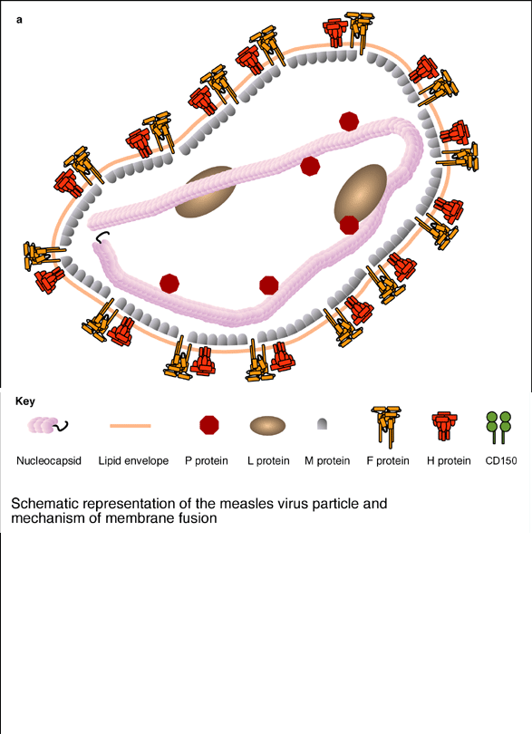
Measles virus - morphology

Slide 42
Measles virus
Grown in cell cultures
CPE is multi-nucleated giant cell formation & nuclear inclusion bodies
Giant cells in patient’s lymphoid tissue- Warthin-Finkeldey cells

Slide 43
Pathogenesis
Enters through Respiratory tract & conjunctiva
Multiply in lymph nodes
Enter blood stream – primary viremia
Enter Reticulo-Endothelial System & multiply there
Secondary viremia
Transported to epithelial surfaces of skin, mouth, respiratory tract & conjunctiva
Viral replication at these sites

Slide 44
Pathogenesis contd….
*Koplik’s spots – Pathagnomonic
Small bluish white ulcerations on buccal mucosa, opposite lower molars
Contain giant cells, inclusion bodies & virions
Rashes are due to immune reaction

Slide 45
Clinical features
IP – 10-12 days
Prodrome – 3-4 days –
fever, conjunctival congestion, cough & nasal discharge
Koplik’s spots appear - early prodrome

Slide 46
Clinical features contd….
Skin rashes appear 1-2 days after Koplik’s spots
Rash start from forehead to downwards
Fever subsides in 1-2 days of rash

Slide 47
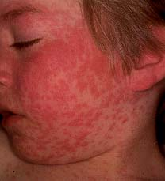
Skin rash of measles

Slide 48
Complications
Due to virus:
Croup, bronchitis, diarrhoea
Giant cell pneumonia (fatal)
Meningoencephalitis (sequelae)
*SSPE (late)
Due to 2ndary bacterial Infection
Bronchopneumonia
Otitis media

Slide 49
Laboratory diagnosis
1) Demonstration of:
-Giant cells by Geimsa stain in nasal
-Viral Ag by IF secretions
2) Virus isolation: from nose, throat, conjunctiva, blood & urine
3) Serology: rise in titre of Ab by IgM ELISA

Slide 50
Prophylaxis
Live attenuated vaccine – at 9 months single S/C - Edmonston-Zagreb strain
Either alone or as MMR vaccine
Live attenuated intranasal vaccine

Slide 51
Thank you!!

