Slide 1
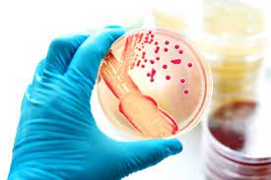
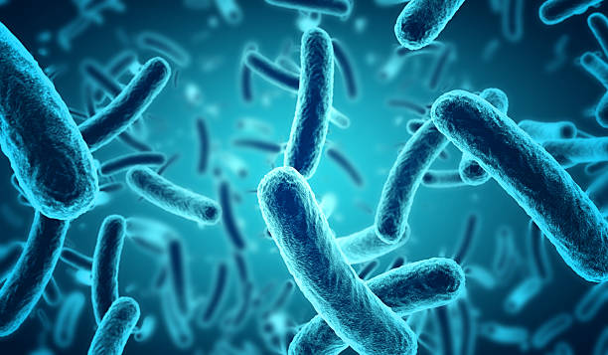
Overview of bacterial infections
Dr. Priyanka Chaturvedi
Assistant Professor

Slide 2
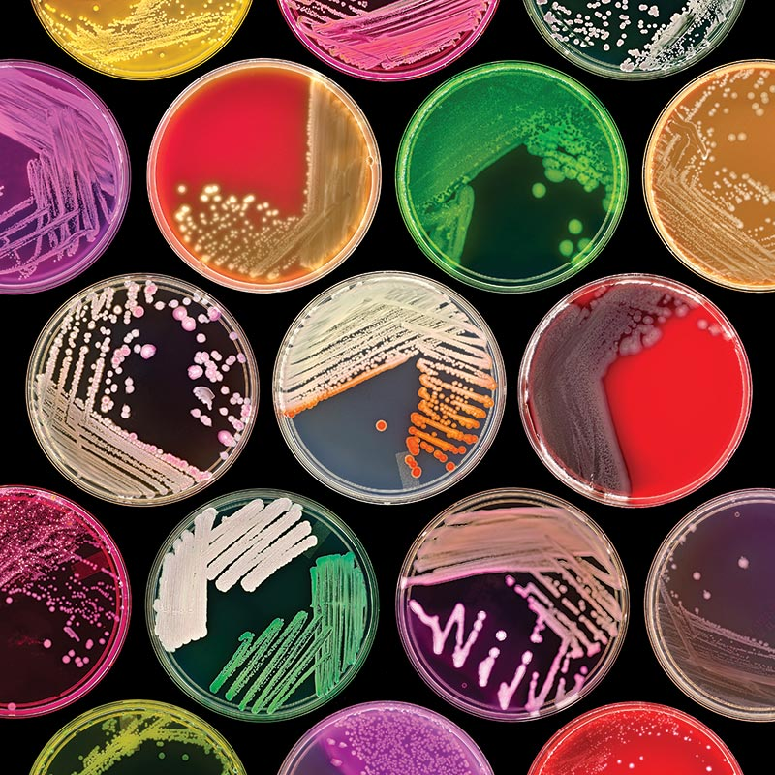
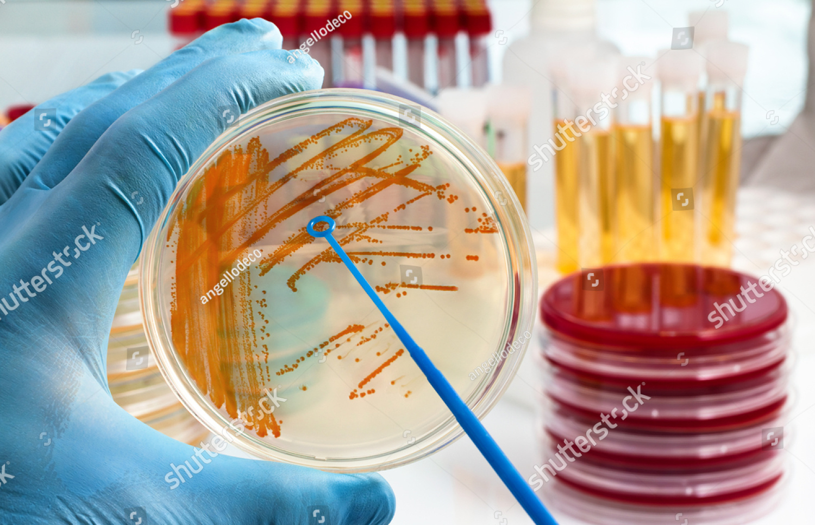
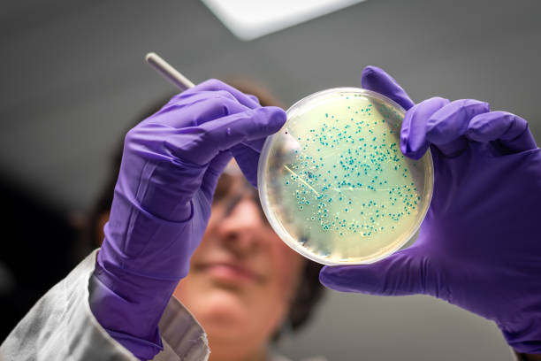
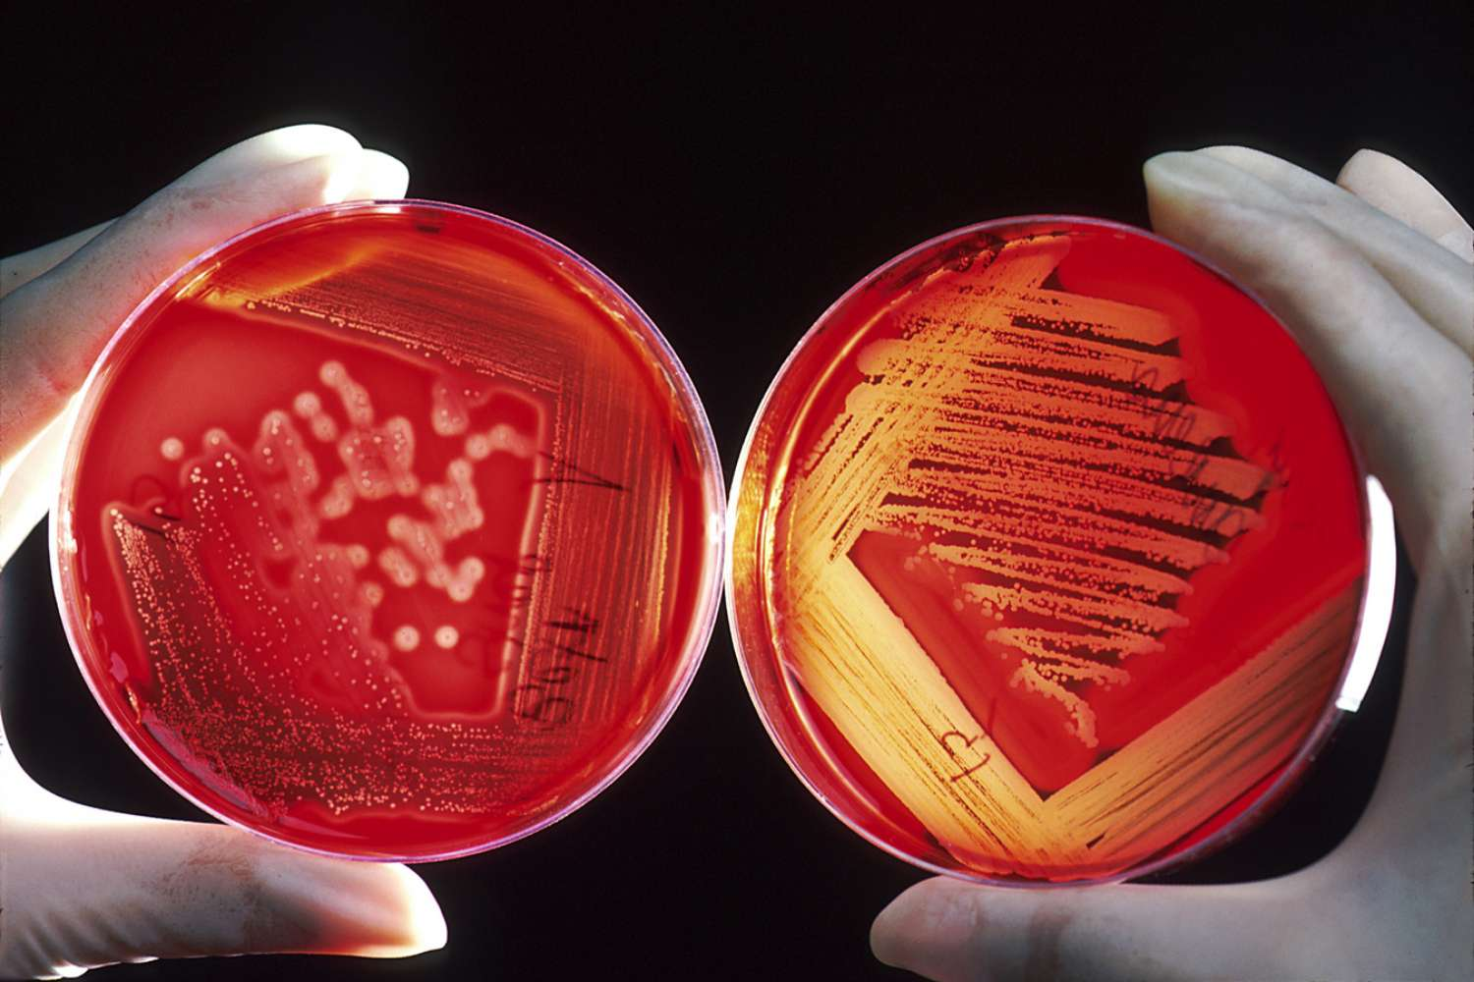
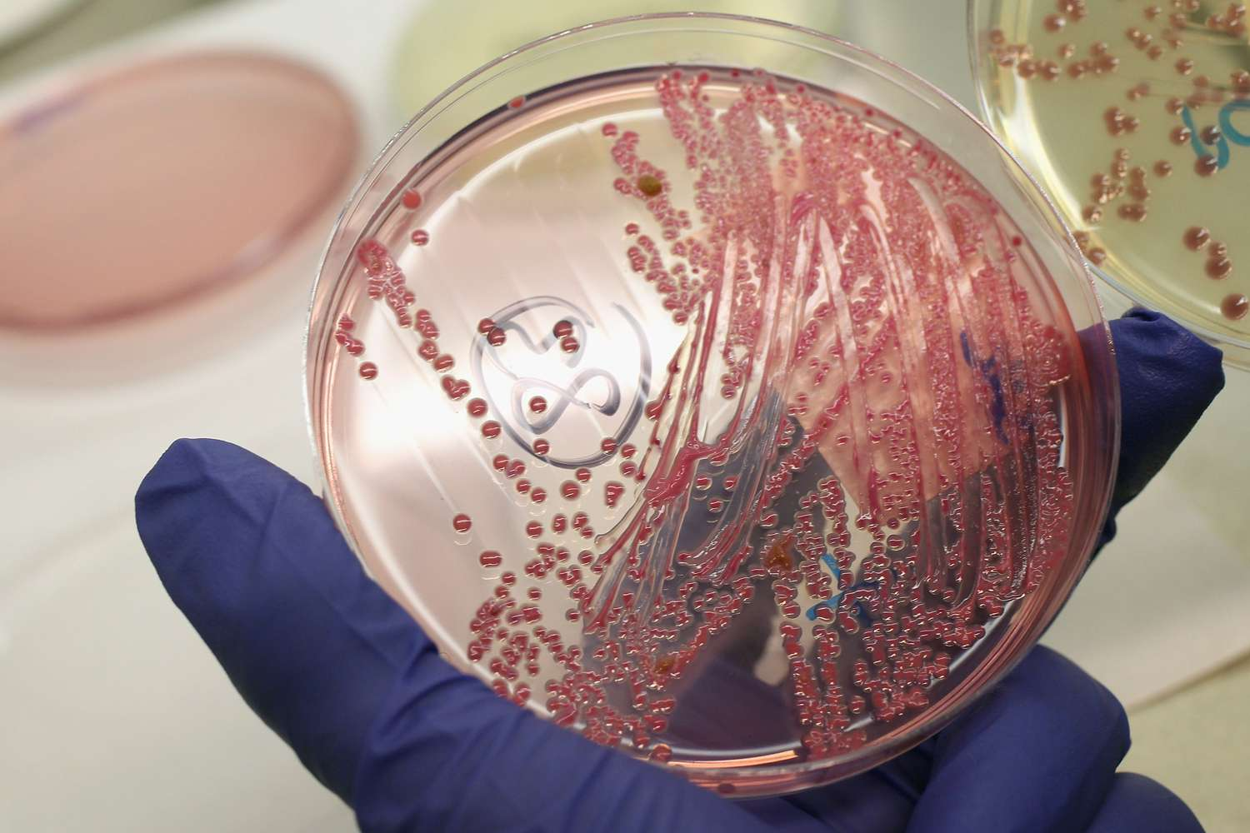

Slide 3

HOW TO GO ABOUT….
SAMPLE (e.g. PUS) received in MICROBIOLOGY LAB.
SMEAR of pus is prepared on slide.
GRAM STAIN is performed.
Presence of any MICROORGANISM in the smear under microscope.
Pus is INOCULATED ON CULTURE MEDIA
INCUBATED for 24-48 hours at 37ºC
GROWTH OF BACTERIA on culture media occurs.
SMEAR is prepared from the COLONY of the bacteria grown
IDENTIFICATION on the basis of colony of bacteria and microscopic appearance

Slide 4
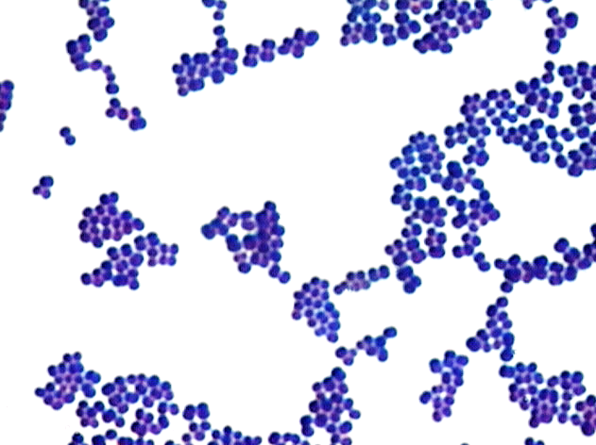
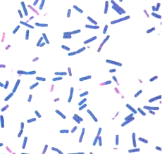
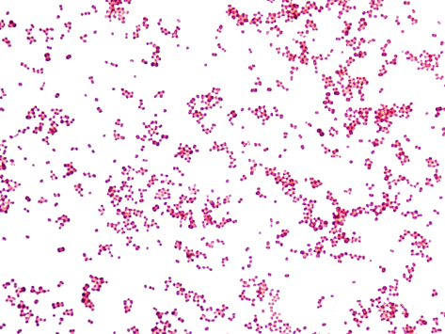
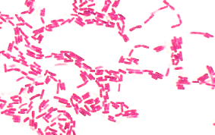
Gram stain smear
Gram positive cocci
Gram negative bacilli
Gram negative cocci
Gram positive bacilli

Slide 5
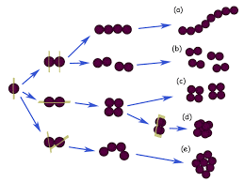
Various arrangement of cocci (on the basis of plane of division) helps in identification of different GPC

Slide 6
GRAM-POSITIVE COCCI INFECTIONS
Gram-positive cocci have been classified into two families –
  Micrococcaceae
  Streptococcaceae
  Differentiated by the catalase test.

Slide 7
Micrococcaceae:
Catalase positive
Gram-positive cocci arranged in tetrads or clusters
Tetrads - Micrococcus, non-pathogenic
Clusters - Staphylococcus, pathogenic

Slide 8
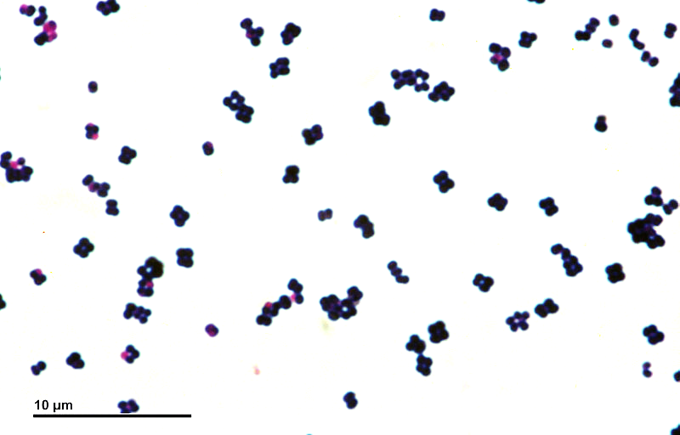
Tetrads - Micrococcus
Clusters - Staphylococcus

Slide 9
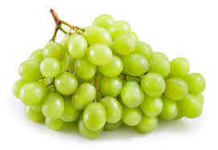
Staphylococcus species:
GPC ARRANGED IN GRAPE LIKE CLUSTER
Staphylococcus aureus is the most virulent species, pathogenic to man.
Catalase Positive & Coagulase Positive
Other species of Staphylococcus are coagulase Negative, collectively known as Coagulase Negative Staphylococcus species. [CoNS]

Slide 10
Clinical manifestations of Staphylococcal infections:
Skin and soft tissue infections - folliculitis, furuncle, and cellulitis, etc.
Musculoskeletal infections - Osteomyelitis, Septic arthritis and Abscess
Respiratory tract infection - Pneumonia (community acquired)
Bacteremia and Sepsis
Urinary tract infections (UTI)
Toxin-mediated infections - Food poisoning and Toxic shock syndrome.

Slide 11
Streptococcaceae:
Catalase negative
Gram-positive cocci, arranged in pairs or chains
Pairs—Enterococcus, S. Pneumoniae
Short chains—Streptococcus pyogenes
Long chains—Streptococcus viridans

Slide 12
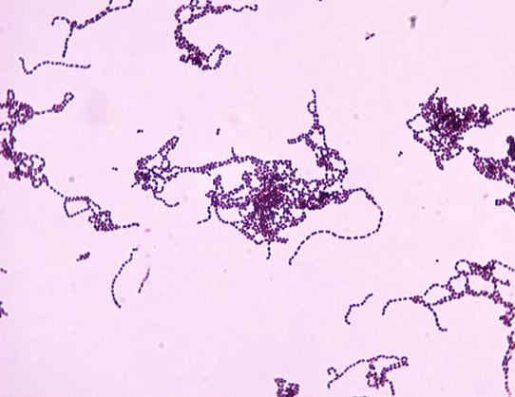
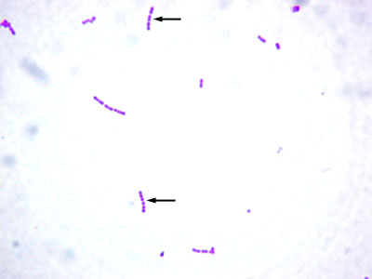
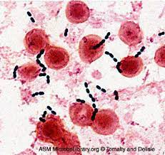
Long chains:
Streptococcus viridans
Short chains:
Streptococcus pyogenes
Pairs:
Enterococcus,
S. Pneumoniae

Slide 13
Streptococcus species
S. pyogenes- leading cause of pyogenic infections in humans.
Clinical manifestations of streptococcal infections:
Suppurative manifestations - sore throat scarlet fever, skin and soft-tissue infections.
Non-suppurative manifestations - Acute Rheumatic Fever and Post Streptococcal Glomerulonephritis (PSGN)

Slide 14
Enterococcus
Catalase negative oval GPC present in pairs at an angle.
Part of normal flora of human intestine.
E. faecalis and E. faecium - species pathogenic to man.
Clinical manifestations: UTI, bacteremia and endocarditis, and intra-abdominal infections.

Slide 15
Streptococci Viridans
Catalase negative GPC in long chains
Commensals of mouth and upper respiratory tract.
Can cause dental caries, Subacute Bacterial Endocarditis (SABE).
Appear as long chains of GPC and produce minute α-hemolytic colonies on blood agar.

Slide 16
Streptococcus pneumoniae
Also known as Pneumococcus
Clinical manifestations of Pneumococcus:
Invasive infections – Lobar Pneumonia, Blood stream infection, Pyogenic meningitis
Non-invasive infections - otitis media and sinusitis

Slide 17
GRAm-negative cocci INFECTIONS

Slide 18
GRAM-NEGATIVE COCCI
Neisseria are Gram-negative diplococci.
Pathogenic to humans - N. meningitidis, and N. gonorrhoeae.
N. meningitidis (or meningococci) - capsulated Gram negative diplococci; lens shaped, causes Meningitis.
N. gonorrhoeae (or gonococcus)- Gram-negative intracellular kidney shaped diplococci, causes Gonorrohea.

Slide 19
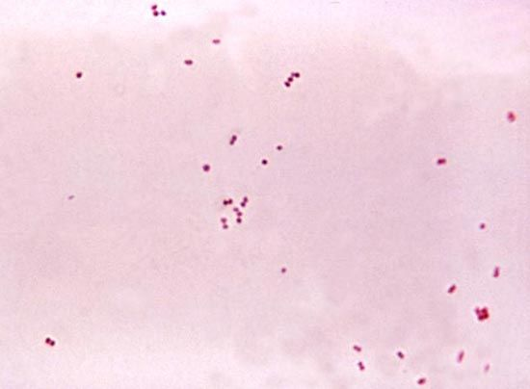
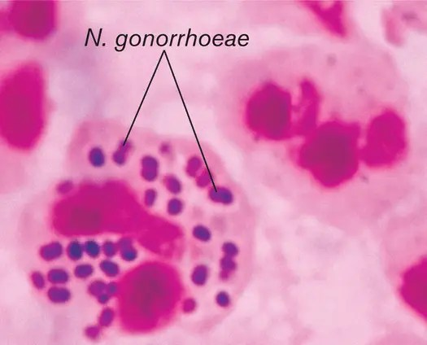
N. meningitidis
(or meningococci)
N. gonorrhoeae
(or gonococcus)

Slide 20
GRAM-POSITIVE BACILLI INFECTIONS

Slide 21
Corynebacterium species
Club-shaped Gram-positive bacilli.
C. diphtheriae is the most important species pathogenic to man
Other species called as diphtheroids are mainly commensals.

Slide 22

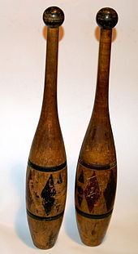
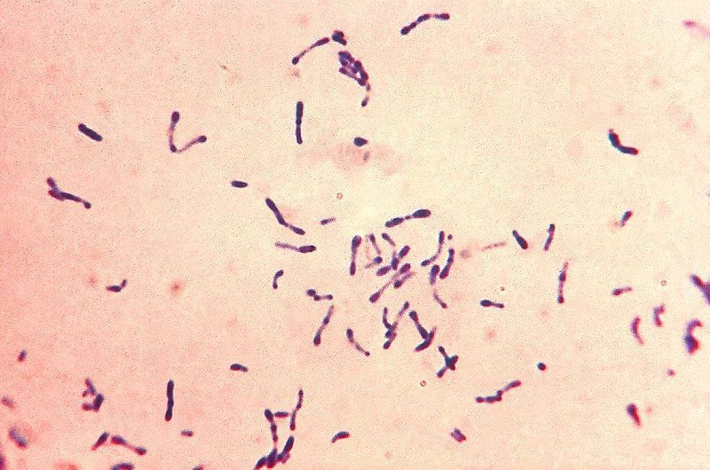
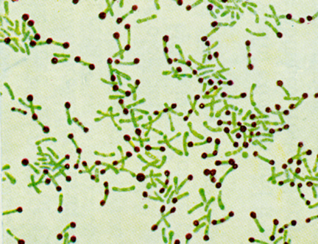
Club-shaped Gram-positive bacilli:
Corynebacterium diphtheriae
Chinese letter appearance on
ALBERT STAIN:
Corynebacterium diphtheriae

Slide 23
Mycobacteria
Acid-fast obligate aerobes.
Classified into:
  M. tuberculosis complex: causes Tuberculosis in humans.
  M. leprae (Hansen’s bacillus): causes Leprosy
  Nontuberculous mycobacteria (NTM)

Slide 24
GRAM-NEGATIVE BACILLI INFECTION

Slide 25
Enterobacterals
Gram negative bacilli, catalase positive and oxidase negative; glucose fermenters and nitrate reducers.
Most of them - commensals in human intestine, called coliform bacilli whereas some are enteric pathogens.

Slide 26
Escherichia coli
Lactose fermenting & motile.
Commensal in human intestine.
One of the most common pathogens encountered clinically.
Clinical manifestations of E. coli:
UTI caused by uropathogenic E. coli (UPEC).
Most common cause of UTI.

Slide 27
Other clinical manifestations of E. coli:
Diarrhea caused by diarrheagenic E. Coli.
Abdominal infections (like Bacterial peritonitis)
Pneumonia
Meningitis (especially in neonates)
Wound and soft tissue infections such as cellulitis.

Slide 28
Klebsiella pneumoniae
Lactose fermenter.
Non-motile, capsulated, and produces mucoid colonies
Cause UTI and various infections - lobar pneumonia, meningitis
(in neonates), septicemia and pyogenic infections such as abscesses and wound infections.

Slide 29
Shigella
Non Lactose Fermenting, non-motile.
Causative the agent of bacillary dysentery.
Characterized by passage of loose stool mixed with blood and mucus.
Comprises of four species— S. dysenteriae, S. flexneri, S. boydii and S. sonnei.

Slide 30
Salmonella
Non lactose fermenting, motile.
Classified into typhoidal and non typhoidal serotypes.
Typhoidal salmonella
Includes serotypes – S. Typhi and S. Paratyphi A, B, and C.
Cause enteric fever (typhoid/paratyphoid fever).
Non-typhoidal salmonella or NTS:
Causing food-borne gastroenteritis and bacteremia

Slide 31
Vibrio
Non lactose fermenting, motility (darting motility)
Most common pathogenic species is : Vibrio cholera.
Causative agent of an acute diarrheal disease - Cholera.

Slide 32
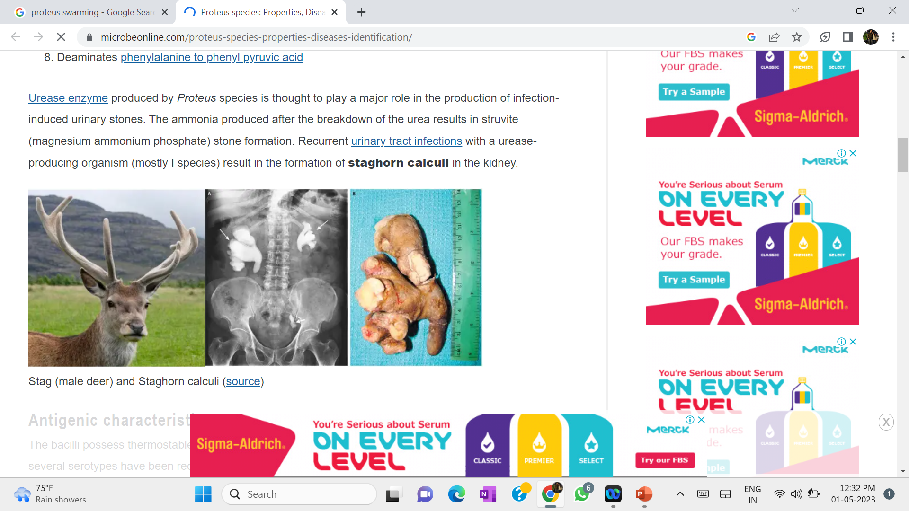
PROTEUS
Non lactose fermenter
Motile by swarming
Causes UTI
(Staghorn appearance calculi).

Slide 33
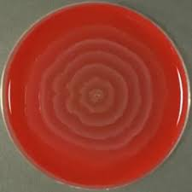

Swarming motility of proteus
Like….Swarm of Fishes in sea

Slide 34
Other Gram-negative Bacilli
Important human pathogens are:
  Pseudomonas aeruginosa
  Acinetobacter species
  Burkholderia species

Slide 35
Pseudomonas aeruginosa
Major pathogenic species, causing infection among hospitalized patients and in patients with cystic fibrosis.
Capable of developing widespread resistance to multiple antibiotics and disinfectants.
Oxidase positive, Produces Blue-Green Pigment.

Slide 36
Clinical manifestations:
Ventilator associated pneumonia, surgical site infections, nosocomial bacteremia, burn wound infection, etc.

Slide 37
Acinetobacter species
Saprophytic bacilli, can cause wide-spread healthcare associated infections especially in patients with underlying diseases and immunosuppression.

Slide 38
THANK YOU

