Slide 1
ORTHOMYXOVIRUS
Dr. Priyanka Chaturvedi
Assistant Professor

Slide 2
INTRODUCTION
Group of viruses that bind to mucin receptors on the surface of RBCs (myxo in Greek meaning ‘mucin’).
Mucin receptors causes clumping of RBCs together to cause hemagglutination.
Myxoviruses are divided into two families—
(1) Orthomyxoviridae and (2) Paramyxoviridae

Slide 3
INTRODUCTION
Orthomyxoviridae:
Influenza viruses — cause upper respiratory tract infections (URTIs), rarely pneumonia

Slide 4
INFLUENZA

Slide 5
Morphology
Influenza viruses consist of 4 genera- Influenza A, B, C and D
Spherical and 80–120 nm in size
Helical nucleocapsid, surrounded by an envelope

Slide 6
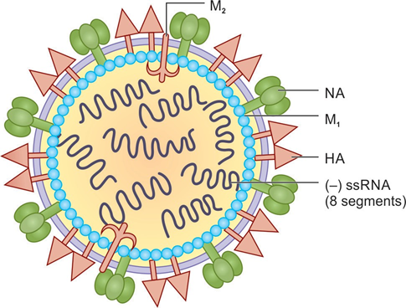
Morphology

Slide 7
Morphology
Viral RNA comprises of multiple segments of negative sense single stranded RNA. Each segment codes for a specific viral protein having a specific function.
    Influenza A & B contain eight segments of RNA
    Influenza C & D contains seven segments of RNA. The segment coding for neuraminidase is absent.

Slide 8
Morphology
Site of replication: RNA replication occurs in - nucleus
Viral proteins: Contains eight structural proteins (PB1, PB2, PA, NP, HA, NA, M1 and M2) and two non-structural proteins (NS1 and NS2)

Slide 9
Morphology
Envelope: Lipid envelope into which two types of glycoproteins are inserted.
    Hemagglutinin (HA)
    Neuraminidase (NA)

Slide 10
Morphology
Hemagglutinin (HA): Triangular-shaped peplomer - binds to mucin or sialic acid receptors on the respiratory epithelial cells – facilitating viral entry
Neuraminidase (NA): Mushroom shaped – sialidase enzyme - degrades the sialic acid receptors on the host cells - facilitates release of virus particles from infected cell surfaces

Slide 11
Antigenic Subtypes and Nomenclature
Based on RNP and M proteins, influenza viruses - divided into four genera: A, B and C and D
Subtypes- Based on HA and NA antigens,
Influenza A has - 18 H subtypes (H1 to H18) and 11 N subtypes (N1-N11).
Influenza B and C viruses - have subtypes - not designated.
Influenza D virus - infects cattle and are not pathogenic to humans.

Slide 12
Antigenic Subtypes and Nomenclature
Standard nomenclature system:
Influenza Type/ host (indicated only for non-human origin)/ geographic origin/strain number/year of isolation/(HA NA subtype).
Examples:
  Human strain- Influenza A/Hong Kong/03/1968(H3N2)
  Nonhuman strain- Influenza A/swine/Iowa/15/1930(H1N1)

Slide 13
Antigenic Variation
Antigenic variation is the unique property of Influenza viruses, which is due to the result of antigenic changes occurring in HA and NA peplomers.
  Antigenic drift
  Antigenic shift

Slide 14
Antigenic drift
Minor change - due to point mutations in the HA/NA gene.
Results in alteration of amino acid sequence of the antigenic sites on HA/NA, such that virus can escape recognition by the host's immune system.
New variant must sustain two or more mutations to become epidemiologically significant.
Seen in both Influenza virus type-A&B
Results in outbreaks and minor periodic epidemics - occurs more frequently every 2-3 years.

Slide 15
Antigenic Shift
Abrupt, major drastic, discontinuous variation in the sequence of a viral surface protein (HA/NA)
Due to genetic re-assortment between genomes of two or more influenza viruses infecting the same host cells, resulting in a new virus strain, unrelated antigenically to the predecessor strains.
Occurs only in Influenza A virus
Pandemics and major epidemics- e.g. H1N1 pandemics of 2009.
Occurs less frequently every 10-20 years.

Slide 16
Pathogenesis
Transmission: (i) inhalation of respiratory droplets, (ii) via contact with surfaces or fomites.
Target cell entry: Viral HA attaches to specific sialic acid receptors on the respiratory mucosa – viral entry
Multiply locally

Slide 17
Pathogenesis
Spread: To the lower respiratory tract or spills over bloodstream –extrapulmonary sites
Local damage: Cellular destruction and desquamation of superficial mucosa of the respiratory tract – secondary bacterial infection.

Slide 18
Clinical Manifestations
Incubation period - 18-72 hours
Uncomplicated Influenza (Flu syndrome):
    Asymptomatic or minor upper respiratory symptoms - chills, headache, and dry cough, followed by high grade fever, myalgia and anorexia.
    Self-limiting condition.

Slide 19
Complications
Pneumonia:
Secondary bacterial pneumonia - most common
Common agents are staphylococci, pneumococci and Haemophilus influenzae.
Primary Influenza pneumonia - rare - leads to more severe complication.

Slide 20
Complications
Other pulmonary complications:
  Worsening of COPD
  Exacerbation of chronic bronchitis and asthma.

Slide 21
Epidemiology
Incidence: 3–5 million cases of severe illness and 3-6 lakhs of deaths occur worldwide.
Seasonality: Common during winters.
Epidemiological pattern: Depends upon the nature of antigenic variation that occurs in the influenza types.

Slide 22
Risk Factors
Age: Child of age < 2 years or age ≥ 65 years
Chronic diseases: Chronic pulmonary, cardiac, renal, hematologic, metabolic, neurological, and neurodevelopmental disorders
Immunosuppression (including HIV/AIDS, use of long term corticosteroids, post-transplant patients), diabetes mellitus.

Slide 23
Major influenza outbreaks
Years | Subtype | Extent of outbreak
1889–1890 | H2N8 | Severe pandemic
1900–1903 | H3N8 | Moderate epidemic
1918–1919 | H1N1a (HswN1) (Spanish flu) | Severe pandemic
1933–1935 | H1N1a (H0N1) | Mild epidemic
1946–1947 | H1N1 | Mild epidemic
1957–1958 | H2N2 (Asian flu) | Severe pandemic
1968–1969 | H3N2 (Hong Kong flu) | Moderate pandemic
1977–1978b | H1N1 (Russian flu) | Mild pandemic
2009–2010 | H1N1 pdm09 | Pandemic

Slide 24
Sialic Acid Receptors
Sialic acid receptors - found on the host cell surfaces are specific for HA antigens
α 2-6 sialic acid receptors:
  Specific for human influenza strains and are found abundantly on human upper respiratory tract epithelium but not on lower upper respiratory tract.

Slide 25
Sialic Acid Receptors
α 2-3 sialic acid receptors:
  Specific for avian influenza strains
  Found abundantly on bird’s intestinal epithelium.
  In humans, they are present in very few numbers on lower upper respiratory tract.

Slide 26
Sialic Acid Receptors
Why pigs are the most common mixing vessels?
  Both α 2-3 &α 2-6 sialic acid receptors are found on the respiratory epithelium of pigs and swine flu strains – hence, specificity for both the receptor types.
  Pigs can be infected simultaneously by human, swine and avian strains - mixing vessel.
  Reassortment - takes place inside the same swine cell.

Slide 27
Avian Flu
Birds - primary reservoir
All influenza subtypes (18H types and 11N types) found in birds and some of the subtypes - transmitted to mammals.
Avian flu strains are highly virulent.
They possess PB1F2 protein which targets host mitochondria causing apoptosis.

Slide 28
Avian Flu Infection in Birds
Bird flu strains - highly lethal to chickens and turkeys -major cause of economic loss in poultry due to mortality in chickens.
Avian flu multiplies in intestinal tracts of birds - shed through feces into water.
Influenza viruses do not undergo antigenic variation in birds due to short life span of birds.

Slide 29
Avian Flu Infection in Humans
Till date, all human pandemic strains - originated by reassortment between avian and human influenza viruses - mixing has occurred in pigs.
A/H5N1 - most common avian flu strain - endemic in the world for the past 15 years.
Origin - first reported from Hong Kong in 1997 - spread to various countries including India within few years.

Slide 30
Avian Flu Infection in Humans
Less morbidity and more mortality
Clinical feature - H5N1 avian flu strains - pneumonia and extra-pulmonary manifestations - diarrhoea and CNS involvement.
Other avian flu strains that can cause human infections are-
  A/H7N7(Netherlands)
  A/H9N2 ( Hong Kong)
  A/H7N9 (caused an outbreak in China, 2013)

Slide 31
Laboratory Diagnosis (Avian Flu)
Avian flu strains can be identified by real time reverse transcriptase PCR detecting specific HA and NA genes.

Slide 32
Influenza A (H1N1) pdm09
Most recent pandemic of influenza, emerged in California in March 2009.
Rapidly spread to the entire world including India over the next few months.
WHO declared the pandemic on 11th June 2009.

Slide 33
Epidemiology
Origin: H1N1 2009 flu originated by genetic reassortment of four strains
(1 human strain + 2 swine strains + 1 avian strain) and the mixing had occurred in pigs.

Slide 34
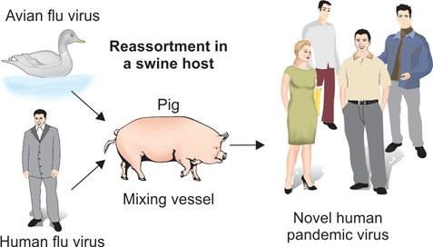
Epidemiology

Slide 35
Epidemiology
Transmission: From human to human - rapid spread
Less virulent (as it lacks the PB1 F2 protein)
More morbidity but less mortality.

Slide 36
Clinical Features
Uncomplicated influenza: Mild upper respiratory tract illness and diarrhea
Complicated/severe influenza - high-risk groups - secondary bacterial pneumonia, dehydration, CNS involvement, and multi-organ failure.

Slide 37
Laboratory diagnosis of Influenza
Specimen: nasopharyngeal swab, kept at 4°C
Isolation of virus:
  Inoculation in embryonated eggs and primary monkey kidney cell lines
  Growth is detected by hemadsorption, hemagglutination test.

Slide 38
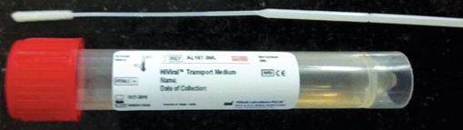
Laboratory diagnosis of Influenza

Slide 39
Laboratory diagnosis of Influenza
Viral antigens detection by direct IF test
Molecular methods: Simultaneously detects - A/H1N1, A/H3N2, Influenza B
  RT PCR: detects viral RNA
  Real time-RT PCR: quantifies viral RNA
Antibody detection by hemagglutination inhibition test, neutralization test and ELISA.

Slide 40
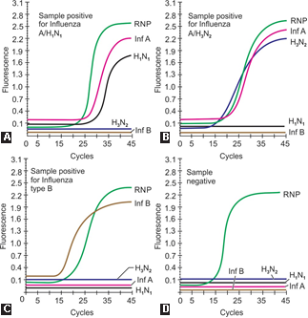
Real time RT-PCR showing the result (amplification curves) of specimen(s) tested positive for Influenza type
Result is expressed as the emission of fluorescence during the cycles
A. A/H1N1
B. A/H3N2
C. Type B
D. Negative

Slide 42
Treatment of Influenza
Specific antiviral therapy - available for influenza virus infection.
Start therapy within 48 hours of onset of symptoms for influenza.
Neuraminidase inhibitors (zanamivir, oseltamivir, and peramivir)

Slide 43
Treatment of Influenza
Matrix protein M2 inhibitor - amantadine and rimantadine - given for some strains of influenza A infection.
Strains of A/H1N1 2009 flu and A/H5N1 avian flu and influenza B virus have developed resistance.

Slide 44
General Preventive Measures
Strict hand hygiene to be followed.
Isolation room: Patients should be kept at isolation room or cohorting to be followed.
Containment of coughs and sneezes
    Respiratory hygiene and cough etiquette
    Use of gloves and mask for staff and patient

Slide 45
General Preventive Measures
Work restriction: CDC recommends - people with influenza-like illness remain at home until at least 24 hours after they are free of fever (100° F) without the use of fever-reducing medications.

Slide 46
Vaccination Prophylaxis
Vaccine strains:
Based on WHO recommendations, influenza vaccines are prepared every year.
Strains to be included - isolated in the previous influenza seasons and strains that are anticipated to circulate in the upcoming season.

Slide 47
Vaccination Prophylaxis
Formulations: Cocktails containing two type A and one or two type B influenza strains.
  Trivalent form: This is the most common form available; comprises of three strains: A/H1N1, A/H3N2 and influenza B strain.
  Quadrivalent form: Comprise of four strains: A/H1N1, A/H3N2 and two lineages of influenza B strain

Slide 48
Vaccination Prophylaxis
Composition: The lineages of A/H1N1, A/H3N2 and influenza B strains -change every year.
Lineages different for northern and southern hemispheres
Types: Both injectable (inactivated) and nasal spray (live attenuated) vaccines are available.

Slide 49
Vaccination Prophylaxis
Injectable Vaccines:
Most widely used vaccines in immunization programmes.
Types: There are three types of injectable vaccines.
  Inactivated Influenza Vaccine (IIV)
  Cell Culture-based Inactivated Influenza Vaccine (ccIIV3)
  Recombinant Influenza Vaccine (RIV)

Slide 50
Vaccination Prophylaxis
Schedule: Single dose - intramuscular (IM) route; except for 6 month-8 year of age (2 doses are required ≥ 4 weeks apart).
Timing of vaccination: Optimally before onset of influenza season, i.e. by end of October.
Side effects: Mild reactions can occur in 5% of cases - redness at injection site, fever and aches. Serious side effects - rare.

Slide 51
Vaccination Prophylaxis
Indication: Routine annual influenza vaccination - recommended for all persons aged ≥6 months who do not have contraindications.
If facility are not feasible, then high-risk groups - first priority for vaccination

Slide 52
Vaccination Prophylaxis
Contraindication: IIV should not be administered to people who have allergy to eggs or have history of hypersensitivity to previous dose of vaccine.
Travelers: If travelling to an area of increased influenza activity; can consider vaccination, preferably ≥2 weeks before departure.

Slide 53
Vaccination Prophylaxis
Live Attenuated Influenza Vaccine (LAIV):
Generated by reassortment between currently circulating strains of influenza A and B virus - cold-adapted attenuated master strain –adapted to grow at 25–33°C.
Can grow in upper respiratory tract (at 33°C) but not in lower respiratory tract (at 37°C) - cause mild flu like symptoms

Slide 54
Vaccination Prophylaxis
Trivalent vaccine - intranasal spray
Indication: Given to all healthy persons of 2–49 years age (except in pregnancy), but is not given to high risk groups.

Slide 55
THANK YOU!

