Slide 1
ONCOGENIC VIRUSES
DR. PRIYANKA CHATURVEDI
ASSISTANT PROFESSOR

Slide 2
OVERVIEW
Among the organisms with oncogenic potential, viruses account for the majority.
Viruses account for 15% of all human malignancies.
Two vaccine preventable oncogenic viral infections:
Human papillomavirus causing carcinoma cervix
Hepatitis B virus causing liver cancer

Slide 3
OVERVIEW
Viral oncogenesis is a complex and multistep process
Multiple oncogenic events that occur to transform host cells into cancer cells.
Notes:
There are multiple oncogenic events that take place in order to transform the host cells into cancer cells.

Slide 4
OVERVIEW
Oncogenes
Oncogenes encode certain proteins (oncoproteins) that trigger the transformation of normal cells into cancer cells.
V-onc (viral oncogenes)
C-onc (cellular oncogenes)
Proto-oncogenes

Slide 5
OVERVIEW
V-onc (viral oncogenes): present in the VIRAL GENOME (in some retroviruses), essential for the replication of the virus.
C-onc (cellular oncogenes): cellular counter part of viral oncogenes present in the CANCER CELLS.
Proto-oncogenes: cellular counter part of viral oncogenes present in the NORMAL HOST CELLS

Slide 6
Genes Regulating Host Cell Growth
Four categories of genes present in the host cell, which regulate the cellular growth.
Defect in any of these regulatory genes
normal host cells into abnormal tumor cells.

Slide 7
Genes Regulating Host Cell Growth
1. Proto-oncogenes:
Over activation of proto-oncogenes lead to transformation of the host cells to cancer cell.
2. Anti-oncogenes or tumor suppressor genes:
Inactivation of this gene lead to transformation of the host cells to cancer cell.

Slide 8
Genes Regulating Host Cell Growth
3. Apoptosis-regulatory genes:
Control the programmed cell death by either upregulating or downregulating apoptosis.
4. DNA repair genes: Normal host genes that repair any mutations occurring during the cell growth. Failure of DNA repair genes lead to persistent mutation.

Slide 9
Events that Must Occur Before Oncogenesis
1. Establishing persistent infection: Long-term persistent infection by oncogenic virus due to prolonged cell interaction between the virus and the host cell.
2. Evades host immune response: The oncogenic virus follows various evasion mechanisms to bypass the host immune response (important for viral clearance), like:

Slide 10
Events that Must Occur Before Oncogenesis
Restricting the expression of viral genes.
Infecting the sites that are inaccessible to immune responses.
Infection and suppression of essential immune cells.

Slide 11
Events that Must Occur Before Oncogenesis
3. Immunosuppression of the host allows the cancer cells to proliferate and escape the host immune response.
4. Host cell susceptibility: Host cells may be permissive or non-permissive for replication of a given virus.
Notes:
Permissive cells support viral growth and replication of a progeny virus; non-permissive cells do not. Non-permissive cells refer to the host cells that either do not have surface receptors for viral attachment or do not support the viral replication or the release of virus progeny

Slide 12
Events that Must Occur Before Oncogenesis
Oncogenicity can occur both in permissive and non-permissive cells.
Risk is more when a non-permissive cell is infected by oncogenic virus, as the virus tries different ways to maintain its survival in a non-permissive cell and by doing so it may undergo some changes, which makes the cell immortal.

Slide 13
Events that Must Occur Before Oncogenesis
This is true for DNA tumor viruses.
In a permissive cell, the DNA tumor viruses are released by host cell lysis.
Hence, the DNA tumor viruses are not oncogenic to a permissive cell.

Slide 14
Events that Must Occur Before Oncogenesis
In contrast, RNA tumor viruses do not cause cell lysis, hence, they can be oncogenic to both permissive and non-permissive cells.

Slide 15
Oncogenic RNA viruses
[A] Oncogenic Retroviruses
Retroviruses are classical example of oncogenic virus.
Possess reverse transcriptase enzyme, that coverts viral RNA to DNA, which is subsequently inserted into host chromosome.

Slide 16
Oncogenic RNA viruses
Oncogenic retroviruses are of two types.
Acutely-transforming viruses:
Possess viral oncogenes (V.onc) in their RNA which directly induce oncogenesis.
Examples : Rous sarcoma virus.

Slide 17
Oncogenic RNA viruses
2. Slow transforming viruses:
Possess additional regulatory gene (e.g. tax gene for HTLV-1and tat gene for HIV) which after inserting into host chromosome, activates the host cell machineries to induces oncogenesis.
Examples: HIV and HTLV-1

Slide 18
Human T Cell Lymphotropic Virus (HTLV)
Family: Retroviridae
Genus: Deltaretrovirus
Members:
HTLV-I
HTLV-II

Slide 19
Human T Cell Lymphotropic Virus (HTLV)
Potential human oncogenic virus
Associated with several malignancies:
(1) Adult T cell leukemia/lymphoma
(2) Cutaneous T cell lymphoma
Transmission:
(1) From mother to child especially via breast milk (most common)
(2) Sexual
(3) Infected blood

Slide 20
Human T Cell Lymphotropic Virus (HTLV)
Target cells: CD4 T cells.
Receptor: GLUT1 (glucose transporter protein-1) on CD4 T cell.
Mechanisms of oncogenesis: Tax gene which has oncogenic potential

Slide 21
Human T Cell Lymphotropic Virus (HTLV): Tax gene
Activates cellular genes involved in T cells proliferation
Promotes cell growth cycle
Activates nuclear factor κβ (NF-κβ),[regulates host antiapoptotic genes]
Interferes with DNA-repair pathways [leads to sustained DNA mutation]

Slide 22
AIDS Associated Malignancies
HIV/AIDS is associated several malignancies, which can be grouped into:
AIDS-defining cancers
Non- AIDS-defining cancers
a) AIDS-defining cancers: These cancers have been enlisted in WHO clinical staging of HIV/AIDS which include:
i) Non-Hodgkin’s lymphomas (NHLs): It is the most common cancer in PLHIV worldwide.

Slide 23
AIDS Associated Malignancies
Common NHLs include:
Burkitt’s lymphoma (associated with EBV)
Diffuse large B cell lymphoma– often involving the CNS
Primary effusion lymphoma (associated with HHV-8)
ii) Kaposi’s sarcoma—in association with HHV-8
iii) Invasive cervical carcinoma—in association with HPV.

Slide 24
AIDS Associated Malignancies
b) Non-AIDS-defining cancers:
Classical Hodgkin’s lymphoma
Anal cancers
Lung cancers.

Slide 25
AIDS Associated Malignancies
Mechanisms of Oncogenesis
Tat protein, a nonstructural protein of HIV virus replication is linked to the malignancies.

Slide 26
Hepatitis C Virus Associated Malignancy
Hepatitis C virus is the only oncogenic virus that does not get integrated with host chromosome & its RNA remains in the host cell.
Strongly linked to LIVER CANCER
Oncogenic mechanisms:
Chronic liver cell injury and compensatory regeneration
HCV core protein, activates growth promoting signal transduction pathways.

Slide 27
Oncogenic DNA viruses
Oncogenic DNA viruses include
EBV
HHV-8
HPV
HBV

Slide 28
EBV Associated Malignancies
1. Burkitt’s lymphoma (tumor of the jaw in children and young adults).
2. Nasopharyngeal carcinoma: Seen among Chinese people with history of intake of salted fish.

Slide 29
EBV Associated Malignancies
3. Hodgkin’s lymphoma (mixed-cellularity type): EBV DNA is found in Reed-Sternberg cells (in 50% cases).
4. NHL (Non-Hodgkin’s lymphoma): All CNS non- Hodgkin’s lymphomas and 50% of systemic non- Hodgkin’s lymphomas

Slide 30
Mechanism of Oncogenesis of EBV
1. Infects B lymphocytes by attaching to the complement receptor (CR2) or CD21.
2. Such infected B cells with EBV become immortalized and acquire the ability to grow indefinitely in cell lines

Slide 31
Mechanism of Oncogenesis of EBV
3. Latent Membrane Protein -1 is the most important viral oncoprotein coated on the surface of the infected cells:
i) Behaves as CD40 receptor, where helper T cell attaches and stimulate B cell growth

Slide 32
Mechanism of Oncogenesis of EBV
ii) Prevents apoptosis by activating antiapoptotic factor BCL2
iii) Induces the expression of vascular endothelial growth factor (VEGF) which contribute to the oncogenesis of nasopharyngeal carcinoma

Slide 33
Mechanism of Oncogenesis of EBV
4. Viral EBNA-2 (EBV Nuclear Antigen) activates host cell cyclin-D, and the protooncogene src, to promotes cell proliferation
5. VIL-10 (viral interleukin 10): Modulates the transformation of B cells.

Slide 34
Human Herpesvirus 8 Associated Malignancies
Human Herpesvirus 8 (HHV-8)
- discovered in 1994 in patients with Kaposi’s sarcoma.
In immunocompromised individuals HHV-8 is associated with:
Kaposi’s sarcoma: A soft tissue sarcoma of vascular origin; characterized by red to purple color growth under the skin, mouth, oral mucosa, lymph nodes, or in other organs
Primary effusion lymphoma (body cavity-based lymphomas).

Slide 35
Mechanism of Oncogenesis of HHV-8
HHV8 infects the endothelial cells.
Expression of early lytic genes of HHV-8, induce the host cells to secrete the angiogenic, inflammatory and proliferative factors that leads to continuous growth and transformation of cells.

Slide 36
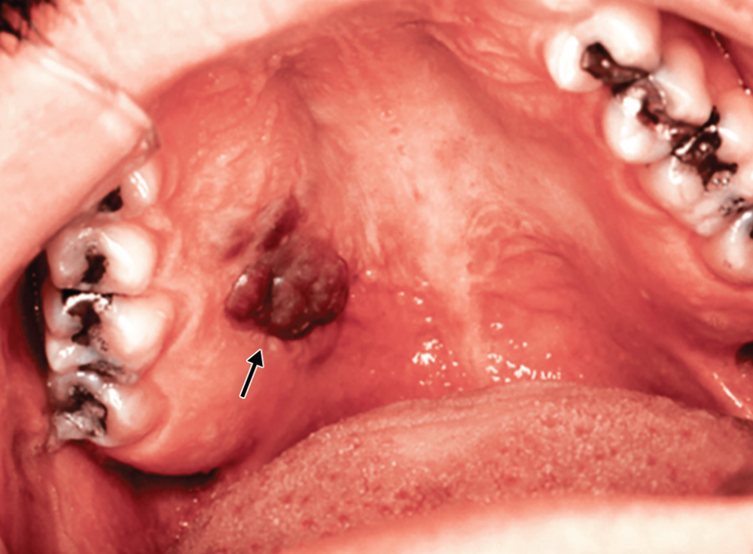
Kaposi’s sarcoma of the hard palate secondary to AIDS infection (arrow showing)

Slide 37
Human Papillomavirus (HPV ) Infections
Human papillomavirus (HPV) has selective tropism for epithelium of skin and mucous membranes and produces an array of infections ranging from benign warts, to malignant neoplasia of cervix.
Morphology
Papillomaviruses are non-enveloped, have icosahedral capsids and contain a circular dsDNA.

Slide 38
Human Papillomavirus (HPV ) Infections
Viral genome consists of an early (E) region, a late (L)
region, and a noncoding regulatory region.
Early region genes (E1-E7):
-They code for early nonstructural proteins.
-The E1 and E2 proteins modulate viral DNA replication.

Slide 39
Human Papillomavirus (HPV ) Infections
Products of early genes E6 and E7 have oncogenic potential, by following ways:
E6 protein facilitates the degradation of the p53 tumor-suppressor protein
E7 protein binds to the retinoblastoma proteins.

Slide 40
Human Papillomavirus (HPV ) Infections
Clinical Manifestations
Benign warts: They are small, hard, rough growth on the skin.
Epidermodysplasia verruciformis: It is a rare benign condition, that may progress to squamous cell malignancy (seen with serotypes 5, 8, 9, 12, 17, 20, 36, 47), particularly in sun-exposed areas

Slide 41
Human Papillomavirus (HPV ) Infections
Cervical lesions: Can produce both benign and malignant cervical lesions, depending upon the serotypes involved.
CIN (Cervical Intraepithelial Neoplasia) is a benign condition, associated with low-risk serotypes 6 and 11
Carcinoma cervix (squamous cell) is associated with high-risk serotypes such as 16, 18, 31, 33, 35, 39, 45, 51, 52, 56, 58 and 59.

Slide 42
Mechanism of Oncogenesis of HPV
Human papillomavirus genome consists of :
Early (E) region [Products of E6 & E7 have oncogenic potential]
Late (L) region
--E6 inhibits p53 → inhibiting the activation of apoptosis promoting gene bax → inhibition of apoptosis and also inhibit activation of tumor suppressor gene p21.

Slide 43
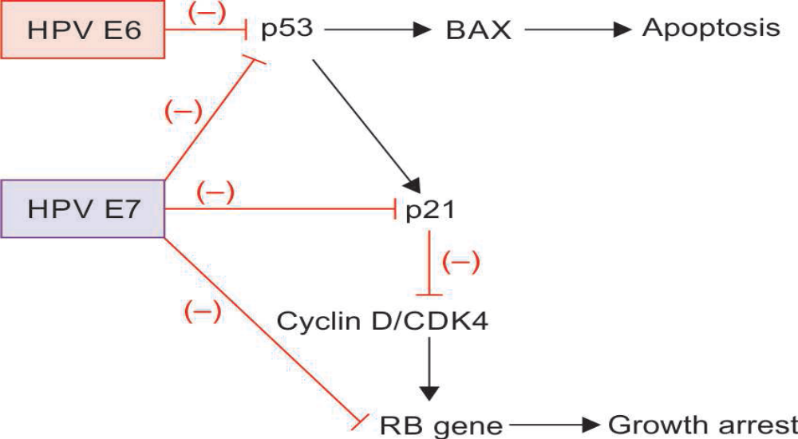
Mechanism of Oncogenesis of HPV
Mechanism of oncogenesis by human papillomavirus

Slide 44
Mechanism of Oncogenesis of HPV
--E7 inhibits the tumor suppressor gene RB (retinoblastoma gene) by:
Inhibiting p53
Inhibiting p21
Directly inhibiting RB gene.
OTHER FACTORS
-Cigarette smoking
-Coexisting microbial infections
-Dietary deficiencies
-Hormonal changes.

Slide 45
Laboratory Diagnosis of HPV
Molecular methods:
To detect HPV DNA
To identify specific virus types by targeting genes coding for E6 and E7 regions
Solutions of 5% acetic acid can be applied to improve visibility of lesions.
Cytologic evidence of HPV infection is detected by:
Papanicolaou smears prepared from cervical or anal scrapings
Histopathological staining of biopsies.

Slide 46
Prevention (HPV Vaccine)
Recently developed HPV vaccines have shown dramatic reduction in the rates of all HPV infections including cervical cancers.
It is recommended to ALL ADOLESCENT BOYS AND GIRLS AT AGES 11–12 YEARS.

Slide 47
Prevention (HPV Vaccine)
Subunit vaccine consists of virus-like particles composed of HPV L1 proteins which are produced in yeast by DNA recombinant technology
Both NINE VALENT AND BIVALENT VACCINES are licensed
Nine valent vaccine (Gardasil 9):
7 common cancer-causing serotypes (16, 18, 31, 33, 45, 52 and 58) & 2 noncancer causing serotypes (6 and 11)
Given IM; at 11-12 years, as 2 doses (at least 6–12 months gap).
If first dose is given after 15 years of age, then 3 doses are recommended (0, 2 and 6 months)

Slide 48
Prevention (HPV Vaccine)
HPV vaccination is also recommended for everyone above age 26 years (if not vaccinated already)
Bivalent vaccine (Cervarix, GSK) includes only the high-risk serotypes 16 and 18.
Given as single dose, IM.

Slide 49
Hepatitis B Virus Associated Malignancy
Hepatitis B virus (HBV), in adjunction with hepatitis C is responsible for 70–85% of hepatocellular carcinomas worldwide.

Slide 50
Mechanism of Oncogenesis of HBV
The HBV genome gets integrated with the host genome randomly in the target cells.
Immunologically mediated chronic inflammation: the most important mechanism in the pathogenesis of viral-induced HCC.

Slide 51
THANK YOU

