Slide 1
OPPORTUNISTIC INTESTINAL COCCIDIAN
PARASITIC INFECTIONS
Dr Priyanka Chaturvedi
Assistant Professor
Dept of Microbiology

Slide 2
OPPORTUNISTIC INTESTINAL COCCIDIAN
PARASITIC INFECTIONS
Cryptosporidium, Cyclospora, and Cystoisospora are the intestinal coccidian parasites - cause opportunistic infections in HIV infected patients producing profuse watery diarrhea.
Diagnosed by detection of acid fast oocysts in stool microscopy

Slide 3
OPPORTUNISTIC INTESTINAL COCCIDIAN
PARASITIC INFECTIONS
Cryptosporidium species infecting man – classified as two separate species, C. parvum (mammals, including humans) and C. hominis (primarily humans).

Slide 4
OPPORTUNISTIC INTESTINAL COCCIDIAN
PARASITIC INFECTIONS
Cyclospora cayetanensis - recently described coccidian parasite, as human intestinal pathogen.
Isospora belli - recently renamed as Cystoisospora belli - only species that infects man.

Slide 5
MORPHOLOGY
The life cycle of coccidian parasites passes through various stages - oocyst, trophozoite, schizont (meront), merozoite, and zygote.
Oocyst is the infective form to man as well as the diagnostic form excreted in the feces.

Slide 6
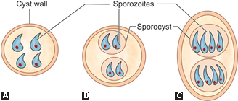
SPORULATED OOCYSTS
A. Cryptosporidium; B. Cyclospora; C. Cystoisospora.

Slide 7
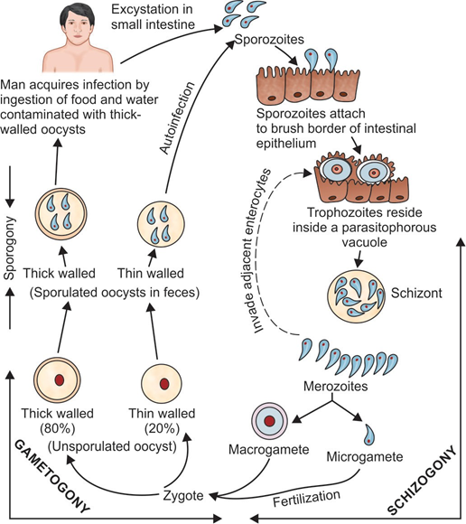
LIFE CYCLE

Slide 8
EPIDEMIOLOGY
Seen worldwide - more prevalent in tropical and subtropical climates of developing countries from South America, Africa, and Southeast Asia including India.

Slide 9
EPIDEMIOLOGY (Cont..)
Risk factors - More common in area with poor sanitation and HIV infected individuals
Peak age: Infants and children are commonly affected
Source of infection - rainwater lodges and swimming pool, recreational water, or contaminated food.

Slide 10
PATHOGENESIS
Excystation: Oocyst secretes proteases and aminopeptidases - facilitate excystation in small intestine, releasing sporozoites
Attachment: Sporozoites attach to the brush border epithelium of the small intestine (ileum) -CP47 (47 kDa Cryptosporidium protein)

Slide 11
PATHOGENESIS (Cont..)
Penetration: Discharges from the apicomplex present in the anterior end of the sporozoites help in invasion
Vacuole: Parasitophorous vacuole near the microvilli surface of the host cells

Slide 12
PATHOGENESIS (Cont..)
Cytokines: Release cytokines like tumor necrosis factor (TNF)-α, IL-8, prostaglandins, etc. which induce Inflammation
These factors increase intestinal secretion of chloride and water and decrease the sodium absorption leading to fluid loss and diarrhea.

Slide 13
CLINICAL FEATURES
Immunocompetent Hosts:
Majority of infections - asymptomatic.
Some individuals develop symptoms - average incubation period of about 1 week.
Watery non-bloody diarrhea - common presentation.
Abdominal pain, nausea, anorexia, fever, and/or weight loss may be present
Self-limiting - subsides within 1–2 weeks

Slide 14
CLINICAL FEATURES
Immunocompromised Hosts (e.g. AIDS):
Chronic, persistent profuse diarrhea (1–25 L/day).
Severe weight loss, wasting and abdominal pain .
Extraintestinal manifestations - biliary tract infection (sclerosing cholangitis), respiratory tract infection, and pancreatitis
Disease is more severe in patients with AIDS when CD4+ T cell counts become <100/μL

Slide 15
LABORATORY DIAGNOSIS

Slide 16
Direct Microscopy (Stool Examination)
Sample collection: Three stool samples should be collected. Rarely (in HIV positive patients), sputum, bronchial wash, duodenal or jejunal aspirate can be collected
Direct wet mount: Highly refractile, double-walled oocyst

Slide 17
Direct Microscopy (Stool Examination)
Concentration technique: If the oocyst load is less, then various techniques are used to concentrate the stool sample
Acid-fast staining: Oocysts are acid-fast to 0.5–1% sulfuric acid or acid alcohol and appear as red color oocysts against blue back ground

Slide 18
Direct Microscopy
(Stool Examination)
Direct fluorescent antibody staining: Available for cryptosporidiosis - oocysts can be detected by using fluorescent labeled monoclonal antibody directed against cyst wall antigens.
Autofluorescence: Oocysts of Cyclospora fluoresce when viewed under ultraviolet epifluorescence microscopy.
Phase contrast microscopy

Slide 19
Differences between Cryptosporidium, Cyclospora and Cystoisospora

Slide 20
PROPERTY | CRYPTOSPORIDIUM | CYCLOSPORA | CYSTOISOSPORA
Infective form | Sporulated oocyst | Sporulated oocyst | Sporulated oocyst
Diagnostic form | Sporulated oocyst | Unsporulated oocyst | Unsporulated oocyst
Oocyst size | 4–6 mm | 8–10 mm | 20–33 mm
Oocyst shape | Round | Round | Oval
Sporulated oocyst contain | Four sporozoites | Two sporocysts, each having two sporozoites | Two sporocysts, each having four sporozoites

Slide 21
Property | Cryptosporidium | Cyclospora | Cystoisospora
Acid-fastness | Uniformly acid-fast | Variable acid-fast | Uniformly acid-fast
Autofluorescence | No, but can be stained with fluorescent dye | Autofluorescence ++ | Autofluorescence +/-

Slide 22
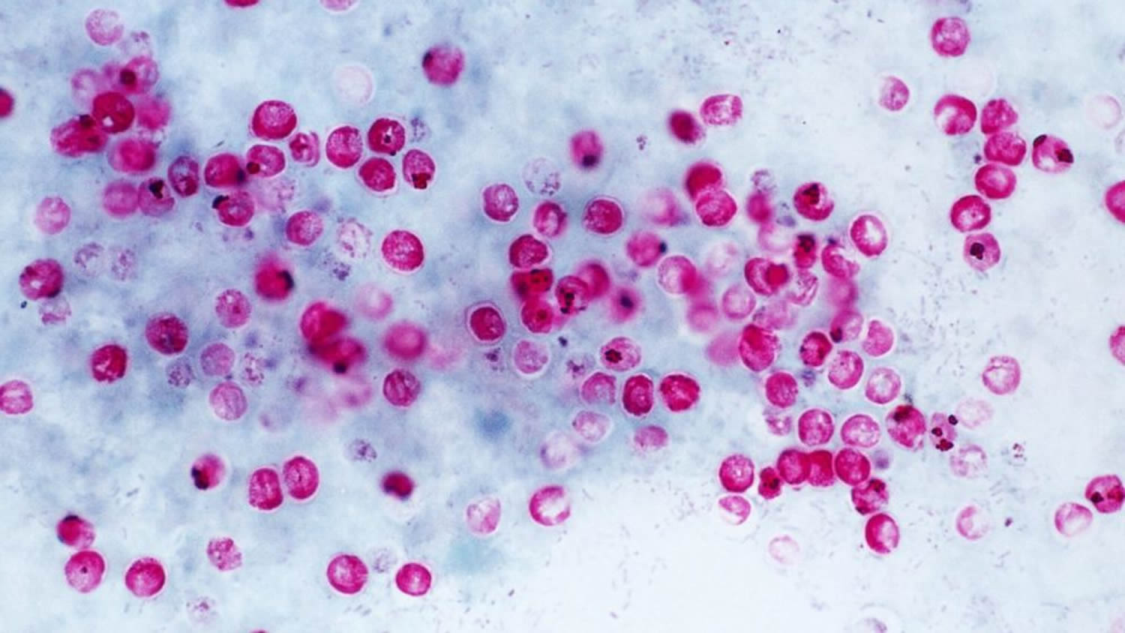
Cryptosporidium species
Modified acid-fast stain showing RED COLOURED OOCYSTS

Slide 23
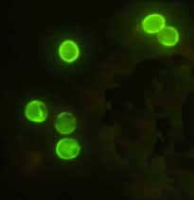
Cryptosporidium species
B. Direct fluorescent antibody staining shows BRILLIANT GREEN FLUORESCENT OOCYSTS

Slide 24
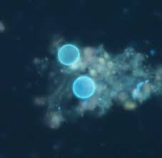
Cyclospora species
B. Epifluorescence microscopy showing
AUTO-FLUORESCENT OOCYSTS

Slide 25
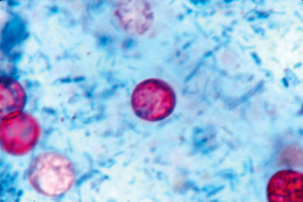
Cyclospora species
C. Modified acid-fast stain showing RED COLOURED OOCYSTS

Slide 26
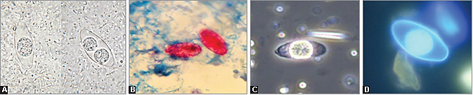
Cystoisospora belli
Saline mount preparation shows
Left—UNSPORULATED OOCYST
Right—SPORULATED OOCYST

Slide 27
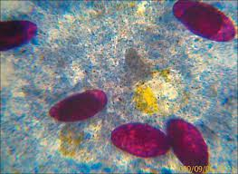
Cystoisospora belli
B. Modified acid-fast stain showing RED COLOURED OOCYSTS

Slide 28
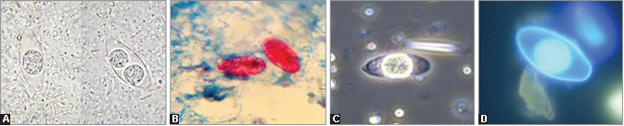
Cystoisospora belli
C. Phase contrast microscopy showing OOCYST

Slide 29
Cystoisospora belli
D. Fluorescent stained smears showing OOCYST.

Slide 30
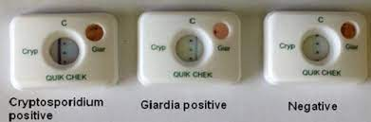
Antigen Detection from Stool
ELISA
ICT

Slide 31
Antibody Detection
ELISA are available detecting antibodies in patient’s serum against oocyst antigens of Cryptosporidium or Cyclospora.

Slide 32
Molecular Diagnosis
PCR or real-time PCR can be performed to detect specific genes such as 18S rRNA or small subunit rRNA.
BioFire FilmArray

Slide 33
Other Methods
Low CD4-T lymphocyte count (especially in HIV positive patient)
Fecal leukocyte marker—lactoferrin is increased in 75% of cases indicating increase pus cells in feces.

Slide 34
Treatment of Intestinal coccidian parasitic infections
Mild cases
Self-limiting, requires fluid replacement like ORS.
Lactose-free glutamine supplemented diet is preferred for cryptosporidiosis.

Slide 35
Treatment of Intestinal coccidian parasitic infections
Severe cases
Cryptosporidiosis: Nitazoxanide is given to adults
Cyclosporiasis and cystoisosporiasis: Cotrimoxazole (for 7-10 days).

Slide 36
Prevention
Requires minimizing exposure to infectious oocysts in human or animal feces
Proper hand washing, use of submicron water filters, use of appropriate disinfectants/sterilants to kill the oocysts (such as hydrogen peroxide, steam sterilization), improved personal hygiene are some of the efforts to prevent transmission.

Slide 37
MCQs

Slide 38
About Cryptosporidium. All are true except:
a. Shape round
b. Size (4–6 μm)
c. Causes cholangitis
d. Having two sporozoites

Slide 39
2. True about cryptosporidium are all except:
a. Oocyst chorine resistant
b. Acid fast oocyst
c. Oocyst > 100 micro meters
d. Enzyme immune assay done

Slide 40
3. Which of the following is not a coccidian?
a. Isospora
b. Cyclospora
c. Crytosporidia
d. Enterocytozoon

Slide 41
4. Cryptosporidium cyst identified by which stain in stool sample?
a. PAS
b. H and E
c. Giemsa
d. Acid fast stain

Slide 42
5. 25-years-old male presented with diarrhea for 6 months. On examination the causative agent was found to be acid fast with 12 micro meter diameter. The most likely agent is:
a. Cryptosporidium
b. Isospora
c. Cyclospora
d. Giardia

Slide 43
THANK YOU

