Slide 1
Atypical pneumonia
Dr Priyanka Chaturvedi
Assistant Professor

Slide 2
INTRODUCTION
Infection occurring in the interstitial space of lungs.
Cough is characteristically non-productive.
Respiratory viruses - influenza viruses, corona viruses, respiratory syncytial virus, Epstein–Barr virus and adenoviruses

Slide 3

MYCOPLASMA

Slide 4
MYCOPLASMA
Smallest microbes capable of free-living in the environment and self-replicating on artificial culture media
Very small (150–350 nm), filterable
Can grow on artificial cell-free culture media

Slide 5
General Properties of Mycoplasma
Lack cell wall
Have a TRIPLE LAYERED CELL MEMBRANE containing sterol - Completely resistant to antibiotics acting on cell wall such as β-lactam
Pleomorphic - coccoid, bacillary or filamentous
Poorly Gram-negative

Slide 6
General Properties
Reproduce by binary fission and budding
Nonmotile.
However, gliding motility is seen in some species due to their specialized tip structures

Slide 7
History
The name ‘Mycoplasma’ - derived from Myco meaning fungus-like, forming branching filaments and plasma, denoting their plasticity of shape
Previously called as pleuropneumonia-like organisms (PPLO) and Eaton’s agent (after the Monroe Eaton, who first isolated).

Slide 8
Classification
Family Mycoplasmataceae comprises of two genera—
  (1) Mycoplasma and
  (2) Ureaplasma

Slide 9
Classification
Human pathogenic species are:
Mycoplasma pneumoniae causing pneumonia
Others cause genital tract infections:
  Mycoplasma hominis
  Mycoplasma genitalium
  Ureaplasma urealyticum
  Ureaplasma parvum.

Slide 10
Pathogenesis
Attachment of M. pneumoniae to the respiratory mucosa (mediated by its membrane bound adhesion proteins)
Induces injury to host respiratory tissue.

Slide 11
Epidemiology
Transmission: Respiratory droplets
Facilitating factors: close contacts as in families, military bases, boarding schools, and summer camps
Incubation period :2–4 weeks.

Slide 12
Clinical Manifestations - Upper Respiratory Tract Infections (URTI)
Pharyngitis, tracheobronchitis or rarely otitis media
Acute in onset and 20 times more common than pneumonia

Slide 13
Clinical Manifestations - Pneumonia
“Atypical” community acquired interstitial pneumonia
Eaton agent pneumonia
Primary atypical pneumonia
Walking pneumonia

Slide 14
Clinical Manifestations - Pneumonia
Gradual onset
Wheeze or rales
Dry cough
Peri-bronchial pneumonia with thickened bronchial markings
Streaks of interstitial infiltration on chest
X-ray.

Slide 15
Clinical Manifestations - Extrapulmonary Manifestations
Occur as a result of active Mycoplasma infection (e.g. septic arthritis)
Postinfectious autoimmune phenomenon (e.g. Guillain–Barre syndrome).
Neurologic: Meningoencephalitis, encephalitis, Guillain- Barre syndrome and aseptic meningitis

Slide 16
Clinical Manifestations - Extrapulmonary Manifestations
Dermatologic: Skin rashes including erythema multiforme major (Stevens–Johnson syndrome)
Cardiac: Myocarditis, pericarditis
Rheumatologic: Reactive arthritis
Hematologic: Anemia and hypercoagulopathy

Slide 17
Laboratory diagnosis of Mycoplasma pneumonia
Specimen: Throat swabs, nasopharyngeal aspirates bronchial brushing, BAL and lung biopsies

Slide 18
Laboratory diagnosis of Mycoplasma pneumonia
Culture:
  Solid medium containing PPLO agar: Produces fried egg appearance colonies
  Liquid medium containing PPLO broth: Produces turbidity and a color change

Slide 19
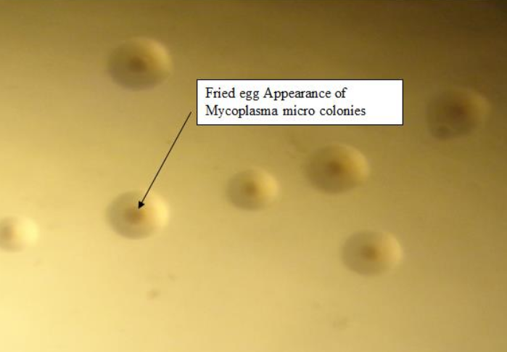
Laboratory diagnosis of Mycoplasma pneumonia
Mycoplasma colonies (typical fried egg appearance)

Slide 20
Laboratory diagnosis of Mycoplasma pneumonia
Identification: By biochemical tests or by automated identification systems such as MALDI-TOF
Antigenic detection: By Direct IF, ELISA

Slide 21
Laboratory diagnosis of Mycoplasma pneumonia
Antibody detection in serum:
  Specific: Indirect-IF, latex agglutination assays and ELISA using protein P1 antigens
  Molecular methods: Detects 16S rRNA and P1adhesin gene.

Slide 22
Treatment of Mycoplasma pneumonia
Macrolides - drug of choice (oral azithromycin, 500 mg on day 1, then 250 mg on days 2 to 5)
Alternative drugs are as follows:
  Doxycycline
  Respiratory fluoroquinolones - levofloxacin, moxifloxacin and gemifloxacin (not ciprofloxacin).

Slide 23
CHLAMYDIAE PNEUMONIA

Slide 24
CHLAMYDIAE PNEUMONIA
There are three Chlamydia species
  C. pneumoniae
  C. psittaci
  C. trachomatis
All capable of causing atypical (interstitial) pneumonia.

Slide 25
Chlamydophila pneumoniae
Exclusive human pathogen, causes various manifestations:
Transmission - person to person by inhalational route
Atypical pneumonia -10% community-acquired pneumonia
Upper respiratory tract - pharyngitis and sinusitis
Asthma and COPD
Treatment: Tetracycline or erythromycin (500 mg four times a day) for 10–14 days.

Slide 26
Chlamydia trachomatis
(Infant Pneumonia)
C. trachomatis serotypes D to K - cause infant pneumonia.
Interstitial pneumonia that develops within 3 weeks to 3 months of birth.
Infection spreads from conjunctiva to pharynx via the nasolacrimal duct.
Infection via the eustachian tube - cause otitis media
Treatment: Erythromycin - orally at a dosage of 50 mg/kg per day in four divided doses, for 2 weeks.

Slide 27
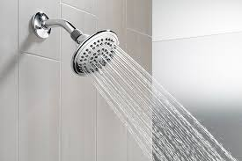
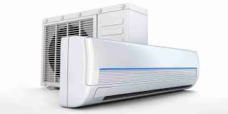
LEGIONELLOSIS

Slide 28
LEGIONELLOSIS
Caused by Legionella pneumophila
Fastidious, pleomorphic Gram-negative, short rods, associated with interstitial pneumonia, known as—Legionnaires’ disease.

Slide 29
History
Legionella was first recognized in 1976 when an outbreak of pneumonia took place at a Philadelphia hotel during an American Legion convention.

Slide 30
Epidemiology
Reservoir: Inhabits on aquatic bodies which could be either:
  Natural water sources - rivers
  Artificial aquatic sources - air conditioners, water coolers, shower head.

Slide 31
Epidemiology
Transmission:
  Aspiration (predominant mode):oropharyngeal colonization or directly via drinking of contaminated water
  Aerosols from contaminated air conditioners, nebulizers, and humidifiers
  Direct instillation into the lungs during respiratory tract manipulations

Slide 32
Pathogenesis
Following entry, legionellae reach the lungs
Engulfed by alveolar macrophages by a mechanism - coiling phagocytosis.
They invade and grow within the alveolar macrophages by inhibiting phagosome-lysosome fusion.

Slide 33
Clinical Manifestations –
Pontiac Fever
Acute, flu-like illness - malaise, fever, and headache.
Incubation period - 24–48 hours.
Self-limiting, never develops into pneumonia.

Slide 34
Clinical Manifestations - Legionnaires’ Disease (Pneumonia)
Interstitial atypical pneumonia with incubation period of 2–10 days.
Characterized by non-productive cough (with or without blood tinged), dyspnea, chest pain & high fever
Chest X-ray - pulmonary infiltrates
Leading cause of pneumonia both in the community and hospital settings.

Slide 35
Clinical Manifestations - Extrapulmonary Legionellosis
Results from blood-borne dissemination from the lung.
Most common extrapulmonary site is heart (myocarditis, pericarditis and prosthetic valve endocarditis)
Other manifestations - sinusitis, peritonitis, pyelonephritis, skin and soft tissue infection.

Slide 36
Laboratory Diagnosis
Specimens - Bronchoalveolar lavage fluid, bronchial wash and pleural fluid.
Direct Microscopy
  Gram stain - Numerous neutrophils but no organisms (as legionellae are poorly stained or sometimes appear as faint pleomorphic Gram-negative rods or coccobacilli)

Slide 37
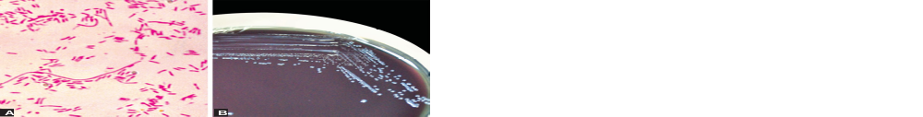
Laboratory Diagnosis
Gram-staining: pleomorphic Gram-negative rods or coccobacilli

Slide 38
Laboratory Diagnosis
Direct microscopy:
  Silver impregnation
  Giemsa stains
  Direct immunofluorescence test - more specific but sensitivity is poor than culture

Slide 39
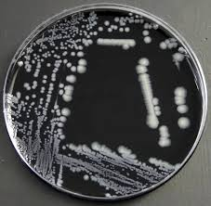
Laboratory Diagnosis
Culture:
Buffered charcoal, yeast extract (BCYE) agar: Incubated at 37°C in 5% CO2 for 3–5 days.
Highly sensitive (80–90%) and specific (100%)

Slide 40
Laboratory Diagnosis
Antibody detection:
  Indirect immunofluorescent antibody test and enzyme immunoassays.
  Antibodies - appear late after 12 weeks; a single titer of 1:256 gives presumptive evidence of Legionnaires’ disease

Slide 41
Laboratory Diagnosis
Urinary antigen test: Detect L. pneumophila antigens in urine.
Advantages:
  Rapid, cheaper, easy to perform
  Highly sensitive (70 to 90%), and specific (95–100%)
  Antigen in urine - detectable shortly after the onset of symptoms and disappears over 10 months

Slide 42
Laboratory Diagnosis
Molecular methods:
  BioFire FilmArray; automated multiplex PCR - its respiratory panel can simultaneously detect 22 pathogens including L. peumophila.

Slide 43
Treatment of Legionnaires’ disease
Macrolides (especially azithromycin) and the respiratory quinolones (e.g. levofloxacin) are now the antibiotics of choice.

Slide 44
Water Surveillance for Legionella
Indication: Performed annually or more often for certain high-risk settings - transplant units
Procedure: Large volume of water (1-10 L) – collected and subjected to membrane filtration, followed by culture on BCYE media.

Slide 45
OTHER BACTERIAL causes of ATYPICAL PNEUMONIA
Coxiella burnetii
Rickettsial infections
Francisella tularensis

Slide 46
THANK YOU!

