Slide 1
SUBCUTANEOUS MYCOSIS
Dr. Priyanka Chaturvedi
Assistant professor

Slide 2
Lesson Plan:
Clinical Classification of Fungal infection
Causes of Subcutaneous Mycosis
Difference between Eumycetoma & Actinomycetoma.
Mycetoma: Pathogenesis & Cardinal signs
Laboratory Diagnosis & Treatment of subcutaneous Mycosis

Slide 3
SUBCUTANEOUS MYCOSES
The agents of subcutaneous mycoses usually inhabit the soil
They enter the skin by traumatic inoculation with contaminated material
Tend to produce granulomatous lesions in the subcutaneous tissue

Slide 4
1. Mycetoma
2. Botryomycosis
3. Sporotrichosis
4. Chromoblastomycosis
5. Phaeohyphomycosis

Slide 5
“MYCETOMA”
“MADURA FOOT”
“MADURAMYCOSIS”
First described in Madurai, South India, by John Gill (1842)
In India, Rajasthan - maximum cases of Mycetoma followed by Tamil Nadu

Slide 6
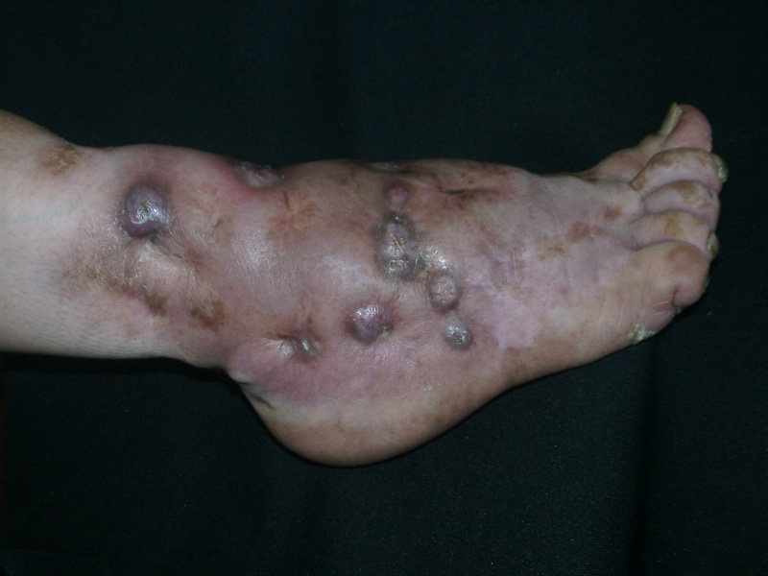
Slowly progressive, chronic granulomatous infection of skin & subcutaneous tissues.

Slide 7
CLASSIFICATION OF MYCETOMA
EUMYCETOMA
(FUNGAL)
ACTINOMYCETOMA
(BACTERIAL)
causes:-
Madurella mycetomatis
Madurella grisea
- Curvularia geniculata
- Fusarium spp
Pseudoallescheria boydii
- Aspergillus nidulans
- Acremonium falciforme
Exophiala jeanselmei
causes:-
- Actinomadura madurae
- Actinomadura pelletieri
- Nocardia brasiliensis
- Streptomyces somaliensis
Nocardia caviae
- Nocardia asteroides
- Nocardiopsis dassonvillei

Slide 8
Agents of mycetoma and types of grains they produce
Eumycetoma | Actinomycetoma
Black granules: Madurella mycetomatis Madurella grisea Exophiala jeanselmei Curvularia species White granules: Pseudallescheria boydii Aspergillus nidulans Acremonium species Fusarium species | White to yellow granules: Actinomadura madurae: It is the most frequent cause Nocardia species Streptomyces somaliensis Pink to red granules: Actinomadura pelletieri

Slide 9
Clinical manifestations of Eumycetoma and Actinomycetoma
Clinical manifestations | Eumycotoma | Actinomycotoma
Tumor | Single, well-defined margins | Multiple tumor masses with ill-defined margins
Sinuses | Appear late, few in number | Appear early, numerous with raised inflamed opening
Discharge | Serous | Purulent
Grains | Black/white | White/ red
Bone | Osteosclerotic lesions | Osteolytic lesions
Grains contain | Fungal hyphae (> 2 um) | Filamentous bacteria (< 2 um)

Slide 10
PATHOGENESIS
Age- 20-40 years
Gender: Men are more prone
Accidental trauma (thorn prick or splinter injury): Trauma or puncture wounds to feet, legs, arms and hands (usually on the feet).
Organisms enter the skin or subcutaneous tissue from contaminated soil
The organisms are large aggregates of filaments found in the center of micro-abscess formed by polymorphonuclear cells

Slide 11
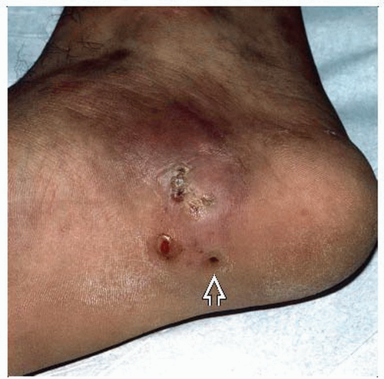
CLINICAL FEATURES-3S
Tumor-like swelling (S)
Multiple draining sinuses (S)
Grains/ Sulphur granules oozing from sinuses (S)
Commonest site – Feet
painless

Slide 12
LABORATORY DIAGNOSIS
History- Occupation, Trauma
Clinical examination: 3S
Sample- Pus, exudates, biopsy, Grains or Granules Grains collected on sterile gauze by pressing the sinuses from periphery or by using a loop

Slide 13
Macroscopic appearance of granules – colour & size
Suspected Eumycetoma :
KOH mount - Hyphae of 2–6 μm width along with chlamydospores at margin

Slide 14
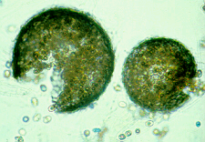
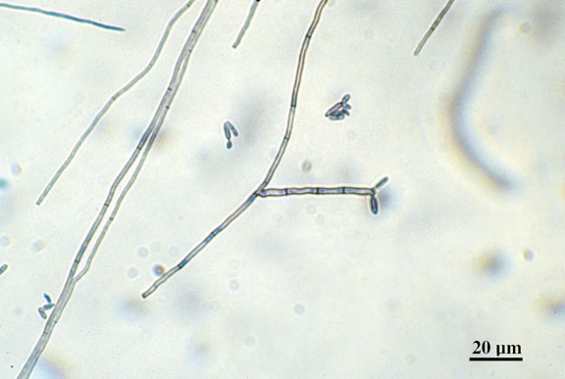
DIRECT EXAMINATION:-
Granules washed in sterile saline & crushed in between the slides
10% KOH mount- To look for hyphae

Slide 15
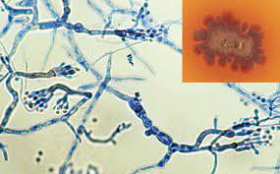
Culture on :
SDA with antibiotics like chloramphenicol & gentamicin
Identify by LPCB mount

Slide 16
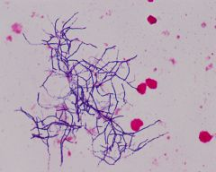
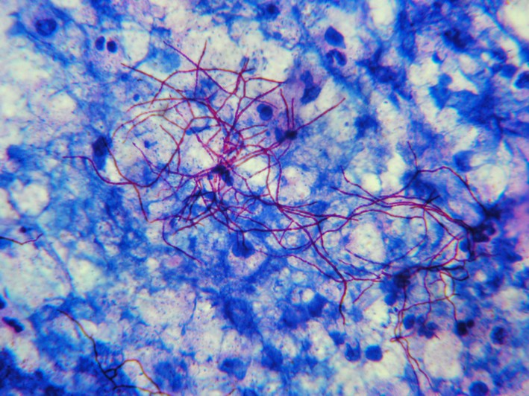
Suspected Actinomycetoma:
Gram staining - filamentous Gram positive bacilli (0.5–1 μm wide)
Modified acid-fast staining (Kinyoun’s method)- with 1% sulfuric acid, shows red colored filamentous bacteria i.e. Nocardia spp whereas other actinomycetes are not acid-fast

Slide 17
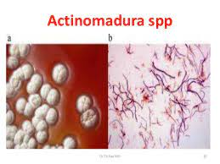
2. CULTURE:- Grains are washed several times in sterile saline, crushed & then cultured
When Actinomadura is suspected then culture on
-- SDA without antibiotics
-- Blood agar
-- LJ media
-- Brain-heart infusion agar

Slide 18
TREATMENT
EUMYCETOMA- a) Ketoconazole
b) Itraconazole
ACTINOMYCETOMA-a) Sulfonamides
b) Tetracyclines
c) Streptomycin
d) Amikacin

Slide 19
Surgical removal of the lesion followed by:
  Antifungal agents for eumycetoma (itraconazole or amphotericin B for
  8 -24 months)
  Antibiotics for actinomycetoma such as Welsh regimen (amikacin plus cotrimoxazole)

Slide 20

BOTRYOMYCOSIS
It is a chronic, purulent, granule-producing, granulomatous lesion of skin, subcutaneous tissues & visceral organs, caused by several bacterial species
Production of Sulphur granules

Slide 21
CAUSATIVE AGENTS
Staphylococcus aureus
Pseudomonas aeruginosa
Coagulase-negative Staphylococci
Escherichia coli
Proteus vulgaris

Slide 22
TYPES
Cutaneous Type:- Inflammatory nodules, discharging ulcers, fistulae affecting hands, feet & head
Visceral type:- Affects lungs, liver, kidney & lymph nodes

Slide 23
LABORATORY DIAGNOSIS
Wet mount
Differential staining: Gram stain
Histopathological examination
Culture on – Blood agar, chocolate agar, LJ media & SDA

Slide 24
Sporotrichosis
Also known a Rose Gardner’s disease
Subcutaneous noduloulcerative lesions
Caused by Sporothrix schenckii, thermally dimorphic fungus

Slide 25
Pathogenesis
After a minor trauma of thorn prick - Spores of S.schenckii enter into the skin.
The fungal Enzymes help in local invasion & spread along the lymphatics

Slide 26
Clinical Manifestations
Chronic subcutaneous pyogranulomatous disease
Incubation period - 3 weeks
Lymphocutaneous type: most common type (80%) – characterised by
  Painless nodulo-ulcerative lesion along the lymphatics
  Enlarged Lymph nodes, indurated and have cord like feeling on palpation

Slide 27
Clinical Manifestations
Other clinical types:
Osteoarticular type: seen among alcoholics
Pulmonary type: following spore inhalation, seen in people with COPD
Disseminated sporotrichosis: in immunocompromised patients (AIDS)
Fixed cutaneous type: Single nodule is found, that is less progressive and does not spread by lymphatics

Slide 28
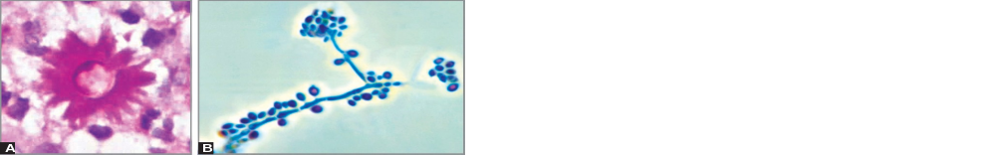
Laboratory Diagnosis
Specimens - pus, aspirate from nodules, curettage or swabbing from ulcers
Direct microscopy: KOH mount or calcofluor staining - elongated yeast cells of 3–5 μm in diameter.
Histopathological staining of tissue sections - asteroid bodies.
Yeast form (asteroid body)

Slide 29

Laboratory Diagnosis
Culture: Goldstandard
Specimens - inoculated onto SDA - incubated at 25°C and 37°C simultaneously as S. schenckii is a dimorphic fungus
  At 25°C: Produces mycelial form - slender delicate hyphae with conidia arranged in - flower-like pattern.
  At 37°C: Produces yeast form - moist creamy white colonies which turn brown black in 10–14 days.

Slide 30
Laboratory Diagnosis
Slender delicate hyphae with conidia arranged in
Flower-like pattern.

Slide 31
Laboratory Diagnosis
Serology: Latex agglutination test detects serum antibodies in patients with extracutaneous form of the disease
Skin test: delayed type of hypersensitivity reaction against sporotrichin antigen

Slide 32
Treatment of Sporotrichosis
Itraconazole - drug of choice for all forms of sporotrichosis;
Amphotericin B -for disseminated form is recommended.
Given until 2–4 weeks after the lesions resolve.

Slide 33
Chromoblastomycosis
Slow growing chronic subcutaneous lesions caused by group of dematiaceous or phaeoid fungi (i.e. darkly pigmented fungi) that produce a characteristic morphology called sclerotic body

Slide 34
Chromoblastomycosis
Agents of chromoblastomycosis:
  Fonsecaea pedrosoi and F. compacta
  Phialophora verrucosa
  Cladosporium carrionii
  Rhinocladiella aquaspersa.

Slide 35
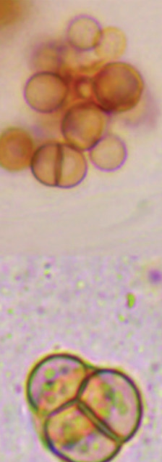
Chromoblastomycosis
Lesions - slow growing and polymorphic - verrucose (most common type), crusted, ulcerative and nodular
Sclerotic bodies: brown thick walled round cells (5–12 μm size) with multiple internal transverse septa - also called Medlar bodies or muriform cells or “copper pennies.”

Slide 36
Treatment of Chromoblastomycosis
Surgical removal (cryosurgery or laser therapy) of the lesion followed by antifungals (itraconazole).

Slide 37
Phaeohyphomycosis
Chronic subcutaneous lesions, caused by dematiaceous or phaeoid fungi.
They exist in mycelial form

Slide 38
Phaeohyphomycosis
Caused by:
  Alternaria species
  Bipolaris species
  Curvularia species
  Exophiala jeanselmei
  Cladophialophora bantiana (it is neurotropic, produces brain abscess)

Slide 39
Rhinosporidiosis
Chronic granulomatous disease, characterized by large friable polyps in the nose & conjunctiva.
Agent: Rhinosporidium seeberi
Source: Stagnant water
Distribution: tropical countries, especially in Sri Lanka and India (Tamil Nadu, Kerala, Odisha and Andhra Pradesh)

Slide 40
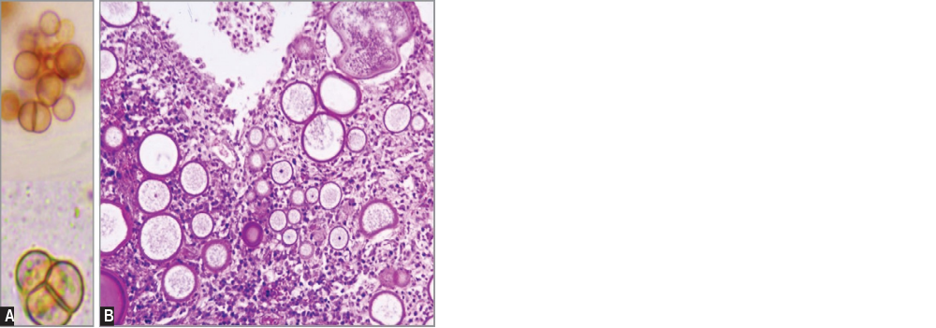
Rhinosporidiosis
Diagnosis - histopathology of the polyps → Spherules (large sporangia) that contain numerous endospores.
R.seeberi - not been cultivated yet

Slide 41
Treatment of Rhinosporidiosis
Radical surgery with cauterization - mainstay of treatment.
Dapsone - found to be affective.
Recurrence is common

Slide 42
THANK YOU!

