Slide 1
INTRODUCTION TO
VIRAL INFECTIONS-2
Dr. Priyanka Chaturvedi

Slide 2

RECAP…..

Slide 3
To learn about….
Pathogenesis
Laboratory Diagnosis of Viral Infections

Slide 4
PATHOGENESIS OF VIRAL INFECTIONS

Slide 5
Pathogenesis….
Transmission (entry into the body)
Primary site replication
Spread to secondary site
Manifestations of the disease

Slide 6
Transmission (entry into the body)
Mode of transmission | Produce Local infection at the portal of entry | Spread to distant sites from the portal of entry
Respiratory route | Produce Respiratory infection- Influenza virus Para-influenza virus Respiratory syncytial virus Rhinovirus Adenovirus Coronavirus such as SARS-COV2 Herpes simplex virus | Measles virus Mumps virus Rubella virus Varicella-zoster virus Cytomegalovirus Parvovirus Small pox virus
Oral route | Produce gastroenteritis- Rotavirus Adenovirus- 40, 41 Calicivirus Astrovirus | Poliovirus Coxsackie virus Hepatitis Virus – A & E Cytomegalovirus Epstein-Barr virus (EBV)

Slide 7
Transmission (entry into the body)
Mode of transmission | Produce Local infection at the portal of entry | Spread to distant sites from the portal of entry
Cutaneous route | Produce skin lesions Herpes simplex virus | Herpes simplex virus
Vector bite | - | Arboviruses such as- Dengue virus (Aedes)
Animal bite | - | Rabies virus

Slide 8
Transmission (entry into the body)
Mode of transmission | Produce Local infection at the portal of entry | Spread to distant sites from the portal of entry
Sexual route | Produce genital lesions- Herpes simplex virus Human papilloma virus | Hepatitis B, C & rarely D HIV
Blood transfusion | - | Hepatitis B, C & rarely D HIV Parvovirus
Injection | - | Hepatitis B, C & rarely D HIV

Slide 9
Transmission (entry into the body)
Mode of transmission | Produce Local infection at the portal of entry | Spread to distant sites from the portal of entry
Transplacental Route | Produce congenital manifestations in foetus Rubella virus Cytomegalovirus (CMV) Herpes simplex virus Varicella-zoster virus Parvovirus | Transmitted through placenta to foetus, without congenital manifestations Measles virus Mumps virus Hepatitis B virus Hepatitis C virus Hepatitis D virus HIV
Conjunctival route | Adenovirus Enterovirus70 Coxsackie virus A-24 Herpes simplex virus

Slide 10
2. Primary site replication
Few Viruses are restricted to the portal of entry where they multiply and produce local diseases.
There is no viremia or spread to distant sites.
Have a shorter incubation period.

Slide 11
2. Primary site replication
Most viruses multiply locally to initiate a silent local infection which is followed by the spread via lymphatics to regional lymph nodes (most viruses) or via blood (e.g. polio virus) or via neuronal spread to reach CNS.

Slide 12
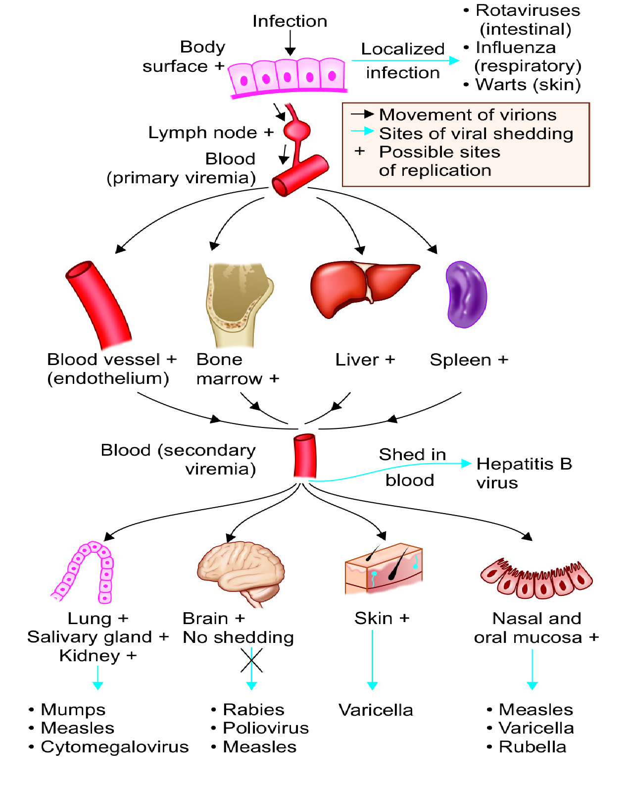

Slide 13
Virus Shedding
Stages | Explanation | Examples
Portal of entry | For those viruses that produce local infection. | Influenza virus is shed in respiratory secretions
Blood | Viruses that spread through vector bite or blood transfusion or needle pricks | Arboviruses, Hepatitis B
Near the target tissue /organ | Skin, salivary gland and kidney | Varicella zoster, mumps, cytomegalovirus
No shedding | Humans are the dead end for certain viruses infecting CNS, such as | Rabies.

Slide 14
Manifestations of Viral Infections
Incubation Period:
Time interval between entry of the virus into the body and appearance of first clinical manifestation.
Depends on the distance between site of entry and the target organ.
  Shorter - if the virus produces lesions near to the site of entry e.g. influenza
  Longer - if the target organ is much far from the site of entry; e.g. polio virus and rabies virus

Slide 15
Clinical Manifestations:
Persons infected with viruses develop either an inapparent (subclinical) infection or apparent (clinical) infection.
The symptoms developed depend up on the target body sites where the virus multiplies.

Slide 16
Viral Pathogenesis at Cellular Level
At the cellular level, the virus can produce three types of infections in a host cell.

Slide 17
[1] Cell Death (Cytocidal or lytic Infection)
Viruses adopt different mechanisms to induce host cell death such as:
Inhibition of host cell DNA.
Inhibition of host cell protein synthesis.
Fusion (syncytia formation)
Immune mediated lysis

Slide 18
[2] Infection without Cell Death
a) Steady state infection -
The virus and host cell enter into a peaceful coexistence, both replicating independently without any cellular injury.

Slide 19
[2] Infection without Cell Death
b) Persistent viral infection
Latent infection with periodic exacerbations
Cell Transformation
Latency

Slide 20
[3] Morphological Changes in the Host Cells
Certain viruses induce characteristic changes in the host cells (e.g. inclusion body), which can be detected by histopathological staining.

Slide 21
Inclusion body
Def: Aggregates of viral proteins & other products of viral replication that confer altered staining property to the host cell.
Characteristic of specific viral infections.
They have distinct size, shape, location and staining properties by which they can be demonstrated in virus infected cells under the light microscope.

Slide 22
Inclusion body
Location
Intracytoplasmic inclusion bodies - Acidophilic and seen as PINK STRUCTURES when stained with Giemsa.
(e.g. poxviruses and rabies)

Slide 23
Inclusion body
Intranuclear inclusion bodies are basophilic in nature.
Cowdry (1934) had classified them into-
  Cowdry type A inclusions are variable in size and have granular appearance
  Cowdry type B inclusions are more circumscribed and multiple
Both intracytoplasmic & intranuclear inclusions.

Slide 24
Inclusion body
Intracytoplasmic inclusion bodies
 | Negri bodies – seen in Rabies virus
 | Paschen body- seen in Variola virus
 | Guarnieri bodies - seen in Vaccinia virus
 | ­Bollinger bodies - seen in Fowl pox virus
 | Molluscum bodies - seen in Molluscum contagiosum virus
 | Perinuclear cytoplasmic body- seen in Reovirus

Slide 25
Inclusion body
Intranuclear inclusion bodies
A)Cowdry type A inclusions
 | Torres body- seen in Yellow fever
 | Lipschultz body - seen in Herpes simplex
B)Cowdry type B inclusions - seen in
 | Poliovirus
 | Adenovirus
Intracytoplasmic & intranuclear inclusion bodies
 | Owl’s eye appearance- seen in Cytomegalovirus
 | Measles

Slide 26
LABORATORY DIAGNOSIS OF
VIRAL DISEASES

Slide 27
LABORATORY DIAGNOSIS OF
VIRAL DISEASES
Laboratory diagnosis of viral infections is useful for the following purposes:
To start antiviral drugs
Screening of blood donors for HIV, hepatitis B and hepatitis C.
Surveillance purpose
For outbreak or epidemic investigation
To start post-exposure prophylaxis

Slide 28
LABORATORY DIAGNOSIS OF
VIRAL DISEASES
Direct Demonstration of Virus
 | Electron microscopy
 | Immuno-electron microscopy
 | Fluorescent microscopy
 | Light microscopy
Detection of Viral Antigens
 | By various formats such as ELISA, direct IF, ICT, flow through assays.

Slide 29
LABORATORY DIAGNOSIS OF
VIRAL DISEASES
Detection of Specific Antibodies
 | ELISA, ICT, flow through assays.
Molecular Methods to Detect Viral Genes
 | Nucleic acid probe—for detection of DNA or RNA by hybridization
 | PCR
 | Reverse transcriptase-PCR
 | Real time PCR
 | Real time RT-PCR

Slide 30
LABORATORY DIAGNOSIS OF
VIRAL DISEASES
Isolation of Virus by
 | Animal inoculation
 | Embryonated egg inoculation
 | Tissue cultures: Organ culture, explant culture, cell line culture (primary, secondary and continuous cell lines).

Slide 31
Electron Microscopy
Specimens are negatively stained by POTASSIUM PHOSPHOTUNGSTATE and scanned under EM.
Shape-Viruses can be identified based on their distinct appearances:
  Rabies- bullet shaped

Slide 32
Immuno-electron Microscopy
Specific antibody to the specimen to cause aggregation of the virus particles.

Slide 33
Detection of Viral Antigens
Some important antigen detection tests include:
  HBsAg and HBeAg antigen detection for hepatitis B infection from serum.
  NS1 antigen detection for dengue virus infection from serum
  p24 antigen detection for HIV from serum

Slide 34
Detection of Viral Antibodies
Antibody detection from serum is one of the most commonly used method in diagnostic virology.
Appearance of IgM antibody indicates recent infection.
Presence of IgG antibody indicates chronic or past infection.

Slide 35
Molecular Methods
More sensitive, specific and yield quicker results than culture.
Polymerase chain reaction (PCR)
Reverse transcriptase-PCR (RT-PCR)
Multiplex PCR formats
BioFire FilmArray
Real time-PCR (rt-PCR)

Slide 36
Isolation of Virus
Viruses cannot be grown on artificial culture media.
Cultivated by animal inoculation, egg inoculation or tissue cultures.
Not routinely used in diagnostic virology.

Slide 37
Egg inoculation
Embryonated eggs - first used for viral cultivation by Good pasture in 1931.
Embryonated hen’s egg has four sites which are specific for the growth of certain viruses.

Slide 38
Egg inoculation
Yolk sac inoculation
Amniotic sac
Allantoic sac
Chorioallantoic Membrane (CAM)

Slide 39
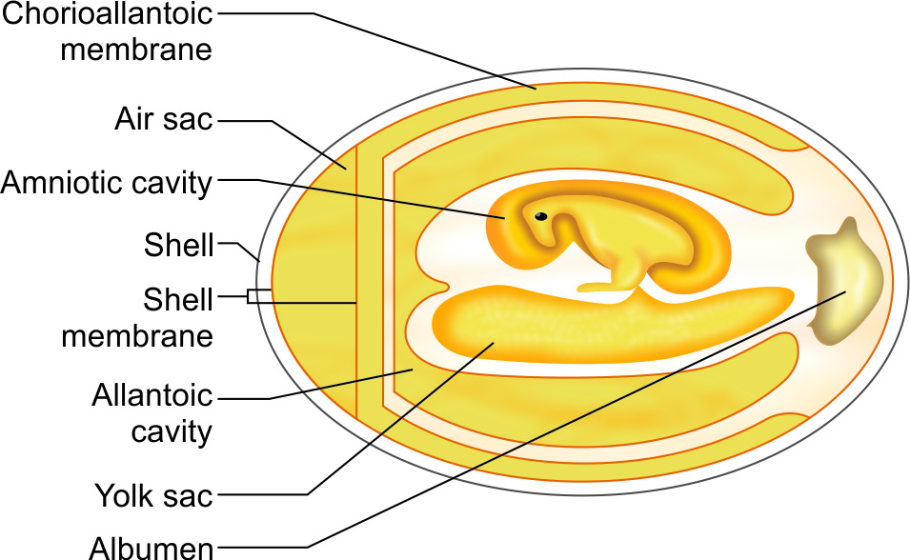

Slide 40
Tissue Culture
Types | Explanation | Examples
Organ culture (obsolete) | Used for certain fastidious viruses that have affinity to specific organs. | Tracheal ring culture for isolation of corona virus
Explant culture (obsolete) | Fragments of minced tissue can be grown as 'explants’ | Adenoid explants used for adenoviruses.
Cell line culture | This is the only isolation method which is in use now.

Slide 41
Preparation of the Cell Lines
Tissues digested – by treatment with proteolytic enzymes followed by mechanical shaking.
Viral growth medium:
  Cells are then washed, counted, and suspended in viral growth medium containing balanced salt solution added with essential amino acids and vitamins, salts and glucose supplemented by 5-10% of fetal calf serum and antibiotics.

Slide 42
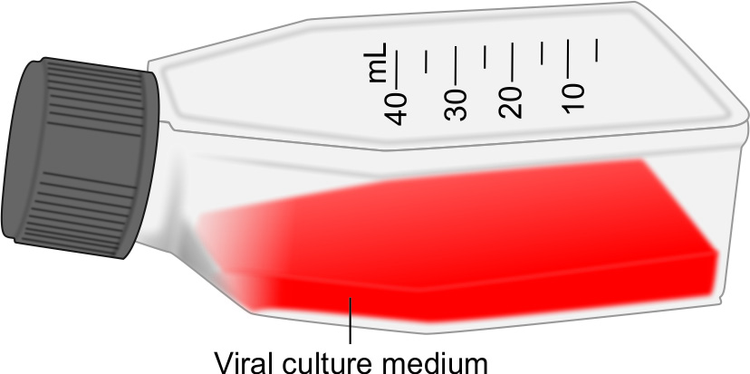
Cell line culture flasks

Slide 43
Types of Cell Lines
Type | Explanation | Examples
Primary cell line | Capable of very limited growth in culture, maximum up to 5-10 divisions. | Monkey kidney cell line- Human amnion cell line Chick embryo cell line

Slide 44
Types of Cell Lines
Type | Explanation | Examples
Secondary or diploid cell lines | Can divide maximum up to 10-50 divisions before they undergo senescence (death). | Human fibroblast cell line. MRC-5 &WI-38

Slide 45
Types of Cell Lines
Type | Explanation | Examples
Continuous cell lines | Derived from cancerous cell lines, hence are immortal. | HeLa cell line (Human carcinoma of cervix cell line) Hep-2 cell line (Human epithelioma of larynx cell line) KB cell line McCoy cell line Vero cell line (Vervet monkey kidney cell line).

Slide 46
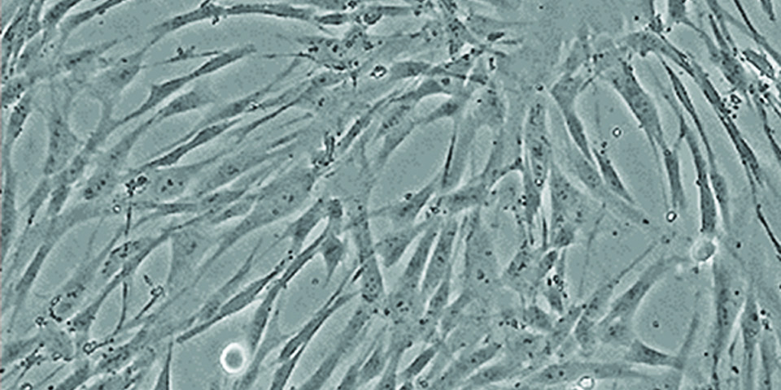
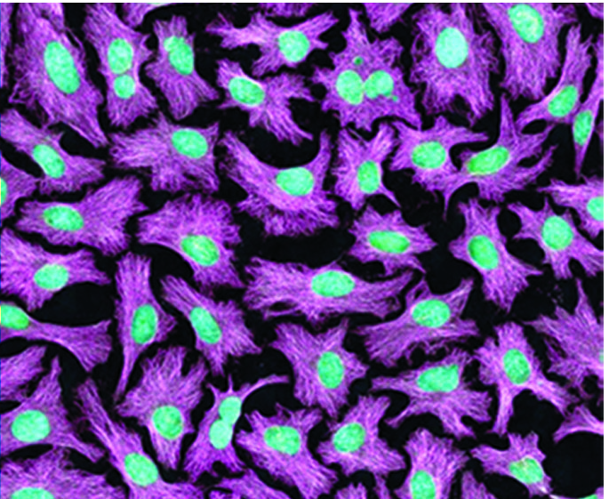
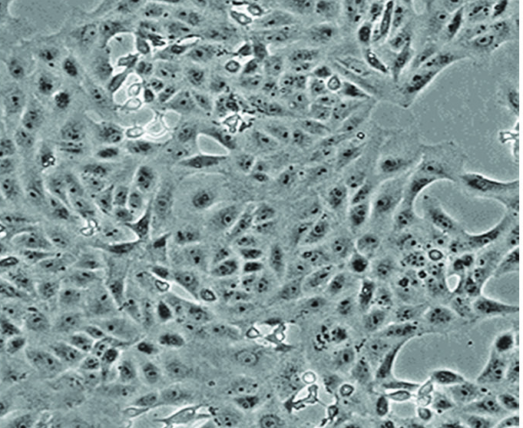
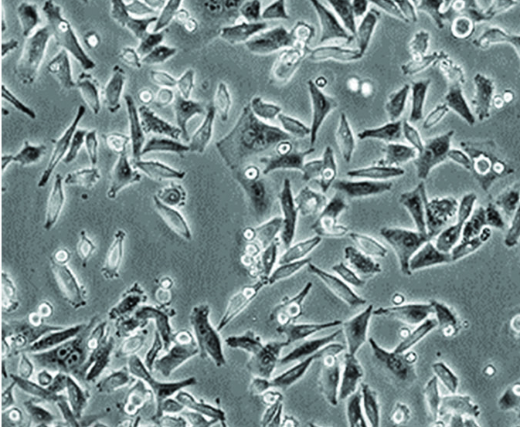
Types of Cell Lines
Human lung fibroblast cell line (Normal)
HeLa cell line (normal, uninfected)
Vero cell line (normal, uninfected)
HEp-2 cell line (normal, uninfected)

Slide 47
Detection of Viral Growth in Cell Cultures
Two methods are used to detect the growth of the virus in cell cultures.
Cytopathic Effect (CPE)
Shell Vial Technique

Slide 48
Cytopathic Effect (CPE)
Defined as the morphological change produced by the virus in the cell line detected by light microscope.

Slide 49
Cytopathic Effect (CPE)
Type of Cytopathic effect (CPE) | Virus
Rapid crenation and degeneration of the entire cell sheet | Enteroviruses
Syncytium or multinucleated giant cell formation | Measles, RSV, HSV
Diffuse rounding and ballooning of the cell line | HSV
Cytoplasmic vacuolations | SV 40 (Simian vacuolating virus-40)
Large granular clumps resembling bunches of grapes | Adenovirus

Slide 50
Shell Vial Technique
Involves centrifugation of cell culture (mixed with the specimen) to enhance the cell contact and viral replication, followed by
Detection of early viral antigen in the infected cells by direct fluorescence technique.

Slide 51
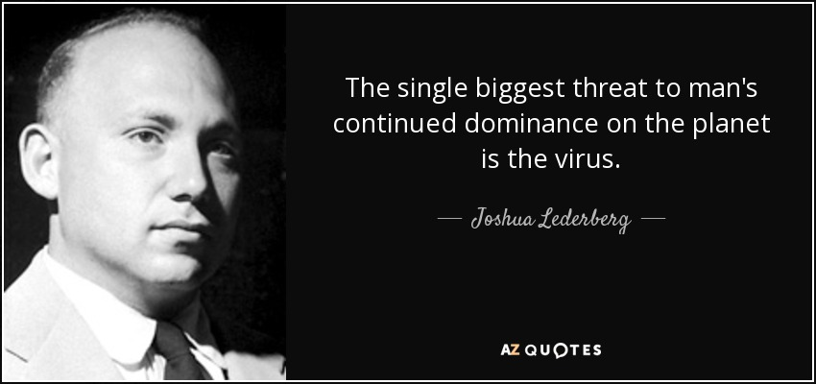
THANK YOU

