Slide 1
immunoprophylaxis
Dr. Priyanka Chaturvedi
Assistant Professor

Slide 2
IMMUNOPROPHYLAXIS
Immunoprophylaxis against microbial pathogens can be classified into:
  Active immunoprophylaxis (or vaccination)
  Passive immunoprophylaxis (or immunoglobulin administration)

Slide 3
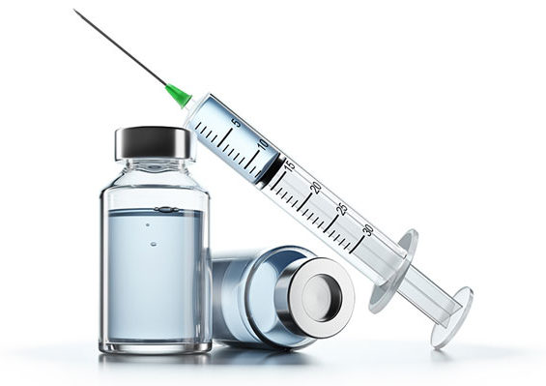
VACCINATION
(ACTIVE IMMUNOPROPHYLAXIS)

Slide 4
VACCINATION
Vaccine:
  It is an IMMUNOBIOLOGICAL PREPARATION which provides SPECIFIC protection against a given disease.
  Following administration of vaccine, the IMMUNOGEN (active ingredient of the vaccine) stimulates the immune system.
  After stimulation, the active immunity is produced, in the form of protective antibody and/or immunocompetent T cell response.

Slide 5
VACCINATION
History :
  The terms Vaccine and Vaccination are derived from ‘VARIOLAE VACCINAE’ (SMALLPOX OF THE COW), the term given by SIR EDWARD JENNER to denote cowpox.

Slide 6
VACCINATION
HOMOLOGOUS AND HETEROLOGOUS VACCINE:
  Homologous vaccine - Immunizing substance is derived from the same microorganism against which it is used.

Slide 7
VACCINATION
HETEROLOGOUS VACCINE or "JENNERIAN" VACCINES :
  Vaccine organism is different from the disease-causing organism
  Examples –
    Edward Jenner used cowpox to protect against smallpox.
    BCG vaccine: Made from Mycobacterium bovis to protect against human tuberculosis caused by Mycobacterium tuberculosis.

Slide 8
VACCINATION
Types of vaccine:
  Live attenuated vaccines
  Inactivated or killed organisms
  Extracted or cellular fractions
  Toxoids
  Subunit vaccines and recombinant vaccine
  DNA vaccine and edible vaccine.

Slide 9
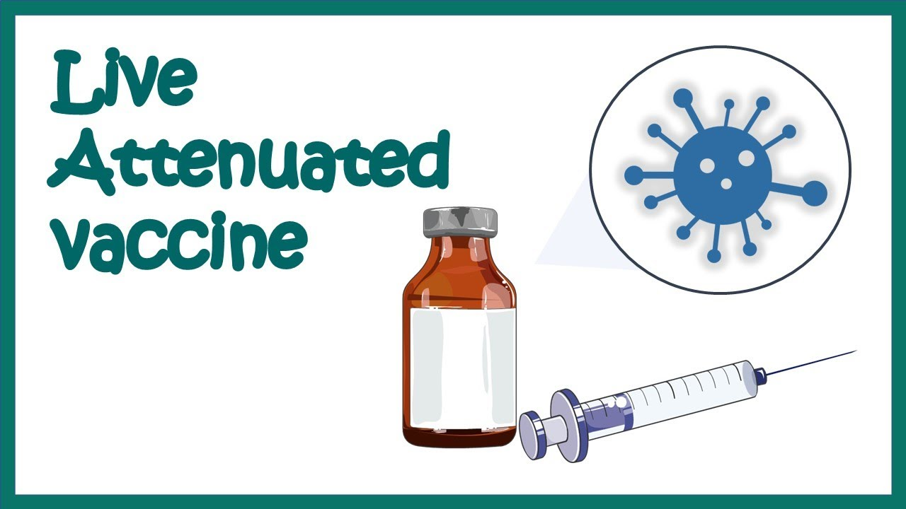

Slide 10
Live Attenuated Vaccine
Live vaccines prepared from live (usually attenuated) organisms.
Attenuated: By passing the live organisms serially through a foreign host, live organisms lose the pathogenicity but retain their immunogenicity.

Slide 11
Live Attenuated Vaccine
Bacterial | Viral
Live attenuated vaccines
BCG vaccine | Measles vaccine
Typhoral vaccine | Mumps vaccine
Epidemic typhus vaccine | Rubella vaccine
 | Live attenuated influenza vaccine
 | Chicken pox vaccine
 | Oral polio vaccine(OPV, Sabin vaccine)
 | Rotavirus vaccine
 | Yellow fever 17D vaccine
 | Hepatitis A
 | Japanese B encephalitis(14-14-2 strain)

Slide 12
Advantages of live attenuated vaccines
More potent immunizing agent compared to killed vaccines, because:-
  Live organisms multiply in the host and the resultant antigenic dose would be larger than what is administered.
  Retain all the immunogenic components (major and minor) of the organisms.
  Capable of inducing mucosal immunity by stimulating secretory IgA antibody production at the local mucosal sites.

Slide 13
Precautions While Using Live Attenuated Vaccines
Contraindications- In immunodeficiency diseases/ immunocompromised state like leukaemia, lymphoma, malignancies or corticosteroid or any other immunosuppressive drug therapy.
Pregnancy
Dosage- Single dose.
Exception – OPV

Slide 14
Precautions While Using Live Attenuated Vaccines
When two live vaccines are required to be given, then administer both the vaccines simultaneously at two different sites or one after another at 3 weeks interval.
Risk of gaining the virulence:- If not properly attenuated

Slide 15
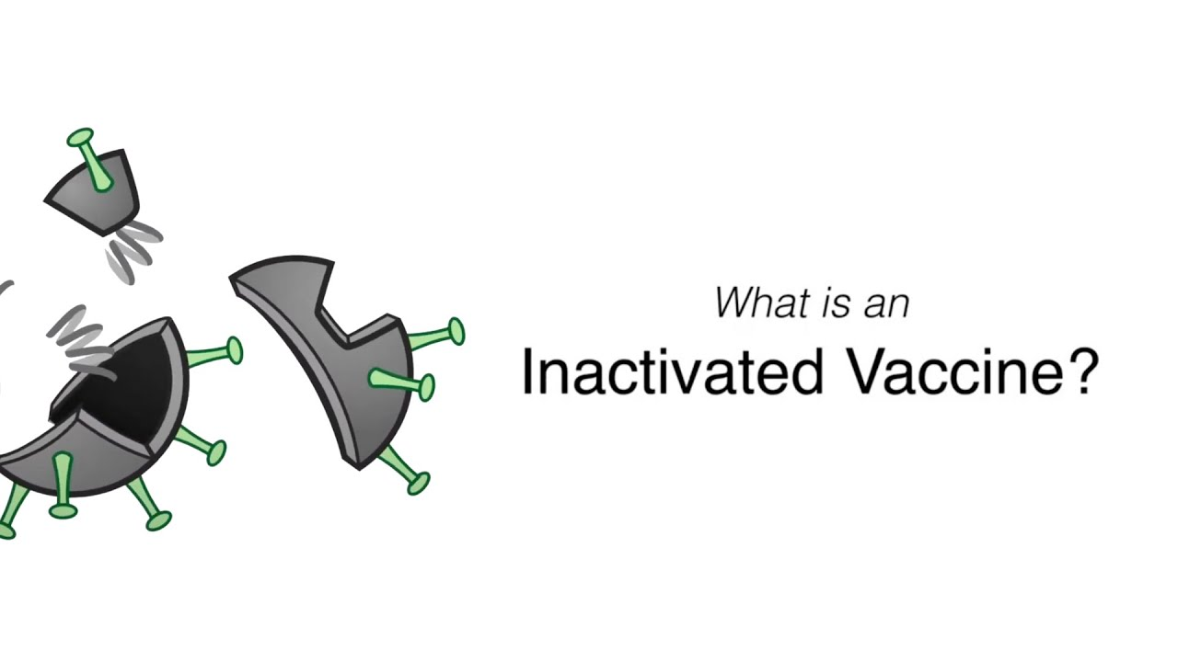

Slide 16
Inactivated or Killed Vaccine
Consists of organisms, which are grown in culture under controlled conditions and then killed using methods such as HEAT OR FORMALDEHYDE.
Safe but less effective than live vaccines.
Killed vaccines require LARGE DOSES, ADJUVANTS, and MULTIPLE DOSES to confer immunity.

Slide 17
Inactivated or Killed Vaccine
Booster dose is needed.
Adjuvants increase the immunogenicity of the antigen present in vaccine. E.g. Alum is used as adjuvant in DPT vaccine.
Killed vaccines are usually administered, subcutaneously or through intramuscular routes.
Absolutely contraindication if severe local or general reaction occurred during previous dose.

Slide 18
Inactivated or Killed Vaccine
Killed/Inactivated vaccine
BACTERIAL | VIRAL
Typhoid vaccine | Injectable polio vaccine (IPV or Salk vaccine)
Cholera vaccine | Killed influenza vaccine
Pertussis vaccine | Rabies vaccine
Plague vaccine | Hepatitis A
 | Japanese B encephalitis vaccine

Slide 19
Live v/s Killed Vaccine
Characteristic | Live Vaccine | Killed Vaccine
Number of doses | Single | Multiple
Need for adjuvant | No | Yes
Duration of immunity | Longer | Shorter
Effectiveness of protection | Greater | Lower
Mimics natural infection | More closely | Less closely
Immunoglobulins produced | IgA and IgG | IgG
Mucosal immunity | Induced | Absent

Slide 20
Live v/s Killed Vaccine
Characteristic | Live Vaccine | Killed Vaccine
Cell-mediated immunity | Induced | Poor
Reverse back to virulent form | Possible | No
Excretion of vaccine virus and transmission to non-immune contacts | Possible | No
Interference by other microorganisms in host | Possible | No
Stability at room temperature | Low | High
Immunodeficiency and pregnancy | Unsafe | Safe

Slide 21
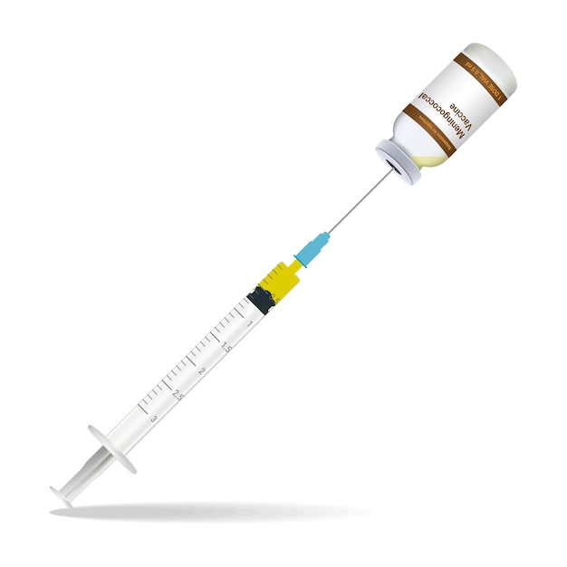
Extracted or Cellular Fractions Vaccine

Slide 22
Extracted or Cellular Fractions Vaccine
Prepared from extracted cellular fractions.
Cellular fraction
Meningococcal vaccine
Pneumococcal vaccine
Haemophilus influenzae type (Hib) vaccine

Slide 23
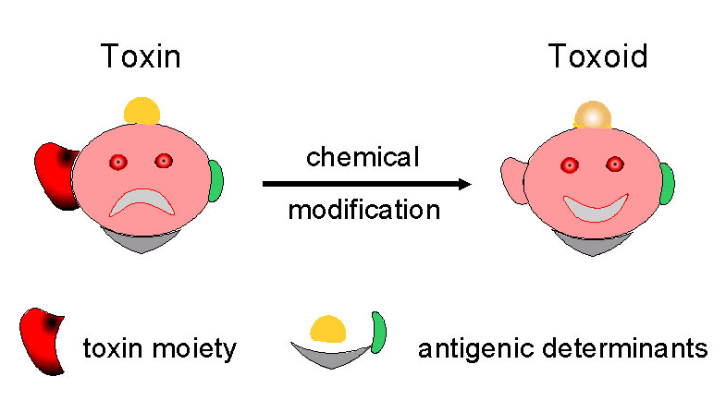
Toxoid Vaccine

Slide 24
Toxoid Vaccine
Exotoxins produced by certain bacteria can be detoxicated to form TOXOID by treating with ACIDIC pH, FORMALIN OR BY PROLONGED STORAGE.
Toxoid is a form of toxin that LOSES ITS VIRULENCE PROPERTY BUT RETAINS IMMUNOGENICITY.

Slide 25
Toxoid Vaccine
INDUCES formation of NEUTRALIZING ANTIBODIES
Toxoid vaccine
DT (Diphtheria toxoid)
TT (Tetanus toxoid)

Slide 26
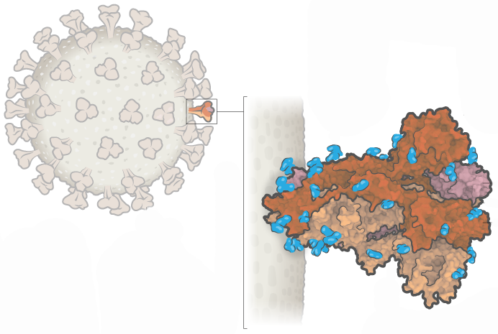
Subunit Vaccines

Slide 27
Subunit Vaccines
For certain viruses, only a particular subunit of the virus is necessary to initiate the infection.
E.g. Hepatitis B surface antigen (HBsAg) is the immunogenic component of hepatitis B virus.
So, the subviral component alone can be used as vaccine rather than the whole virus.

Slide 28
Subunit Vaccines
DNA recombinant technology is used for the preparation of such sub viral components
Subunit vaccine
Hepatitis B
HPV(Human papilloma virus) vaccine

Slide 29
Combinations
If more than one immunizing agents are included in a vaccine preparation, it is called as combined vaccine.
Aim of the combined vaccine is to:
  Simplify administration and
  Augment the immunogenicity of the immunogen.

Slide 30
Combinations
Combined vaccine
Bacterial | Viral
DPT vaccine (Diphtheria, pertussis & tetanus) | MMR vaccine [mumps, measles, rubella]
Pentavalent vaccine (DPT + Hib + Hepatitis B)

Slide 31
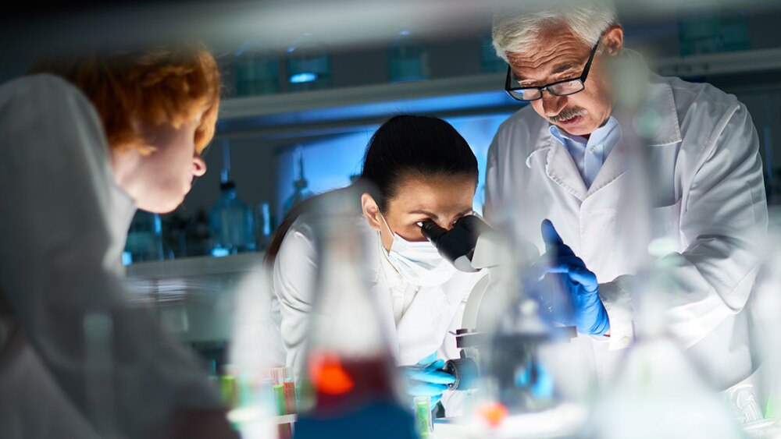
Newer Vaccine Approaches

Slide 32
“DNA Vaccine”
ZyCoV-D :- World's 1st and India's indigenously developed DNA Vaccine.
It received EUA (Emergency Use Authorization) from FDA, USA on 20th August, 2021 for use in 12 years and above age group.
Advantages:
  Cost effective.
  Mounting a stronger and wider range of immune response

Slide 33
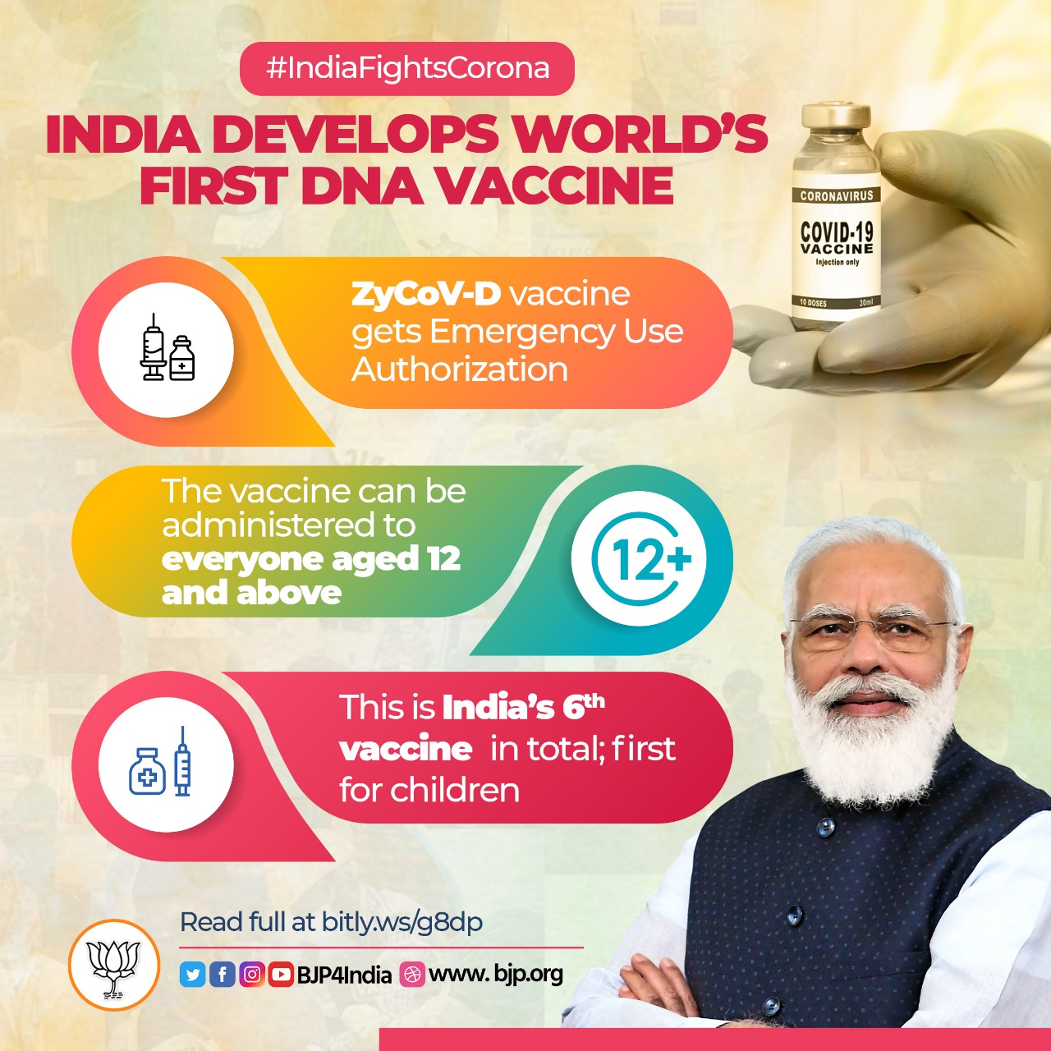

Slide 34
“DNA Vaccine”
Small pieces of DNA containing genes from the pathogenic microorganism are injected into the host.
The gene of interest gets integrated with the host cell genome and starts transcribing the proteins against which the host mounts an immune response.

Slide 35
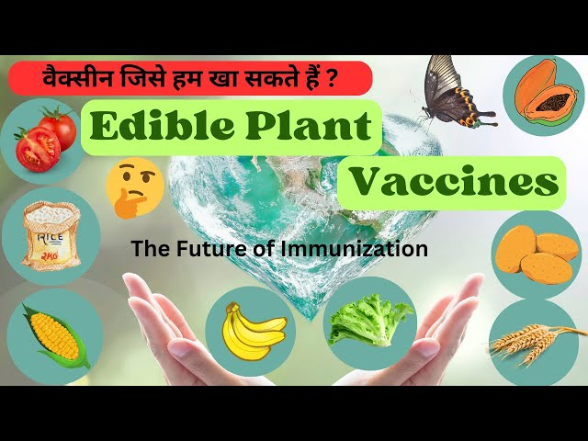
“Edible Vaccine”

Slide 36
“Edible Vaccine”
New concept introduced recently.
GENE ENCODING THE ORALLY ACTIVE ANTIGENIC PROTEIN is isolated from the pathogen and is transferred to suitable plant bacteria (plasmid), which are then incorporated in plant cell of any plant (e.g. banana, potato etc.).

Slide 37
“Edible Vaccine”
Plants infected by the bacteria (Transgenic plant) then start producing the antigen of interest in large scale.
Appropriate plant parts having the antigen may be fed raw to animals or humans to bring about immunization.

Slide 38
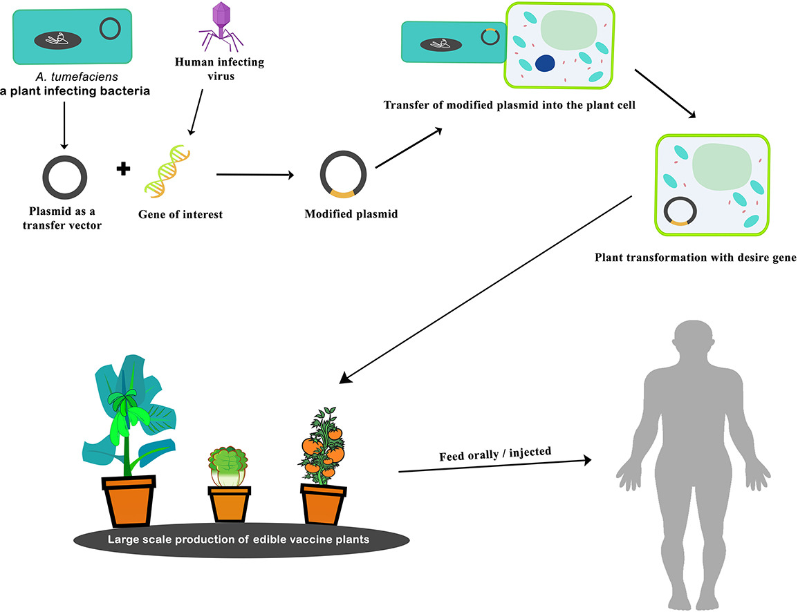
Edible Vaccine
Notes:
Agrobacterium

Slide 39
“Edible Vaccine”
Advantages:
  Low cost
  Ability to produce in large scale
  Administered orally
  Induces local immunity
  Heat stable

Slide 40
“Edible Vaccine”
Applications :-
Transgenic potatoes and tomatoes against diarrheagenic organisms
Edible banana against Norwalk virus

Slide 41
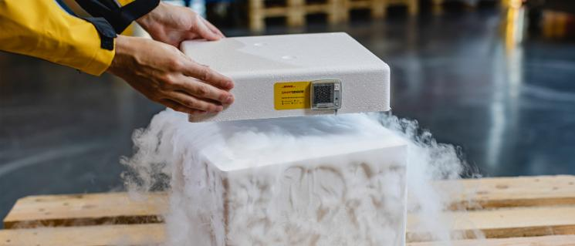
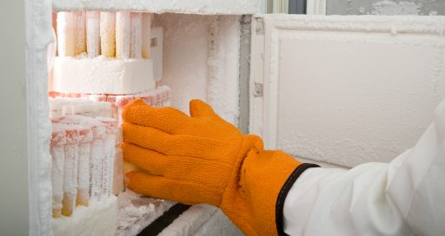
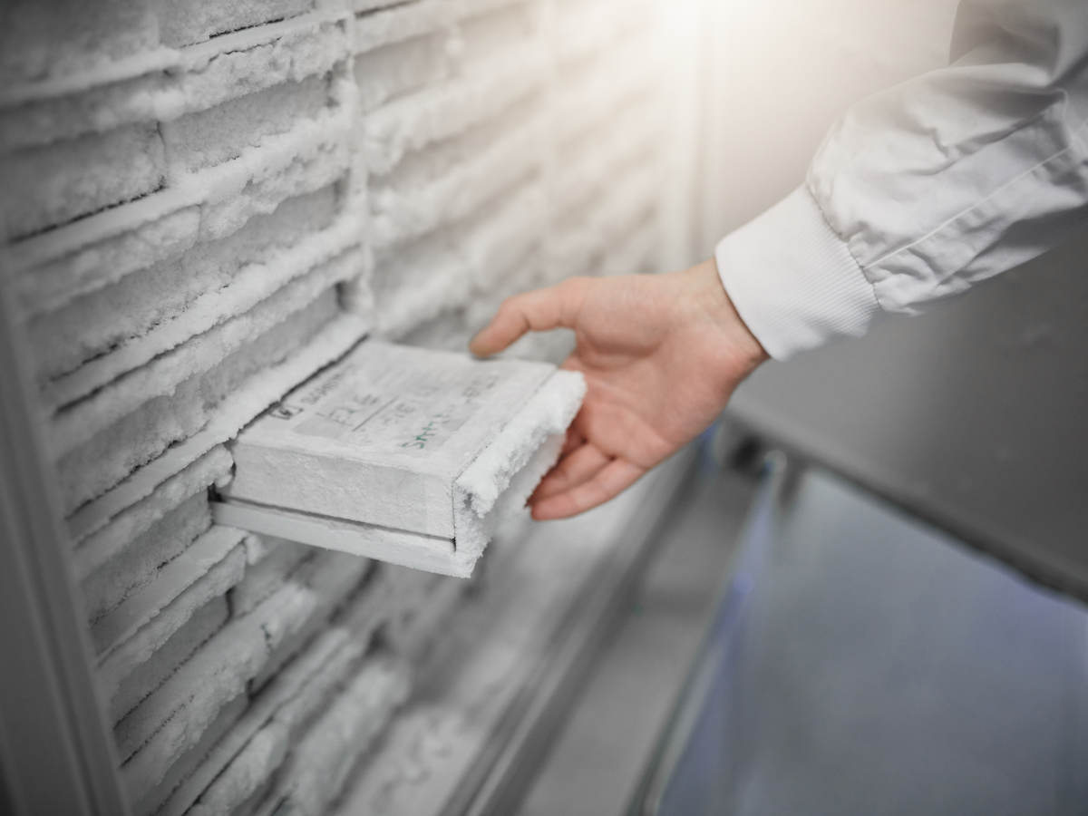
Cold Chain

Slide 42
Cold Chain
System of transport, storage, and handling of vaccines, starting at the manufacturer level and ending with the site of administration of the vaccine to the client.
Optimum temperature:
  Refrigerated vaccines -between +2°C and +8°C.
  Frozen vaccines - -15°C or lower.

Slide 43
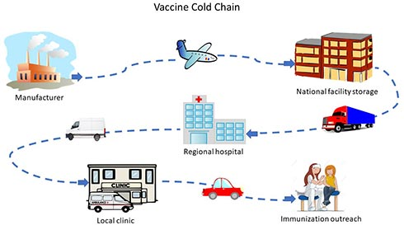

Slide 44
Cold Chain
Protection from light is a necessary condition for some vaccines.
Improper cold chain maintenance is one of the most common causes of vaccine failure; especially oral polio vaccine which is the most sensitive vaccine to heat; must be stored at - 20⁰C.

Slide 45
Vaccine Vial Monitor (VVM)
Tool to monitor the stability/potency of a vaccine and to check the efficiency of cold chain.
It is heat sensitive label lining the vaccine vial.
Contains an outer blue circle and an inner white square.

Slide 46
Vaccine Vial Monitor (VVM)
With increase in Time and Temperature, the inner square changes its color gradually from white towards blue, whereas the outer circle is not heat sensitive; it remains blue throughout.

Slide 47
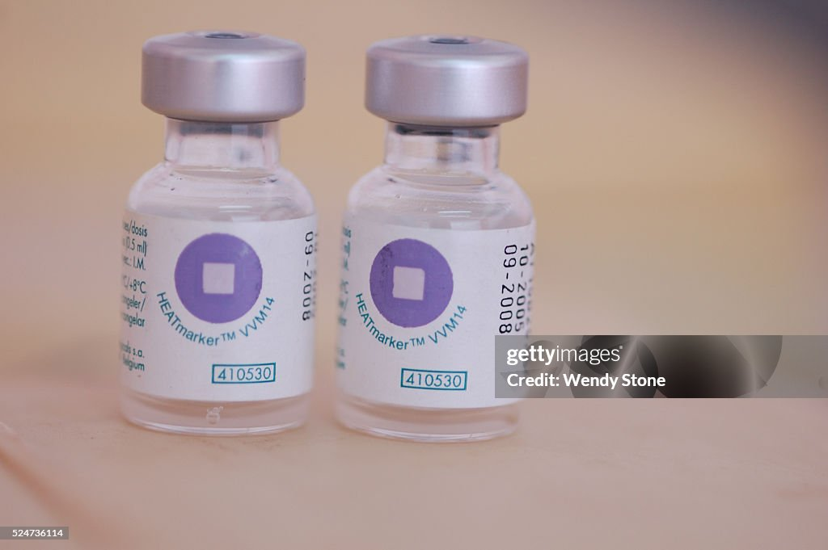
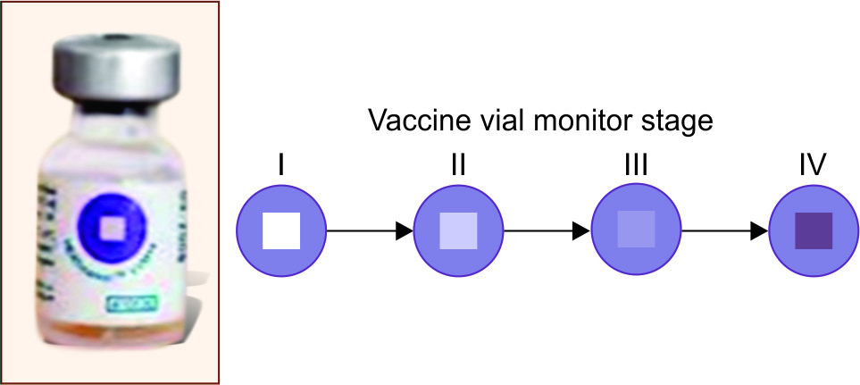
Vaccine Vial Monitor (VVM)
 | Inner square | Outer circle | Vaccine
Stage-1 | White | Blue | CAN BE USED
Stage-2 | Light blue | Blue | CAN BE USED
Stage-3 | Blue | Blue | DISCARD
Stage-4 | Dark blue | Blue | DISCARD

Slide 48
PASSIVE IMMUNOPROPHYLAXIS
(IMMUNOGLOBULINS)

Slide 49
PASSIVE IMMUNOPROPHYLAXIS
(IMMUNOGLOBULINS)
Given in the form of readymade IMMUNOGLOBULINS prepared against the pathogenic microorganism.
Unlike vaccines, IMMUNOGLOBULINS ACT FASTER, WITHOUT involvement of host immune apparatus.

Slide 50
PASSIVE IMMUNOPROPHYLAXIS
(IMMUNOGLOBULINS)
Useful in the following circumstances:
  For immunocompromised individuals
  For post exposure prophylaxis of HIV infection
  For the treatment of toxin mediated diseases:- Antibiotics cannot neutralize the toxin; hence they cannot be used for the treatment of toxin mediated diseases.

Slide 51
PASSIVE IMMUNOPROPHYLAXIS
(IMMUNOGLOBULINS)
IMMUNOGLOBULIN PREPARATIONS | INDICATIONS
Diphtheria antitoxin | Treatment of respiratory diphtheria
Tetanus immune globulin (TIG) | Treatment of tetanus as PEP, for people not adequately immunized with tetanus toxoid
Botulinum antitoxin | Treatment of botulism
Varicella-zoster immune globulin (VZIG) | PEP for immunosuppressed contacts of acute cases or new born contacts
Cytomegalovirus immune globulin (CMV-IG) | PEP in hematopoietic stem cell and kidney transplant recipients
Rabies immune globulin (RIG) | Treatment of rabies & PEP in people not previously immunized with rabies vaccine

Slide 52
PASSIVE IMMUNOPROPHYLAXIS
(IMMUNOGLOBULINS)
IMMUNOGLOBULIN PREPARATIONS | INDICATIONS
Hepatitis B immunoglobulin (HBIG) | PEP for- Percutaneous or mucosal or sexual exposure Newborn of mother with HBsAg +ve
Hepatitis A immunoglobulin (HAIG) | Post exposure prophylaxis for Family contacts Travelers
Rubella | Women exposed during early pregnancy
Measles | Infants or immunosuppressed contacts of acute cases exposed <6 days previously
Rh-isoimmunization (RhIG) | As treatment:– Rh-ve mother on delivery of a Rh+ve baby

Slide 53
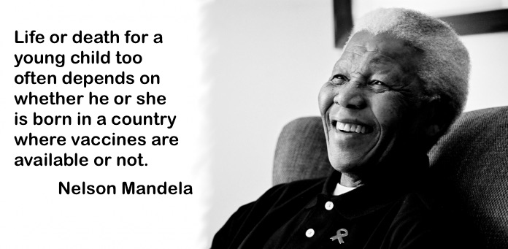
Thank you!

