Slide 1
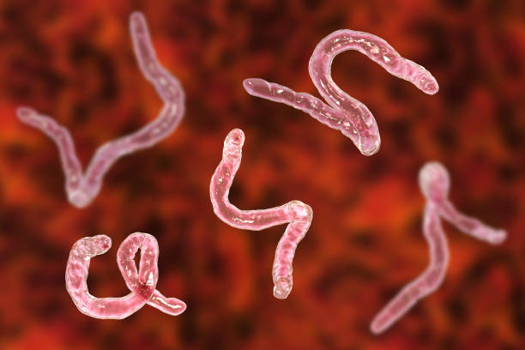
HOOKWORM
Dr. Priyanka Chaturvedi
Assistant Professor
Dept. of Microbiology

Slide 2
Classification based on Habitat
Intestinal nematodes
Tissue or somatic nematodes

Slide 3
Intestinal Nematodes
Small intestinal nematodes:
Ascaris, Strongyloides and Hookworm
Large intestinal nematodes:
Trichuris and Enterobius.

Slide 4
Classification based on they Lay Egg or Larva
oviparous | viviparous | ovoviviparous
Following fertilization, the female worms produce eggs that take some time to hatch out to form larvae in the environment | Female worms directly give birth to larvae; there is no egg stage | Female worms lay eggs containing larvae; which immediately hatch out
hookworm, Ascaris, Trichuris, Enterobius, etc. | filarial worms, Trichinella and Dracunculus | Strongyloides species
Diagnosis is made by detection of eggs in feces. | Diagnosis is made by detection of larvae in tissues or blood. | Larvae - diagnostic form detected in stool examination.

Slide 5
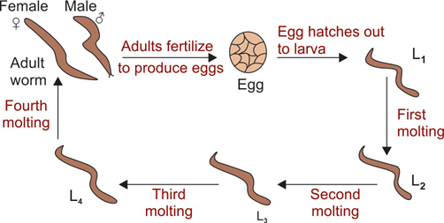
Morphology (Nematodes)
Developmental stages of nematodes

Slide 6
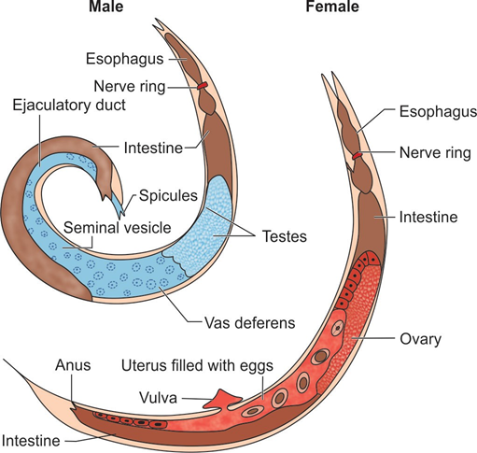
Adult Worm
Adult male and female nematode

Slide 7
HOOKWORM INFECTION

Slide 8
HOOKWORM INFECTION
Hookworm - one of the important causes of iron deficiency anemia .

Slide 9
Classification
Ancylostoma duodenale or old world hookworm
Necator americanus or new world hookworm or American hookworm.

Slide 10
Epidemiology
World: Hookworm infection is widespread.
India: Hookworm infection is widely prevalent in India.
  N. americanus - predominant in South India
  A. duodenale - North India

Slide 11
Epidemiology
Endemic index: Chandler’s index - used to estimate the morbidity and mortality in the community due to hookworm infection (depends much upon the worm load).

Slide 12
Morphology
Three morphological forms:
Adult
Larvae (four stages)
Egg
Ancylostoma and Necator - differentiated by the morphology of adult worm and third stage larva.

Slide 13
Morphology
Adult worm is small and has a bent in the anterior end (hence called as hookworm)
The adult worm - differentiated by buccal capsule with teeth or cutting plate (present in the anterior end) and copulatory bursa (present in the posterior end)
L1 larva - Rhabditiform larva
L3 larva - Filariform larva

Slide 14
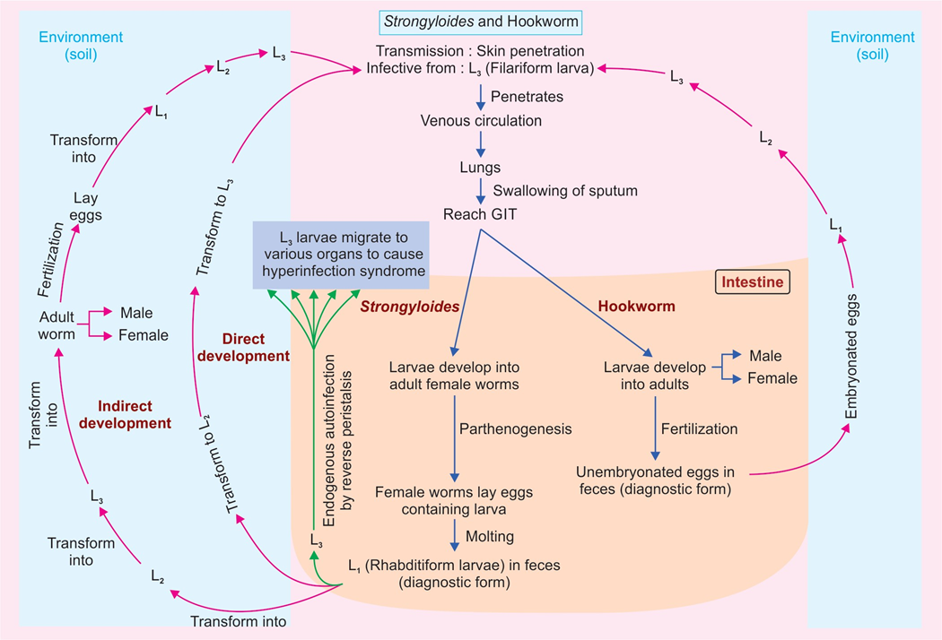
Life Cycle

Slide 15
Pathogenicity
Hookworm has ability to suck blood from the intestinal vessels, which occurs by several ways:
Attaching and making cuts in the intestinal wall by buccal capsule and teeth followed by sucking the blood through contraction of their muscular esophagus
Secreting hydrolytic enzymes
Releasing anticoagulants – maintain continuous oozing of blood from the attachment site.

Slide 16
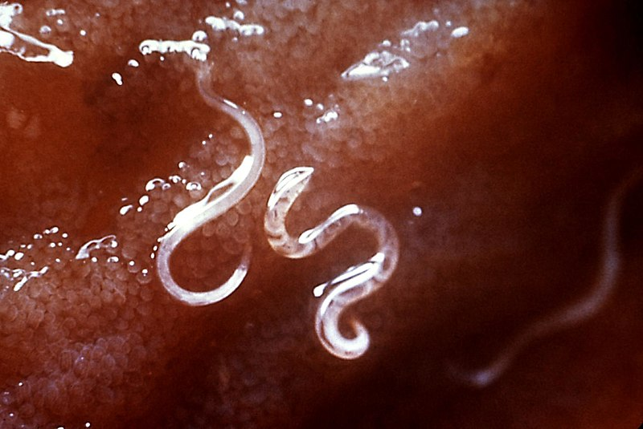
Pathogenicity

Slide 17
Pathogenicity
Ancylostoma is more pathogenic than Necator - because of its larger size, armed with teeth and more migratory.
Blood loss in Ancylostoma infection is 0.15–0.26 mL/worm/day, compared to Necator (0.03 mL/worm/ day).

Slide 18
Clinical Features - Affect due to Migrating Larva
Cutaneous lesions
  Ground itch - at the site of skin penetration
  Serpiginous tracks
Mild transient pneumonitis

Slide 19
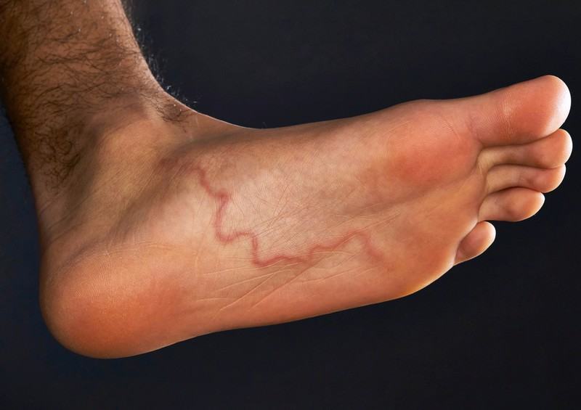
Clinical Features - Affect due to Migrating Larva
  Serpiginous tracks

Slide 20
Clinical Features - Affect due to Adult Worm in Intestine
Asymptomatic
Early intestinal phase (less worm load)
Late intestinal phase (chronic infection with heavy worm load)

Slide 21
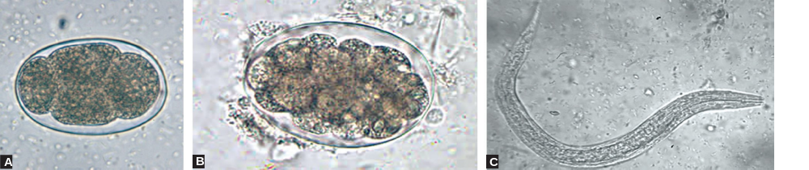
Laboratory Diagnosis - Stool Microscopy
Sample: Stool
Stool concentration procedures - required to detect lighter infections
In a stool sample that is not fresh, the eggs may hatch out to release rhabditiform larvae - which need to be differentiated from that of Strongyloides

Slide 22
Laboratory Diagnosis - Stool Microscopy
Egg counting: To estimate the disease burden in the individual as well as in the community.

Slide 23

Laboratory Diagnosis - Stool Microscopy
Egg with four blastomeres;
Egg with many blastomeres;
Rhabditiform larva.

Slide 24
Laboratory Diagnosis – Stool Culture
Freshly passed stool samples - cultured - eggs hatch out to develop to L3 stage filariform larvae in 5–7 days
Various culture techniques used are:
  Harada-Mori filter paper tube method
  Baermann funnel technique
  Charcoal culture method
  Agar plate technique (more sensitive).

Slide 25
Laboratory Diagnosis - Molecular Diagnosis
PCR and real-time PCR - mitochondrial cytochrome oxidase genes.
Molecular methods have the advantages such as:
Species specific; can differentiate between Ancylostoma and Necator
More sensitive, can detect as low as one copy per 200 mg of stool.

Slide 26
Treatment of Hookworm disease
Antiparasitic:
Antiparasitic drugs:
Albendazole (400 mg once)
Mebendazole (500 mg once)

Slide 27
Treatment of Hookworm disease
Symptomatic treatment:
Mild iron-deficiency anemia - treated with oral iron and folic acid
Severe hookworm disease with protein loss and malabsorption - nutritional support and oral or parenteral iron replacement

Slide 28
Prevention
Improved personal hygiene
Proper disposal of feces
Improved nutrition with dietary iron
Treatment of infected persons

Slide 29
Soil-transmitted helminth infection
Soil-transmitted helminth (STH) infections – intestinal worms infecting humans - transmitted through contaminated soil - Ascaris, Trichuris and hookworm.

Slide 30
Soil-transmitted helminth infection
High-risk group - preschool children, school-age children, women of childbearing age (including pregnant women) and adults in certain high-risk occupations - tea-pickers or miners

Slide 31
Soil-transmitted helminth infection
Presentation: Infected children - nutritionally, intellectually and physically impaired - suffer from malabsorption of nutrients, anemia, diarrhea and dysentery - depending upon the type of helminths infected

Slide 32
Soil-transmitted helminth infection
Deworming: Periodic prophylactic measure to prevent high-risk people from worm infestation; initiated by World Health Organization (WHO)
  The National Deworming Day: Every year, 10th February and 10th August
  Deworming - once in a year if the prevalence of STH infection is >20% in the community and twice a year if >50%
  In this day, single-dose albendazole (400 mg) - all children aged 1–19 years.

Slide 33
MCQs

Slide 34
1. Which of the following is not a nematode:
A) Ascaris lumbricoides
B) Taenia solium
C)Trichuris trichura
D) Ancystoma duodenale

Slide 35
2. Which of the following is not a hookworm
A) Ancystoma duodenale
B) Necator americanus
C)Trichuris trichura

Slide 36
3. Which helminth is not transmitted through skin penetration
A) Ancystoma duodenale
B) Necator americanus
C) Strongyloides
D) Trichuris trichura

Slide 37
4. Which of the following is not oviparous nematodes
A) Ancystoma duodenale
B) Ascaris lumbricoides
C) Strongyloides
D) Trichuris trichura

Slide 38
5. Which of the following hookworm is common in India?
A) Ancystoma duodenale
B) Necator americanus
C) Both
D) Trichuris trichura

Slide 39
Thank you

