Slide 1

HIV-2
Dr. Priyanka Chaturvedi
Assistant professor

Slide 2
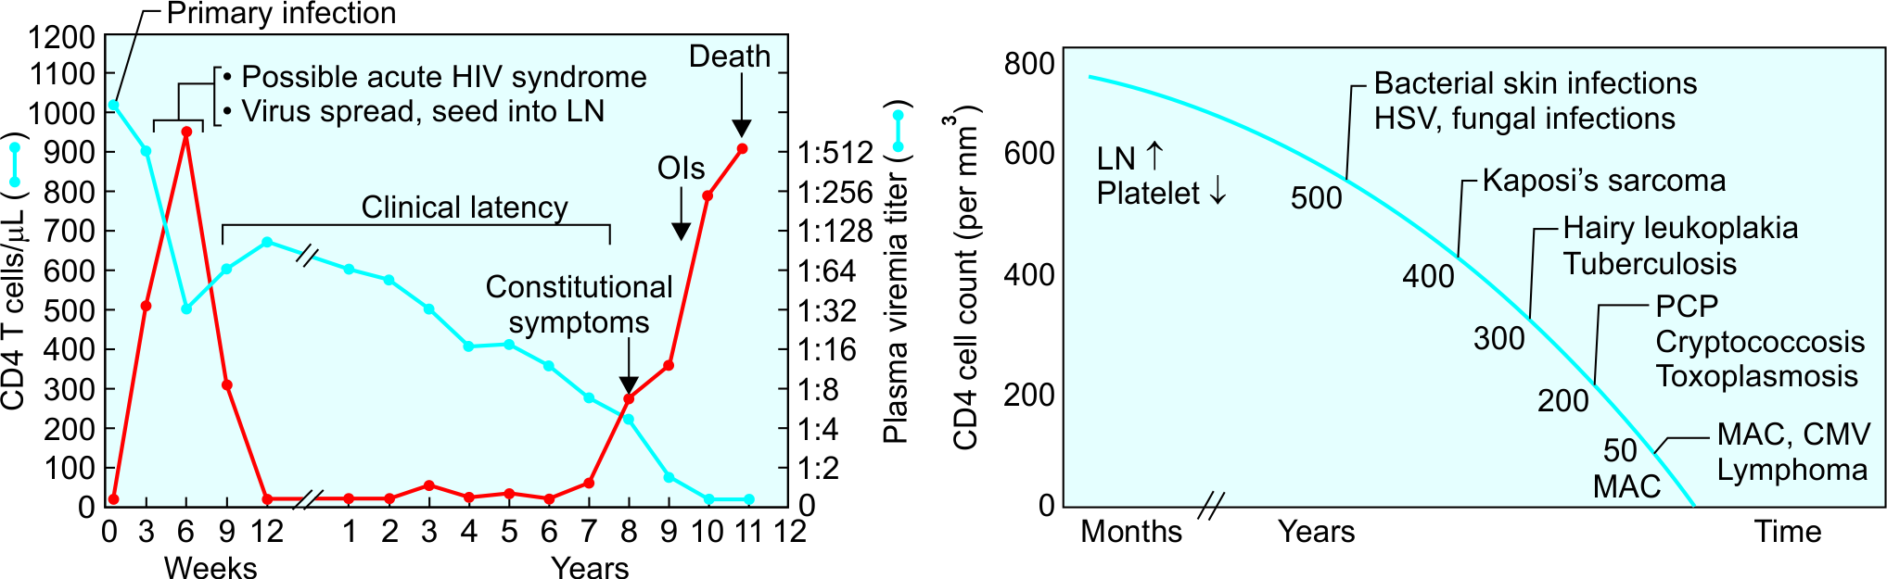
Natural Course (Typical Progressors)
Natural course of HIV infection

Slide 3
Persistent Generalized Lymphadenopathy (PGL)
As a result of HIV replication in lymph nodes, infected people, develop lymphadenopathy.
PGL is defined as ENLARGED LYMPH NODES OF >1cm SIZE IN TWO OR MORE NON-CONTIGUOUS SITES THAT PERSIST FOR AT LEAST 3 MONTHS.

Slide 4
Symptomatic HIV Infection (AIDS-related Complex)
Patients develop CONSTITUTIONAL SYMPTOMS such as:
  Unexplained diarrhoea for >1 month
  Weight loss >10% of body weight, fatigue malaise, and night sweat
  Mild opportunistic infections such as oral thrush

Slide 5
AIDS - Advanced end stage
Rapid fall in CD4 T cell count (usually less than 200 cells/µl)
High virus load
Lymphoid tissue is totally destroyed and replaced by fibrous tissue.
Opportunistic infections set in secondary to profound immune suppression.
Development of neoplasia (e.g. CNS lymphoma)

Slide 6
AIDS - advanced end stage
Opportunistic infections associated with HIV infection and correlation with CD4 T cell counts

Slide 7
CLINICAL DIAGNOSIS

Slide 8
CLINICAL DIAGNOSIS
Two such systems are in use worldwide:
  CDC classification system
  WHO clinical staging of HIV/AIDS for adults

Slide 9
WHO clinical staging of HIV/AIDS for adults: 4 clinical stages
Clinical Stage 1
Asymptomatic HIV infection Persistent generalized lymphadenopathy (PGL)
Clinical Stage 2
Unexplained moderate weight loss (>10%) Recurrent respiratory tract infections Herpes zoster Angular cheilitis Recurrent oral ulcers Papular pruritic eruptions Seborrheic dermatitis Fungal nail infection

Slide 10
WHO clinical staging of HIV/AIDS for adults
Clinical Stage 3
Unexplained severe weight loss (>10%) Unexplained chronic diarrhea: >1 month Unexplained persistent fever: 1 month Oral candidiasis Oral hairy leukoplakia Pulmonary tuberculosis Severe bacterial infections (pneumonia, empyema, etc.) Acute necrotizing ulcerative stomatitis, gingivitis, and periodontitis Unexplained anemia, neutropenia or chronic thrombocytopenia

Slide 11
WHO clinical staging of HIV/AIDS for adults
Clinical Stage 4
HIV wasting syndrome (Slim disease): Characterized by profound weight loss (>10%), chronic diarrhea (>1 month), prolonged unexplained fever (1 month)
Bacterial opportunistic infections: Recurrent severe bacterial infections Extra-pulmonary tuberculosis Disseminated non-tubercular mycobacterial infection Recurrent septicemia (including non-typhoidal salmonellosis)
Viral opportunistic infections: Chronic HSV infection Progressive multifocal leukoencephalopathy CMV (retinitis, or infection of other organs)

Slide 12
WHO clinical staging of HIV/AIDS for adults
Clinical Stage 4
Fungal opportunistic infections: Pneumocystis jirovecii pneumonia Esophageal candidiasis Extra-pulmonary cryptococcosis (meningitis) Disseminated mycoses (histoplasmosis and coccidioidomycoses)
Parasitic opportunistic infections: Toxoplasma encephalitis Chronic intestinal cystoisosporiasis (>1 month) Atypical disseminated leishmaniasis
Neoplasia: Kaposi’s sarcoma Invasive cervical cancer Lymphoma (cerebral, B-cell and non-Hodgkin)

Slide 13
WHO clinical staging of HIV/AIDS for adults
Clinical Stage 4
Other conditions (direct HIV induced): HIV encephalopathy Symptomatic HIV-associated nephropathy or cardiomyopathy

Slide 14
EPIDEMIOLOGY

Slide 15
EPIDEMIOLOGY
Global prevalence: 0.8% in adults.
HIV prevalence in India : 0.22% in adults
Northeast states - Mizoram (2%), Manipur & Nagaland have highest prevalence

Slide 16
EPIDEMIOLOGY
Reservoir:
Infected people (both symptomatic as well as asymptomatic) are the only reservoir host.
Once infected, they harbor the virus for life.

Slide 17
High-risk Groups
Extremely high-risk group:
  Female sex workers
  Men who have sex with men
  Transgenders
  IV drug abuser group

Slide 18
High-risk Groups
Moderately high-risk group:
  Health care workers (via needle pricks or splashes injury)
  Hemophiliacs and other recipients of blood products
  People with other STIs (sexually-transmitted infections).

Slide 19
Opportunistic Infections
Globally including India, tuberculosis is the most common OI that occurs in HIV infected people
  Common fungal infections are candidiasis (oral thrush) and Pneumocystis jirovecii
  Frequent viral infections are herpes simplex mucosal lesions and CMV retinitis
  Common parasitic infections are Cryptosporidium parvum diarrhoea and Toxoplasma encephalitis

Slide 20
AIDS Control Organizations
UNAIDS: The Joint United Nations Program on HIV and AIDS (UNAIDS)
NACO-National AIDS Control Organisation (NACO)
SACS-State AIDS Prevention and Control Societies (SACS)
National Strategic Plan for HIV/AIDS and STI (2017–2024)

Slide 21
KINETICS OF IMMUNE RESPONSE
Window period- 3 to 12 weeks.
Antibodies to gag protein (p24 and p55) usually first to appear.
Antibodies to env proteins persist throughout the infection.

Slide 22
KINETICS OF IMMUNE RESPONSE
Anti-HIV antibodies: All IgA, IgM and IgG are produced, but IgG response is consistent and long lasting.
Most currently available assays detect IgG antibodies.

Slide 23
LABORATORY DIAGNOSIS HIV INFECTION

Slide 24
LABORATORY DIAGNOSIS HIV INFECTION
3Cs while performing the test for HIV.
Consent in written bingual format should be taken before the test is done.
Confidentiality of a POSITIVE TEST RESULT is a must. Patient name or the word “HIV positive” SHOULD NOT be written on the report form
Counselling should be provided to motivate the individual to tell the spouse/family and induce behavioural change

Slide 25
LABORATORY DIAGNOSIS HIV INFECTION
ANTIBODY DETECTION
ANTIGEN DETECTION
GENOME DETECTION

Slide 26
LABORATORY DIAGNOSIS HIV INFECTION
ANTIBODY DETECTION:
1. SCREENING TESTS
Take less time
Highly sensitivity
Should be confirmed: Results of a single screening test should never be used as the final interpretation of HIV status as false positive results or technical errors can occur.

Slide 27
LABORATORY DIAGNOSIS HIV INFECTION
1. Rapid/Simple Test
  Easy & quick (< 30 mins)
  MOST COMMONLY USED TESTS IN INDIA:-
    Dot blot assays (or Immunoconcentration or flow through method, e.g. Tridot test)
    Immunochromatography (or ICT, lateral flow assay)
    Dip stick/Comb tests (Enzyme immune assay-based tests).

Slide 28
LABORATORY DIAGNOSIS HIV INFECTION
2. ELISA –Most common performed screening test at blood banks and tertiary care sites.
  Sensitive, specific, and cost effective.

Slide 29
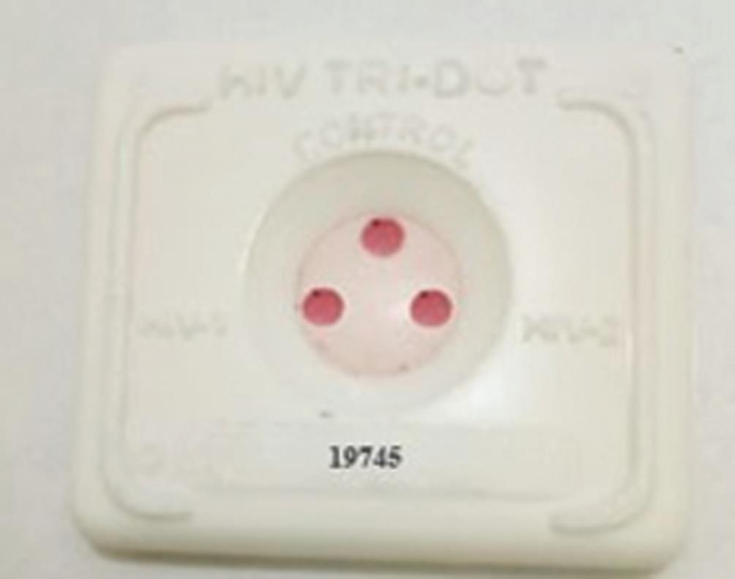
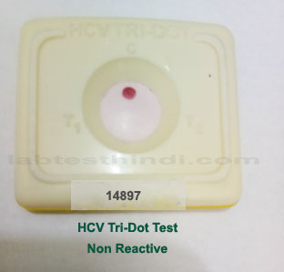
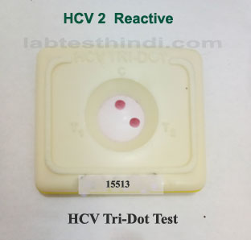
LABORATORY DIAGNOSIS HIV INFECTION
TRIDOT TEST

Slide 30
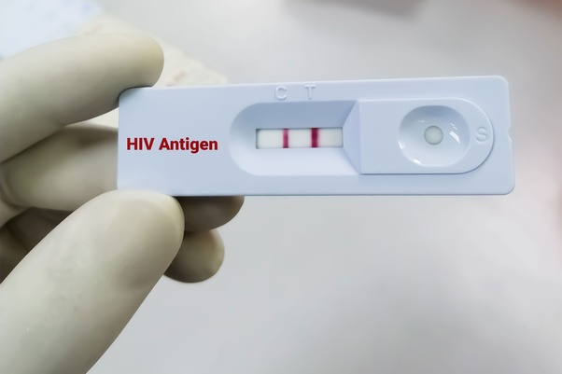
LABORATORY DIAGNOSIS HIV INFECTION
LATERAL FLOW ASSAY

Slide 31
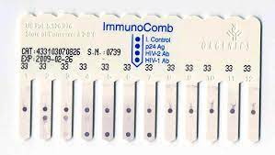
LABORATORY DIAGNOSIS HIV INFECTION
COMB TESTS

Slide 32
LABORATORY DIAGNOSIS HIV INFECTION
2. SUPPLEMENTAL TESTS
Highly specific and is used for validation of positive results of screening tests.
They are expensive, labour intensive, need expertise to interpret.

Slide 33
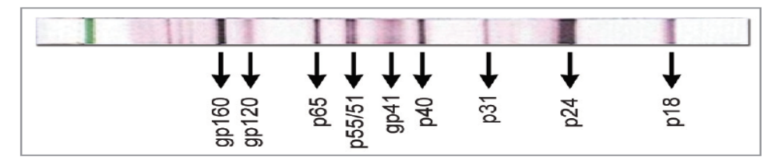
LABORATORY DIAGNOSIS HIV INFECTION
WESTERN BLOT - Most commonly used supplemental test available and is also recommended by NACO.
It detects individual antibodies in serum separately against various antigenic fragments of HIV
Presence of at least two envelope bands (out of gp120, gp160 or gp41) with or without gag or pol bands

Slide 34
LABORATORY DIAGNOSIS HIV INFECTION
ANTIGEN DETECTION
Detection of p24 Core Antigen
p24 antigen becomes detectable after 12–26 days of infection and lasts for 3–4 weeks thereafter.
p24 Ag is detected by 4th generation ELISA

Slide 35
LABORATORY DIAGNOSIS HIV INFECTION
Uses of p24 antigen detection test:
  For confirmation of diagnosis of HIV/AIDS
  Diagnosis of HIV during the window period
  Diagnosis of HIV in infants
  Monitoring the progress of HIV infection

Slide 36
LABORATORY DIAGNOSIS HIV INFECTION
GENOME DETECTION
HIV RNA (best confirmatory method) - detected 10 -14 days after infection
HIV DNA detection: Useful for diagnosis of pediatric HIV

Slide 37
LABORATORY DIAGNOSIS HIV INFECTION
Other tests:-
Low CD4 T-cell count
Hypergammaglobulinemia:
  Neopterin
  β2-macroglobulin
Altered CD4: CD8 T-cell ratio

Slide 38
NACO Strategy for HIV Diagnosis
NACO (National AIDS Control Organization, India) has formulated a strategic plan for HIV diagnosis.
Depending on the situation/condition, for which the test is done, the positive result of the first screening test should be either considered as such or confirmed by another one or two screening tests

Slide 39
NACO Strategy for HIV Diagnosis
First screening test should be highly sensitive whereas the second and third screening tests should have high specificity.
Three screening tests should use different principles or different antigens. The same kit should not be used again.
Supplemental or confirmatory tests should be used only when the screening test(s) result equivocal/intermediate.

Slide 40
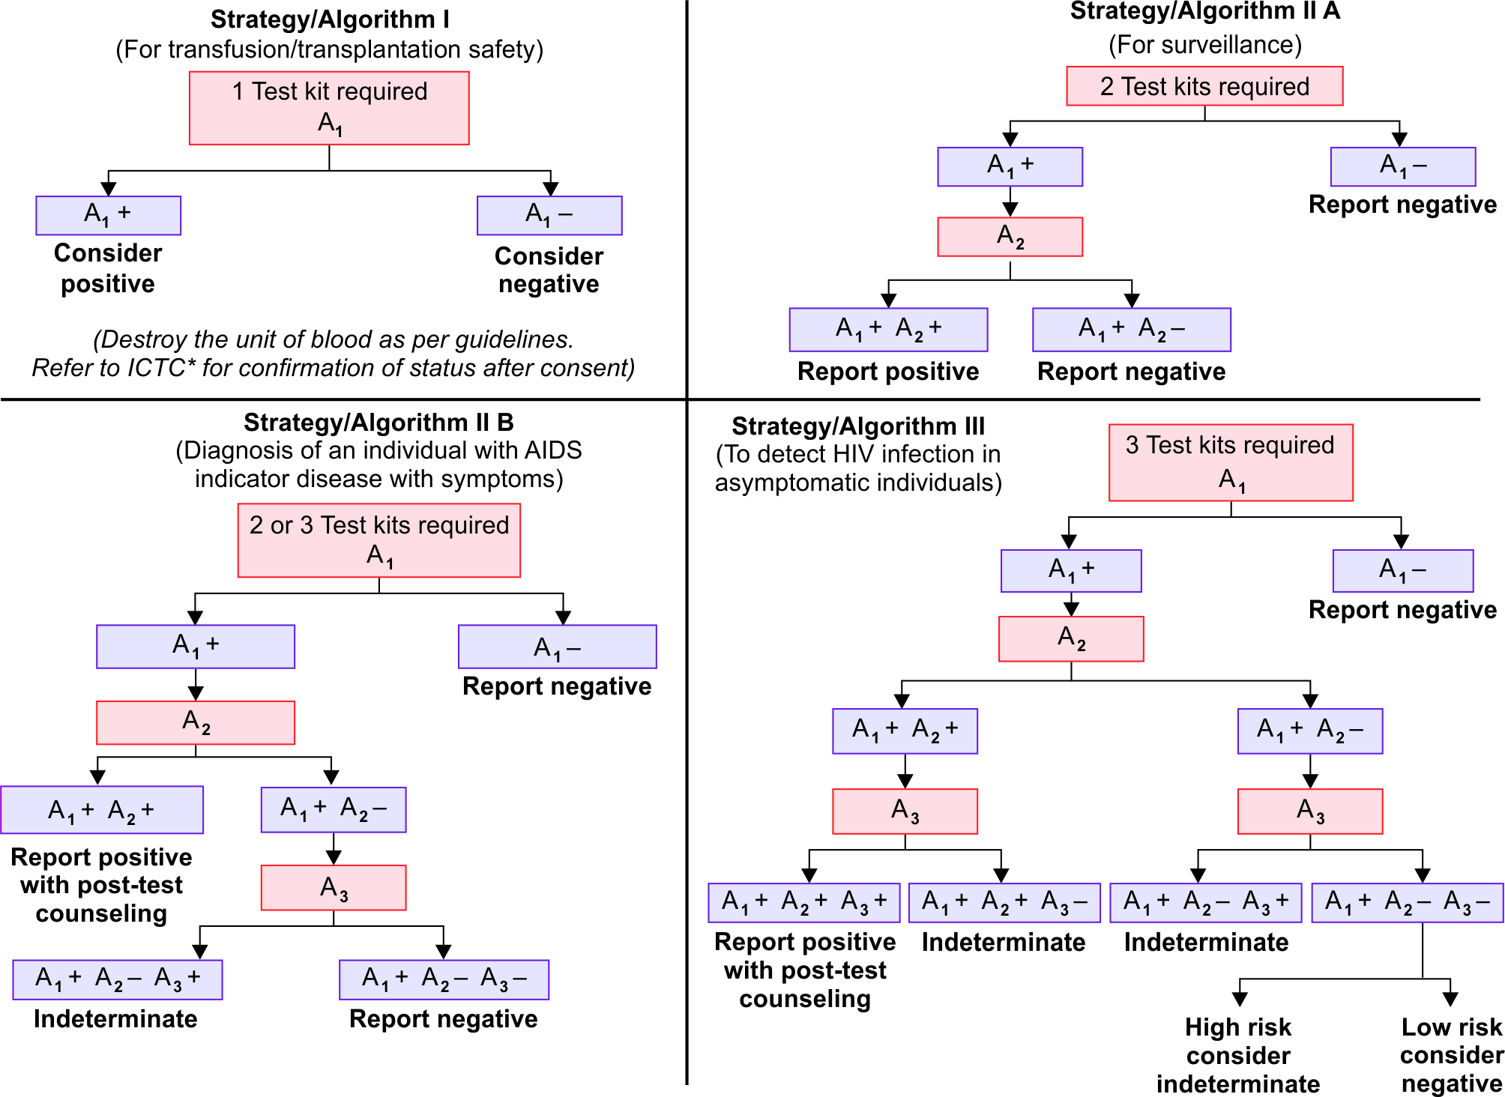
NACO Strategy for HIV Diagnosis

Slide 41
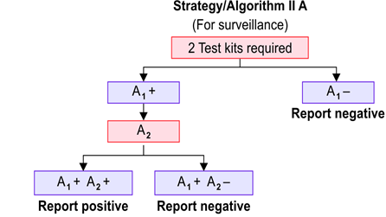
NACO Strategy for HIV Diagnosis

Slide 42
NACO Strategy for HIV Diagnosis

Slide 43
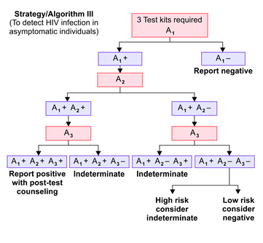
NACO Strategy for HIV Diagnosis

Slide 44
Prognosis/monitoring of HIV
  CD4 T cell count – most commonly used
  HIV RNA load– most consistent and best tool at present
  p24 antigen detection

Slide 45
Diagnosis of pediatric HIV infection
The recommended methods for diagnosis of paediatric HIV include-
  HIV DNA detection-most recommended
  HIV RNA detection
  p24 antigen detection
  IgG ELISA-only after 18 months of age

Slide 46
Diagnosis of HIV in Window Period
HIV RNA detection (by RT-PCR) is the best method - detects HIV RNA around 10–14 days after infection.

Slide 47
Few Thoughts….regarding HIV/AIDS

Slide 48
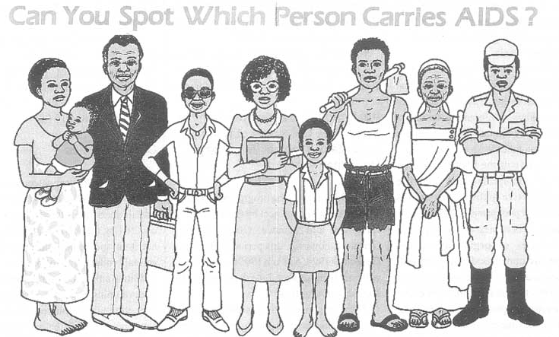
NO

Slide 49
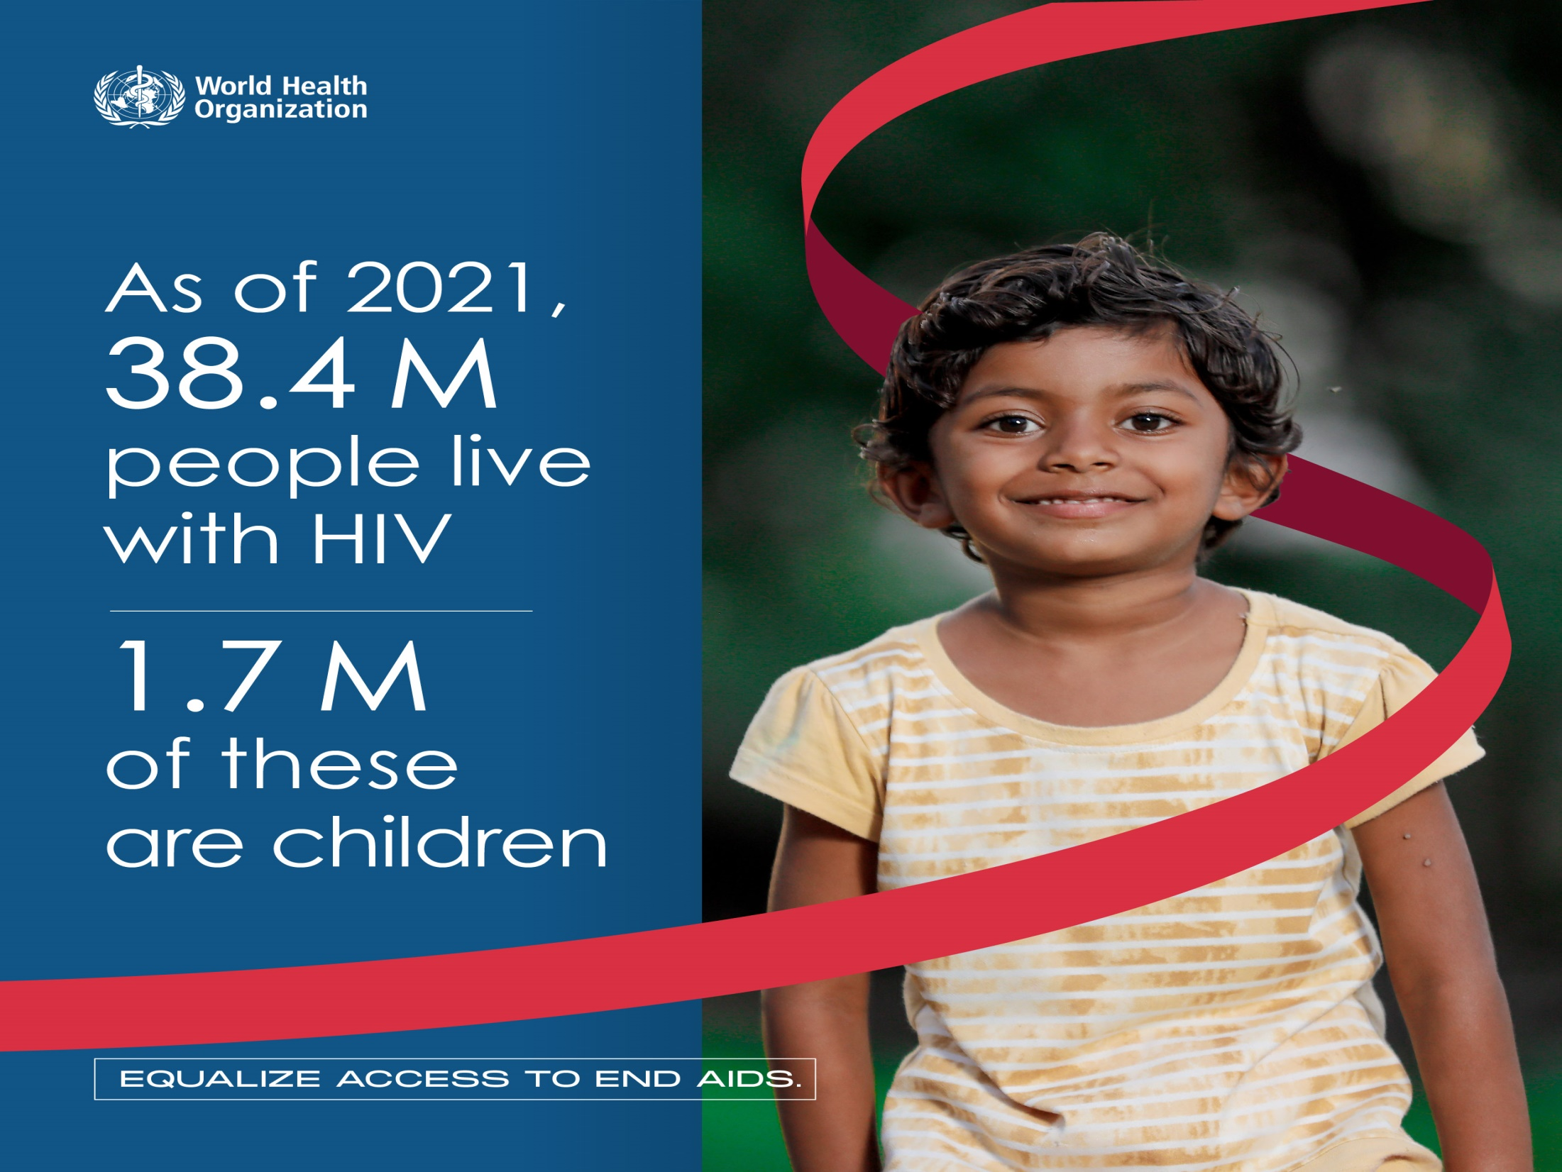

Slide 50
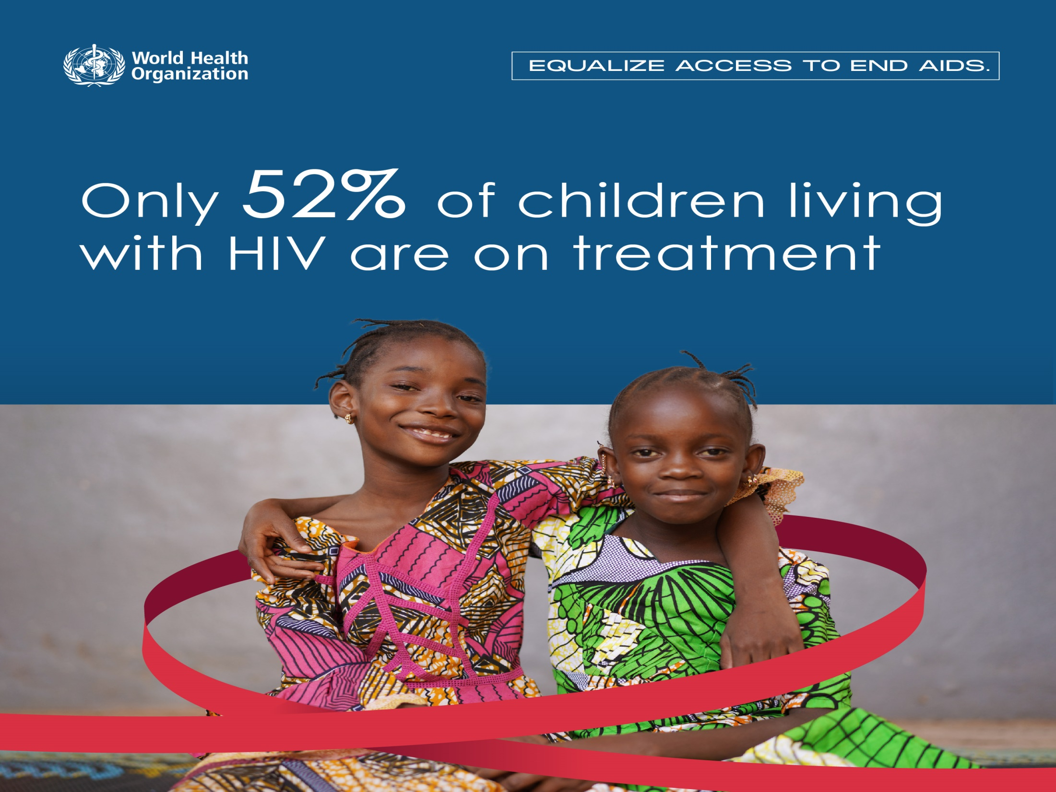

Slide 51
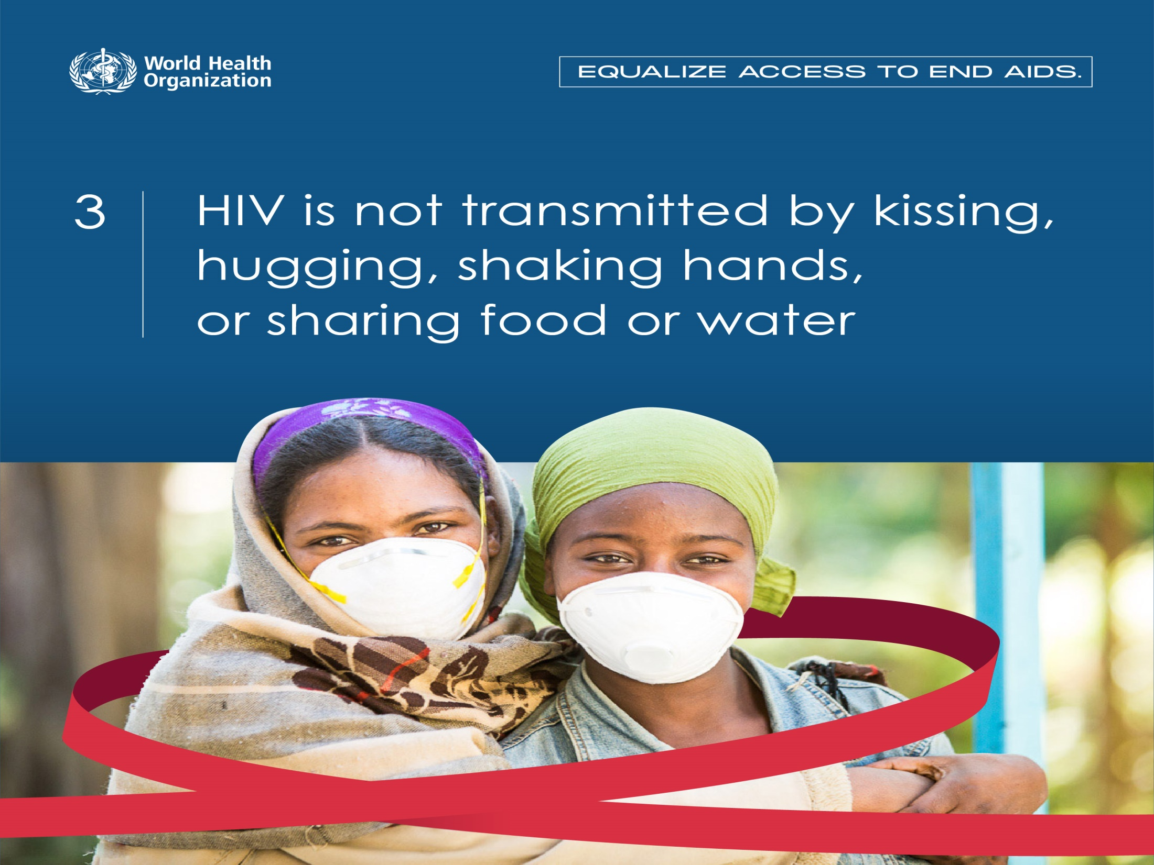

Slide 52
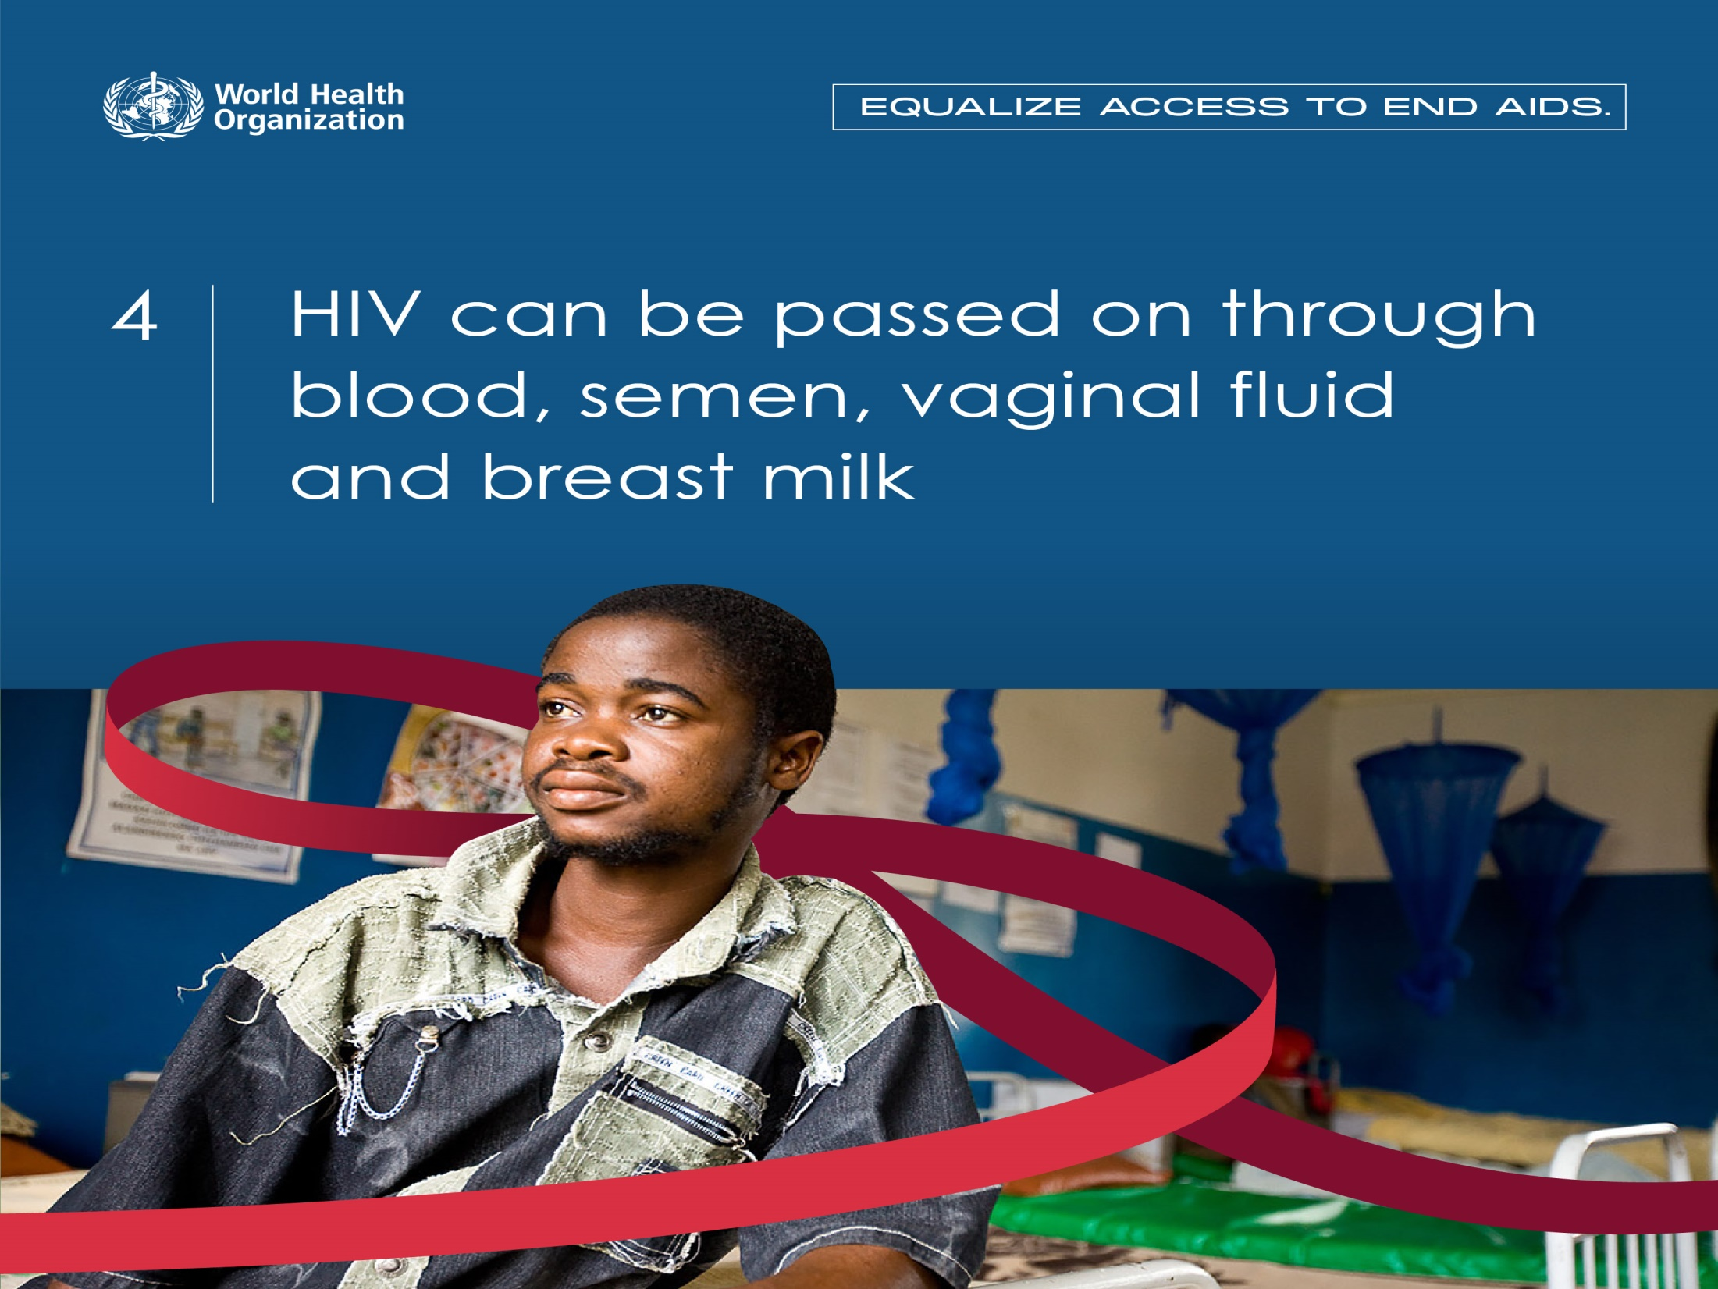

Slide 53

HIV CANNOT be transmitted from the following

Slide 54


Slide 55
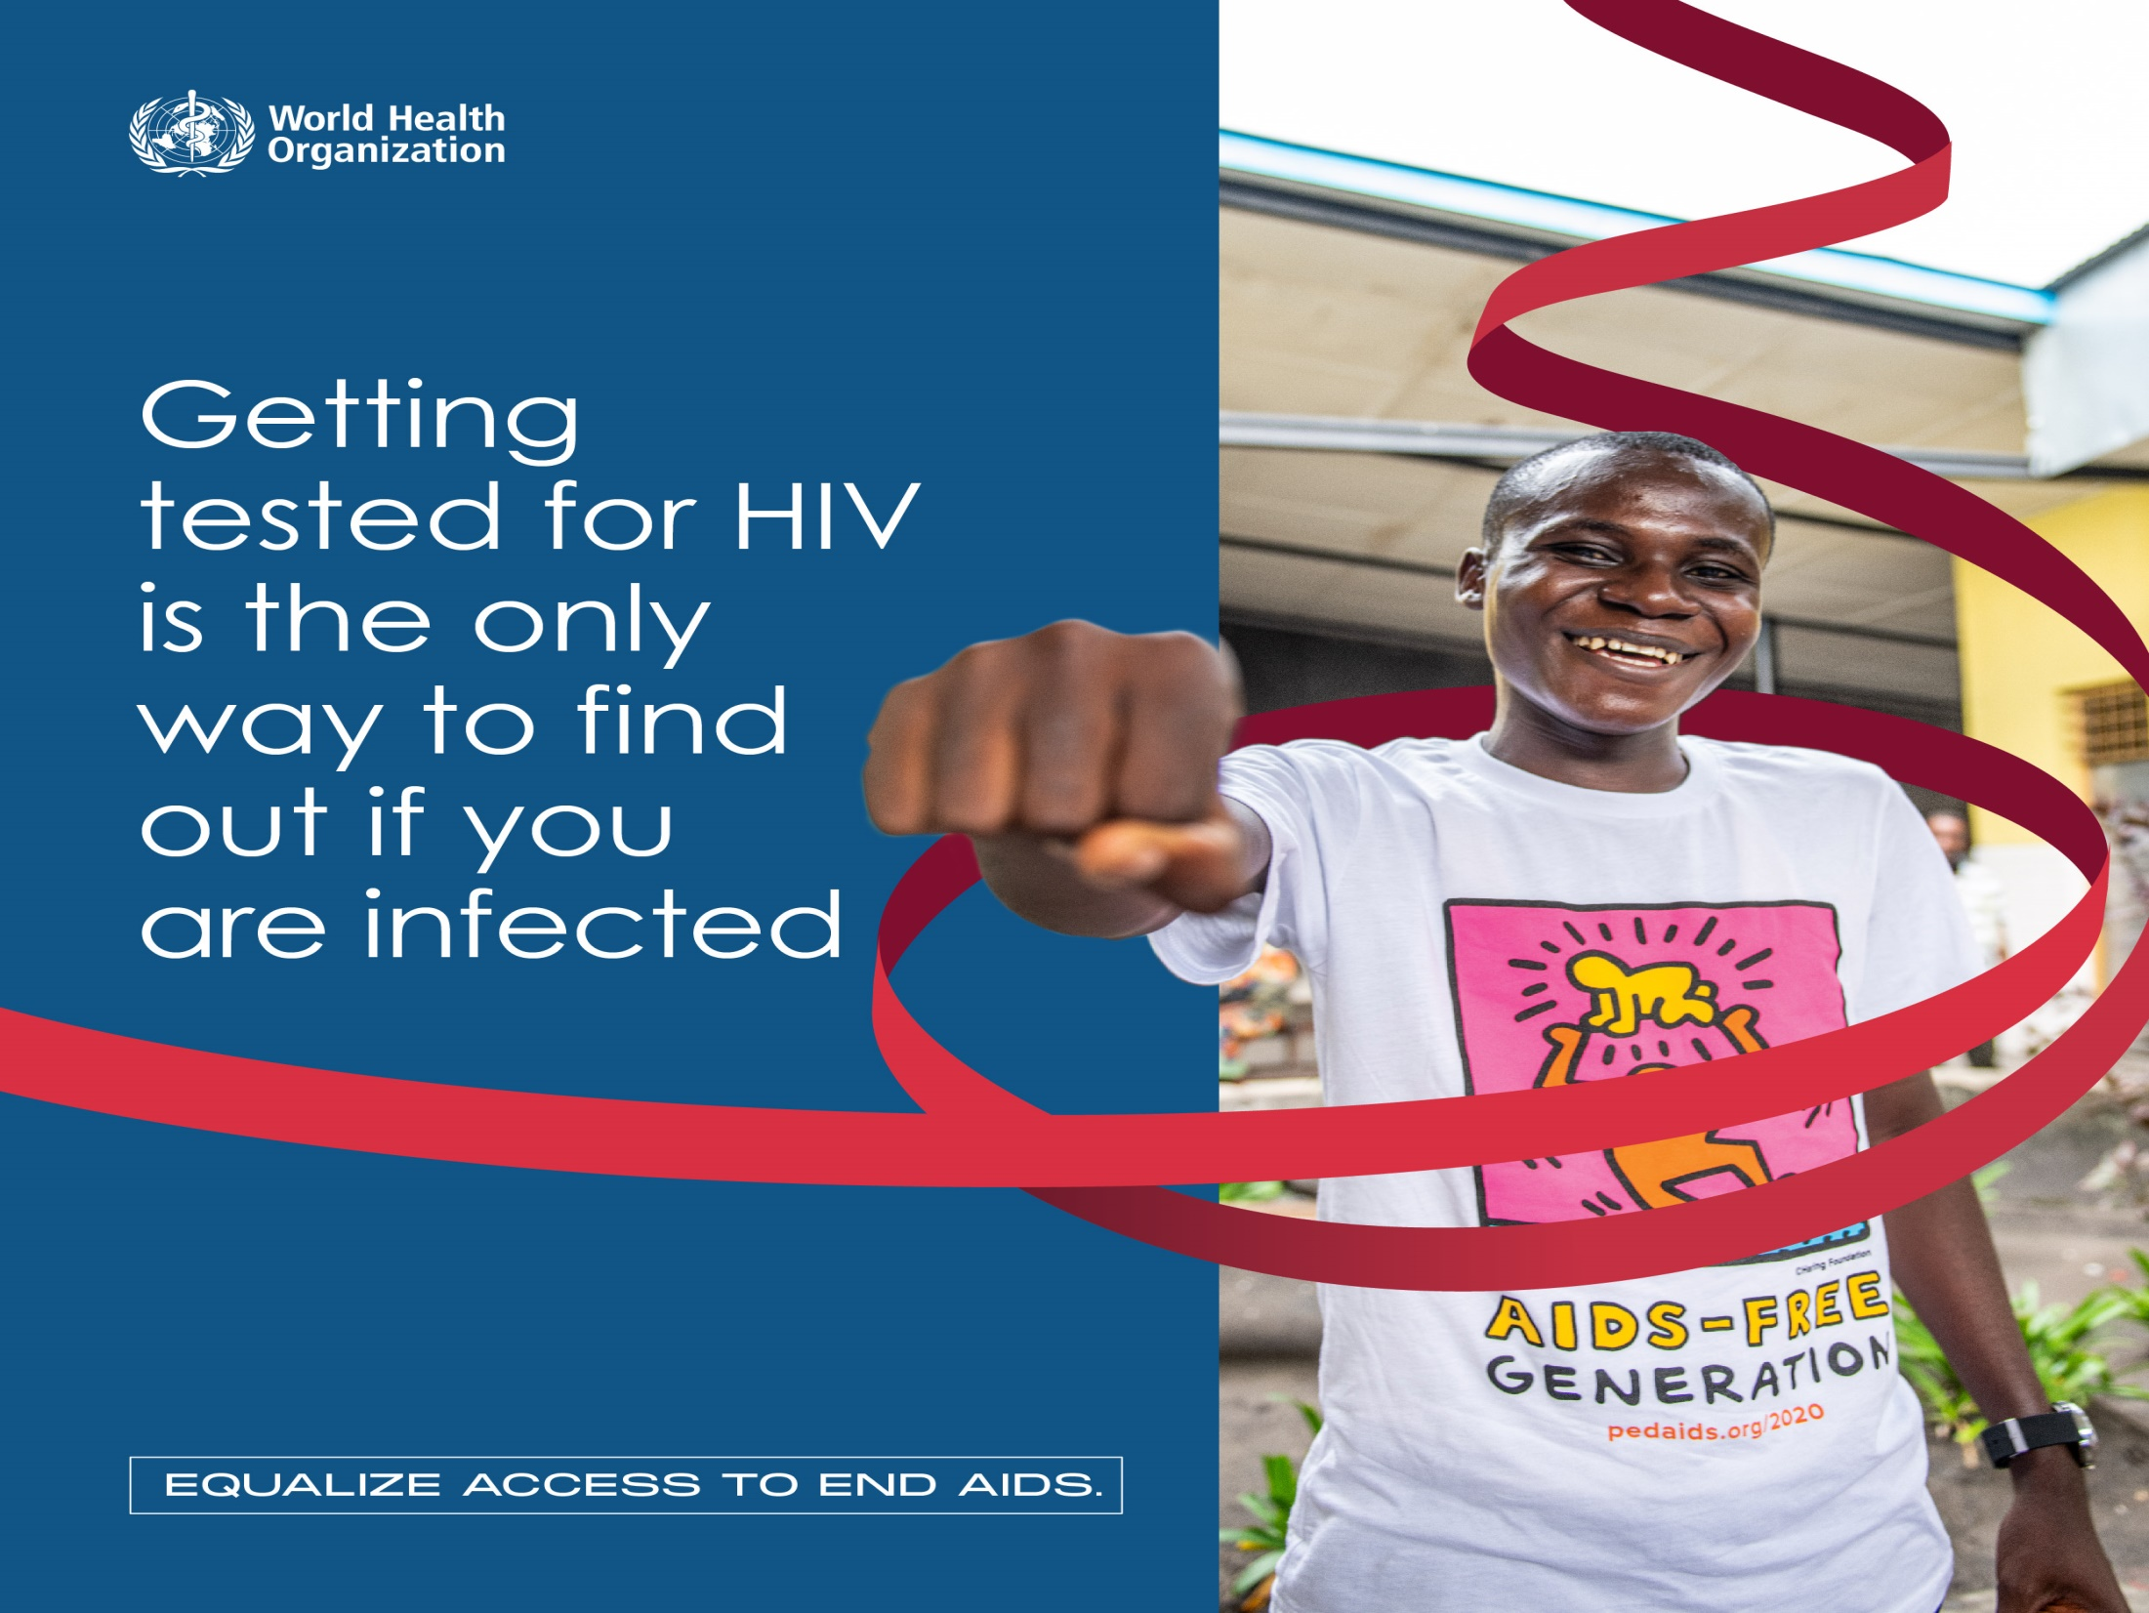

Slide 56


Slide 57


Slide 58


Slide 59
RED RIBBON SYMBOLIZE?
It is an internationally recognized symbol for AIDS awareness.
Worn by people in support of people living with HIV and in remembrance of those who have died of AIDS.
The Red Ribbon Express (RRE) campaign launched
in India on World AIDS Day.

Slide 60



Slide 61

THANK YOU!!!
Let all of us JOIN OUR HANDS TO FIGHT AGAINST HIV/AIDS

Slide 62


