Slide 1
HIV-1
Dr. Priyanka Chaturvedi
Assistant professor

Slide 2
INTRODUCTION

Slide 3
INTRODUCTION
Retroviruses - A group of RNA viruses that possess a unique enzyme ‘reverse transcriptase’ that directs the synthesis of DNA from the viral RNA after infection into a host cell.
  Genus Lentivirus – contains Human Immunodeficiency Virus (HIV)- 1 & 2
  Genus Deltaretrovirus – contains Human T cell Lymphotropic Virus-1 (HTLV-1).

Slide 4
HISTORY OF AIDS
The first case of AIDS was from New York (USA) in 1981.
Discovery & isolation of HIV-1 from Pasteur Institute, Paris in 1983.
HIV in humans is believed to be acquired from chimpanzee by the cross species infections of simian counterpart of HIV (simian immunodeficiency virus or SIVcpz) in rural Africa.

Slide 5
MORPHOLOGY

Slide 6
Morphology
Spherical, 80–110 nm in size, Enveloped virus.
Envelope is made up of-
Lipid part is host cell membrane derived.
Protein part has two components -
  Glycoprotein-120(gp120) are projected as knoblike spikes on the surface
  Glycoprotein- 41(gp41)- They form anchoring transmembrane pedicles.

Slide 7
Morphology
Nucleocapsid- Capsid is ICOSAHEDRAL IN SYMMETRY,
Inner core encloses-
  RNA- Two identical copies of SINGLE-STRANDED POSITIVE SENSE LINEAR RNA
  Viral enzymes such as REVERSE TRANSCRIPTASE, INTEGRASE and PROTEASES

Slide 8
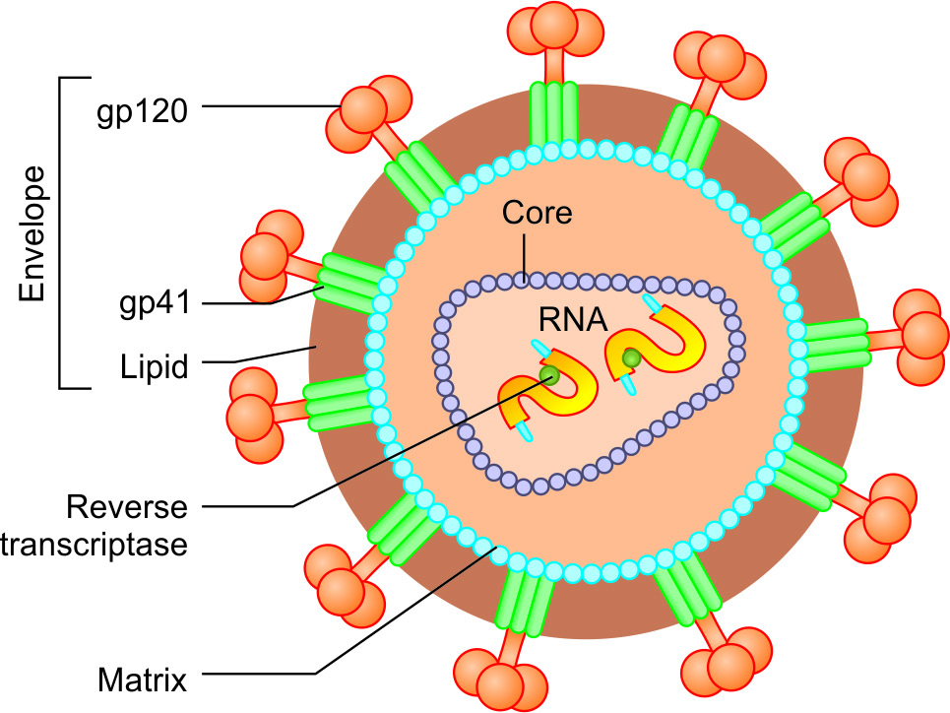
Morphology of HIV

Slide 9
HIV Genes and Antigens
Three structural genes—gag, pol, and env
Six non-structural or regulatory genes.

Slide 10
Structural Genes
gag gene codes for the core and shell of the virus.
pol gene codes for viral enzymes.
env gene codes for the envelope glycoprotein (gp160), which is cleaved into two components:
  gp 120
  gp41

Slide 11
Non-structural Genes
Non-structural genes regulate viral replication.
They can be grouped into:
  Essential regulatory genes: tat (transcriptional transactivator), nef (negative factor) and rev genes
  Accessory regulatory genes: vif (viral infectivity factor), vpr and vpu genes

Slide 12
Antigenic Variation and Diversity
HIV shows extensive antigenic diversity: Most notably - env gene.
  High rates of mutation
  Due to the error-prone nature of reverse transcriptase enzyme.
Envelope proteins - major target against which antibodies are produced.
Hence mutations in env gene are the main reason which explains why-
  HIV evades the host’s immune response
  Vaccination against HIV is extremely difficult.

Slide 13
HIV Serotyping
Based on env gene, HIV comprises of two serotypes -HIV 1 & 2
HIV-1- divided into three distinct groups (M, N, &O).
‘M’ is the m/c group worldwide (10 subtypes or "clades" A-J)
Subtype C – m/c in India, and China)
HIV-2 comprises of eight groups (A–H) (A is m/c)

Slide 14
PATHOGENESIS

Slide 15
Transmission of HIV
Route of transmission | Risk of transmission (Worldwide, %) | % of total transmission
 |  | World | India
Blood transfusion | >90 | 5 | 1
Parent to child | 13–40 | 10 | 5.4
Sexual intercourse | 0.1-1 | 75 | 88.9
Injection drug abuse | 0.5-1.0 | 10 | 1.6%
Needle stick exposure | 0.3 | 0.1 | 1
Unknown | - | - | 3

Slide 16
Mode of Transmission
Viral load is maximum in blood, genital secretions and CSF
Variable in breast milk and saliva
Zero to minimal in other body fluids or urine.

Slide 17
Receptor Attachment
Main receptor - HIV enters into the target cells by binding its gp120 to the CD4 receptor on host cell surface.
A second co-receptor - chemokine receptors act as co- receptors for HIV :-
  CXCR4 molecules present on T lymphocytes
  CCR5 molecules present on cells of macrophage lineage

Slide 18
Receptor Attachment
DC-SIGN - dendritic cell-specific lectin receptor facilitate transport of HIV by dendritic cells to lymphoid organs where HIV replicates further in T cells.

Slide 19
Mutation in CCR5 (delta 32 mutation)
Mutation in CCR5, results in blockade of HIV entry into the cells.
Observed in some lucky people of Europe and Western Asia who are either:
  Completely resistant to HIV infection
  Susceptible, but progression to AIDS is VERY LATE.

Slide 20
Replication of HIV in host cell
Fusion
Penetration & uncoating
Reverse transcription
Pre-integration complex
Integration
Latency

Slide 21
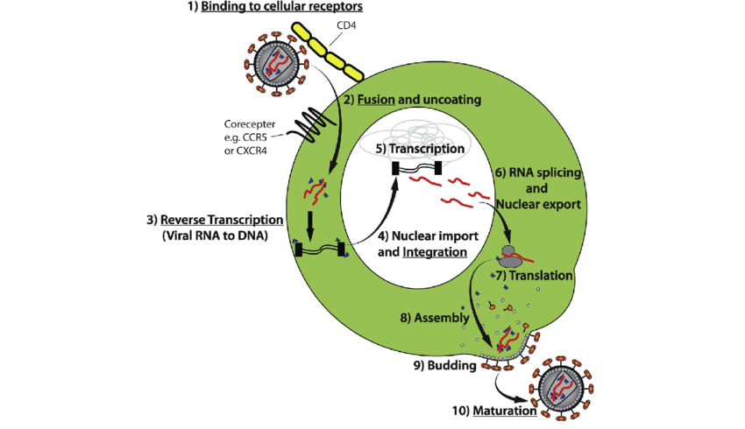

Slide 22
Disease Progression
Progressors | Develops into AIDS | % of PLHA
Typical Progressor | Within 10 years. | 80-90%
Rapid Progressor | Within 2-3 years. | 5-10%
Long-term Non-progressor (LTNP) | After long time (10-30 years) without ART. They show <5000 HIV RNA copies /ml. Usually associated with CCR5 mutation. | 5%
Elite Controller (subset of LNTP) | After long time (10-30 years) without ART. They show <50 RNA copies /ml (below detectable level). | <1%

Slide 23
Natural Course (Typical Progressors)
About 80–90% of HIV, infected individuals are “typical progressors,” with a median survival time of approximately 10 years.

Slide 24
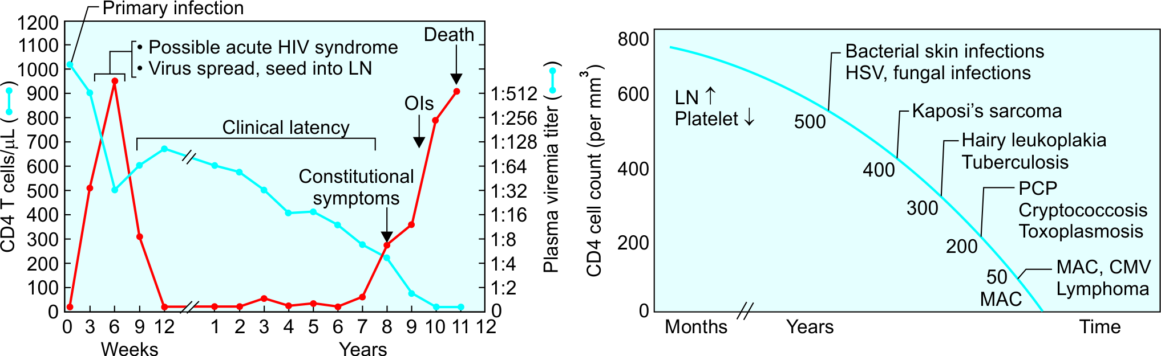
Natural Course (Typical Progressors)
Natural course of HIV infection

Slide 25
Acute HIV Disease/Acute Retroviral Syndrome
Following infection, HIV is carried to the lymph nodes and other lymphoid tissues where further multiplication occurs in T cells.
Initially, HIV destroys the infected T cells and spills over into blood stream to cause PRIMARY VIREMIA (or acute mononucleosis-like syndrome)

Slide 26
Acute HIV Disease/Acute Retroviral Syndrome
This coincides with an initial flu like illness that occurs in many patients (50-75%) 3-6 weeks after the primary infection.
There is a significant drop in numbers of circulating CD4 T cells at this stage.

Slide 27
Asymptomatic Stage (Clinical Latency)
Adequate immune response develops within 1-months in most of the patients.
Both effective CMI response (HIV specific CD8 T cells) and humoral response (HIV specific neutralizing antibodies) comes into play.
Viremia drops down and CD4 T cell count becomes normal.
State of clinical latency, but NOT MICROBIOLOGICAL LATENCY.

Slide 28
Asymptomatic Stage (Clinical Latency)
Immune response cannot clear the infection completely, HIV-infected cells persist in the LN, and there is a high level of ongoing viral replication.
May last for 10 years
Once the latency is broken, the disease progresses rapidly and death usually occurs within 2 years if left untreated.

Slide 29
Persistent Generalized Lymphadenopathy (PGL)
As a result of HIV replication in lymph nodes, infected people, develop lymphadenopathy.
PGL is defined as enlarged lymph nodes of >1cm size in two or more non-contiguous sites that persist for at least 3 months.

Slide 30
Symptomatic HIV Infection (AIDS-related Complex)
After variable period of clinical latency, the CD4 T cell level starts falling.
Eventually patients develop CONSTITUTIONAL SYMPTOMS such as:
  Unexplained diarrhoea lasting for >1 month
  Weight loss >10% of body weight, fatigue malaise, and night sweat
  Mild opportunistic infections such as oral thrush

Slide 31
AIDS - advanced end stage
Rapid fall in CD4 T cell count (usually less than 200 cells/µl)
High virus load
Lymphoid tissue is totally destroyed and replaced by fibrous tissue.
Opportunistic infections set in secondary to profound immune suppression.
Development of neoplasia (e.g. CNS lymphoma)
Development of direct HIV induced manifestations such as HIV encephalopathy

Slide 32
AIDS - advanced end stage
Opportunistic infections associated with HIV infection and correlation with CD4 T cell counts

Slide 33
CLINICAL DIAGNOSIS

Slide 34
CLINICAL DIAGNOSIS
Classification systems for HIV disease have been developed - useful for tracking and monitoring the HIV epidemic, for providing clinicians and patients with important information about HIV disease stage and clinical management.

Slide 35
CLINICAL DIAGNOSIS
Two such systems are currently in use worldwide:
  CDC classification system (Centers for Disease Control and Prevention, revised 1993)
  WHO clinical staging of HIV/AIDS for adults (World Health Organization, revised 2007)

Slide 36
WHO clinical staging of HIV/AIDS for adults
Clinical Stage 1
Asymptomatic HIV infection Persistent generalized lymphadenopathy
Clinical Stage 2
Unexplained moderate weight loss (<10%) Recurrent respiratory tract infections (sinusitis, tonsillitis, otitis media, pharyngitis) Herpes zoster Angular cheilitis Recurrent oral ulcers Papular pruritic eruptions Seborrheic dermatitis Fungal nail infection

Slide 37
WHO clinical staging of HIV/AIDS for adults
Clinical Stage 3
Unexplained severe weight loss (>10%) Unexplained chronic diarrhea: >1 month Unexplained persistent fever: 1 month Oral candidiasis Oral hairy leukoplakia Pulmonary tuberculosis Severe bacterial infections (pneumonia, empyema, etc.) Acute necrotizing ulcerative stomatitis, gingivitis, and periodontitis Unexplained anemia, neutropenia or chronic thrombocytopenia

Slide 38
WHO clinical staging of HIV/AIDS for adults
Clinical Stage 4
HIV wasting syndrome (Slim disease): Characterized by profound weight loss (>10%), chronic diarrhea (>1 month), prolonged unexplained fever (1 month)
Bacterial opportunistic infections: Recurrent severe bacterial infections Extrapulmonary tuberculosis Disseminated non-tubercular mycobacterial infection Recurrent septicemia (including non-typhoidal salmonellosis)
Viral opportunistic infections: Chronic HSV infection Progressive multifocal leukoencephalopathy CMV (retinitis, or infection of other organs)

Slide 39
WHO clinical staging of HIV/AIDS for adults
Clinical Stage 4
Fungal opportunistic infections: Pneumocystis jirovecii pneumonia Esophageal candidiasis Extrapulmonary cryptococcosis (meningitis) Disseminated mycoses (histoplasmosis and coccidioidomycoses)
Parasitic opportunistic infections: Toxoplasma encephalitis Chronic intestinal cystoisosporiasis (>1 month) Atypical disseminated leishmaniasis
Neoplasia: Kaposi’s sarcoma Invasive cervical cancer Lymphoma (cerebral, B-cell and non-Hodgkin)

Slide 40
WHO clinical staging of HIV/AIDS for adults
Clinical Stage 4
Other conditions (direct HIV induced): HIV encephalopathy Symptomatic HIV-associated nephropathy or cardiomyopathy

Slide 41
Fast-track strategy ending the AIDS epidemic by 2030 by UNAIDS (United Nations Programme on HIV/AIDS)
Target indicators | By 2030
% of infected people should know about their disease status | 95%
% of infected people receiving antiretroviral treatment (ART) | 95%
% of people receiving ART have viral suppression | 95%
New infection among adults | 2 Lakh
To eliminate HIV-related stigma and discrimination | Zero

Slide 42
Thank you!

