Slide 1
Hand Hygiene
&
PPE

Slide 2

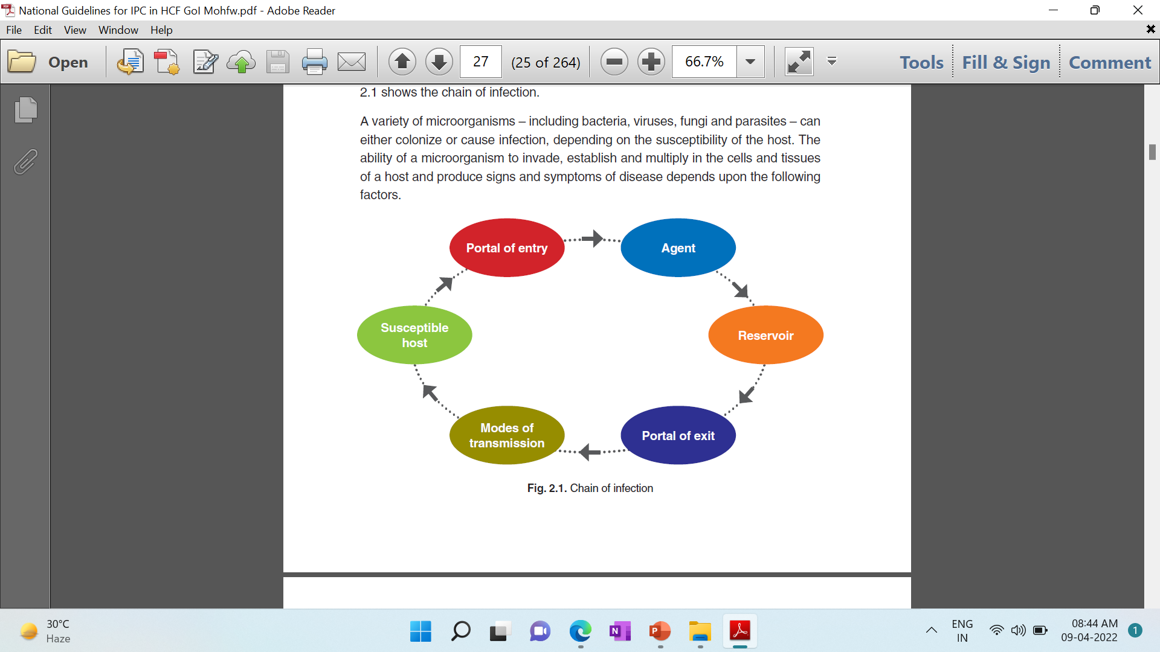
CHAIN OF INFECTION
YOU HAVE TO BREAK THIS CHAIN

Slide 3
INFECTION CONTROL PRACTICES
A practical approach which prevents patients and health-care workers from being harmed by avoidable infection and as a result of antimicrobial resistance.

Slide 4

WHAT
WHO
HOW

Slide 5
WHAT
Hand Hygiene
BMWM
Appropriate use of PPE
NSI/SI: its management & PEP

Slide 6
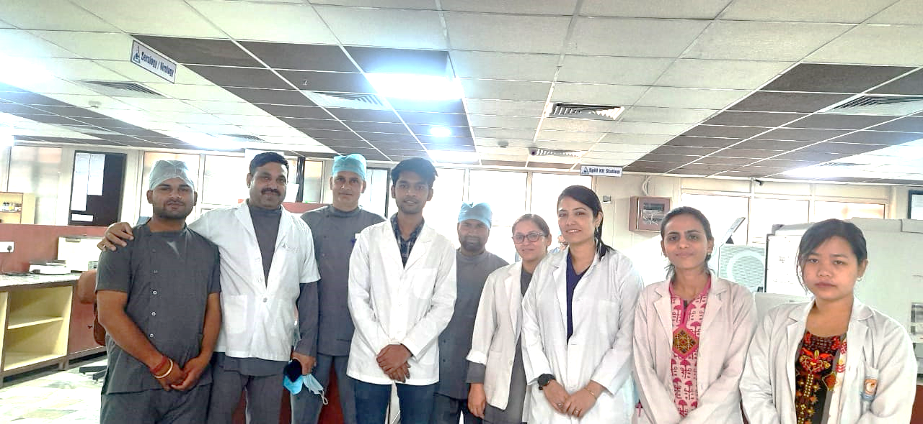
WHO
ALL OF US

Slide 7
HOW
GATEWAY TO INFECTION CONTROL PRACTICES:
STANDARD PRECAUTIONS

Slide 8

Hand Hygiene

Slide 9
WHY HAND HYGIENE?
Hands are the main pathways of
transmission of microorganism in health care
Resident Flora
Normal flora & has negligible pathogenic potential
Transient Flora
Carried on hands due to handling of patients, equipments or environment.
Responsible for Cross infection
REMOVED BY HAND HYGIENE

Slide 10
HAND RUB
After routine activity like after daily rounds
Alcohol Based Hand Rub
30 seconds
HAND WASH
When visibly dirty or soiled with blood or other body fluids
SOAP & WATER
60 SECONDS
HAND SCRUB
Before surgery
Povidone iodine
3-5 minutes

Slide 11
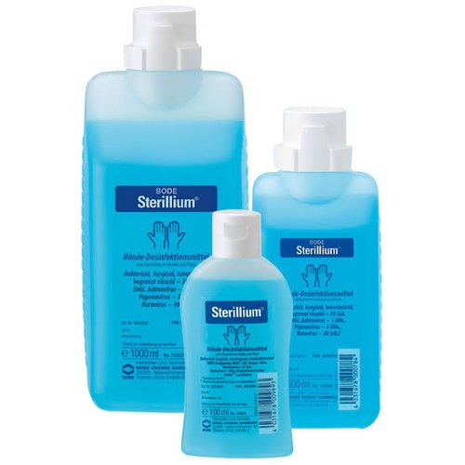
Alcohol based Hand Rub
70% Alcohol &
0.5% Chlorhexidine
Point of care

Slide 12
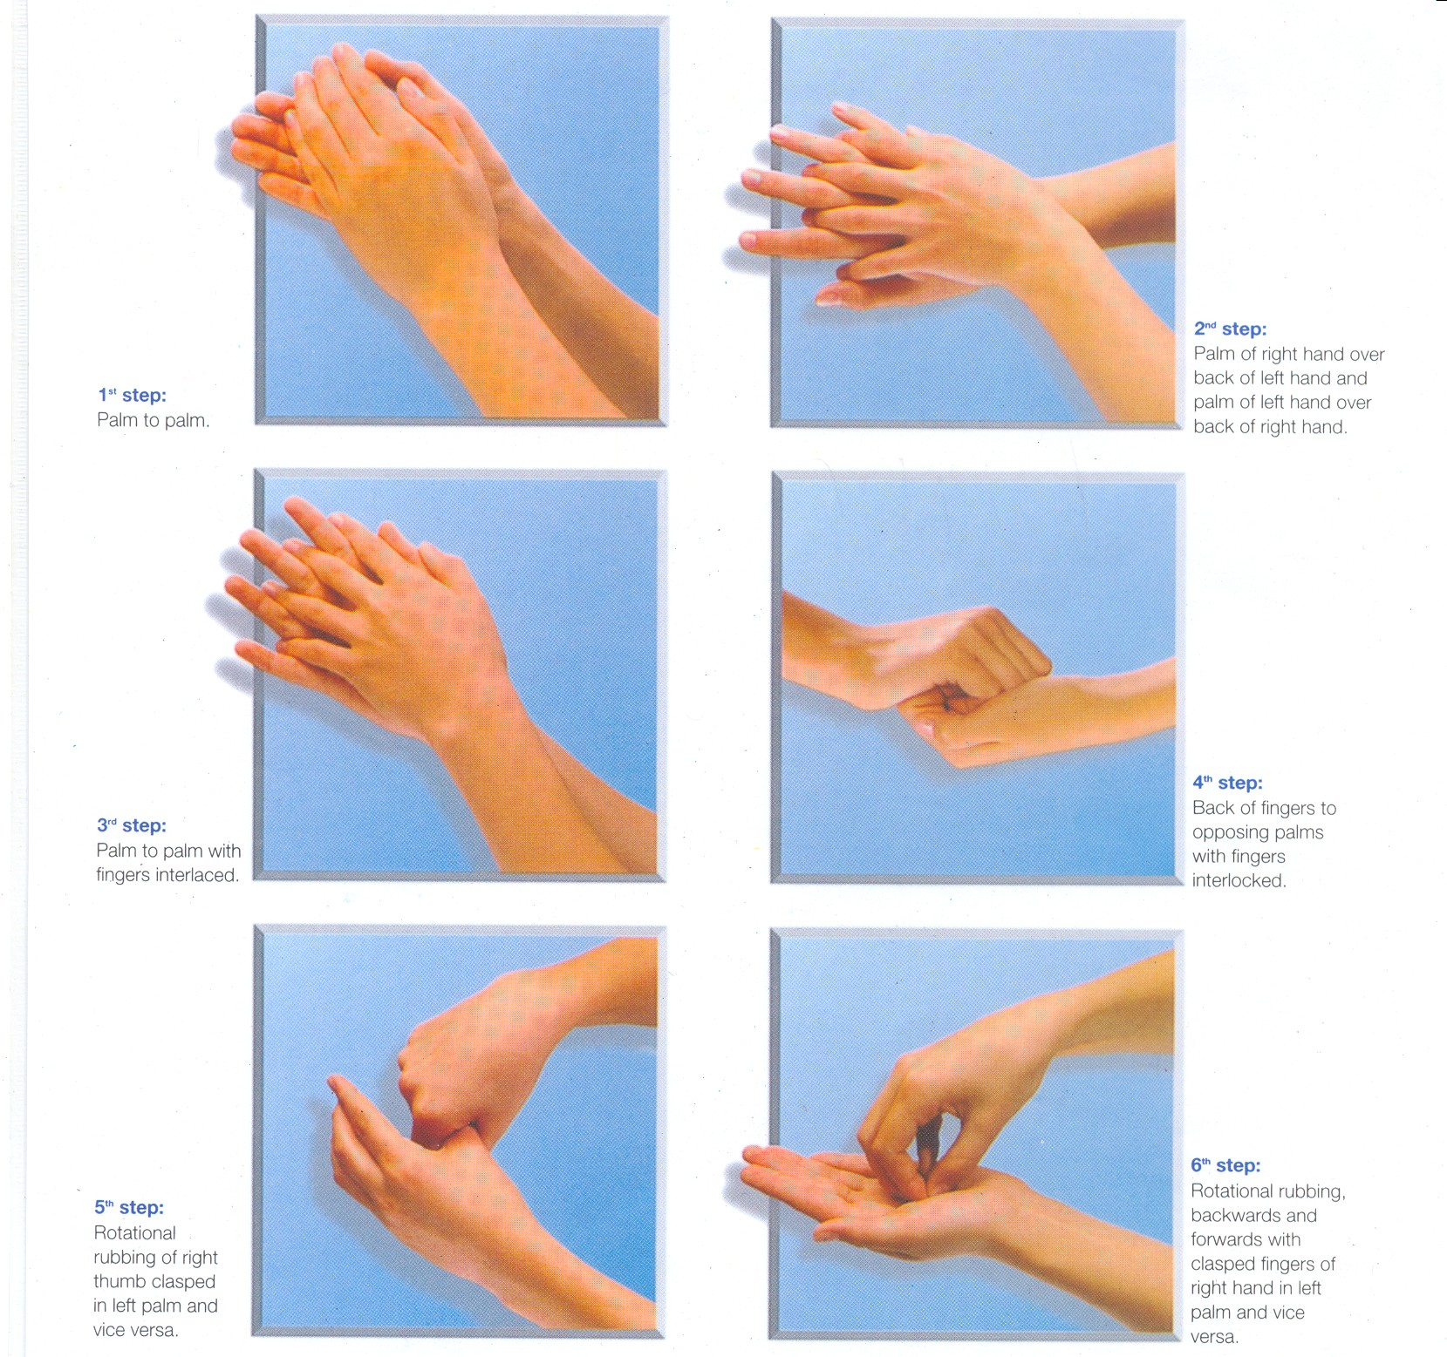
6 STEPS of HAND HYGIENE

Slide 13
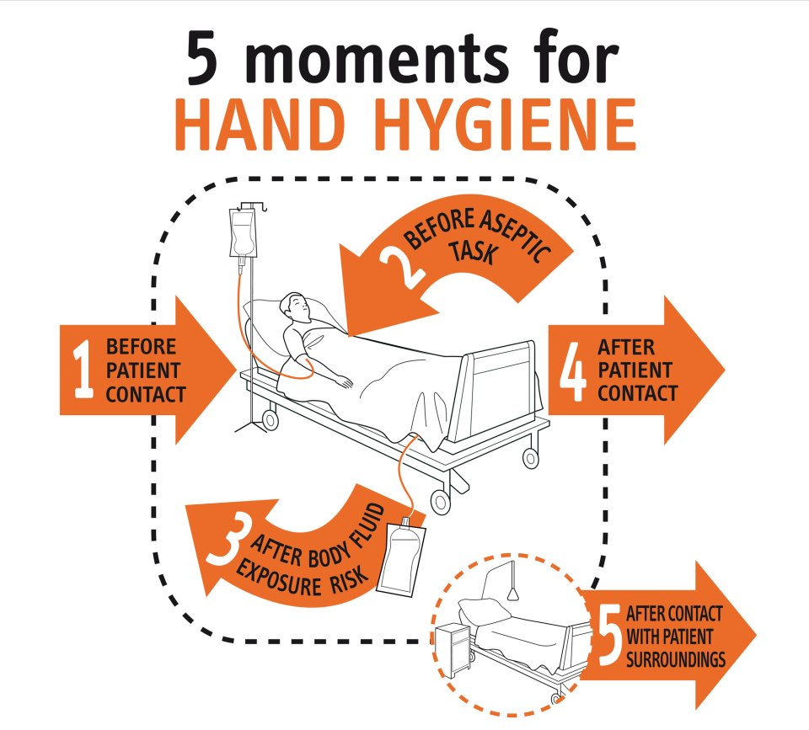

Slide 14
MY 5 MOMENTS OF HAND HYGIENE
(According to WHO)
Before touching the patient
Before doing any aseptic procedure
After body fluid exposure risk
After toucjing the patient
After touching paetint’s surrounding

Slide 15
SCENARIO 1
A Nurse working in an Intensive care unit goes to Patient A, checks the pulse, performs hand rub and then she adjusts the drip flow. She informs the doctor about the patient.

Slide 16
SCENARIO 2
The Doctor decides to see the Patient A. She talks to the patient-A while feeling for the pulse. The doctor wears a pair of gloves and then draws the blood sample. After drawing blood , she removes the gloves and performs hand rub.

Slide 17
SCENARIO 3
After some time, the Nurse finds the urobag of Patient-B full and she decants the bag. The nurse then goes to check the pulse of Patient-C, the she records the pulse on the case sheet. Then she goes to Patient D, checks the pulse following which she performs hand rub. After noting down the pulse rate on the case sheet she performs hand hygiene.

Slide 18
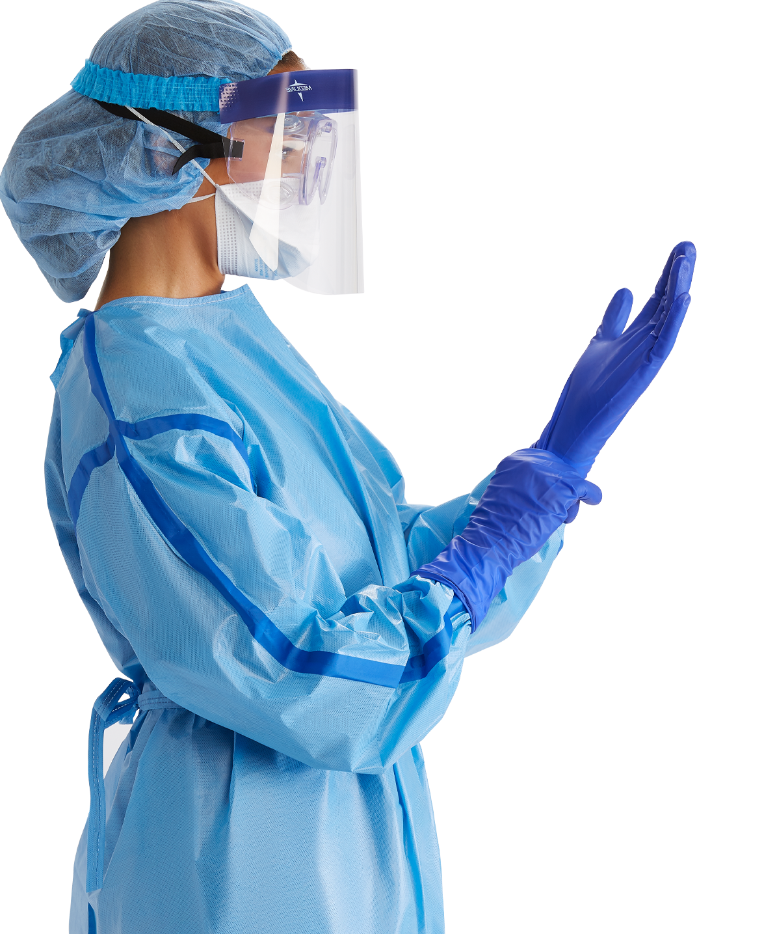
SAFETY FIRST
PERSONAL PROTECTIVE EQUIPEMENTS

Slide 19
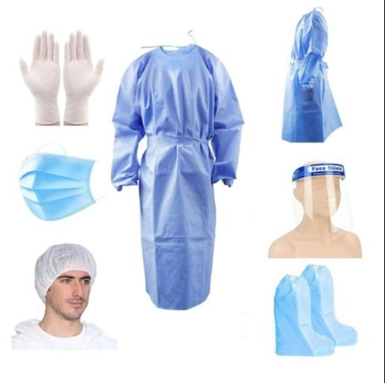
MOST IMPORTANT PPE
GLOVES GOWN MASK
SHOE COVER GOGGLES

Slide 20

DONNING
DOFFING
SHOE COVER
GOWN
MASK
GOGGLES
HEAD CAP
GLOVES
GLOVES
GOWN
SHOE COVER
HEAD CAP
GOGGLES
MASK

Slide 21
TAKE HOME MESSAGE
Practice Standard Precautions
Hand hygiene
PPE
NSI/PEP
BMW

Slide 22
THANK YOU!!

