Slide 1
HEALTHCARE-ASSOCIATED INFECTION-II

Slide 2
VENTILATOR ASSOCIATED PNEUMONIA

Slide 3
VENTILATOR ASSOCIATED PNEUMONIA
Second most common nosocomial infection (after CAUTI)
Accounts for 15–20% of the total HAIs.
Most common cause of death among HAIs.
Primary cause of death in ICUs.

Slide 4
Microbiological causes
Early-onset VAP - Occurs in first 4 days of MV
Late-onset VAP - Develops ≥5 days after MV
  Commonly caused by
  P. aeruginosa
  A. baumannii
  E.coli
  Klebsiella
  MRSA

Slide 5
Pathogenesis
Colonization – with hospital MDROs
ET intubation – disrupts normal defense mechanisms
Subglottic secretion – microaspiration
Critical illness with comorbidities

Slide 6
Risk factors
Device- or intervention-related | Patient-related | Healthcare personnel-related
Device-related Duration of ventilation Failed subglottic aspiration Intra-cuff pressure <20 cm of H2O | Advanced age (>60 years) Patient position: Supine position Critically-ill with comorbidities Underlying condition such as COPD, ARDS, head trauma Patients with coma Immobilization | Improper adherence to aseptic techniques specially hand washing Contaminated environmental sources

Slide 7
Diagnosis
Most popular and widely used criteria - CPIS system.
CPIS system - based on six parameters (clinical, radiological and microbiological) with each parameter given a score scale ranging from 0 to 2.
Maximum score -12 & a score >6 is diagnostic of VAP.

Slide 8
Modified Clinical Pulmonary Infection Score (CPIS)
CPIS points | 0 | 1 | 2
Temperature (°C) | ≥36.5°C and ≤38.4°C | ≥38.5°C and ≤38.9°C | ≥39°C or ≤36°C
Leukocyte count (per mm3) | 4,000–11,000 | <4,000 or >11,000 | <4,000 or >11,000 + band forms ≥50%
Tracheal secretions | Rare | Non-purulent | Abundant + purulent
Oxygenation PaO₂ /FiO₂ mm Hg | >240 with ARDS | - | ≤240 and no ARDS
Chest radiograph | No infiltrate | Diffuse or patchy infiltrate | Localized infiltrate
Tracheal aspirate culture report | Light growth or no growth | Moderate or heavy growth of pathogenic bacteria | Moderate or heavy growth of bacteria and presence of bacteria with similar morphology on Gram stain

Slide 9
Microbiological Criteria
Specimens - Endotracheal aspirate (most common), BAL.
Gram staining
Culture

Slide 10
Radiological Criteria
Highly subjective
Most accepted - chest X-ray or CT scan showing one of the following—infiltrate, consolidation or cavitation, in the absence of underlying pulmonary or cardiac disease.

Slide 11
Treatment
Empirical antimicrobial therapy once the clinical diagnosis of VAP is made - modified subsequently based on AST report.

Slide 12
SURGICAL SITE INFECTION

Slide 13
SURGICAL SITE INFECTION
Defined as infections that develop at the surgical site within 30 days of surgery (or within 90 days for some surgeries such as breast, cardiac and joint surgeries including implants).
Affects up to one third of patients who have undergone a surgical procedure.
In India: 4 to 11 per 100 surgeries.

Slide 14
Microbiology
The site of surgical procedure and the source of infection from which they are acquired.
  Endogenous source – Patients own skin or mucosa
  Exogenous source – Operative personnel or instruments

Slide 15
Risk factors for development of SSI
Patient-related | Procedure-related
Age >60 years | Improper surgical scrub
Malnutrition, diabetes | Inadequate skin antisepsis
Immunosuppression | Prolonged operative time
Skin colonization at the time of surgery (e.g. MRSA carrier) | Inadequate antimicrobial prophylaxis
Duration of hospital stay | Poor perioperative glycemic control
Smoking, obesity | Emergency procedure
 | Preoperative shaving

Slide 16
Wound Class Type
Depending up on the degree of microbial contamination, wounds are classified as:
Class I, Clean Wound – uninfected, no inflammation and hollow viscus is not entered
Class II, Clean-contaminated Wound – hollow viscus entered under controlled conditions and without unusual contamination
Class III, Contaminated Wound – Open fresh accidental wounds, major break in sterile technique during surgeries, colonic surgeries etc
Class III, Dirty/infected Wound –Surgical procedure done when active infection already present

Slide 17
Classification and Diagnosis of SSI
Superficial SSI—develops at the level of superficial incisional site (skin and subcutaneous level) within 30 days regardless of type of surgery.
Deep SSI—develops at the level of deep incisional site (muscle and facial level) within 30 days for all surgeries except for breast, cardiac and implant surgeries (90 days)

Slide 18
Classification and Diagnosis of SSI (Cont..)
Organ space SSI—develops at the level of organ space site within 30 days for all surgeries except breast, cardiac and implant surgeries (90 days).

Slide 19
Treatment of SSI
Suture removal plus incision and drainage
Systemic antimicrobial therapy.

Slide 20
Prevention of surgical site infection (SSI)
Preoperative measures
Preoperative bathing: with plain soap or an antimicrobial soap to reduce the bacterial load For MRSA carriers: Decolonization with mupirocin ointment for patients undergoing surgery Hair removal: should not be done or, if absolutely necessary, it should be removed only with a clipper. Shaving is strongly discouraged at all times

Slide 21
Prevention of surgical site infection (SSI)
Intraoperative measures
SAP: 60–120 minutes before incision. Surgical hand disinfection: antimicrobial soap or with ABHR Surgical site preparation: alcohol-based chlorhexidine antiseptic solution Perioperative maintenance of oxygenation, temperature, blood glucose level (target level of <200 mg/dL), adequate circulating volume and nutritional support

Slide 22
Prevention of surgical site infection (SSI)
Postoperative measures
Wound dressing—Daily dressing and removal of any discharge present at the site OT disinfection—Performed with a high level disinfectant in between cases and after the last case (terminal disinfection) Periodic monitoring of the air quality of operation theater SAP prolongation is not recommended in any situation.

Slide 23
HAI SURVEILLANCE

Slide 24
HAI SURVEILLANCE
System that monitors the HAIs in a hospital.
Main objectives:
  Provides baseline HAI rate and information on type of HAIs in the hospital
  Helps in comparing HAI rates within and between hospitals

Slide 25
HAI SURVEILLANCE (Cont..)
  Identifies the problem area; based on which root cause analysis can be conducted to find out the breakdowns in infection control measures and then the appropriate corrective measures are implemented
  Provides timely feedback to the clinicians; thus, reinforces them to adopt best practices.

Slide 26
Targeted Surveillance
National Healthcare Safety Network division of CDC provides guidelines for the surveillance of HAIs.
  Where to conduct: Only for high-risk locations such as ICUs.
  What type of HAIs to be monitored: CA-UTI, CLABSI, VAP and SSI.
  Who will conduct: Infection Control Nurses under the supervision of the Hospital Infection Control Officer.

Slide 27
Formulae of HAI infection rates
HAI infection rates | Formulae
CAUTI Rate | No. of CA-UTI cases/ total no. of urinary catheter days × 1000
CLABSI Rate | No. of CLABSI cases/ total no. of central line days × 1000
VAE Rate | No. of VAE cases/ total no. of ventilator days × 1000
SSI Rate | No. of SSI/No. of surgeries done × 100

Slide 28
PREVENTION OF HAIs

Slide 29
PREVENTION OF HAIs
The preventive measures for HAIs can be broadly categorized into:
  Standard precautions
  Transmission-based or specific precautions.

Slide 30
STANDARD PRECAUTIONS
IPC practices - to prevent transmission of diseases
Hand hygiene
Personal protective equipment
Biomedical waste management
Spillage cleaning
Disinfection of patient care items
Environmental cleaning
Respiratory hygiene and cough etiquette
Safe use and disposal of sharp

Slide 31
TRANSMISSION-BASED PRECAUTIONS

Slide 32
TRANSMISSION-BASED PRECAUTIONS
Set of infection control practices which should be followed over and above standard precautions.
Should be practiced – handling patients infected with infectious agents having specific mode of transmission
TBPs include - CONTACT, DROPLET AND AIRBORNE

Slide 33
1. Contact Precautions
Direct transmission - from one person to another person without a contaminated intermediate object or person.
Indirect transmission - through a contaminated intermediate object (clothes, patient-care devices, environmental surfaces, fomite) or person

Slide 34
Agents transmitted through contact
MDROs – MRSA, CRE, VRE, MDR-NFGNB
Enterically transmitted hepatitis viruses (HAV and HEV)
Agents of conjunctivitis (e.g. adenovirus, gonococcus, Chlamydia)
Contagious skin lesions (abscess, infected ulcers) - GAS, Staphylococcus, HSV
Agents of diarrhea such as rotavirus, cholera, Clostridium difficile

Slide 35
IC Measures – Contact Precautions
Hand hygiene
PPEs
Single use- patient dedicated equipment
Patient placement – single isolation room
Disinfection of the rooms

Slide 36
2. Droplet Precautions
Prevent the spread of infectious agents - transmitted through droplet.
Respiratory droplets - large-particles (>5 µm in size) - generated by a patient who is coughing, sneezing or talking.
Transmission via large droplets requires close contact (<3 feet) – do not remain suspended in the air - travel shorter distances.

Slide 37
Agents transmitted through droplets
Diphtheria, Hib, N. meningitidis, pertussis, pneumonic plague, Mycoplasma pneumoniae
Influenza viruses, seasonal
SARS-CoV2 (COVID-19)
Viral hemorrhagic fevers - Lassa, Ebola, Marburg viruses
Other viruses: Mumps, Parvovirus B19, Rhinovirus, Rubella, Adenovirus

Slide 38
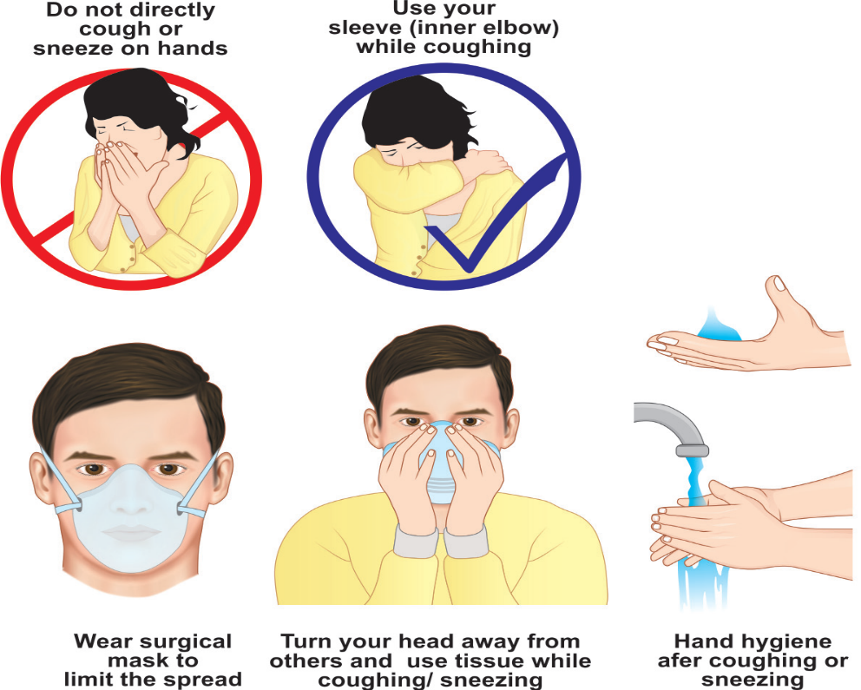
IC Measures- Droplet Precautions
Hand hygiene
PPEs – Surgical mask or N95
Respiratory Hygiene/Cough Etiquette
Patient placement – Single isolation room
Disinfection of the rooms

Slide 39
3. Airborne Precautions
Prevent the spread of infectious agents - transmitted through aerosols.
Aerosols are small-particles (<5µm) generated by an infectious person during certain aerosol generating procedures (e.g. intubation)
These smaller droplets remain suspended in air for long periods of time and may disperse to a distant place along the air current.

Slide 40
Agents transmitted through aerosols
Mycobacterium tuberculosis
Measles virus
Varicella (chickenpox and zoster disseminated or in an immunocompromised host)
Smallpox (variola) and monkeypox virus
Aerosolizable spore-containing powders - Bacillus anthracis
Aspergillus (pulmonary aspergillosis)

Slide 41
Aerosol-generating Procedures (AGPs)
AGPs - generate much higher concentrations of aerosols and are associated with higher risk of pathogen transmission.
Examples: Endotracheal intubation, open respiratory and airway suctioning, tracheostomy care, cardiopulmonary resuscitation, sputum induction and bronchoscopy

Slide 42
IC Measures – Airborne precautions
PPE – N95 respirator
Patient Placement – Airborne isolation room (AIIR)
Transfer of Patients- patient should wear surgical mask
Respiratory Hygiene and Cough Etiquette
Visitors and Staff – restricted access

Slide 43
HOSPITAL INFECTION CONTROL COMMITTEE

Slide 44
HICC Constitution
Chairperson, MS
Secretary, HOD, Microbiology
HICO, representative from the Dept of Microbiology
HICN - Hospital Infection Control Nurses
Head of all the clinical (all medical and all surgical) departments
Nursing Superintendent
Head of the staff clinic

Slide 45
THANK YOU

