Slide 1
Healthcare-associated Infections- I

Slide 2
HAI DEFINITION
Infections acquired in hospital by a patient - admitted for a reason other than the infection.
Infection - not present or incubating at the time of admission
Symptoms should appear at least after 48 hours of admission.

Slide 3
HAI DEFINITION
Also include:
Infections acquired in the hospital but symptoms appearing after discharge
Occupational infections among staff of the HCF (e.g. needle stick injury transmitted infections)

Slide 4
Burden of HAI
According to WHO, on average:
  7% of patients in developed countries and
  10% in developing countries - acquire at least one HAI.
Mortality- 10% of affected patients.

Slide 5
Factors Affecting HAIs
Immune status
Hospital environment
Hospital organisms
Diagnostic or therapeutic interventions
Transfusion
Poor hospital administration

Slide 6
Sources of Infection
Endogenous source- involves patient’s own flora
Exogenous source
  Environmental sources- Inanimate objects.
  Health care workers- e.g. Hands of HCWs harboring MRSA
  Other patients

Slide 7
Microorganisms Implicated in HAIs
The ESKAPE pathogens-
  Enterococcus faecium
  Staphylococcus aureus
  Klebsiella pneumoniae
  Acinetobacter baumannii
  Pseudomonas aeruginosa
  Enterobacter species

Slide 8
Microorganisms Implicated in HAIs
Other infections that can spread in hospitals include:
  Escherichia coli
  SARS-CoV-2 (COVID-19)
  Nosocomially-acquired Mycobacterium tuberculosis
  Legionella pneumophila, Candida albicans, Clostridium difficile diarrhea.
  Blood-borne infections - HIV, hepatitis B and C viral infections.

Slide 9
Modes of Transmission
Contact transmission
Droplet transmission
Airborne transmission

Slide 10
MAJOR HAI TYPES

Slide 11
MAJOR HAI TYPES- 4 common types
Catheter-associated urinary tract infection (CAUTI, 35%)
Central line-associated blood stream infection (CLABSI, 15%)
Ventilator-associated pneumonia (VAP, 15%)
Surgical site infection (SSI, 35%).

Slide 12
CATHETER-ASSOCIATED URINARY TRACT INFECTION (CAUTI)

Slide 13
CAUTI
Most common HAI worldwide.
Accounting : 35- 40% of nosocomial infections.
Attributable to the presence of an indwelling urinary catheter.

Slide 14
Definitions
Catheter-associated bacteriuria (CA-bacteriuria) has been defined as presence of significant bacteriuria in a catheterized patient.
Classified as:
  Catheter-associated UTI (CAUTI)
  Catheter-associated asymptomatic bacteriuria (CA-ASB)

Slide 15
Epidemiology
Risk of developing CA-bacteriuria increases with time with an average risk of 3–10% per catheter day.
CAUTI rate varies from 0 to 5 per 1000 catheterized depending up on the hospital location (ward vs ICU)

Slide 16
Microbiological factors
In short-term catheterized patients:
E. coli - predominant agent.
GNB - Klebsiella, Pseudomonas and Acinetobacter
GPC - Enterococcus

Slide 17
Microbiological factors
In long-term catheterized patients:
Usually polymicrobial.
Pathogens of short-term catheterization + Proteus, Providencia and Morganella

Slide 18
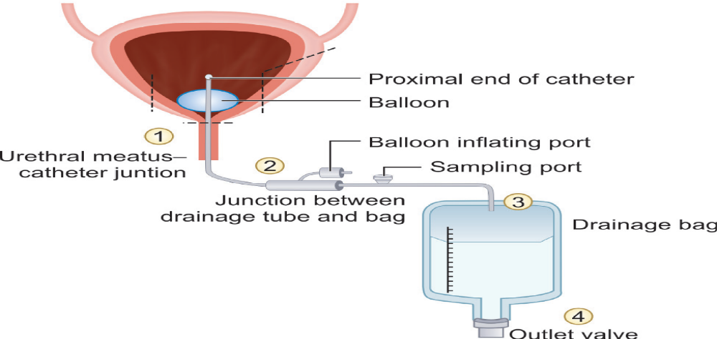
Pathogenesis
Entry points through which the microorganism may reach the bladder in a catheterized patient

Slide 19
Pathogenesis
Microorganisms may ascend to urinary tract by either:
Extraluminal spread - Patients endogenous flora or Hands of HCWs
Intraluminal spread - Open drainage bag or breach in closed drainage system.

Slide 20
Pathogenesis
Indwelling urinary catheter – Risk of UTI ??
Risk – directly proportional to duration of catheterization
Urethral pressure- decreased mucosal blood flow, mucosal disruption and impaired mucin secretion
Incomplete emptying

Slide 21
Risk factors for CAUTI
Device-related risk factors | Patient-related risk factors | Caregiver-related risk factors
Duration: Long-term (≥30 days) catheterization has a higher risk than short-term (<30 days) Type of catheter material: Latex catheter has higher CAUTI risk than silicone catheters | Female gender Fatal underlying illness Older age (>50 years) Diabetes mellitus Poor personal hygiene Incomplete emptying of bladder Fecal incontinence | Failure in adherence to aseptic technique. Emergency catheter insertion outside the operating room.

Slide 22
Laboratory Diagnosis
Urine should be collected through the catheter port using aseptic technique or by puncturing the catheter tubing with a needle and syringe.
Urine should never be collected from the urobag.

Slide 23
Laboratory Diagnosis
Clinical diagnosis of CAUTI is based on the following three criteria:
Catheter criteria | Catheterized or history of recent catheterization within 48 hours
Clinical criteria | Presence of at least one signs or symptoms of UTI: fever, suprapubic tenderness, costovertebral angle pain, urinary urgency, frequency or dysuria (pain during micturition)
Urine culture criteria | Presence of significant bacteriuria, defined as colony count exceeding: ≥10³ CFU/mL: in symptomatic patients ≥10⁵ CFU/mL: in asymptomatic patients

Slide 24
Treatment
Removal of catheter
Institution of appropriate antimicrobial therapy based on AST report
Treatment of CA-ASB not indicated except when:
  Bacteriuria persists for >48 hours after removal of the catheter
  Pregnancy
  Prior to traumatic urological procedures

Slide 25
CATHETER RELATED BLOOD
STREAM INFECTION
(CRBSI)

Slide 26
CRBSI
Development of BSI in a hospitalized patients
  Attributed to the presence of a central line as a source of infection.
  Not associated with any other secondary cause of BSI.
CLABSI - strictly used only for surveillance purpose.

Slide 27
Central Line or Central Venous Catheter
Intravascular device that terminates in the great vessels. (subclavian, femoral, internal jugular veins )
Needed for various purposes such as:
  Central venous pressure monitoring
  Administration of drugs
  Total parenteral nutrition
  Hemodialysis access (hemodialysis catheters)

Slide 28
Epidemiology
Approximately <3% of hospitalized patients require central line at some time during their stay.
Out of which 3-8 % develop CLABSI.

Slide 29
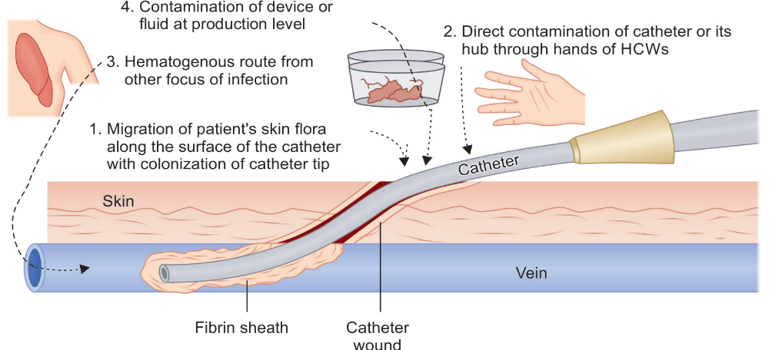
Pathogenesis
Routes of access of organisms to central line

Slide 30
Pathogenesis
Following events take place after the entry of the organism into the CL.
  Foreign body reaction
  Colonization of the organism by microbial adherence
  Biofilm formation on catheter surface

Slide 31
Risk factors for CRBSI
Device-related | Patient-related | Caregiver-related
Duration of CL: Longer duration (≥72 hrs) has higher risk than shorter duration (<72 hrs) Site: Femoral vein CL has higher risk than jugular vein and subclavian vein Number of lumens: Multi-lumen CLs have a higher risk than single-lumen Insertion circumstances: Emergency insertion has a higher risk than elective insertion | Immunodeficiency Severe underlying illness Hematologic malignancy Loss of skin integrity (e.g., burns, psoriasis) Presence of distant infection Alteration in patient’s cutaneous microflora | Poor hand hygiene Lack of infection control practices Skin antisepsis: Use of alcohol has a higher risk than chlorhexidine

Slide 32
Intrinsic and extrinsic contamination of central line
Intrinsic contamination (intraluminal source) | Extrinsic contamination (extraluminal source)
Contamination during device or fluid production | Contamination at the time of insertion
Due to defect during manufacture | Poor sterile precautions during drug or IV fluid administration
Most common causative agents include Klebsiella, Enterobacter or Pseudomonas | Most common causative agents include Skin commensals like CoNS and S. aureus

Slide 33
Diagnosis of CRBSI
Clinical criteria: Presence of fever, chills, rigor or hypotension after the CL is used and or signs of catheter site infection such as erythema, tenderness, warmth, swelling at the catheter exit site.
Microbiological criteria: Simultaneous blood culture from CL and PL is carried out and the CL blood culture bottle flags ≥2 hrs earlier to peripheral line blood culture.

Slide 34
Treatment
Appropriate systematic antimicrobial therapy and removal of the central line.
Systematic antimicrobial therapy (SAT) - empirical therapy and later should be modified later based on susceptibility report.

Slide 35
THANK YOU!

