Slide 1
FREE LIVING AMOEBA
Dr. Priyanka Chaturvedi
Assistant Professor

Slide 2
Introduction
Normal inhabitants of soil and water
Feed on bacteria, yeast and other organisms
Also known as opportunistic amoebae
A few members have the ability to become facultative parasites on vertebrate
They are able to infect humans

Slide 3
Disease causing free living amoebae belong to 4 genera:
Naegleria
  Acanthamoeba
    Balamuthia
      Sappinia

Slide 4
Naegleria
One of the Major disease causing Free living amoeba
Typically found in warm fresh water (thermo-tolerant amoeba) such as ponds, lakes, rivers, hot springs and swimming pools
Worldwide distribution
Brain eating amoeba

Slide 5
Naegleria
Naegleria fowleri
Infection in humans
Naegleria australiensis
Naegleria italica
Infection in mice

Slide 6
Naegleria fowleri
First described by physicians M. Fowler (hence named as fowleri) and R.F. Carter in Australia in 1965
About 200 cases of PAM have been reported worldwide
  Mainly from USA (about 90 cases)
In India, about 20 cases have been reported from Mangalore, Kolkata, Himachal Pradesh and Rajasthan

Slide 7
Morphology
Naegleria fowleri
Trophozoite
Cyst
Amoeboid
Flagellated

Slide 8
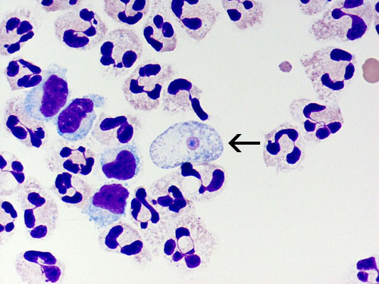
Trophozoite Stage
Trophozoites occur in two forms, amoeboid and flagellated
Amoeboid form:
  Possesses lobate pseudopodia (called as lobopodia)
  Cytoplasm is granular with food vacuoles
  Nucleus with central karyosome
  It is the only replicating form
  Divides by binary fission

Slide 9
Flagellated form:
  When the amoeboid forms are exposed to a change in ionic concentration or low nutrient, they transform to pear shaped flagellated form
  This change occurs very quickly within a few hours
  Possesses two flagella at the broader end
  Shows typical jerky or spinning motility
  In presence of suitable environment flagella are lost and they revert back to amoeboid form

Slide 10
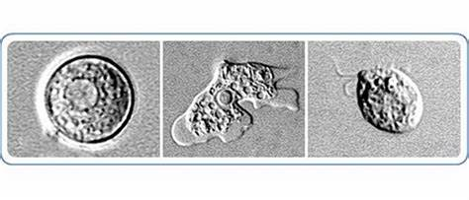
Cyst Stage:
  Surrounded by a thick, smooth double wall
  Nucleus is identical to that found in the trophozoite
  Not found in human tissue but can be grown in culture

Slide 11
Life Cycle
Infective form:
  Amoeboid form is the invasive form and usual infective form of the parasite
Mode of transmission:
  Humans acquire infection by nasal contamination during swimming in fresh hot water bodies like ponds, river, swimming pools or lakes

Slide 12
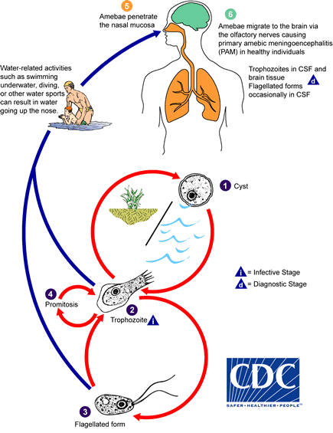

Slide 13
Amoeboid form invades nasal mucosa & cribriform plate
Travels along the olfactory nerve to reach the brain
Ingestion of brain tissue by food cups or amoebostome, into which the cytolytic enzymes are liberated
Contact dependent cytolysis of brain tissue mediated by:
  Hemolytic proteins
  Cytolysins
  Phospholipase enzymes
Acute Suppurative Meningoencephalitis
Later turns into
Hemorrhagic & Necrotic Meningoencephalitis

Slide 14
Primary Amoebic Meningoencephalitis (PAM)
N. fowleri causes acute suppurative fulminant infection of CNS known as Primary Amoebic Meningoencephalitis (PAM)
Occurs in children or young adults with recent history of swimming in fresh warm water
Incubation period: 1–2 days to 2 weeks after exposure
Clinical course: Acute and fulminant

Slide 15
Clinical Features
Initial symptoms
Change in the taste & smell
Headache
Anorexia
Nausea
Vomiting
High grade fever
Signs of meningeal irritation
Secondary symptoms
  Confusion
  Hallucinations
  Lack of attention
  Ataxia
  Seizures
The mortality rate is nearly 98%
Death occurs within 7–14 days after exposure

Slide 16
Laboratory Diagnosis of Naegleria fowleri
Cerebrospinal fluid analysis
Microscopy
ELISA
PCR
Imaging methods - CT and MRI
Culture on non nutrient agar

Slide 17
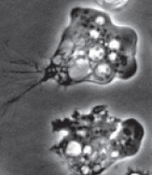
CSF Analysis:
  CSF is thick purulent
  Polymorphonuclear cells more than 20,000/μl
  Elevated protein
  Reduced sugar levels (mimic bacterial meningitis)
Microscopy
  Direct microscopy: Motile amoeboid trophozoites can be demonstrated in wet mount preparation of CSF

Slide 18
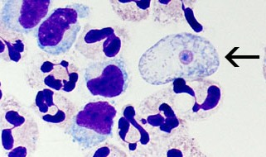
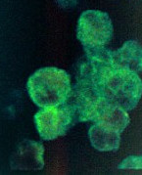
Histopathological staining:
  Wright’s or Giemsa staining of CSF or brain biopsied tissue demonstrate trophozoites with sky blue cytoplasm with a pink nucleus
Trophozoites can also be demonstrated by direct fluorescence antibody staining of centrifuged CSF using monoclonal antibody

Slide 19
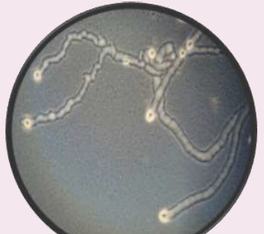
Culture:
  Can be cultivated on nonnutrient agar (Page’s saline with 1.5% agar)
  Lawn cultured with bacterial supplement like E. coli
  Naegleria feeds on bacteria and crawls over the lawn culture of E. coli to produce trails (Trail sign)

Slide 20
Enflagellation test:
  When the scrapping of the non nutrient agar is transferred to sterile tubes containing distilled water, N. fowleri undergoes transformation to a pear shaped flagellate form.
ELISA:
A commercially available ELISA.
Based on the use of a monoclonal antibody.
PCR

Slide 21
  TREATMENT
No effective treatment is available
Amphotericin B has considerable anti Naegleria effect

Slide 22
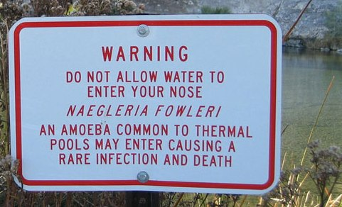
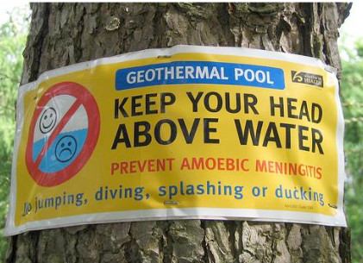
Prevention and Control
Chlorination of heavily used swimming pools, especially during summer months
Appropriate warnings particularly during the hot summer months

Slide 23
Acanthamoeba
Another one of the most common pathogenic free living amoeba
Ubiquitous in nature and worldwide distribution
It is so named because of the spine like pseudopodia present in trophozoite (acanthopodia)

Slide 24
Found in:
    Soil
    Sea water
    Sewage
    Swimming pools
    Contact lenses cleaning solutions
    Dental treatment units
    Air conditioning systems

Slide 25
Important species causing human infection include
    Acanthamoeba astronyxis
    A. castellanii
    A. culbertsoni
    A. polyphaga
Principally affects CNS and eye

Slide 26
About 400 cases of GAE due to Acanthamoeba have been reported worldwide
Most of the cases from USA (about 50%)
In India, few cases are reported (from Vellore, Puducherry, Chandigarh and U.P)
  Amoebic Keratitis is commonly associated with contact lens users (75–93%) [Mannose binding protein on Acanthamoeba adheres to glycoprotein receptors on corneal epithelium]

Slide 27
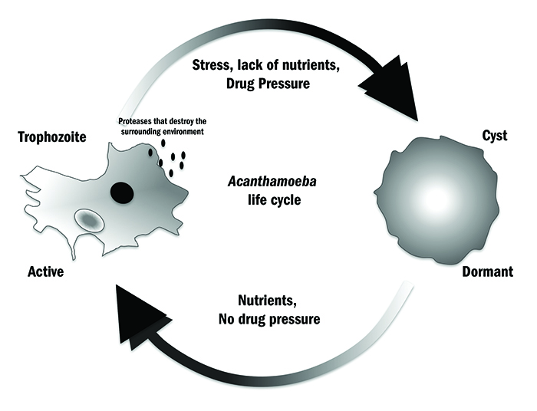
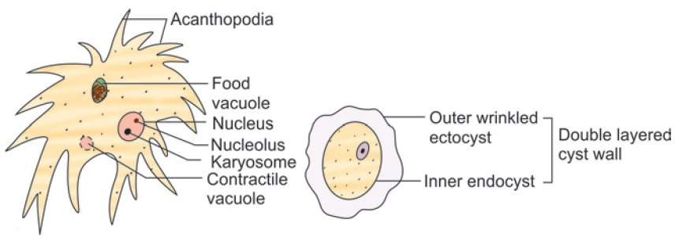
Morphology
Acanthamoeba species exists in nature as
    Cyst (12-20 μm)
    Trophozoite (15-25 μm)
There is no flagellated form

Slide 28
Life Cycle and Pathogenesis
Mode of transmission:
Humans acquire infection by inhalational route by aerosol contaminated with cyst or trophozoite
Contact lens wearers can get infection by swimming when wearing lenses
Trophozoites reach CNS by:
    Hematogenous route from lungs
    Direct invasion from eyes

Slide 29
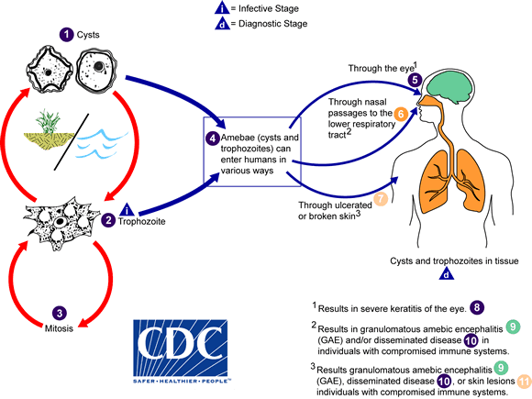

Slide 30
Acanthamoeba causes 3 diseases:
Granulomatous Amoebic Encephalitis (GAE)
Amoebic Keratitis: Sight threatening disease, mostly in contact lens wearers
Disseminated Granulomatous Amoebic Diseases (eg, skin, sinus, and pulmonary infections)

Slide 31
Laboratory Diagnosis of Acanthamoeba
Direct Microscopy:
  Wet mount examination of CSF or corneal scrapping
  Permanent staining of brain biopsy
CSF examination
Indirect fluorescent antibody technique
PCR
Culture on non-nutrient agar

Slide 32
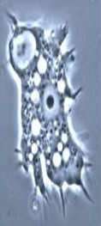
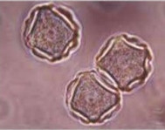
Direct Microscopy
Wet mount examination:
CSF or corneal scrapping is done to demonstrate both cyst and trophozoites
Trophozoite is characterized by acanthopodia
Cyst having two layers with an outer wrinkled ectocyst and inner smooth endocyst

Slide 33
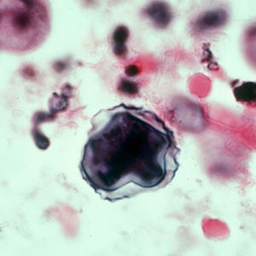
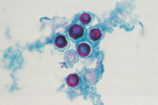
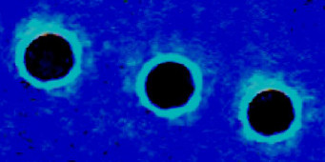
Calcofluor stain:
  It is recommended to visualize the double walled cyst

Slide 34
TREATMENT
Granulomatous amoebic encephalitis:
No therapy with proven efficacy against this disease
Only three cases are survived so far
They were treated with multidrug combinations of:
  Cotrimoxazole
  Ketoconazole
  Pentamidine
  Flucytosine
  Rifampicin
Amoebic keratitis:
Topical antiseptic agents, biguanide or chlorhexidine are used
Keratoplasty in severe cases of vision impairment

Slide 35
Balamuthia mandrillaris
A free living amoeba
It is distributed in the temperate regions of the world
About 150 cases of GAE have been reported worldwide
Most of the cases reported form USA and South America

Slide 36
Total 3 cases of Balamuthia GAE are reported from India
All 3 died, only 1 was diagnosed before death
First case was reported from AIIMS, New Delhi in 2007:
  A young man described as a case of brainstem inflammation
  Expired without diagnosis
  Not diagnosed in autopsy at AIIMS
  After sending paraffin blocks to the CDC in Atlanta USA, they suggested the diagnosis of Balamuthia infection
  2 Cases were reported from PGIMER Chandigarh in 2013

Slide 37
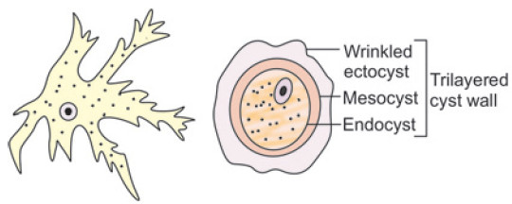
Morphology:
  Trophozoite:
Size: About 30 μm
Shape: Irregular
Finger like pseudopodia
  Cyst:
Measures about 6–30 μm
Surrounded by a 3 layers:
  Ectocyst
  Mesocyst
  Endocyst
Large vesicular nucleus

Slide 38
Life Cycle:
  Enters the body through the respiratory tract or through open wounds
  Life cycle is similar to Acanthamoeba
Diseases:
  Granulomatous Amoebic Encephalitis
  Skin lesions similar to Acanthamoeba

Slide 39
Diagnosis
Often diagnosed only after death
Can be diagnosed by examining:
  Blood
  Cerebrospinal fluid
  Tissue samples

Slide 40
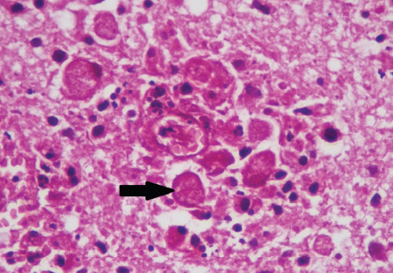
Microscopy: CSF microscopy reveals trophozoites and cysts
Brain tissue, H & E Staining

Slide 41
Indirect Immunofluorescence Assay (IFA): used to detect antibodies attached to Balamuthia amoebae in body tissues
Polymerase Chain Reaction (PCR)

Slide 42
Culture:
It can be cultured on:
  Monkey kidney cell line
  HEp2
  Vero cell line
  Diploid macrophage cell line
It doesn’t grow on agar plate

Slide 43
Treatment
In vitro studies indicate that B. mandrillaris is susceptible to:
      Ketoconazole
      Propamidine
      Clotrimazole
      Fluconazole
      Clarithromycin
      Sulfadiazine

Slide 44
 | Acanthamoeba | Balamuthia mandrillaris
Trophozoite | 15-25 μm in size Spine/thorn like pseudopodia | 6-30 μm in size Irregular finger like pseudopodia
Cysts | 12-20 μm in size Double walled: Ectocyst Endocyst | About 30 μm In size Triple walled: Ectocyst Mesocyst Endocyst

Slide 45
Sappinia
Newly recognized pathogenic free living amoeba
Found in soil and water
Sappinia is ubiquitous in nature and present worldwide
It is usually found in:
  Fresh water sources

Slide 46
Amoebic Encephalitis:
Sappinia causes amoebic encephalitis
Similar to those caused by other free-living amoebae
Only one case of amebic encephalitis due to Sappinia infection has been reported worldwide
Recently, this infection was reidentified as being caused by Sappinia pedata
No case reported from India till date

Slide 47
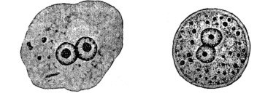
Morphology
The characteristic feature is binucleated trophozoite and cyst
Trophozoite:
    Oval in shape
    Measures 40–70 μm
Cyst:
    Round in shape
    Measures 15–30 μm

Slide 48
Mode of transmission:
Sappinia enters the body through:
  Nasal mucosa
  Cuts and bruises on the body
Life cycle is similar to that of Acanthamoeba

Slide 49
Laboratory Diagnosis
Microscopy:
  Wet mount
  Hematoxylin Eosin staining
  Giemsa staining
  Transmission Electron Microscopy: Brain tissue fixed in glutaraldehyde
Neuroimaging: MRI
PCR

Slide 50
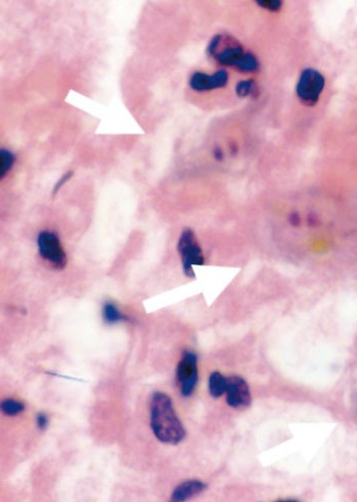
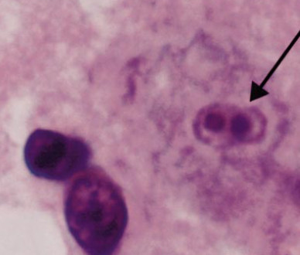
Giemsa Staining
H & E Staining

Slide 51
Culture:
  Sappinia can be cultivated on non nutrient agar plate coated with bacteria.
  PCR

Slide 52
MCQs

Slide 53
Q. No. 1. Which of the following can not be cultured on non nutrient agar plate:
  Naegleria fowleri
  Acanthamoeba culbertsoni
  Balamuthia mandrillaris
  Sappinia diploidea

Slide 54
  Key : c
  Learning statement : Balamuthia mandrillaris can be cultured on:
  Monkey kidney cell line
  Vero cell line
  Diploid macrophage cell line
It doesn’t grow on non nutrient agar plate

Slide 55
Q. No. 2. A 30 years female with habit of not changing her contact lens saline solution frequently, noticed deterioration of vision and visited an ophthalmologist, who diagnosed her with severe retinitis and keratitis. Culture of the water and vitreous fluid would most likely reveal:
  Naegleria
  Acanthamoeba
  Balamuthia
  Sappinia

Slide 56
  Key : b
Learning statement : Keratitis, uveitis, and corneal ulceration have been associated with Acanthamoeba spp. Infections have been seen in both hard and soft contact lens wearers, and particular attention has been paid to soft-lens disinfection systems, including homemade saline solutions

Slide 57
Q. No. 3. Flagellated trophozoite is characteristic of:
  Naegleria fowleri
  Acanthamoeba culbertsoni
  Balamuthia mandrillaris
  Sappinia diploidea

Slide 58
  Key : a
  Learning statement : Both amoeboid and flagellated trophozoites are seen in Naegleria fowleri. Only amoeboid trophozoite is seen in Acanthamoeba culbertsoni, Balamuthia mandrillaris and Sappinia diploidea.

Slide 59
Q. No. 4. Double walled cyst is seen in all except:
  Naegleria fowleri
  Acanthamoeba culbertsoni
  Balamuthia mandrillaris
  Sappinia diploidea

Slide 60
  Key : c
  Learning statement : The cyst of Balamuthia mandrillaris is triple walled, while the cyst is double walled in Naegleria fowleri, Acanthamoeba culbertsoni and Sappinia diploidea

Slide 61
Q. No. 5. Which of the following is not correctly matched:
 | Amoeba | Disease
A | Sappinia | Amoebic Encephalitis
B | Naegleria | Primary Amoebic Meningoencephalitis
C | Balamuthia | Amoebic Keratitis
D | Acanthamoeba | Disseminated Granulomatous Amoebic diseases

Slide 62
  Key : C
  Learning statement : Amoebic Keratitis is caused by Acanthamoeba

Slide 63
Q. No. 6. A 6 years child presented with signs and symptoms of acute bacterial meningitis with history of swimming in canal. Wet mount of CSF revealed amoeboid and actively motile flagellated forms of trophozoites. CSF culture on 1.5% non-nutrient agar with a lawn culture of Escherichia coli kept at 37°C did not reveal any growth. The test of flagellation on passing CSF in distilled water was positive in 3 hours. Water from the canal also showed actively motile trophozoites similar to the forms obtained from the CSF. Most probable diagnosis is:
  Granulomatous Amoebic Encephalitis
  Primary Amoebic Meningoencephalitis
  Amoebic Encephalitis
  Acute Bacterial Meningitis

Slide 64
  Key : b
  Learning statement : Findings are suggestive of Primary Amoebic Meningoencephalitis (PAM). Causative organism is Naegleria fowleri.

Slide 65
Q. No. 7. Which Naegleria species is pathogenic to humans:
  Naegleria gruberi
  Naegleria fowleri
  Naegleria australiensis
  Naegleria italica

Slide 66
  Key : b
Learning statement : Only Naegleria fowleri is known to be pathogenic to humans.

Slide 67
Q. No. 8. Recently identified free living amoeba causing amoebic encephalitis is:
  Naegleria fowleri
  Acanthamoeba culbertsoni
  Balamuthia mandrillaris
  Sappinia pedata

Slide 68
  Key : d
  Learning statement : Amoebic encephalitis was found to be due to Sappinia diploidea. Recently, this infection was reidentified as being caused by Sappinia pedata.

Slide 69


