Slide 1

Cryptococcal meningitis
Dr. Priyanka Chaturvedi
Assistant Professor

Slide 2
FUNGAL INFECTIONS OF CNS
Primary CNS pathogen: Cryptococcus neoformans
Secondary CNS pathogen: Agents of systemic mycoses: Blastomyces dermatitidis, Histoplasma capsulatum and Coccidioides immitis Agents of subcutaneous mycoses: Sporothrix schenckii, Pseudallescheria boydii and Cladophialophora bantiana Opportunistic fungal agents : Candida albicans, Aspergillus species and Mucor (rhinocereberal mucromycosis)

Slide 3
CRYPTOCOCCAL MENINGITIS

Slide 4
CRYPTOCOCCAL MENINGITIS
Cryptococcal meningitis is caused by a Cryptococcus neoformans
It is a capsulated yeast
Capable of producing fatal meningitis in immunocompromised individuals like PLHIV/AIDS.

Slide 5
Species and Serotypes
Two species:
C. neoformans and
C. gattii
Four serotypes A, B, C and D.
Two varieties—
C. neoformans var. grubii ( serotype A)
C. neoformans var. neoformans ( serotype D)

Slide 6
Pathogenesis
Mode of Infection: By inhalation of aerosolized forms of Cryptococcus
Immunocompetent individuals - defense mechanisms limit the infection.
Immunocompromised individuals - Pulmonary infection - dissemination through blood- CNS

Slide 7
Pathogenesis
CNS spread: Cross blood-brain barrier - migrate directly across the endothelium or carried inside the macrophages.

Slide 8
Pathogenesis
Virulence factors
POLYSACCHARIDE CAPSULE
  Antiphagocytic
  Inhibits the host’s local immune responses
Ability to make melanin by enzyme PHENYL OXIDASE
Other enzymes – PHOSPHOLIPASE AND UREASE

Slide 9
Pathogenesis
Risk factors :
Patients with advanced HIV infection with CD4 T cell counts <200/μL
Patients with hematologic malignancies
Transplant recipients
Patients on immunosuppressive or steroid therapy

Slide 10
Clinical Manifestations
Pulmonary cryptococcosis: Most common presentation
Cryptococcal meningitis: Chronic meningitis, with headache, fever, sensory and memory loss, cranial nerve paresis and loss of vision (due to optic nerve involvement)
Skin lesions
Osteolytic bone lesions

Slide 11
Epidemiology
Geographical distribution:
C. neoformans var. grubii strains -- Worldwide
C. neoformans var. neoformans strains -- Europe
C. gattii is confined to tropics
Habitat: C. neoformans – soils contaminated with avian excreta, pigeon droppings, Eucalytus tree..

Slide 12
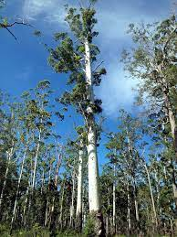
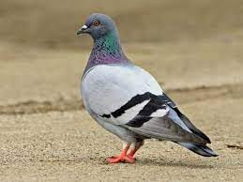
Hello Crypto!!

Slide 13
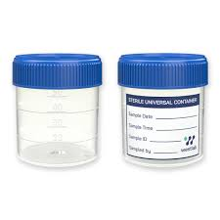
Laboratory Diagnosis
Specimens – CSF

Slide 14
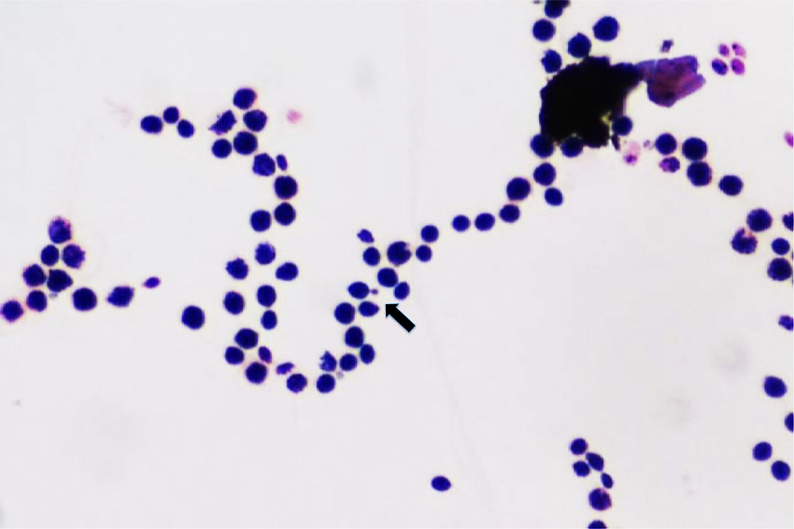
Direct Detection Methods Gram stain
Gram-positive round budding yeast cells with no pseudohyphae.

Slide 15
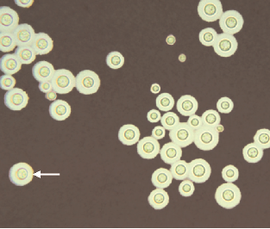
Direct Detection Methods
Negative staining
Modified India ink stain and Nigrosin stain - demonstrate the capsule

Slide 16
Direct Detection Methods
  Mucicarmine stain: Stains the carminophilic cell wall of C. neoformans
  Masson-Fontana stain: Demonstrates the production of melanin
  Alcian blue stain to demonstrate the capsule.

Slide 17
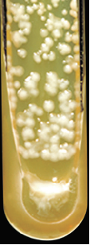
Culture
SDA without antibiotics incubated at 37°C
Colonies - Mucoid creamy white colony

Slide 18
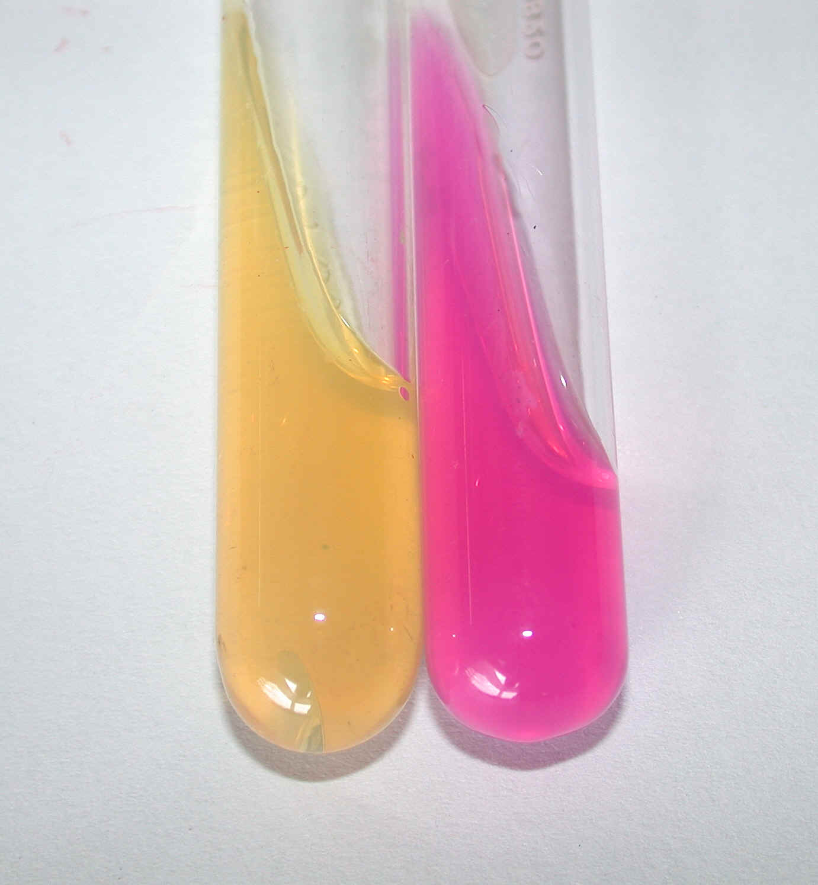
Biochemical Reactions
Urease test
  Niger seed agar and Bird seed agar
  Urease test is positive
  Assimilation of inositol and nitrate
  Growth at 37ºC
  Mouse pathogenicity test
-
+

Slide 19
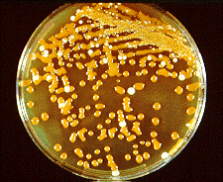
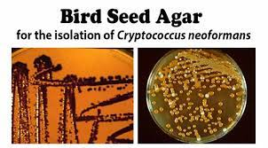
Phenoloxidase Test:
Dark brown colonies of Cr.neoformans on bird seed agar

Slide 20
Phenoloxidase Test:
Production of Dark brown/ Black colonies of Cryptococcus neoformans on medium containing Diphenolic compound (Birdseed agar) due to conversion of diphenolic compound to melanin by its Phenoloxidase enzyme.

Slide 21
Sugar Fermentation
This test involves liquid media supplemented with different carbohydrates, a color indicator to assess pH change to measure acid formation and inverted Durham tube for gas production.

Slide 22
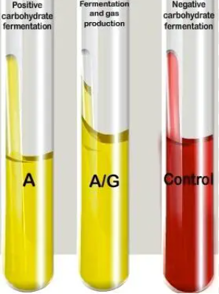
Sugar Fermentation

Slide 23
Sugar Fermentation
Species | Glucose | Sucrose | Lactose | Maltose
Cr.neoformans | - | - | - | -

Slide 24
Sugar assimilation test
This test checks the ability of a yeast to utilize a specific carbohydrate(sugar) as a source of nutrition, in a carbohydrate free medium aerobically.

Slide 25
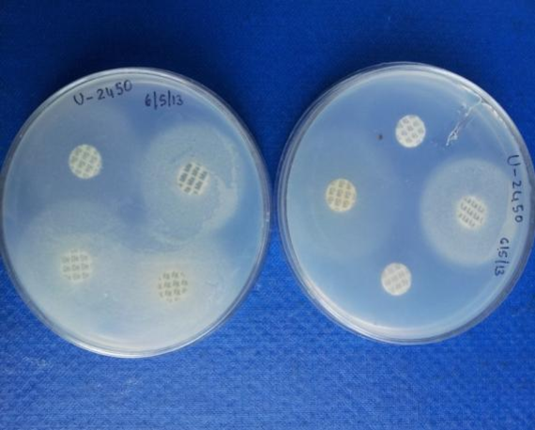
Sugar assimilation test

Slide 26
Sugar assimilation of Cryptococcus
Species | Glu | Mal | Suc | Lac | Gal | Mel | Cel | Ino | Xyl | Raf | Tre | Dul
C. neoformans | + | + | + | - | + | - | + | + | + | + | + | +

Slide 27
Nitrate Assimilation Test
Performed on YEAST CARBON BASE agar.
Used in identification of Cryptococcus species.

Slide 28
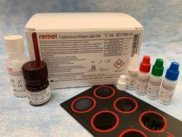
Serological Test:
”CALAS”
CRYPTOCCUS ANTIGEN LATEX AGGLUTINATION SYSTEM
Capsular Antigen detection: From CSF or serum by latex agglutination test

Slide 29
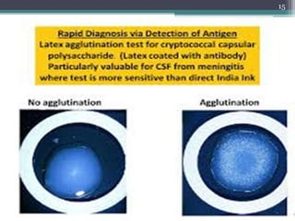
Serological Diagnosis
NO AGGLUTINATION
AGGLUTINATION PRESENT

Slide 30
Cryptococcus Laboratory Diagnosis
Demonstration of Capsule on India ink/ Nigrosin stain
Narrow neck budding with no pseudohyphae or hyphae on microscopy
Mucoid, cream to buff colored colonies on SDA
Brown to Black color colonies on Bird seed / Caffeic acid agar
Urease test positive, Nitrate assimilation positive, Inositol assimilation, growth at 37°C.
CALAS

