Slide 1
CORONA VIRUS
SARS CoV-2

Slide 2
INTRODUCTION
Coronaviruses (CoV) cause respiratory tract infections in man.
Ranging from mild common cold to pneumonia.

Slide 3
Morphology
Enveloped virus
Petal or club-shaped or crown-like peplomer spikes giving appearance of solar corona.
Large (120–160 nm) spherical viruses, helical symmetry
Linear, positive-sense ssRNA
Largest among the non-segmented RNA viruses.

Slide 4
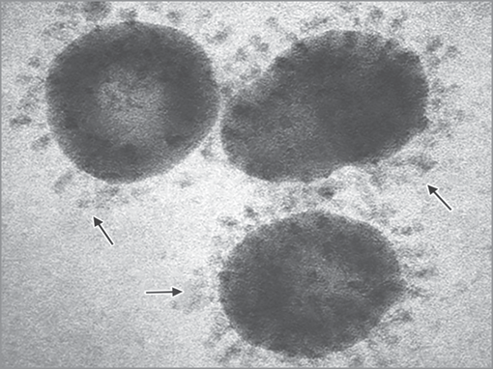
Morphology

Slide 5
Classification
Coronaviridae family contains two subfamilies:
Coronavirinae and Torovirinae.
Former - grouped into four genera—α, β, γ and δ.
Most of them-infect animals except γ Coronavirus species - pathogens of birds.

Slide 6
Human Coronaviruses
Coronaviruses that produce milder disease
Common coronaviruses that are widespread in distribution, affecting people of most part of the world and cause mild upper respiratory tract infections Human coronavirus 229E Human coronavirus NL63 Human coronavirus OC43 Human coronavirus HKU1
Coronaviruses that produce severe disease
Coronaviruses that caused explosive outbreaks of severe respiratory disease with higher mortality are: SarS-Cov (Severe acute respiratory syndrome coronavirus): It has caused an explosive epidemic called ‘SarS’ in China in 2003 MerS-Cov (Middle East respiratory syndrome coronavirus): It has caused an explosive epidemic ‘MerS’ in Middle East in 2012 SarS-Cov-2 (Severe acute respiratory syndrome coronavirus-2): It is the causative agent of explosive pandemics affecting the whole world in 2019-20; called Covid-19 (Coronavirus disease, 2019)

Slide 7
CORONAVIRUS DISEASE
(COVID)-2019

Slide 8
CORONAVIRUS DISEASE (COVID)-2019
Acute respiratory disease caused by severe acute respiratory syndrome coronavirus 2 (SARS-CoV-2).
Caused an explosive catastrophic pandemic - affected almost all part of the world.

Slide 9
Epidemiology
SARS-CoV-2 originated from China - spread rapidly to affect rest the world over a period of 3-4 months.
First identified in December 2019 in Wuhan, China - produced a large cluster of pneumonia cases - initially called as the ‘Wuhan Virus’.
Subsequently - named as the 2019- novel coronavirus (2019-nCoV).

Slide 10
Epidemiology (Cont..)
Nomenclature: On 11th February 2020, WHO announced the official name ‘COVID-19’ for this new coronavirus disease - also renamed the virus as SARS-CoV-2.
Pandemic: On 11th March 2020, WHO declared it as a global pandemic

Slide 11
MORPHOLOGY

Slide 12
MORPHOLOGY
SARS-CoV-2 comprises of a nucleocapsid, surrounded by an envelope.
Measures 120 nm in size; has a helical symmetry.
Possesses 4 structural proteins (N, S, M and E),
16 nonstructural proteins and several other accessory proteins

Slide 13
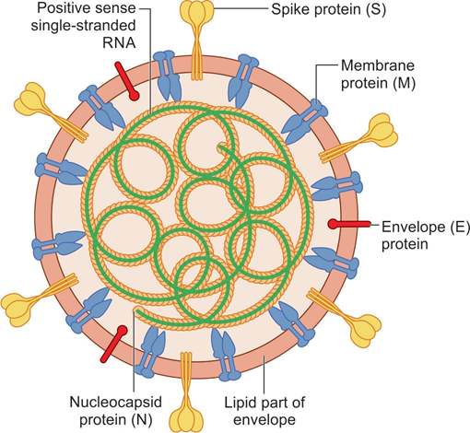
MORPHOLOGY

Slide 14
MORPHOLOGY
Nucleocapsid consists of a positive-sense single stranded RNA , surrounded by nucleocapsid protein (N)
Envelope is lipoprotein in nature; lipid part - host-derived into which a number of proteins are embedded such as:
  Spike protein (S)
  Membrane glycoprotein (M)
  Envelope protein (E)

Slide 15
PATHOGENESIS

Slide 16
Transmission
Primarily transmitted via respiratory droplets and contact routes.

Slide 17
Droplet Transmission
Occurs when a person is in close contact (within 1 meter) with an infected person.
Occurs through coughing, sneezing or very close personal
Use of mask can prevent droplet transmission.

Slide 18
Contact Transmission
Transmission of the COVID-19 virus can occur directly by contact with infected people, or indirectly.
Following contact (direct or indirect), the virus can only be transmitted by touching the contaminated hand to a person’s mouth, nose or conjunctiva.
Frequent hand hygiene following potential contact exposure is crucial to prevent this type of transmission

Slide 19
Aerosol Transmission
Spread of the infected droplet nuclei
Specific settings in which aerosol-generating procedures are performed (e.g. endotracheal intubation), aerosol transmission of the COVID-19 virus may be possible.
Use of N95 respirator - important to prevent this type of transmission.

Slide 20
Host Cell Entry
SARS-CoV-2 enters into the target host cells by binding of its spike glycoprotein (S) antigen with the host cell receptor, i.e. angiotensin converting enzyme-2 (ACE-2).
Spike protein cleavage
Fusion
ACE-2 receptors

Slide 21
Development of ILI
ACE-2 receptors - highly expressed on the epithelial cells of oral mucosa.
At the initial stage, SARS-CoV-2 infects the pharyngeal epithelium, induces inflammation - influenza-like illness (ILI).

Slide 22
Development of ARDS
Leading cause of mortality in patients with COVID-19 is hypoxemic respiratory failure - result in acute respiratory distress syndrome (ARDS).

Slide 23
Reduced Surfactants
Damage to the type-II alveolar cells – reduced production of pulmonary surfactants - alveoli tend to collapse - air-liquid-interphase is perturbed - fluid retention in the interstitial space
To prevent collapse - muscular movement of inspiration becomes hyperactive - increased lung volume in the interstitial space – attracts liquid - edema in the lungs.

Slide 24
CLINICAL MANIFESTATIONS

Slide 25
CLINICAL MANIFESTATIONS
Incubation period - 5-6 days, but can be as long as 14 days.
Common features: Fever, cough with expectoration, fatigue, shortness of breath, myalgia, rhinorrhea, sore throat, diarrhea. Loss of smell or taste sensation - occasionally occur preceding the onset of respiratory symptoms.

Slide 26
CLINICAL MANIFESTATIONS
Atypical symptoms: Seen in older people and immune-suppressed patients— fatigue, reduced alertness, reduced mobility, diarrhea, loss of appetite, delirium, and absence of fever.
Children might not develop fever or cough as frequently as adults.

Slide 27
Clinical severity of COVID-19 disease
Clinical stage | Clinical presentations
Mild disease
ILI ((influenza-like illness) | Patients with uncomplicated upper respiratory tract infection, may have mild symptoms such as fever, cough, sore throat, nasal congestion, malaise, headache Without evidence of breathlessness or hypoxia (normal saturation)
Moderate disease
Pneumonia with no signs of severe disease | Dyspnea, fever and cough Hypoxia, SpO2 <94%, respiratory rate ≥ 24 per minute

Slide 28
Clinical severity of COVID-19 disease
Clinical stage | Clinical presentations
Severe disease : Called as severe acute respiratory illness (SARI)
Severe pneumonia | Clinical signs of pneumonia plus one of the following sign of severe respiratory distress: (i) Respiratory rate >30 /min or (ii) SpO2 <90%
Acute respiratory distress syndrome (ARDS) | Symptoms: Onset of new or worsening respiratory symptoms within one week Chest imaging: Shows bilateral opacities, not fully explained by effusions, lobar or lung collapse, or nodules

Slide 29
Clinical severity of COVID-19 disease
Clinical stage | Clinical presentations
Severe disease : Called as severe acute respiratory illness (SARI)
Sepsis | Acute life-threatening multi-organ dysfunction: Clinically diagnosed by SOFA (sequential organ failure assessment) score
Septic shock | Persisting hypotension despite volume resuscitation.

Slide 30
Laboratory diagnosis of COVID-19
Specimens: Throat and nasal swabs
NAAT: Nucleic acid amplification testing
  Formats: Real time RT-PCR, automated formats (CBNAAT and Truenat)
  Gene targets: Screening (E, N, M genes), confirmatory (RdRp, N2 genes, etc.)

Slide 31
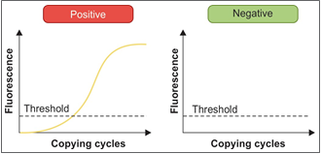
Interpretation of real-time RT-PCR result for COVID-19 diagnosis

Slide 32
Laboratory diagnosis of COVID-19 (Cont..)
Antigen detection assay: Point-of-care test; detects nucleocapsid protein antigen in nasopharyngeal swab
Antibody (IgG) detection assay: Used for serosurveillance and survey in high-risk and vulnerable group; not for clinical diagnosis

Slide 33
Laboratory diagnosis of COVID-19 (Cont..)
Sequencing: To determine mutations in the viral genome
Viral culture: Used for research purpose
Nonspecific tests include:
  Radiology (chest CT scan): Ground-glass appearance
  Biomarkers: IL-6, D-dimer

Slide 34
Treatment of COVID-19
Symptomatic management
In patients with severe respiratory distress
Supplemental oxygen therapy is given immediately
High-flow nasal cannula oxygenation (HFNO)
Non-invasive mechanical ventilation

Slide 35
Treatment of COVID-19 (Cont..)
Mechanical ventilation
Management of septic shock by—vasopressors, fluid replacement by crystalloids such as normal saline and Ringer’s lactate

Slide 36
Thank you

